Slide 2
Culture and cryopreservation of melanoma cells for PALS measurements – biomedical study
Kraków, 13 September 2018
Agnieszka Kamińska, MSc. Eng.
Faculty of Physics, Astronomy and Applied Computer Science
Jagiellonian University
3rd Symposium on Positron Emission Tomography, Kraków 2018

Slide 3
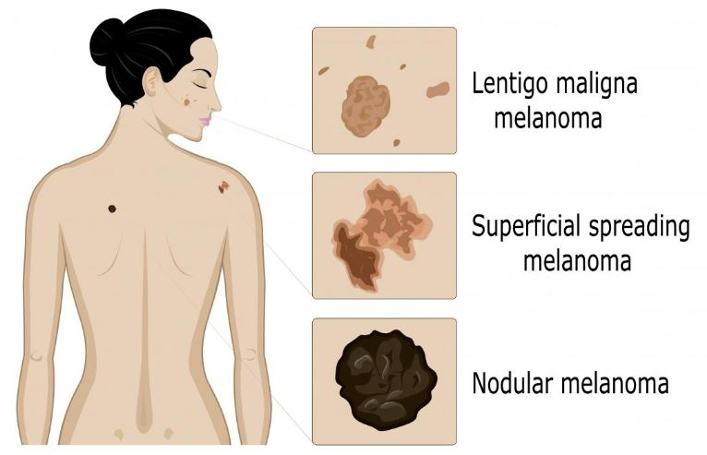
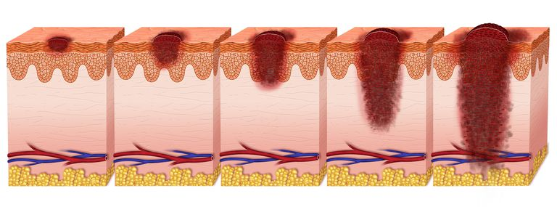
Characteristic of melanoma tumor
Stages:
Stage 0: the cancer is in the outermost layer of skin
Stage 1: the cancer is less than 1 mm thick
Stage 2: the cancer is 1-4 mm thick
Stage 3: the cancer has spread to lymph nodes
Stage 4: the cancer has spread to distant lymph nodes or organs
https://www.medicalnewstoday.com/articles/154322.php
https://www.verywellhealth.com/melanoma-staging-what-it-means-and-reveals-3010755

Slide 4
Culture of melanocytes and melanoma cells
Culture conditions:
5% CO₂
37 °C
HEMa-LP
(melanocytes)
WM115
(primary melanoma)
WM266
(metastatic)
medium 254 supplemented
with HMGS (Human Melanocyte
Growth Supplement)
0.5% FBS
Penicyllin/Streptomycin
RPMI (with L-glutamine)
10% FBS
RPMI (with L-glutamine)
10% FBS

Slide 5
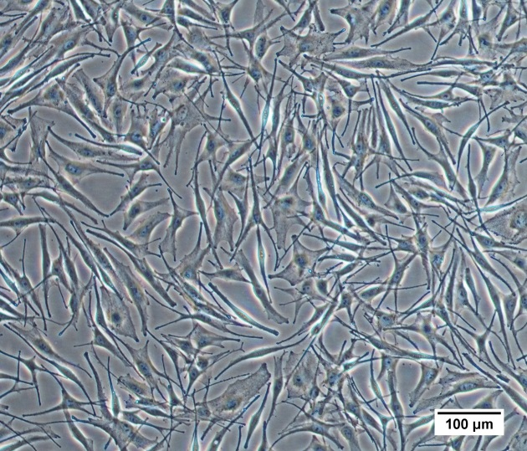
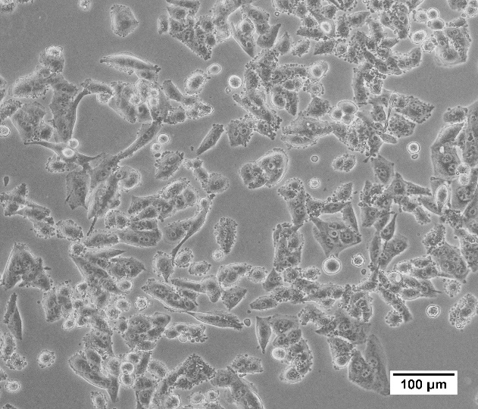
Melanoma cells vs. melanocytes
irregular shape
reduced amount of cytoplasm
bigger/multiplied nuclei
higher level of cortactin
VEGF
E-cadherin
N-cadherin
differential expression of miRNA
a)
b)
Melanocytes (a) and melanoma cells (b), images by E. Kubicz

Slide 6
Freezing of the cells – damaging factors
Thermal shock
Formation of ice crystals
Dehydration
Increased salt concentration
Osmotic shock

Slide 7
Cryopreservation – the technique of freezing cells and tissues
at very low temperatures (-196 °C) which requires the use of a
cryoprotective agent.
biological material retains genetically stable
stopping the biological activity
minimaizing ice crystals formation
Notes:
This technique has been discovered in 1949 by English biologist (Ernest Polge) whos accidently discovered the cryoprotective properties of glycerol
Cryopreserveation minimizes: genetic changes, transformation to tumour related properties
Cryopreservation is a process that preserves cells and tissues by cooling the samples to very low temperatures.
It is currently the only method allowing long-term storage of living cells and tissues for years to decades.

Slide 8
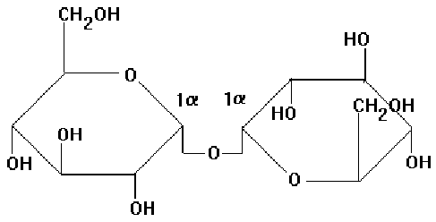
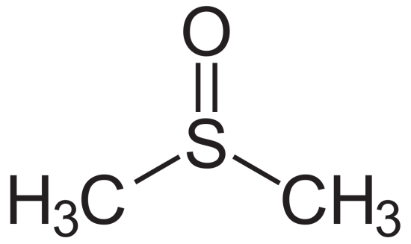
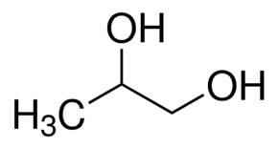
Cryoprotectants
Dimethyl sulfoxide
Trehalose
1,2 - Propanediol
Notes:
Cryoprotectants are macromolecules added to freezing medium to protect cells from effects of intracellular ice crystals formation and from solution effects, during the proces of freezing and thawing.
Cryoprotectant affects the rates of water transport, nucleation, and ice crystals growth. Cryoprotectant operate simply by increasing the solute concentration in cells. CPA should be biocompatible, be able to penetrate the cells, and have low toxicity.

Slide 9
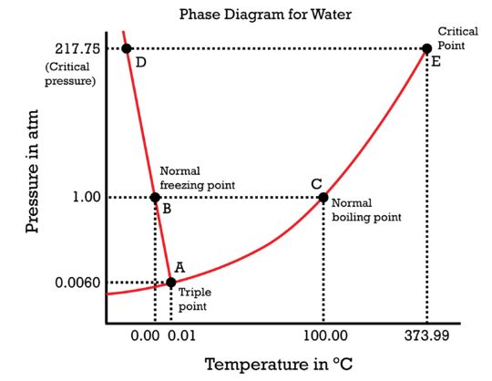
Lyiophilization
Liquid
Solid
Gas
https://courses.lumenlearning.com/cheminter/chapter/phase-diagram-for-water/
Notes:
At the triple point (0.0098°C and 4.58
mm Hg), ice , water and water vapor coexist in equilibrium.
Freeze drying takes place below the triple point, where water passes from solid phase directly to the vapor phase

Slide 10
Lyiophilization
Sample
preparation
Freezing
Primary
drying
Secondary
drying
Final
product

Slide 11
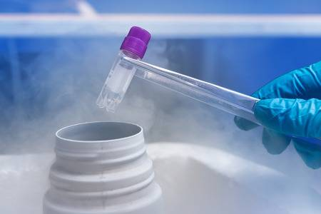
Cryopreservation
Freezing media:
PBS (Ca²⁺, Mg²⁺ free)
PBS (Ca²⁺, Mg²⁺ free) + 10% DMSO
RPMI+20% FBS+10% DMSO
1.5M PROH+0.5M Trehalose
0.25M Trehalose

Slide 12
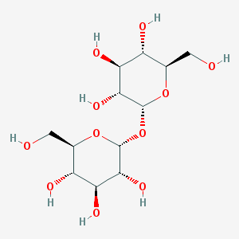
Cryoprotectant - Trehalose
Disaccharide of glucose (342 Da)
α, α-1, 1-glycosidic bond
Bioprotective action of trehalose - hypothesis:
Water replacement
Rearrengement of water molecules
Transition to glassy state
Notes:
Freeze-drying requires use of specific protectants to stabilize biomolecules during freezing and drying proces for example non reducing disaccharadise such as sucrose or trehalose

Slide 13
Conclusions
The preservation of cells is an extremely important aspect of cell culture
To ensure high viability of cells (>90%) it is very important to choose appropriate
cryoprotectant and handling techniques.
Supplementation of standard cryoprotective medium with trehalose improving post-thaw
cell viability and metabolism.
Lyophilization of cultured cells allows to performing Positron Annihilation Lifetime
Spectroscopy (PALS) measurements for several hours without cell damage.

