Slide 1

Beta-Decay Correlations in the LHC Era
Kazimierz Bodek
Marian Smoluchowski Institute of Physics, Jagiellonian University, Cracow, Poland

Slide 2
Outline
EFT approach in β-decay
β-decay correlation coefficients
Scalar and tensor contributions – limits from β-decays
High energy experiment – MET channel
Limits from MET
Neutron decay correlations
BRAND project
Conclusions
V. Cirigliano et al., Nucl. Phys. B 830 (2010)
T. Bhattacharya et al., Phys. Rev. D 85 (2012)
V. Cirigliano et al., JHEP 1302 (2013)
M. Gonzalez-Alonso et al., Ann. Phys. 525 (2013)
M. Gonzalez-Alonso et al., Phys. Rev. Lett. 112 (2014)

Slide 3
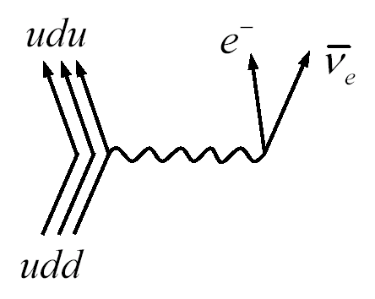
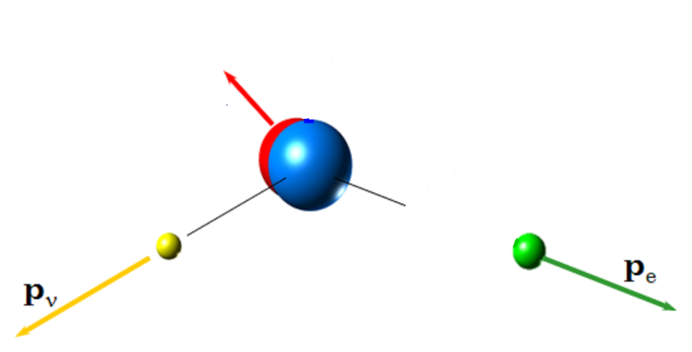
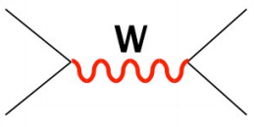


β-decay
Approximation level
B
M_{F} , M_{GT}
A
g_{L}, g_{R}, g_{S}, g_{T}
Nuclear
Nucleon
(point-interaction)
Quark
?
?
+
Standard Model
Beyond Standard Model

Slide 4

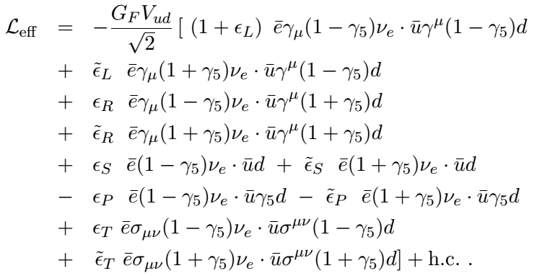

EFT approach in β-decay
Semi-leptonic processes, partonic level, exchanged W-boson is heavy – SM interaction Lagrangian takes the contact (V-A)x(V-A) form
Need for more precision (finiteness of W, radiative corrections, …)
Low energy (<1 GeV) model independent EFT (W and BSM particles – heavy)
Valid also for

Slide 5



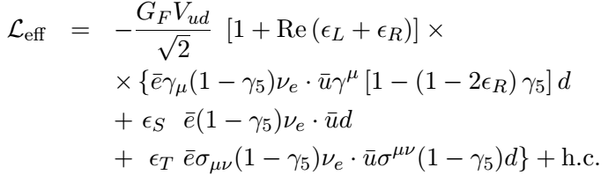





EFT approach in β-decay (cont.)
Low-energy simplifications:
  RH neutrinos –
  Pseudo-scalar contribution (non-relativistic limit) –
If g_{A} from experiment (Lattice QCD still not accurate):
6 parameters left for probing:
  – can be absorbed in V_{ud} (CKM unitarity tests)
  Real parts of and
  Imaginary parts of , and

Slide 6
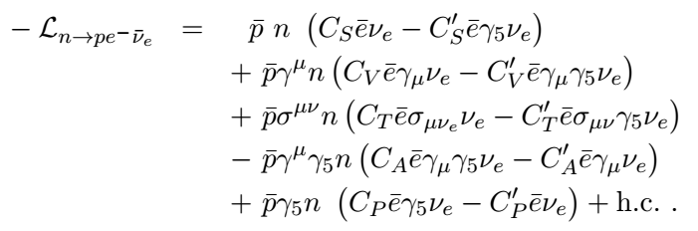



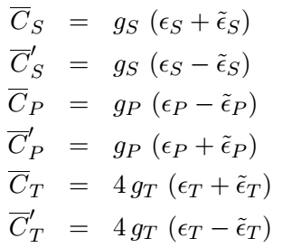
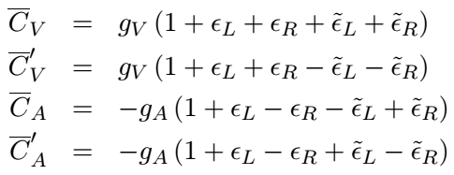
Nucleon-level effective couplings
Lee-Yang effective Lagrangian (leading order, momentum transfer):
Effective nucleon-level couplings can be expressed in parton-level parameters:
Form factors are the key ingredients in translation of hadron-level to parton-level coupling constants

Slide 7
Nuclear level
Matrix elements are needed that encode nuclear structure effects into:
  Vector and scalar mediated transitions: Fermi M_{F} = ⟨ j|1|i⟩
  Axial-vector and tensor mediated transitions: Gamow-Teller
  M_{GT} = ⟨j|σ|i⟩
Experiments offer:
  Decay rates – life times
  Differential rates – distributions dependent on momentum
  and spin vectors of involved particles
Differential decay rates for allowed transition were parametrized in terms of correlation coefficients in seminal paper of J.D. Jackson,
S.B. Treiman and H.W. Wyld:
(J.D. Jackson et al., Phys. Rev. 106, 517 (1957))
More about nuclear β-decays and state-of-the-art experimental techniques in the talk by Stephan Malbrunot

Slide 8
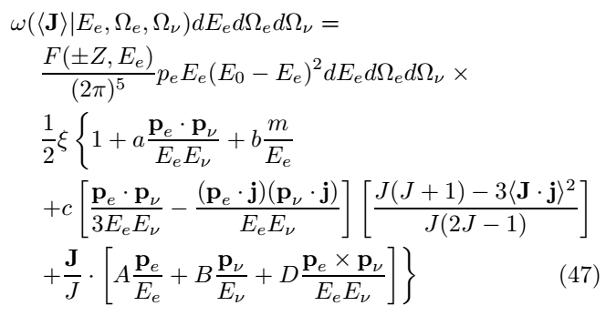
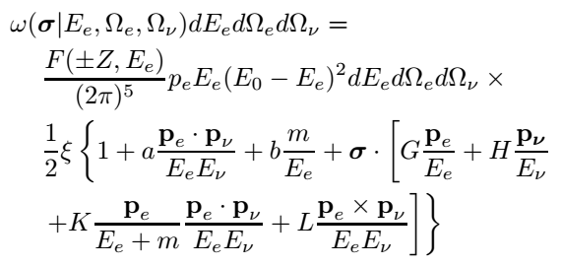




Differential decay rate
Observable quantities: momenta, spins (conservation laws), initial and final states – lowest order expressions [see e.g. N. Severijns et al., Rev. Mod. Phys. 78, 991 (2006)]
Oriented nuclei, electron energy, electron and neutrino directions:
Non-oriented nuclei, electron energy and polarization, electron and neutrino directions:
Oriented nuclei, electron energy, electron direction and polarization:

Slide 9




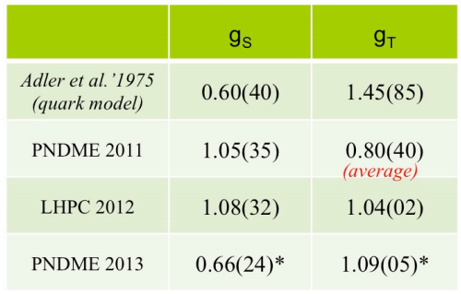
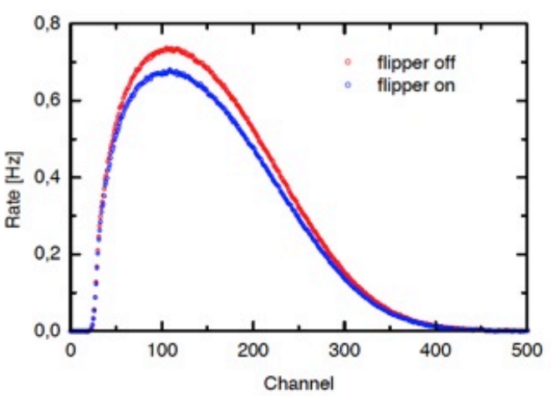
Differential decay rate (cont.)
Correlation coefficients are functions of
,
,
,
Translation into possible, if corresponding form factors are known – from Lattice QCD calculation
,
,
At present accuracy level of experimental observables modest knowledge of g_{S} and g_{T} is sufficient
Several dozens of measured correlation coefficients but only few of them really matter
Crucial role is played by the b_{n} coefficient (Fierz term) – to be extracted from the electron spectrum shape
|b_{n}| ~ 10⁻³

Slide 10
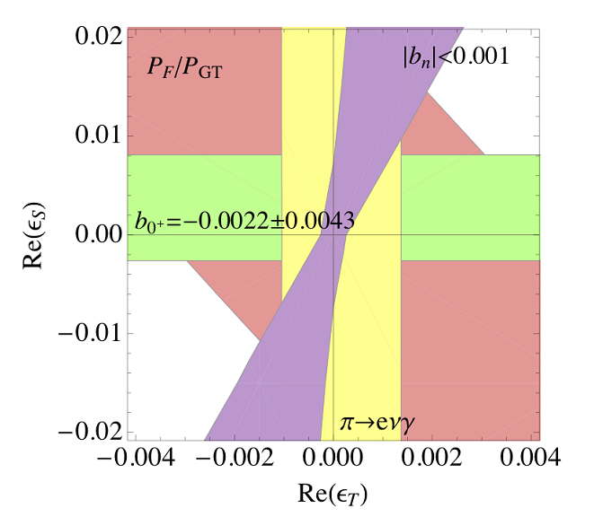
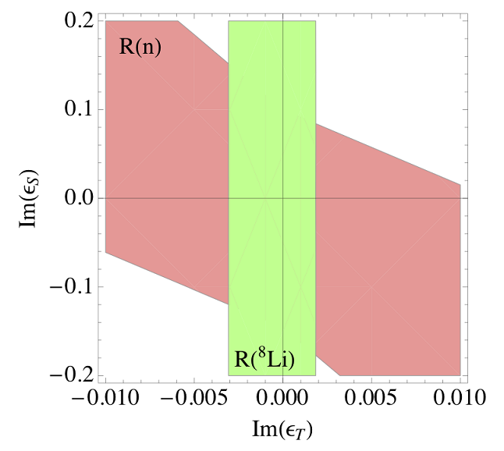
Current (?) experimental limits from β-decay
Future !

Slide 11


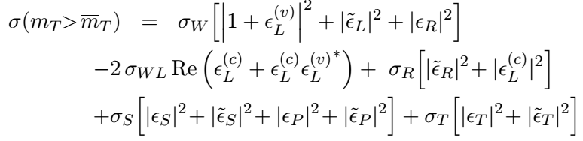
Limits from high energy
Electrons and missing transverse energy (MET) channel
Underlying partonic process is the same as in β-decay
If BSM particles are too heavy to be produced on-shell → EFT analysis appropriate
Express weak scale Lagrangian in terms of EFT parameters and calculate cross section

Slide 12
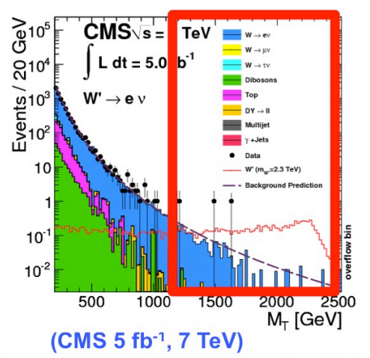
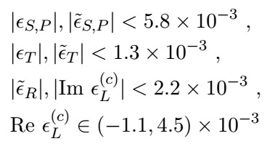
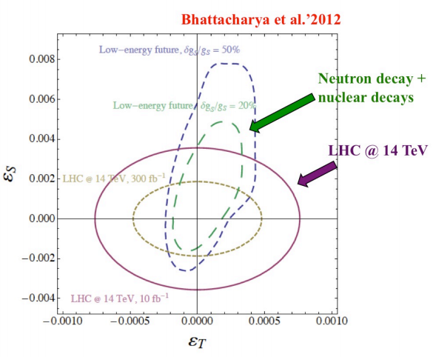
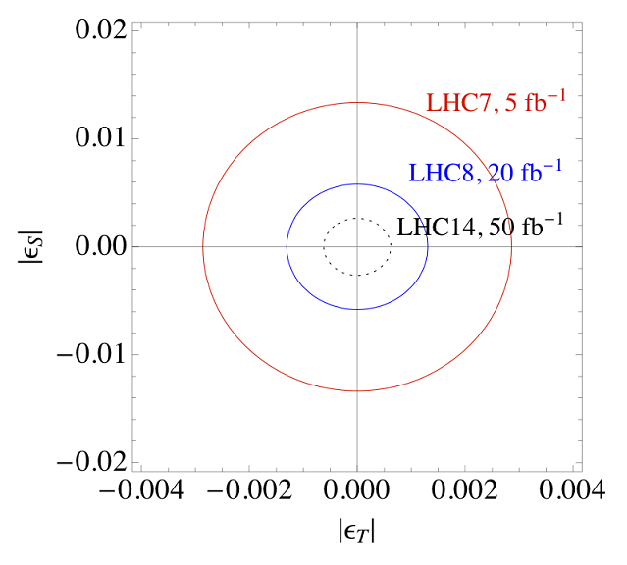
CMS results
M. Gonzalez-Alonso et al., Ann. Phys. 525 (2013)

Slide 13
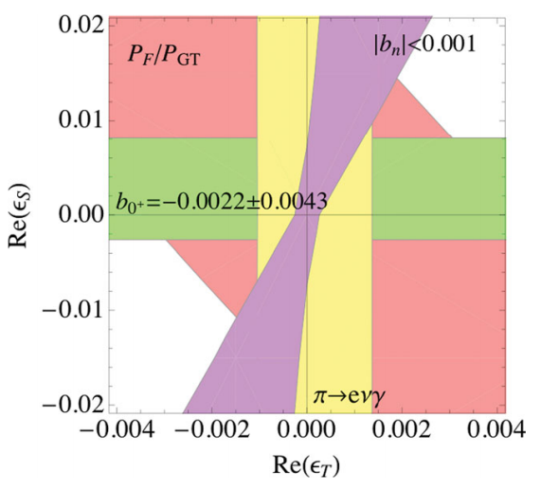
LE-HE competition
Next generation neutron and nuclear β-decay experiments will compete even with full luminosity LHC results
M. Gonzalez-Alonso et al., Ann. Phys. 525 (2013)
The dream scenario would be that LHC finds a BSM particle on-shell and β-decay has to confirm it in observables (off-shell corrections)

Slide 14
Neutron decay – prospects
Current and next generation neutron decay experiments
Most of planned n-decay experiments anticipate the accuracy required to compete with HE experiments in the BSM sector of weak interactions

Slide 15
Electron polarization in β-decay
J_{n}
P_{p}
σ_{e}
J.D. Jackson et al., Phys. Rev. 106, 517 (1957)
p_{e}
p_{ν}
G-coefficient can be deduced from the longitudinal electron polarization component
N-coefficient can be deduced from the transverse electron polarization component contained in the plane parallel to the parent polarization
R-coefficient can be obtained from the transverse electron polarization component perpendicular to the plane spanned by the neutron polarization and electron momentum

Slide 16
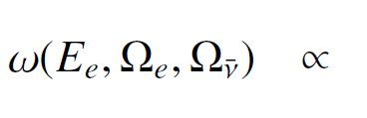
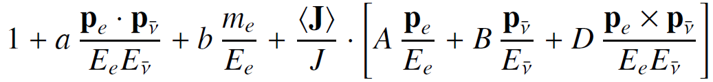
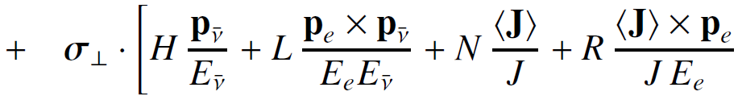
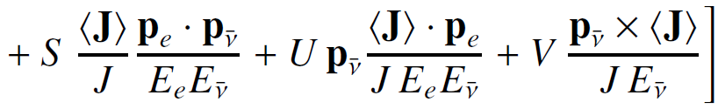
Transverse electron polarization
a
b
A
B
D
^
H
L
N
R
S
U
V

Slide 17
Sensitivity factors for scalar and tensor couplings
 | SM (λ) | FSI (λ) | c(ReS) | c(ReT) | c(ImS) | c(ImT)
a | -0.104793 | 0 | -0.171405† | 0.171405† | -0.000727 | +0.001171
b | 0 | 0 | +0.171405 | +0.828595 | 0 | 0
A | -0.117233 | 0 | 0 | 0 | -0.000923 | +0.00142
B | +0.987560 | 0 | -0.126422 | +0.194539 | 0 | 0
D | 0 | 0 | 0 | 0 | +0.000923 | -0.000923
H | 0 | +0.060888 | -0.171405 | +0.276198 | 0 | 0
L | 0 | -0.000444 | 0 | 0 | +0.171405 | -0.276198
N | 0 | +0.068116 | -0.217582 | +0.334815 | 0 | 0
R | 0 | +0.000497 | 0 | 0 | -0.217582 | +0.334815
S | 0 | -0.001845 | +0.217582 | -0.217582 | 0 | 0
U | 0 | 0 | -0.217582 | +0.217582 | 0 | 0
V | 0 | 0 | 0 | 0 | -0.217582 | +0.217582
* Kinematical factor averaged over electron kinetic energy E_{k} = (200,783) keV
† (|C_{S}|²+|C’_{S}|²)/2 instead of ReS and (|C_{T}|²+|C’_{T}|²)/2 instead of ReT, respectively

Slide 18
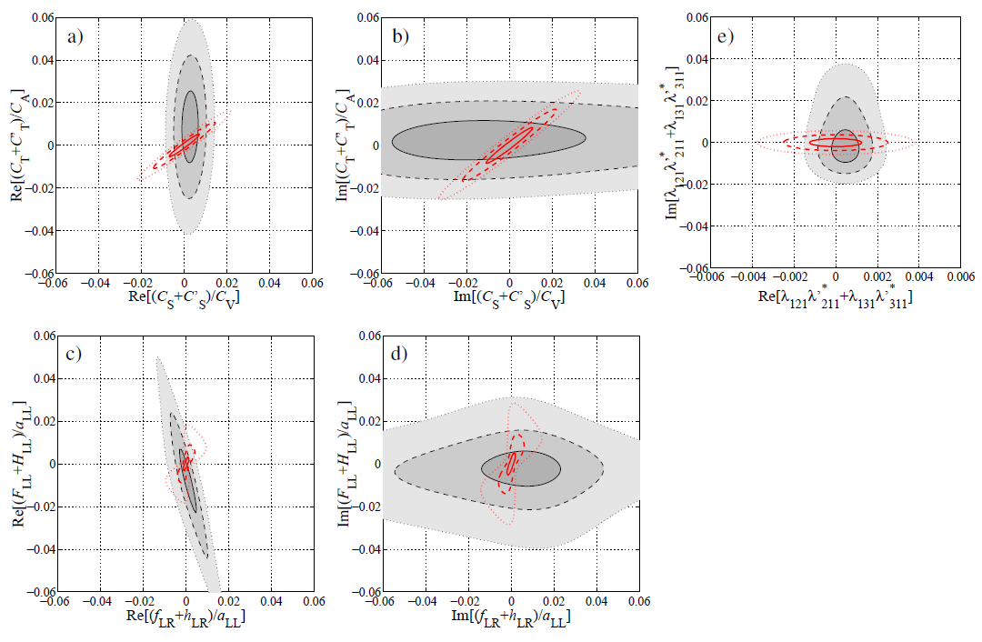
Impact of H, L, N, R, S, U, V measurement with anticipated accuracy of 5×10⁻⁴
RPV MSSM
Constraints on real scalar contributions dominated by:
  Super-allowed 0⁺→0⁺
  Correlations in mirror transitions
n-decay correlations could join the game !
Leptoquark exchange model

Slide 19
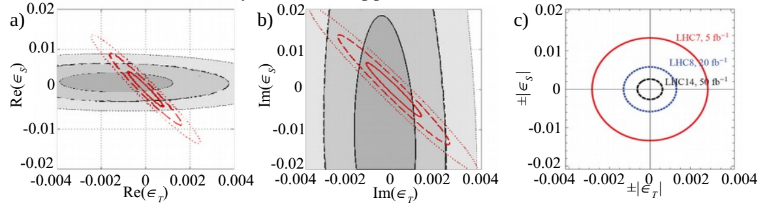
Impact of H, L, N, R, S, U, V measurement with anticipated accuracy of 5×10⁻⁴
Translated into EFT parameters
GOAL: measure 11 correlation coefficients (a, A, B, D, H, L, N, R, S, U, and V ) at once !
Perform global analysis
B R A N D project

Slide 20
Option 1 – layout
“HE experimental approach”:
  Particle tracking
  Vertex reconstruction
scintillator
He, 0.2-0.3 bar
Pb-foil
0.0
0.5
1.0 m
MWDC
(He+isobutane, 0.2-0.3 bar)
CN beam

Slide 21
With detection of electrons and recoil protons…
Grounded vacuum window: 6 µm Mylar, reinforced with Kevlar fibers
Longitudinal neutron polarization,
Axial guiding field B = 0.1÷0.5 mT
Mott scattering foil
Plastic scintillator
e⁻
MWPC, 1 layer
p⁺
Grounded grid
p-e conversion foil
LiF (20nm) + Al (10nm) + 6F6F(100nm),
-25 kV
[S. Hoedl et al., J. Appl. Phys. 99, 084904 (2006)]
MWDC, hexagonal, 5 layers

Slide 22
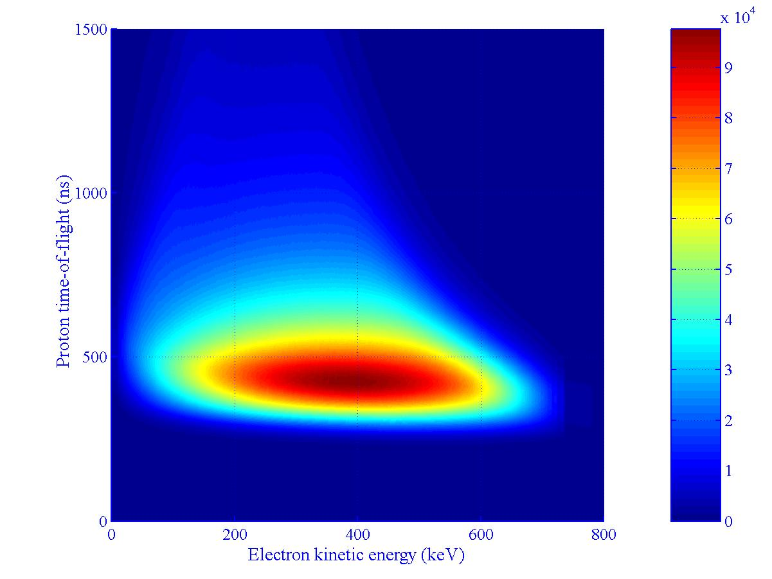
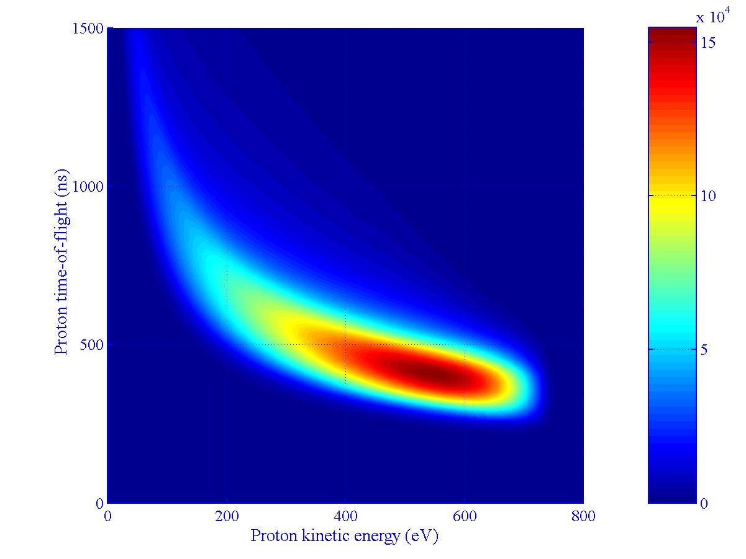
Electron-proton kinematics
700 ns
700 ns
100 keV
100 eV
(200 keV for Mott scat.)
Measured electron energy, reconstructed proton flight path and measured proton time-of-flight must match !
Constraints from 3-body kinematics will considerably reduce coincidence time
With 10⁵ decays per second: single rate (per wire) < 1 kHz

Slide 23
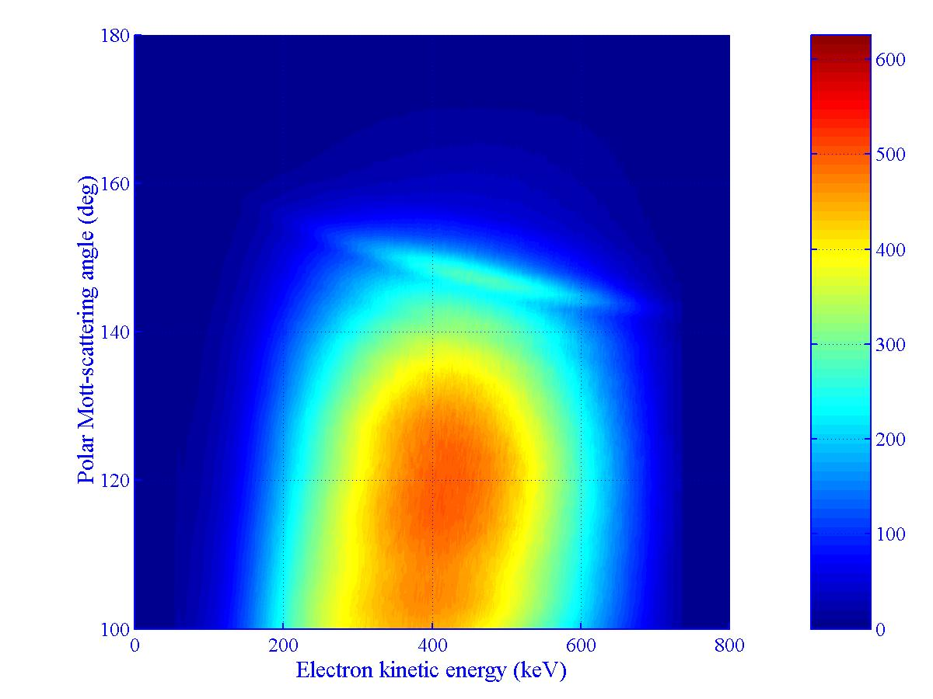
Figure-of-Merit for Mott scattering
Electron energy threshold

Slide 24
Option 2 – layout
  Idea: replace MWDC with two layers of HV-MAPS
Mott scattering foil
Plastic scintillator
e⁻
p⁺
Grounded grid
p-e conversion foil
LiF (20nm) + Al (10nm) +
6F6F(100nm), −25 kV
Si pixel detector (35 μm)
All four intrinsic difficulties of MWDC setup – relaxed

Slide 25
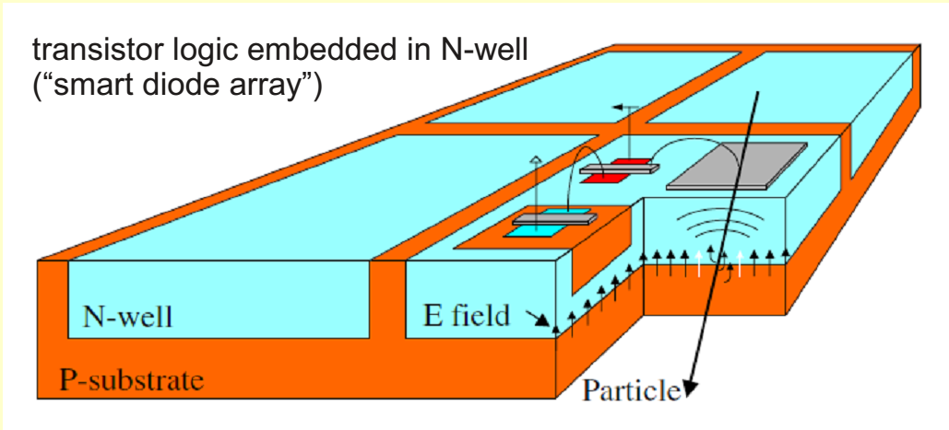
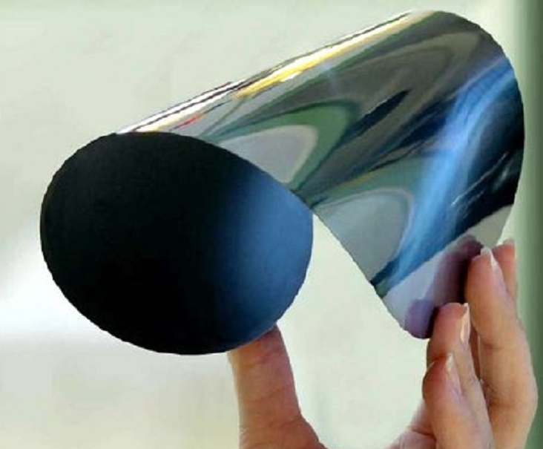
Option 2 - detectors
  Progress in Si-pixel detectors:
    HV-MAPS [I. Peric, P. Fischer et al., NIM A 582 (2007) 876]
    High position resolution (pixels 20×20 μm²)
    Thickness 35 μm – can be thinned down to 25 μm (I. Peric, priv. comm.)
    Small R/O bandwidth (active sensors), triggerless, LVDS link integrated
    Low power dissipation – 7 μW/pixel
    Low production costs (standard HV-CMOS process, 60-80 V) – 75 k€/m²
    Mu3e Collaboration at PSI follows this track !
50 μm thick Si wafer

Slide 26
Conclusions
EFT approach – common language to compare LE and HE results in the sector of BSM week interactions
Currently, neutron and nuclear β-decay correlation experiments deliver similar constrains for exotic scalar and tensor contributions as deduced from specific HE experiments
If the mass scale of BSM weak interaction increases, the role of β-decay will increase, too
The dream scenario would be to discover BSM particles on-shell in LHC and confirm them via off-shell effect in β-decay (or vice versa)
The role of neutron decay is special – their results are not biased with nuclear structure uncertainties
The most wanted parameter is the Fierz term b_{n}
HE experimental strategy (particle tracking, vertex reconstruction) is also applicable to neutron decay correlations
Novel experiment is planned to measure simultaneously 11 correlation coefficients and deduce constrains for scalar and tensor contributions with unprecedented accuracy

Slide 27
“neutron alphabet”
BRAND
a, A, B, D, H, L, N, R, S, U, V

Slide 28
Backup slides

Slide 29
Scalar and tensor couplings
SM contributions:
  Mixing phase δ_{CKM} gives contribution which is 2nd-order in weak interaction: < 10⁻¹⁰
  θ-term contributes through induced NN PVTV interactions: < 10⁻⁹
Candidate models for scalar couplings (at tree-level):
  Charged Higgs exchange
  Slepton exchange (R-parity violating super symmetric models)
  Vector and scalar leptoquark exchange
The only candidate model for tree-level tensor contribution (in renormalizable gauge theories) is:
  Scalar leptoquark exchange

Slide 30
Guidelines:
Measurements of the transverse electron polarization in n-decay provide direct, i.e. first-order access to the exotic scalar and tensor coupling constants
In order to simultaneously access REAL and IMAGINARY parts of the exotic couplings - measure both components of the transverse polarization of electrons emitted in neutron decay

Slide 31
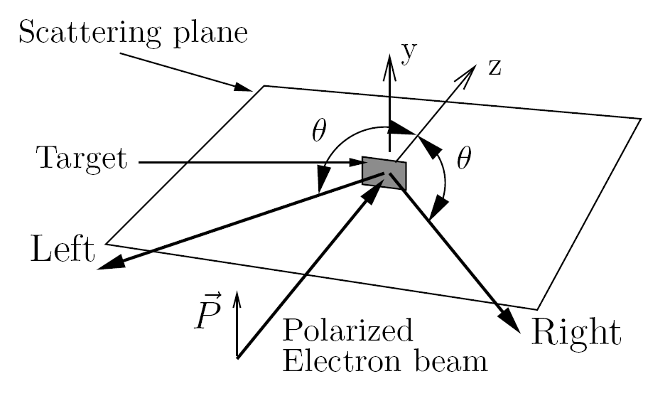
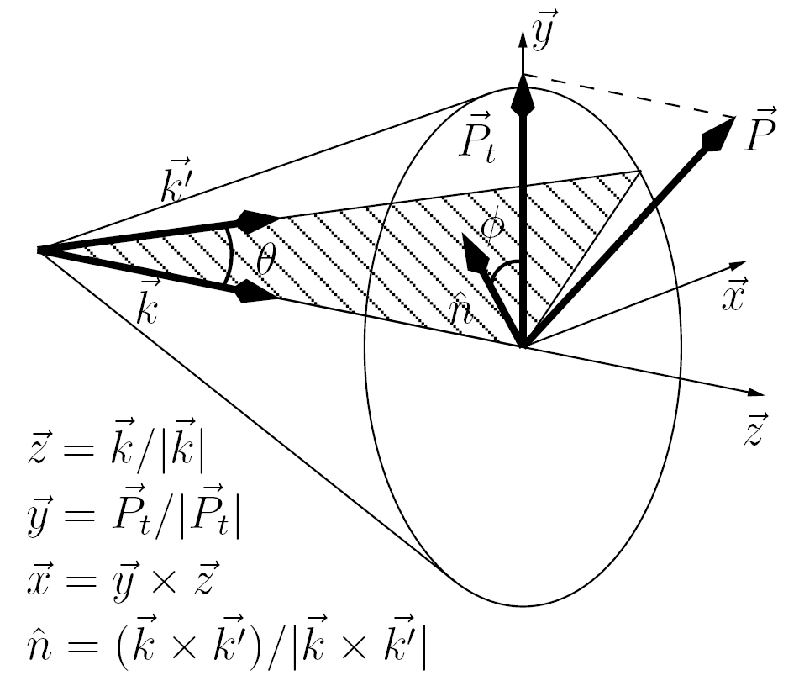
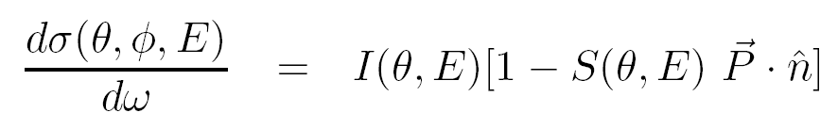
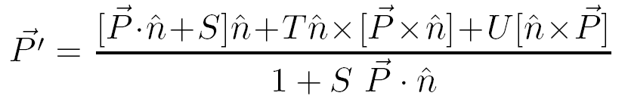
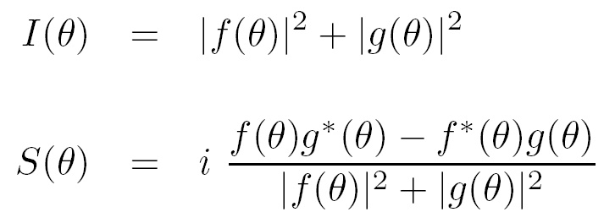
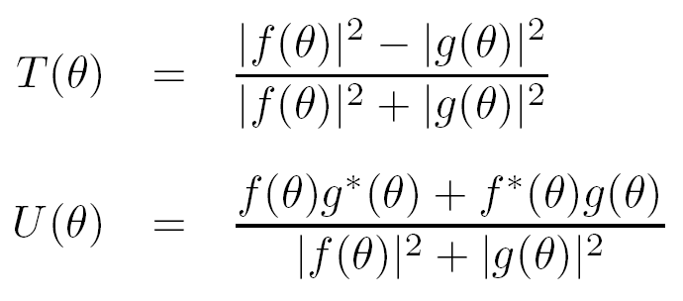
Electron depolarization in multiple Coulomb scattering
ELSEPA

Slide 32
Reconstruction of momenta
Actual position of the decay vertex is not known
But:
It must be located on the electron trajectory segment coincident with the beam
p_{e}
p_{p}
Neutron decay density distribution in the beam is known
Finally:
p_{ν}
In extraction of correlation coefficients we sum over momenta – ambiguity in vertex position is not essential
assigned weight is proportional to the decay density

Slide 33
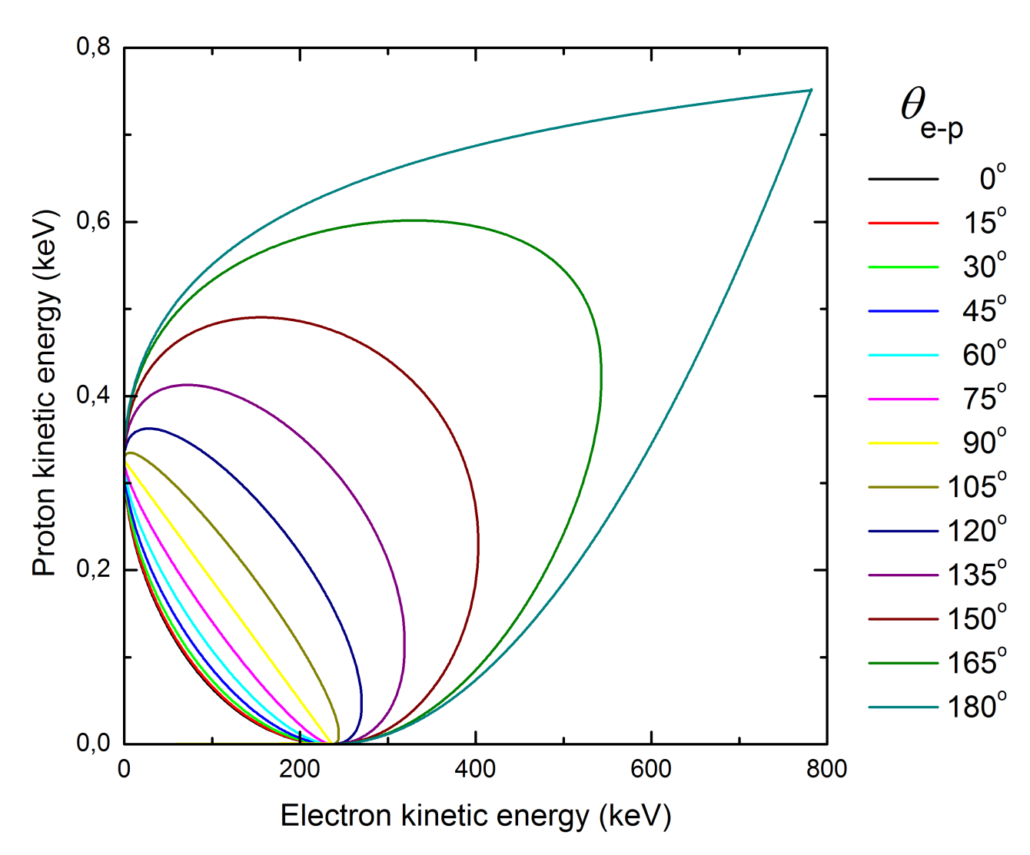
Electron-proton kinematics
p_{e}
θ_{e-p}
p_{p}
p_{ν}

Slide 34
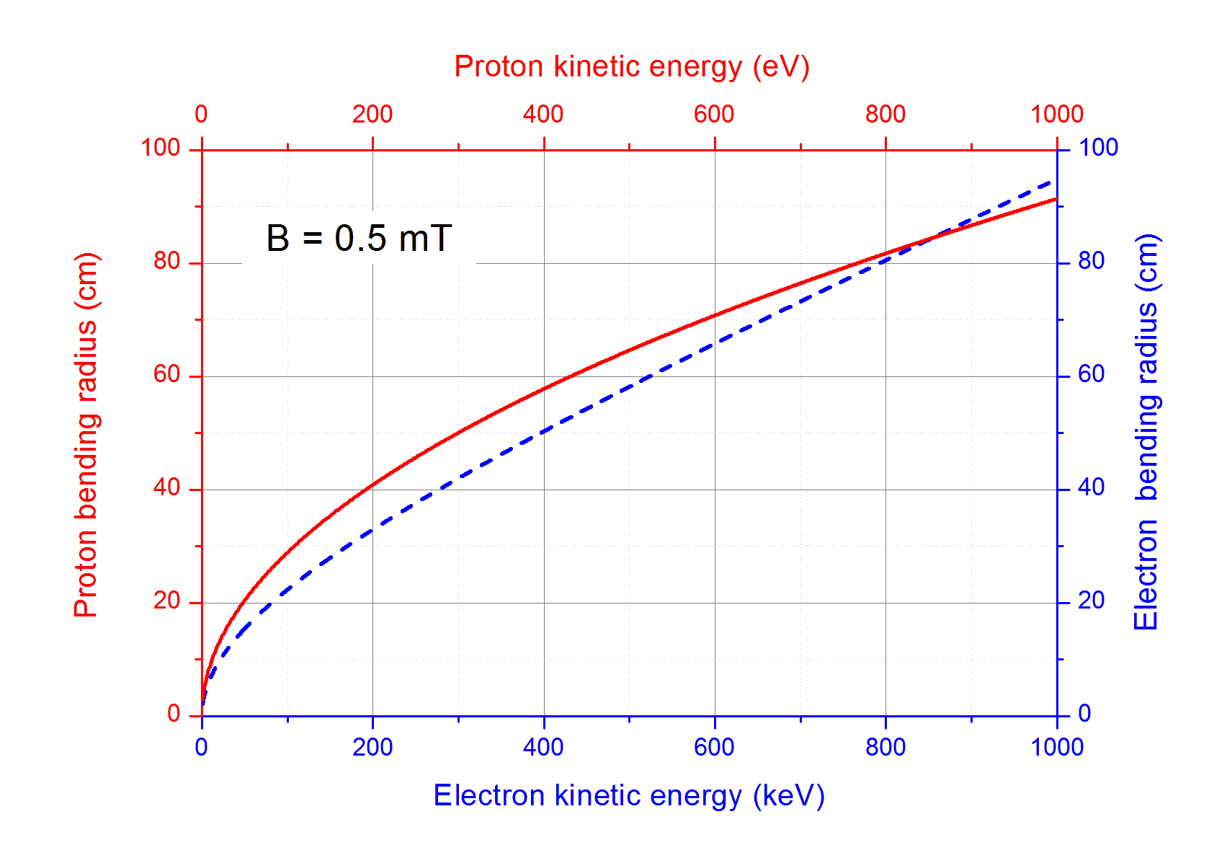
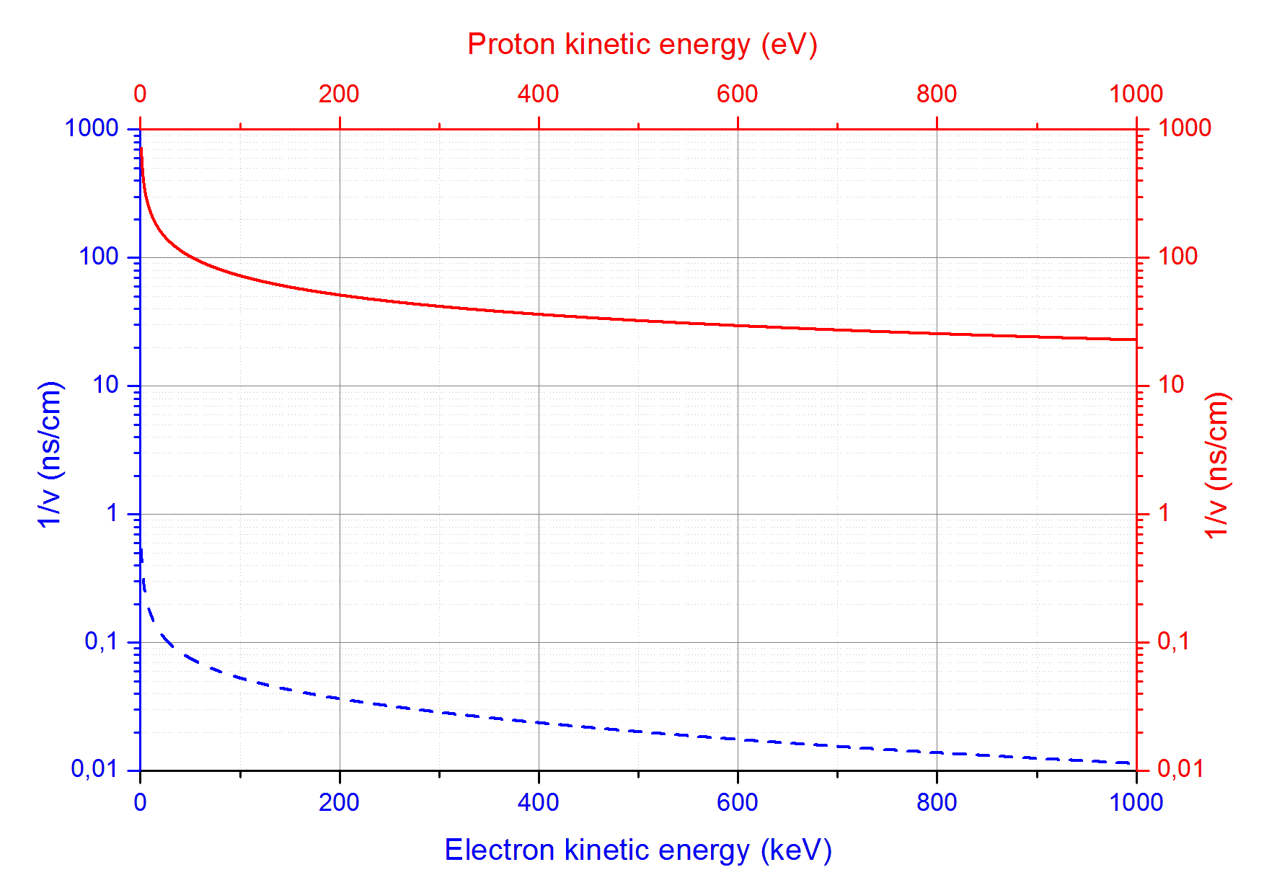
Electron and proton trajectories and ToF
Bending radii of protons and electrons are similar in the interesting energy ranges: 50÷800 eV for protons and 50÷800 keV for electrons
p-e Time-of-Flight difference ranges from 20 to 100 ns/cm for interesting proton energy range 50÷800 eV

Slide 35
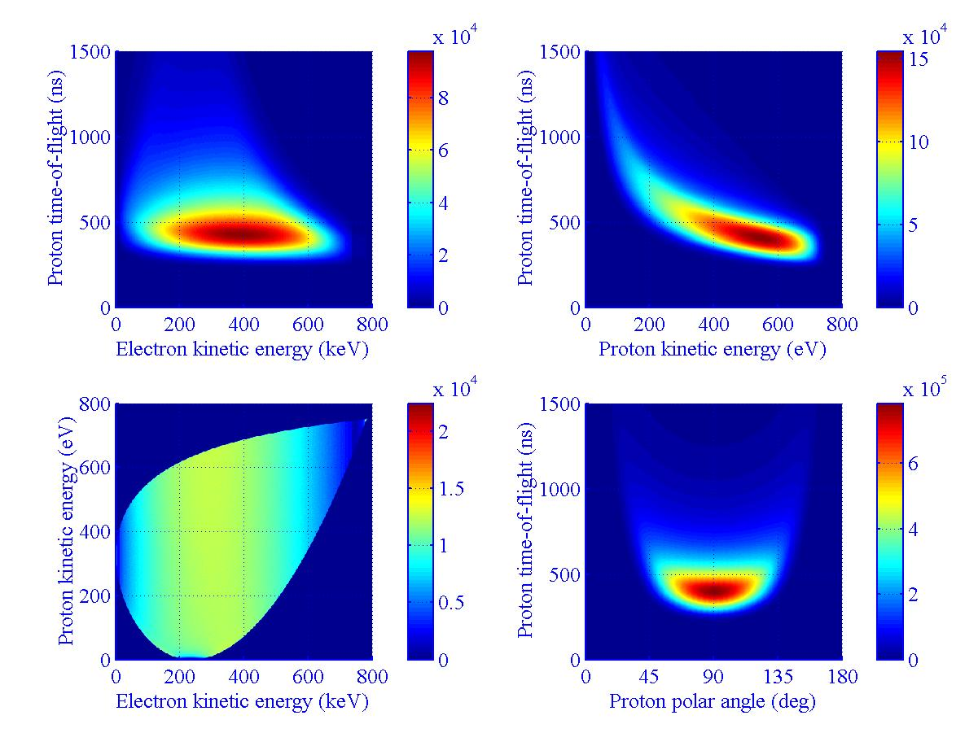
Electron-proton kinematics

Slide 36
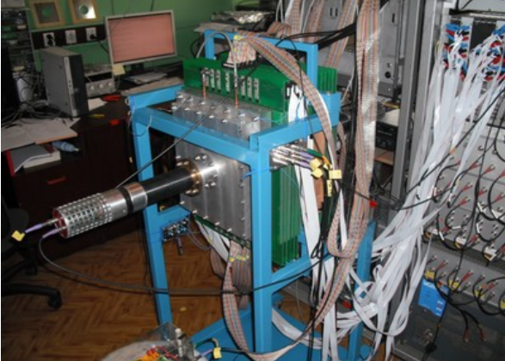
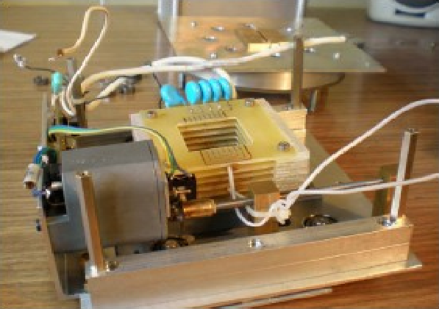
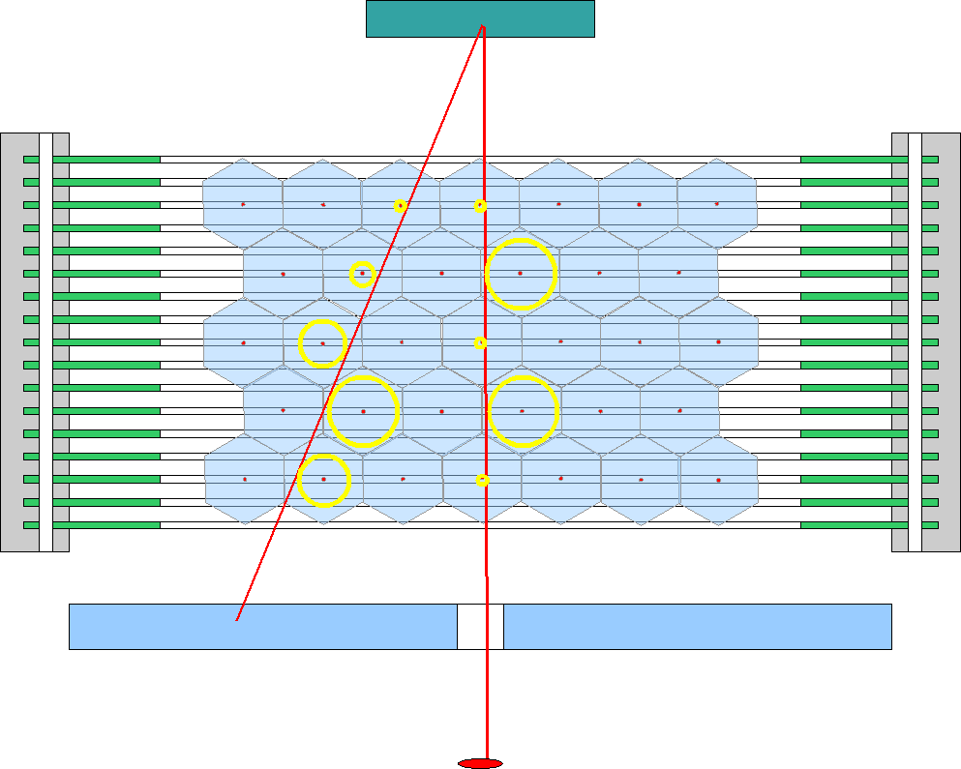
Option 1 – detectors
Electrons:
  Tracking with Multi Wire Drift Chambers (instead of MWPC):
  Hexagonal cell geometry
  x-, y-coordinates from drift time (Δx = Δy = 0.5 mm)
  z-coordinate from charge division (Δz = 20 mm for 2 m long wires)
  Reduced pressure (0.2-0.3 bar) WORKS !
  K. Lojek at al., NIMA 611 (2009) 284
  miniBETA spectrometer (collaboration with KULeuven)
Protons:
  p-e conversion, detection with Multi Wire Proportional Chamber (1 plane)
  Time-of-Flight registration
Scatterer
Source

Slide 37
DAQ
SCINTILLATOR
(TRIGGER)
Quantity | Exp. Information
Electron momentum | Scintillation light & electron track*
Proton momentum | Time-of-flight & hit position
E_{e}
dt₁
dt₂
*
Electron track reconstructed with drift times (x, y) and charge division (z)
MWDC
dt₃
dt₄
dt₅
MWPC
Time-of-Flight
1 µs

Slide 38
Option 1 – experimental challenges
Intensive, parallel and highly polarized CN beam (with well known phase space)
p-e conversion foil (~2 m² in total !)
[S. Hoedl et al., J. Appl. Phys. 99, 084904 (2006)]
Vacuum window (~3 m² – segmented, supported with mesh structure!)
Low pressure MWDC
Within 6 months long data taking:
  3×10⁸ Mott scattered electrons (N, R)
  10⁸ protons in coincidence with Mott scattered electrons (H, L, S, U, V)
  10¹² single electrons (A)
  3×10¹¹ e-p coincidences (a, B, D)

Slide 39
Option 2 - detectors
General features of the experimental setup:
  Axial polarimeter geometry (instead of planar)
    0.5 m long beam acceptance
  Tracking of electrons
    2 layers of HV Monolithic Active Pixel Sensors
  Detection of proton recoils (with Time-of-Flight registration)
    Detection in HV Monolithic Active Pixel Sensors
  Anticipated dimensions:
    Length: ~30÷50 cm
    Outer diameter: ~30 cm
    Pixel detector diameter: ~15÷20 cm
    Pixel size: 100×100 μm²
  Feasible electron energy threshold:
    150 keV for direct electrons
    250 keV for Mott scattered electrons

