Slide 1
Micro Pattern Gas Detectors - new developments and applications
Bartosz Mindur
Faculty of Physics and Applied Computer Science Department of Particle Interactions and Detection Techniques
Jagiellonian Symposium, Kraków, 08-06-2015
www.agh.edu.pl

Slide 2
Introduction
Gaseous detector types – very brief history
MultiWire Proportional Counter (MWPC) ancestor of all “new” gas detector types
First micro detector: MicroStrip Gas Chamber (MSGC)
Family of Micro-Pattern Gas Detectors (MPGD)
Gas Electron Multiplier (GEM)
Example applications of MPGD
RD51 MPGD Collaboration
Conclusions

Slide 3
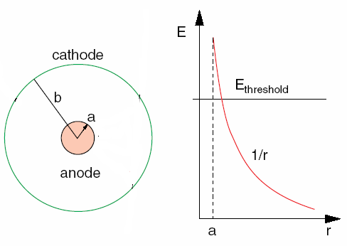
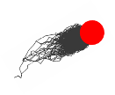
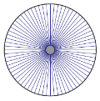
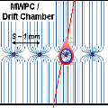
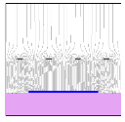
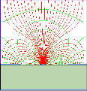
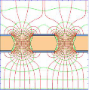
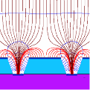
Gaseous detectors
Best way to make detectors on large scale with little matter and at low cost
Electric field high enough (above 10kV/cm) for electrons to ionize active gas
Avalanche creation
Exponential increase of number of electron and ion pairs
Large signal
Wire
MWPC
Parallel Plate
Strip
Hole
Groove/Well

Slide 4
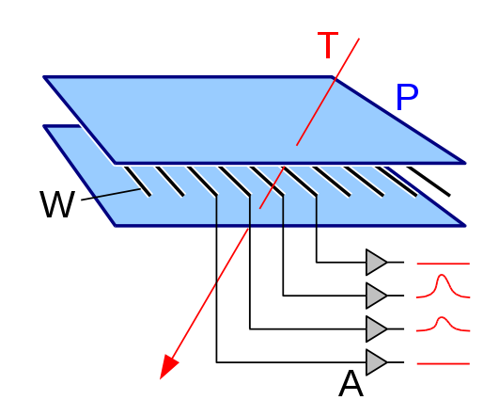
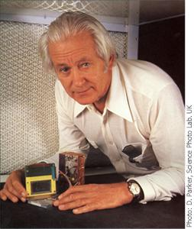
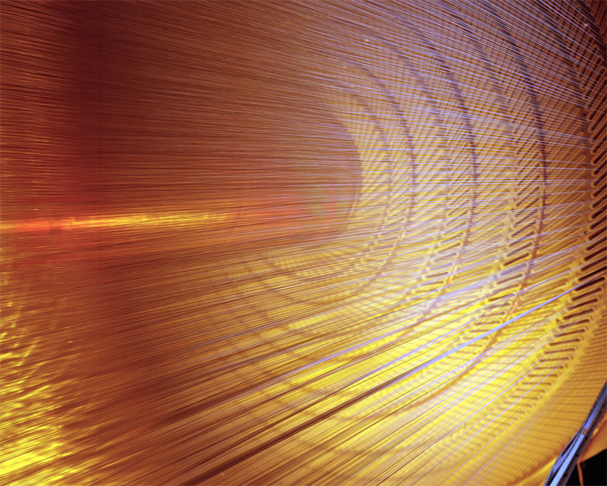
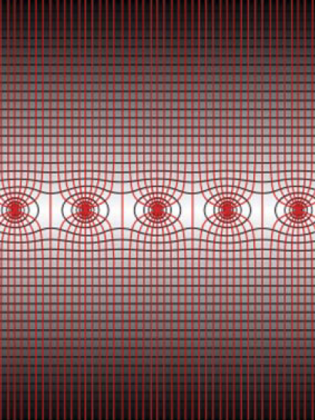
Multi Wire Proportional Chamber - MWPC (Georges Charpak, 1968)
Nobel Prize in Physics in 1992 "for his invention and development of particle detectors, in particular the multiwire proportional chamber"
Schematic drawing of the MWPC.
Charpak, D. Rahm, H. Steiner, Some developments
in the operation of multiwire proportional chambers,
Nuclear Instruments and Methods, Volume 80, Issue
1, 1970, 13-34
Schematic drawing of equipotential lines of the electrical ﬁeld in a MWPC.
Central Outer Tracker, Collider Detector at Fermilab, Tevatron

Slide 5
Multi Wire Proportional Chamber
Position resolution down to 100 μm
By centre of gravity method
The cathode can be spited into the segments
2D position determination of the particle track
Having a stack of MWPC a full 3D particle trajectory can be obtained
Much faster that previous designs (like bubble chambers or spark/streamer chambers)
Event rate up to 2-3x10⁵ cps per wire
Very successful design, however
Mechanical problems and complex assembling process
Fast drop of gas gain at high particle fluxes
Space charge effect
Aging
Permanent damage of the structures after long-term exposure to radiation due to the formation of solid deposits on electrodes
F. Sauli, Principles of operation of multiwire proportional and drift chambers, CERN-77-09
Notes:
Typically, the distance between the electrode planes is some millimeters and the wire pitch ranges from 1 to 3 mm
The active area, depending on the speciﬁc experimental need, can range from a few cm 2 to 10–100 m 2

Slide 6
Post MWPC era – first Micro Pattern Gas Detector (MPGD)
The basic ideas to overcome MWPC limitations
Add cathodes (very) close to anodes
Faster evacuation of the ions – no/reduced space charge effect
Move down in size
Benefits
Higher spatial resolution and multitrack separation
Faster particles rates
Semiconductor technology (PCB)
Photolithography, Etching, Lift-off, Coating, Doping
20 years after invention of MWPC the first MPGD detector was introduced
MicroStrip Gas Chamber (MSGC)
Oed A., Position-sensitive detector with microstrip anode for electron multiplication with gases, Nucl. Instrum. Methods A263:351 (1988)

Slide 7
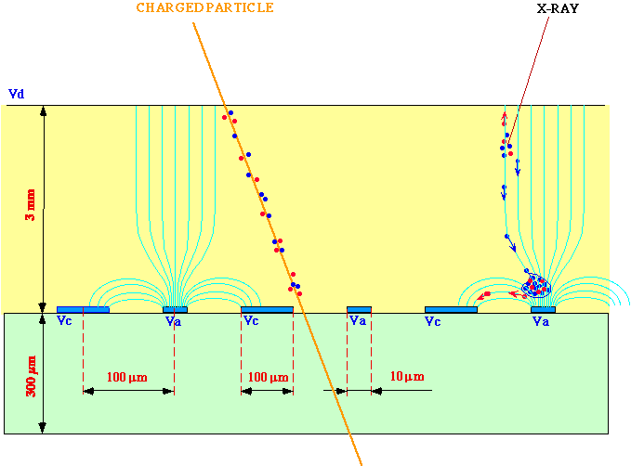
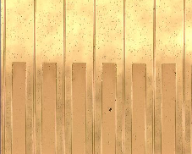
MicroStrip Gas Chamber - MSGC
Micro-anode structure similar to wires
High electric field in most of the region in between the amplification stage electrodes
Insulating material (glass) between electrodes
Oed A., Position-sensitive detector with microstrip anode for electron multiplication with gases,
Nucl. Instrum. Methods A263:351 (1988)

Slide 8
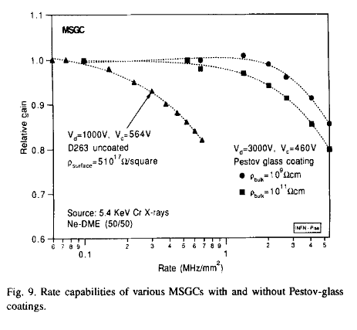
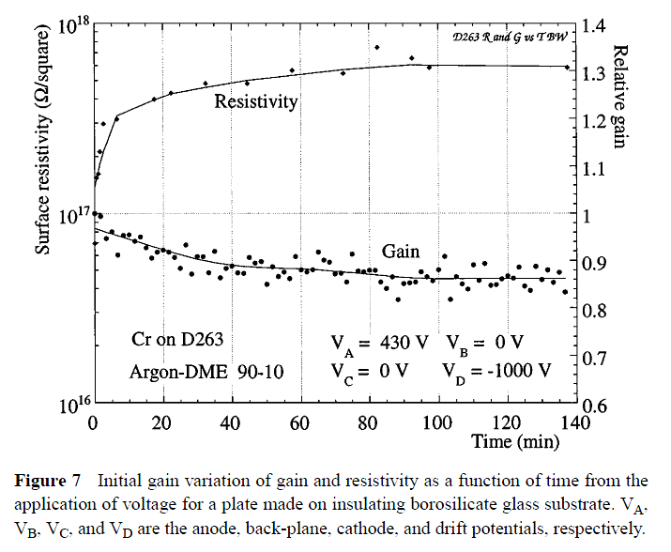
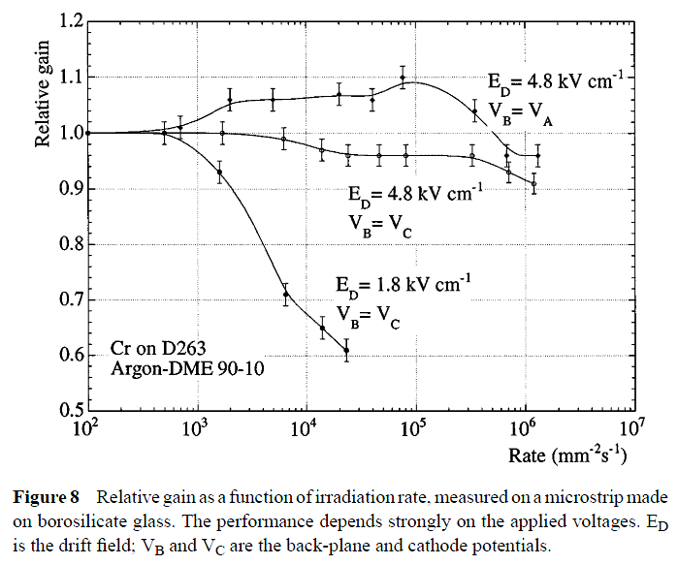
MSGC limitations
Insulation material between anodes and cathodes
Substrate polarization (after application of HV)
Surface charge accumulation
Result dynamic changes of the gas gain vs. time and rate
Solution: substrate with lower resistivity
Eliminates surface charge accumulation
Stable operation up to very high rates
E.g. Pestov-glass coating
Diamond-Like Carbon (DLC)
F,Sauli, A. Sharma, Micropattern Gaseous Detectors , Annu. Rev. Nucl. Part. Sci. 1999. 49:341–88
W.G. Gong et.al., MSGCs with Pestov-glass coatings, NIMA 374 1996
Notes:
Bare borosilicate glass Desag D263 ≈10¹⁷ Ω/sq
DLC undercoated DESAG ≈10¹⁴ Ω/sq

Slide 9
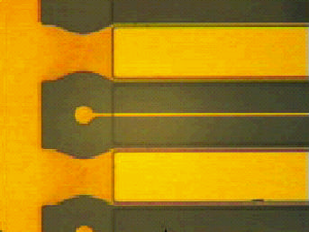
MSGC limitations
Discharges
High electric field in most of the region between wires
Field emission from the cathode edge
High primary ionization – avalanche size exceeds Reather’s limit (Q ~ 10⁷)
Solution
Substrate coating
Cathode edge passivation
Aging – permanent deterioration
Small size of the structures
Solution
Usage of very clean materials and gases
Strips made out of gold
Notes:
Cathode edge passivation – 1-2um polyimide

Slide 10
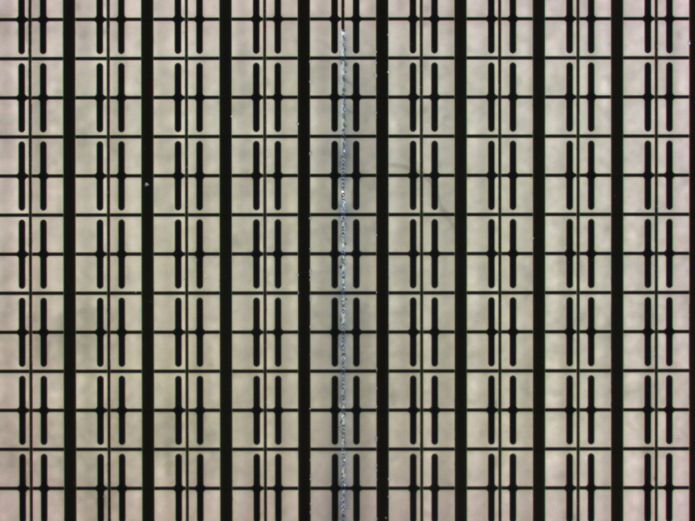
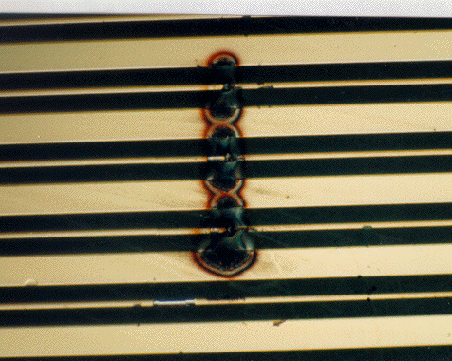
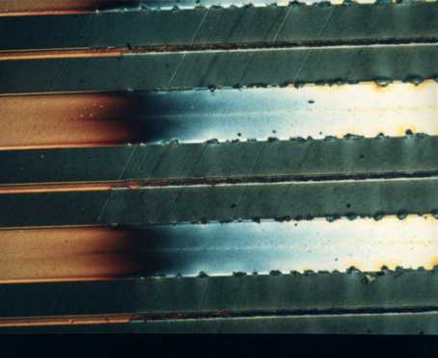
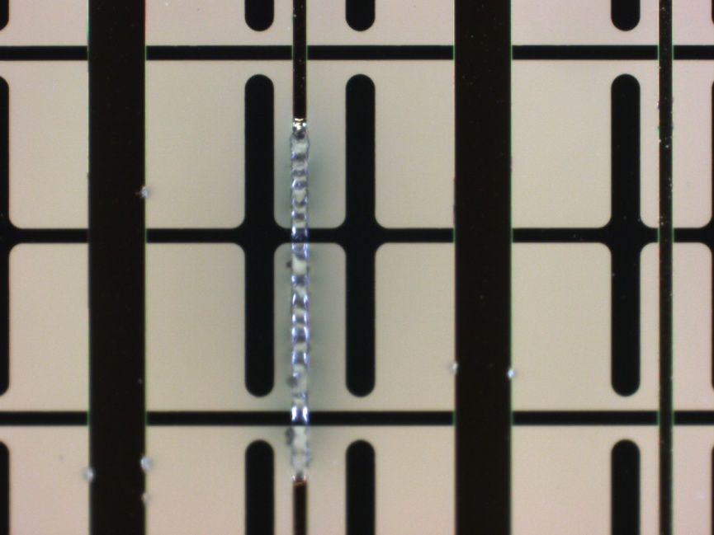
MSGC spark damages and aging

Slide 11
MSGC detector for thermal neutrons (AGH & HZB)
MSGC have quiet a few issues which limits their applications
However they are still used
MSGC with Gd/CsI solid converter for thermal neutron detection
Triggerless application (dedicated electronics needed)
2D position resolution (~110 μm rms.)
Time Of Flight (~5 ns rms.)
Low pressure
Two stage amplification (no drift region)

Slide 12
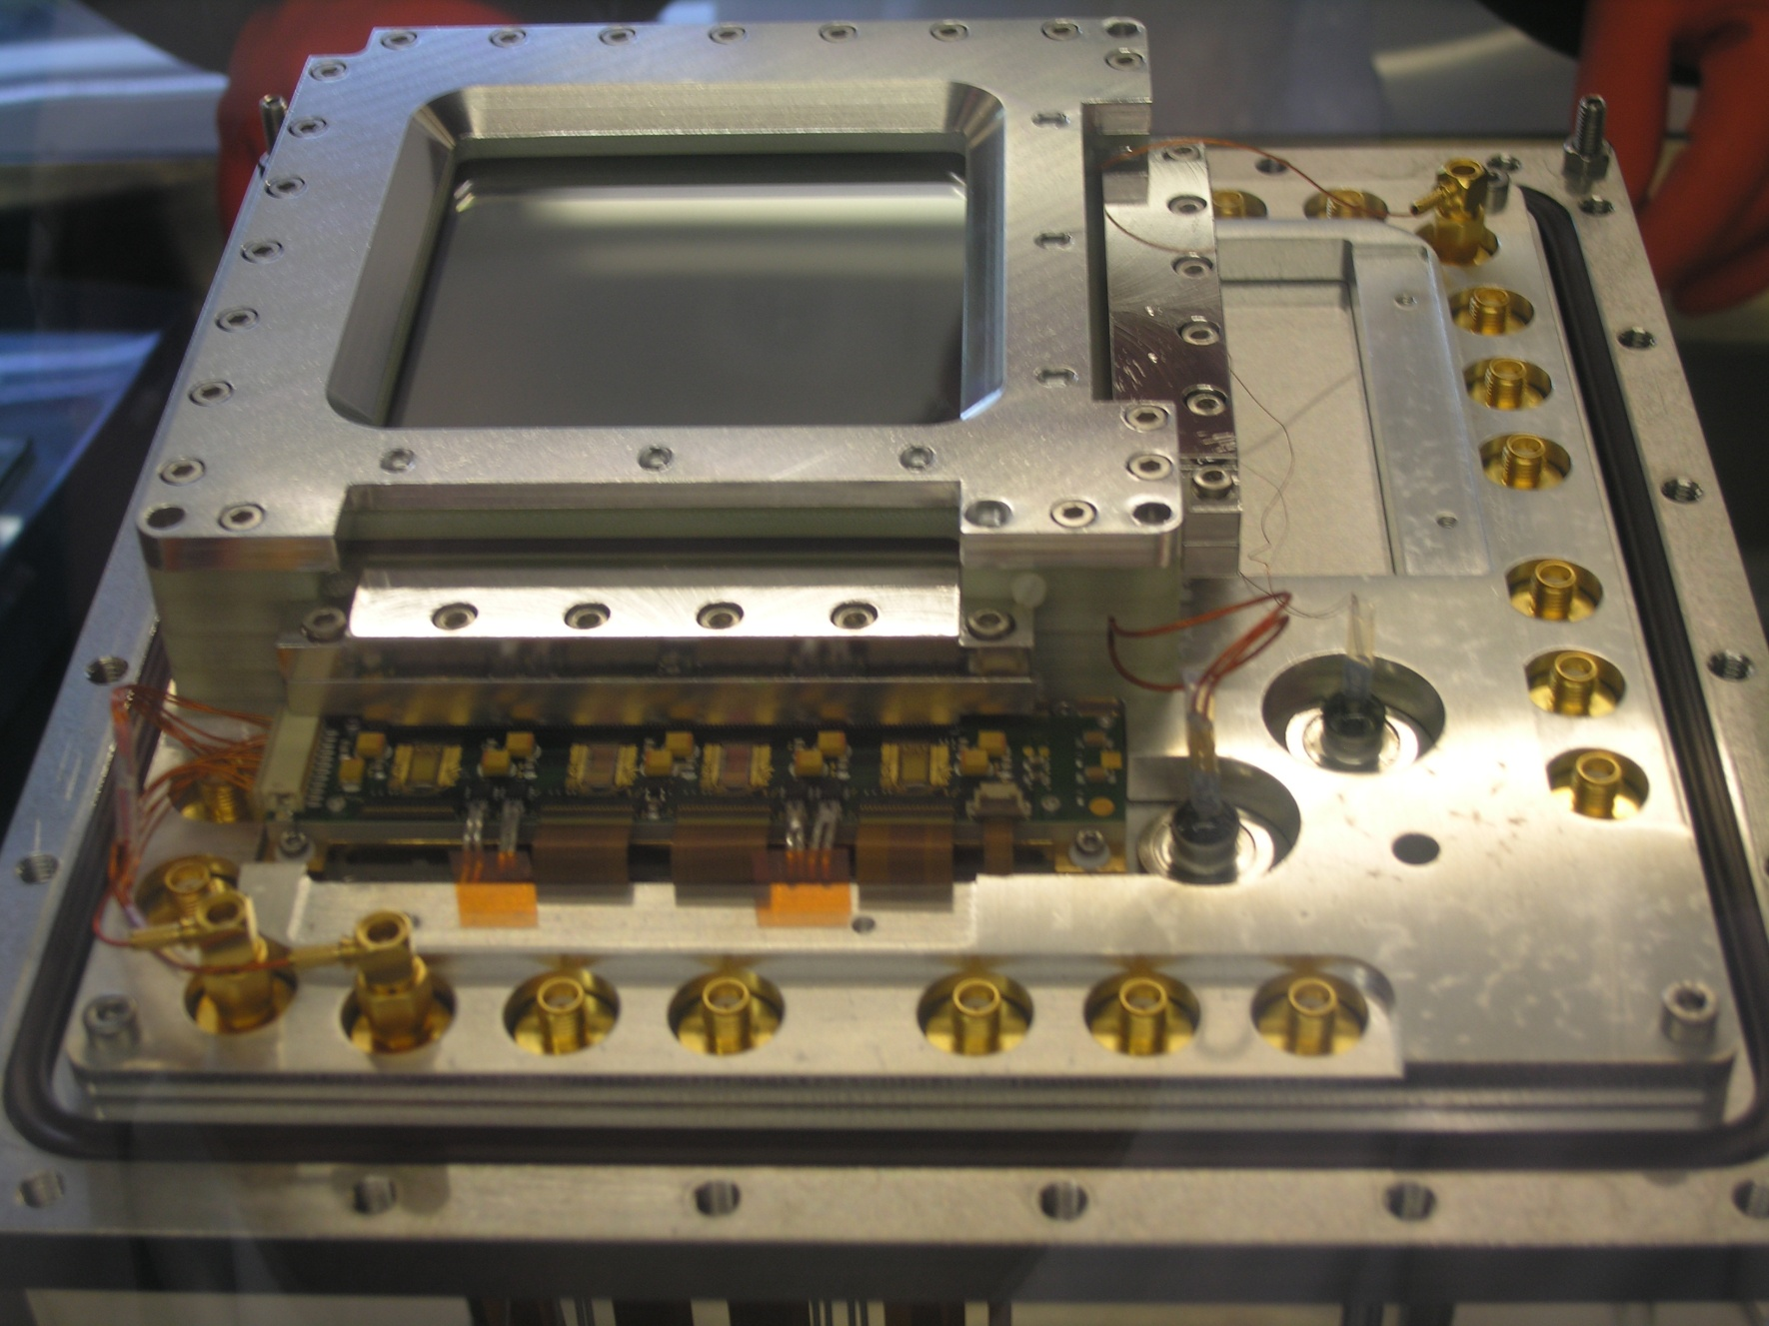
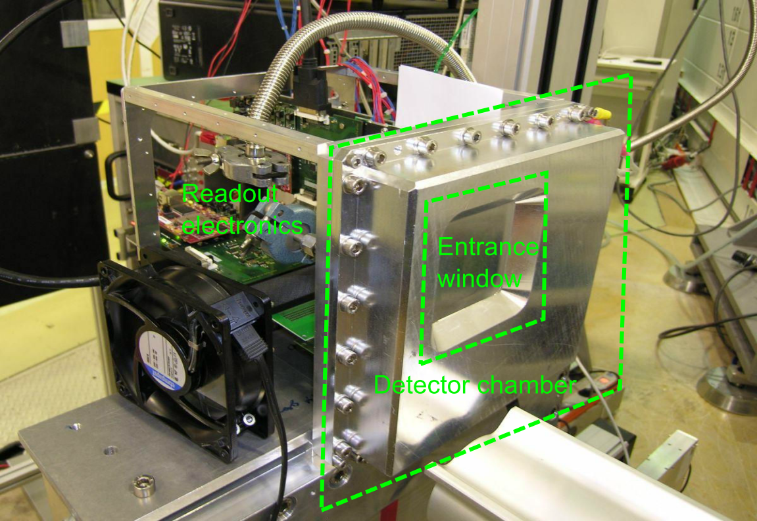
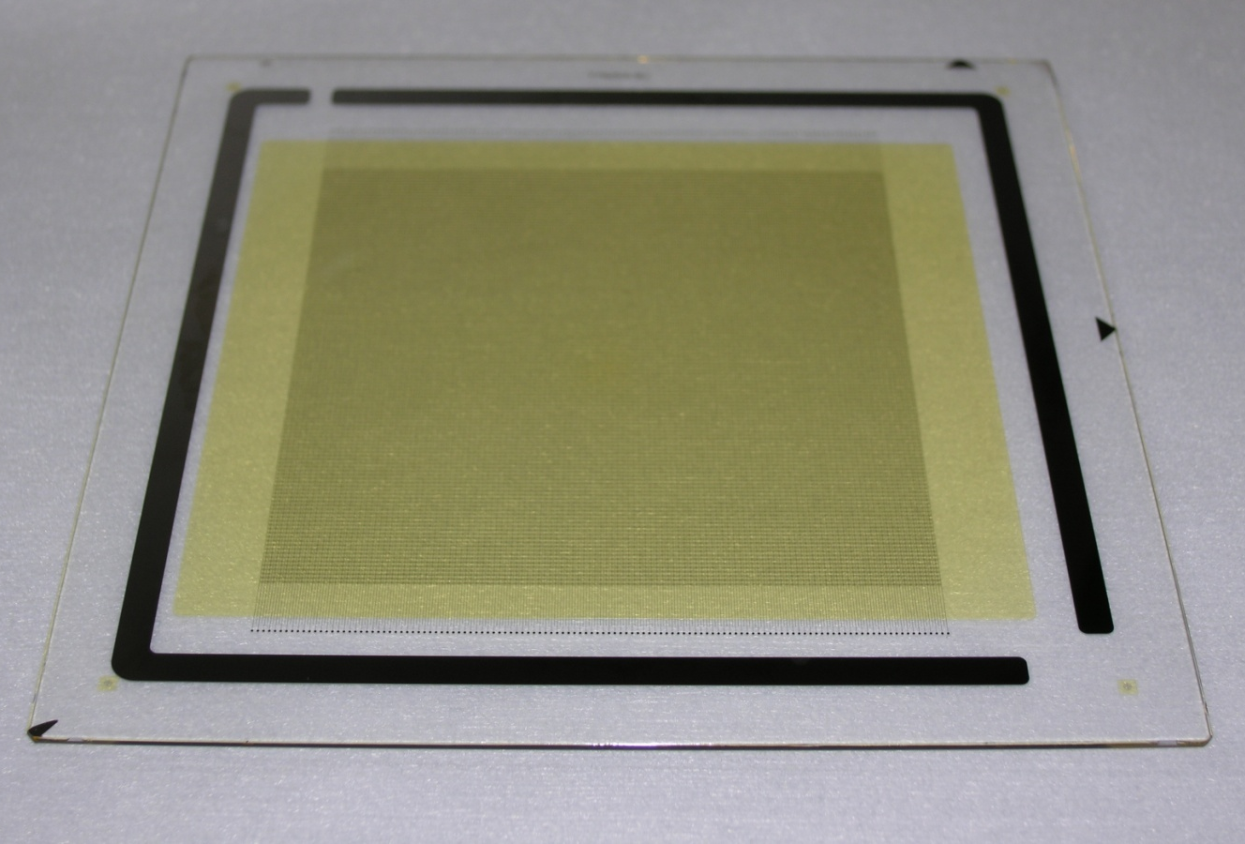
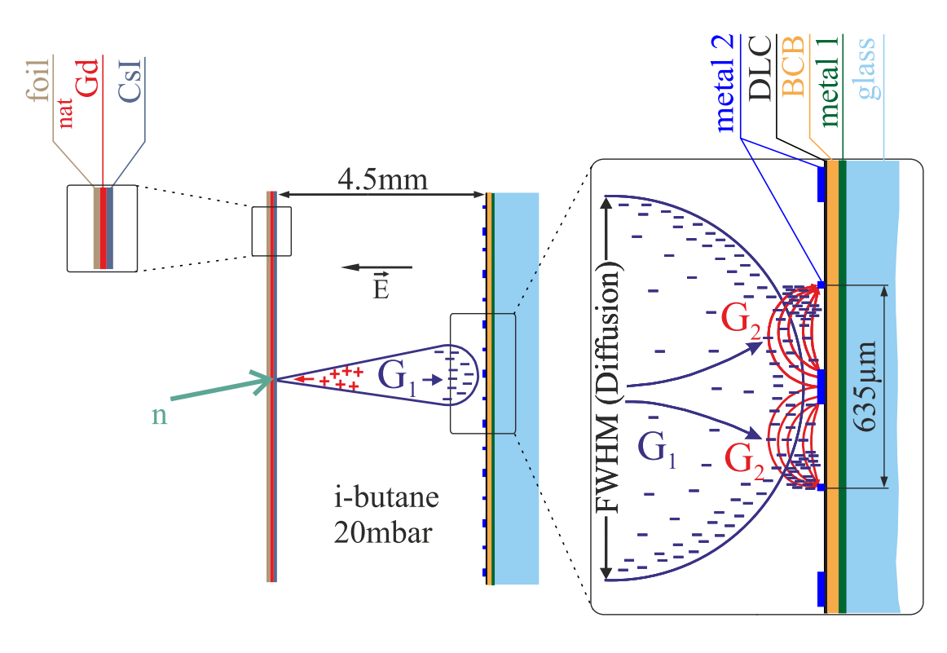
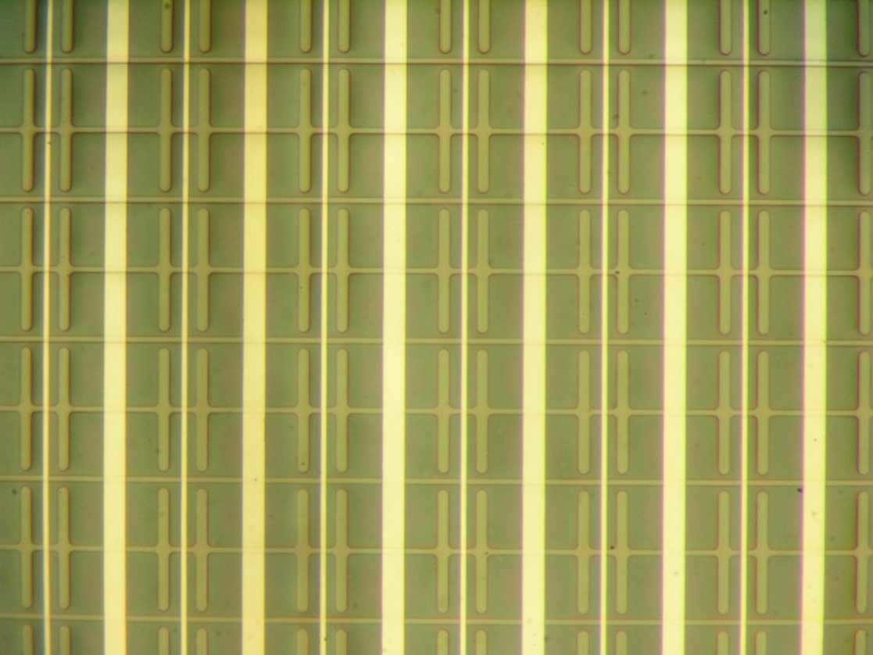
MSGC detector for thermal neutrons (AGH & HZB)
Cathode
Anode
Second coordinate strip
Mindur B. et.al., Performance of a Micro-Strip Gas Chamber for event wise, high rate thermal neutron detection with accurate 2D position determination, JINST 9 P12004, 2014.
Notes:
DLC – diamond like carbon
BCB – benzocyclobutane insulation layer

Slide 13
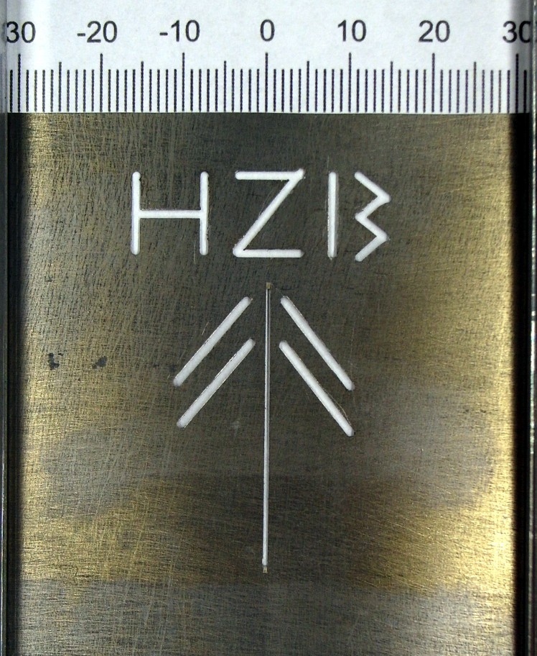
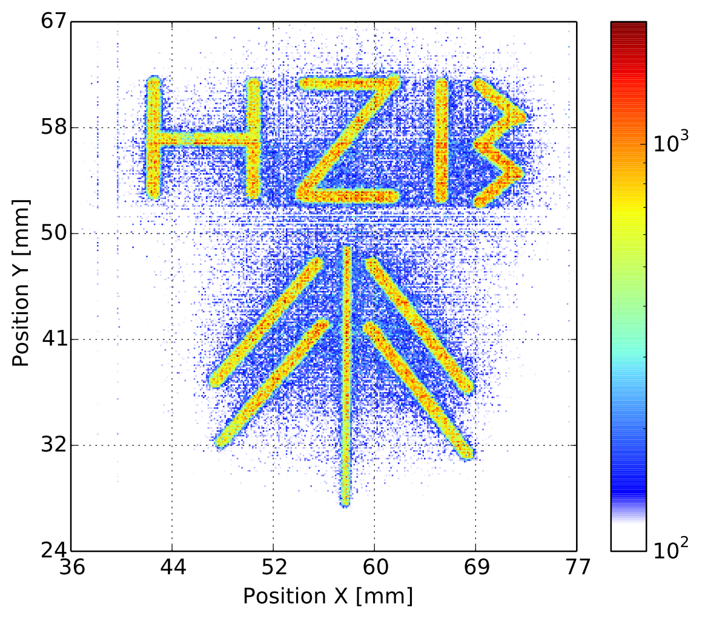
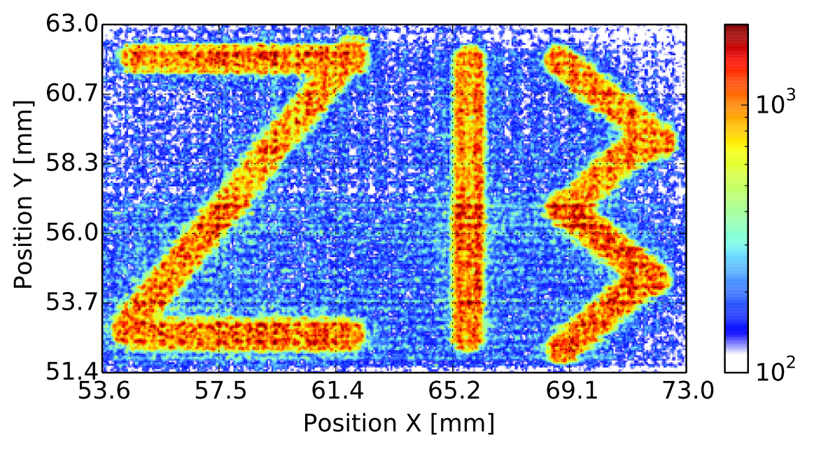
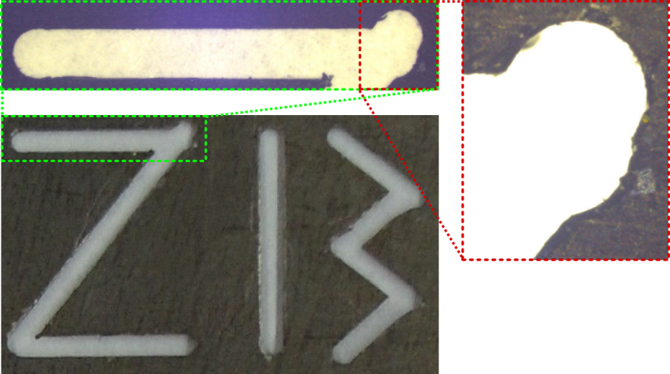
MSGC imaging results with neutrons (AGH & HZB)
Mindur B. et.al., Performance of a Micro-Strip Gas Chamber for event wise, high rate thermal neutron detection with accurate 2D position determination, JINST 9 P12004, 2014.

Slide 14
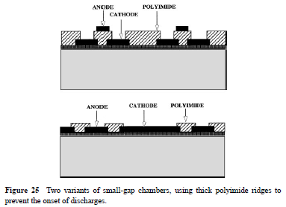
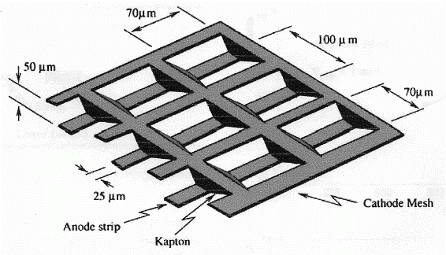
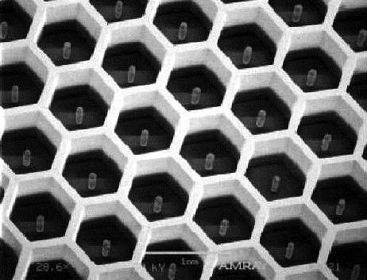
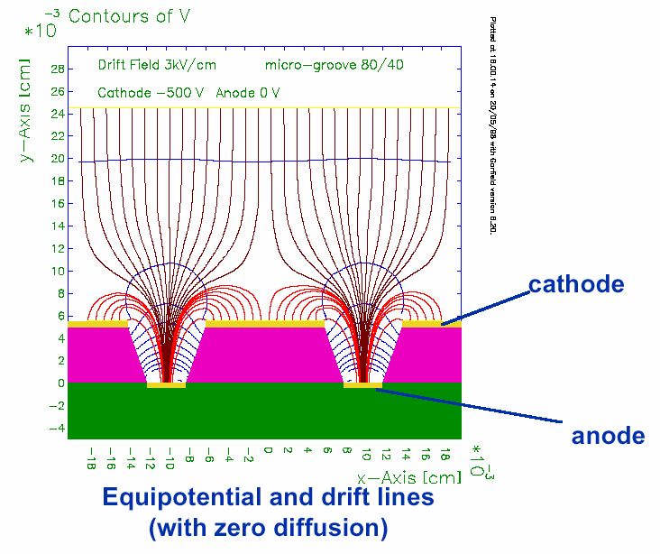
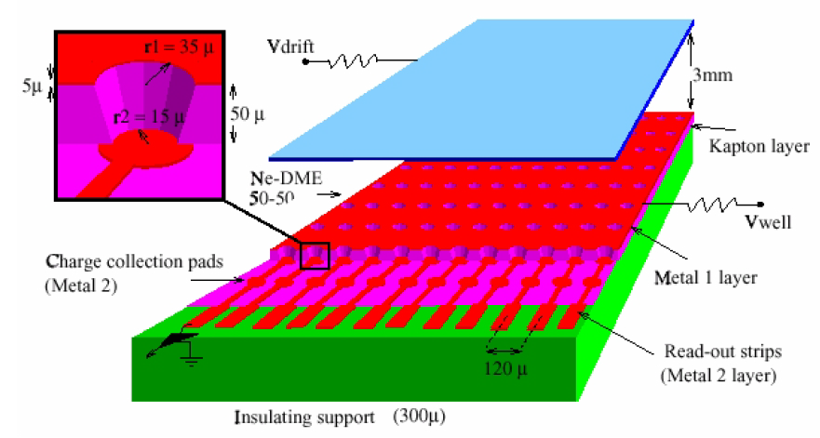
Micro-Pattern Gas Detectors (MPGD)
MSGC pave the way for development of many new types of structures and detectors
MicroGap Chamber (1993)
MicroWire Chamber (1997)
MicroPin (1999)
MicroGroove (1999)
MicroWell (1999)
μPIC (2001)
…
MicroMEGAS – Micro Mesh Gaseous Structure (1996)
GEM – Gas Electron Multiplier (1997)
“…The successful development of multiwire and microstrip structures has somewhat sidestepped the research on gas detectors that exploit the multiplication in uniform fields. Parallel-plate multipliers not only are mechanically sturdier but also have better energy resolution and higher rate capability. ”
F. Sauli, A. Sharma, MICROPATTERN GASEOUS DETECTORS, Annu. Rev. Nucl. Part. Sci. 1999. 49:341–88

Slide 15
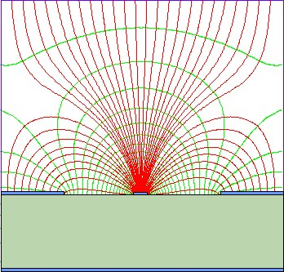
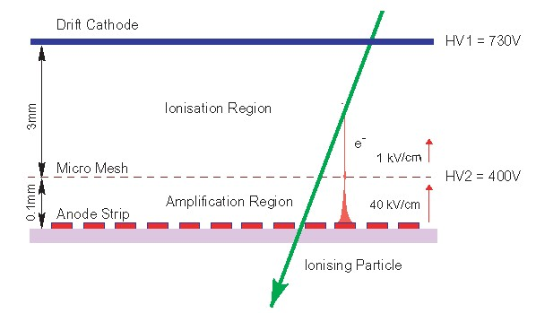
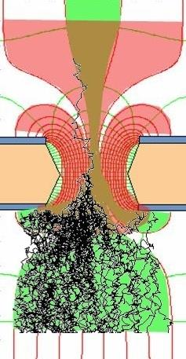
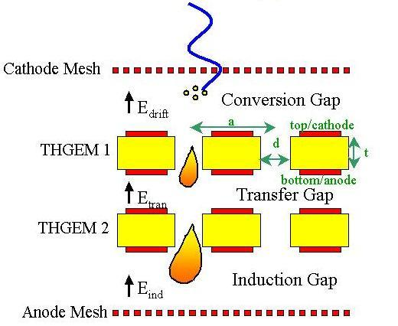
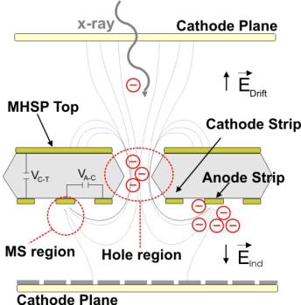
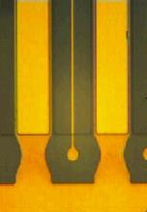
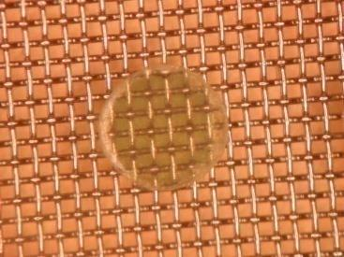
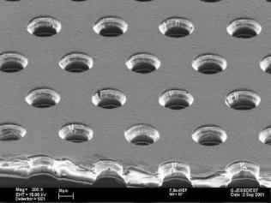
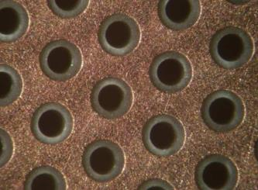
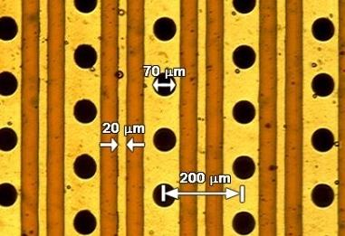
Micro-Pattern Gas Detectors
High gas gain
High rate capabilities
Good space, time and energy resolution
Reduction of ion backflow and photon feedback
Large size
Low cost
MSGC
MicroMEGAS
GEM
THGEM
MHSP
Notes:
MHSP – MicroHole and Strip Plate

Slide 16
MPGD important limitations
MPGD are faster because of smaller gaps between anode and cathode, however
Streamer -> fast discharges
Spontaneous breakdown in absence of radiation above a critical voltage
Heavily ionizing tracks can trigger discharge
Solutions
Multi stage amplification (GEM)
Sparks rate massively decreased
Resistive readout (MicroMEGAS) learnt from RPCs
Sparks not harmful for the detector

Slide 17
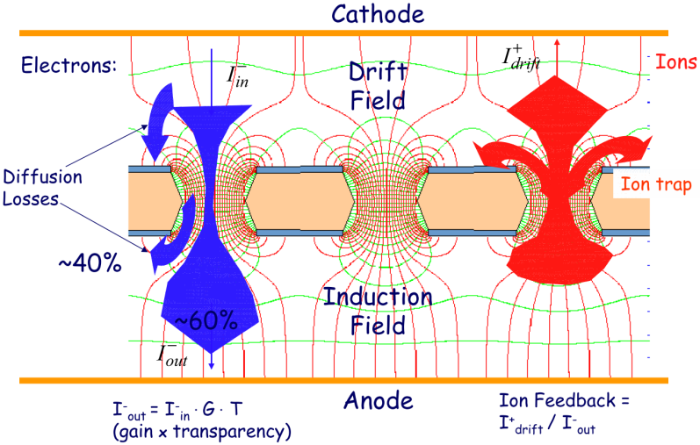
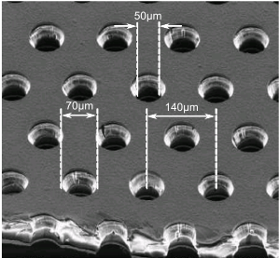
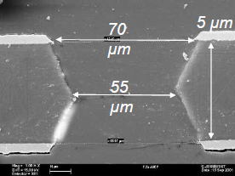
Gas Electron Multiplier (GEM) - foils
Introduced by F. Sauli in 1997
Thin metal-clad polymer foil
Perforated by high density of holes (~100/mm²)
F. Sauli, GEM: A new concept for electron amplification in gas detectors, Nucl. Instr. and Meth. A386(1997)531

Slide 18
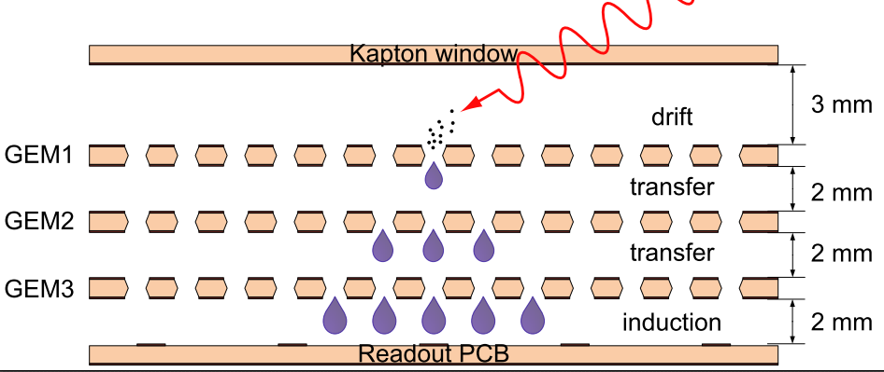
Standard (tripple) GEM detector
Most of the detectors use three GEM foils in cascade for amplification to reduce discharge probability by lowering field strength
Multiple structures provide equal gain at lower voltage
Discharge probability on exposure to a particles is strongly reduced
S. Bachmann et al Nucl. Instr. and Meth. A479(2002)294
Notes:
Discharge probablity on exposure to 5MeV alphas

Slide 19
GEM properties
Excellent behavior even under harsh conditions
A. Bressan et al, Nucl. Instr. And Meth. A425(1999)262
C. Altunbas et al, DESY Aging Workshop (Nov. 2001), Nucl. Instr. and Meth. A

Slide 20
GEM unique feature
Full decoupling of the charge amplification structure(-s) from the charge collection and readout structure
Both structures can be optimized independently!
A. Bressan et al, Nucl. Instr. and Meth. A425(1999)254

Slide 21
GEM readout structures
Variety of readout structures
Different sizes, granulation and shapes
Cartesian
Small angle
Mixed (radial strips & pads)
Pads
Notes:
Cartesian – Compass, LHCb
Hexaboard pads – MICE,
Mixed - TOTEM

Slide 22
Nonstandard GEM detectors

Slide 23
GEM & AGH readout electronics
Front-end ASIC - GEMROC
32 channel
Self triggering
Data derandomization
Low noise
FPGA based DAQ
2 x 1Gbit throughput
Counting rate 5x10⁶ cps
2D readout
B. Mindur et.al, A compact system for two-dimensional readout of gas electron multiplier detectors, JINST 8 T01005 (2013)

Slide 24
GEM & AGH readout results and application
A. Zielinska, B. Mindur et.al, X-ray fluorescence imaging system for fast mapping of pigment distributions in cultural heritage paintings, JINST 8 P10011 (2013)

Slide 25
GEM and painting arts studies at AGH
X-ray tube at 30 kV
Beam illuminates 10x10 cm² of painting
Pinhole camera (camera obscure)
Position resolution (0.86mm rms.)
For 1 mm pinhole camera
Energy resolution ~20% (FWHM) for 6 keV photons
Relatively fast measurement
5 hours with Ar/CO₂ gas mixture
More about this topic on Thursday (session no.7), presentation by: Alicja Zielińska
“Optimisation of the X-ray fluorescence imaging system for mapping of pigments in historical paintings”
A. Zielinska, B. Mindur et.al, X-ray fluorescence imaging system for fast mapping of pigment distributions in cultural heritage paintings, JINST 8 P10011 (2013)

Slide 26
RD51 MPGD Collaboration
~450 Authors
75 Institutes from
25 Countries

Slide 27
MPGD Technology and new structures
Characterization and understanding of physical phenomena in MPGD
WG2:
WG1:
Development of common software for MPGD Simulation
WG5:
RD51
WG4:
Electronics optimization and integration with MPGD
WG3:
WG6:
WG7:
CERN MPGD Workshop,
Quality Control and Industrialization
Common Test Beam
and Lab Facilities
Applications,
Conferences / Schools

Slide 28
Conclusions
MPGD continues very successful design of classical gas detectors, especially MWPC
Many possibilities and structures to fit with the applications
One of the key feature is separation the amplification stage(-s) from readout structures
Among others types, micromesh and hole-type (uniform field) represent nowadays a robust and mature-enough solution for variety of applications
MPGD are suitable for large areas
Low production costs
Wide spectrum of applications
Not only HEP (however, development is mostly driven by HEP)
Neutrons
X-ray
Imaging
Homeland security
…
Large community – RD51
Spread knowledge
Access to the technology, tools and test beam facility (at CERN)

Slide 29
Thank you for your attention

Slide 30
Backup slides
Backup slides

Slide 31
MicroMEGAS
Parallel-plate avalanche chamber
Uniform field (except mesh vicinity)
Small gap, high field
Fast movement of positive ions (mostly collected on the mesh)
Small space-charge accumulation
Very fast signals
Y. Giomataris”, Development and prospects of the new gaseous detector “Micromegas”, NIMA 419 (1998)

Slide 32
THGEM – Thick GEM
Standard PCB technology
Etching & drilling
Very simple and robust
Voltage about 2kV
Gain for single structure 10⁵
Position resolution at the level of mm
Fast (ns)
Really cheap
Hole diameter: 0.3-1mm
Pitch: 0.7-7mm
Thickness: 0.4-3mm
Rim: ~0.1mm
Large holes – larger the e- diffusion
Full e- collection
Efficient e- transfer
Large multiplication factors
Up to 10⁵ for single THGEM
High rate capability
10MHz/mm² @ 10⁴
C.K. Shalem el.al,
Advances in thick GEM-like gaseous electron multipliers,
NIMA 558 (2006) 475 & 468

Slide 33
GEM and painting arts studies at AGH
X-ray radiography
Simple setup rearrangement
Fast measurement
~minutes

