Slide 1


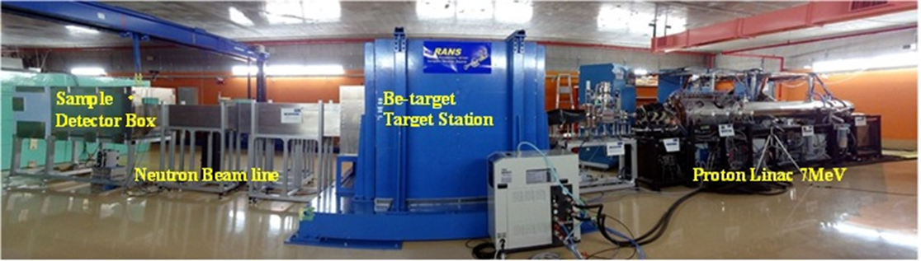
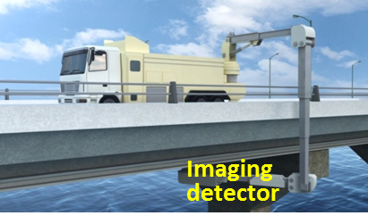

RIKEN compact neutron source RANS and its applications
-RIKEN Accelerator-driven compact Neutron Source
検出器
8th June 2015
Jagiellonian Symposium
Krakow
Great thanks
Yoshie OTAKE Riken center for advanced Photonics(RAP), Neutron beam team technology Team RIKEN
M.Takamura, Y.Yamagata, H.Sunaga, A.Taketani, Y.Ikeda, M.Yamada Y.Seki
H.Suzuki(JAEA), Y.Kumagai(Tokyo city Univ.) et al

Slide 2
RANS project goals：CANS for practical use
Compact neutron source system easy and handy to use –floor-standing type
  industrial use,
    non-destructive inspection
    industrial material development analysis,
      Together with VCAD (simulation)
RANS-RIKEN Accelerator-driven compact Neutron Source
      Transportable non-destructive inspection of large scale bridges
Power suppl
Cooling pomp
X-ray
High frequency gene.
Fast neutron large area imaging system
Transportable X-ray instrument for bridges Prof.M.UESAKA (Univ.Tokyo) 3.95MeV
X-band e-linac

Slide 3
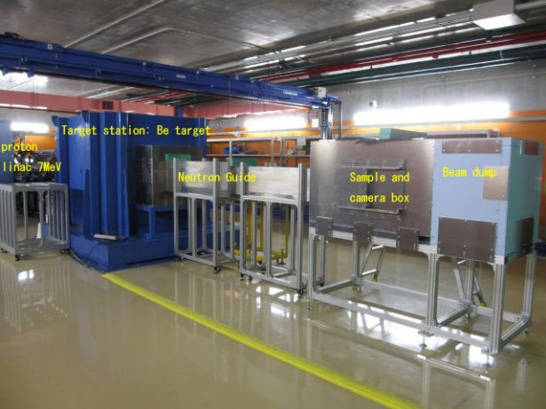
RANS=RIKEN Accelerator-driven compact Neutron Source development policy : easy to access on-site
<Techniques overcome and features>・・・・・・・・・
1.Small system including shielding-> proton linac
2011started. 2012 construction Main members
7MeV proton
=low energy Be(p,n) reaction
=low energy Be(p,n) reaction
★blistering (hydrogen embrittlement damage)
  2.Long Life Be target invention by Dr.Y.Yamagata
3.compact and low cost shielding design
  Multilayer shielding of target station
Easy maintenance
  Neutron flux ~10¹²/sec@７MeV, 100μA(max)
  Is nearly 30 times more than with 3.5MeV (proton nergy)
Space ~4m*15m
  ７MeV、100μA、Rf power supply.: 350kW(peak) duty 1.3%,Electric power peak 40kVA,
  Cooling water：75L/min ,pulse width (30～200μs)repetition frequency～20～180Hz
  RF power 425MHz, Injection energy0.030-3.5MeV

Slide 4
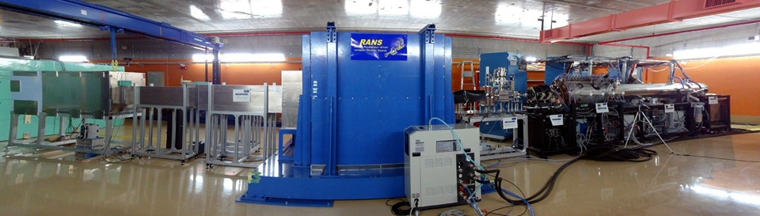
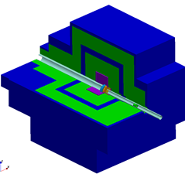
RANS compact Neutron source for realization of practical use, and development of trans-portable instrument for infrastructure safety
Be
Neutron
Proton 7MeV
Neutron Beamline
Proton Linac’7MeV
Q DTL RFQ
Target station
Neutron detector,
sample box
2013 January,
RANS starts running
After ten month construction.
Inside Target station
BPE
①
：Be(Target)
：V(backing) Hydrogen diffusion
：PE(polyethylene)Moderator
：C(graphite) Reflector
：BPE(Boron PE )Neutron Shielding
：Pｂ γ-ray shielding
②
Neutron
Proton
Be
③
④
Reflector
Graphite
Moderator
absorber
⑤
⑥

Slide 5
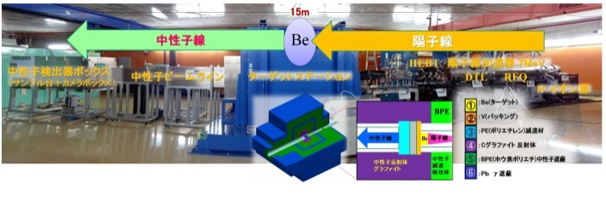
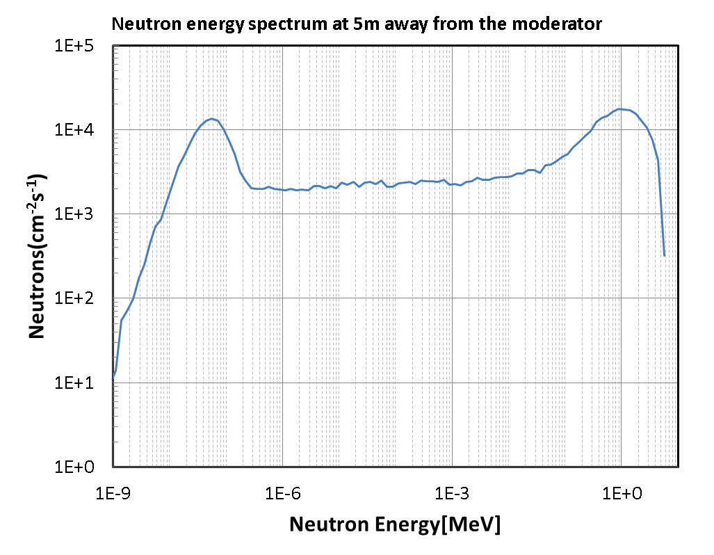
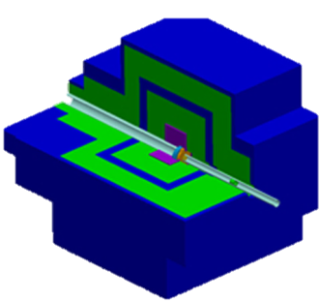

RANS Neutron spectrum (PHITS simulation)
@ maximum averaged current 100μA
N
BPE
Proton
Lower peak energy
E~50meV λ~0.13nm
thermal neutron
E=25meV, λ=1.8Å
Be
higher peak energy
E~1.5MeV
fast neutron
Development for the fast neutron imaging detector
Reflector
Graphite
Moderator
absorber
：Be(Target)
：V(backing) Hydrogen diffusion
：PE(polyethylene)Moderator
：C(graphite) Reflector
：BPE(Boron PE )Neutron Shielding
：Pb γ-ray shielding

Slide 6

Long life Be(p,n) target development Yutaka Yamagata RIKEN
P
Be
B
Ｎ
7 MeV proton
Neutron
↓V backing +Be
Y.Yamagata
Be(p,n) reaction seems to be ideal for low energy neutron source, while major problem in Be target is the blistering (hydrogen embrittlement damage) of target caused by low energy proton beam.
We proposed a new structure target with backing of highly hydrogen diffusible material.
The performance estimation and design was done by using ion injection simulation (SRIM), and finite element simulation (hydrogen diffusion, thermo-fluid analysis, structural analysis).
We expect that the newly-designed target has life time more than several thousand hours.
Target destruction by blistering
Patent PCT/HP2013/056188

Slide 7
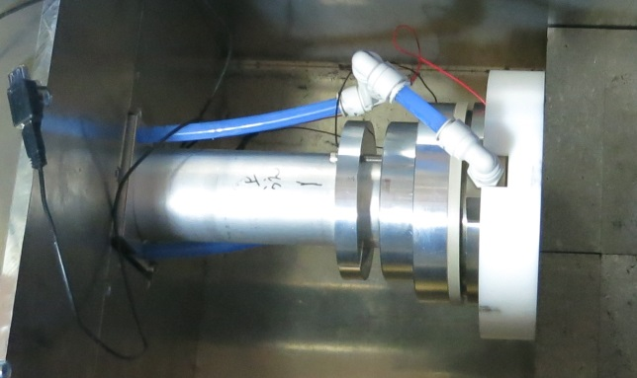
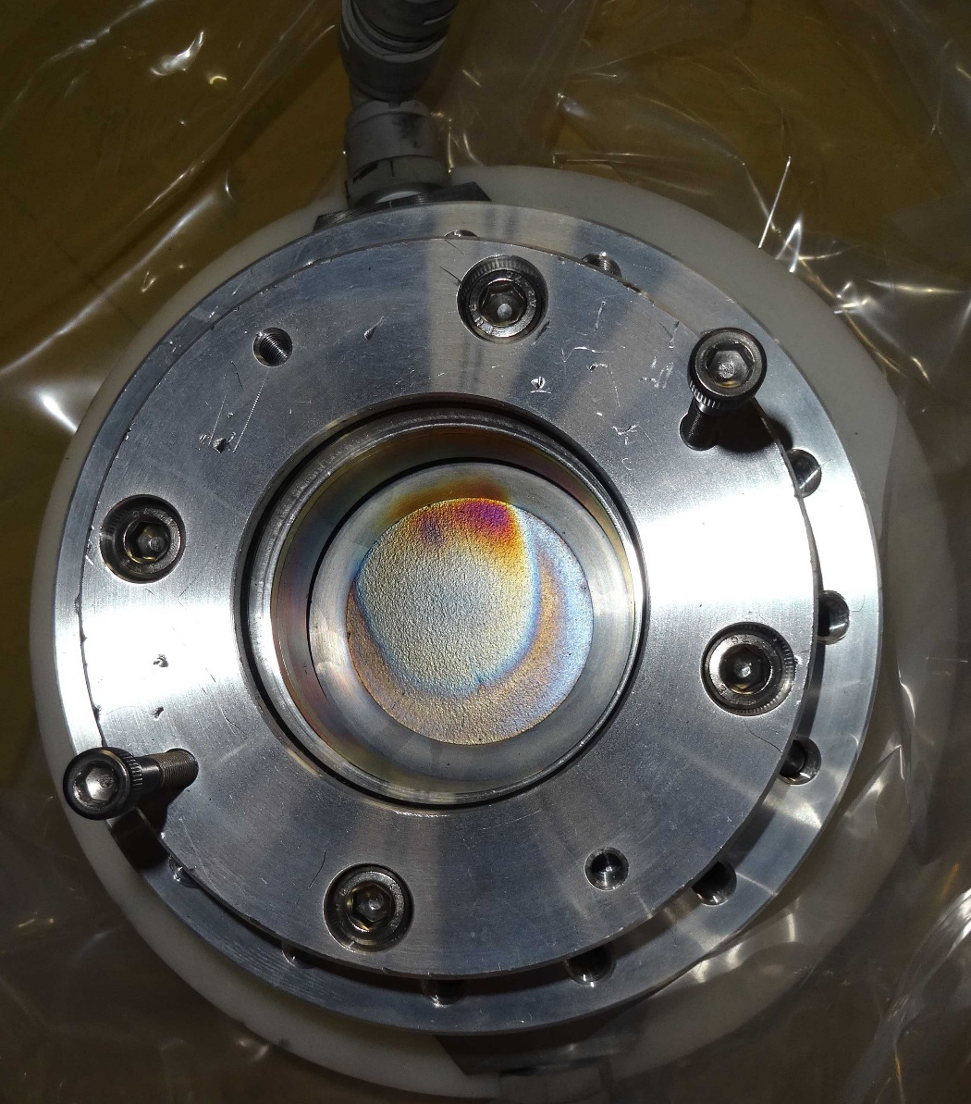
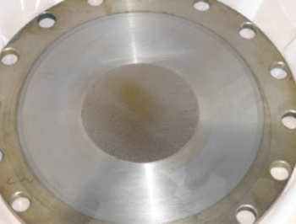
Long life Be(p,n) target Yutaka Yamagata RIKEN
Neutron
Proton 7MeV
After 2 years, ~9100 μA H
NO cracks or blistering is observed
Y.Yamagata, K.Hirota, J.Ju, S.Wang, S.Morita, J.Kato, Y.Otake, A.Taketani, Y.Seki, Y.Yamada, H.Ota, U.Bautista, Q.Jia
“Development of a neutron generating target for compact neutron soruces using low energy proton beams” Journal of Radioanalytical and Nuclear Chemistry
DOI 10.1007/s10967-015-4059-8
Picture taken in Feb. of 2014
after about 3900μAh

Slide 8
A example of industrial use,
Compact neutron Application results for practical use.
Steel
Compact neutron source is useful!!

Slide 9




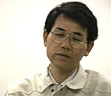
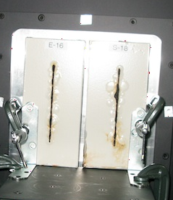
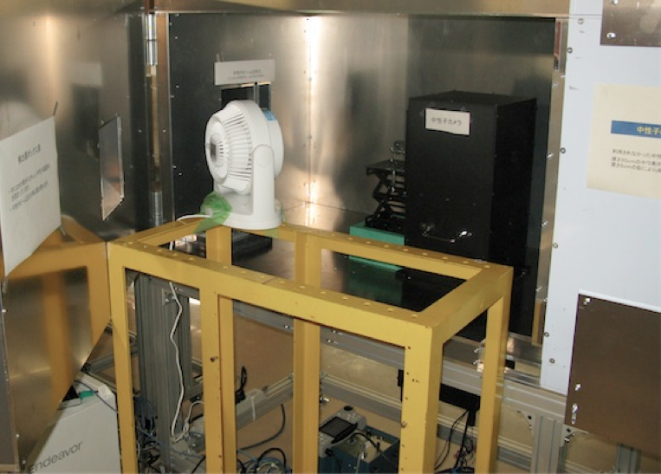
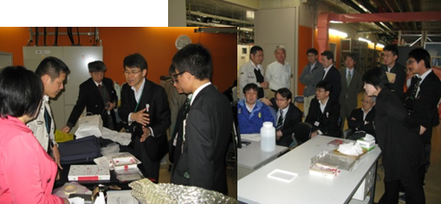
RANS take on a challenge,
Non-destructive observation of inside the steel
under the film
A.Taketani H.Sunaga, M.Yamada, S.Mihara
中性子
イメージング
測定 (10分）
KOBELCO
Dr. T . Nakayama
ISIJ (the Ion and Steel Institute of Japan) Research Activity,
Nippon Steel and Sumitomo Metal
JFE-Steel
Kobelco
Daido Steel
Univ. Inst. (Hokkaido, Tohoku, Ibaraki, Kyoto, Tokyo city, Toyohashi, Tokyo metropolitan, CROSS)
Neutron imaging detector
Scintillator + C CCD
蒸留水中浸漬処理110分
Alloy
Steel
中性子
イメージング
測定 (10分）
エアブロー乾燥処理30分
(位置固定）
中性子
イメージング
測定 (10分）
RANS on-site

Slide 10
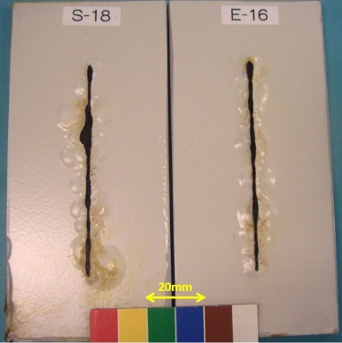
Industrial application- Ion and steel
KOBELCO
Proposed by Dr. T . Nakayama
Corrosion Visualization
Alloy
Whether it is possible to visualize the steel corrosion under-film?
base material is Ｆｅ
What we should find is ＦｅＯＯＨ, Fe₂O₃, Fe₃O₄
Film contains a lot of H,
→It is impossible for X-ray to distinguish the corrosion from base material Fe
Steel
Using neutrons can we distinguish corrosion, rust under the film, difference between steel and alloy?
RANS imaging time~5~20 min.

Slide 11
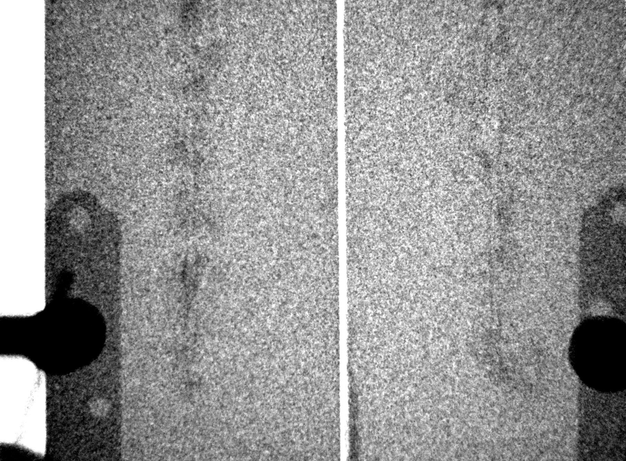
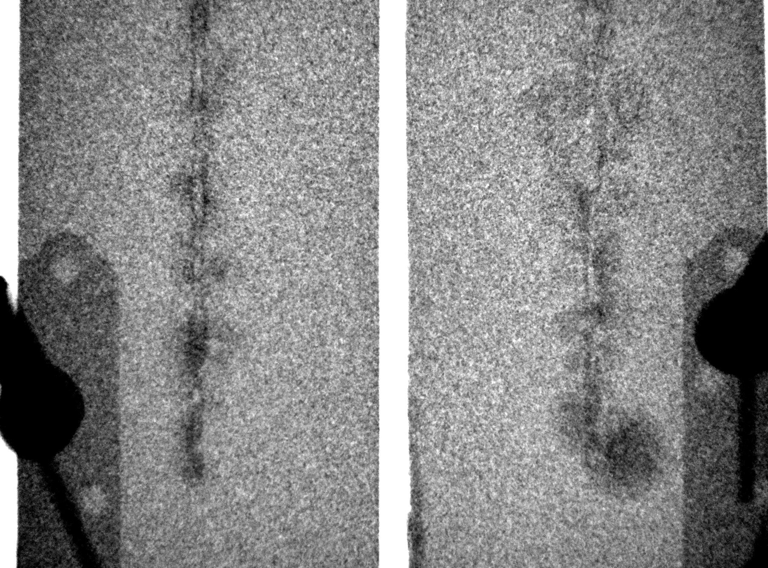
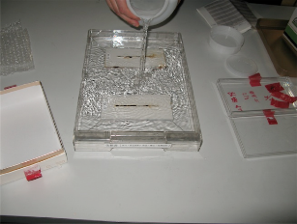
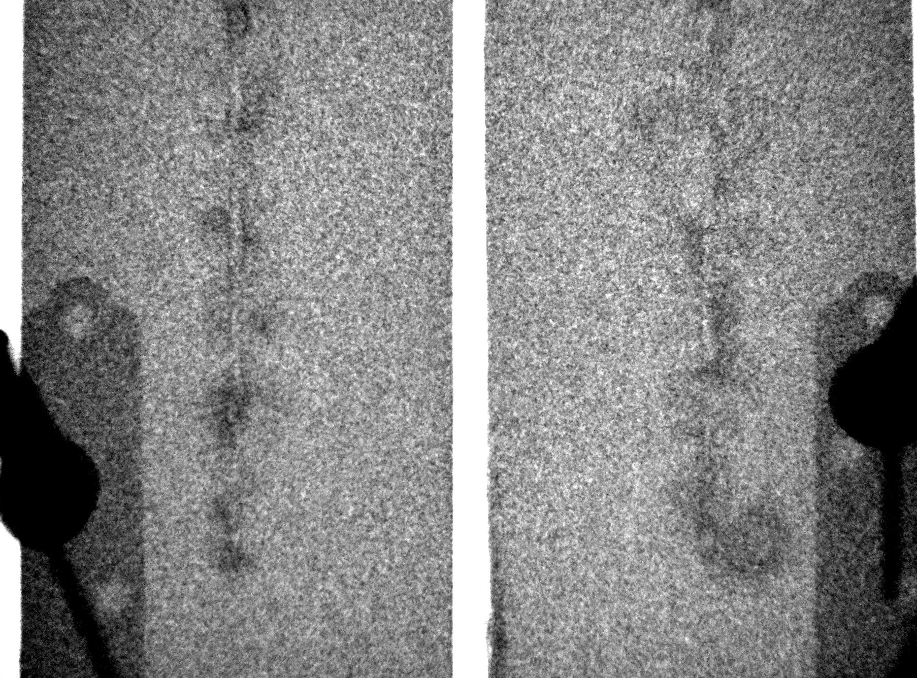

Success of the visualization wet-dry process
Alloy
Steel
Normal condition( in the room)
110minutes wet
30minutes trying

Slide 12
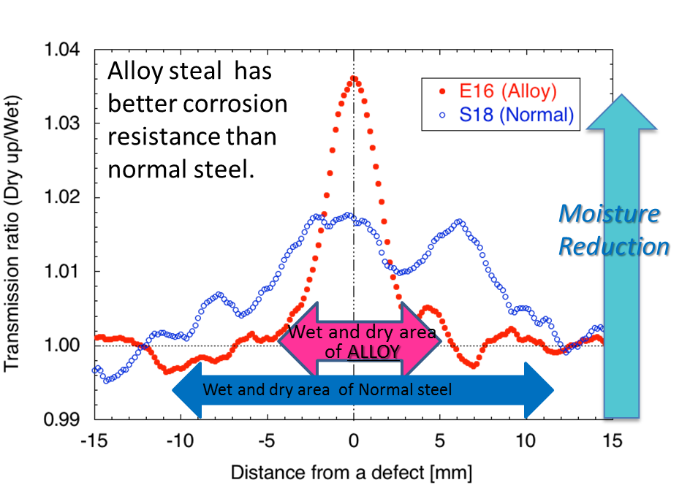
RANS Success of non-destructive visualization of the rust in the steel under-film different kinds of steels and moisture reduction
The ratio of projection into horizontal axis of neutron intensity taken after water immersion treatment and after drying treatment. Only artificial defect parts of E16 (open circle) and S18 (closed circle) were projected, respectively.

Slide 13
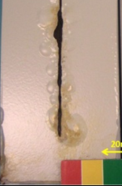
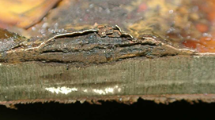
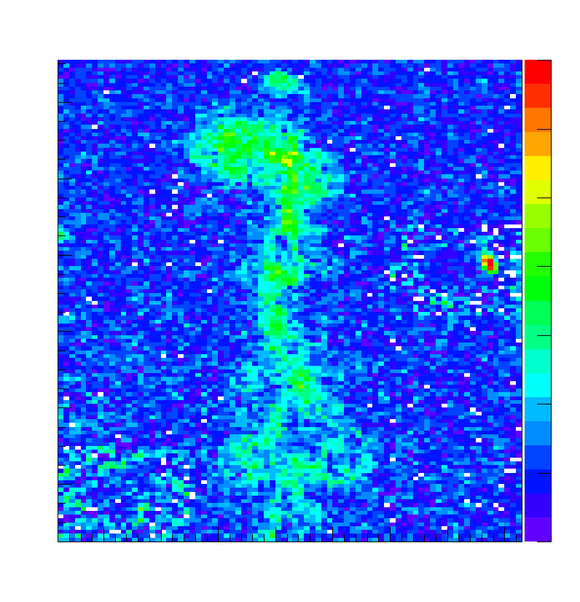
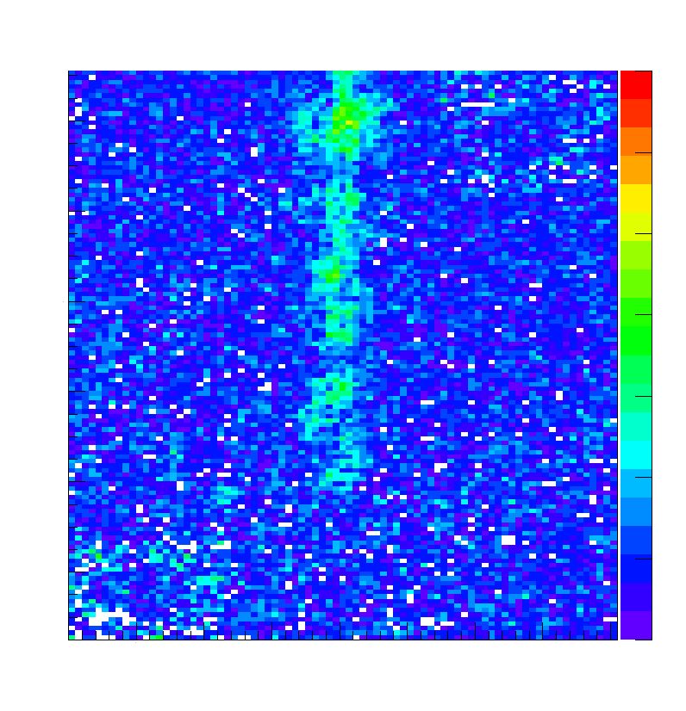
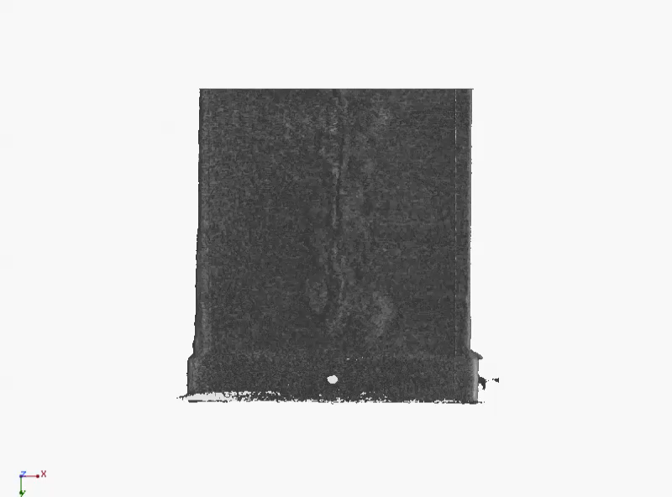
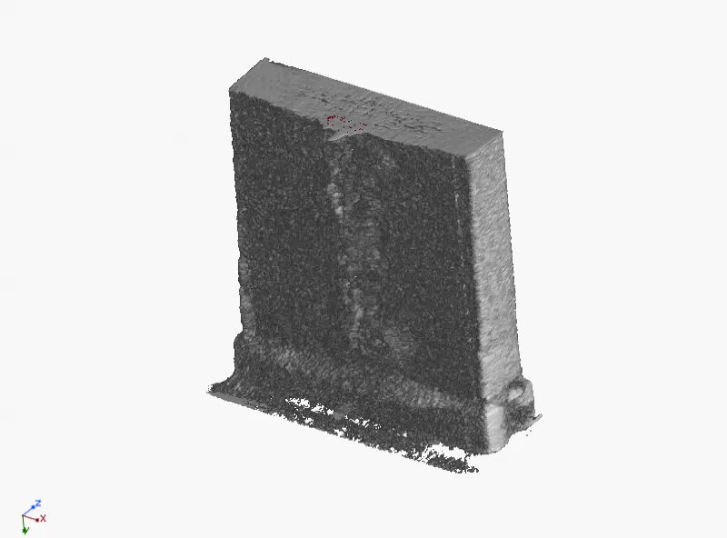

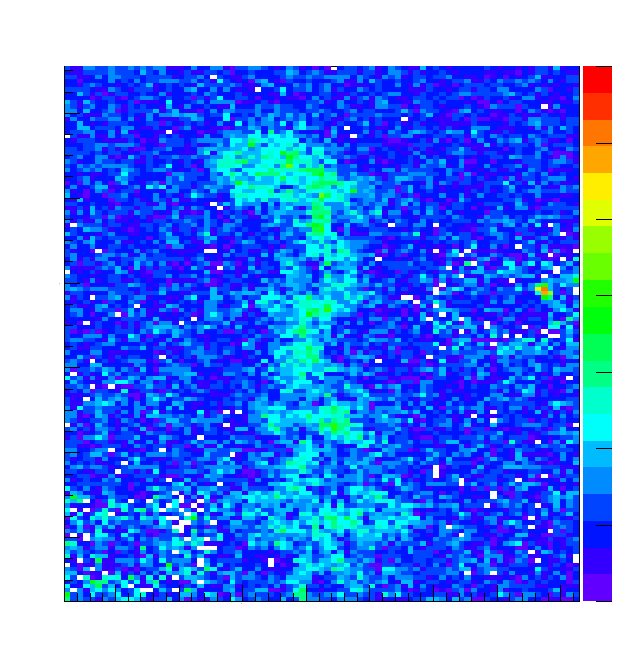
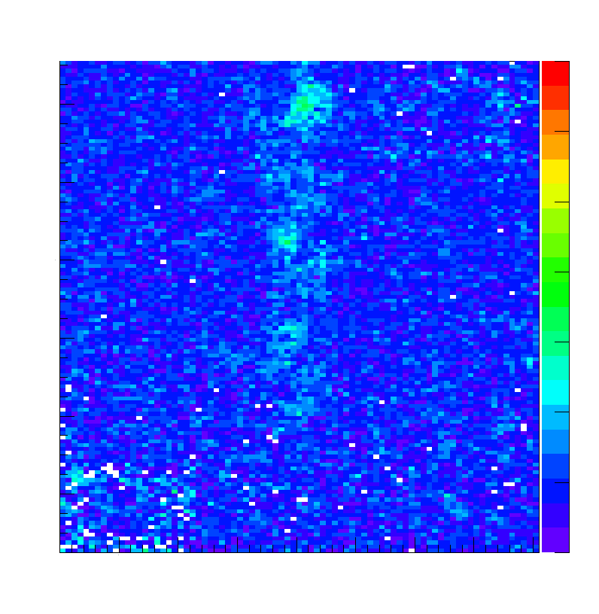

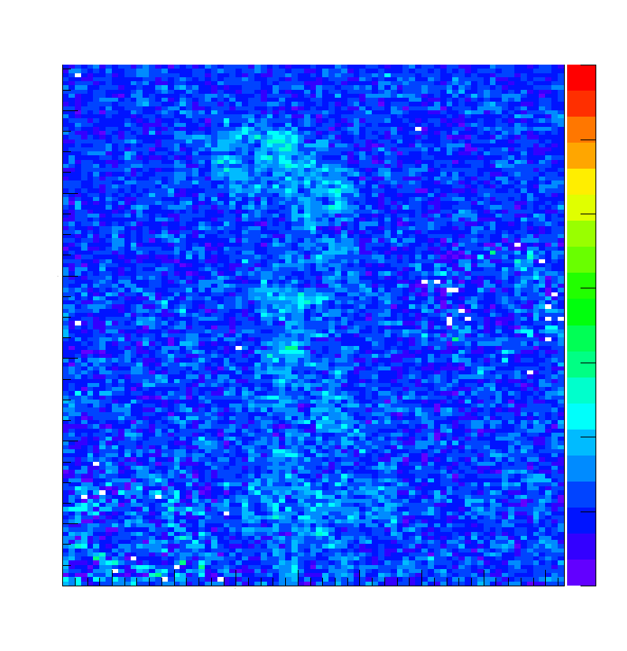
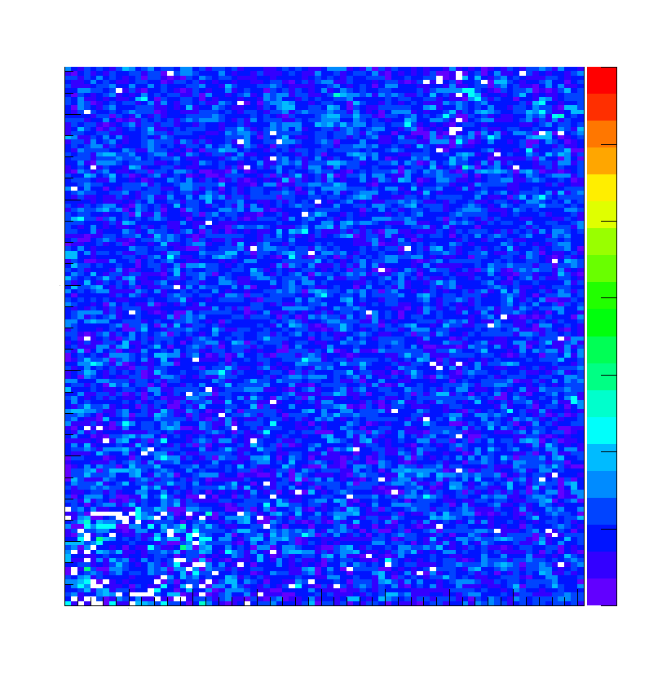
Success of moisture reduction for long time
3D information of the corrosion in the steel under-film
Corrosion with water
Steel
alloy
Dr.Taketani
wet
1 hour
Low energy neutrons of compact neutron source is powerful tool!!
2 hours
RANS explosure time~5 min per one shot.

Slide 14

Metallographic observation, plastic forming process on 13th Y.Ikeda has presented
Neutron diffraction
with compact neutron source??
Pulsed neutron TOF measurement
Electron Back Scattering Diffraction Only surface information Pure Titanium (together with Prof. T.Hama Kyoto Univ)
as received
After compression

Slide 16
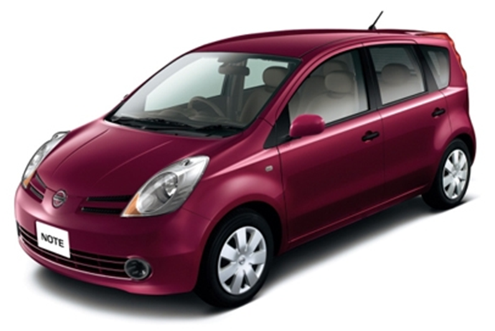
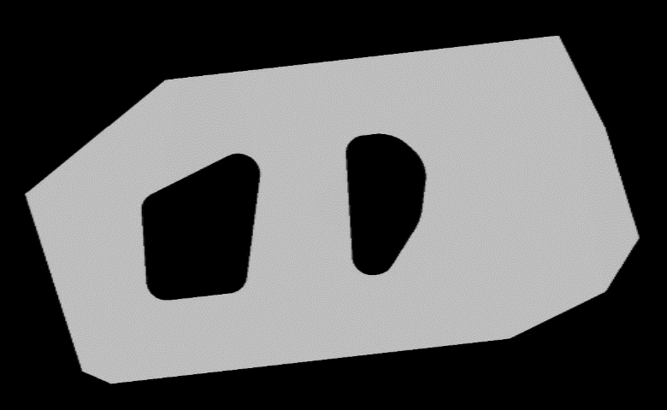
VCAD project RIKEN 2001-2011
Makinouchi M.Takamura, H.Sunaga
RIKEN has the special Simulation technique : Body Side Outer Sheet metal forming simulation the largest parts
bulk metal observation on site should be possible only with neutron beam
Body Side Outer
Plastic deformation under press process, to prevent racks, wrinkles, FEM analysis is useful tool.

Slide 17
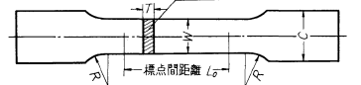
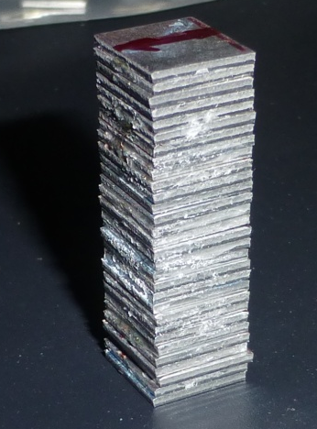
First trial experiment at RANS was done 30 31 July 2014
Sample with 19.4% elongation
引張試験片
JSC440W
Cut
W=30mm、t=1.2mm
Load direction of elongation
Nominal stress
>30
~10
~10
30 plates with the same direction
Nominal strain
Stress-strain curve

Slide 18
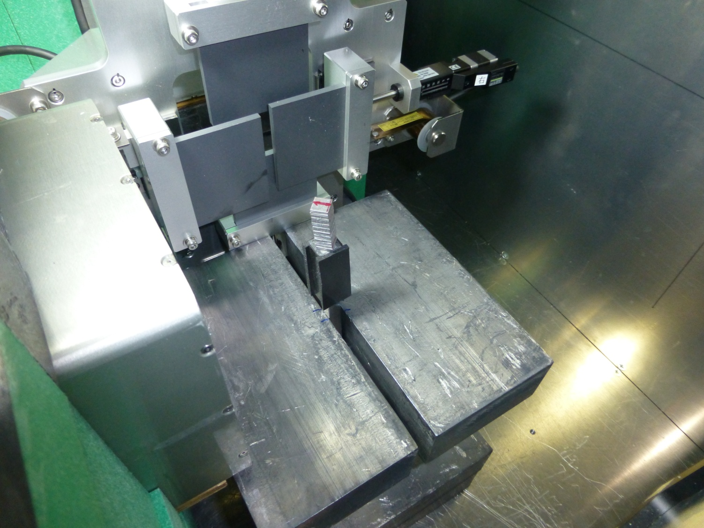
JAEA H.Suzuki,
RIKEN Takamura, Y.IKEDA
Diffraction results by RANS
タイムフォーカシング
Cut
JSC440W
JSC440W
W=30mm、t=1.2mm
Neutron
10 minutes measurement
Before elongation
Neutrons
Ditector
負荷方向の回折を測定
BCC steel sample
JSC440W
>30
~10
~10

Slide 19
JAEA H. Suzuki,
RIKEN Takamura, Y.IKEDA
Success of the observation of texture @ RANS
As-receive（0%）rather strong orientation along (110)
Under elongation along 110 orientation
入射エネルギースペクトルで規格化
タイムフォーカシング
JSC440W
90分測定→２０分から１０分で様子見える
Neutron
success of the observation of texture component
Neutrons
負荷方向の回折を測定
After 19% elongation
Stress-strain curve
Lattice constant [nm]

Slide 21
Neutron diffraction
→ texture component (10min.measurement)
→Whether the polar figure can be obtained with compact neutron source with reasonable time?
(110)
Neutron beam
steel

Slide 22
Crystal texture information of all direction for one crystal orientation
Neutron beam
Change of crystal texture structures before and after the plastic deformation can be observed.
Compact neutron source will be new tool for industrial use on-site!

Slide 23
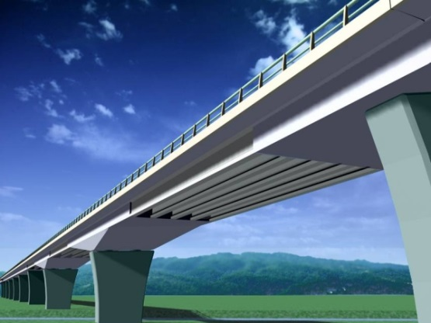

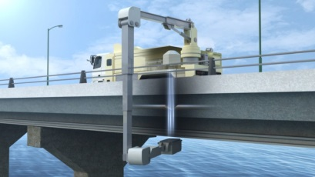
Fast neutron imaging system for nondestructive inspection of large-scale concrete structures
Y. Seki¹，A. Taketani¹, T. Hashiguchi¹, H. Ota¹, S. Tanaka²,
K. Kino³, K. Hirota⁴, H. Baba¹, S. Wang^{1,4}, Y. Yamagata¹, Y. Otake¹
RIKEN¹, KEK², Hokkaido Univ.³, Nagoya Univ.^{4 ,} Xi’an Jiaotong Univ.⁵
1
Notes:
Thank you, Mr. Chairman.
I will be talking about
"Fast neutron imaging system for nondestructive inspection of large-scale concrete structures".

Slide 24
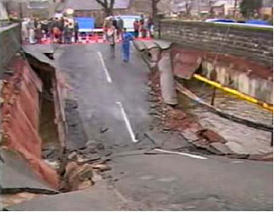
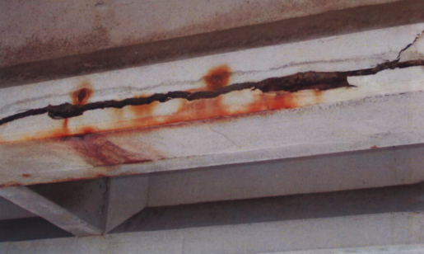
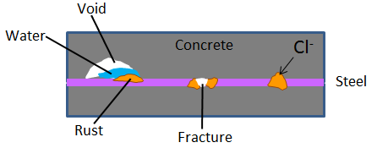
Background
Aging deterioration of large-scale concrete structures
  Lifespan of concrete ∼ 60 years → peak in 2025 in Japan
  → Lifetime expiration 42,000 bridges
  New construction of bridges/highways is impossible
  → Diagnosis, preventive maintenance, life extension
Collapse of the Ynys-y-Gwas brg.
(UK, 1985)
Assessment of concrete deterioration
Width of Steel bar
Void
Water
Fracture of steel bar
Deteriorated concrete
→Required resolution ∼ 3 cm
Fast neutron transmission imaging
High penetration power
as on-site nondestructive inspection technique
Sensitivity to water
3
Notes:
So,
we have to diagnose concrete deterioration as soon as possible,
and extend its lifetime with preventive maintenance.
The concrete deterioration is evaluated
by observing inside concrete,
observing cracks, water,
rust on steel and fractures of steel.
Fracture of steel can directly cause the collapse of the structures.
For this nondestructive inspection of concrete,
Civil engineering researchers require
the spatial resolution of 3 cm.
For such purpose,
we propose a new method of the fast neutron imaging.
The fast neutron, with the energy of a few MeV, is a promising probe
because it can penetrate thick concrete
and is sensitive to water.

Slide 25
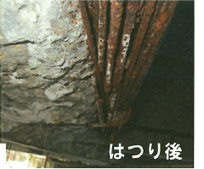
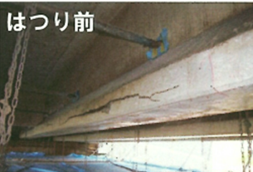

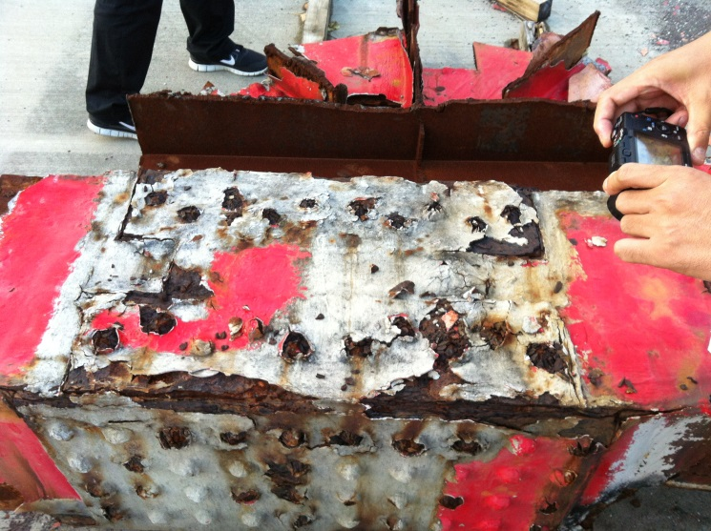
Transportable compact neutron system
Pre-stressed bridge,
External aspects
we cannot know without pealing the concrete slab
PC bridge
steel brake
Internal aspect
Steel bridges
Non-destructive inspection, use fast neutron beam (~MeV)
steel bridge
corrosion
After disassemble joint part・・・

Slide 26
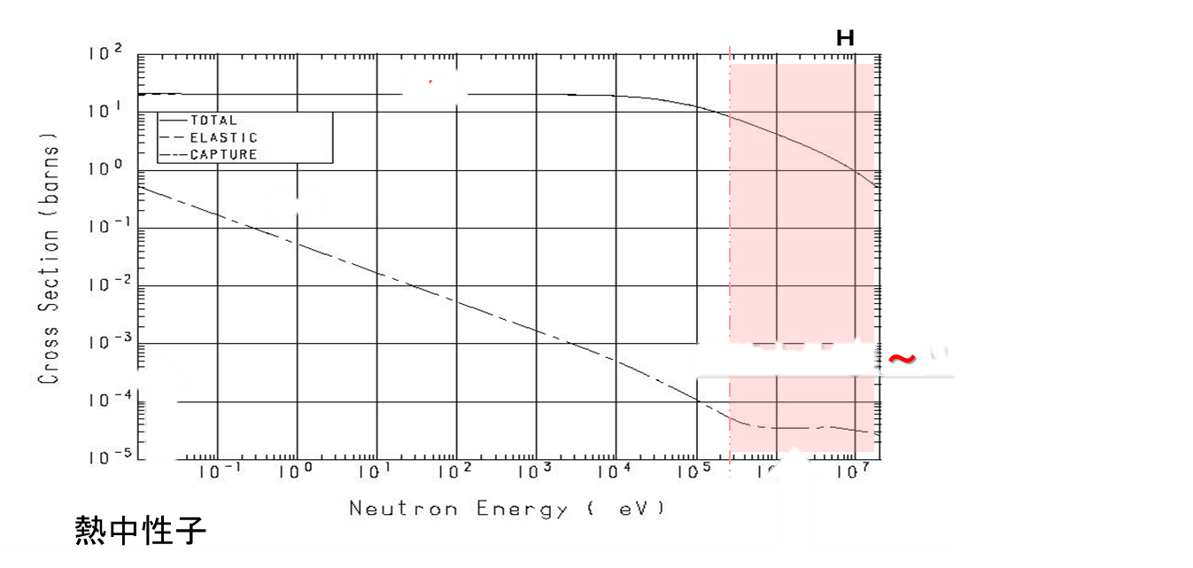
Fast neutron (some MeV)：concrete slab with~50cm thickness
Fast neutrons
Slow neutrons)
E Energy |  | 10⁶eV | 10³eV | 25meV |  | 1meV | 0.01meV | 10⁻⁷eV
Temperature |  | 10¹⁰K |  | 300K |  | 10K | 0.1K | 10⁻⁵K
Velocity |  | 10⁷m/s |  | 2200m/s |  |  | 1m/s
Wave length |  |  |  | 0.18nm |  | 1nm |  | 1μm
10⁻¹²m
Hydrogen and neutron nuclear reaction
Scattering cross section
E~1MeV,
Low absorption for almost all elements,
But still high scattering cross section for H atom
↓
Detection of Water in the concrete (~50cm)
Absorption cross section
Fast neutrons *MeV
10⁶
Slow neutrons
(25 meV)

Slide 27
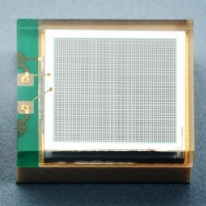
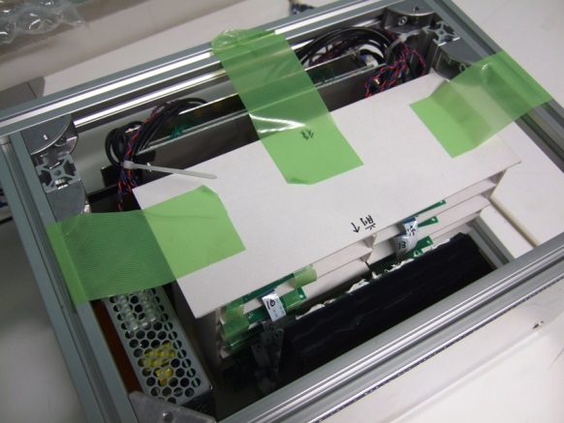
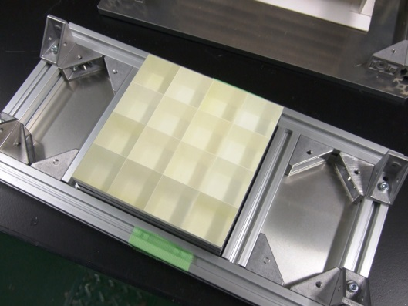
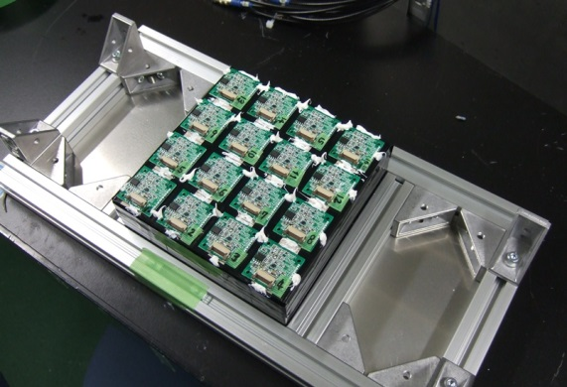
Fast neutron detector for concrete inspection
Detector design
  Outdoor use
  Mobile use
  Mass production
Plastic scintillator
BC-408
3 cm(H) x 3 cm(W) x 5 cm(D)
Multi-Pixel Photon Counter (MPPC)
PC
HAMAMATSU S10931-050P
Amplifier
Comparator
Network
Effective area: 3 mm x 3 mm
Counting ability: 3 mV/p.e.
Time resolution: 500-600 ps
Plastic
Scintillator
Neutron
MPPC
Counter
Accelerator
T0
2nd Prototype 4 x 4 ch (12 cm x 12 cm) detector
Readout
circuit
Scintillators
+ MPPCs
Scintillators
Scintillators
+ MPPCs
Neutron beam
5
Notes:
Taking into account outdoor use, mobile use, and capability of mass production,
we designed the detector as simple as possible.
Our detector consists of plastic scintillators and
solid state Multi-Pixel Photon Counters (MPPCs).
The incident neutrons recoil protons in the scintillator,
and the recoiled protons produce scintillation light,
and eventually the MPPCs detects the light.
The cross-section of one scintillator is 3 cm high, 3 cm wide.
A prototype has 4 x 4 array structure,
thus, the total detector area is 12 cm x 12 cm.

Slide 28
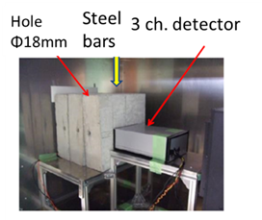


Success of observation difference of steel bar in the concrete
・comparison with the experimental results and simulation by GEANT4.
Concrete +Pb 10cm
Transmission pro.
Concrete 30cm
Insert ion bars into concrete
0, 1, 2, 3
Number of steel bar

Slide 29



Fast neutron imaging through 30cm concrete block
(>1MeV)Non-destructive inspection
Observation of the steel bar
30cm
Neutron
Neutron
30cm
Neutron
4*4pixel detector
Observation of the hall inside
中性子線
Proton linac
Proton energy: 7 MeV
Beam current: 11 μA (avg.)
Rep. rate: 20 Hz
Pulse width: 100 μs

Slide 30

Steel observation
1
2
5
6
透過率
9
10
13
14
Position [mm]
3
4
7
8
11
12
15
16
8

Slide 31
Towards the health diagnostics for the infrastructure

Slide 32






Based on the imaging data what we can predict?
VCAD project RIKEN
2001-2011
A. Makinouchi director
Example wooden house basement
Φ12㎜
φ12㎜
（出典： Google Map)
520mm
φ16㎜
φ16㎜
200mm
100mm
（出典： www.hirosima.co.jp）
Cement, concrete

Slide 33











X-ray CT
VCAD project
2001-2011
Once we have 3D data,
Using industrial X-ray
CT instrument
a
b
a
X-ray
b
c
c
d
e
Steel
粗骨材
f
d
Rotation and upward movement
e
CT measurement parameter,
Upward pitch：1mm
×：520times
M time： 38hours
空洞（巣）
f
Modeling of 3D data

Slide 34




Results from x-ray CT-> 3D shape modeling
（wooden house basement）
VCAD project
2001-2011
After these procedure,
Billion air holes become visible
Outside shape
Extraction part of
Cement
coarse aggregate inforced steel air hole
Inside elements

Slide 35




Analytical model tetrahedron elements method and give some constraints-> structural analysis simulation
VCAD project2001-2011
Push １２ｋN
Steel bar
coarse aggregate
Air holes）
Number of elements： 9,880,531
Number of contacts： 1,772,314
Completely fixed
tetrahedron elements model

Slide 36










Analytical results
（wooden house basement）
VCAD project
2001-2011
We are able to predict, from where the crack will start with which stress, now.
From the measurement to prediction,
health diagnostics for infrastructure!
Without drawing for design (or different from design),
whenever we get such inside data as structure, picture, imaging, radiography, we can predict when or how it will destroy
MPa
3.00
2.25
1.5
0.75
0.00
Steel bar
elastic deformation
analysis result
（distribution of stress）
X-ray CT data

Slide 37


Trans portable compact neutron system in a truck will be realized in some years.
50cm
50cm
N
The radiation level 3m far from the center of the target will be 0.6μSv/h by GEANT4 simulation.
放射線障害等防止法第１０条 および 関連規定（平成１７年７月改定）Japanese regulation 4MeV>linac
  橋梁等の非破壊検査に用いる直線加速器で４メガ電子ボルト以上のエネルギーを有する放射線を発生しないものは、放射線発生装置の使用の場所の変更を都度許可を得る必要がなく届出で足りることとする。（ただし、設備については、事前に原子力規制委員会原子力規制庁の届け出許可が必要。）

Slide 38

Collaboration and the support from
JCANS (Prof. Kiyanagi), and
M.Furusaka
M.Onuma
H.M.Shimizu
Y.Iwashita,
N.Hayashizaki
T.Sato
W.Yashiro
Y.Tomota
H.Suzuki
Steel companies,
RIKEN
Y.Yamagata,
J.Kato,
A.Taketani,
H.Sunaga,
M.Takamura,
S.Wang,
T.Hashiguchi,
Y.Seki,
M.Yamada,
M.Ikeda,
S.Mihara
H.Ohta,
S.Yanagimachi,
Many people
S.Sato
S.Tasaki
K.Hirota,
Y.Shiota,
T.Nagae,
Hirose,
A.Momose,
T.Shinohara,
So many people
A.Prof.N.Hayashizaki
TITECH
Dr.T.Sakai
JAEA
Dr.H.Suzuki, JAEA
Dr.Y.Kumagai,
Tokyo City Univ.
Dr.N.Hagura,
Tokyo City Univ.

Slide 39




New: neutron application facilities building in RIKEN

Slide 40




Summary RANS, towards practical use
Compact neutron source for industrial use floor-standing type
3D neutron imaging (3D)
Neutron diffraction for metal deformation
Crystal texture,
pole figure measurement
Development for the transportable neutron system
②
Portable system
①
Non-destructive diagnostic system
Large are detector
Fast neutron imaging detector,
health diagnosis system development

Slide 42


Success of the observation of steels, void
New fast neutron imaging detector development
1pixel = 30 mm x 30 mm
10 mm x 10 mm steel
Φ18 mm void (air hole)
1m*1m 1024 channner large area fast neutron imaging detector is now being tested with real bridge
1平米
橋梁用1024チャンネル検出器
[32 x 8 ピクセル (1ピクセル = 20 mm x 20 mm)]

