Slide 1
Performance of the LHCb VELO
Outline
LHCb Detector and its performance in Run I
LHCb VELO
VELO performance in Run I and radiation damage
Look into the future – Run II and upgrade
Summary
On behalf of the LHCb Collaboration
Tomasz Szumlak AGH-UST
Jagiellonian Symposium of Fundamental and Applied Subatomic Physics
07/06 – 12/06/2016, Krakow, Poland

Slide 2
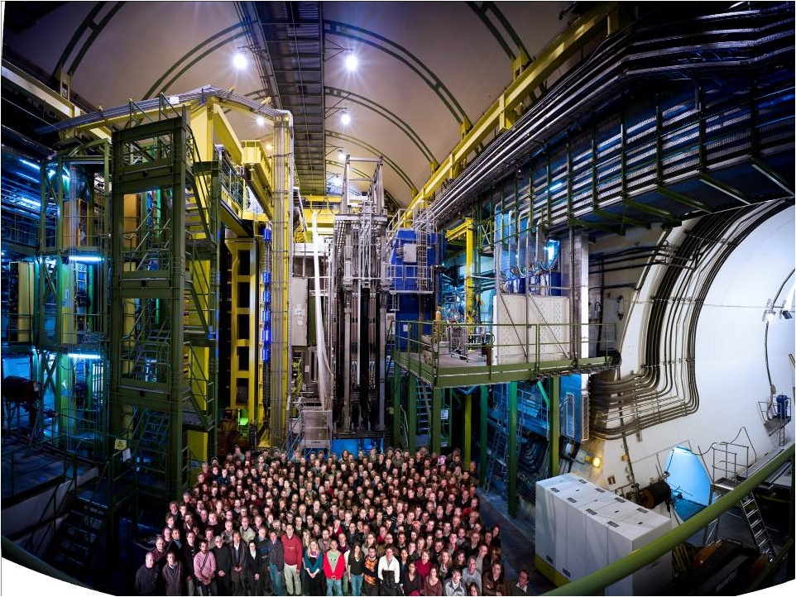
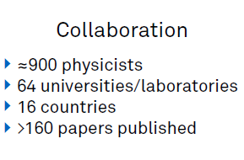
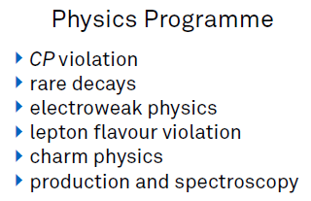

Slide 3
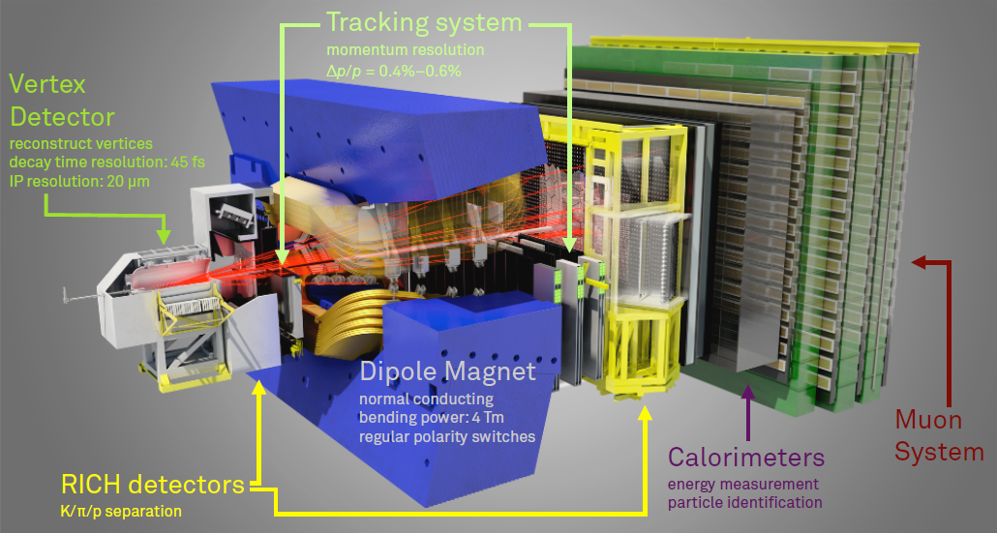
LHCb is dedicated for studying heavy quark flavour physics
It is a single arm forward spectrometer with pseudorapidity coverage 2 < η < 5
Precise tracking system (VELO, upstream and downstream tracking stations and 4 Tm magnet)
Particle identification system (RICH detectors, calorimeters and muon stations)
Partial information from calorimeters and muon system contribute to L0 trigger (hardware)
that works at LHC clock – 40 MHz
Max rate of full detector readout at 1.1 MHz
The LHCb detector at LHC (JINST 3 2008 S08005)

Slide 4
Summary of the LHCb Performance
$$\frac{δp}{p}=0.4 −0.6\%$$
$$σ_{IP}\sim 20 μm$$
$$for high p_{T} tracks$$
$$\frac{σ_{E}^{hcal}}{E}\sim \frac{70\%}{\sqrt{E}GeV}⨁9\%$$
$$ε\left(K→K\right)\sim 95\%$$
$$π→K misID \sim 5\%$$
$$\frac{σ_{E}^{ecal}}{E}\sim \frac{10\%}{\sqrt{E}GeV}⨁1\%$$

Slide 5
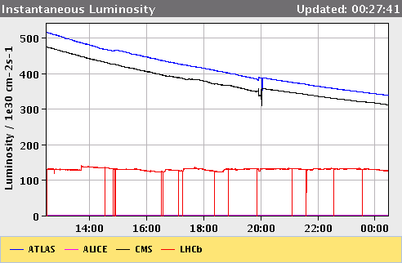
Operation conditions of the LHCb in 2011
recorded luminosity L ≈ 1,2 [fb⁻¹] at beam energy 3.5 [TeV]
LHCb stably operated at L_{inst} = 4.0 x 10³² [cm⁻²s⁻¹ ] (nominal 2.0 x 10³²)
Average number of visible interactions per x-ing µ = 1.4 (nominal 0.4)
Data taking efficiency ~90 % with 99 % of operational channels
HLT (High Level Trigger) input ~ 0.85 MHz, output ~ 3 kHz
Ageing of the sub-detectors monitored – according to expectations
Luminosity leveling
Use displaced p-p beams
Lower inst. Luminosity
Stable conditions during the run
Lower pile-up

Slide 6
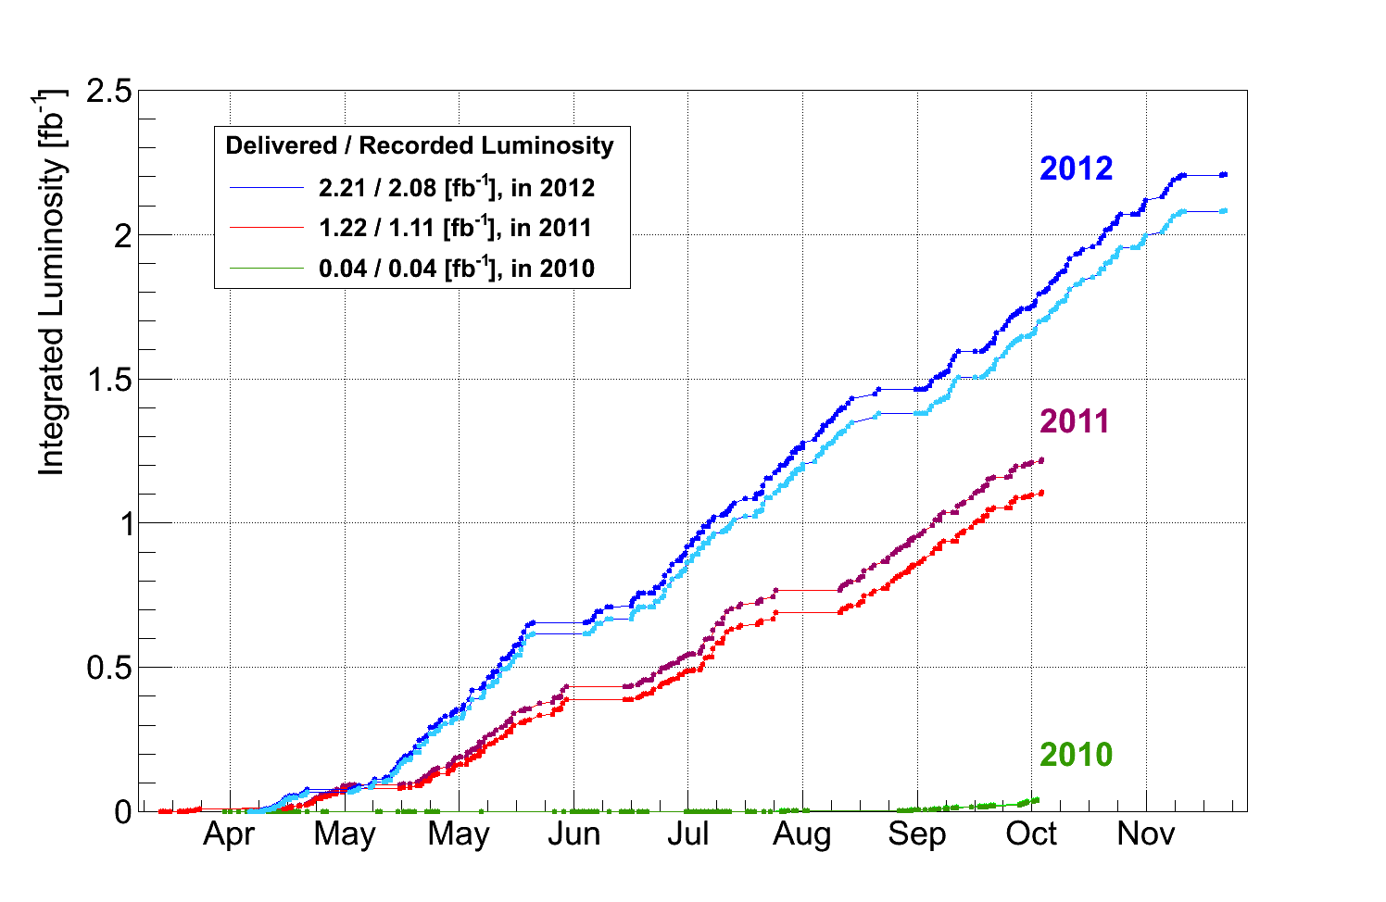
Operation conditions of the LHCb in 2012
Beam energy 4.0 [TeV] (15 % increase of the b-barb x-section)
Keep the luminosity at L_{inst} = 4.0 x 10³² [cm⁻²s⁻¹ ] for this year
Average number of visible interactions per x-ing slightly higher µ = 1.6
Keep high data taking efficiency and quality
HLT (High Level Trigger) input ~ 1.0 MHz, output ~ 5 kHz (upgraded HLT farm and revisited code)
Collected ~ 2.1 fb⁻¹ of collision data

Slide 7
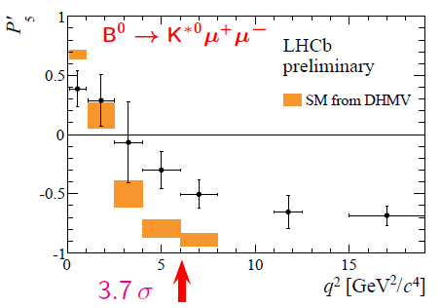
Intriguing results from LHCb – possible hints of New Physics
No NP effects has been confirmed so far, however…
Two interesting anomalies seen by LHCb
$P_{5}^{′}$ observable measured in the $B_{d}^{0}→K^{∗0}μ^{+}μ^{−}$ above the SM predictions
Rates of charged beauty semileptonic decays below the SM predictions

Slide 8
Overall summary of Run I
LHCb:
Superb performance – greatly exceeded any expectations
Stable operation at inst. luminosity 100% higher than nominal
General purpose detector in forward direction
Many world best results
Over 230 papers published!
The pinch of salt:
No conclusive BSM physics discovered
There is still room for NP!
Need push precision to the limits in order to challenge theoretical predictions
Need more data

Slide 9
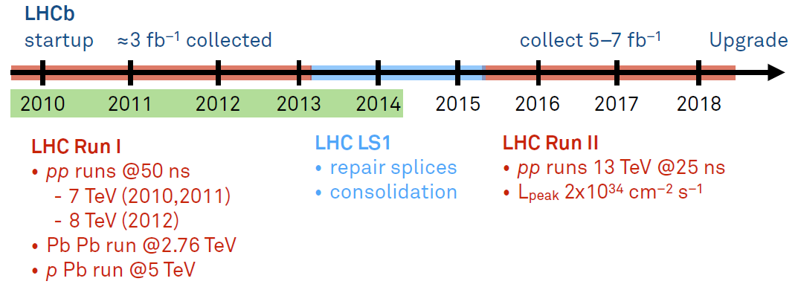
Data taking road map for LHCb before the upgrade

Slide 10
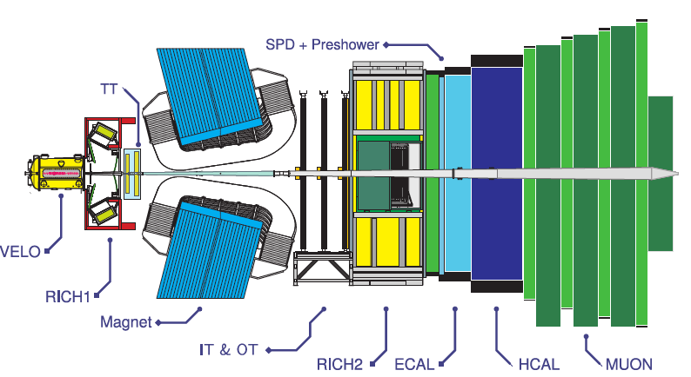
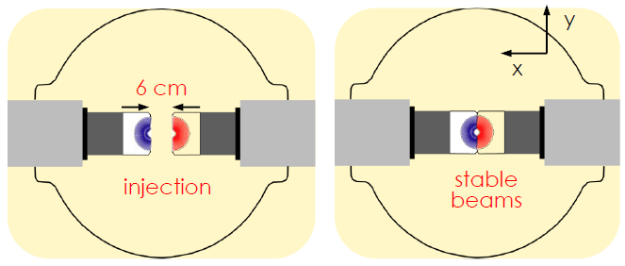
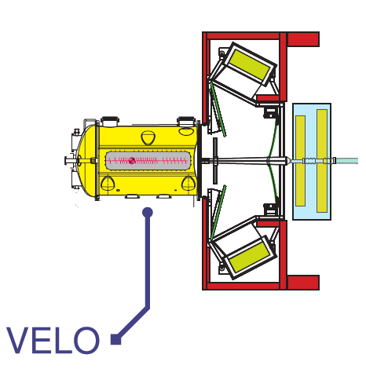
The LHCb VELO (VErtex LOcator)
VELO surrounds the proton-proton interaction point
Consists of two halves that can be open and close
They are retracted (30 mm) during beam injection and closed (5 mm) for the collisions

Slide 11
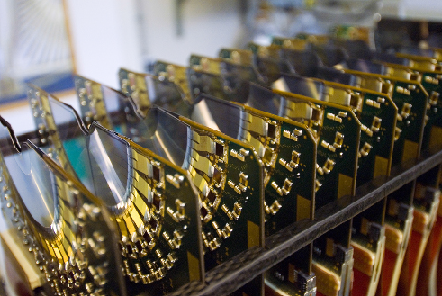
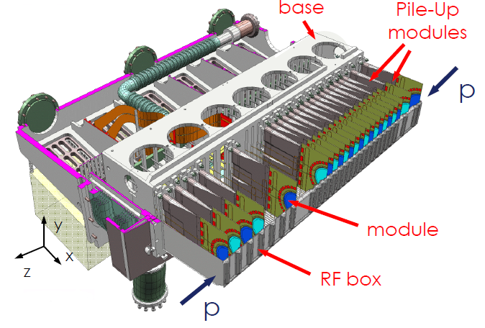
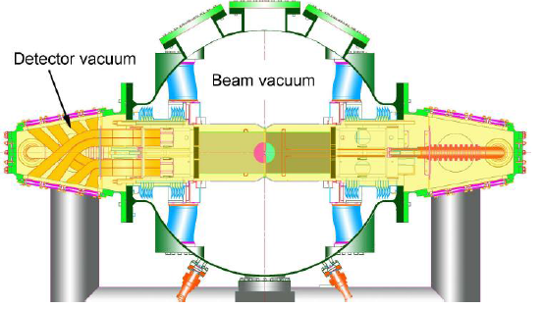
The LHCb VELO (VErtex LOcator)
21 stations per half, each of which has one R- and Φ-type sensors
Two pile-up stations in each half (trigger)
First active channel just 8.2 mm from the proton beam
Operates in secondary vacuum separated from the beam vacuum by 300 µm thick foil
CO₂ cooling system

Slide 12
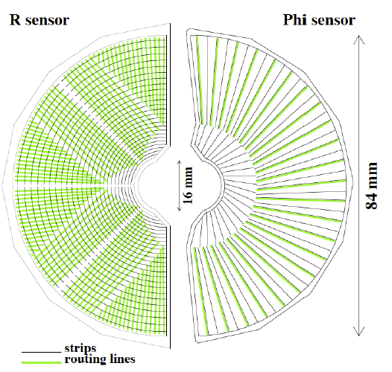
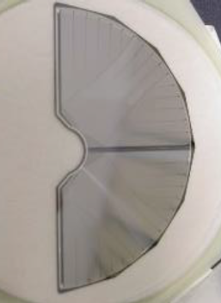
VELO sensors
Semicircular micro-strip silicon sensors with floating pitch (40 – 100 µm)
One R- and one Φ-type sensor per module
300 µm thick $n^{+}−on−n$
Signal routed via second metal layer
2048 strips (channels) per sensor
Two 45 degree quadrants for R-type
Two regions of short and long strips
~ 180 000 readout channels in total!

Slide 13
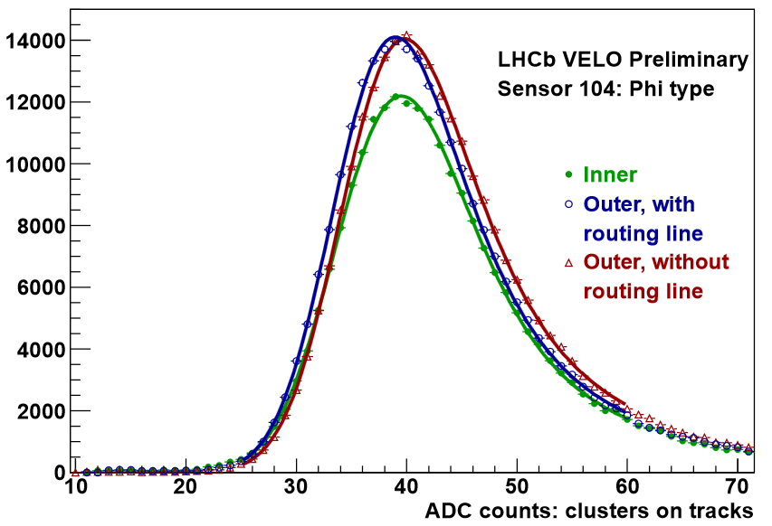
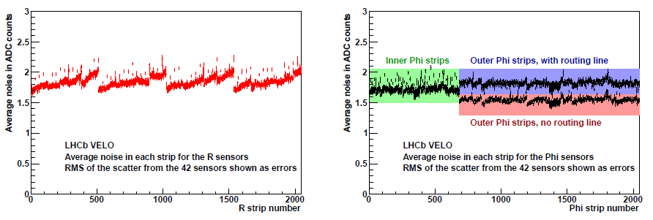
Signal and noise
Typical noise measured to be around 2 ADC (Analog to Digital Count) counts
ADC distribution fitted with Landau convoluted with Gaussian (MPV for signal/noise)
Signal to noise performance
${\left(\frac{S}{N}\right)}_{R}≈19$
${\left(\frac{S}{N}\right)}_{φ}≈21$
$φ$-sensor
$R$-sensor
$φ$-sensor

Slide 14
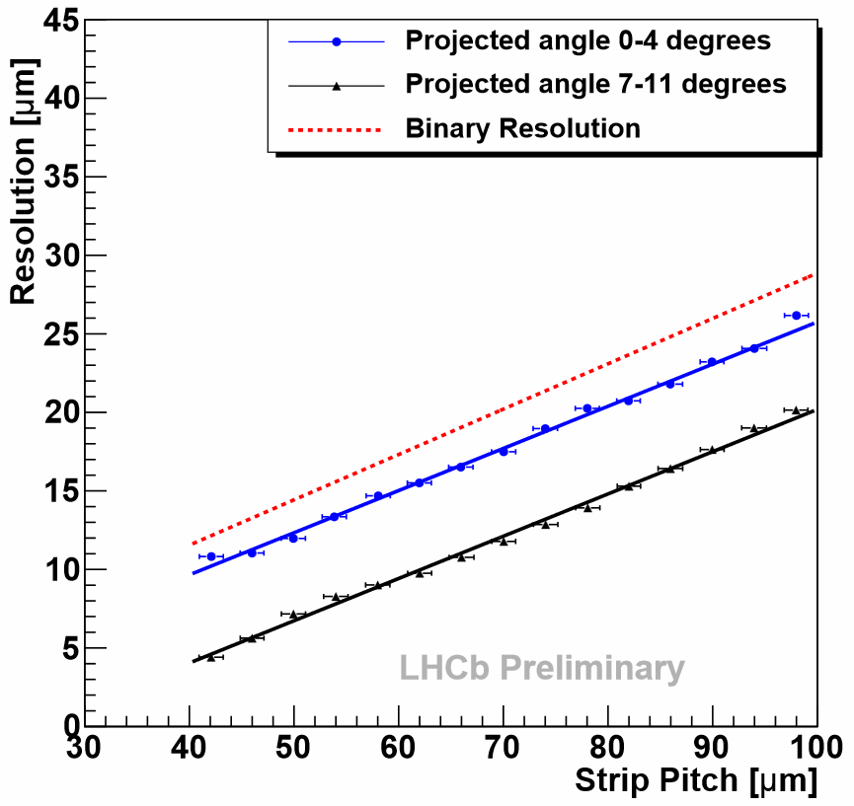
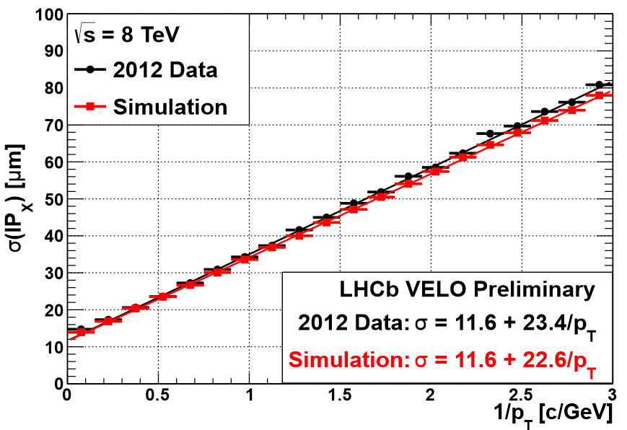
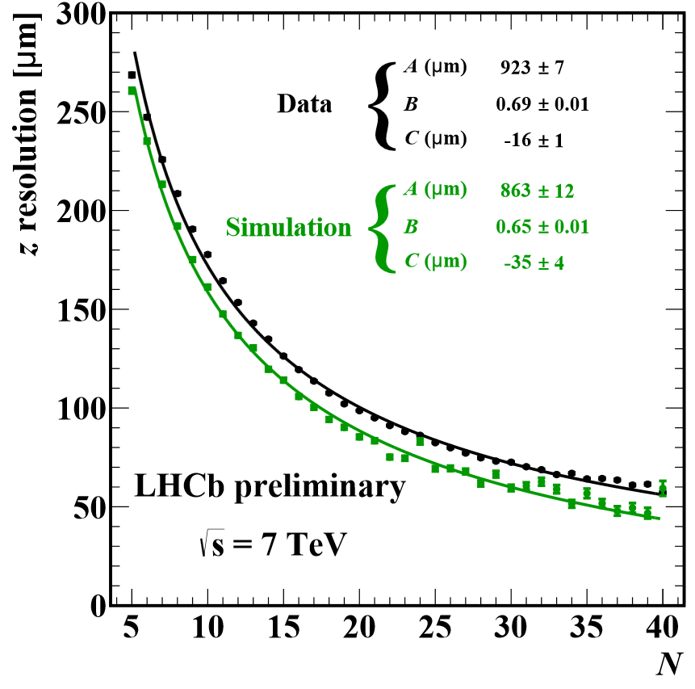
Resolutions
IP resolution
Single hit resolution
Excellent single hit resolution ~ 4 µm for the optimal angle and smallest sensor pitch
Primary Vertex resolutions: $σ_{x}=σ_{y}≈13 μm$ and $σ_{z}≈69 μm$ for 25 tracks
Impact Parameter: $σ_{IP}≈11.6+\frac{23.4}{p_{T}} μm$
Very good agreement between data and simulation
PV resolution
Performance of the LHCb VELO (JINST 9 2014 P09007)

Slide 15
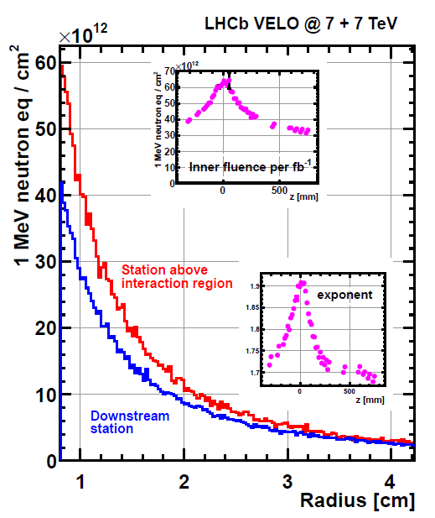
Radiation Damage
Harsh hadronic environment – particle fluences up to $5×{10}^{13} 1MeV n_{eq}/{cm}^{2}{fb}^{−1}$
Charged particle flux causes surface and bulk damage and has direct impact on
Leakage current
Effective doping concentration
This must be carefully monitored and analysed
Currents vs. Voltage (a.k.a. IV scan)
Currents vs. Temperature (a.k.a. IT scan)
Full Depletion Voltage
Cluster Finding Efficiency

Slide 16
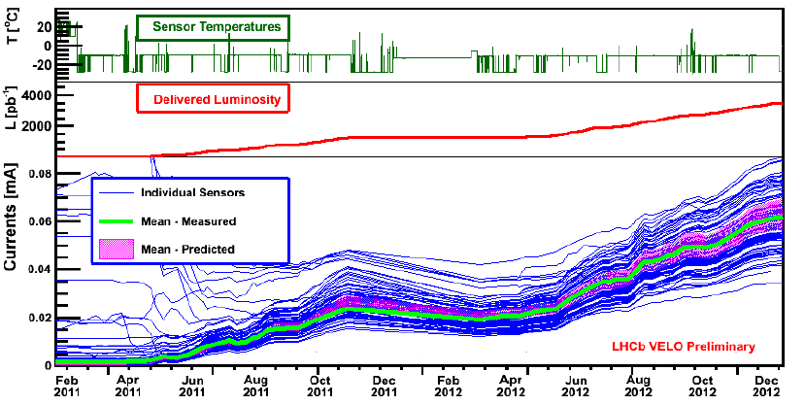
Leakage currents
Measured leakage current in good agreement with predicted values
Typical increase $\sim 1.9 μA/100 {pb}^{−1}$
Dominated by the bulk current
Observed increase in current proportional to the fluence
All sensors (Run I) operated at the nominal bias voltage 150 V and temperature of -7 ${}_{}^{o}C$
All effects well understood!

Slide 17
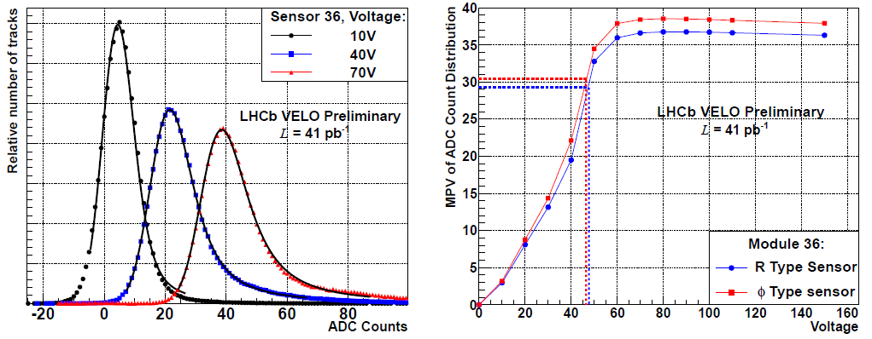
Radiation damage monitoring – Effective Depletion Voltage (EDV)
Measured during assembly – capacitance at different bias voltages – not possible during operation!
Method based on track extrapolation to test sensor, which bias voltage is varied (0 – 150 V)
EDV is the voltage at which the MPV is ~ 80% of the plateau

Slide 18
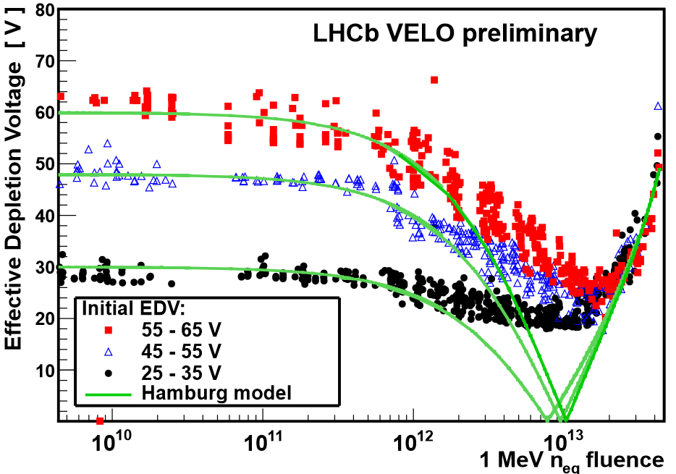
Radiation damage monitoring – Effective Depletion Voltage (EDV)
Effective depletion voltage $V_{ED}$ decrease with fluence
Minimum of $V_{ED}\sim 18 V$ observed @ ~ $1.5 ×{10}^{13} n_{eq}{cm}^{−2}$
Overall good agreement with the Hamburg Model for both low and high fluences – the apparent departure related to small electric field
Can operate the current VELO till the end of Run II

Slide 19
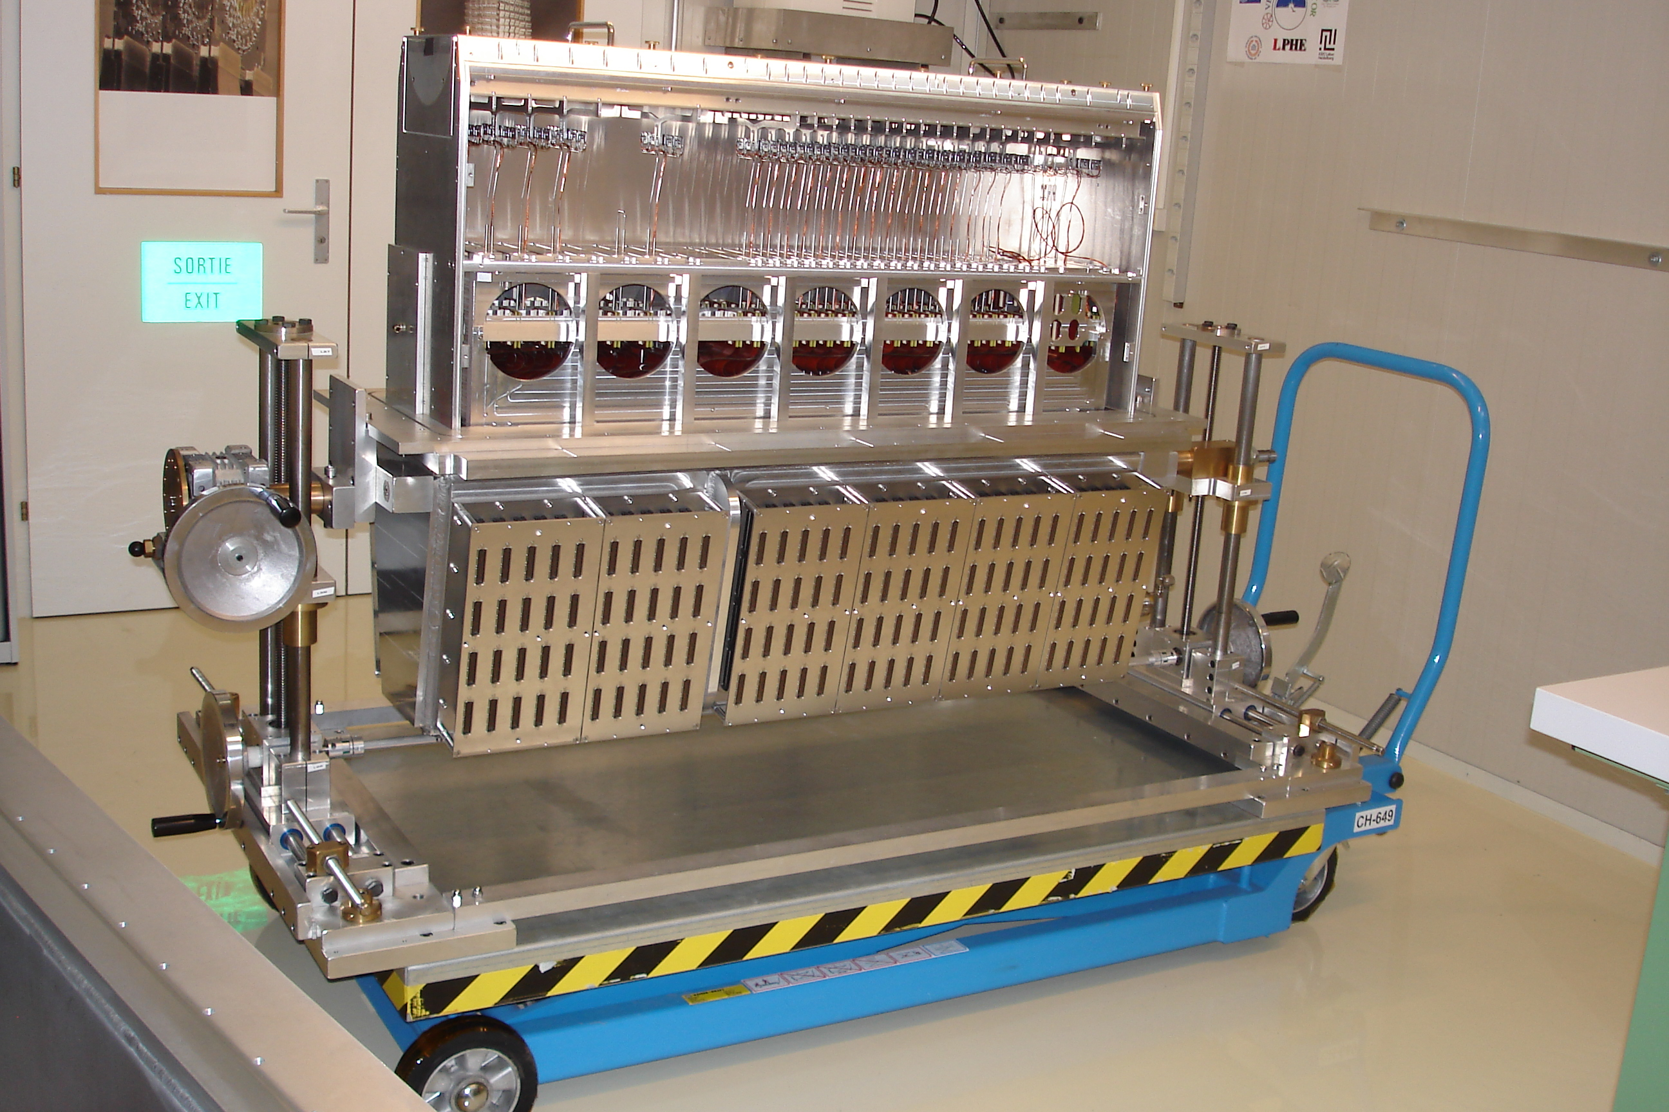
Preparation for Run II (started officialy last week)
Fully operational VELO replacement has been built in case of an accident with beam
Need to define new procedures for CCE
More aggressive approach to calibration scans – done on daily basis
$V_{ED}$ is not going to be uniform across sensors – careful monitoring needed
Operation with different bias voltage for different sensors envisaged

Slide 20
Preparation for Run II (started officialy last week)
Why upgrade (i.e., what’s wrong with the current design…?)
Superb performance – but 1 MHz readout is a sever limit
can collect ~ 2 fb⁻¹ per year, ~ 5 fb⁻¹ for the „phase 1” of the experiment
this is not enough if we want to move from precision exp to discovery exp
cannot gain with increased luminosity – trigger yield for hadronic events saturates
Upgrade plans for LHCb do not depend on the LHC machine
we use fraction of the luminosity at the moment
Upgrade target
full event read-out@40 MHz (flexible approach)
completely new front-end electronics needed (on-chip zero-suppression)
redesign DAQ system
HLT output@20 kHz, more than 50 fb⁻¹ of data for the „phase 2”
increase the yield of events (up to 10x for hadronic channels)
experimental sensitivities close or better than the theoretical ones
expand physics scope to: lepton flavour sector, electroweak physics, exotic searches and QCD
Installation ~ 2018 - 2019

Slide 21
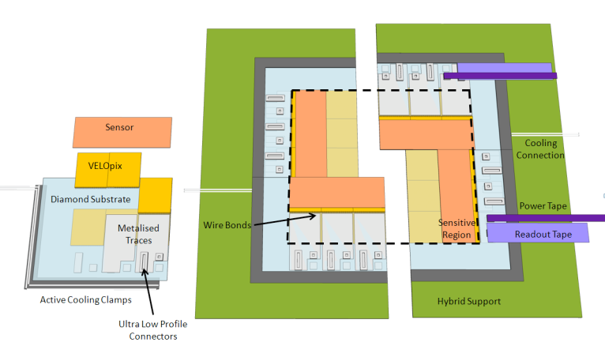
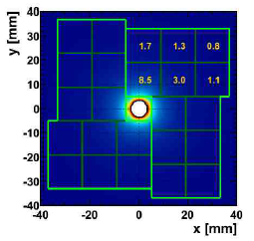
VErtex LOcator VELO2
Current design: R-Φ geometry Si strip sensors with pitch between 38 – 100 µm
To be replaced with pixel based device
low occupancy
much easier patter recognition
easier to control alignment
radiation hardness
extremely high data rate ~ 12 Gbit/s
un-uniform data rates/radiation damage
micro-channel CO₂ cooling
Read-out ASIC, VeloPix, based on TimePix/Medipix chip
256x256 pixel matrix
equal spatial resolution in both directions
IBM 130 nm CMOS process
great radiation hardness potential ~ 500 Mrad

Slide 22
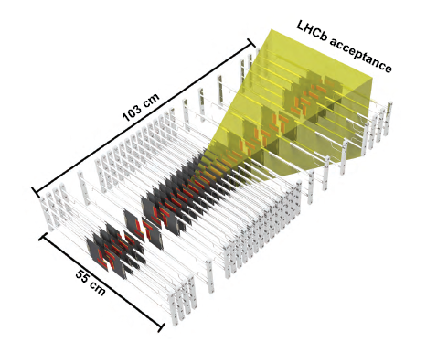
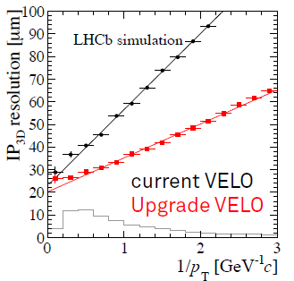
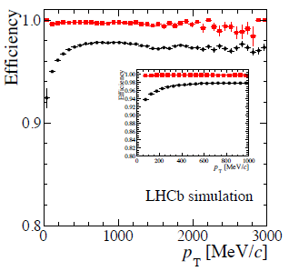
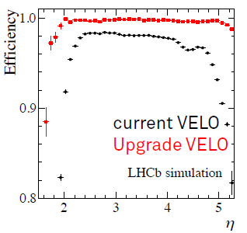
VErtex LOcator VELO2
Predicted performance superior in almost any aspect w.r.t the current VELO
This is essential for physics performance of the upgraded spectrometer
(VELO Upgrade: Technical Design Report, LHCb-TDR-13)

Slide 23
SUMMARY
Excellent performance of the LHCb VELO during Run I data taking
Average signal to noise: ${\left(\frac{S}{N}\right)}_{R}≈19$ and ${\left(\frac{S}{N}\right)}_{φ}≈21$
Single hit resolution ~ 4 µm
Typical IP resolution ~ 12 µm for high perpendicular momentum
Typical PV resolution ~ 13 (69) µm in x, y (z) for 25 tracks
Radiation damage effects studied and understood
Leakage currents (bulk dominated) increase ~ $1.9 μA/100 {pb}^{−1}$
Type inversion observed in inner part of sensors
Increase of EDV
Major upgrade of the LHCb VELO detector is planned
New readout electronics and sensors (pixels)

Slide 24
Back-up

Slide 25
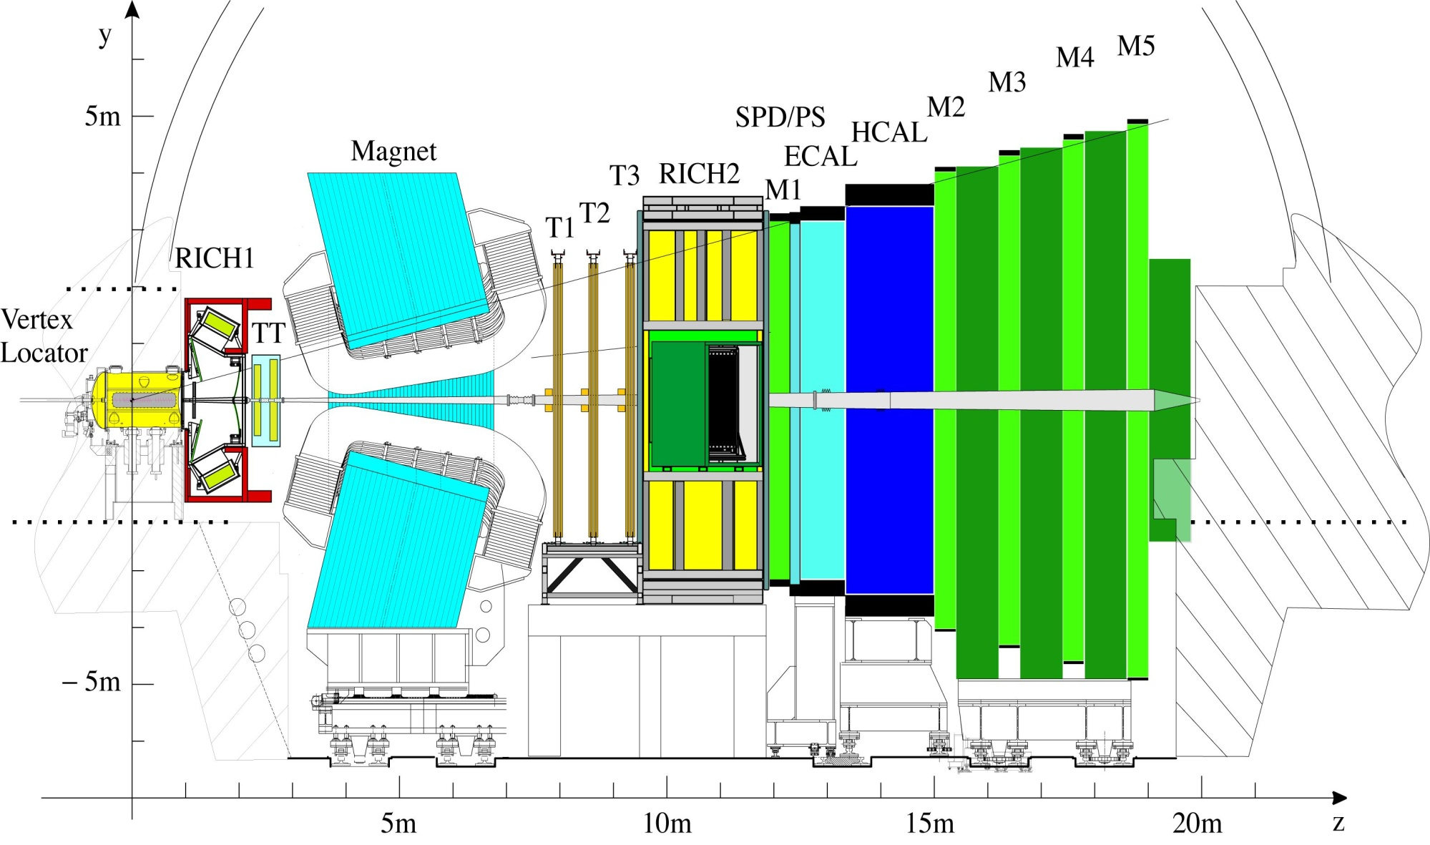
What we must change to cope with the 40 MHz read-out
VELO
Si strips
(replace all)
Silicon Tracker
Si strips
(replace all)
Outer Tracker
Straw tubes
(replace R/O)
Muon MWPC
(almost compatible)
RICH
HPDs
(replace HPD & R/O)
Calo
PMTs (reduce PMT gain, replace R/O)

Slide 26
Summary
Run II and the upgrade road map

Slide 27
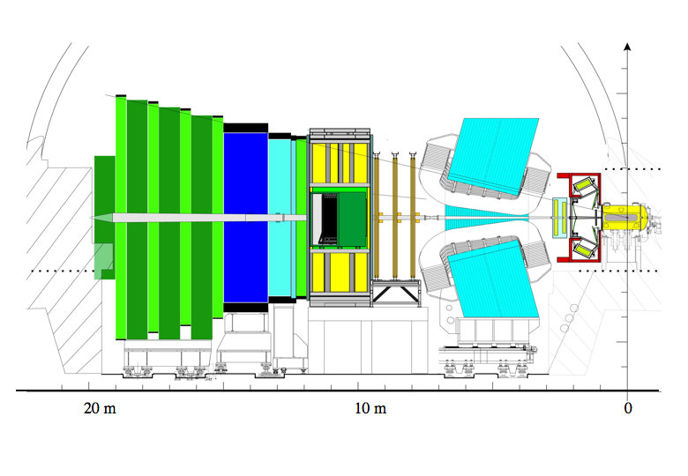
Muon system
TT+IT (Silicon Tracker)
300(H)/250(V) mrad
OT
Calorimeters
Dipole magnet
Vertex Locator
15mrad
Interaction
Point
OT – Outer Tracker
IT – Inner Tracker
TT – Trigger Tracker
RICH detectors
Single arm spectrometer geometry
Fully instrumented in rapidity range 2 < η <5
Capable of reconstructing backward tracks (-4 < η < -1.5)

