Slide 1
X-ray radiation damage of silicon strip detectors
Piotr Wiącek, Władysław Dąbrowski
AGH University of Science and Technology Faculty of Physics and Applied Computer Science, Kraków, Poland Jagiellonian Symposium 2015 7-12/06/2015

Slide 2
Outline
Radiation damage in silicon detector – short overview
Ionisation damage effects in a silicon strip detector for powder diffraction
Ionisation damage effects in a silicon pad detector for high resolution spectroscopy
Investigation of the dose rate effect
Summary

Slide 3
Radiation damage in silicon detectors
Displacement damage by charged particles and neutrons
Creation of defects in the lattice
Some defects form localised electronic states, which behave like deep level depends in the energy bandgap
Deep levels act as generation-recombination centres and contribute to the bulk leakage current
Deep levels contribute to the effective doping of silicon and change the resistivity
In silicon most of the defects form acceptor-like deep levels
After sufficiently high fluence the low-doped n-type silicon (used commonly for silicon strip and pixel detectors) becomes p-type
Displacement damage effects in silicon detectors for the LHC experiments have been extensively studied and are quite well understood.
Notes:
3
The effects of displacement damage caused by charged particles and neutrons are as follow:

Slide 4
Radiation damage in silicon detectors
Ionisation damage by charged particles and by X and gamma radiation
Ionisation processes do not lead to any permanent defects in the silicon bulk
Ionisation processes lead to building-up positive charge in the insulator layers (SiO₂/ Si₃N₄) due to trapped holes
Additional surface states are generated in the Si-SiO₂/Si₃N₄ interface
Generation recombination processes at the surface states contribute to the surface leakage current
In silicon detectors for LHC experiments the ionisation effects have been mostly ignored as the effects due to displacement damages are dominant
Ionisation effects in SiO₂ are the primary source of radiation damage in CMOS devices (electronics)
Radiation damage in silicon strip and silicon pixel detectors caused by X-ray has become recently an important research topic driven mainly by development of new detectors for applications at the intensive synchrotron sources
Notes:
4

Slide 5
Consequences of radiation damage effects for parameters and performance of Si strip and pixel detectors
Displacement damage effects
Increase of the bulk leakage current
Change of full depletion voltage (increase or decrease depending on the type of substrate
Trapping of signal charge - decrease of charge-collection efficiency
Ionisation damage effects
Increase of the surface leakage current
Relatively small increase of the full depletion voltage due to surface charge
Increase of interstrip/interpixel capacitance
Changes of the breakdown voltage
Charge losses in the surface layer below the Si- SiO₂ interface
Decrease of charge-collection efficiency
Increase of the charge division
Notes:
5

Slide 6
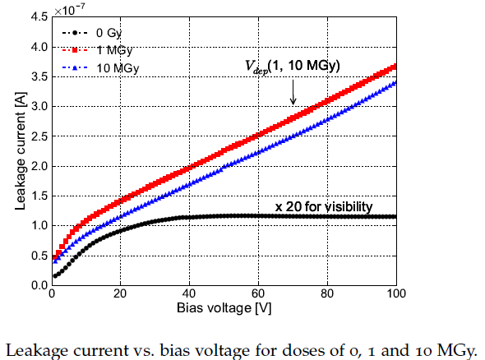
Ionisation damage – know results increase of the leakage current
Significant increase of leakage current by a factor ~100
Saturation after a dose of about 1 MGy
Linear behaviour of the I-V curve after irradiation indicates that the dominant component is the surface current due to generation-recombination processes at the interface states
JINST 2011, 6 C11013
Notes:
6
Here we show a couple of examples of radiation tests performed for pixel detector being developed for applications at XFEL – radiation doses up to 10 MGy are expected, For comparison, maximum radiation doses for the most inner pixel detectors at the LHC experiments in the range of 1 MGy. We can see that the leakage current saturates after about 1 MGy, which is typical for ionisation effects.

Slide 7
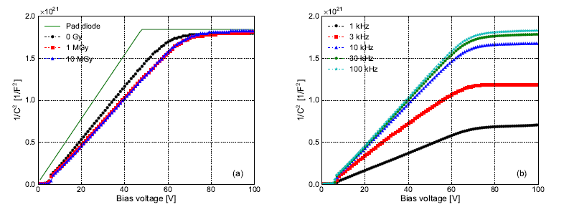
Ionisation damage – known results increase of the full depletion voltage
Moderate increase of the full depletion voltage does not generate any significant problem for detector operation in contrary to displacement damage, which in LHC environment may cause increase of the full depletion voltage by a factor 10
(a) 1/C² vs. bias voltage of the microstrip sensor for dose of 0, 1 and 10MGy and of pad diode. 100kHz curves are shown.
(b) 1/C² vs. bias voltage for frequencies of 1, 3, 10, 30 and 100kHz after irradiating the sensor to 10MGy
JINST 2011, 6 C11013
Notes:
7

Slide 8
Radiation damage effects in laboratory instruments
Question: are the radiation damage effects relevant for silicon detectors used in laboratory instruments like XRF spectrometers, diffractometers, based on X-ray tubes?
The detectors can be exposed to doses up to 100 Gy in normal operation
In some instruments the requirements for performance silicon detector are pushed to the technological limits and there is no room for even small degradation caused by radiation damage
We present here the results of our investigation of radiation damage effects in silicon detectors developed for powder diffraction and for XRF spectroscopy
Notes:
In my Group we asked:...

Slide 9
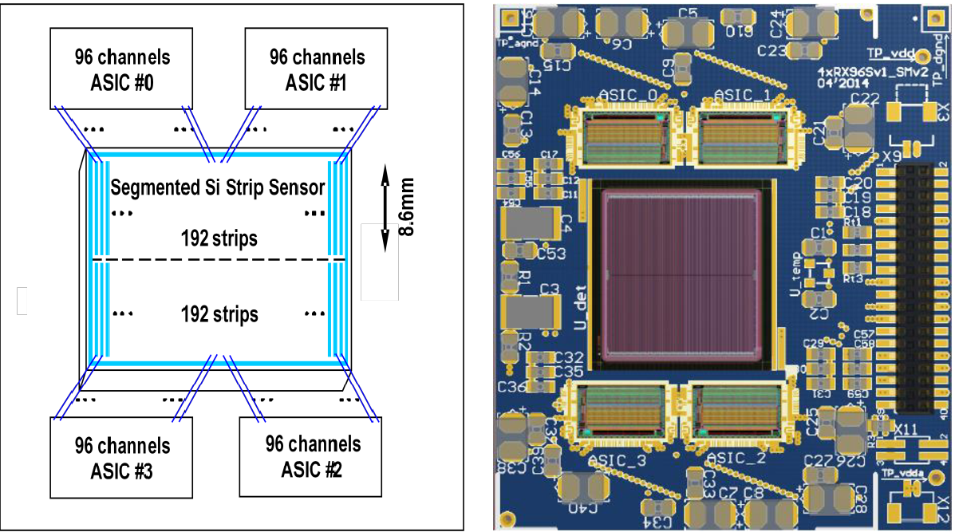
Silicon strip detector for X-ray powder diffractometers
Design requirements
Position sensitivity to replace a point detector and the scanning slit - with 192 strips measurement speed can be increased by a factor ~200
Energy resolution to allow electronic discrimination of Kβ line and eliminate the filters and monochromators in the X-ray optics – potential gain in the beam intensity (measurement time) by a factor of ~10
Detector thickness | 500 μm
Strip length | 17.2 mm divided into two segments
Strip pitch | 75 μm
Number of strips | 192 (384 segments)
Total strip capacitance of 8.6 mm segment | 1.2 pF
Maximum leakage current per strip segment at 20°C and detector bias of 300 V | 25 pA (4nA/cm²)
Notes:
The concept of the detector module is illustrated schematically here. The total active length
of strips determined by the beam geometry in laboratory diffractometers is 17.2 mm. The strips are split in the middle so that each functional strip is formed by two segments, each one of 8.6 mm. Thus, the sensor comprises 384 strips, which are read out by four 96-channel ASICs.
By the dividing the strips into two segments we reduce the capacitance
seen by the front-end electronics, and the leakage current flowing in the front-end inputs.

Slide 10
Spectroscopic performance of the detector
Electronic noise 325eV FWHM with sensor (C_{total}=2.3pF) at room temperature
Total Energy resolution:
<400eV FWHM up to 20kcps for SSH
<500eV FWHM up to 75kcps for MSH
<800eV FWHM up to 500kcps for FSH
Count rate saturation levels:
70kcps for SSH
520kcps for MSH
1.6Mcps for FSH
Notes:
For the commonly used tubes with Cu anodes the energies of Ka and Kb are 8.04 keV and 8.9 keV respectively and the energy resolution better than 400 eV FWHM is required to suppress the Kb line below the background level.

Slide 11
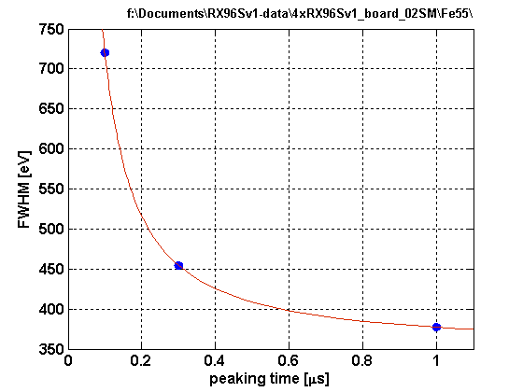
Factors limiting the energy resolution
Limited by the shot noise of the sensor leakage current
Any small increase of the leakage current will degrade the energy resolution
Notes:
In high energy resolution spectrometry using cooled silicon detector the sensor leakage current can be reduced to a negligible level and longer shaping times can be used to reduce the contribution from the voltage noise of the front-end electronics.

Slide 12
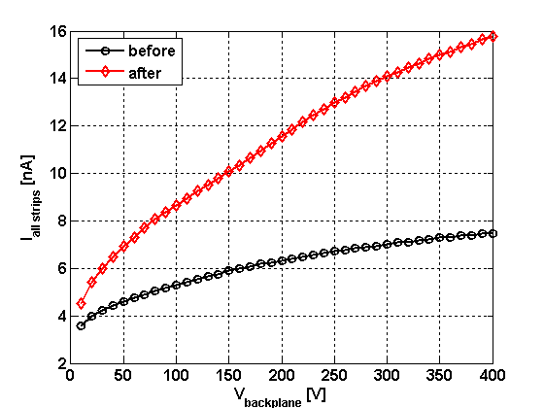
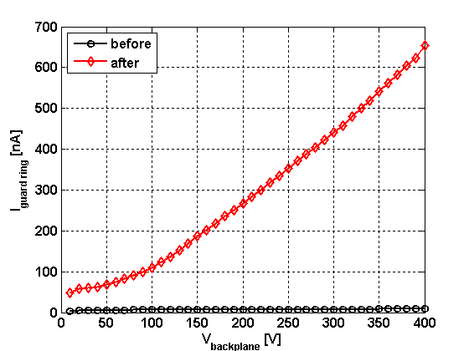
Leakage current after X-ray irradiation
Leakage current at 20^{O}C before and after irradiation
Dose: ~66Gy (SiO₂), dose rate: ~0.42Gy/h
Increase of the leakage current of the active area after irradiation by a factor ~2.5
Very significant increase of the guard-ring current – it should not affect the performance of the detector

Slide 13
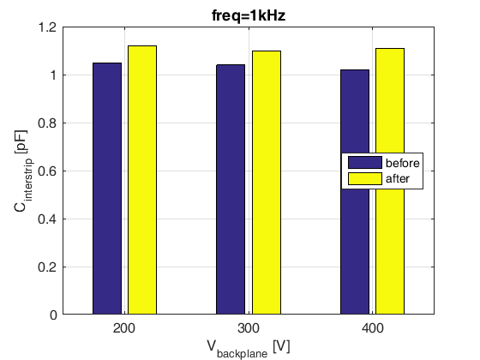
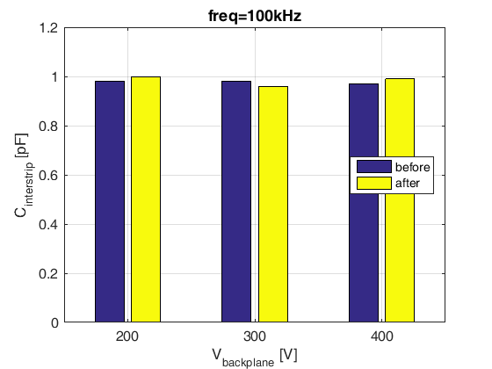
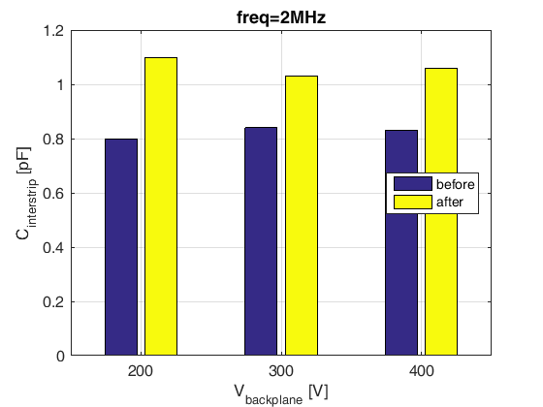
Interstrip capacitance after X-ray irradiation
Interstrip capacitance before and after irradiation
Dose: ~66Gy (SiO₂), dose rate: ~0.42Gy/h, cumulative time: ~160h
More significant increase of the interstrip capacitance after irradiation for higher frequency – will affect the ENC for short shaping times

Slide 14
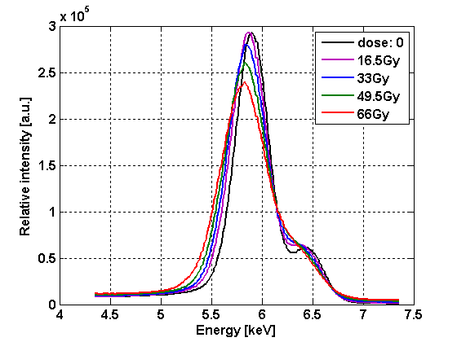
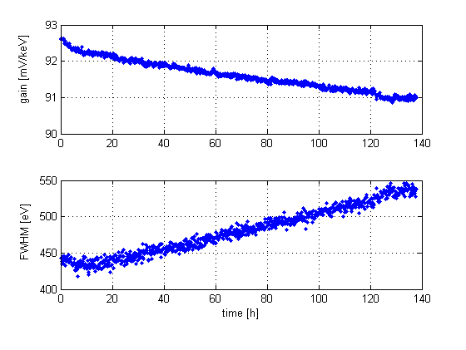
Degradation of spectroscopic performance after X-ray irradiation
Fe-55 spectrum before and after irradiation
Dose: ~66Gy (SiO₂), dose rate: ~0.42Gy/h, cumulative time: ~160h
Detector biased at 320 V during irradiation
Energy resolution is affected by electronic noise and by charge division effects

Slide 15
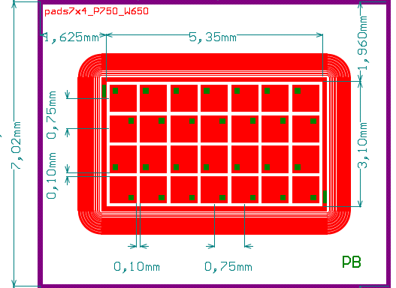
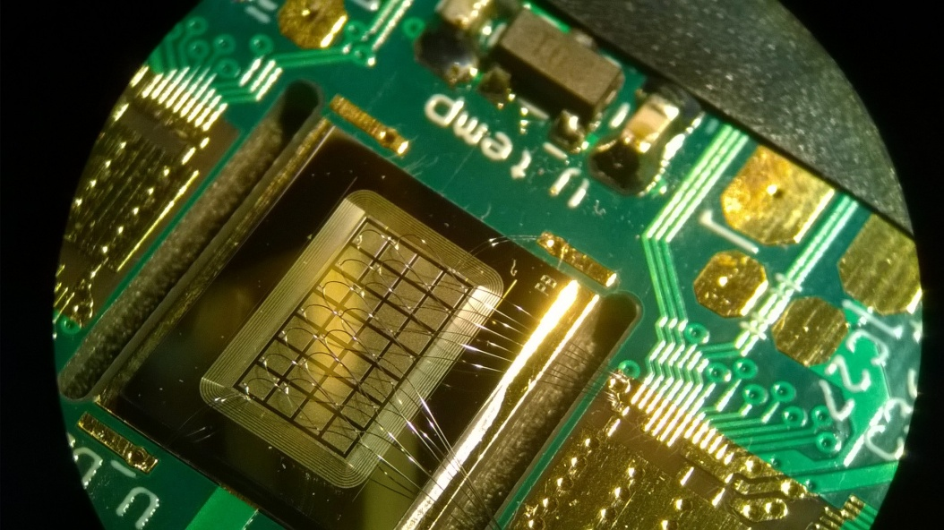
Silicon pad detector for high performance spectroscopy
Design principle
Divide the active area to reduce the capacitance and leakage current of each individual sensor element
Reach the energy resolution for each pad comparable with the energy resolution of silicon drift detectors
Use a multichannel ASIC for readout
Obtain a high throughput rate by parallel readout
Detector thickness | 500 μm
Pad dimension | 750μm x 750μm (0.56mm²)
Active area | 5.35mm x 3.1mm (16.6mm²)
Number of pads | 7 x 4
Total pad capacitance | 0.3 pF
Maximum leakage current at 20°C and detector bias of 300 V | 4nA/cm²

Slide 16
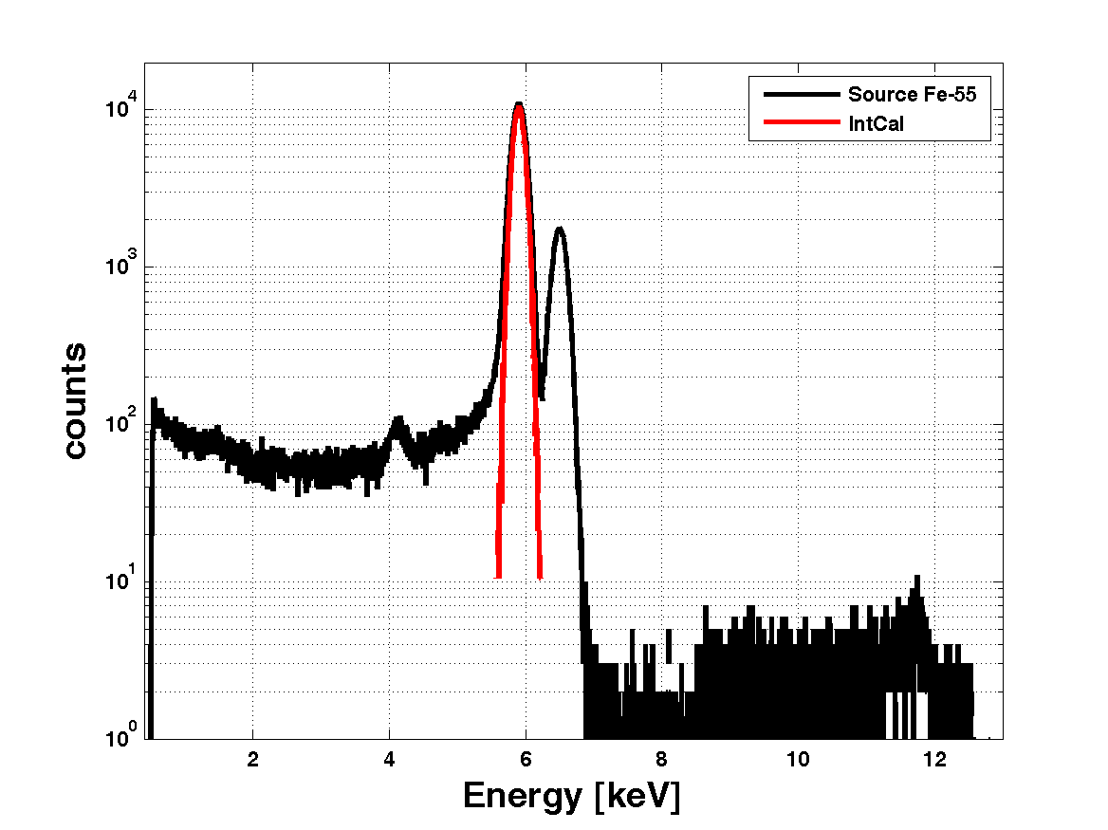
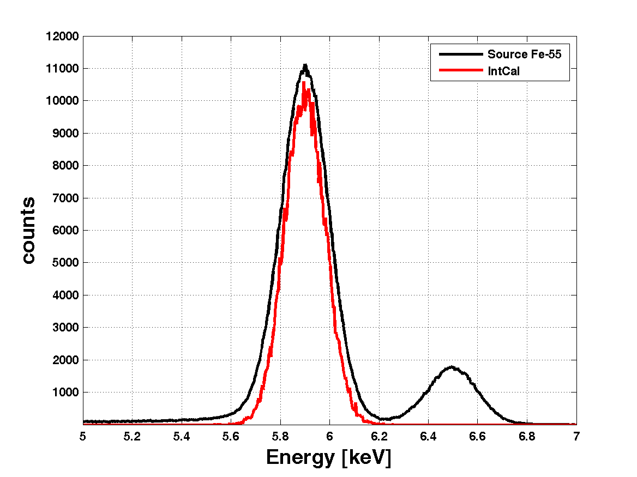
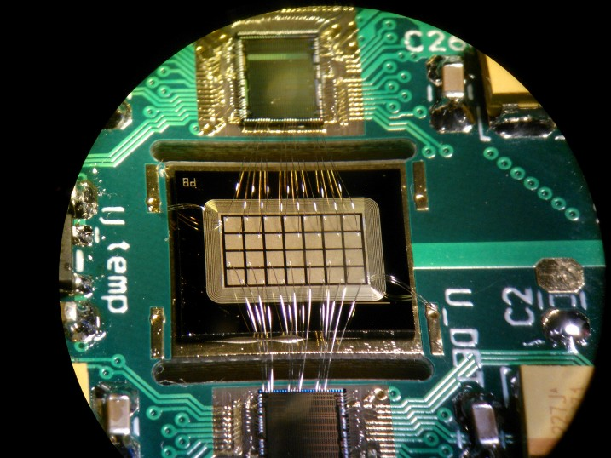
Spectroscopic performance
Energy resolution of pad: 225eV FWHM @ 17 ^{O}C
Electronic noise: 183eV FWHM @ 17 ^{O}C
Further improvement can be obtained by cooling the detector

Slide 17
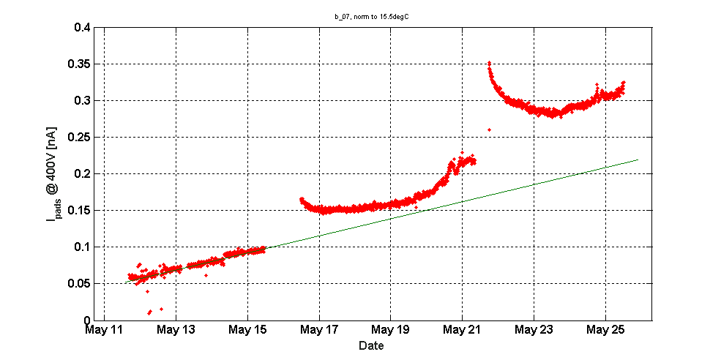
Pad sensor: Leakage current after X-ray irradiation
Dose ~164Gy (SiO₂), dose rate ~0.55Gy/h, cumulative time: ~300h
Detector biased at 400 V during irradiation
IV and CV meas.
IV and CV after
IV and CV meas.
IV and CV before
Very significant increase of the leakage current when detector bias voltage is reduced to zero between irradiation periods
Notes:
The increase of the leakage current between the irradiation periods may indicate for reverse annealing – an effect, which is observed for displacement damage in the detectors as well as for some electronic devices. This effect requires more systematic investigations.

Slide 18
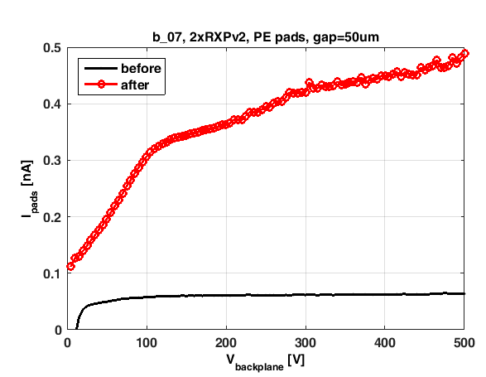
Pad sensor: I-V characteristic after X-ray irradiation
Dose ~164Gy (SiO₂), dose rate ~0.55Gy/h, cumulative time: ~300h
Detector biased at 400 V during irradiation
No surface leakage current before irradiation
Increase of the leakage current mainly due to increase of the surface leakage current

Slide 19
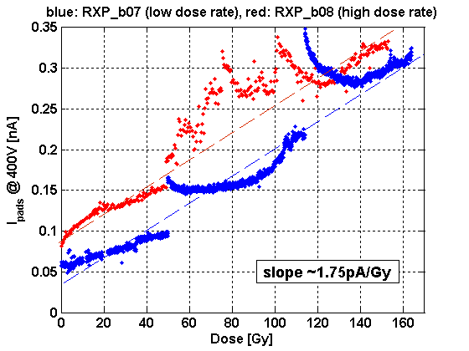
Dose rate effects
Leakage current during irradiation
Dose ~164Gy (SiO₂), dose rate ~0.55Gy/h)
Dose ~153Gy (SiO₂), dose rate ~2.55Gy/h)
Ionisation damage effects are potentially dependent on the dose rate during irradiation.
Two identical pad sensor structures have irradiated with different dose rate up to the same level of the total dose. There are some differences but the global trend seems to be the same for both dose rates.
More systematic studies are needed .
Notes:
This is an important aspect if we want to perform radiation tests in a reasonable time, while during normal operation the devices will be irradiated over much longer periods with much lower dose rate. Two identical pad sensor structures have irradiated with different dose rate up to the same level of the total dose. There are some differences but the global trend seems to be the same for both dose rates. Again, more systematic studies is needed

Slide 20
Summary
Ionisation damage effects caused by soft X-rays in silicon strip and silicon pad detectors are observed starting from very low doses of a few Grays.
The main effects which affect performance of the detector are:
increase of the surface leakage current
increase of the interstrip capacitance
building-up of the positive charge in the inter-strip (inter-pixel) surface layers, which affect charge division
In high performance detectors employed in the laboratory instruments using X-ray tubes the ionisation damage effects by soft X-rays cannot be ignored
More of detail studies in the low dose region is needed

Slide 21
Back up slides

Slide 22
Silicon strip detectors developed for applications in X-ray diffractometers
ASIC features:
Switchable shaping:
“slow”- SSH (T_{P}=1 μs) for high resolution applications
“medium”- MSH (T_{P}=300ns)
“fast”- FSH (T_{P}=100 ns) for high count rate application
Switchable gain (gain_high=4 x gain_low) - dynamic ranges 0-12keV / 0-48keV in Si
Low noise front-end – below 38el. rms in Si for slow shaping at room temperature and C_{total at input} = 2.3pF
Binary readout architecture with window discrimination (10-bit resolution)
Base line restorer
Interstrip logic allows rejection of events with significant charge sharing between adjacent strips
Notes:
Ten slajd można wyrzucić, jakby brakowało Ci czasu

Slide 23
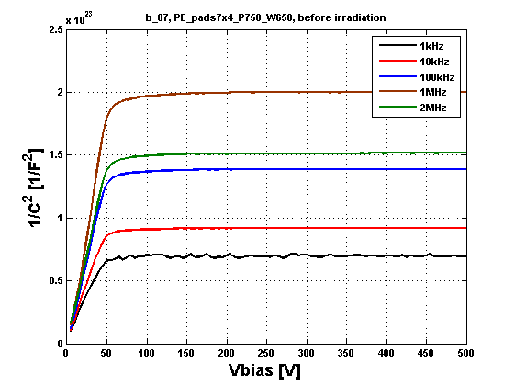
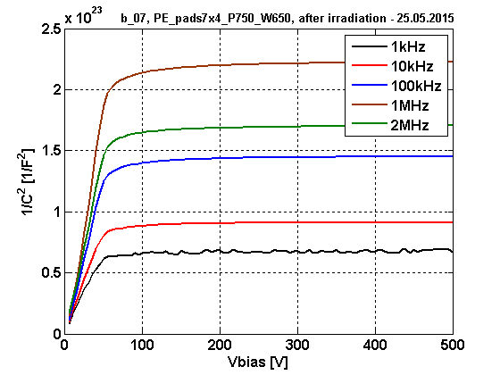
Pad sensor: capacitance after X-ray irradiation
Dose ~164Gy (SiO₂), dose rate ~0.55Gy/h, cumulative time: ~300h
Detector biased at 400 V during irradiation
Small increase of the full depletion voltage
Notes:
After irradiation we observe a larger transition range between almost fully depleted and definitely fully depleted detector when 1/C^2 characteristic is completely flat – this indicates for large amount of surface charge in the inter-pad gaps

Slide 24
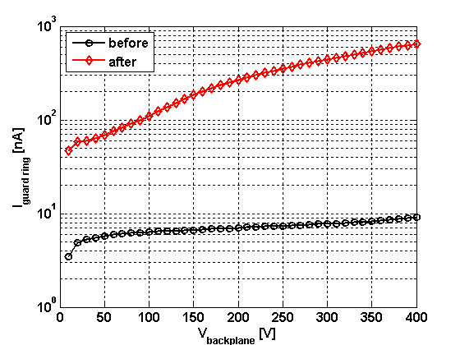
Degradation of parameters after X-ray irradiation
Leakage current at 20^{O}C before and after irradiation
Dose: ~66Gy (SiO₂), dose rate: ~0.42Gy/h
Notes:
Pokazałbym na jednym plocie prąd stripów przed i po, a na drugim gaurd ring przed i po. Obecnie wykresy są nieczytelne

