Slide 1

Determination of the 3γ fraction
in positron annihilation
Bożena Jasińska
Institute of Physics, Maria Curie Sklodowska University
20-031 Lublin, Poland
Jagiellonian Symposium
on Fundamental and Applied Subatomic Physics,
Kraków, June 7-12, 2015

Slide 2
OUTLINE:
Positron and positronium in the vacuum
Positronium annihilation in the condensed matter
ETE model
Lifetime spectra -3γ determination
Energetic spectrum - 3γ determination

Slide 3

Positron annihilation
511 keV
_
+
$$e^{+}+e^{−}→nγ$$
σ_{3y} = (4/9π)(π² - 9)ασ_{2y} = (l/372) σ_{2y}
511 keV

Slide 4
POSITRONIUM in the vacuum
= 125 ps
λ_{p-Ps} = (7,98950 ± 0,00002) ns⁻¹
P(o-Ps)/P(p-Ps) = 3/1
τ = 142 ns
λ_{o-Ps} = (7,03993 ± 0,00001) ms⁻¹

Slide 5
Experimental techniques based on positron annihilation:
Positron Annihilation Lifetime Spectroscopy (PALS)
Doppler Broadenining of annihilation radiation (DB)
Angular Momentum Correlation (ACAR)
Age MOmentum Correlation (AMOC)
3γ measurements
2γ/3γ ratio determination from:
PALS measurements
Energetic spectrum

Slide 6
POSITRONINUM
IN THE
MATTER

Slide 7
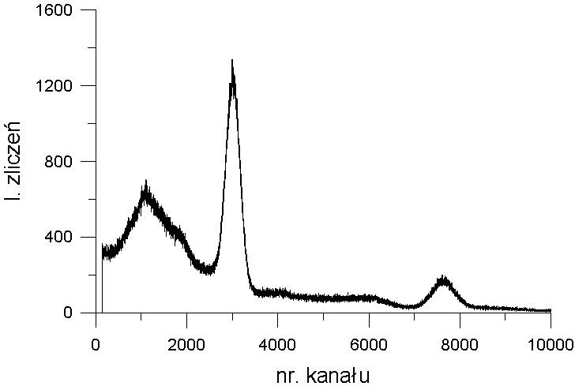
PALS
Positron Annihilation Lifetime Spectroscopy
²²Na
2.6y
β⁺ 90.4%, EC 9.5%
1.274
3.7ps
β⁺ 0.006%
1274 keV
511 keV
γ
0
Δt

Slide 8
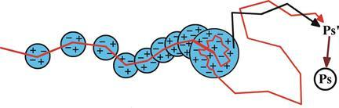
POSITRONIUM in the condensed matter
Thermallization
Positronium – lifetime value shortening due to:
ortho-para conversion
chemical and magnetic quenching
pick-off

Slide 9
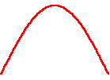

POSITRONIUM in the condensed matter
pick-off process
Shortening of the o-Ps lifetime value
1 to 142 ns

Slide 10
POSITRONIUM in the condensed matter
1/τ =λ_{po}=λ_{b}P
Dependence of the mean
o-Ps lifetime value
on the free volume size
and shape

Slide 11
POSITRONIUM in the condensed matter
(For sphere)

Slide 12
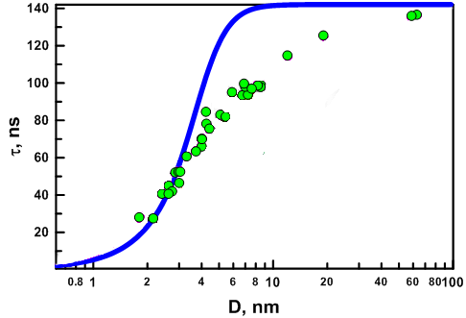
POSITRONIUM in the condensed matter
Porous materials

Slide 13
POSITRONIUM in the condensed matter
Porous materials
EXCITED STATES
Spherical potential well

Slide 14
POSITRONIUM in the condensed matter
Porous materials
Decay constanst for pick-off process (averaged over all populated states) :
Decay constant for nl-th state, spherical shape:
Decay constant for nm-th state, cyllindrical shape:

Slide 15
POSITRONIUM in the condensed matter
Porous materials
PALS vs LN
τ, ns
R, nm
3γ fraction f = τ_{o-Ps}/τ_{T.}

Slide 16
3γ fraction – LT spectrum
COUNT NUMBER
P=4/3I _{i} - Ps i-th component
Formation probability
(calculated from o-Ps intensity)
τT = 142 ns
p-Ps
e⁺
o-Ps

Slide 17
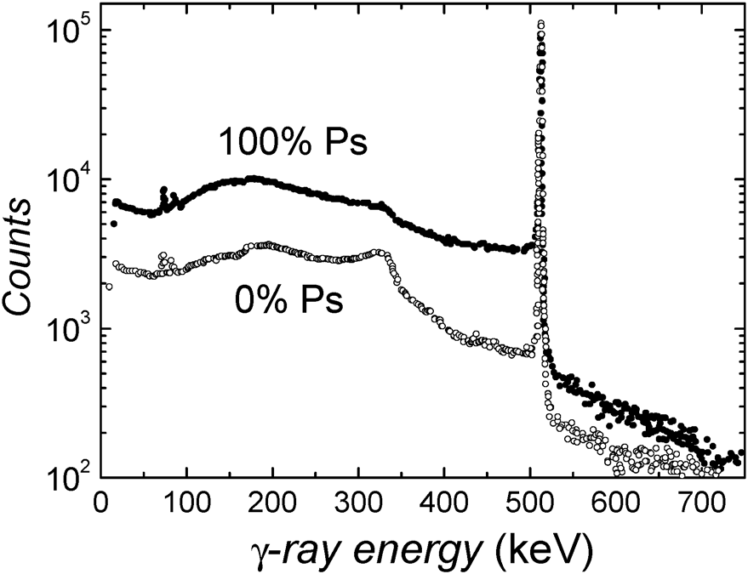
Na 22 spectrum
Annihilation γ spectra measured using a Ge detector at an Al(110)
surface, where no positronium is formed (0% Ps) and where 100% Ps emission
occurs at 900 K. Both curves were normalized to an equal height of the 511 keV
line
J. Lahtinen, A. Vehanen, H.Huomo, J. Makinen, P. IIuttunen,
K. Rytsolii, M. Bentzon and P. Hautojarvi, Nucl. Instrum.
Methods Phys. Res., Sect. B, 1986, 17, 73.

Slide 18
511 keV peak
Spectra normalized to the same number
of emitted positrons (1274 keV peak height)

Slide 19
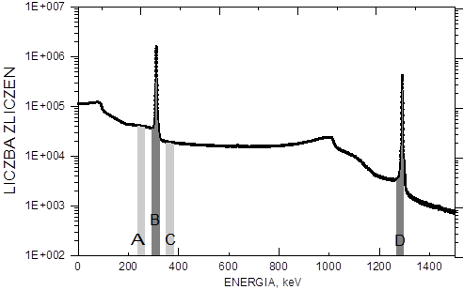
Na 22 spectrum
COUNT NUMBER
Methods:
peak/peak
Peak/valley
3γ fraction f₅₁₁ = R_{sample} - R_{ref}

Slide 20
Comparison 3γ fraction from LIFETIME and Na 22 spectra
3γ fraction for Vycor glasses and MCM-41

Slide 21
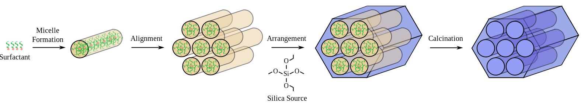
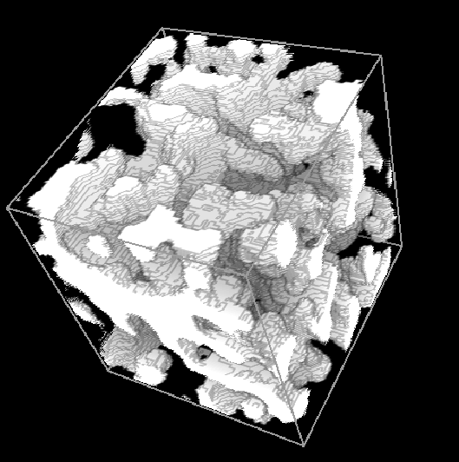
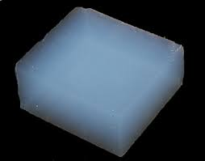

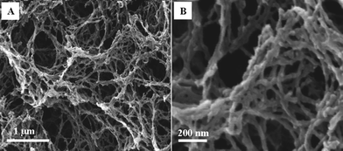
SILICA BASED POROUS MATERIAL

Slide 22
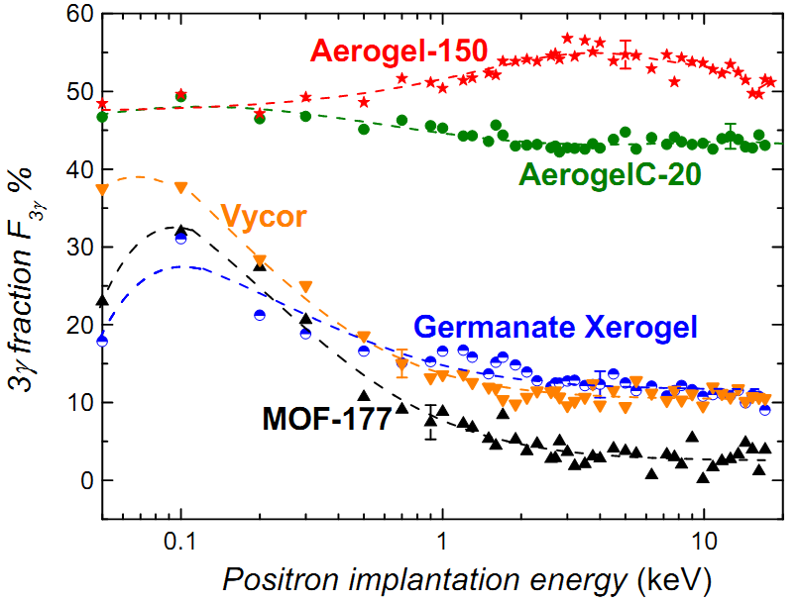
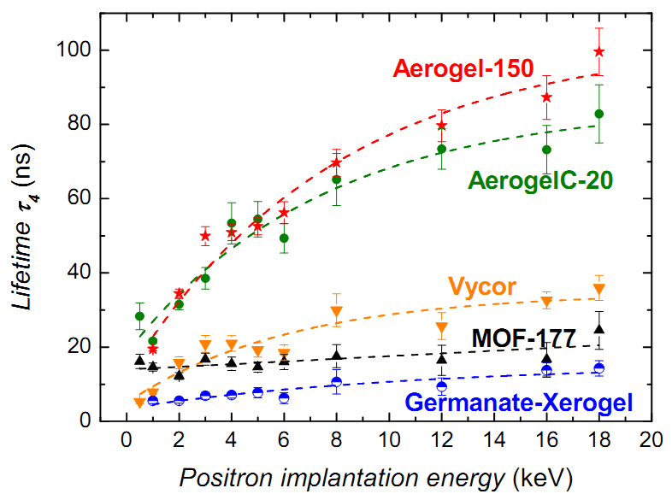
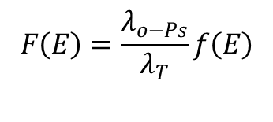
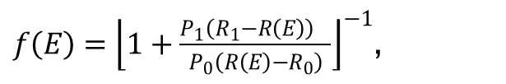
Positron beam
$$F\left(E\right)=\frac{λ_{o−Ps}}{λ_{T}}f\left(E\right)$$
$f\left(E\right)={\left\lfloor 1+\frac{{P_{1}\left(R_{1}−R\left(E\right)\right)}_{}}{P_{0}\left(R\left(E\right)−R_{0}\right)}\right\rfloor }^{−1}$,
R(E)=V/P
R. Ferragut et al., Jornal of Physics:
Conference Series 225 (210) 012007

Slide 23
Summary:
- 3γ fraction determined from γ spectrum gives more accurate values then from lifetime values
in hi-tech silica based porous materials 3γ fraction reaches 50 % (hi porosity materials)
in silica materials additional effects influencing o-Ps lifetime and intensity values
like ortho-para spin conversion or Ps enchancement are not observed
Thank you for attention

Slide 24
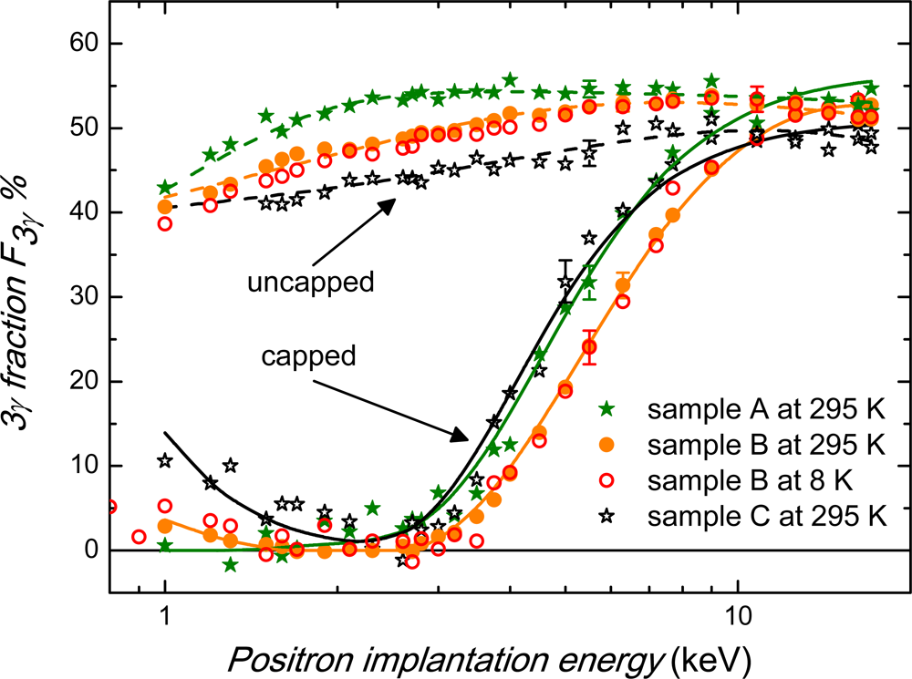
Positron beam
Positronium 3γ fraction F3γ as a function of the positron
implantation energy in uncapped and capped swollen
MCM-41(samples A and B,) and Davicat
measured at room temperature and at 8 K
G. Consolati, R. Ferragut, A Galarneau, F Di Renzo
and F Quasso, Chem. Soc. Rev., 2013,
42, 3821

Slide 25
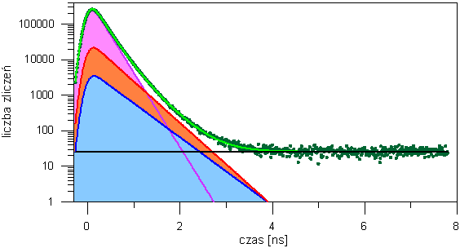
PALS
COUNT NUMBER
TIME, ns
τ- lifetime , I – intensity
measure of cavity size measure of formation
probability

