Slide 1


Slide 2


Positron as a probe for studying of matter at atomic level
Jerzy Dryzek
Insitute of Nuclear Physics PAS, Kraków

Slide 3
Outline
Annihilation channels.
Experimental methods commonly used for spectroscopy.
Annihilation in flight.
Two experimental methods for detection
of annihilation in flight process.

Slide 4
Annihlation process
Annihilation is a subatomic process when a fermion and its antiparticle are converted into bosons.
In the case of e⁺ and e⁻ , annihilation results in production of photons but at higher energies also production of other bosons: Z⁰ ,W^{+ ,}W⁻ or Higgs boson H⁰ is possible.

Slide 5
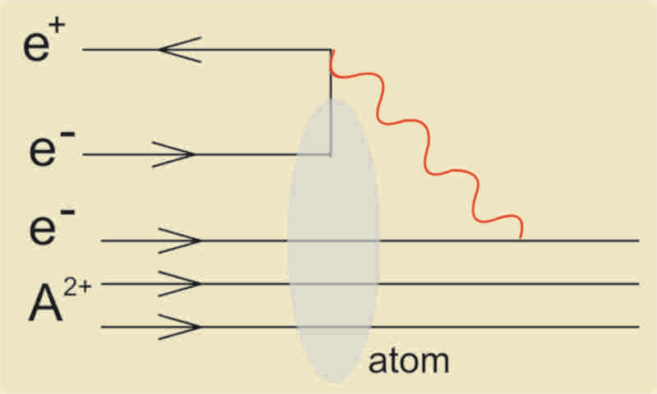
e+e-; annihilation channels
A positron annihilates with a core electron of an atom then such a process can be radiationless, i.e., no photon is emitted

Slide 6
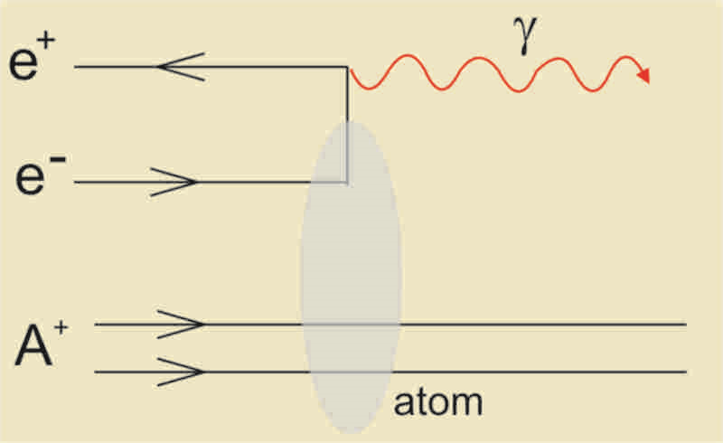
e+e-; annihilation channels
During annihilation with a core electron of an atom, the single photon annihilation is possible.

Slide 7
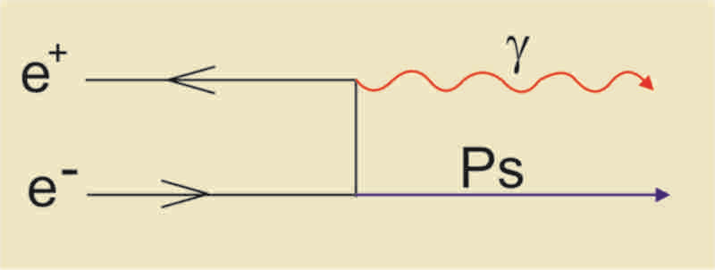
e+e-; annihilation channels
Another rare process, radiative trapping. As the result Positronium, i.e., bound state of a positron and an electron is formed with the emission of an energetic photon. The cross section is very small 10⁻²⁰cm² at 1 eV.

Slide 8
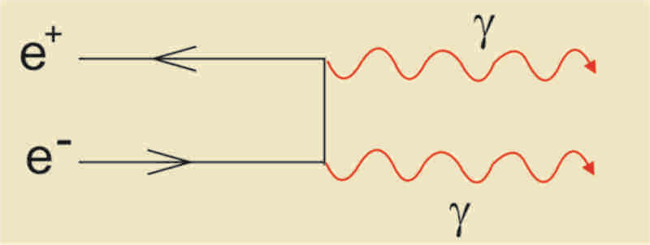
e+e-; annihilation channels
Emission of two photons is the main annihilation channel. Such a process manifests itself with the emission of two photons in the opposite directions each of energy of about 511 keV.

Slide 9
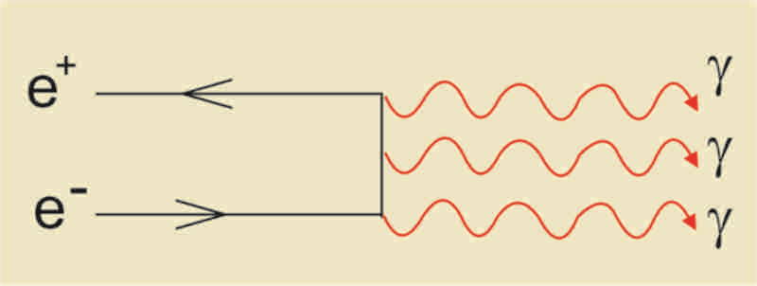
e+e-; annihilation channels
When the total spin of the annihilating pair is equal to unity, i.e., spins of two particels are parallel then the annihilation with three photons occurs. Each photon energy exhibits the continuous spectrum.

Slide 10
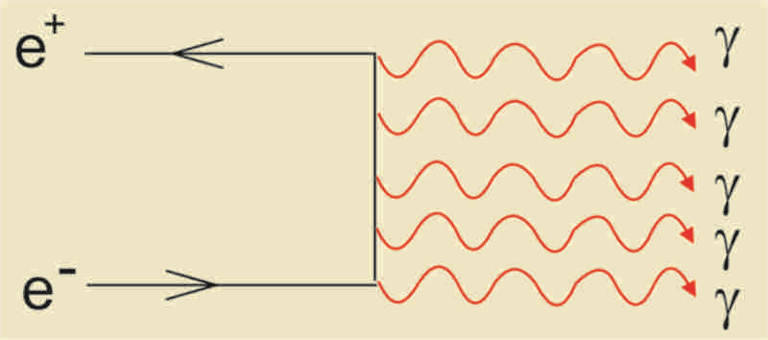
e+e-; annihilation channels
There is possible emission of more than three photons as well. Number of emitted photons n depends on the spin S and orbital angular momentum L of the annihilating pair as follows:
(-1)^{n}=(-1)^{L+S}.

Slide 11
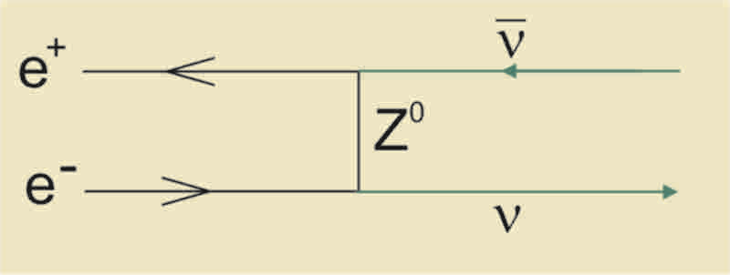
e+e-; annihilation channels
Due to the week interaction, e⁺ and e⁻ can annihilate emitting two neutrinos. This is very rare, the average lifetime for such a process is about 5x10⁵ years.

Slide 12
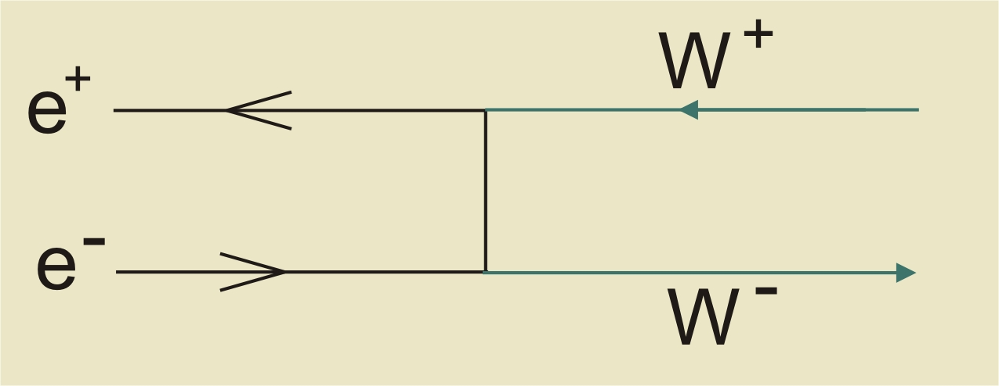
e+e-; annihilation channels

Slide 14
Annihilation at rest; momentum of an electron contributes to the momentum of the annihilating pair

Slide 15
Doppler broadenning of the annihilation line
Commonly used apparatus

Slide 16
Photon energy spectrum
511 keV annihilation line
Backscattering peak
Compton edge
X-ray

Slide 17
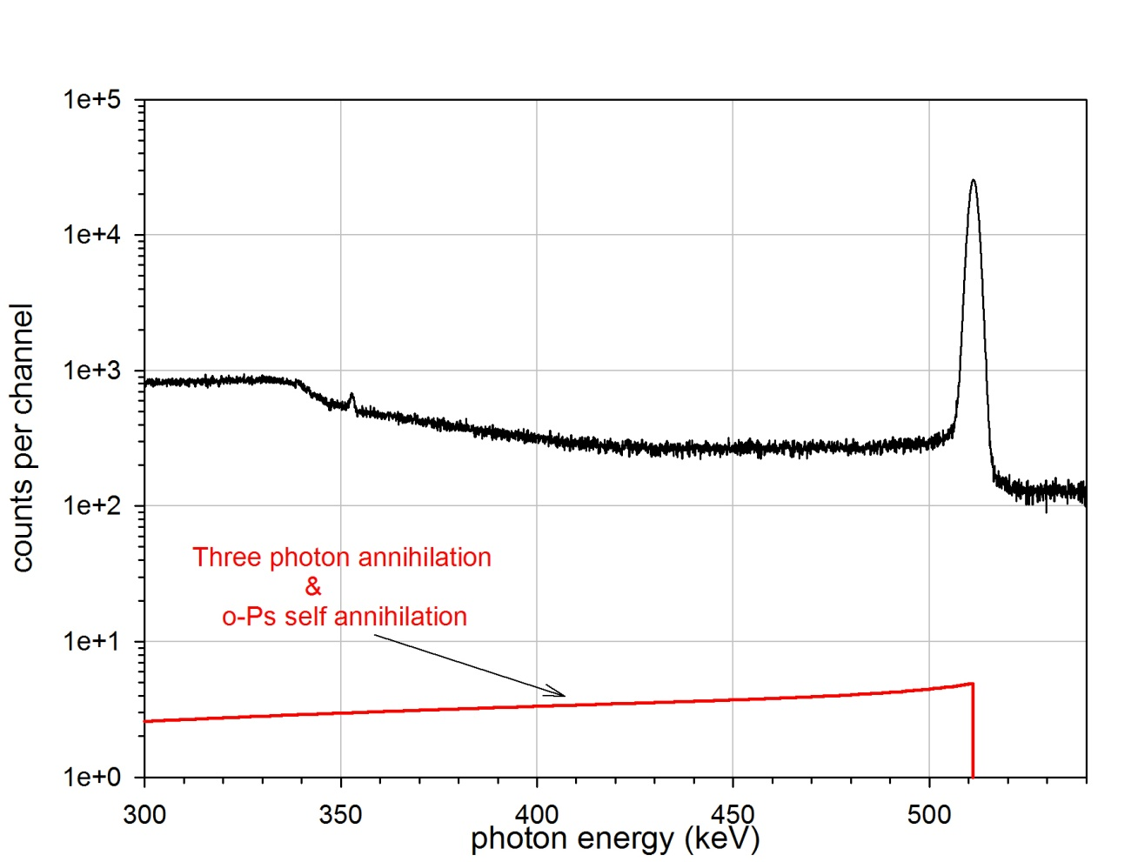
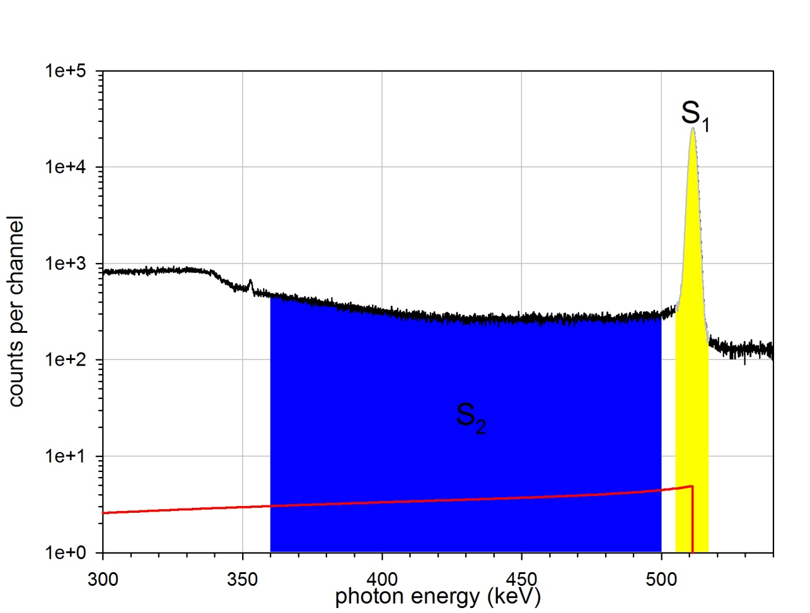
Three gamma annihilation
R-parameter, called “valley to peak” defined as ratio: S₂ /S₁

Slide 18
Triplet annihilation of the o-Ps at the surface of Zr
The R-parameter as the function of the positron incident energy for the reference sample of Zr and the sample exposed to dry sliding.

Slide 19
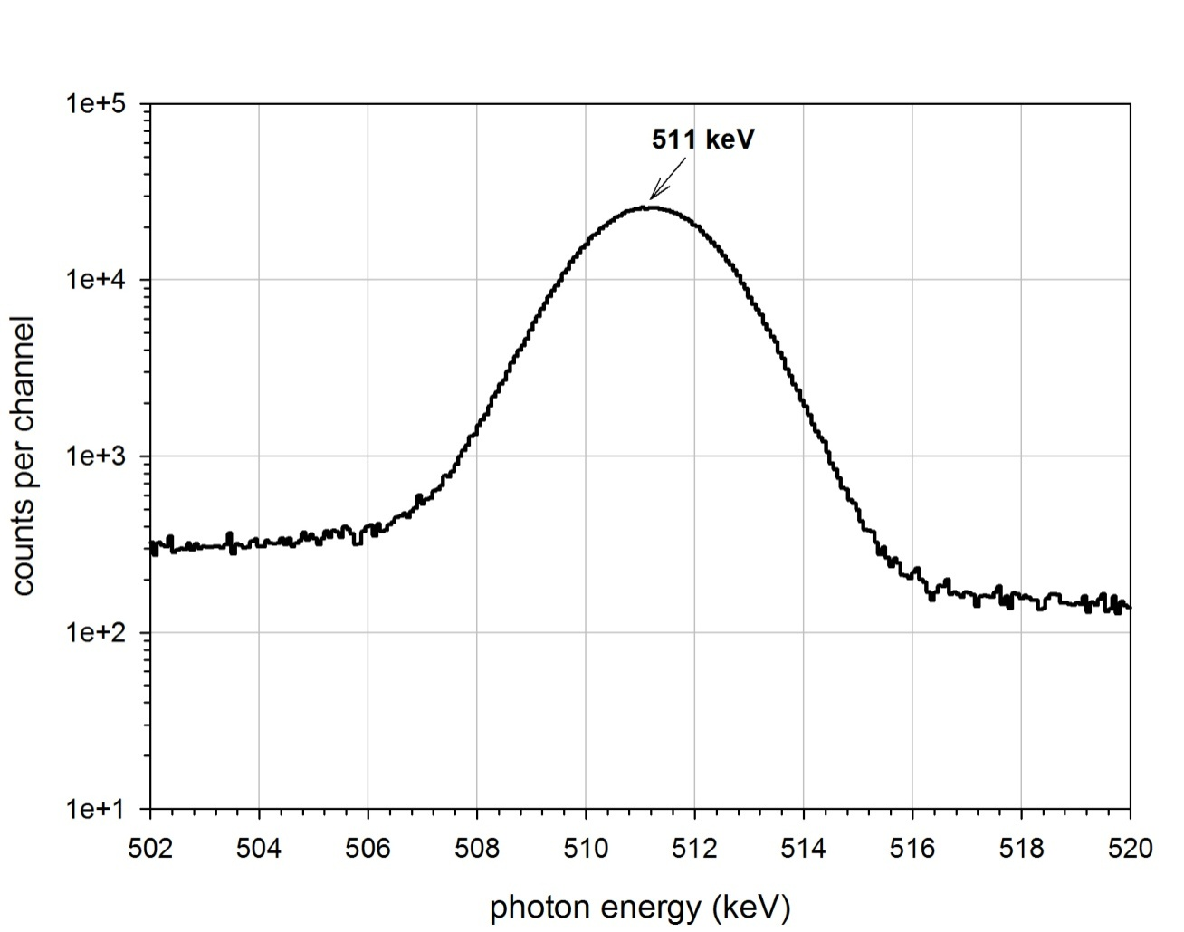
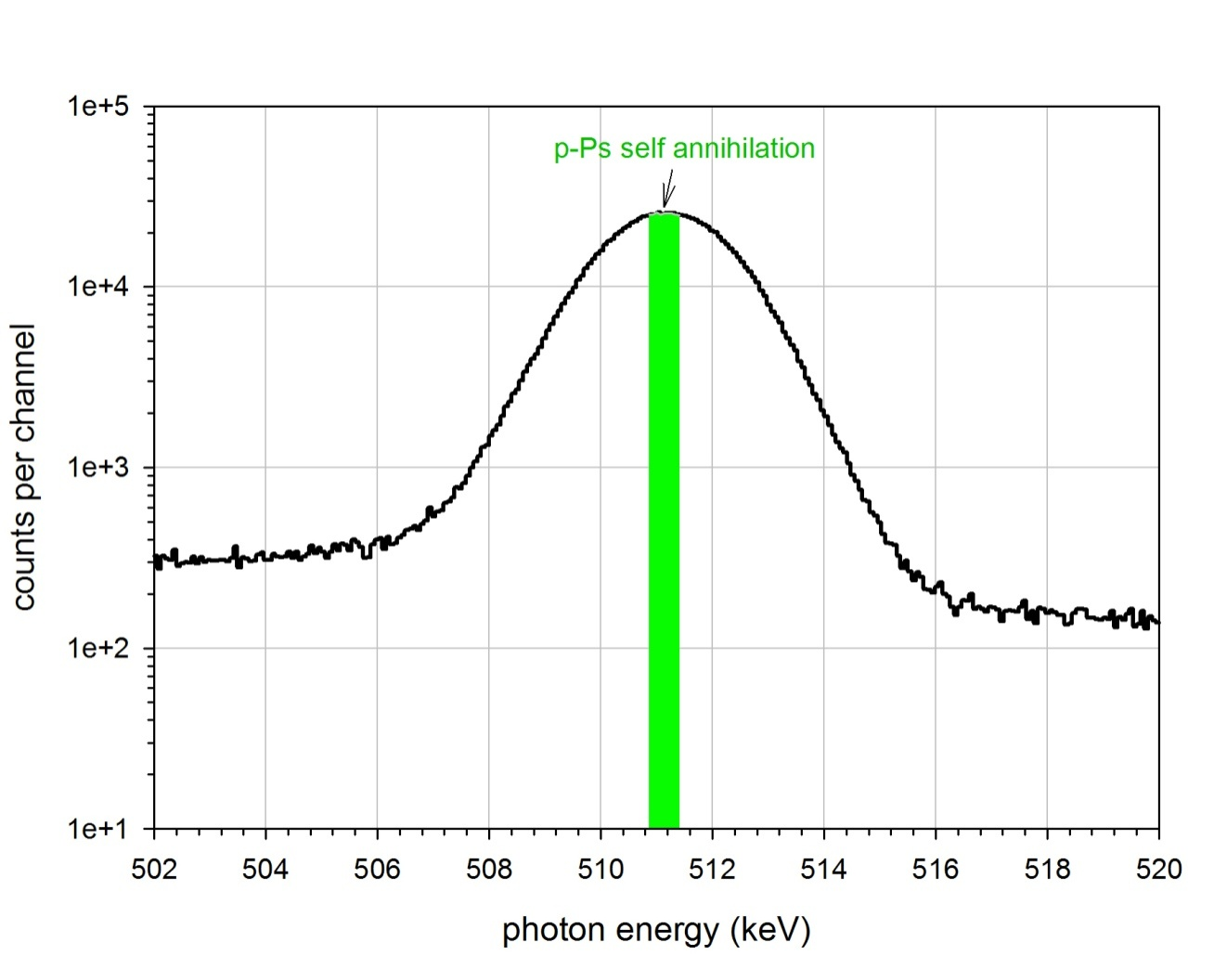
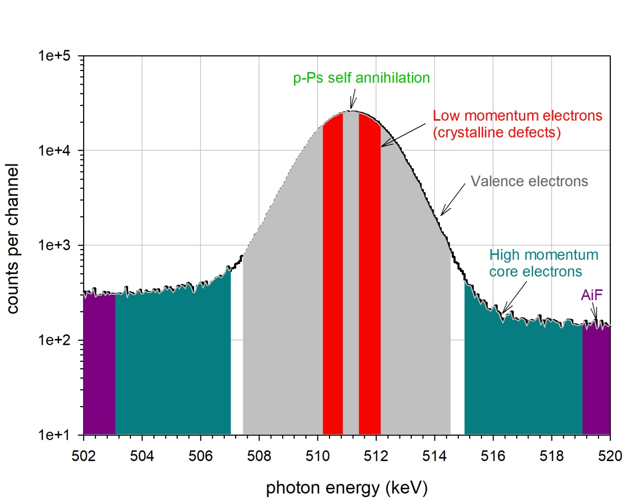
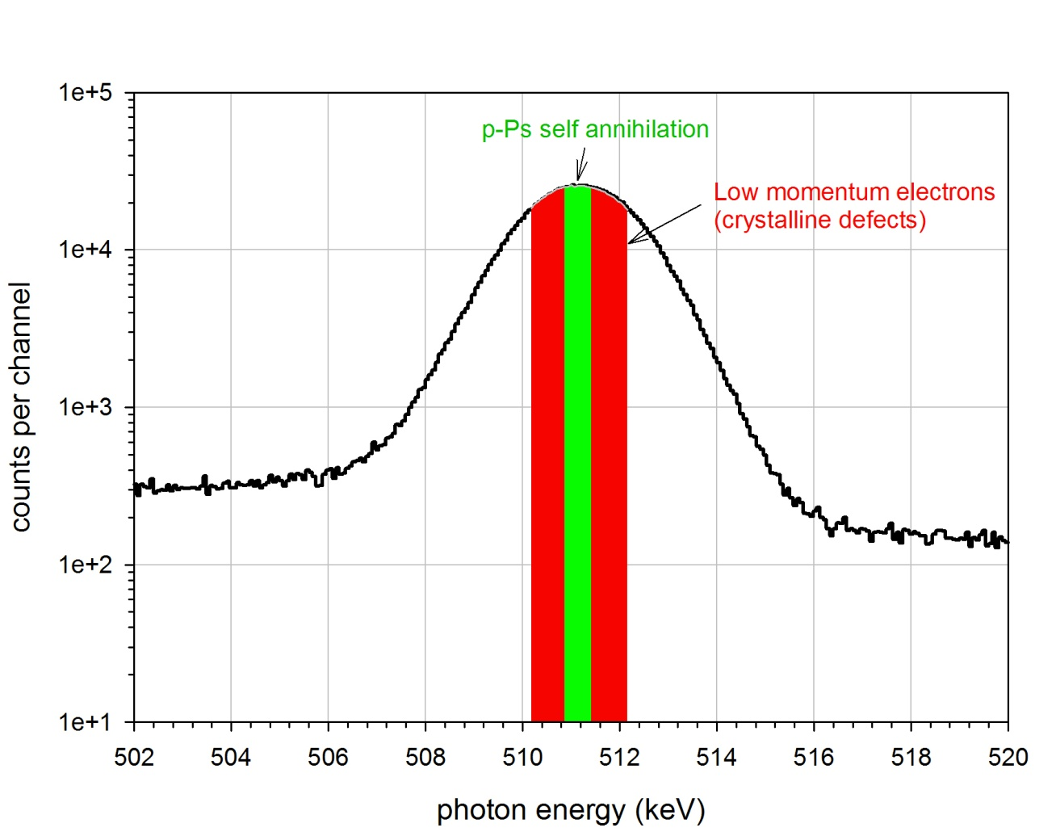
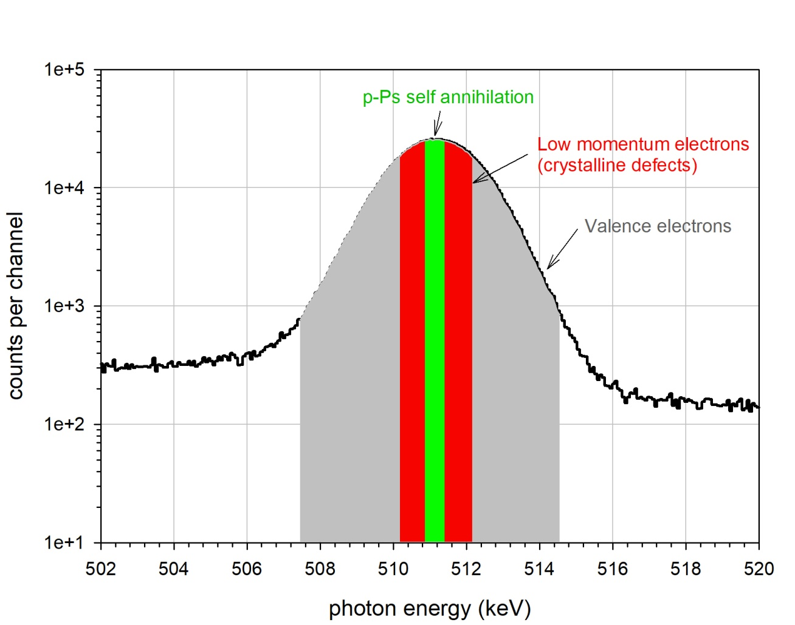
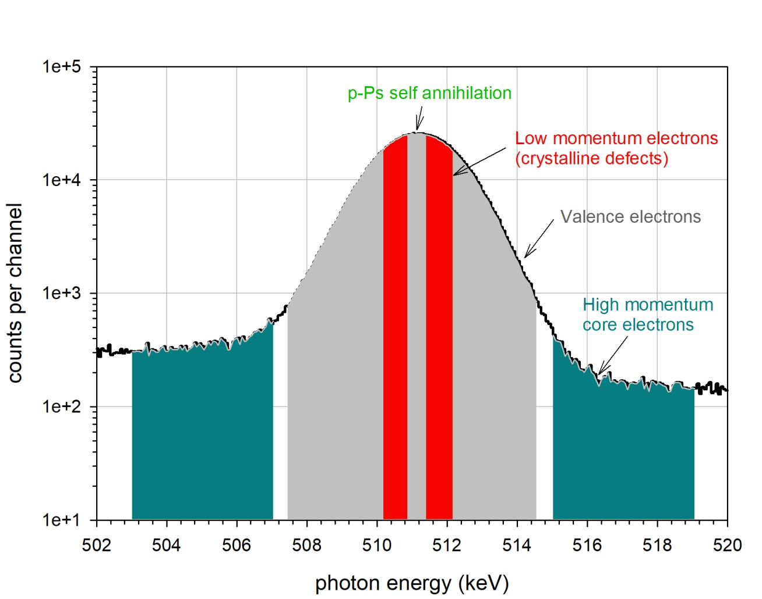
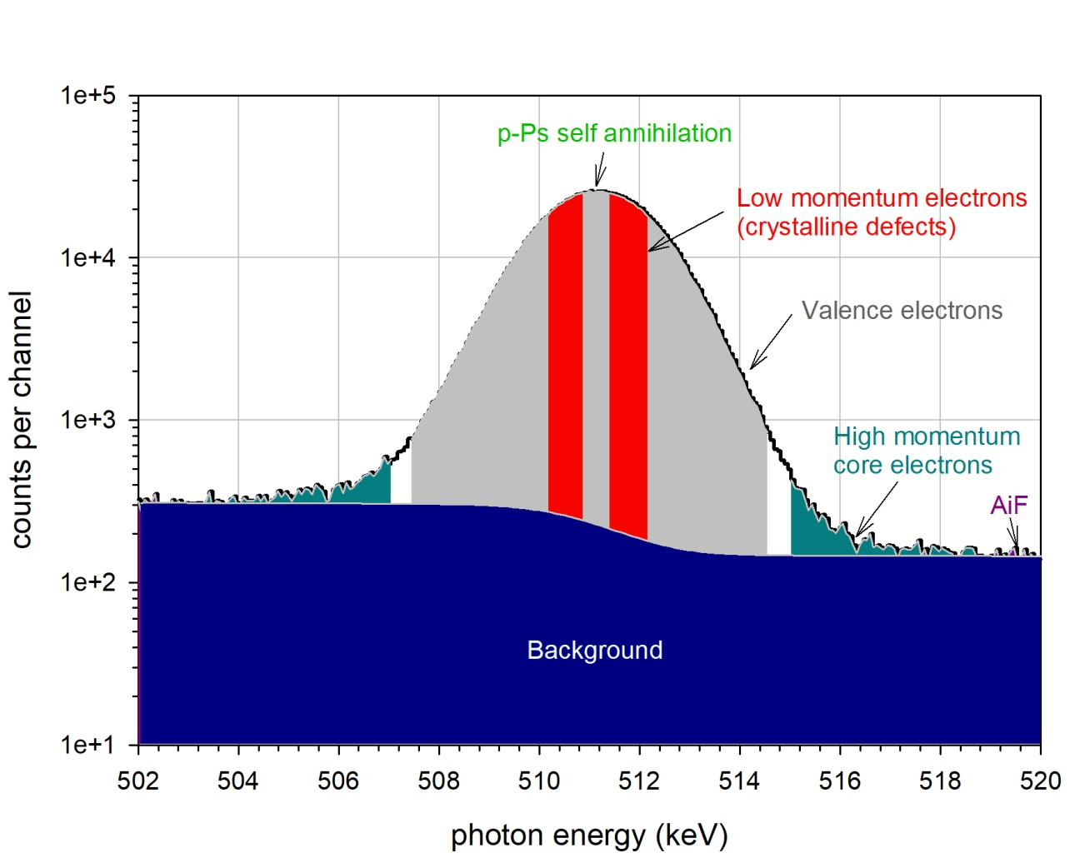
Annihilation line

Slide 20
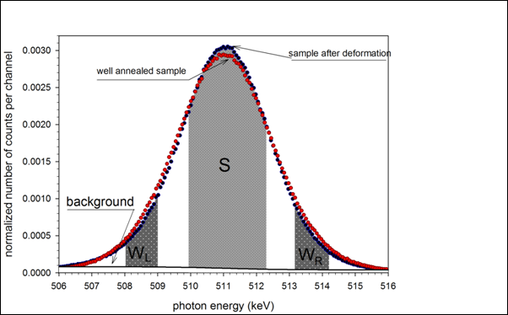
How we define the S-parameter

Slide 21
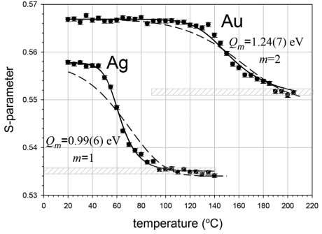
S-parameter value is sesitive to the structure changes in a sample
Dependency of the S-parameter on the temperature for an isochronal annealing sequence of deformed pure Au and Ag.

Slide 22
Coincidence system for reduction of background under annihilation line

Slide 23
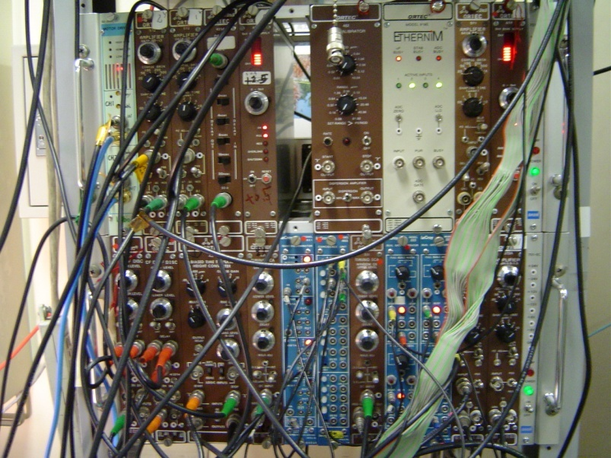
Coincidence DB spectrometer
²²Na & Sample
AMP
Ge
Ge
AMP
BI
BI
SCA
DISC
DISC
SCA
UNI
UNI
COIN
GATE
GATE
ADC
ADC
2d MCA & PC

Slide 24
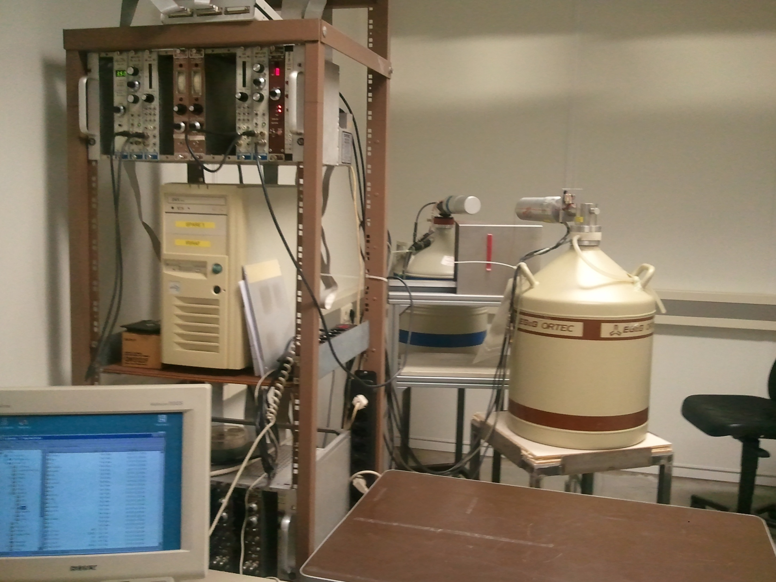
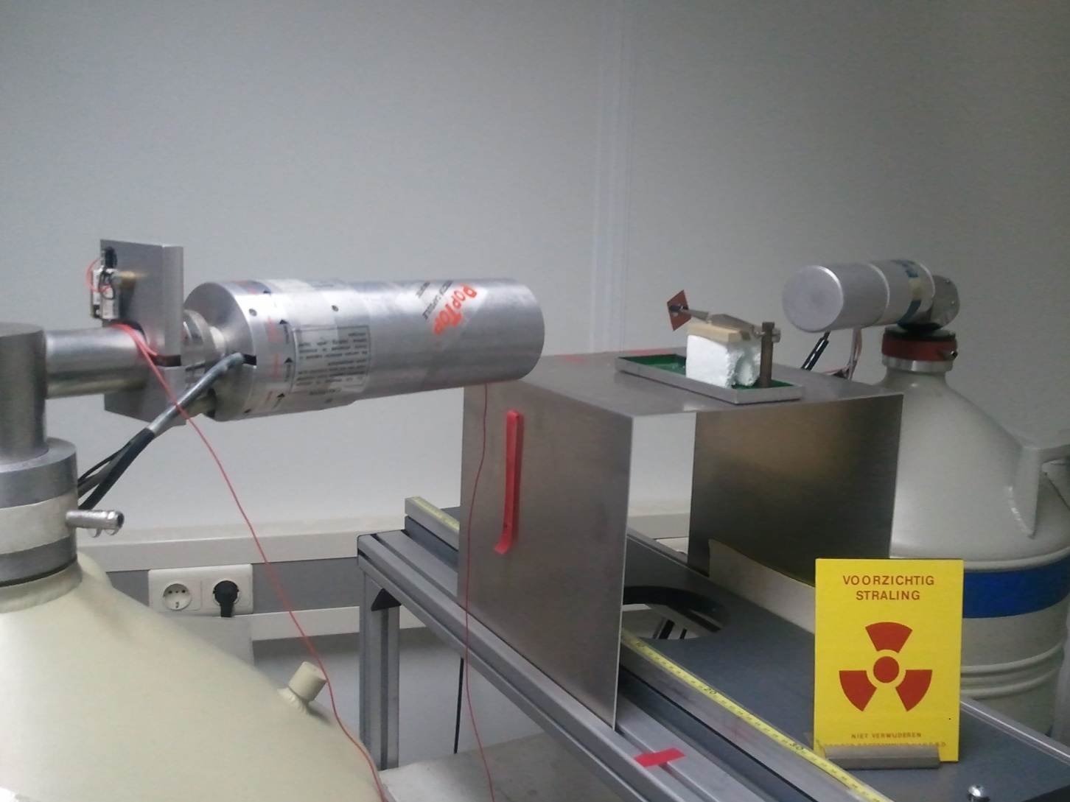

Slide 25
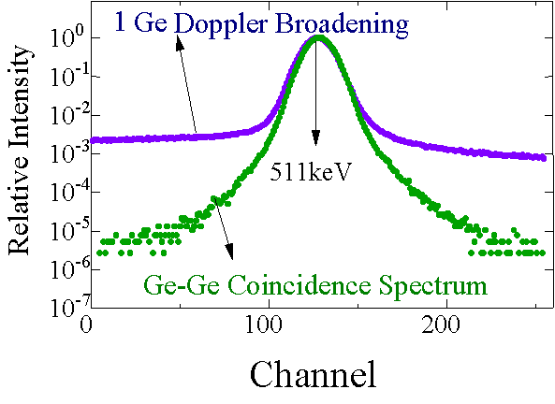
Coincidence Doppler Broadening (CDB) spectroscopy
Core region

Slide 26
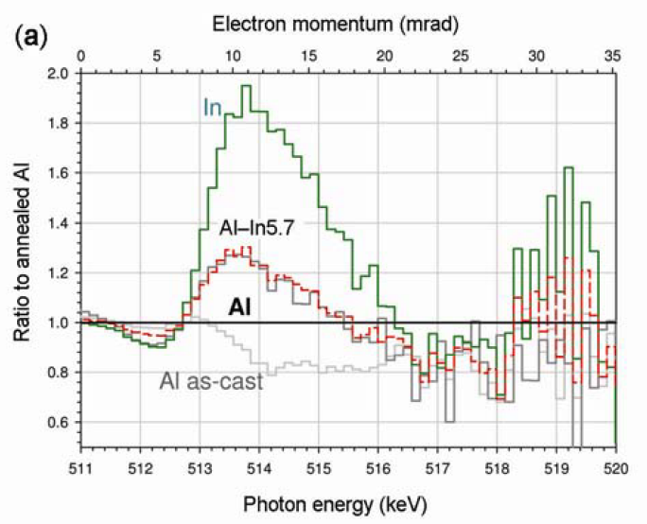
CDB - ratio spectra

Slide 27
Positron lifetime spectroscopy

Slide 28
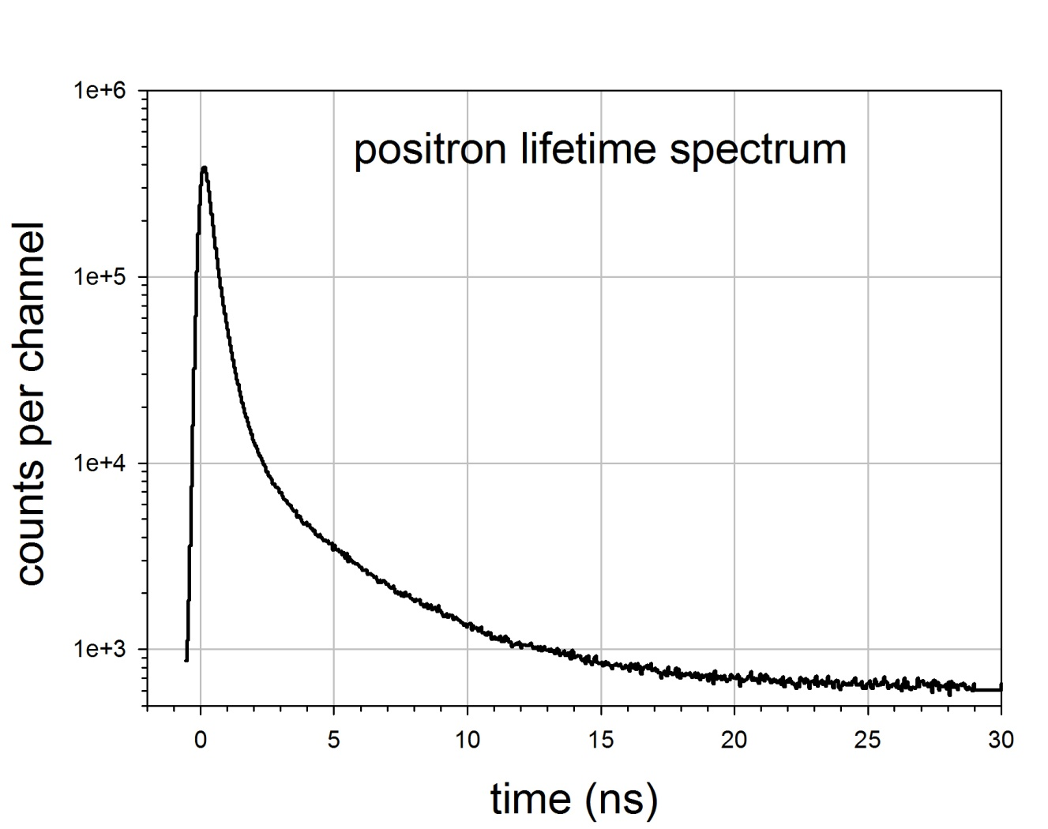
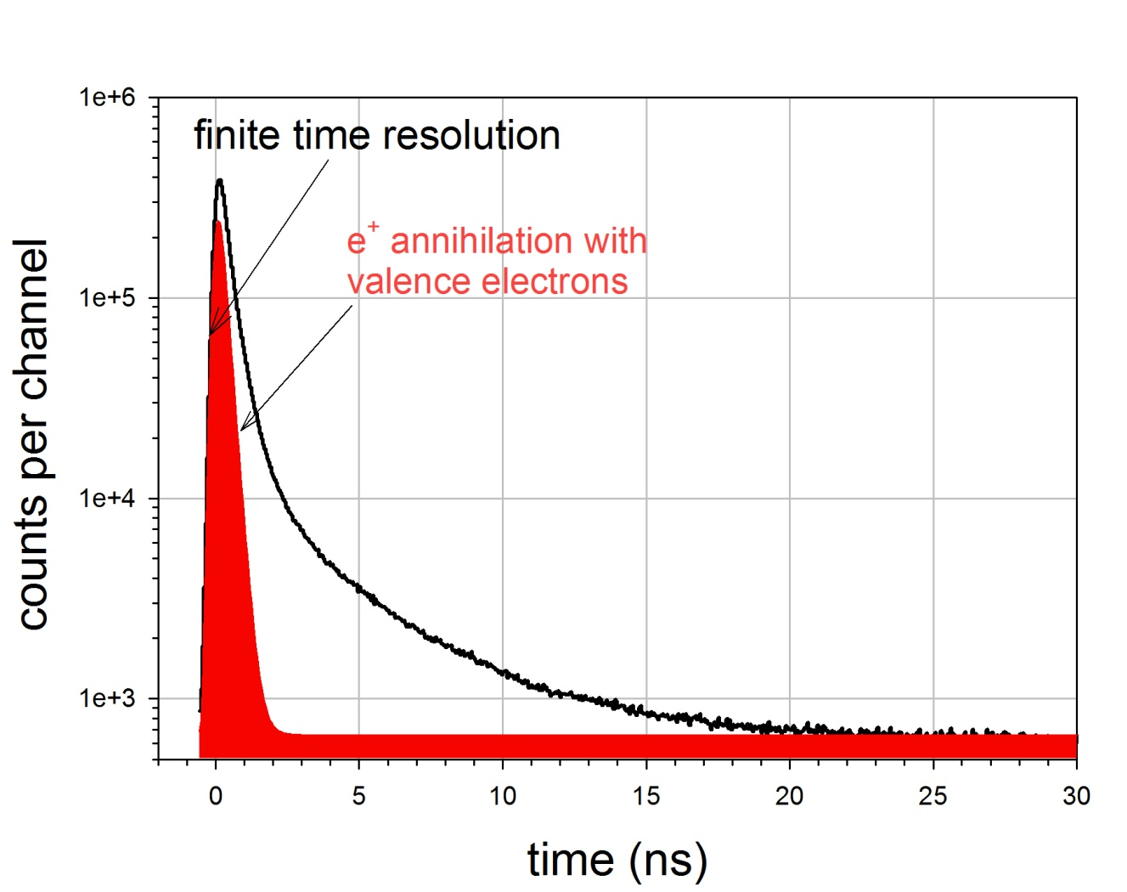
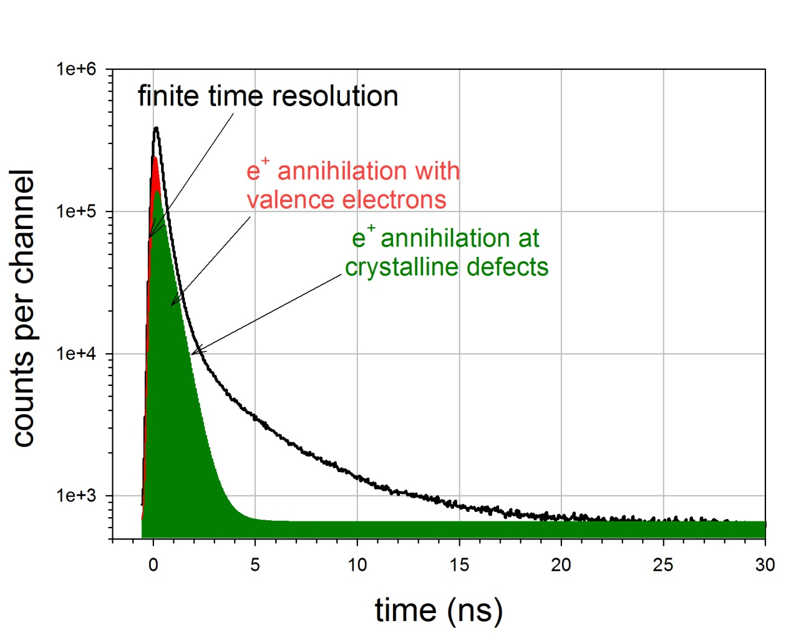
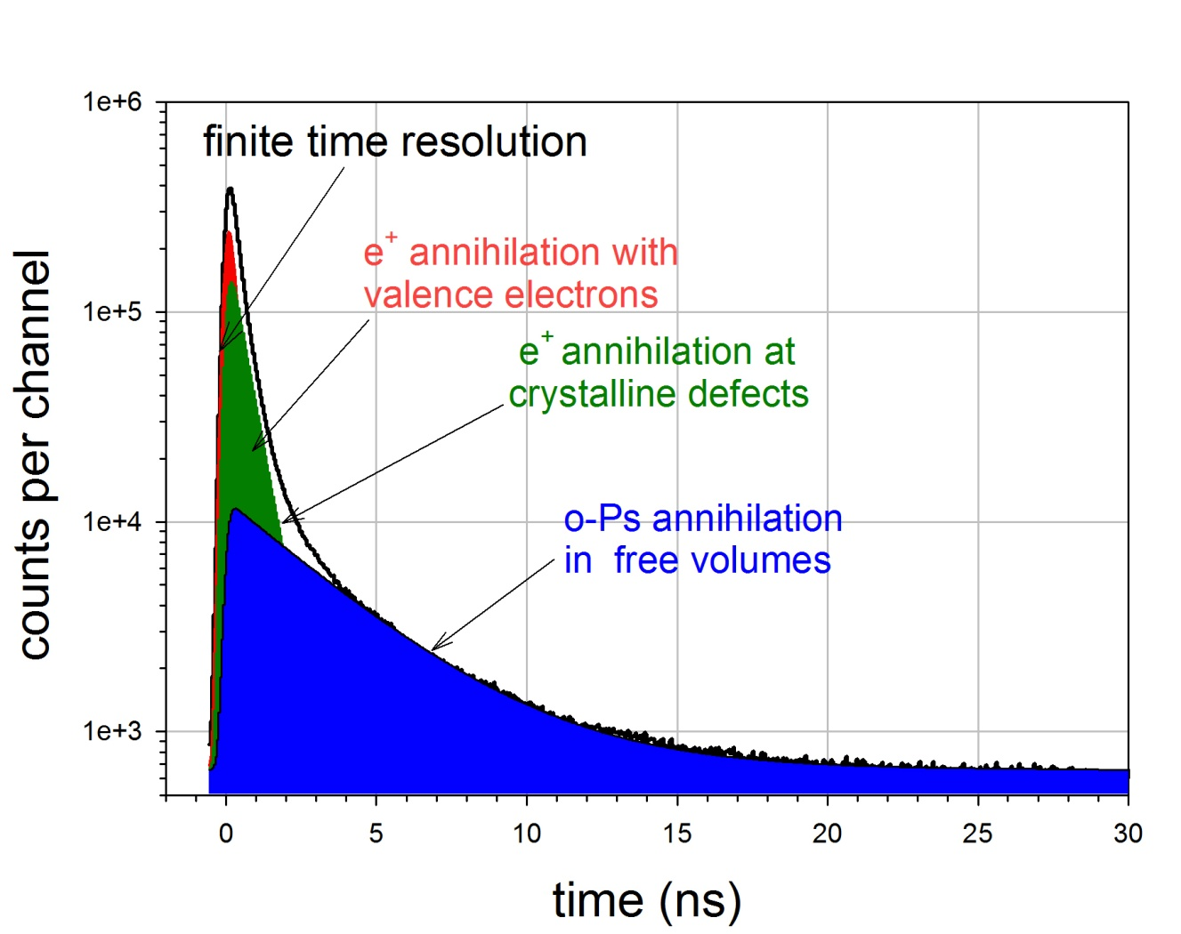

Positron lifetime spectrum, decomposition

Slide 29
Positron lifetime spectrum
Intensity depends on the positron
trapping rate i.e., defect concentration
Time resolution function,
(gaussian)
Annihilation rate or positron lifetime:

Slide 30
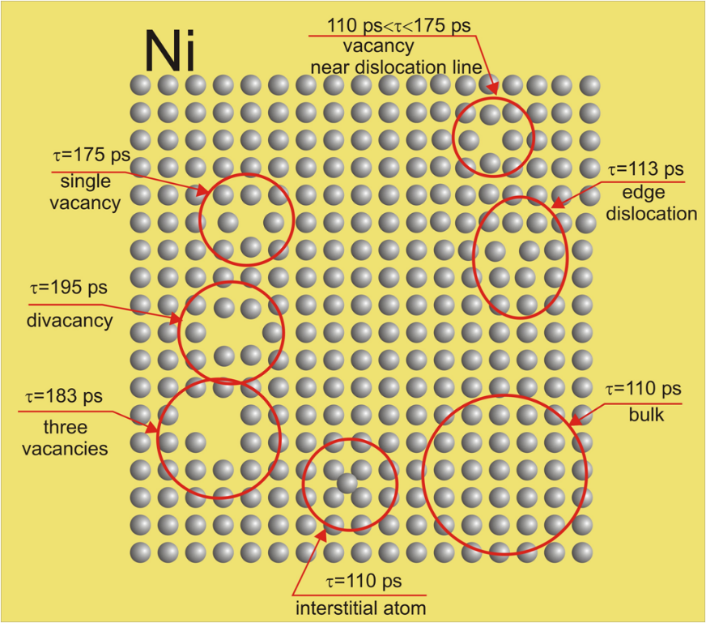
Positron lifetime in crystalline defect in Ni

Slide 31
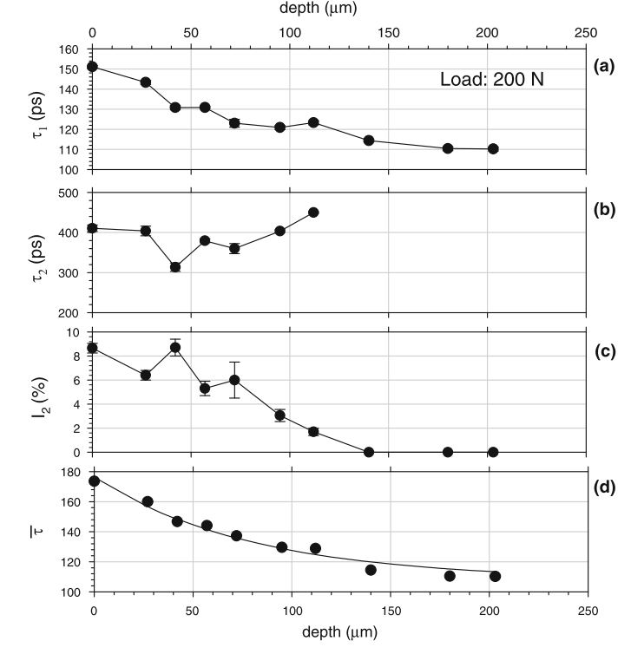
Positron Studies of Subsurface Zone Inducedby Sliding in Pure Iron
The depth proﬁle of the
positron lifetime components, measured in the sequenced
etching procedure for pure iron
sample exposed to dry sliding.
The solid line in (d) represents
the best ﬁt of the exponential function to the
experimental points
Mean positron lifetime

Slide 32
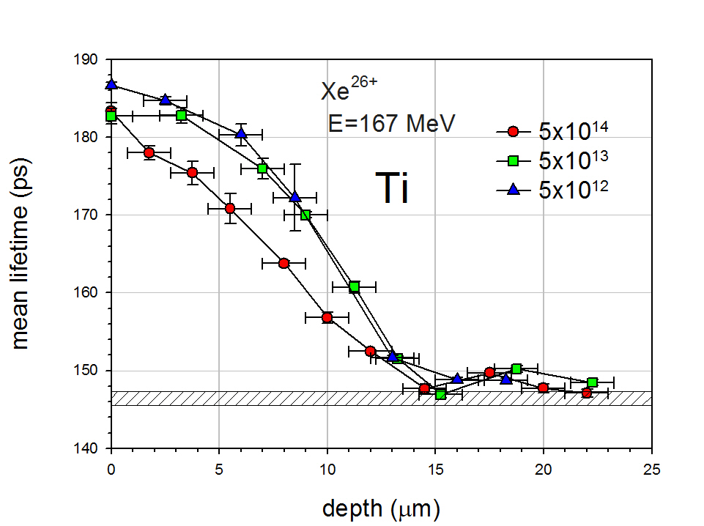
Positron lifetime in Ti irradiated with swift Xe²⁶⁺ ions
bulk

Slide 33
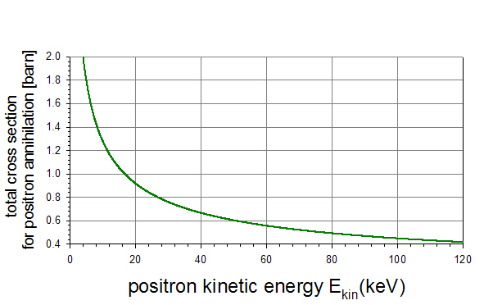
The total cross section for two photons annihilation

Slide 34
Annihilation in flight

Slide 35
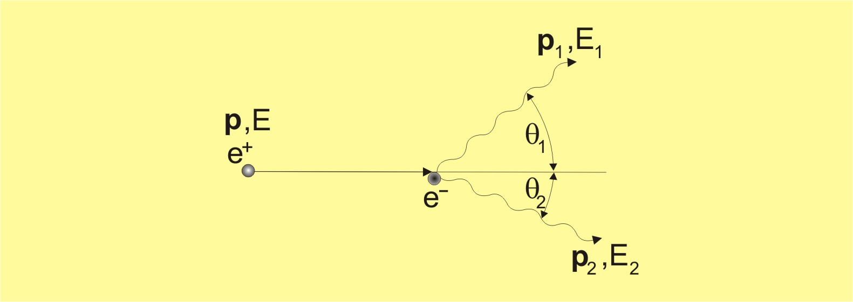
Kinematics of AiF
Relativistic approach

Slide 36
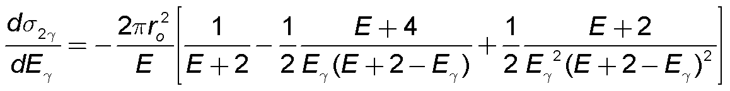
Calculated AiF photon spectra
The differential cross section for the two gamma process versus the emitted
gamma energy for different values of the positron kinetic energy E.
which is valid only for Eγ(min)<Eγ< Eγ(max)

Slide 37
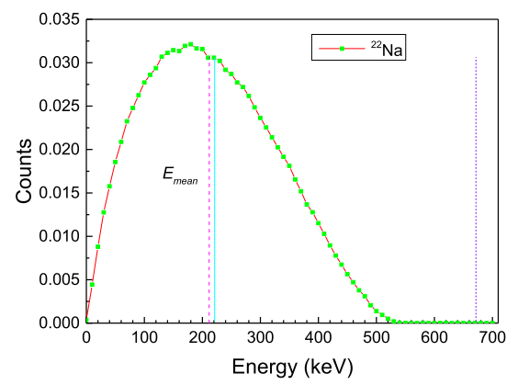
Energetic spectrum of ²²Na positrons

Slide 38
Two edges of AiF process
E is the positron kinetic energy

Slide 39
²²Na spectrum, non edges due to high background

Slide 40
Only coincidence can help to detect AiF

Slide 41
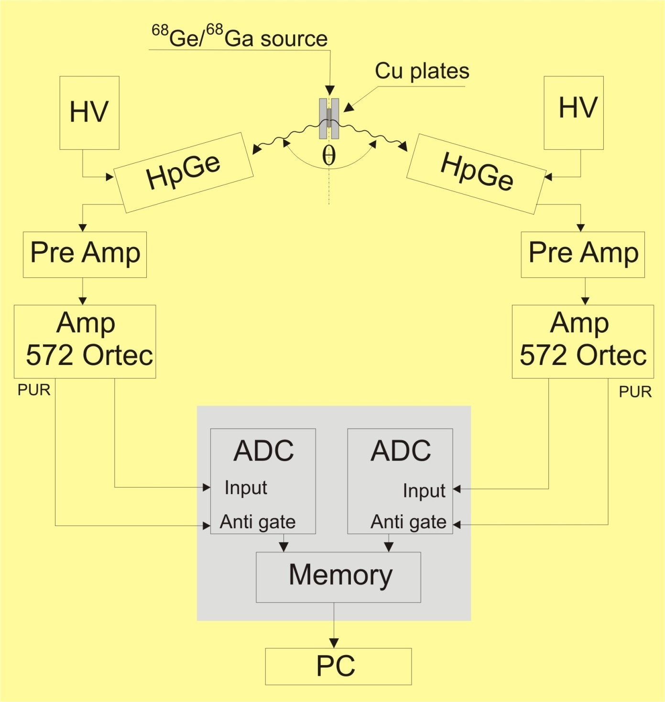
Concidence system for detection of AiF

Slide 42
2D histogram of annihilation photons

Slide 44
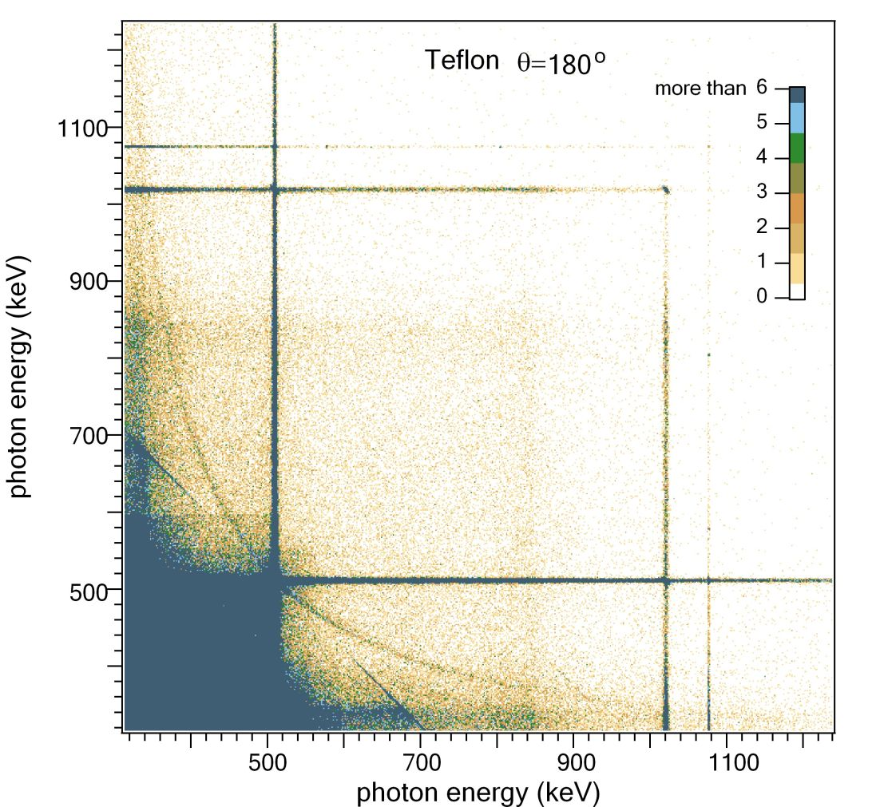

Slide 45
The red lines:

Slide 46
The red lines:

Slide 47
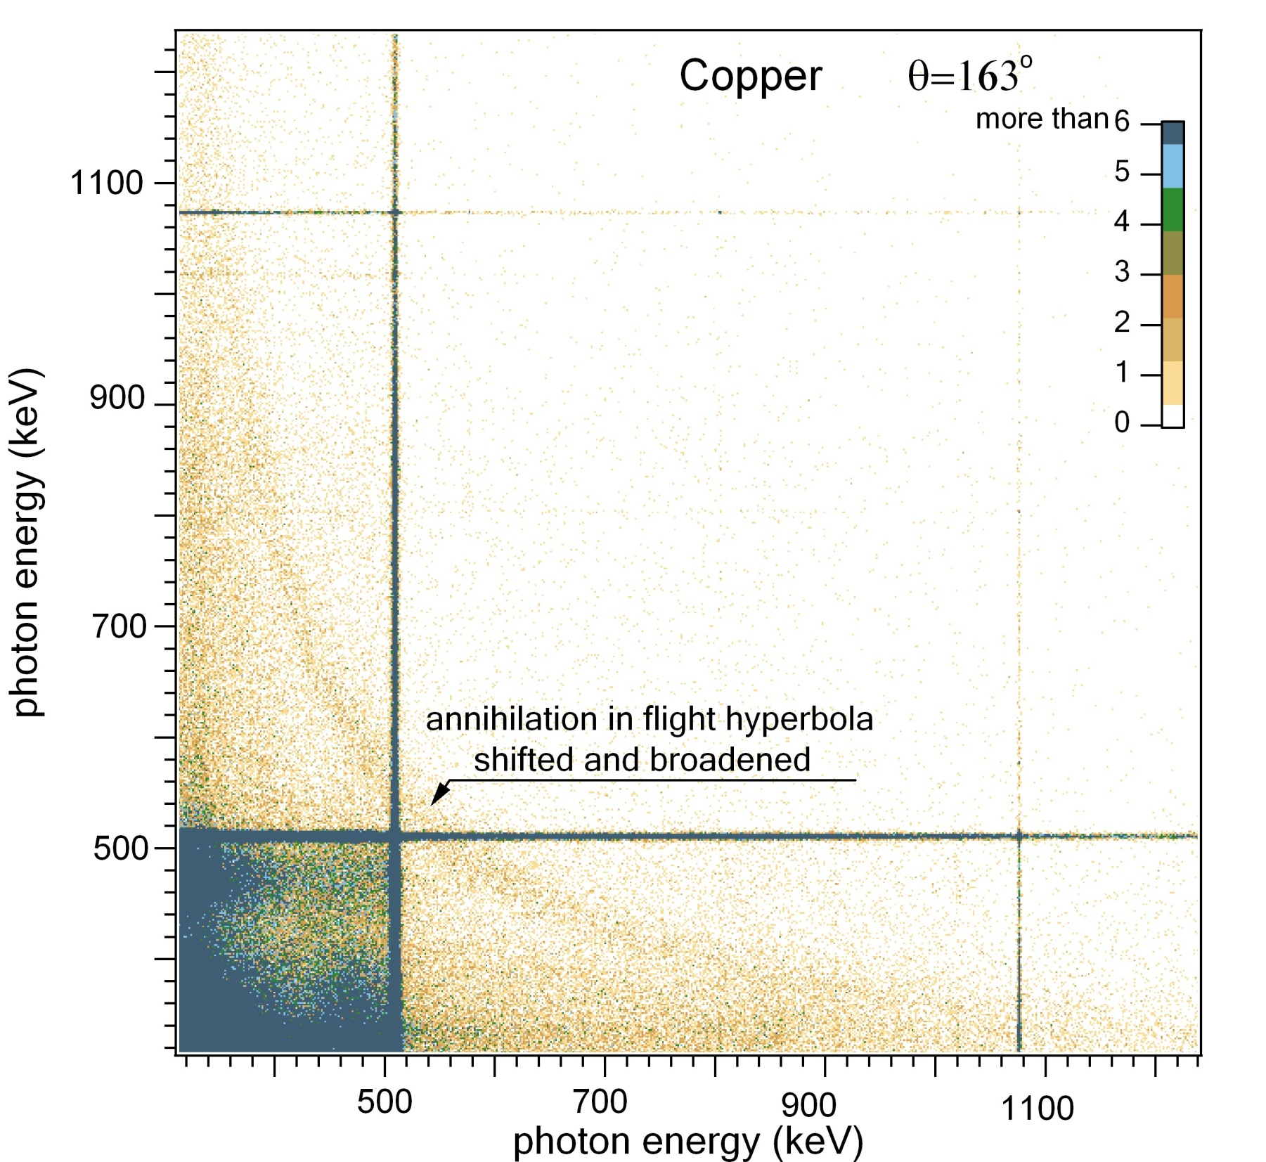

Slide 48
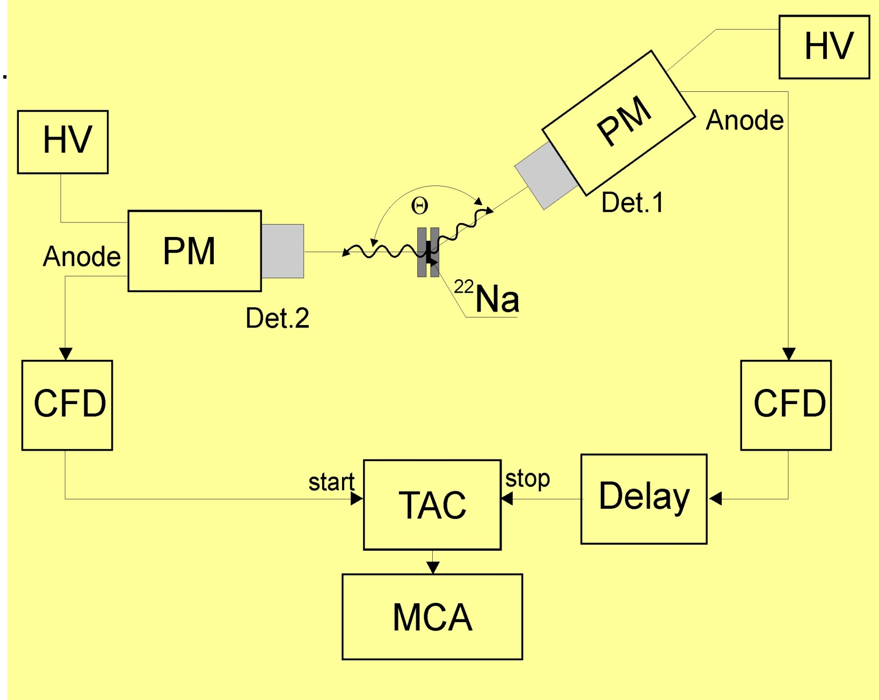
Second method for detection of AiF

Slide 49
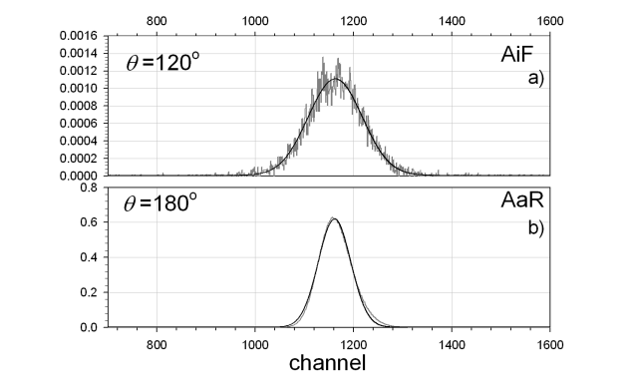
Prompt curves
The prompt peaks measured when the angle θ between the directions of emit-
ted photons is equal to 120◦ ; it corresponds to the AiF process and 180◦ i.e., when AaR process was detected. Both peaks were normalized to time of measurement. Solid black lines represent the Gaussian curve.

Slide 51
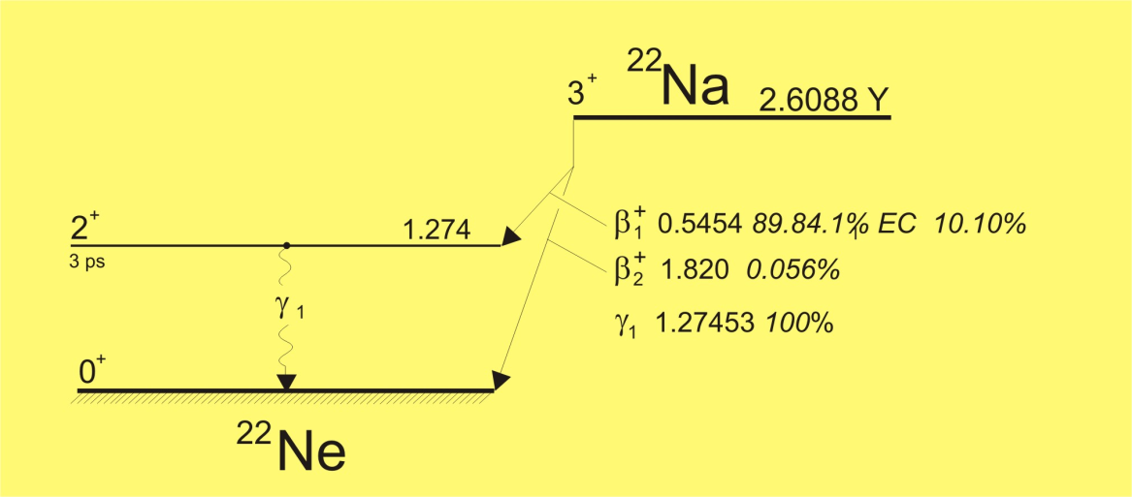
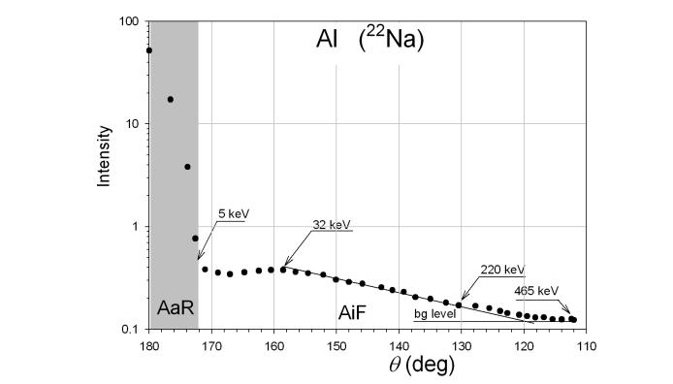
Intensity of prompt curves as the function of angle between two detectors

Slide 52
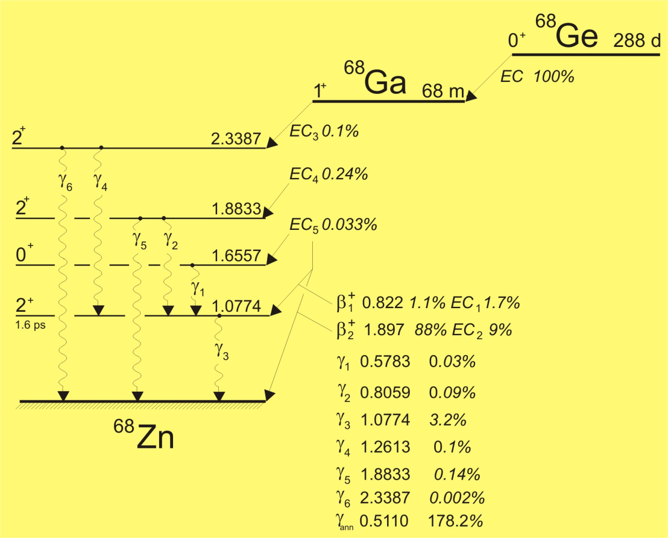
Intensity of prompt curves as the function of angle between two detectors

Slide 53
Intensity of prompt curves as the function of angle between two detectors

Slide 54
Intensity of prompt curves as the function of angle between two detectors

Slide 55
Intensity of prompt curves as the function of angle between two detectors

Slide 56
Fraction of positrons which annihilate in flight for two emitters (GEANT 4)
 | ²²Na | ⁶⁸Ge/ ⁶⁸Ge
C | 0.68% | 2.79%
Al | 0.75% | 3.48%
Cu | 0.82% | 3.24%
Cd | 0.89% | 3.42%
W | 0.93% | 3.60%
Au | 1.28% | 3.42%
Pb | 0.97% | 3.68%

Slide 57
Experimental values for fraction of AiF process for ⁶⁸Ge/⁶⁸Ga positrons

Slide 58
EGS 4 nrs simulation of the AiF process for ⁶⁸Ge/⁶⁸Ga positrons

Slide 59
Conclusions
- Variety of issues in physics, chemistry, medicin etc. can be studied using positron annihilation methods. Numerous experimental techniques have been established and new experimental techniques are developing as well.
Positron annihilation in flight process has been observed. It manifests itself as the hyperbola in the measured 2D histogram but also in the simpler experiments.
- The hyperbola results from the relativistic kinematics.

Slide 60

Thank you for your attention

