Slide 1
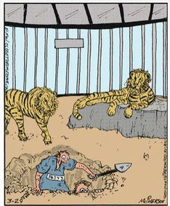
ELECTRON TUNNELING TIMES
N. G. Kelkar
Dept. de Física, Universidad de los Andes, Bogotá, Colombia
Tunneling and collision times
Tunneling electron measurements
Few early experiments
Attoclocks:
strong field ionization experiments
Tunneling times in
metal-insulator-metal junctions
Lou, we did it! Twelve years of tunneling but we are finally freee!!

Slide 2
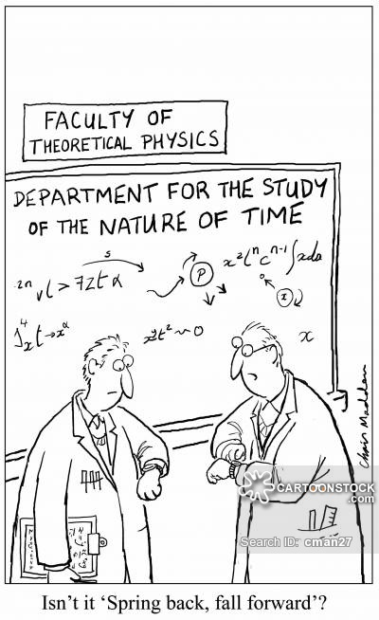
A brief history of tunneling time
1932 - 2017

Slide 3
How much time does a particle need to tunnel through a barrier?
In an attempt to the answer the question …

Slide 4



A RATHER SIMPLE DEFINITION
Dwell Time = Probability of finding the particle in a given region of space
_________________________________________________
Flux through the surface
Starting classically:
with
Among most definitions of dwell time, the current appears outside the integral

Slide 5






Dwell time in tunneling: M. Buettiker, Phys. Rev. B 27, 6178 (1983)
in collisions: F. Smith, Phys. Rev. 118, 349 (1960)
Back in 1938 – Kapur and Peierls, Proc. Of the Royal Society of London A 166, 277 (1938)
- a by product of the formalism for cross sections with resonances in nuclear reactions.
The partial wave
satisfies the equation
… (1)
For
V vanishes and
… (2)
The solution of this eq. can be written as,
At

Slide 6






For the case of no incident waves
Imposed as a boundary condition
This boundary condition is not consistent with Eq. (1), but rather is
consistent with
… (3)
where
is real but
is a complex energy eigenvalue
Multiplying (3) by the complex conjugate
and subtracting the
the complex conjugate of this equation

Slide 7



which on integration gives
With
typical pole of an unstable state
Kapur and Peierls did not identify this expression as a dwell time, but
simply as the width of a resonant level.
A similar derivation by Smith followed much later in 1960.

Slide 8
Phase time
E.P. Wigner, Phys. Rev. 98, 145 (1955)
Based on a wave packet approach was first introduced by Eisenbud and Wigner and
later taken over in the case of tunneling
(E. H. Hauge, and J. A. Støvneng, Rev. Mod. Phys. 61, 917 (1989))
Following the peak of the transmitted wave packet,
the tunneling process causes a spatial delay
Dividing by the group velocity, gives the temporal delay

Slide 9




E.P. Wigner, Phys. Rev. 98, 145 (1955)
A simple wave packet description of a collision implies a delay time of the magnitude
Simple picture: Wave packet with superposition of two frequencies:
The first term has a peak at
and the second one at
The interaction has delayed the radial wave packet by

Slide 10
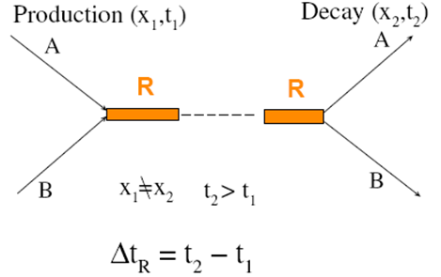
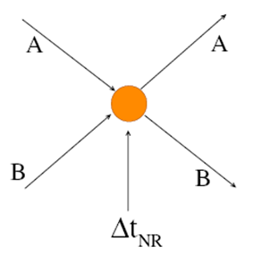
An intuitive picture …
Phase time delay is useful in identifying resonances in hadron and nuclear scattering.
Phase and dwell time are related!
In 1-dimension
H. G. Winful, Phys. Rev. Lett. 91, 260401 (2003)
The last term – self-interference term – due to overlap of the incident and the reflected waves in front of the barrier
In 3-D
N. G. Kelkar, Phys. Rev. Lett. 99, 210403 (2007)

Slide 11
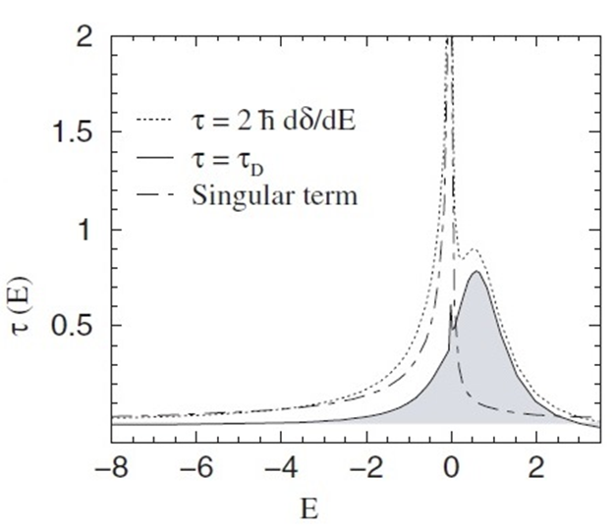
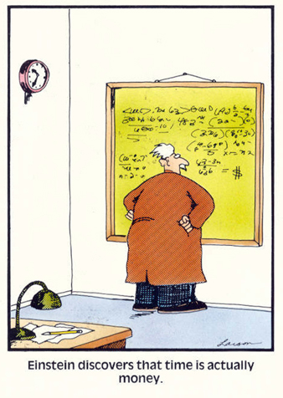
Dwell time delay displays the correct
behaviour of resonances near threshold

Slide 12
Larmor time - considering spin precession in a weak magnetic field -
Baz and Rybachenko gave the theoretical formalism
Larmor time can be rewritten in terms of dwell and phase times
A. J. Baz´, Sov. J. Nucl. Phys. 4, 182 (1967); 5, 161 (1967)
V. F. Rybachenko, Sov. J. Nucl. Phys. 5, 635 (1967)
M. Buettiker, Phys. Rev. B 27, 6178 (1983)
In the particular case of a rectangular barrier, dwell time

Slide 13
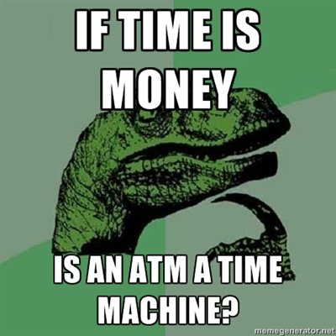

Slide 14
Extension of the Buettiker – Landauer time to arbitrary barriers was done by
Leavens and Aers. They gave expressions for the characteristic times in case
of frequently used potential barriers –
C. R. Leavens and G. C. Aers, Solid State Comm. 63, 1101 (1987).
Generalized Buettiker-Landauer time
Pollak-Miller time:
E. Pollak and W. H. Miller, Phys. Rev. Lett. 53, 115 (1984)

Slide 15
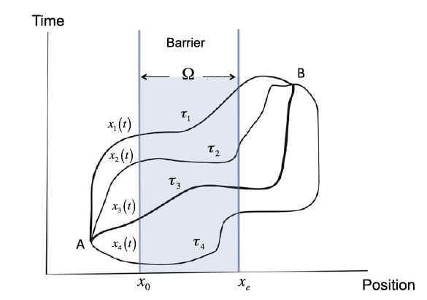
Feynman Path Integral Approach
Norifumi Yamada, Phys. Rev. Lett. 93, 170401 (2004)
The four tunneling times: the Larmor time, Buettiker Landauer time, Wigner’ s phase time and
Pollak-Miller time, originally derived from very different physical assumptions are derived in a
unified manner using Gell – Mann – Hartle decoherence functionals.
The total wave function is expressed as a sum over all possible “paths” with each path contributing a phase containing the action for that path.
Details and references can be found in
A. S. Landsman and U. Keller,
Phys. Rep. 547, 1 (2015).

Slide 16
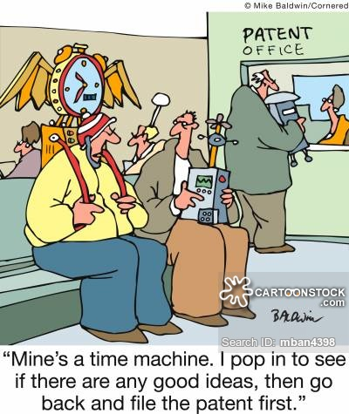
Tunneling Electron measurements
Solid state junctions, superconductors
and attoclocks

Slide 17
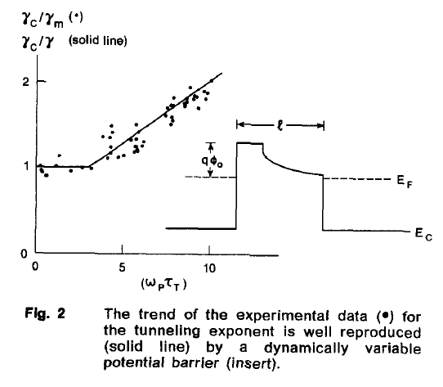



Early experiments:
P. Gueret, E. Marclay and H. Meier, Solid State Comm. 68, 977 (1988)
Tunneling through n-GaAs / Al_{x} Ga_{1-x} As / n-GaAs barriers was investigated
for various heights and widths (up to 100 nm) of the barriers. The general
form of the potential was inferred from data.

Slide 18
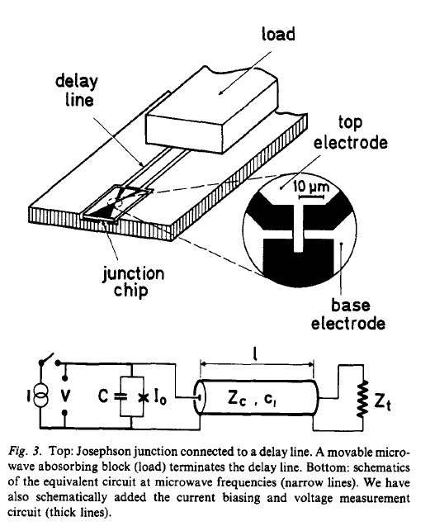
Quantum Tunneling in a Josephson junction
D. Esteve et al., Phys. Scrip. T 29, 121 (1989)
Josephson junction – Two layers of superconductor separated by a thin insulating barrier
The junction is connected in a circuit such that the superconducting phase difference between the two layers is coupled to the electromagnetic degrees of freedom of the circuit.
The authors studied the temperature dependence and damping effects of the environment on the tunneling junction.

Slide 19
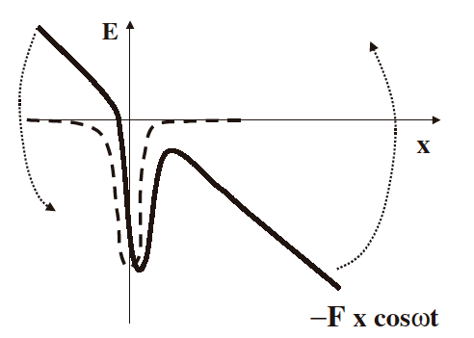
Attosecond Science: Strong field ionization
The finite (Coulomb) potential well is shaken (and bent) in every laser cycle creating
a barrier.
The barrier is oscillating up and down, opening the possibility for the electron to
tunnel out every half-cycle.

Slide 20
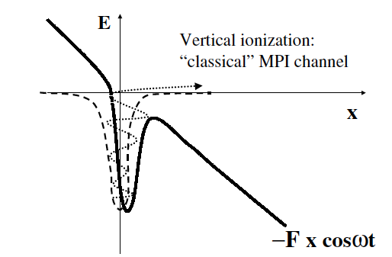
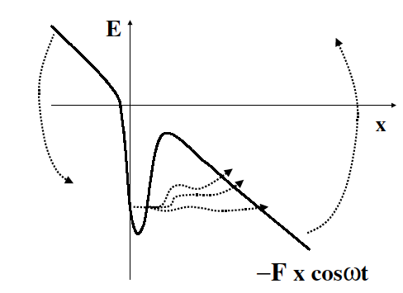
Electron can get “heated up” by the applied field and escape by multiphoton
ionization (so called “vertical ionization”)
OR
by tunneling ionization
M. Yu Ivanov, M. Spanner and O. Smirnova, J. Mod. Opt. 52, 165 (2005)

Slide 21
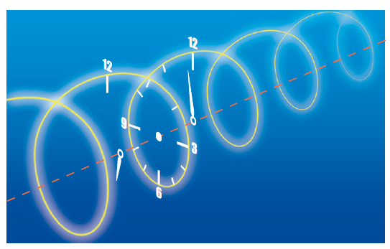
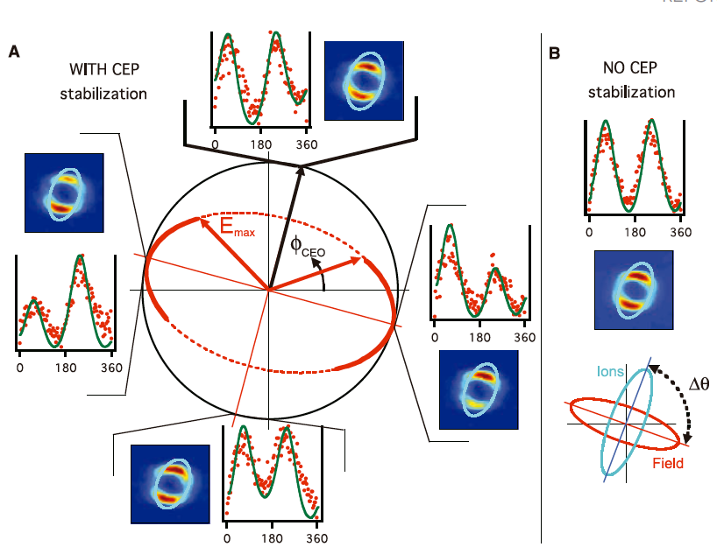
Attoclock
1 attosecond = 10⁻¹⁸ s
The rotating electric field vector of a close to circularly polarized light is used to deflect the ionized electrons (or ions) in the radial spatial direction. The moment of ionization is mapped to the final angle of the momentum vector in the polarization plane.
The “minute hand” of the clock runs over one 360 degree turn of the electric in a couple of femtoseconds (10⁻¹⁵ s).

Slide 22


Given the electric field of the laser pulse (close to circularly polarized with ellipticity ε)
The final momentum of the electron is given approximately as
First step: electron is liberated by tunneling - quantum mechanical process
Second step: electron moves in the joint field of the parent ion and laser
- classical trajectory
P. Eckle et al., Science 322, 1525 (2008)
A. N. Pfeiffer et al., Nat. Phys. 8, 76 (2012)
K. Ueda, K. L. Ishikawa, Nat. Phys. 7, 371 (2011)
A. N. Pfeiffer et al., Chem. Phys. 414, 84 (2013)

Slide 23
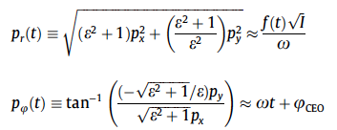
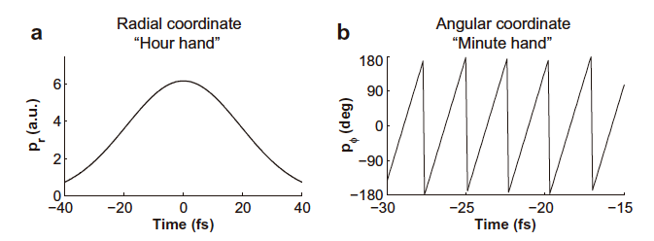
To calculate the moment when the electron is liberated from the ion – the moment of exiting the tunnel

Slide 24
A. N. Pfeiffer et al., Chem. Phys. 414, 84 (2013)
find that the time delay in tunneling zero for helium and argon atoms within
the experimental uncertainty of a few 10s of attoseconds.
P. Eckle et al., Science 322, 1525 (2008)
placed an intensity avergaed upper limit of 12 attoseconds on the tunneling
time delay in helium atoms.

Slide 25
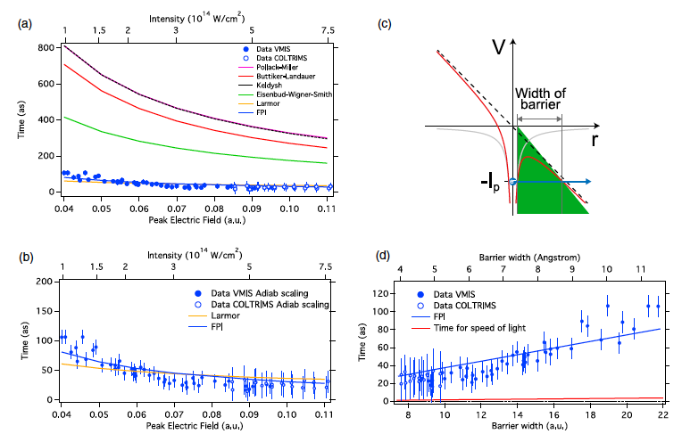
More recently: A. S. Landsman et al., Optica 1, 343 (2014)

Slide 26

TUNNELING IN
SOLID STATE JUNCTIONS

Slide 27
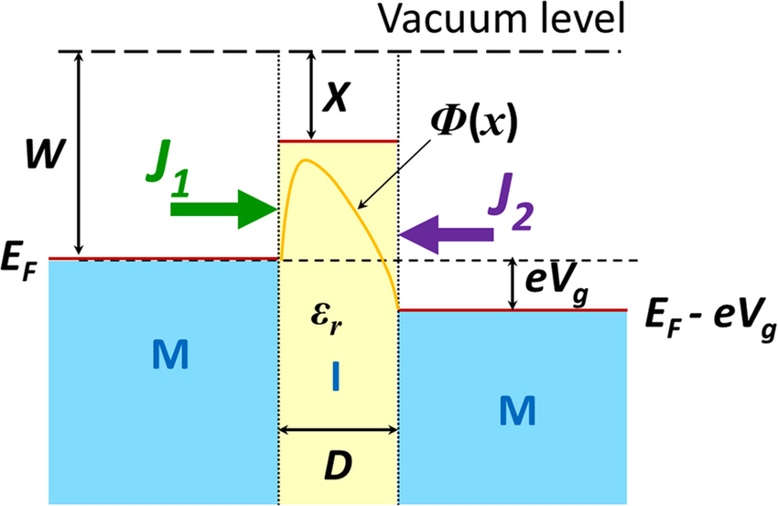
Metal – Insulator –Metal junction
The insulating layer in the tunnel junction forms a potential barrier between the electrodes.
The height of the barrier is the difference between the Fermi level of the metal electrode and the conduction band of the insulator.
Effective work function is lower than the work function of the metal with respect to the vacuum level, hence it requires less energy to excite electron from metal to the conduction band of an insulator than emit electron from metal to the vacuum.
Thickness of the insulator determines the thickness of the barrier.

Slide 28
Al – Al₂O₃ – Al junction was fabricated and current-voltaje
characteristics were measured at various temperatures ranging
from 3.5 to 300 K.
Edgar J. Patiño and N. G. Kelkar,
Applied Physics Letters 107, 253502
(2015)
The I-V characteristics are fitted with a rectangular barrier

Slide 29
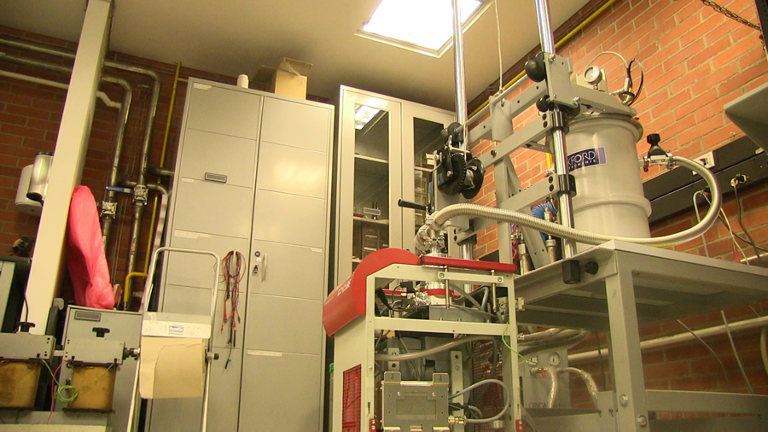
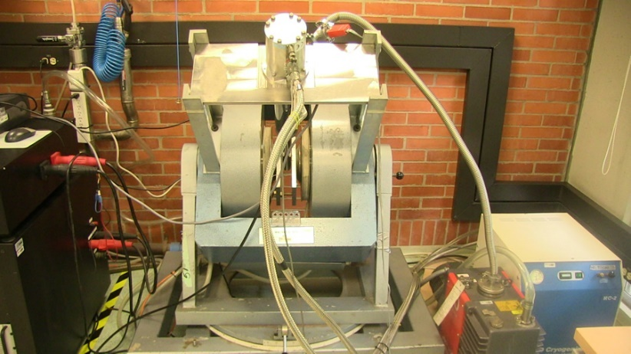
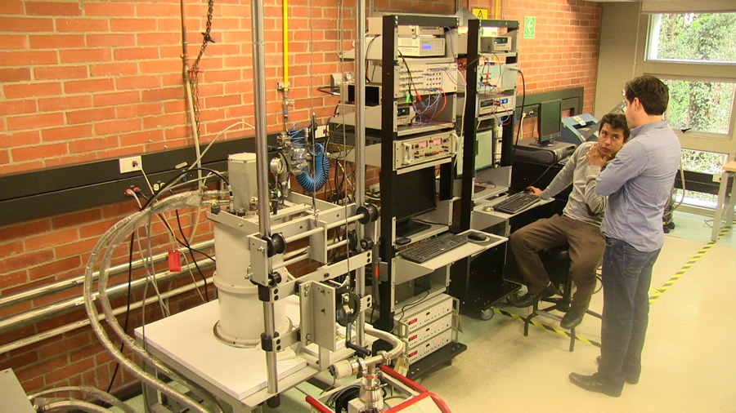
Superconductivity and
Nanodevices Laboratory
at the Universidad de los Andes

Slide 31
An indirect measurement of tunneling
time from a rather simple tunneling
experiment!
The dwell time is 360 as at mid-barrier energies.
Barrier width 20 Å
Temperature dependent characteristics have implications.

Slide 32
Dissipative effects in tunneling
Damping force:

Slide 35
“Time in dissipative tunneling:Subtleties and Applications”,
N. G. Kelkar, D. Lozano Gómez and Edgar J. Patiño, Ann. Phys. 382, 11 (2017)

Slide 36

THANK YOU FOR LISTENING!

