Slide 1
Prompt Gamma Imaging in Hadron Therapy
Jagiellonian Symposium of Fundamental and Applied Subatomic
Physics, 04.-9.6.2017, Krakow, Poland
Fine Fiedler
Institute of Radiation Physics
Helmholtz-Zentrum Dresden-Rossendorf
Nuclear methods for range measurements in hadron therapy

Slide 2
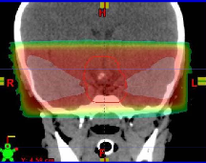
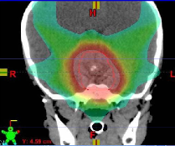
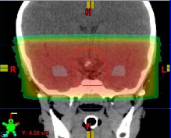
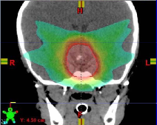
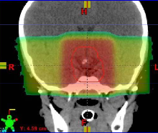
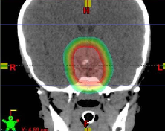
History of External Radiotherapy
Opp 6X
~1980
3D C
~1995
Opp 15X
~1985
IMRT
~2005
3-Field
~1990
Protons
~2009
Courtesy of N Mendenhall, D Louis, D Yeung, Z Li, C Li, Jacksonville, FL

Slide 3
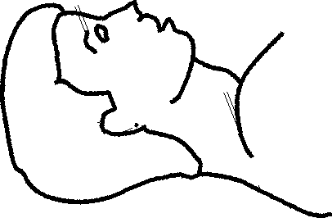
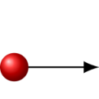
Ion beam

Slide 4
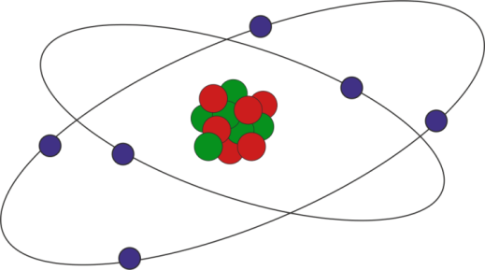
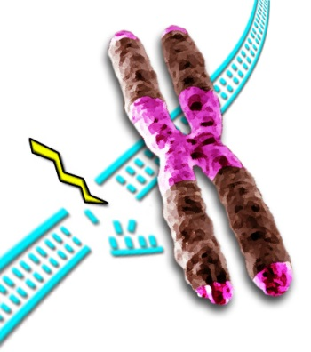
Ion beam
Interaction with electrons of tissue
Nuclear reactions with tissue atoms
Courtesy of P. Preuss, LBL

Slide 5
Ion beam
Interaction with electrons of tissue
Nuclear reactions with tissue atoms

Slide 6
Ion beam
Interaction with electrons of tissue
Nuclear reactions with tissue atoms

Slide 7
Ion therapy – Basic interaction between ions and tissue
Interaction vertex imaging
Prompt Gamma Imaging
Positron Emission Tomography
Henriquet et al. 2012
Nuclear reaction → Emission of secondaries and γ-rays
Radioactive nucleus
Residual nucleus
Ion beam
Secondaries
Nucleus
β⁺
Prompt γ-rays
E < 10 … 15 MeV
e⁻
511 keV γ-rays

Slide 8
Ion therapy – Basic interaction between ions and tissue
Interaction vertex imaging
Prompt Gamma Imaging
Positron Emission Tomography
Nuclear reaction → Emission of secondaries and γ-rays
Radioactive nucleus
Residual nucleus
Ion beam
Secondaries
Nucleus
β⁺
Prompt γ-rays
E < 10 … 15 MeV
e⁻
511 keV γ-rays
MRI – Analysis of radiation effects on tissue
Ionoacoustics – Ultrasound pressure waves
…

Slide 9
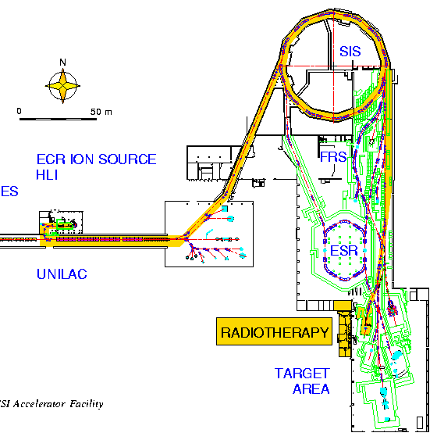

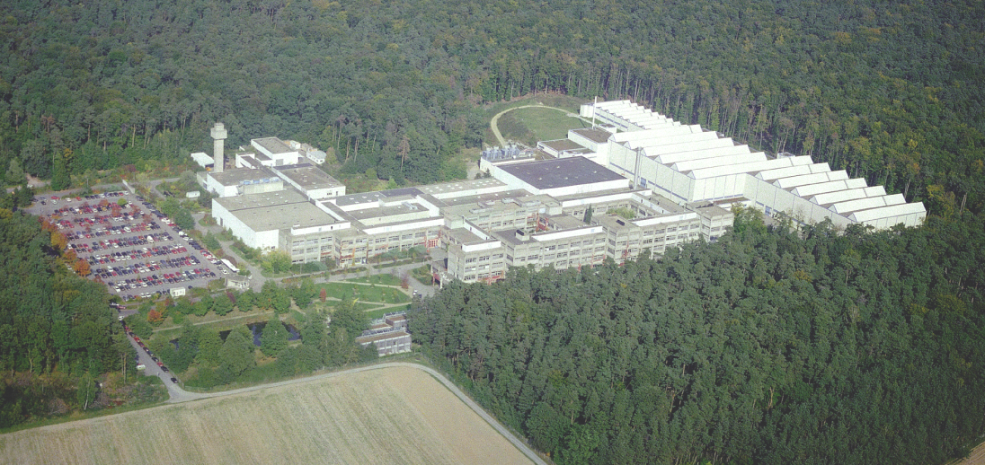
Positron Emission Tomography
Imaging for hadron therapy quality assurance: HZDR @ GSI
German Heavy Ion Tumor Therapy Project
Heavy ion
synchrotron
β⁺
e⁻
511 keV γ-rays
Ion source
Method was proposed at LBNL
Tobias et al. 1977, Llacer 1988
Ablenk-
magnet
Linear accelerator
Schardt et al., Rev. Mod. Phys. 82(2010) 383

Slide 10
Positron Emission Tomography
Imaging for hadron therapy quality assurance: HZDR @ GSI
German Heavy Ion Tumor Therapy Project
Heavy ion
synchrotron
β⁺
e⁻
511 keV γ-rays
Ion source
Method was proposed at LBNL
Tobias et al. 1977, Llacer 1988
Ablenk-
magnet
Linear accelerator
1997 – 2008:
Monitoring of the treatment of more than 440 patients irradiated with ¹²C-beams
Mostly head & neck
Schardt et al., Rev. Mod. Phys. 82(2010) 383

Slide 11
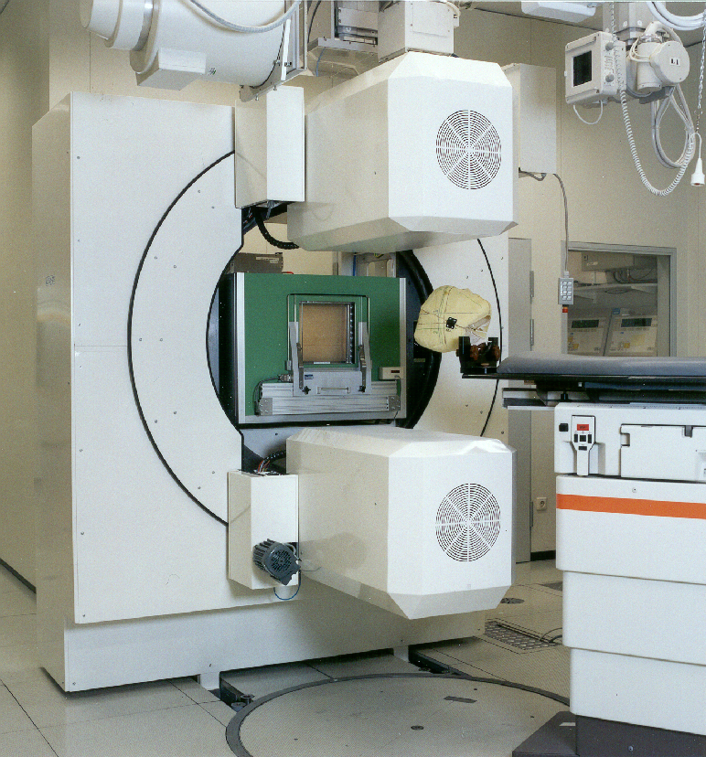
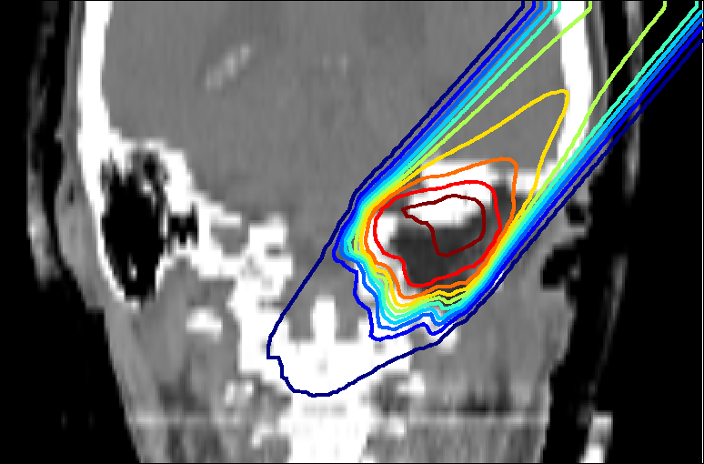
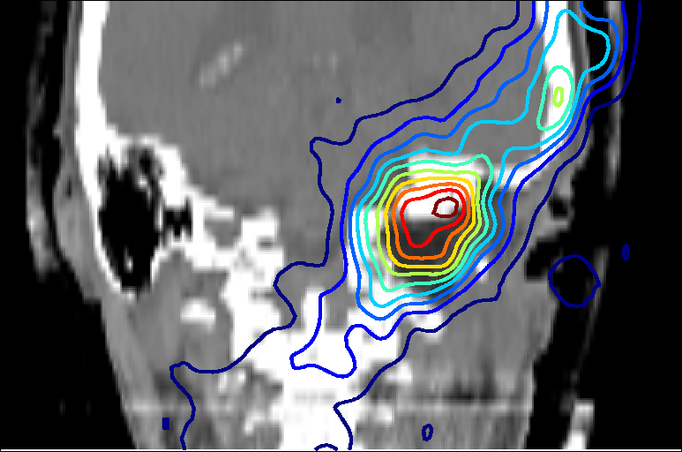
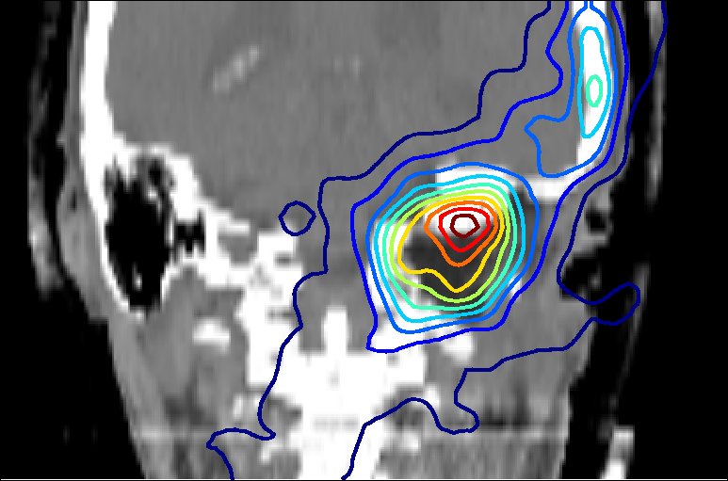
Positron Emission Tomography
Imaging for hadron therapy quality assurance: HZDR @ GSI
Dose distribution
γ
Simulation
Tomographic
Reconstruction
Prediction Measurement
W. Enghardt et al., Nucl. Instr. Meth. A 525(2004) 284
F. Pönisch et al., PMB, 49(2004) 5217

Slide 12
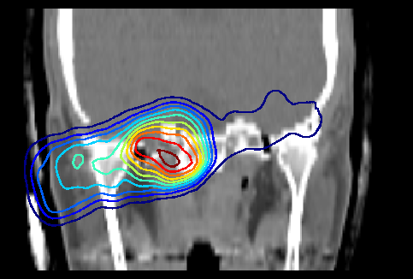
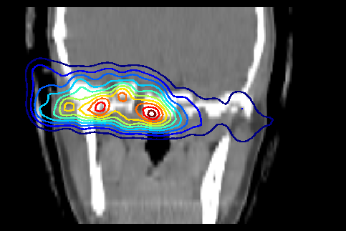
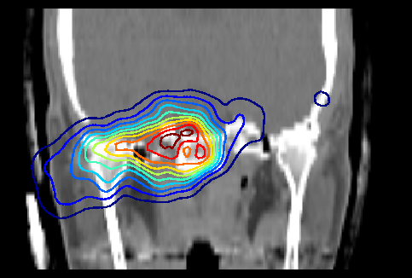
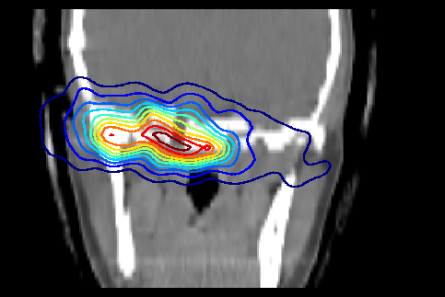
PT- PET – Clinical results
Positron Emission Tomography
1998
Since 1999
Prediction
2,5
Table 08/98
Prediction
2
Table 08/99
1,5
Rel. water equiv. path
1
0,5
0
-1000
0
1000
2000
3000
Hounsfield
unit
Measurement
Measurement
Soft tissue
Validation of the physical beam model and the treatment planning software
E. Rietzel et al. Radiat Oncol 2(2007)14, M. Krämer et al.: Radiother. Oncol. 73(2004) S80

Slide 13
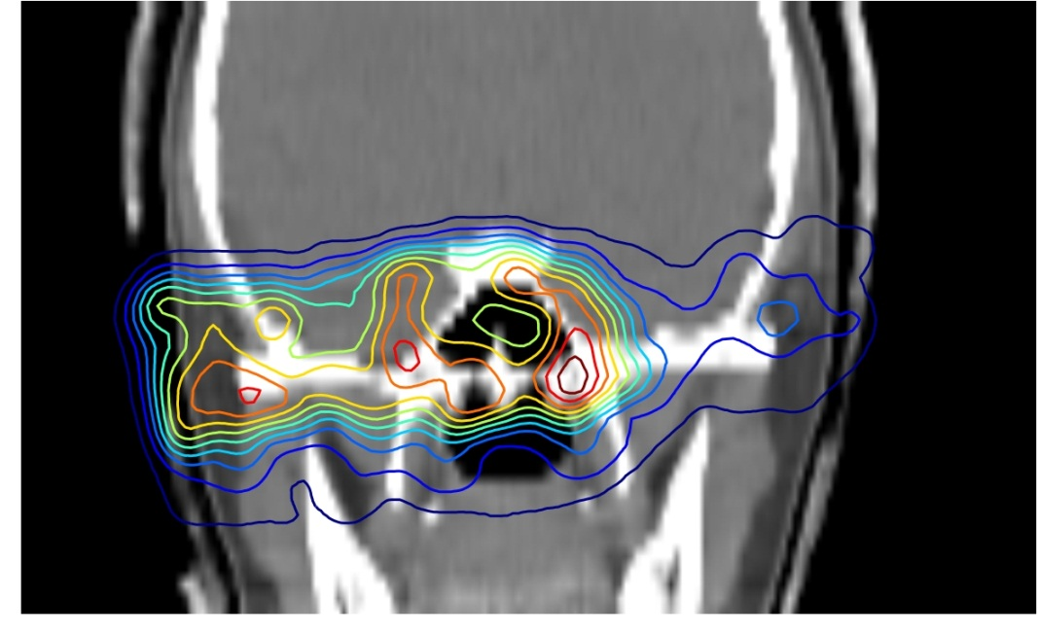
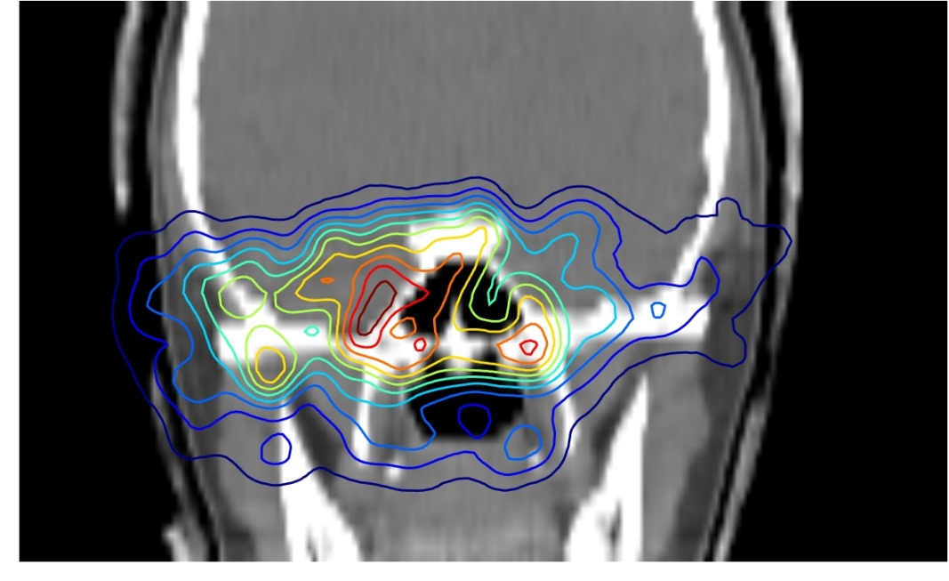
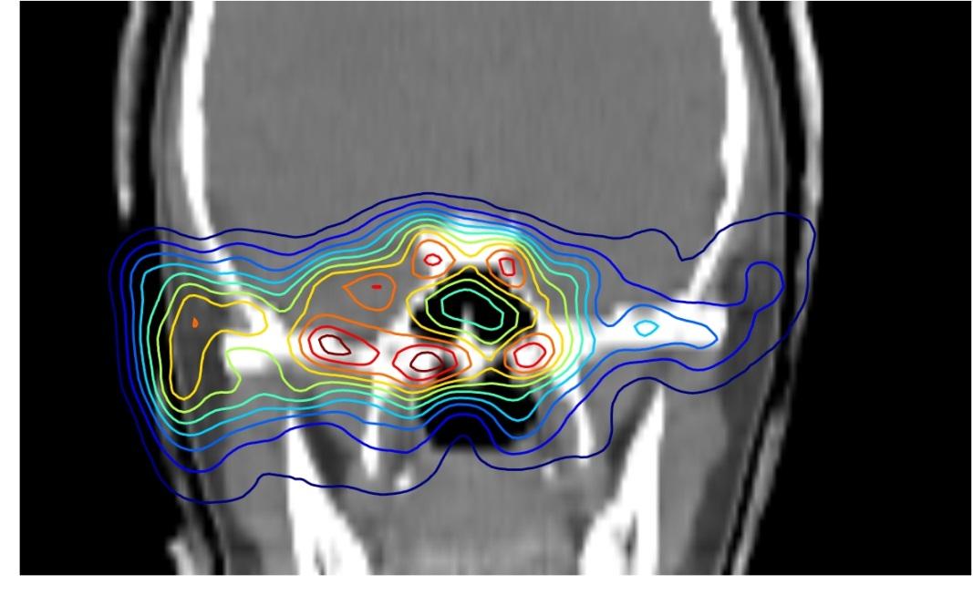
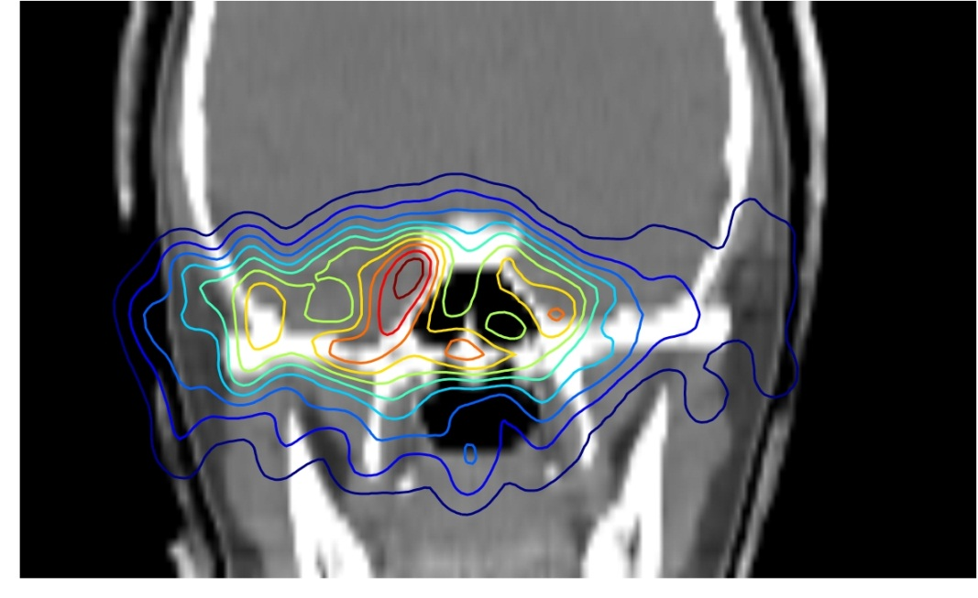
PT- PET – Clinical results
Positron Emission Tomography
Overdosage in
the normal tissue
Beam direction
Underdosage
in the tumor
Prediction
Measurement
Filling of cavity
Reduced range
Prediction
3 days later, after medicaments
prescribtion
Measurement

Slide 14

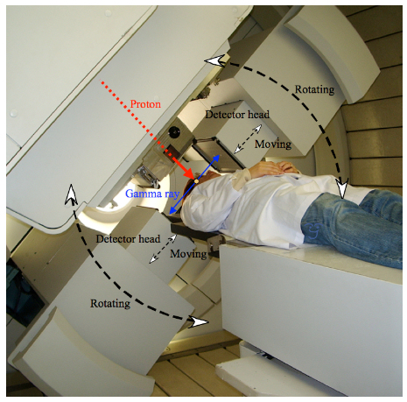
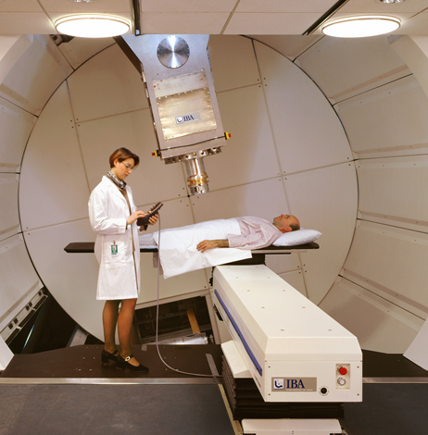
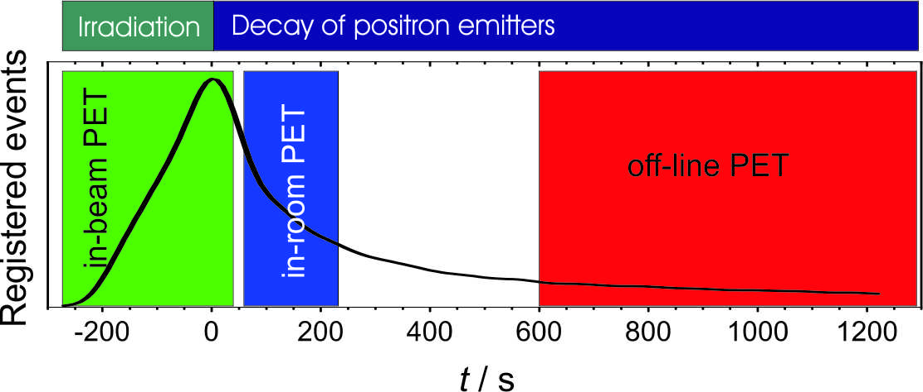
PT- PET – Particle Therapy Positron Emission Tomography
Positron Emission Tomography
Measurement during irradiation
Measurement shortly after the irradiation
Measurement some time after irradiation
W. Enghardt et al.: Nucl. Instr. Meth. A 525 (2004) 284
T. Nishio et al.: Med. Phys. 33 (2006) 4190
K. Parodi et al.: Int. J. Radiat. Oncol. Biol. Phys. 68 (2007) 920
Influence of metabolism increases, count rate decreases

Slide 15
Particle Therapy Positron Emission Tomography
→ is the only nuclear based method for range verification with large expertise
→ Technology is available from the shelf
Issues: Complex simulation of β⁺-activity required
Reliable and fast prediction of β⁺-activity distribution from treatment plan
Priegnitz et al., IEEE Trans. Nucl. Sci. (2012)
Priegnitz et al., Phys. Med. Biol. 53(2008) 4443
Helmbrecht et al., IEEE Trans. Nucl. Sci. 63 (2016) 612016) 61
Time consuming evaluation requires experts
Semiautomatic evaluation of the activity distribution
Fiedler et al., Phys. Med. Biol. 55 (2010) 1989
Helmbrecht et al., Phys. Med. Biol. 57 (2012) 1387
Helmbrecht et al., Z. Med. Phys. 25 (2015) 146. Phys. 25 (2015), 146
Irradiation of non-static tumors
Intrafractional moving targets
Laube et al., Phys. Med. Biol. 58 (2013) 513
Stützer et al., Phys. Med. Biol. 58 (2013) 5085
Tian et al., Phys. Med. Biol. 61 (2016) N20ys. Med. Biol. 61 (2016) N20
Metabolism
Assessment of the washout
Helmbrecht et al., Med. Phys. 40 (2013) 091918
In-beam only proven @ synchrotron
Application to cw beams
Helmbrecht et al., Z. Med. Phys. (2017)
Positron Emission Tomography

Slide 16
Particle Therapy Positron Emission Tomography
→ is the only nuclear based method for range verification with large expertise
→ Technology is available from the shelf
Issues: Complex simulation of β⁺-activity required
Reliable and fast prediction of β⁺-activity distribution from treatment plan
Priegnitz et al., IEEE Trans. Nucl. Sci. (2012)
Priegnitz et al., Phys. Med. Biol. 53(2008) 4443
Helmbrecht et al., IEEE Trans. Nucl. Sci. 63 (2016) 612016) 61
Time consuming evaluation requires experts
Semiautomatic evaluation of the activity distribution
Fiedler et al., Phys. Med. Biol. 55 (2010) 1989
Helmbrecht et al., Phys. Med. Biol. 57 (2012) 1387
Helmbrecht et al., Z. Med. Phys. 25 (2015) 146. Phys. 25 (2015), 146
Irradiation of non-static tumors
Intrafractional moving targets
Laube et al., Phys. Med. Biol. 58 (2013) 513
Stützer et al., Phys. Med. Biol. 58 (2013) 5085
Tian et al., Phys. Med. Biol. 61 (2016) N20ys. Med. Biol. 61 (2016) N20
Metabolism
Assessment of the washout
Helmbrecht et al., Med. Phys. 40 (2013) 091918
In-beam only proven @ synchrotron
Application to cw beams
Helmbrecht et al., Z. Med. Phys. (2017)
Positron Emission Tomography

Slide 17

Particle Therapy Positron Emission Tomography
→ is the only nuclear based method for range verification with large expertise
→ Technology is available from the shelf
Issues: Complex simulation of β⁺-activity required
Reliable and fast prediction of β⁺-activity distribution from treatment plan
Priegnitz et al., IEEE Trans. Nucl. Sci. (2012)
Priegnitz et al., Phys. Med. Biol. 53(2008) 4443
Helmbrecht et al., IEEE Trans. Nucl. Sci. 63 (2016) 612016) 61
Time consuming evaluation requires experts
Semiautomatic evaluation of the activity distribution
Fiedler et al., Phys. Med. Biol. 55 (2010) 1989
Helmbrecht et al., Phys. Med. Biol. 57 (2012) 1387
Helmbrecht et al., Z. Med. Phys. 25 (2015) 146. Phys. 25 (2015), 146
Irradiation of non-static tumors
Intrafractional moving targets
Laube et al., Phys. Med. Biol. 58 (2013) 513
Stützer et al., Phys. Med. Biol. 58 (2013) 5085
Tian et al., Phys. Med. Biol. 61 (2016) N20ys. Med. Biol. 61 (2016) N20
Metabolism
Assessment of the washout
Helmbrecht et al., Med. Phys. 40 (2013) 091918
In-beam only proven @ synchrotron
Application to cw beams
Helmbrecht et al., Z. Med. Phys. (2017)
Positron Emission Tomography

Slide 18
Particle Therapy Positron Emission Tomography
→ is the only nuclear based method for range verification with large expertise
→ Technology is available from the shelf
Issues: Complex simulation of β⁺-activity required
Reliable and fast prediction of β⁺-activity distribution from treatment plan
Priegnitz et al., IEEE Trans. Nucl. Sci. (2012)
Priegnitz et al., Phys. Med. Biol. 53(2008) 4443
Helmbrecht et al., IEEE Trans. Nucl. Sci. 63 (2016) 612016) 61
Time consuming evaluation requires experts
Semiautomatic evaluation of the activity distribution
Fiedler et al., Phys. Med. Biol. 55 (2010) 1989
Helmbrecht et al., Phys. Med. Biol. 57 (2012) 1387
Helmbrecht et al., Z. Med. Phys. 25 (2015) 146. Phys. 25 (2015), 146
Irradiation of non-static tumors
Intrafractional moving targets
Laube et al., Phys. Med. Biol. 58 (2013) 513
Stützer et al., Phys. Med. Biol. 58 (2013) 5085
Tian et al., Phys. Med. Biol. 61 (2016) N20ys. Med. Biol. 61 (2016) N20
Metabolism
Assessment of the washout
Helmbrecht et al., Med. Phys. 40 (2013) 091918
In-beam only proven @ synchrotron
Application to cw beams
Helmbrecht et al., Z. Med. Phys. (2017)
Positron Emission Tomography

Slide 19
Particle Therapy Positron Emission Tomography
→ is the only nuclear based method for range verification with large expertise
→ Technology is available from the shelf
Issues: Complex simulation of β⁺-activity required
Reliable and fast prediction of β⁺-activity distribution from treatment plan
Priegnitz et al., IEEE Trans. Nucl. Sci. (2012)
Priegnitz et al., Phys. Med. Biol. 53(2008) 4443
Helmbrecht et al., IEEE Trans. Nucl. Sci. 63 (2016) 612016) 61
Time consuming evaluation requires experts
Semiautomatic evaluation of the activity distribution
Fiedler et al., Phys. Med. Biol. 55 (2010) 1989
Helmbrecht et al., Phys. Med. Biol. 57 (2012) 1387
Helmbrecht et al., Z. Med. Phys. 25 (2015) 146. Phys. 25 (2015), 146
Irradiation of non-static tumors
Intrafractional moving targets
Laube et al., Phys. Med. Biol. 58 (2013) 513
Stützer et al., Phys. Med. Biol. 58 (2013) 5085
Tian et al., Phys. Med. Biol. 61 (2016) N20ys Med. Biol. 61 (2016) N20ys. Med. Biol. 61 (2016) N20
Metabolism
Assessment of the washout
Helmbrecht et al., Med. Phys. 40 (2013) 091918
In-beam only proven @ synchrotron
Application to cw beams
Helmbrecht et al., Z. Med. Phys. (2017)
Positron Emission Tomography

Slide 20
Particle Therapy Positron Emission Tomography
→ is the only nuclear based method for range verification with large expertise
→ Technology is available from the shelf
Issues: Complex simulation of β⁺-activity required
Reliable and fast prediction of β⁺-activity distribution from treatment plan
Priegnitz et al., IEEE Trans. Nucl. Sci. (2012)
Priegnitz et al., Phys. Med. Biol. 53(2008) 4443
Helmbrecht et al., IEEE Trans. Nucl. Sci. 63 (2016) 612016) 61
Time consuming evaluation requires experts
Semiautomatic evaluation of the activity distribution
Fiedler et al., Phys. Med. Biol. 55 (2010) 1989
Helmbrecht et al., Phys. Med. Biol. 57 (2012) 1387
Helmbrecht et al., Z. Med. Phys. 25 (2015) 146. Phys. 25 (2015), 146
Irradiation of non-static tumors
Intrafractional moving targets
Laube et al., Phys. Med. Biol. 58 (2013) 513
Stützer et al., Phys. Med. Biol. 58 (2013) 5085
Tian et al., Phys. Med. Biol. 61 (2016) N20Med. Biol. 61 (2016) N20ys. Med. Biol. 61 (2016) N20
Metabolism
Assessment of the washout
Helmbrecht et al., Med. Phys. 40 (2013) 091918 , Med. Phys. 40 (2013) 091918
In-beam only proven @ synchrotron
Application to cw beams
Helmbrecht et al., Z. Med. Phys. (2017)
Positron Emission Tomography

Slide 21
Particle Therapy Positron Emission Tomography
→ is the only nuclear based method for range verification with large expertise
→ Technology is available from the shelf
Issues: Complex simulation of β⁺-activity required
Reliable and fast prediction of β⁺-activity distribution from treatment plan
Priegnitz et al., IEEE Trans. Nucl. Sci. (2012)
Priegnitz et al., Phys. Med. Biol. 53(2008) 4443
Helmbrecht et al., IEEE Trans. Nucl. Sci. 63 (2016) 612016) 61
Time consuming evaluation requires experts
Semiautomatic evaluation of the activity distribution
Fiedler et al., Phys. Med. Biol. 55 (2010) 1989
Helmbrecht et al., Phys. Med. Biol. 57 (2012) 1387
Helmbrecht et al., Z. Med. Phys. 25 (2015) 146. Phys. 25 (2015), 146
Irradiation of non-static tumors
Intrafractional moving targets
Laube et al., Phys. Med. Biol. 58 (2013) 513
Stützer et al., Phys. Med. Biol. 58 (2013) 5085
Tian et al., Phys. Med. Biol. 61 (2016) N20Med. Biol. 61 (2016) N20ys. Med. Biol. 61 (2016) N20
Metabolism
Assessment of the washout
Helmbrecht et al., Med. Phys. 40 (2013) 091918 , Med. Phys. 40 (2013) 091918
In-beam only proven @ synchrotron
Application to cw beams
Helmbrecht et al., Z. Med. Phys. (2017)
Positron Emission Tomography

Slide 22
Ion therapy – Basic interaction between ions and tissue
Interaction vertex imaging
Prompt Gamma Imaging
Positron Emission Tomography
Nuclear reaction → Emission of secondaries and γ-rays
Radioactive nucleus
Residual nucleus
Ion beam
Secondaries
Nucleus
β⁺
Prompt γ-rays
E < 10 … 15 MeV
e⁻
511 keV γ-rays

Slide 23
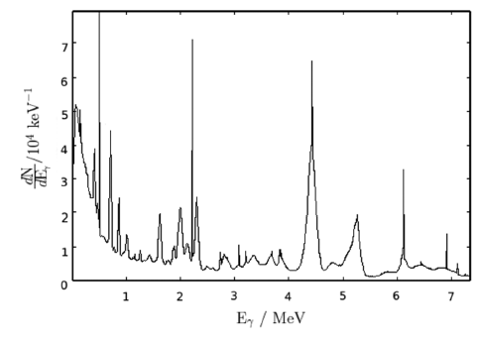
Ion therapy – Basic interaction between ions and tissue
Interaction vertex imaging
Prompt Gamma Imaging
Positron Emission Tomography
Nuclear reaction → Emission of secondaries and γ-rays
Radioactive nucleus
Residual nucleus
Ion beam
Secondaries
H. Rohling et al. Phys. Med. Biol. 62 (2017) 2795
Nucleus
β⁺
→ Talk of Denis Dauvergne
Prompt γ-rays
E < 10 … 15 MeV
e⁻
511 keV γ-rays

Slide 24
Prompt Gamma Imaging
Energy • Time • Space
Prompt γ-ray range verification
Energy: Prompt Gamma Spectroscopy – Verburg et al. 2014
Measure: Energy spectrum
→ depends on penetration depth and tissue composition
Requires: High-resolution detectors and collimator
Time: Prompt Gamma Timing – Golnik et al. 2014
Measure: Emission time of γ-rays
→ Emission time is a measure for proton transit time
Requires: Timing detectors
Space: Prompt Gamma Imaging

Slide 25

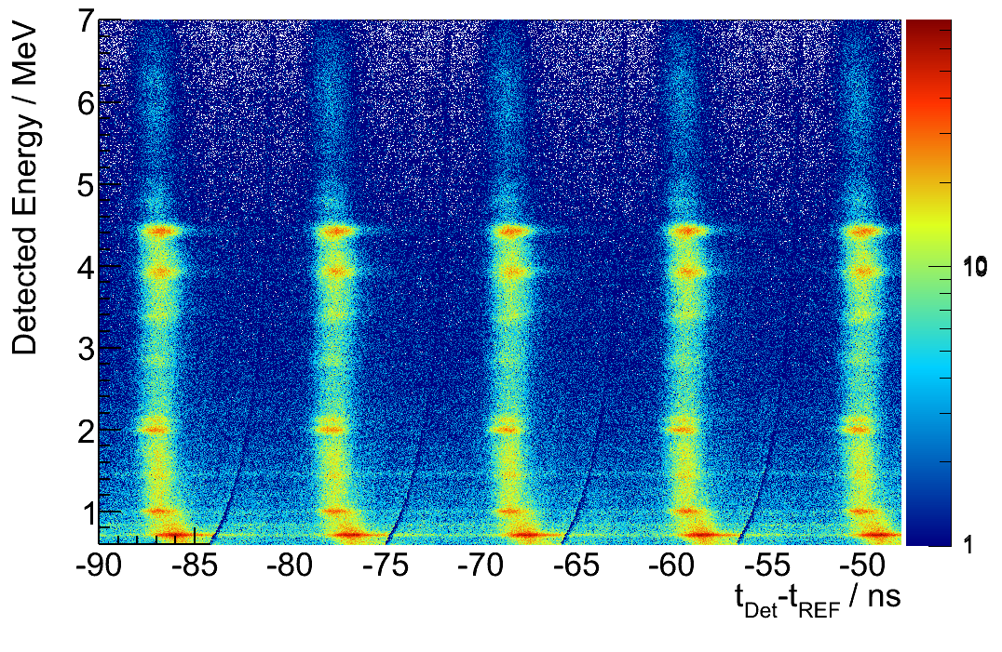
Prompt γ-ray timing
Prompt Gamma Imaging
Energy • Time • Space
γ-rays
Proton beam
n
C. Golnik, Phys. Med. Biol. 59 (2014) 5399–5422
Range
Time

Slide 26
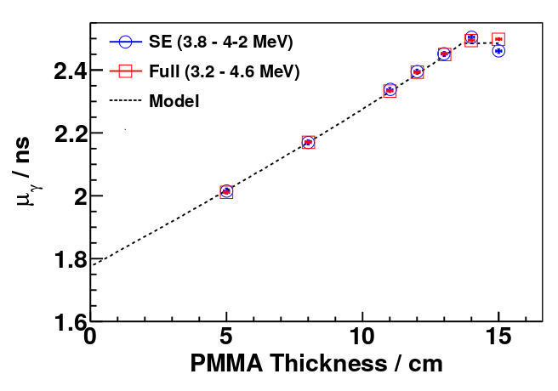
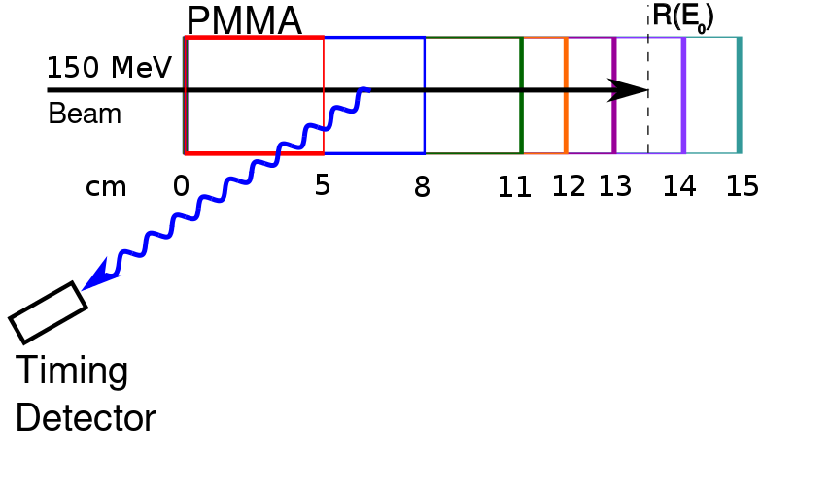


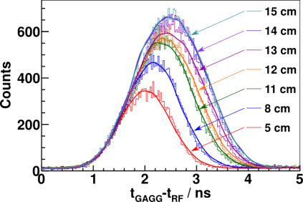
Prompt γ-ray timing
Prompt Gamma Imaging
Energy • Time • Space
PGT Mean
Target thickness ↑
Proton transit time ↑
Later (on average) prompt gamma-ray emission
PGT Mean µ ↑ and Std. Dev. (RMS) σ ↑
µ and σ are sensitive to range variations even if the system time resolution is poor
C. Golnik, Phys. Med. Biol. 59 (2014) 5399–5422

Slide 27
Prompt γ-ray timing
Prompt Gamma Imaging
Energy • Time • Space
Simple Setup
Single standard gamma-ray scintillation detector (LaBr₃, GAGG, LSO) on photomultiplier tube
Reasonable time and energy resolution
No passive or electronic collimation
PGT Mean
Measurement process:
Uncertainties typically lead to convolution of the measured profile
Spectral shape lost under convolution
Spectral momenta (mean, std. deviation) still sensitive to range variation
Target thickness ↑
Proton transit time ↑
Later (on average) prompt gamma-ray emission
PGT Mean µ ↑ and Std. Dev. (RMS) σ ↑
µ and σ are sensitive to range variations even if the system time resolution is poor
C. Golnik, Phys. Med. Biol. 59 (2014) 5399–5422

Slide 28
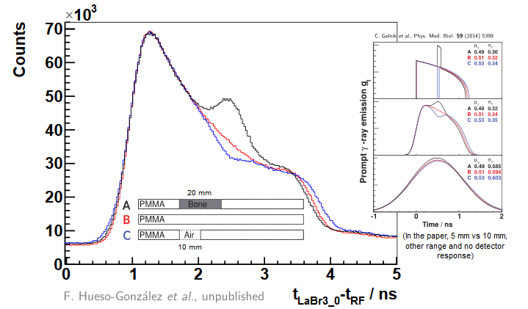
Prompt γ-ray timing – inhomogeneous targets
Prompt Gamma Imaging
Energy • Time • Space
0.1 ns
0.5 ns
Hueso-González et al. Phys. Med. Biol. 60 (2015) 6247

Slide 29
Prompt Gamma Imaging
Energy • Time • Space
Prompt γ-ray range verification
Energy: Prompt Gamma Spectroscopy – Verburg et al. 2014
Measure: Energy spectrum
→ depends on penetration depth and tissue composition
Requires: High-resolution detectors and collimator
Time: Prompt Gamma Timing – Golnik et al. 2014
Measure: Emission time of γ-rays
→ Emission time is a measure for proton transit time
Requires: Timing detectors
Space: Prompt Gamma Imaging

Slide 30
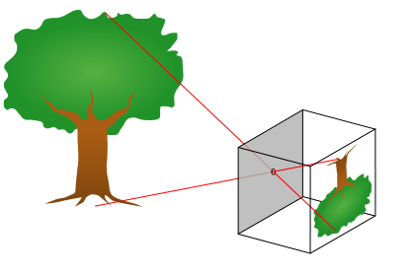
Prompt Gamma Imaging
Energy • Time • Space
Wikipedia.org
Collimation required → active or passive

Slide 31
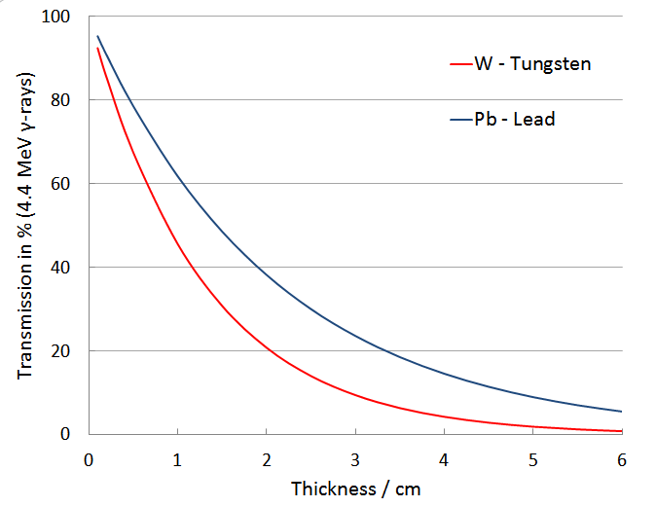
Prompt Gamma Imaging
Energy • Time • Space
Passive collimation
Proton beam
n
R (x)

Slide 32
Prompt Gamma Imaging
Energy • Time • Space
Passive collimation
Proton beam
Neutrons
Neutrons
n
R (x)

Slide 33
Prompt Gamma Imaging
Energy • Time • Space
Passive collimation
Proton beam
Neutrons
Neutrons
n
Background
R (x)

Slide 34
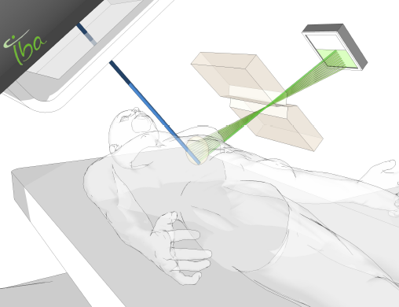

Detector systems for prompt γ-rays
Prompt Gamma Imaging
Energy • Time • Space
Slit camera

Slide 35
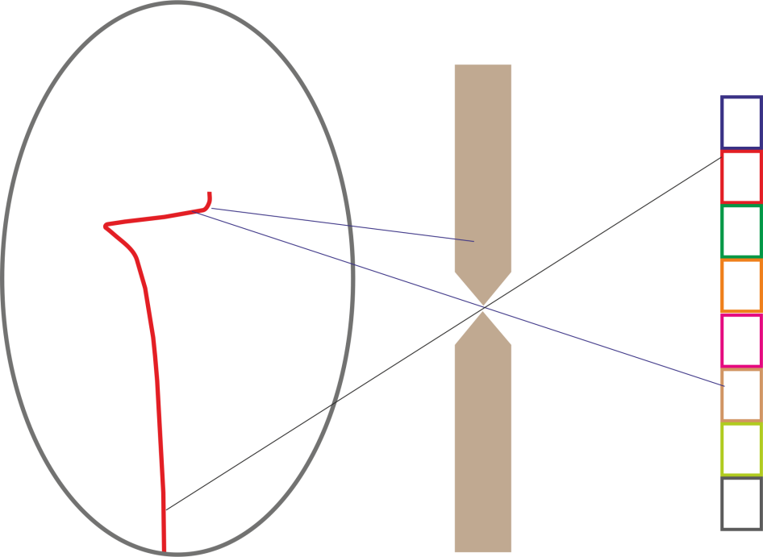
Prompt Gamma Imaging
Energy • Time • Space
Slit camera – The IBA solution
Vision
Tungsten Collimator 4 cm
Segmented detector
Irradiated volume
LYSO
20 × 0.8 × 0.32 cm³
Beam
J. Smeets et al.: Phys. Med Biol. 57 (2012) 3371

Slide 36
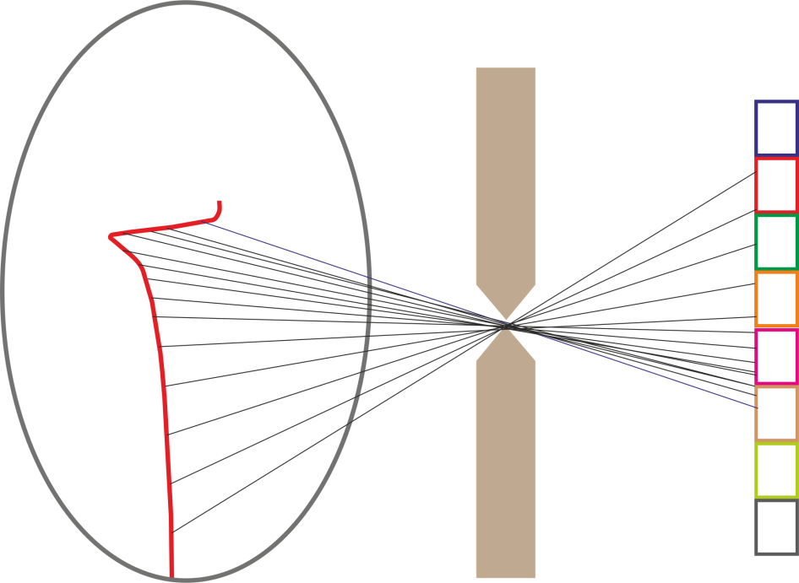
Prompt Gamma Imaging
Energy • Time • Space
Slit camera – The IBA solution
Vision
Tungsten Collimator 4 cm
Segmented detector
Irradiated volume
LYSO
20 × 0.8 × 0.32 cm³
Beam
J. Smeets et al.: Phys. Med Biol. 57 (2012) 3371

Slide 37
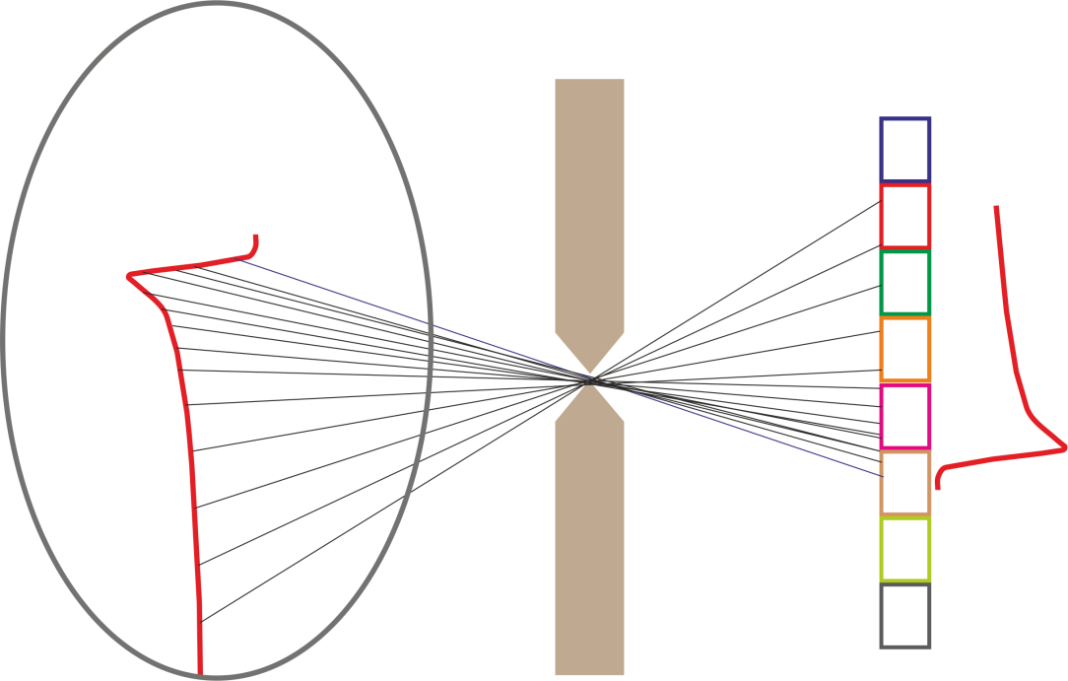
Prompt Gamma Imaging
Energy • Time • Space
Slit camera – The IBA solution
Vision
Tungsten Collimator 4 cm
Segmented detector
Irradiated volume
LYSO
20 × 0.8 × 0.32 cm³
Beam
J. Smeets et al.: Phys. Med Biol. 57 (2012) 3371

Slide 38
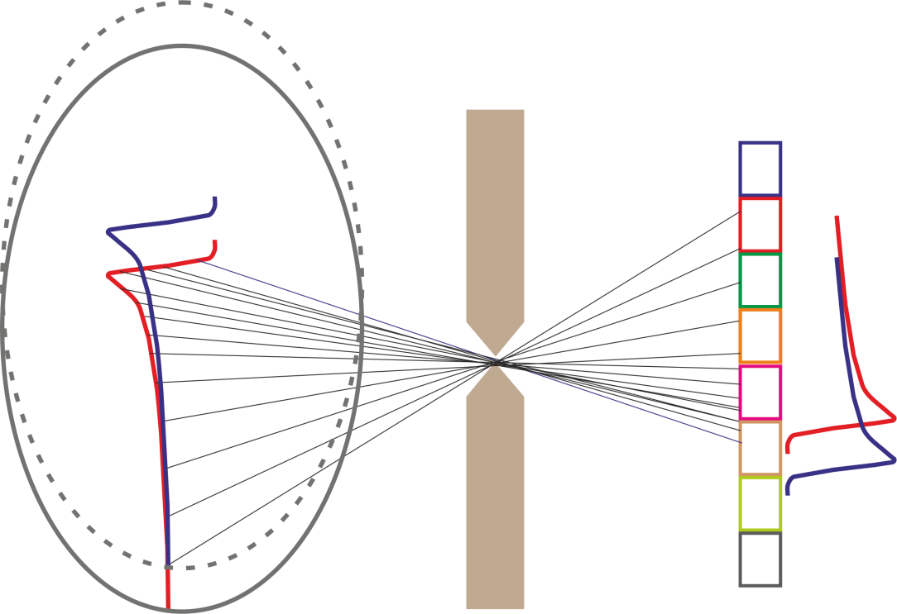
Prompt Gamma Imaging
Energy • Time • Space
Slit camera – The IBA solution
Vision
Tungsten Collimator 4 cm
Segmented detector
Irradiated volume
LYSO
20 × 0.8 × 0.32 cm³
Beam
J. Smeets et al.: Phys. Med Biol. 57 (2012) 3371

Slide 39
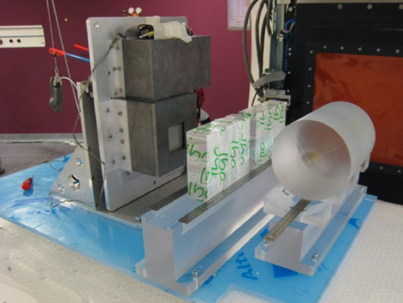
Prompt Gamma Imaging
Energy • Time • Space
Slit camera – The IBA solution
Vision
Tungsten Collimator 4 cm
Segmented detector
Irradiated volume
Experiment
LYSO
20 × 0.8 × 0.32 cm³
Beam
J. Smeets et al.: Phys. Med Biol. 57 (2012) 3371

Slide 40
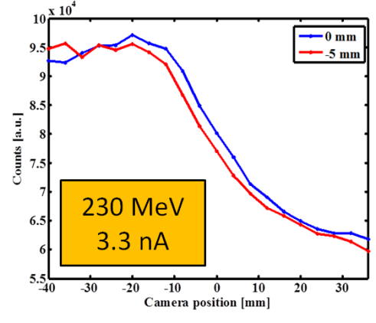
Prompt Gamma Imaging
Energy • Time • Space
Slit camera – The IBA solution
beam
Tungsten Collimator 4 cm
Segmented detector
Irradiated volume
Experiment
LYSO
20 × 0.8 × 0.32 cm³
Beam
J. Smeets et al.: Phys. Med Biol. 57 (2012) 3371

Slide 41
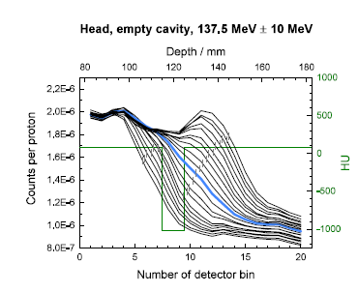
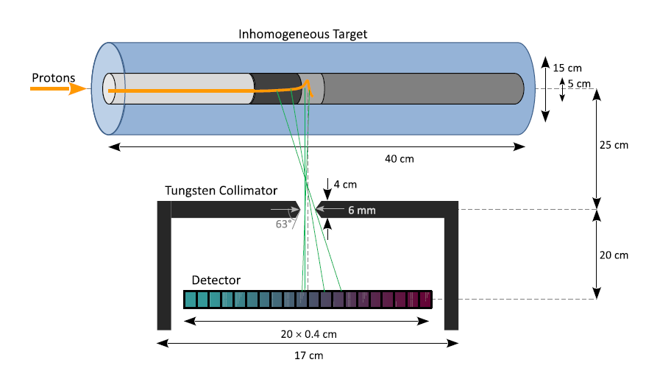
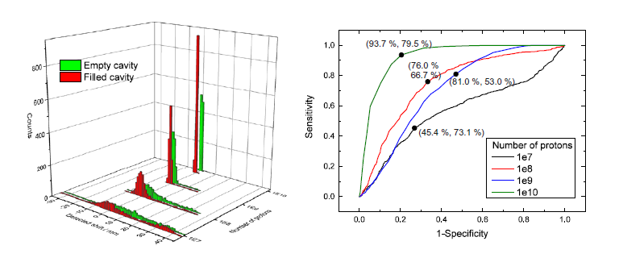

Prompt Gamma Imaging
Energy • Time • Space
Slit camera – also for inhomogeneous targets
Priegnitz et al. Phys. Med. Biol. 60 (2015) 4849

Slide 42
Prompt Gamma Imaging
Energy • Time • Space
Wikipedia.org
Collimation required → active or passive

Slide 43
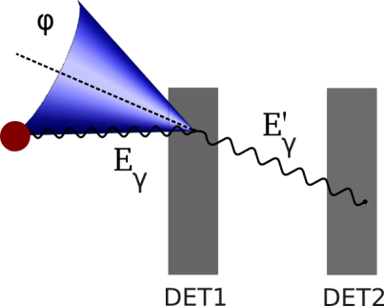
Detector systems for prompt γ-rays
Prompt Gamma Imaging
Energy • Time • Space
Compton Camera

Slide 44
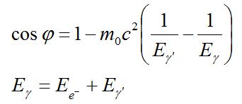
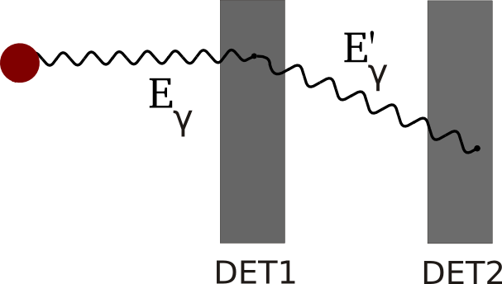
Prompt Gamma Imaging
Energy • Time • Space
Compton camera – The working principle
Electronically collimated detectors

Slide 45
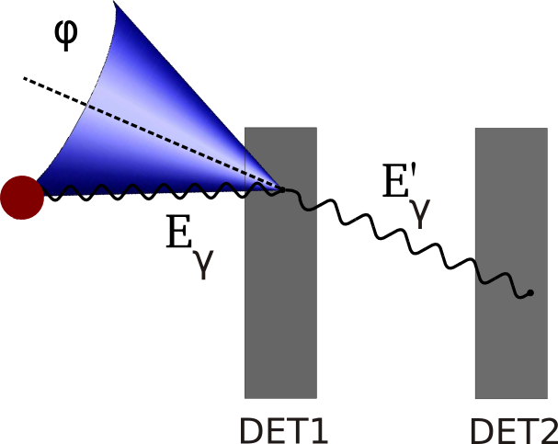
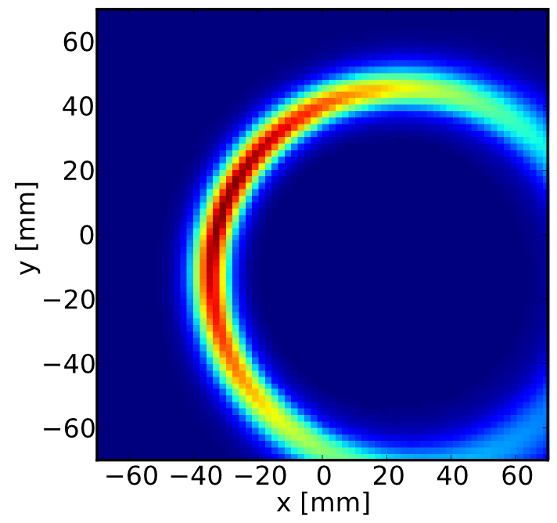
Prompt Gamma Imaging
Energy • Time • Space
Compton camera – The working principle
Backprojection

Slide 46



Compton camera – The working principle
Backprojection
MLEM

Slide 47
Prompt Gamma Imaging
Energy • Time • Space
Compton camera – The working principle
Si-Detector
Does pair production help us?
e⁺
e⁻
H. Rohling et al., IEEE Trans. Nucl. Sci. 62 (2015) 2023

Slide 48





Prompt Gamma Imaging
Energy • Time • Space
Compton camera – Prototypes
Silicium detector
Scintillator
CdZnTe
Scintillator
CdZnTe
CdZnTe
2010-2014
Scintillator
Scintillator

Slide 49




Compton camera – Challenges for detector developments
Prompt Gamma Imaging
Energy • Time • Space
Challenges: Many readout channels
Timing
Coincidence building
Discrimination of valid events
J. Petzoldt et al., in prep.
2.18 · 10⁻³ γ⁻¹
3.05 · 10⁻⁴ p⁻¹
2.49 · 10⁻⁴ γ⁻¹
3.49 · 10⁻⁵ p⁻¹
1 nA proton beam current -> 59 protons @ 9.4 ns; peak current up to 50 times higher
Highly asymmetric load on the detectors
→ Optimization of detector system, development of filter criteria
H. Rohling, PhD thesis, TU Dresden, 2015, Rohling et al. TNS 62 (2015) 2023, Rohling et al., PMB 62 (2017) 2795

Slide 50






Prompt Gamma Imaging – Detectors and test sources
Prompt Gamma Imaging
Energy • Time • Space
  Detectors
  CZT 2 × 2 × 0.5 cm³
  LSO / BGO 5.2 × 5.2 × 2 cm³
  BGO 3.6 × 3.95 × 3 cm³
  CZT - LSO
  CZT - CZT
  CZT - CZT - LSO
  CZT - BGO
  BGO - BGO
  CZT - CZT - BGO
CZT detector
Bruker Baltic Ltd.
Tests @
Lab sources ~1 MeV
Tandedron 4.44 MeV
ELBE - Bremsstrahlung
AGOR @ KVI Groningen
WPC @ Essen
Dresdner Protonentherapie
BGO / LSO detector
Siemens Medical Systems
Notes:
BGO4: Scatterer: 36x39.5x30 mm³
BGO1: Absorber: 53x 53 x20 mm³

Slide 51




Compton camera – Detector developments: CZT
Prompt Gamma Imaging
Energy • Time • Space
CZT
→ Spectroscopic readout system for pixelated CZT detectors room-temperature semiconductor detectors using commercial ASICs
→ Transit to fully-digital signal processing in order to improve timing and energy resolution
CZT
δE/E = 3.6%
at 511 keV
δE/E = 2.8%
at 511 keV
P. Födisch et al., Proceedings DESY, 978-3-935702-72-0, 135-143, PhD thesis

Slide 52

Compton camera – Detector developments: CZT
Prompt Gamma Imaging
Energy • Time • Space
CZT
→ Development of spectroscopic readout system for pixelated CZT room-temperature semiconductor detectors using commercial ASICs
P. Födisch et al., Proceedings DESY, 978-3-935702-72-0, 135-143
→ Transit to fully-digital signal processing in order to improve timing and energy resolution
CZT
→ Development of discrete readout electronics for detection and amplification of the deposited charge in CZT detectors
Energy Spectrum of ¹³⁷Cs
δE/E = 1.05 %
at 622 keV
Coincidence between CZT and CZT @ UPTD of 7 ns
Weinberger et al., 2016 IEEE NSS/MIC/RTSD

Slide 53





Prompt Gamma Imaging
Energy • Time • Space
Compton camera – Detector tests
Test of spatial and temporal detector resolution @ ELBE @ HZDR
Hueso-González et al., JINST 9 (2014) P05002

Slide 54


Prompt Gamma Imaging
Energy • Time • Space
Compton camera – The Dresden Prototype
Prototype I
Scatterer CZT, Absorber LSO
²²Na source in steps of 10 mm from (0,0) to (0, 50 mm)
1275 keV line, ca. 900 cones per image
Kormoll et al., Nucl. Instr. Meth. A 626-627, 114, 2011

Slide 55

Prompt Gamma Imaging
Energy • Time • Space
Compton camera – The Dresden Prototype
Prototype I
Scatterer CZT, Absorber LSO
²²Na source in steps of 10 mm from (0,0) to (0, 50 mm)
1275 keV line, ca. 900 cones per image
Kormoll et al., Nucl. Instr. Meth. A 626-627, 114, 2011

Slide 56

Compton camera – Test @ 4.44 MeV
Prompt Gamma Imaging
Energy • Time • Space
Tandedron - HZDR
¹⁵N(p, αγ)¹²C,
E_{p} = 897 keV, I_{p} = 10 µA, TiN Target
Questions to be answered
  Detector performance
    Spatial resolution (LSO → BGO)
    Efficiency (CZT @ E = 4.44MeV)
  Modeling – How do simulations fit with the detector responses?
    Shape of spectra (E = 4.44MeV)
    Absolute rates (E = 4.44MeV)
  Reconstruction algorithm
    How does reconstruction work if E = 4.44MeV is postulated by the algorithm?
    Does the algorithm converge if this assumption is abandoned?
Golnik et al., JINST 11 (2016) P06009

Slide 57



Compton camera – Test @ 4.44 MeV
Prompt Gamma Imaging
Energy • Time • Space
Tandedron - HZDR
HPGe Monitor @ 90°
LaBr₃(Ce) monitor @ 90°
Golnik et al., JINST 11 (2016) P06009

Slide 58



Compton camera – Test @ 4.44 MeV
Prompt Gamma Imaging
Energy • Time • Space
Tandedron - HZDR
BGO
Golnik et al., JINST 11 (2016) P06009

Slide 59

Prompt Gamma Imaging
Energy • Time • Space
Tandedron - HZDR
Tandetron at HZDR: ¹⁵N(p,αγ)¹²C
Energy filter: 4.44 MeV ± 20 %
BGO
Golnik et al., JINST 11 (2016) P06009

Slide 60






Compton camera – Test @ 4.44 MeV
Prompt Gamma Imaging
Energy • Time • Space
Simulation
Measurement
142
771
143
772
772
Golnik et al., JINST 11 (2016) P06009

Slide 61
Compton camera – Test @ 4.44 MeV
Prompt Gamma Imaging
Energy • Time • Space
Simulation
Measurement
142
771
143
772
772
Golnik et al., JINST 11 (2016) P06009

Slide 62


Compton camera – Experiment @ Dresdner Proton therapy
Prompt Gamma Imaging
Energy • Time • Space
Courtesy: Fernando Hueso-González
Hueso-González et al., IEEE Transactions on Radiation and Plasma Medical Sciences 1 (2017) 76

Slide 63

Compton camera – Experiment @ Dresdner Proton therapy
Prompt Gamma Imaging
Energy • Time • Space
Courtesy: Fernando Hueso-González
Hueso-González et al., IEEE Transactions on Radiation and Plasma Medical Sciences 1 (2017) 76

Slide 64
Compton camera – Modelling: Continuing translation
Prompt Gamma Imaging
Energy • Time • Space
Two Compton cameras in 25 cm distance from the isocenter
Scatter layer: CZT 10 × 10 × 0.5 cm³
Absorber layer: LSO 20 × 20 × 2 cm³
y
LSO
CZT
z
CZT
LSO
x
Beam
H. Rohling et al. Phys. Med. Biol. 62 (2017) 2795

Slide 65



Compton camera – Modelling: Continuing translation
Prompt Gamma Imaging
Energy • Time • Space
y
Head-neck patient
plan with 0.1 Gy,
8.73 × 10⁸ protons
LSO
CZT
z
CZT
x
Beam
LSO
Planned dose
Emissions
γ-ray emissions:
7 × 10⁷
Registered coincidence events
3.4 × 10⁵
Reconstructed image, valid events
3.4 × 10⁴
H. Rohling et al. Phys. Med. Biol. 62 (2017) 2795
Notes:
Events (coincident energy depositions in one of the two cameras):
6.6 × 10⁴ (20 % valid events)
Events after filtering (realistic):
1.9 × 10⁴ (44 % valid events)
Valid events (1 scatter event + complete absorption and no energy escape):
1.3 × 10⁴

Slide 66




Compton camera – Modelling: Continuing translation
Prompt Gamma Imaging
Energy • Time • Space
Dose
γ-ray Emissions
Unmodified
Modified,
with range deviation,
+ 15 mm
H. Rohling et al. Phys. Med. Biol. 62 (2017) 2795

Slide 67


Compton camera – Modelling: Continuing translation
Prompt Gamma Imaging
Energy • Time • Space
Emissions
Emissions with range shift
Beam
H. Rohling et al. Phys. Med. Biol. 62 (2017) 2795

Slide 68



Compton camera – Modelling: Continuing translation
Prompt Gamma Imaging
Energy • Time • Space
filtered events
Beam
in beam direction
through the isocenter
64 iterations of MLEM
Reconstructed activity
Reconstructed activity with range shift
valid events
Beam
H. Rohling et al. Phys. Med. Biol. 62 (2017) 2795

Slide 69
PGI
Energy
Prompt Gamma Spectroscopy
Time
Prompt Gamma Timing
Space
Prompt Gamma Imaging
Slit camera
Compton camera
MRI
PET
Ionoacoustics
In-beam
In-room
Off-line
Interaction vertex imaging
Summary

Slide 70
PGI
Energy
Prompt Gamma Spectroscopy
Time
Prompt Gamma Timing
Space
Prompt Gamma Imaging
Slit camera
Compton camera
MRI
PET
Ionoacoustics
In-beam
In-room
Off-line
Interaction vertex imaging

Slide 71


PGI
Energy
Prompt Gamma Spectroscopy
Time
Prompt Gamma Timing
Space
Prompt Gamma Imaging
Slit camera
Compton camera
MRI
PET
Ionoacoustics
In-beam
In-room
Off-line
Interaction vertex imaging

Slide 72
Thank you for your attention
PGI
Energy
Prompt Gamma Spectroscopy
Time
Prompt Gamma Timing
Space
Prompt Gamma Imaging
Slit camera
Compton camera
MRI
PET
Ionoacoustics
In-beam
In-room
Off-line
Interaction vertex imaging
HZDR - Radiation Physics
HZDR - Radiation Oncology
HZDR – Ion beam center
UPTD
KVI
PTC
WPE

Slide 74


Compton camera – Modelling: Continuing translation
Prompt Gamma Imaging
Energy • Time • Space
Head-neck patient
plan with 0.1 Gy,
8.73 × 10⁸ protons
with and without range deviation (modified HUs)
with 5000 filtered events
Planned dose
Emissions
γ-ray emissions:
6.9 × 10⁷
32 iterations,
non- filtered events
6.6 × 10⁴
32 iterations, filtered events
1.9 × 10⁴
32 iterations, valid events
1.3 × 10⁴
H. Rohling et al. Phys. Med. Biol. 62 (2017) 2795
Notes:
Events (coincident energy depositions in one of the two cameras):
6.6 × 10⁴ (20 % valid events)
Events after filtering (realistic):
1.9 × 10⁴ (44 % valid events)
Valid events (1 scatter event + complete absorption and no energy escape):
1.3 × 10⁴

