Slide 1
Versatile Compton camera for high energy gamma rays: Monte Carlo comparison with Anger camera for medical imaging
Mattia Fontana
2nd jagiellonian symposium - krakow
2017 – 06 - 08

Slide 2
OUTLINE
INTRODUCTION
Nuclear medicine: PET & SPECT
Radionuclides
Compton camera principle
Anger vs Compton for SPECT
COMPTON CAMERA DEVELOPMENT
CLaRyS prototype
SIMULATION STUDY
Comparison between Compton and Anger cameras for medical imaging

Slide 3
INTRODUCTION

Slide 4
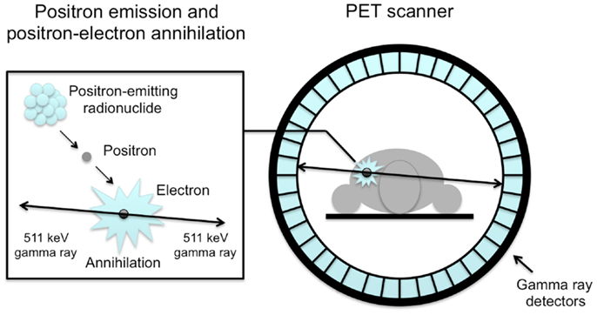
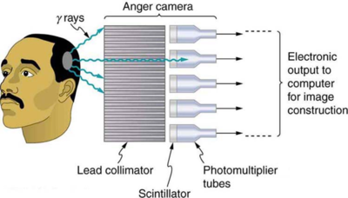
Nuclear medicine
Diagnosis/therapy techniques based on radioemitters injected into the patient body (bloodstream, inhaled, swallowed)
Diagnosis: physiological information based on SPECT (Single Photon Emission Computed Tomography) or PET (Positron Emission Tomography) imaging
PET
β⁺ annihilation: 2 back-to-back 511 keV gammas
Clinical system based on a ring of scintillating-segmented photodetectors
Coincidence detection: no need for mechanical collimation
good detection efficiency
Positron diffusion before annihilation:
spatial accuracy affected
SPECT
Single photon detection from gamma emitters
Clinical routine based on Anger cameras (Hal Anger 1958)
Mechanical collimator coupled to scintillating-segmented photodetector
low detection efficiency
limited energy range exploitable
low energy sources

Slide 5
Radionuclides
Common radioemitters for clinical use
Application | Isotope | Decay mode | γ energy [keV] | Half-life
SPECT | Thallium 201 | γ | 135 | 73 h
 | Technetium 99m | γ | 140 | 6 h
 | Iodine 123 | γ | 159 | 13 h
 | Iodine 131 | γ | 364 | 8 d
PET | Fluorine 18 | β+ | 511 | 110 m
 | Oxygen 15 | β+ | 511 | 2 m
But…
Higher energy sources [Nurdan 2015]:
²⁴Na, ⁴²K, ⁵⁹Fe, ⁴⁷Ca, ⁶⁵Zn, ²⁸Mg, ²¹²Bi, ²⁰⁸Tl, ¹³²I, ^{91m}Y, ...
Vectorised targeted therapy:
Beta/alfa sources used for targeted cancer therapy often emit also high energy gamma rays (ex: ⁸⁹Sr, ¹¹¹At, ²²⁵Ac, …) with limited BR
Pre-/per- treatment imaging for therapy monitoring
What’s needed:
Handle higher energy photons
Higher efficiency

Slide 6
Radionuclides
Common radioemitters for clinical use
Application | Isotope | Decay mode | γ energy [keV] | Half-life
SPECT | Thallium 201 | γ | 135 | 73 h
 | Technetium 99m | γ | 140 | 6 h
 | Iodine 123 | γ | 159 | 13 h
 | Iodine 131 | γ | 364 | 8 d
PET | Fluorine 18 | β+ | 511 | 110 m
 | Oxygen 15 | β+ | 511 | 2 m
But…
Higher energy sources [Nurdan 2015]:
²⁴Na, ⁴²K, ⁵⁹Fe, ⁴⁷Ca, ⁶⁵Zn, ²⁸Mg, ²¹²Bi, ²⁰⁸Tl, ¹³²I, ^{91m}Y, ...
Vectorised targeted therapy:
Beta/alfa sources used for targeted cancer therapy often emit also high energy gamma rays (ex: ⁸⁹Sr, ¹¹¹At, ²²⁵Ac, …) with limited BR
Pre-/per- treatment imaging for therapy monitoring
COMPTON CAMERAS

Slide 7
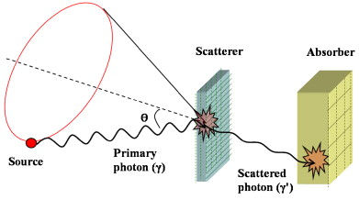
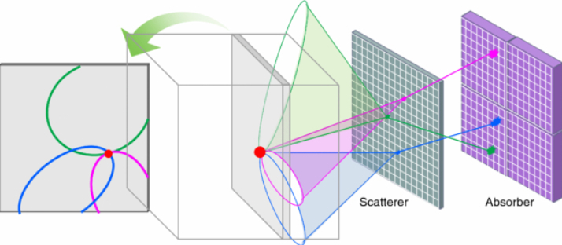
Compton camera: the principle
Seo 2009
Two detector components:
Scatterer – low Z position sensitive detector
Absorber – high Z segmented detector
Two positions and energy deposits
Compton scattering formula
$$\cos{θ=1+ m_{e}c^{2} (\frac{1}{E_{0}}−\frac{1}{E_{1}})}$$
Reconstruction of a cone surface for each gamma event
Cones overlapping to retrieve the radioactive source distribution
E₂, r₂
E₀
E₁, r₁
Kim 2013

Slide 8
ANGER vs COMPTON for SPECT
 | ANGER CAMERA | COMPTON CAMERA
Events | Single interaction | Time coincidences
Collimation | Physical | “Electronic”
Efficiency | Low | Intrinsically higher
Source energy | <= 364 keV | 100 keV – some MeV
Image reconstruction | Tomography (not needed for 2D) | Iterative algorithms (complex and long)
Image | 3D with tomography | Potentially 3D with single detector
Cost | Relatively low | High
Status | Commercially available | Several prototypes under test
[McKisson 1994]
γ
γ
γ
Source
Collimator
Photodetector
Source
Scatterer
Absorber

Slide 9
COMPTON CAMERA DEVELOPMENT

Slide 10
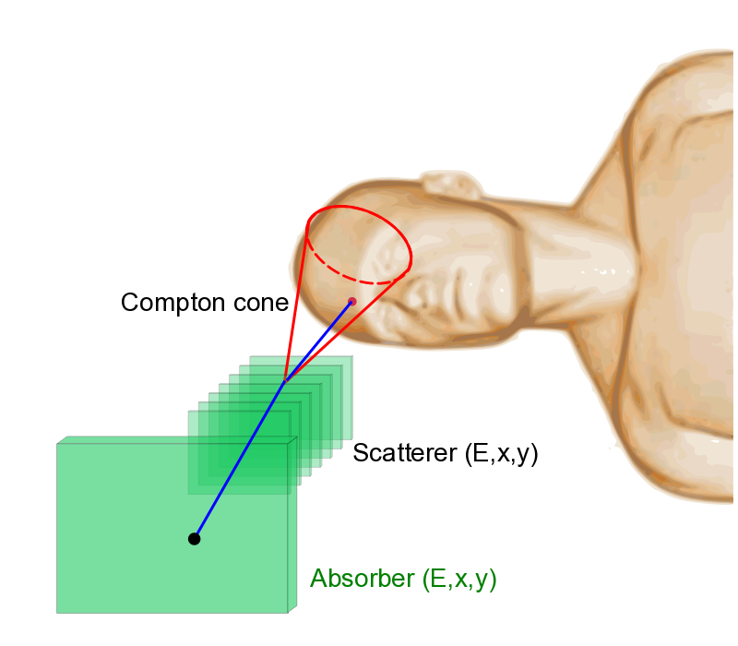
Compton camera: the prototype
5 French institution involved in the development –
CLaRyS collaboration -> IPNL, LPSC, LPC, CPPM, CREATIS
COMPTON CAMERA (CC)
Components: [Krimmer 2015]
silicon scatterer stack
7 planes of DSSDs (Double-sided Silicon Strip Detectors)
9x9x0.2 cm³ each
segmented BGO (Bismuth Germanate) absorber
96 blocks
3.5x3.8x3.0 cm³ each
4 tube PMs per block
LM-MLEM (List-Mode MLEM) algorithm developed by the CREATIS group (Lyon)
Prototype design optimized by Monte Carlo simulations for ion beam therapy monitoring
(Roellinghoff 2011)

Slide 11
SIMULATION STUDY
Study objective and description

Slide 12
Simulation study
STATE OF THE ART
Comparison with commercial Anger camera performed at single gamma energy (364 keV) – Han 2008
Encouraging results:
Efficiency gain of a factor > 20
Comparable spatial resolution for the same number of events
OBJECTIVE OF THE PRESENT WORK
Estimate of Compton camera performance in SPECT as a function of:
Scatterer energy resolution and material
Main development challenge
Source activity and random coincidences
Benchmark Anger camera (AC) and Compton camera (CC):
Comparison of main performance parameters in wide
energy range (245 keV – 2614 keV)
AC
CC

Slide 13
Simulation settings
GATE simulation of Infinia by GE Healthcare
Collimator HEGP (High Energy General Purpose)
19x28x6.6 cm³
Lead
Hexagonal holes 2.0 mm radius
1.8 mm septal thickness
NaI block
19x28x1 cm³
4 mm FWHM spatial resolution
10% FWHM energy resolution @ 140 keV
80 keV energy threshold
Back compartment
19x28x2.5 cm³
Glass
[HealthCare 2006]
Geant4 simulation of the CLaRyS Compton camera
Scatterer
7 Si planes (500 e⁻ ENC)
1 cm distance between each plane
FWHM resolutions: 20 ns time,~ 5 keV energy, 1 mm spatial
BGO Absorber
21x28x3.0 cm³ (adapted size for efficiency comparison) – 8 x 6 block matrix
FWHM resolutions: 3 ns time, 21% energy @ 667 keV, 4.4 mm spatial transverse plane
MLEM reconstruction method (CREATIS)
28 cm
28 cm
Point-like radioactive source study at different energies
21 cm
19 cm
10 cm
10 cm
6 cm
15 cm

Slide 14
Compton camera study for SPECT
SCATTERER ENERGY RESOLUTION
$σ_{E}$ = 1 keV in Han 2008
2 energy resolution values tested
$σ_{E}$ = 2 keV close to design expectations
$σ_{E}$ = 4 keV test with preliminary electronics card
Comparison with alternative material – cadmium telluride (CdTe)
SOURCE ACTIVITY
True and random coincidences studied as a function of the source activity at fixed energy (555 keV)
Activity fixed to value of Anger-SPECT clinical interest
200 MBq – 50 % of random coincidences
Random coincidence ratio studied as a function of primary energy at fixed activity
$σ_{E}$ = 2 keV fixed for comparison study
Activity of 200 MBq for comparison study

Slide 15
Simulation study
STATE OF THE ART
Comparison with commercial Anger camera performed at single gamma energy (364 keV) – Han 2008
Encouraging results:
Efficiency gain of a factor > 20
Comparable spatial resolution for the same number of events
OBJECTIVE OF THE PRESENT WORK
Estimate of Compton camera performance in SPECT as a function of:
Scatterer energy resolution and material
Main development challenge
Source activity and random coincidences
Benchmark Anger camera (AC) and Compton camera (CC):
Comparison of main performance parameters in wide
energy range (245 keV – 2614 keV)
AC
CC
HOW TO ?

Slide 16
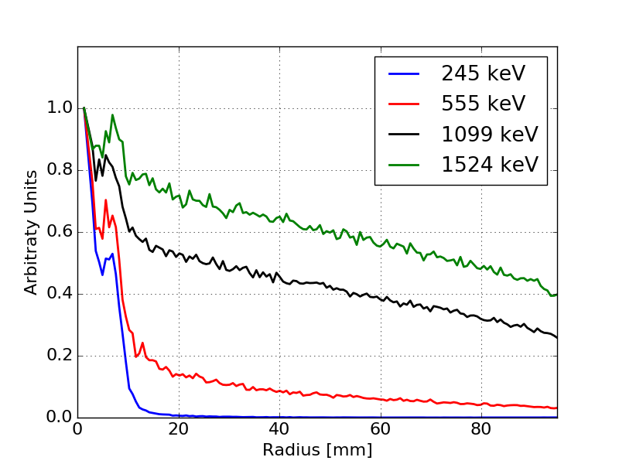
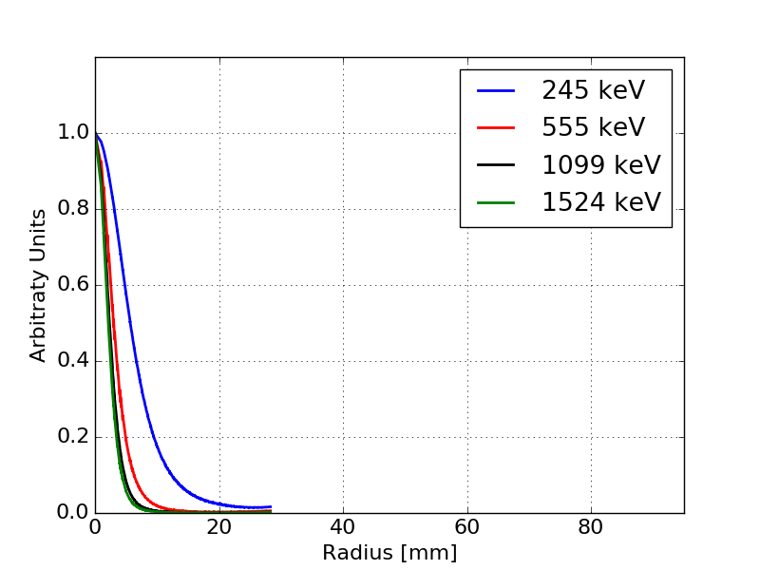
…image…
AC
Radial distribution from raw data
Background to be studied and handled
…
CC
Coincidence reconstruction
Radial distribution only after reconstruction
…
Radial distributions

Slide 17
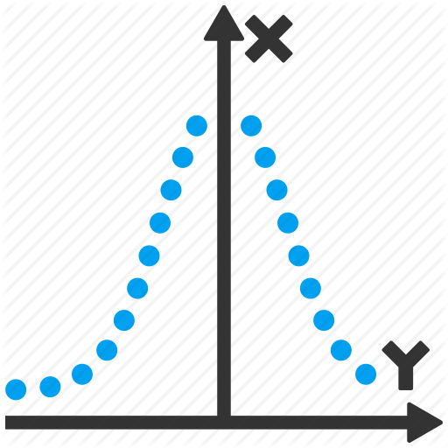
Analysis method
Focus on detector performance in terms of spatial resolution and detection efficiency
Definition of three figures of merit
Detection efficiency: ratio between reconstructed events and total emitted primary gammas
Spatial resolution: RMS of radial distribution
Signal-to-background ratio: ratio between “detected events” and “useful events”
Figures of merit:
1. P/N
2. R
3. P/M
10 cm
CC
#
Interaction + coincidence
MLEM reconstruction
M “detected events”
γ
SOURCE:
N primaries
in 4π
AC
R
r
Transmission + interaction
Background
rejection
Radial distributions: P entries

Slide 18
Data treatment: CC
10⁷ primary gammas simulated in 0.08x4π (camera acceptance cone)
Scatterer-absorber coincidences retrieved with dedicated analysis based on:
Source activity
Examination time
Detector time resolutions
Radial distribution after MLEM reconstruction obtained and analyzed to retrieve the spatial information

Slide 19
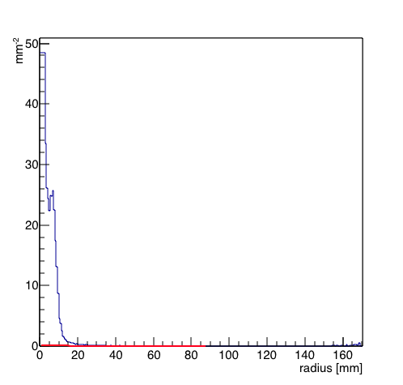
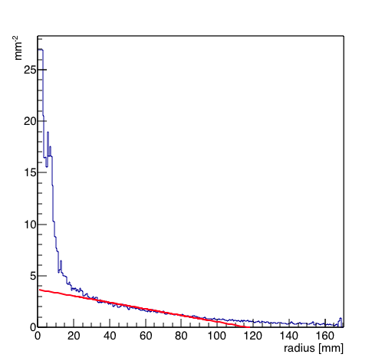
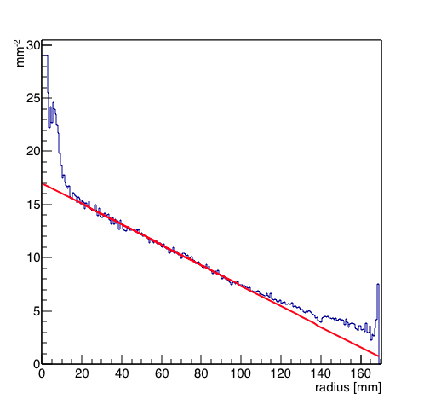
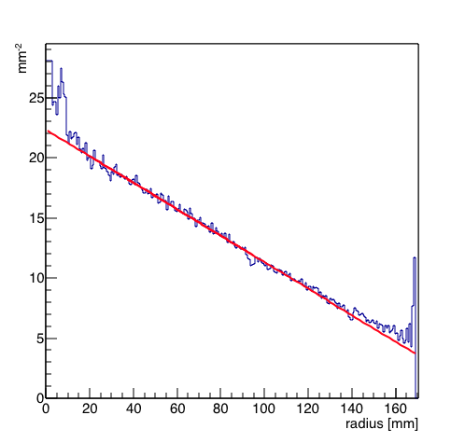
Data treatment: AC
10⁸ primary gammas simulated in 4π
Raw radial distribution analyzed to retrieve the spatial information
Event selection performed by linear fit – background rejection
245 keV
555 keV
1099 keV
1524 keV

Slide 20
SIMULATION STUDY
Results

Slide 21
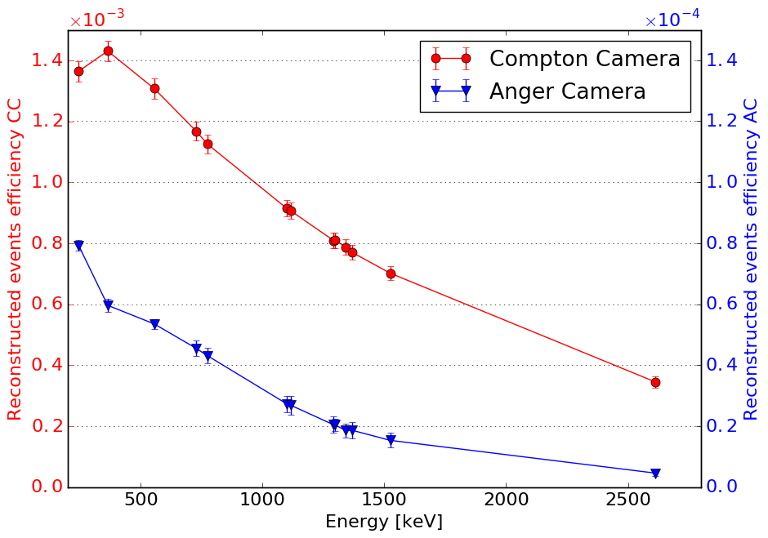
Comparison results: detection efficiency
NB: Different scales for the two plots – factor 10
Detection efficiency = reconstructed events / total primaries
Confirmation of Han results @ 364 keV
Detection efficiency increased by a factor > 20
for whole investigated energy range

Slide 22
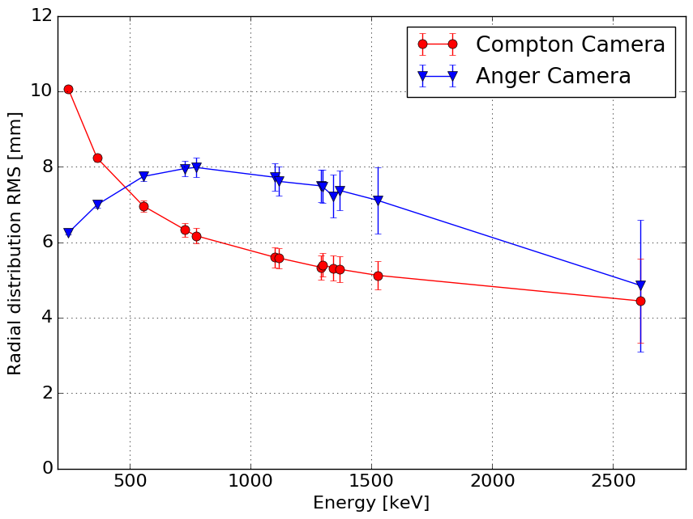
Comparison results: spatial resolution
Spatial resolution = RMS radial distribution
Interaction in the patient not considered in this study, reduced at higher energy
Reduction of AC RMS at increasing energy connected to a strong reduction of selected events
Favorable spatial resolution for energies above 500 keV

Slide 23
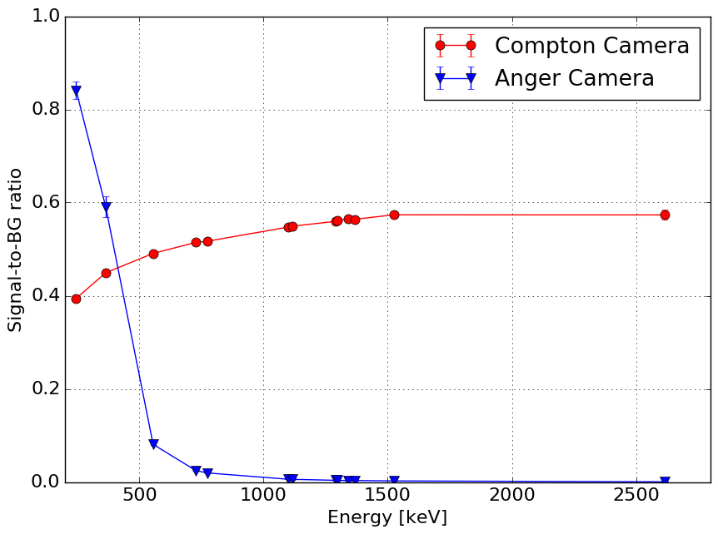
Comparison results: signal-to-BKG ratio
Signal-to-BKG ratio = reconstructed events / detected events
AC optimization for reduced energy range
CC selected events coherent with coincidence study expectations

Slide 24
Conclusion
Possible application of Compton camera for SPECT further verified
Increased detection efficiency thanks to the “electronic collimation”
factor > 20 between 245 keV and 2614 keV
Favorable spatial resolution for energies above 500 keV
Wider energy acceptance with the same detector (slight geometrical modifications possible for optimization)
… with Compton cameras
Reduction of injected activity and/or examination time
New high energy sources should be moved to the clinical practice
Reduced interaction in the patient
Reduced overall dose
Increased spatial accuracy
Possibility of control of vectorised therapy
High energy gamma emission used for imaging
TO DO
Verification tests
Phantom studies
Clinical studies
Clinical test of Compton camera prototype
Promising preliminary results
Further study required

Slide 25
Acknowledgements
CLaRyS Collaboration
L. Balleyguier, E. Bechetoille, D. Bon, A. Bongrand, J.-P. Cachemiche, C. Caplan, L. Caponetto, B. Carlus, X. Chen, M. Dahoumane, D. Dauvergne, D. Delaunay, R. Della Negra, F. Doizon,
N. Freud, M.L. Gallin-Martel, L. Gallin-Martel, N. Giraud, J. Krimmer, D. Lambert, J.M. Létang,
M. Magne, F. Martin, H. Mathez, V. Maxim, G. Montarou, J.-L. Montorio, C. Morel, F. Mounier,
M. Rodo-Bordera, E. Testa, W. Tromeur, Y. Zoccarato
LabEx PRIMES
This work was supported by the LABEX PRIMES (ANR-11-LABX-0063) of Université de
Lyon and by France HADRON (ANR-11-INBS-0007), within the program "Investissements
d'Avenir" (ANR-11-IDEX-0007) operated by the French National Research Agency (ANR).

Slide 26
Thanks for your attention

Slide 27
BACKUP

Slide 28
Radiotracers for comparison study
Decay mode list: e for electron capture, β- for electron emission, β+ for positron emission, IT for isomeric transition. Half-life expressed in days (d), hours (h) or minutes (m). Data extracted using the NNDC On-Line Data Service from the ENSDF database, file revised as of (2017-05-17) ^{[1]}
[1] Bhat, M. R., Evaluated Nuclear Structure Data File (ENSDF), Nuclear Data for Science and Technology, page 817, edited by S. M. Qaim (SpringerVerlag), Berlin, Germany, 1992, https://www.nndc.bnl.gov/, 2017-03-27

Slide 29
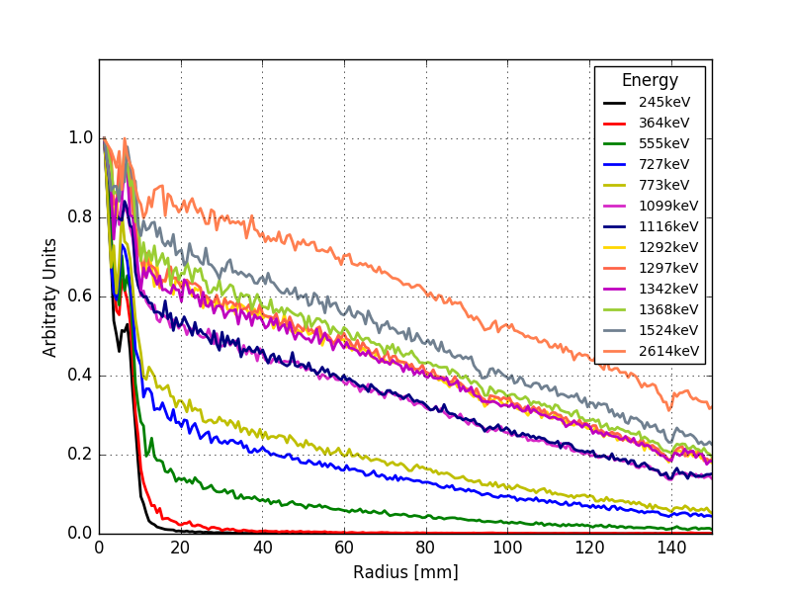
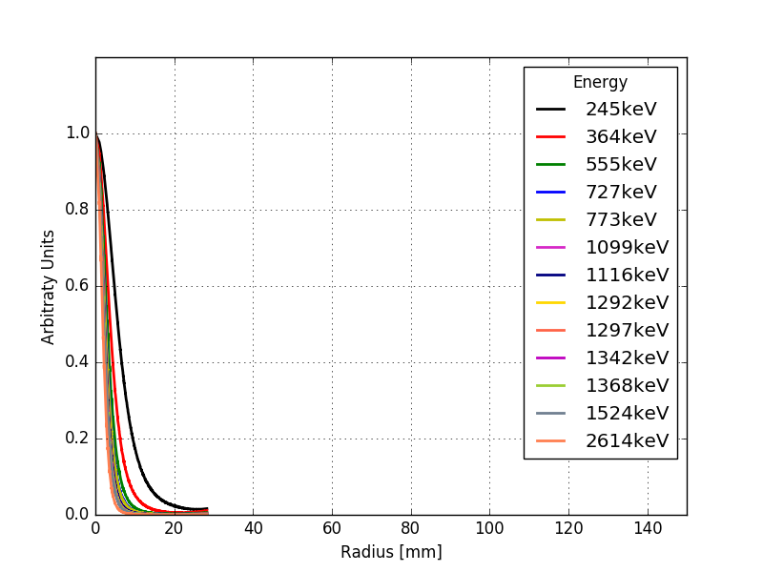
Radial distributions all energies
ANGER
COMPTON

Slide 30
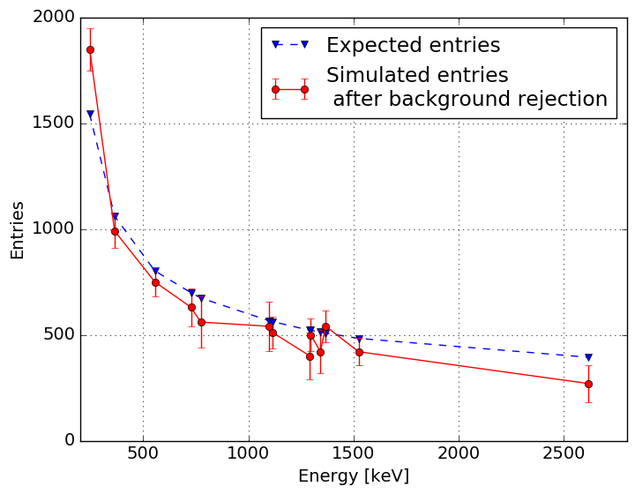
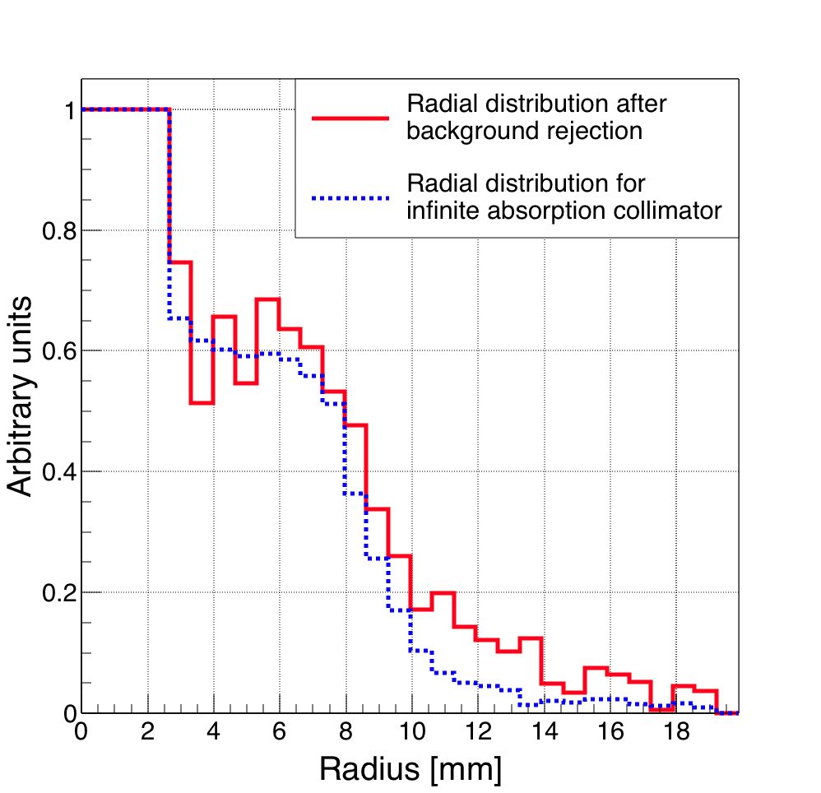
AC data: analysis method validation
Two main tests performed
Check of the number of events in the central collimator holes after fit selection
Ideal detector
Comparison with geometrical and physical expectations (gamma absorption in the detector material)
Check the noise-background contribution
Spatial noise composed by
Scattered gammas
Traversing gammas
Test with infinitely dense collimator – total absorption
Only gammas traversing the collimator holes are detected
Qualitative comparison to radial events distribution after selection
1099 keV
Robust analysis method

Slide 31
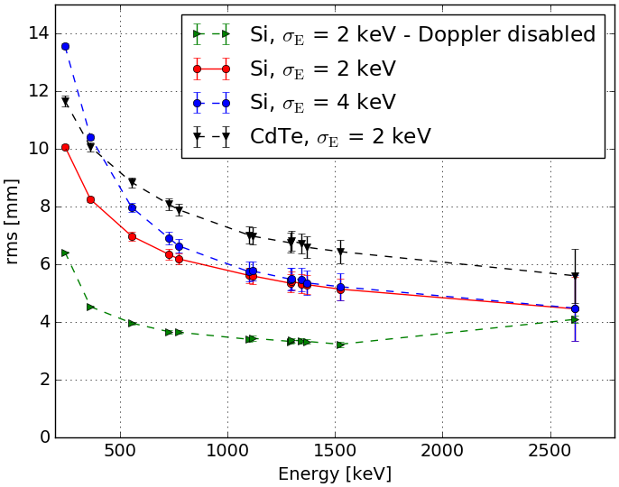
Compton camera energy resolution
Scatterer energy resolution
Important parameter for the camera performance
Mainly determined by the Electron Noise Charge (ENC)
$σ_{E}=3.6 \sqrt{{ENC}^{2 }+ F_{Si}\frac{E_{dep}}{3.6}{10}^{6}}$
2 ENC values tested according to design expectation and first estimate
ENC = 500 corresponding to about
$σ_{E}$ = 2 keV
ENC = 1100 corresponding to about
${ σ}_{E}$ = 5 keV
Reduced effect at increasing energy
ENC = 500 chosen for the further study
Closer to design expectations

Slide 32
Compton camera energy resolution
Doppler broadening
Second parameter affecting the energy scatterer resolution
Compton scattering electron approximated to be at rest in reconstruction
The electron energy state affects the energy spectrum – broadening effect
Test of alternative scatterer material for comparison - CdTe
Effect reduced for energies above 1 MeV

Slide 33
Compton camera: random coincidence rate vs source activity
Effect of random coincidences
Studied as a function of the source activity
Source activity in the range 1-500 MBq – clinical interest
Compatible amount of random and true coincidences at 200 MBq – coherent with clinical routine
200 MBq fixed for further study
Source activity [MBq]

Slide 34
Compton camera: random coincidence rate vs source energy
Effect of random coincidences
Random coincidence ratio studied as a function of the source energy
Energies involved in the study
Number of random coincidences decreases at increasing energy, as expected
Random coincidence are partially rejected by the MLEM reconstruction algorithm

Slide 35
Particle therapy for cancer treatment (i)
Standard cancer treatment composed by
radiotherapy or/and chemotherapy and/or surgery
Increasing number of patients treated with particle therapy all over the world (p + heavier ions, mostly C)
Many new particle therapy centers built or commissioned
ADVANTAGES (with respect to photons):
Favorable depth-dose distribution – Bragg Peak
Ballistic targeting of the tumor
Reduction in the integral dose
Less dose to healthy tissues
Reduction of secondary cancer probability and toxicity
Increased Relative Biological Effectiveness (RBE)
Mostly for ions heavier than protons
RBE_{p} = 1.1 in clinic
RBE_{C} = [2-3]
Possibility to treat radio-resistant tumors (hypoxic)
Durante-Paganetti, 2016, Report of Progress in Physics, Nuclear physics in particle therapy: a review

Slide 36
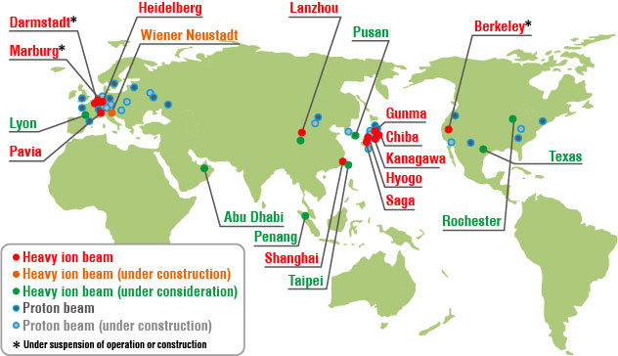
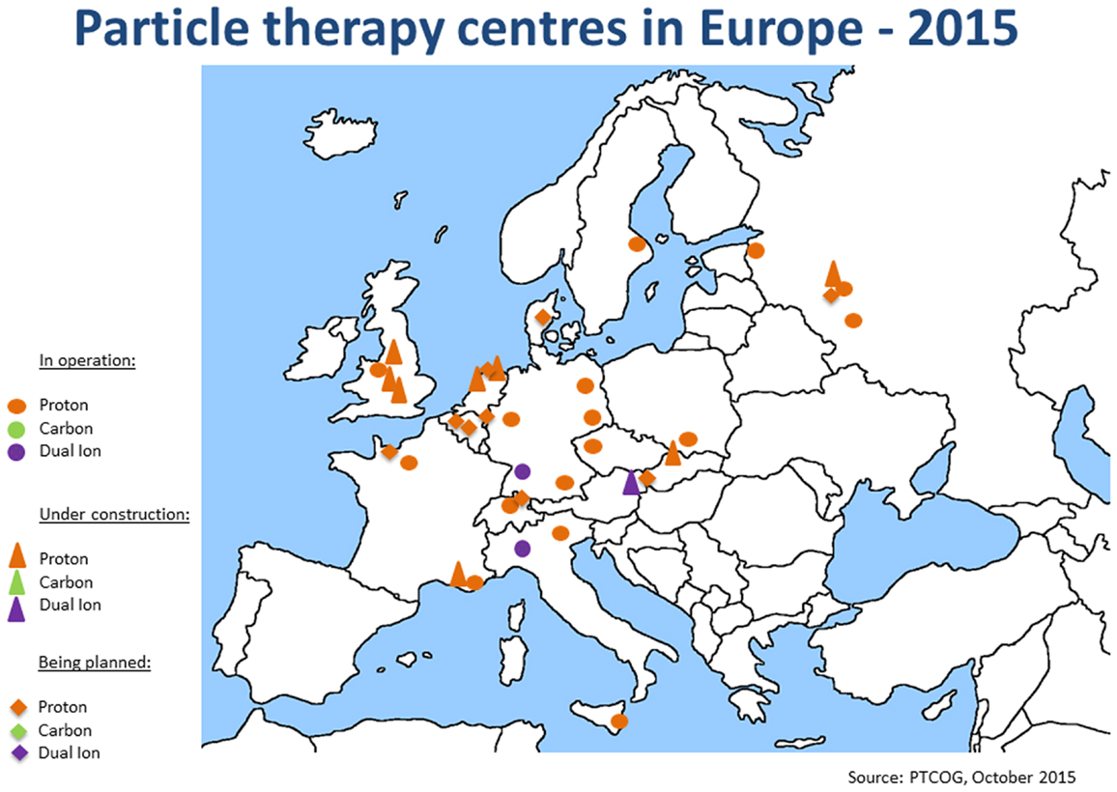
Particle therapy for cancer treatment (i.i)
Particle therapy centers in the world,
with focus on Europe
http://www.hirt-japan.info/en/what/japan.html

Slide 37
Particle therapy for cancer treatment (ii)
Standard clinical routine:
CT scan and treatment planning
Treatment limits defined to spare the healthy tissues
Fractioned dose delivery
Two main methods:
Passive scanning (beam scatters + collimators)
Active scanning (scanning magnets)
OBJECTIVE
Cover the whole tumor volume
Bragg peak location determined by the beam energy (Spread-Out Bragg Peak - SOBP)
Lateral spread to be taken into account
Durante-Paganetti, 2016, Report of Progress in Physics, Nuclear physics in particle therapy: a review

Slide 38
Particle therapy for cancer treatment (iii)
Standard clinical routine:
CT scan and treatment planning
Treatment limits defined to spare the healthy tissues
Fractioned dose delivery
Two main methods:
Passive scanning (beam scatters + collimators)
Active scanning (scanning magnets)
OBJECTIVE
Cover the whole tumor volume
Bragg peak location determined by the beam energy
Lateral spread to be taken into account
Ballistic features allows a reduction in the irradiation fields
Further reduction in healthy tissue dose
Durante-Paganetti, 2016, Report of Progress in Physics, Nuclear physics in particle therapy: a review

Slide 39
Particle therapy for cancer treatment (iv)
DRAWBACKS
Several sources of incertitude
Common to conventional radiotherapy
Target volume definition
Intra-fractional changes (tumor shape, size, position, patient weight, positioning, etc.)
Anatomical uncertainties (lung filling, gas components, bone composition)
Range uncertainties
CT Hounsfield units conversion to stopping power values -> interest to develop Proton Radiography
CT imaging uncertainties
Stopping power measurements / calculation
Biological uncertainties
RBE definition
Knopf-Lomax, 2013, PMB, In vivo proton range verification: a review
NEED FOR ONLINE RANGE MONITORING

Slide 40
Ion range monitoring (i)
Online projectile range control needed to fully exploit the dose delivery features of protons and heavier ions (Bragg Peak)
Reduce treatment planning limitations on volume definition
Possibly increase the dose per fraction
Reduce number of fractions and the number of needed irradiation fields
Monitoring possible with secondary radiation produced by nuclear reactions
High probability:
~10 % for protons – 10 cm range
~ 40 % for C ions – 10 cm range
Projectile and target-like fragments (Ex: positron emitters - ¹¹C, ¹⁵O)
PET
Prompt radiation
Charged particles -> Interaction Vertex Imaging (IVI)
Neutrons
Prompt gammas

Slide 41
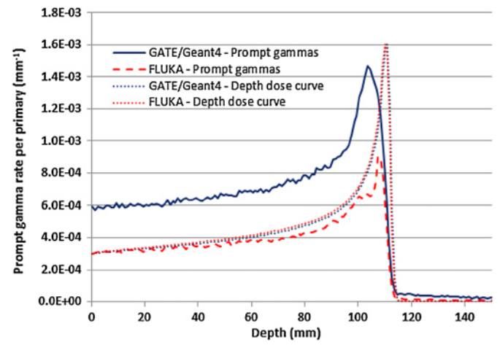
Ion range monitoring (ii)
Prompt radiation emission directly correlated to the dose profile
Prompt gamma emission distal fall-off correlated to the dose profile and to the Bragg peak position (Min 2006, Testa 2008)
Advantages:
Emission time < 1 ns after the nuclear interaction – physiological wash-out processes negligible
Reduced interactions in the patient – millimeter resolution for 10⁸ protons in proton therapy (maximum number of particle per spot)
(Smeets 2012, Pinto 2014)
Challenge:
Wide gamma energy range ( ~ 1-10 MeV)
Large neutron-induced background
Dedes 2014
GAMMA CAMERA DEVELOPMENT
Robert 2013

Slide 42
Range uncertainties
Paganetti PMB 2012
Secondary radiation monitoring

Slide 43
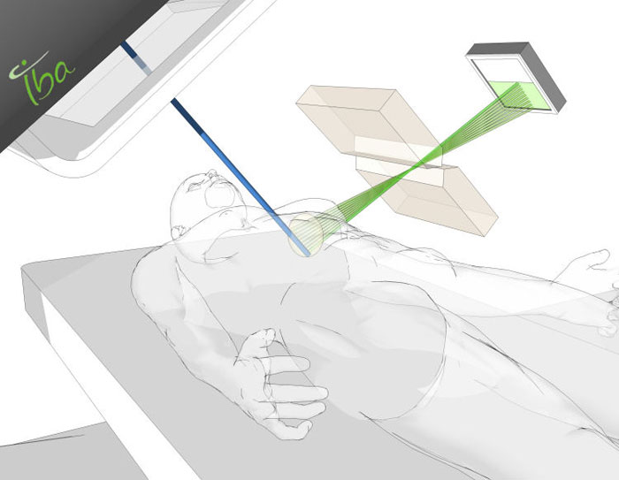
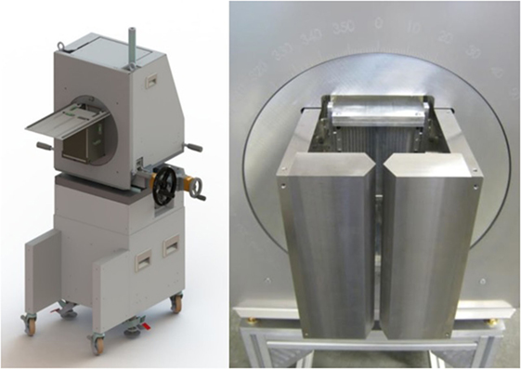
PG ion range monitoring: state of the art
PGT
Prompt Gamma (PG) monitoring:
Collimated detection systems
Knife-edge cameras
Multi-slit cameras
Compton cameras – “electronical collimation”
Non-collimated techniques
PG timing (PGT)
PG spectroscopy (PGS)
PG peak integral (PGPI)
Several gamma camera projects
Several prototypes tested in lab
First prototype in clinical trials (with patients) is by IBA
Knife-edge camera – Dresden group
LYSO slabs (4 mm wide, 31.5 mm thick)
FOV: 10 cm in the Bragg peak region
Efficiency: 4 x 10⁻⁴ (Priegnitz, PMB 2015)
4 mm fall-off position resolution with 10⁸ protons
Golnik 2014
PGPI
PGS
Verburg 2015

Slide 44
Prompt gamma yield
160 MeV protons in PMMA
Detection with IBA knife edge camera prototype
¹²C/p prompt gamma yield ratio
Perali PMB 2014

Slide 45
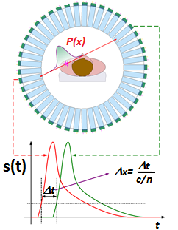
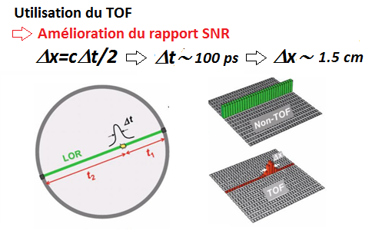
PET ion range monitoring: state of the art
PET monitoring:
β⁺ annihilation: 2 back-to-back 511 keV gammas
Coincidence detection
Several groups working on new prototypes of
In-beam PET
OpenPET
DoPET-L
INSIDE
TOF PET DPC
DPGA – CLaRyS group
In beam
Off line
In room
GSI -
HIT -
MGH -
Shakirin 2011

Slide 46
Compton camera state of the art
Several groups working on Compton camera prototypes
VALENCIA (Llosa, NIMA 2012):
LaBr₃ scatterer and absorber
~30 mm absorber size
Status: In-beam tests
US (Polf 2015):
CdZnTe scatterer and absorber
~40 mm absorber size
Status: In-beam tests
DRESDEN (Hueso-Gonzalez, JINST 2014):
CdZnTe scatterer, LSO absorber
~30 mm absorber size
Status: components characterized and tested
MUNICH (Thirolf 2014):
Si scatterer, LaBr₃ absorber
~50 mm absorber size
Status: components characterized and tested

Slide 47
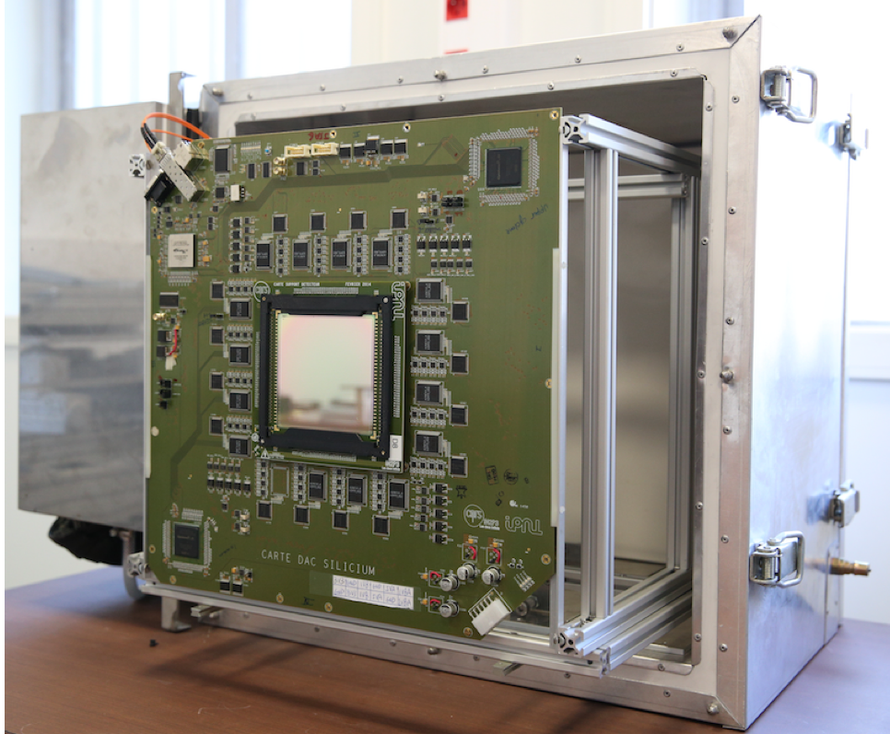
Detector components: scatterer / collimator
SCATTERER 7 DSSD (Double-Sided Silicon Detectors) 96x96x2 mm³ planes (10 planes were foreseen at the beginning, 3 are not suitable for the camera)
1.4 mm strip pitch
2 x 64 strips, XY position sensitive
isolated box for thermal regulation
custom electronic cards with new ASIC (developed by IPNL electronics group)
Small prototype tested with radioactive sources
14 keV FWHM energy resolution @ 122 keV (⁵⁷Co) at room temperature
~20 ns FWHM time resolution P channels
Final detectors characterized in terms of leakage currents
Tests performed with electronics card first prototype

Slide 48
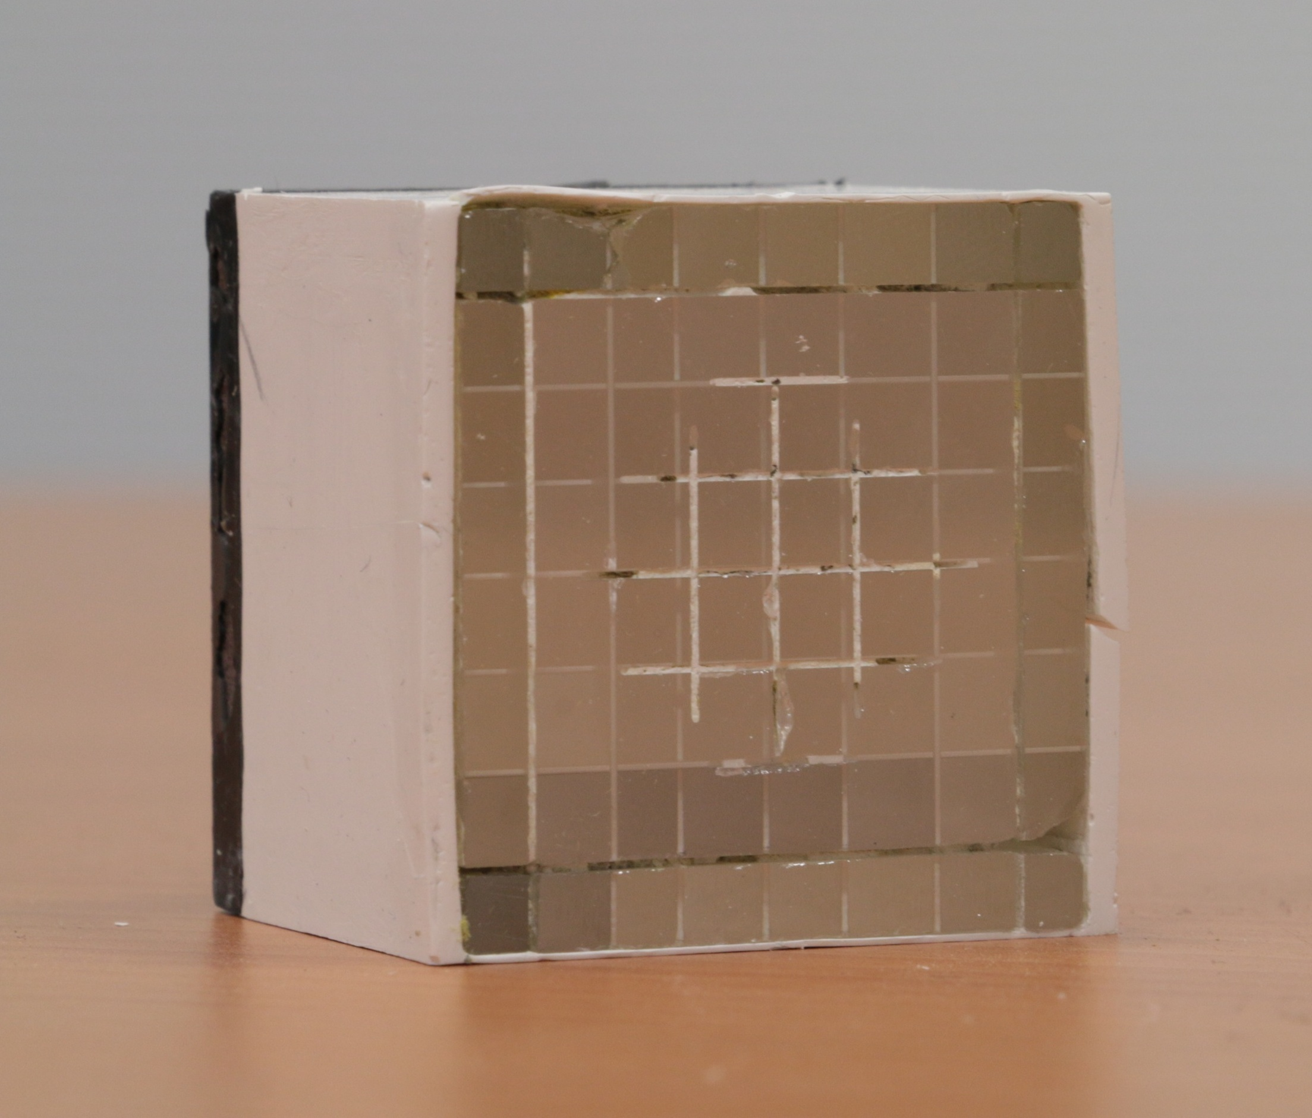
Detector components: absorber
ABSORBER
LPC Clermont
modular structure
96 BGO streaked blocks (~4 mm spatial resolution)
4 cylindrical PMs (Photo-Multipliers) for each block
ASM front-end cards
BGO blocks from a PET HR⁺ system by Siemens
Reconditioning process – scintillating block treatment and PM recoupling
5 reconditioned blocks available for the first tests
First characterization tests performed on original blocks @ GANIL and with radioactive sources
Energy resolution: 21 % FWHM @ 667 keV (¹³⁷Cs)
Time resolution: ~2 ns FWHM

Slide 49
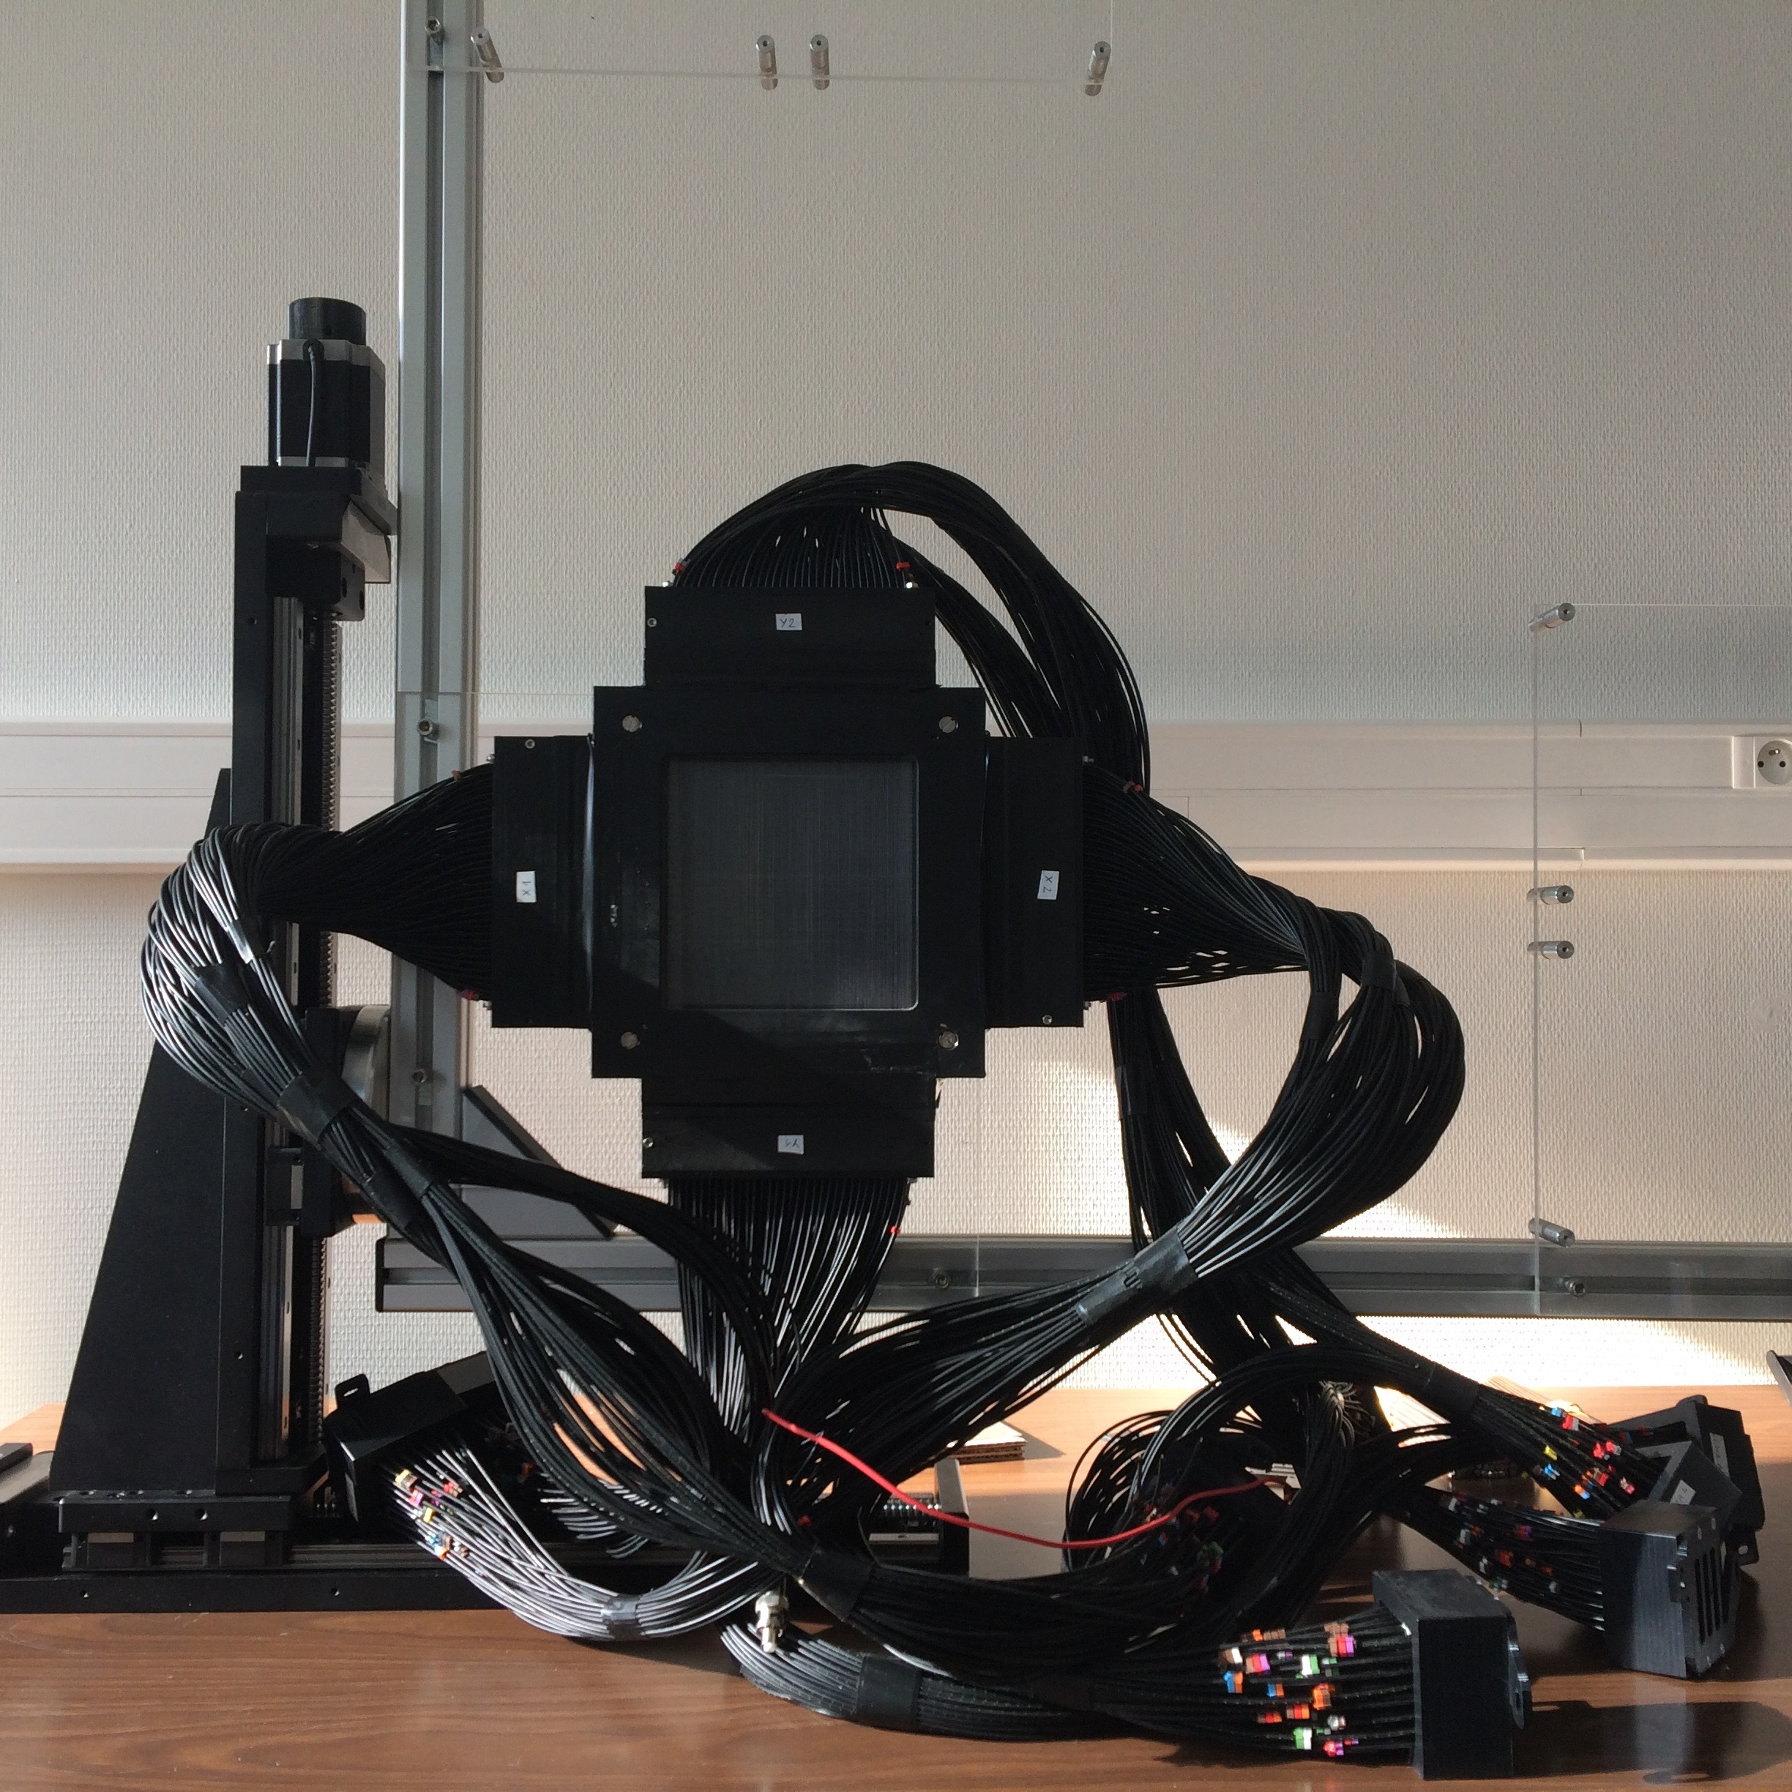
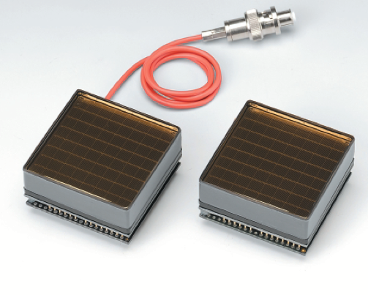
TOF and beam hodoscope
For ion beam therapy monitoring, secondary particle background has to be handled and possibly subtracted
Time Of Flight technique can be employed -> demonstrated possibility to reduce the background level and improve the SNR (Signal to Noise Ratio) – Testa 2010
Fast beam tagging detector needed -> hodoscope under development
SCINTILLATING FIBER HODOSCOPE
128x2 scintillating fibers for 2D information
1 mm² squared fibers BCF 12 (Saint Gobain) , 140 mm long
2-sided read-out through 1 m optical fibers (one per channel)
8 Hamamatsu PM, 64 channels each (8x8 matrix)
512 channels in total
Optical fibers connection in order to have the two sides of the same fiber on the same PM – uniform response
Custom electronics cards
Remotely controlled moving table as mechanical support, 2 axes
Beam tests 2010-2014
1 ns FWHM time resolution
~90% efficiency
Rate 10⁷ Hz per PM

Slide 50
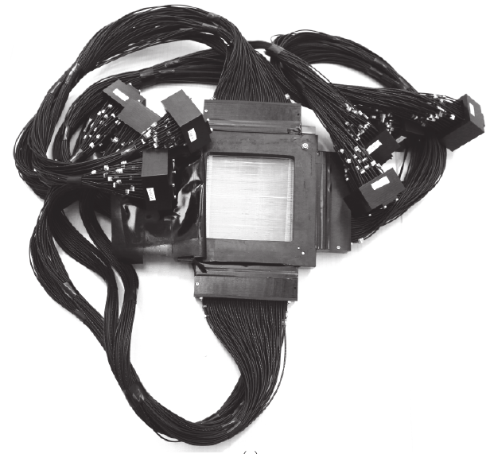
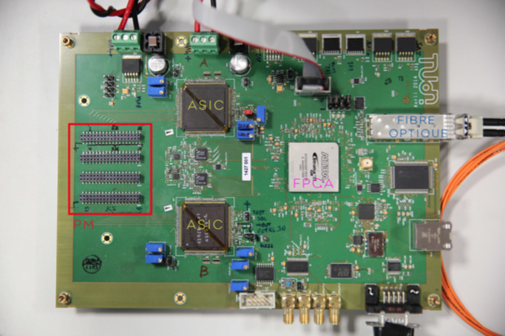
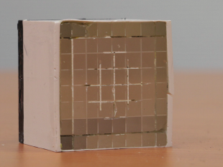
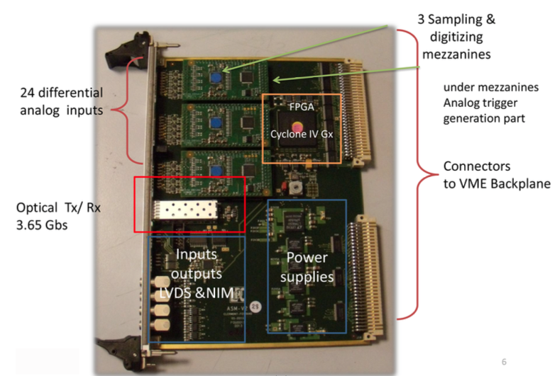
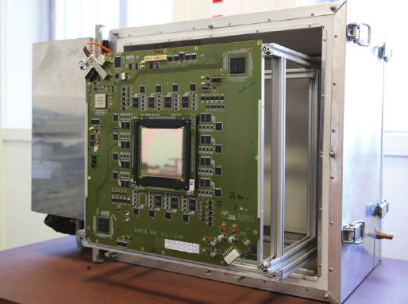
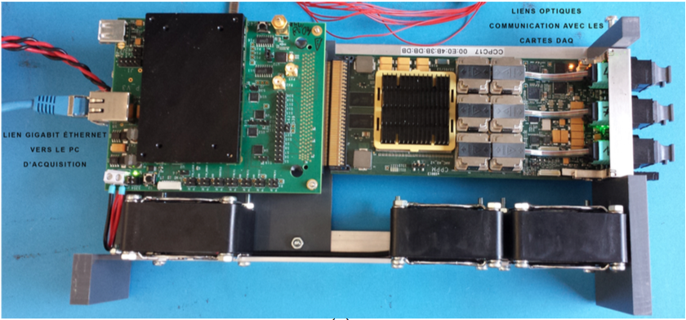
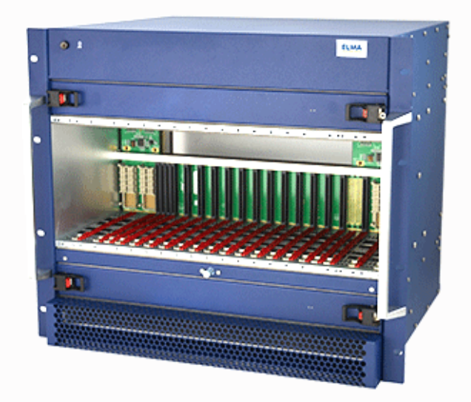
Complete acquisition system
8 hodoscope DAQ cards – 1 PM each
ASM cards for the absorber
TRIGGER
7 custom ASIC cards for scatterer detectors
THOR
Clock
AMC40
(µ-TCA standard)
EVENT
BUILDER

Slide 51
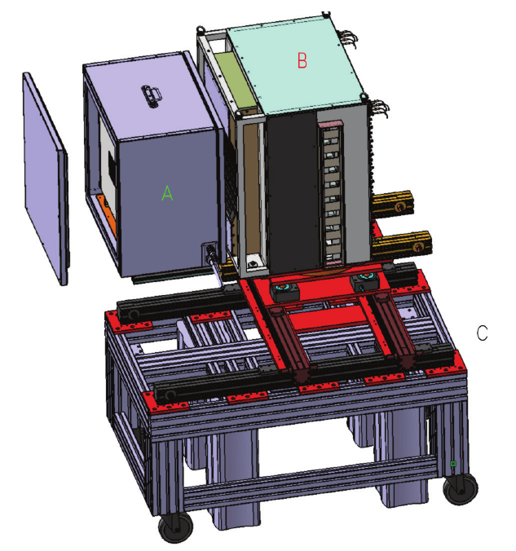
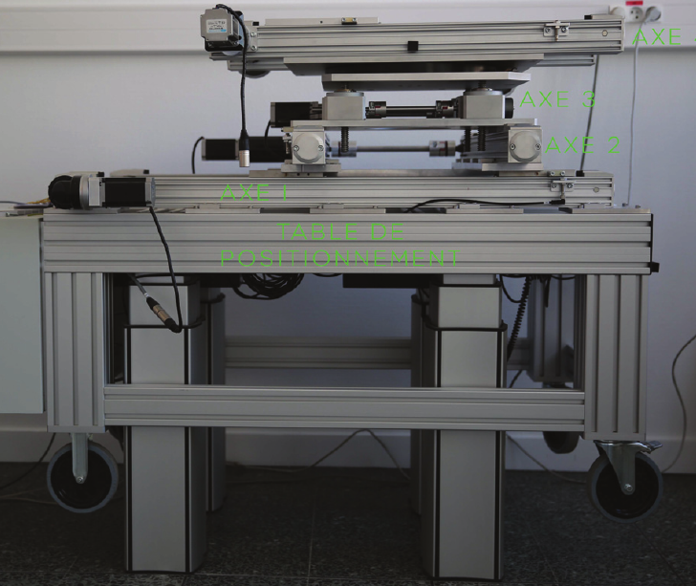
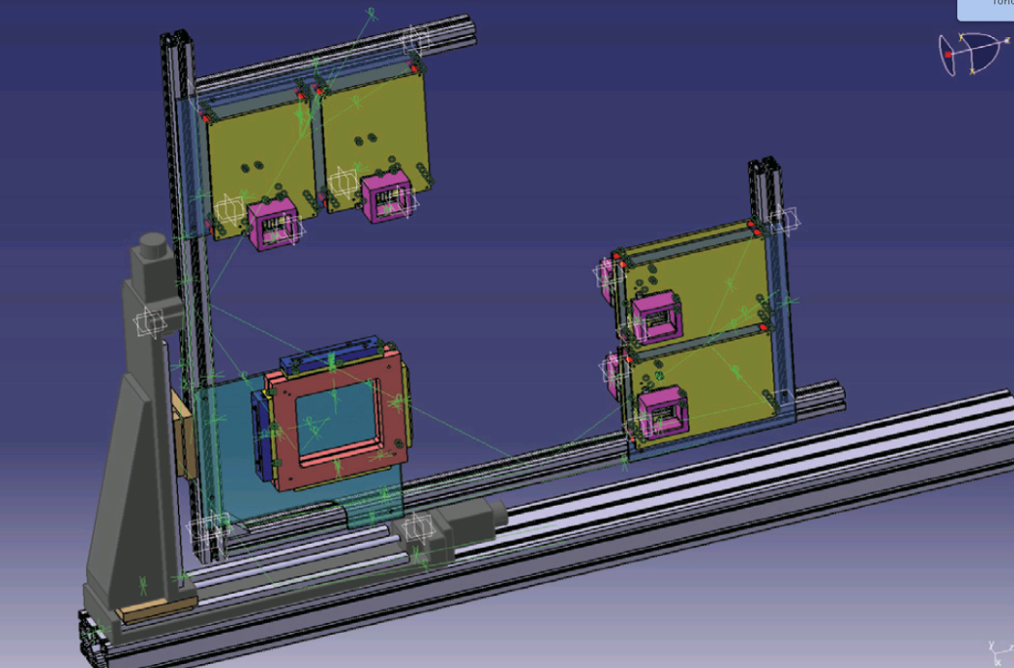
Mechanical supports
A : thermal box with Silicon detectors / collimator
B : Absorber
C : Positioning table
D : Hodoscope table
D
4 movement axes
3 D overall movement
2 section distance regulation
Height range from 60 to 150 cm
Wheels for portability
2 movement axes
Electronics cards support integrated

