Slide 1
GEANT4 Simulations of a Beam Shaping Assembly Design and Optimization for Thermal/Epithermal Neutrons
Vahagn Ivanyan
Yerevan Physics Institute, Armenia
9-June-2017

Slide 2
Overview
Introduction
Cyclotron C18/18
Difference of neutron yield depends on target thickness
GEANT4 simulations for creating Beam Shaping Assembly
Conclusion

Slide 3
Introduction
The possibility of obtaining thermal/epithermal neutron beams using external protons from Cyclotron C18/18 is studied based on GEANT4 simulations.
In this model of the GEANT4 simulation included two programs for physics lists. These are the one of the most important parts of the creation the correct model, which will as much as possible closer to the future experiment.
The formed beam of thermal/epithermal neutron beams will be used not only in fundamental research, but also for practical purposes, in particular, to explore the possibility of applying it in Boron Neutron Capture Therapy (BNCT).

Slide 4
Cyclotron C18/18
18 MeV Proton Beam Energy
Up to 100 μA Beam Current

Slide 5
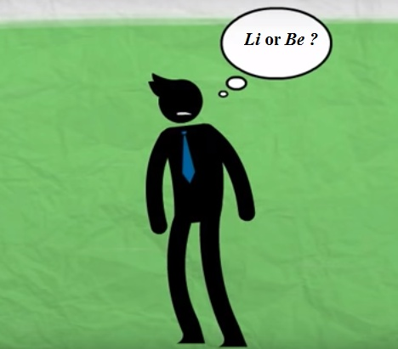
Beryllium
Melting Point = 1287 C
Lithium
Melting Point = 180.5 C
Cooling System
Difficult, Expensive,
Just a small difference of Neutrons
Be

Slide 6
All Neutron Emitted Reactions on ⁹Be Target With Thresholds Less Than 14.8 MeV
Reaction | Q – value (MeV) | Threshold (MeV)
p+⁹Be → n+⁹B | -1.8504 | 2.0572
p+⁹Be → γ+n+⁹B | -1.8855 | 2.057
p+⁹Be → p+n+⁸Be | -1.6645 | 1.85070
p+⁹Be → γ+n+p+⁸Be | -1.7011 | 1.85070
p+⁹Be → γ+n+α+⁵Li | -3.5377 | 3.9333
p+⁹Be → p+n+2α | -1.5727 | 1.74859

Slide 7
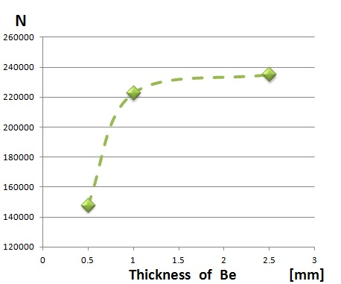
Neutron Energy Spectra after 3 cm Air and Beryllium Targets
Count [au]
1. 3cm Air and 0.5 mm Be
2. 3cm Air and 1 mm Be
3. 3cm Air and 2.5 mm Be
Energy [MeV]

Slide 8
1. Neutron Energy Spectrum after 2.5 mm Be and 5cm Bismuth
2. Neutron Energy Spectrum after 2.5 mm Be
Count [au]
Energy [MeV]

Slide 9
²⁰⁹Bi(n,xn) Reactions
n + ²⁰⁹Bi → ²⁰⁸Bi + 2 n
n + ²⁰⁹Bi → ²⁰⁸Bi + 2 n + N γ
n + ²⁰⁹Bi → ²⁰⁹Bi + n + N γ
n + ²⁰⁹Bi → ²⁰⁹Bi + n

Slide 10
Neutron Energy Spectrum after 2.5 mm Be, 5 cm Bismuth and 50 cm Iron
Count [au]
Energy [MeV]

Slide 11
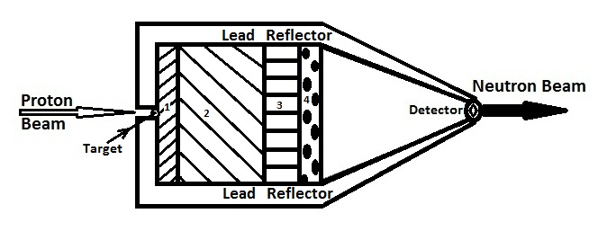
Neutron Energy Spectrum after 5 cm Bismuth, 50 cm Iron, 10 cm Aluminum and 5 cm Graphite
Count [au]
Neutrons
Up to 200 keV
6.25%

Slide 12
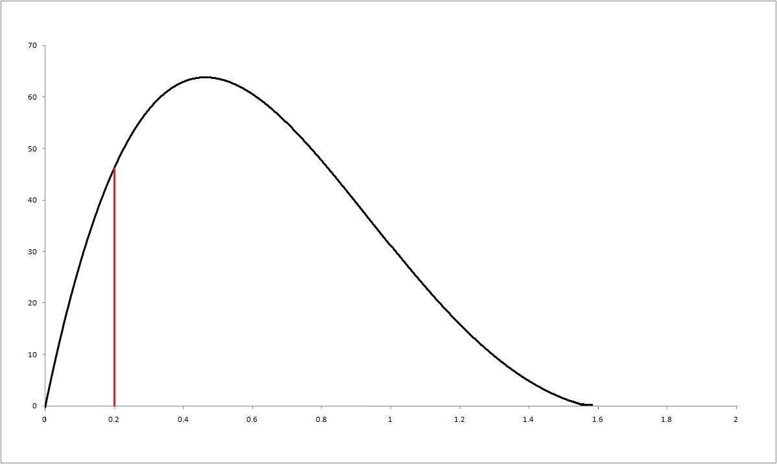
Neutron Energy Spectrum after 5 cm Bismuth, 50 cm Iron, 15 cm Aluminum, 5 cm Graphite and 4cm Lead
Count [au]
Err=17.7%
Neutrons
Up to 200 keV
18.2%
Err=44.7%
Energy [MeV]

Slide 13
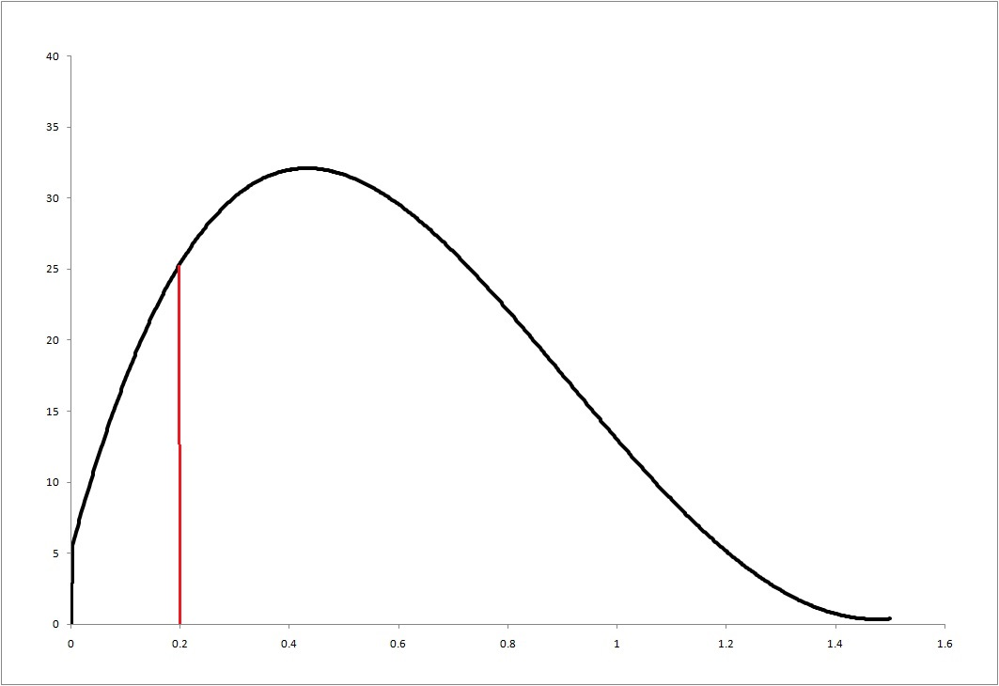
Neutron Energy Spectrum after 5 cm Bismuth, 50 cm Iron, 15 cm Aluminum, 5 cm Graphite and 4cm Aluminum
Count [au]
Neutrons
Up to 200 keV
20.1%
Energy [MeV]

Slide 14
GEANT4 Simulation
14

Slide 15
GEANT4 Simulation
2nd Jagiellonian Symposium
15

Slide 16
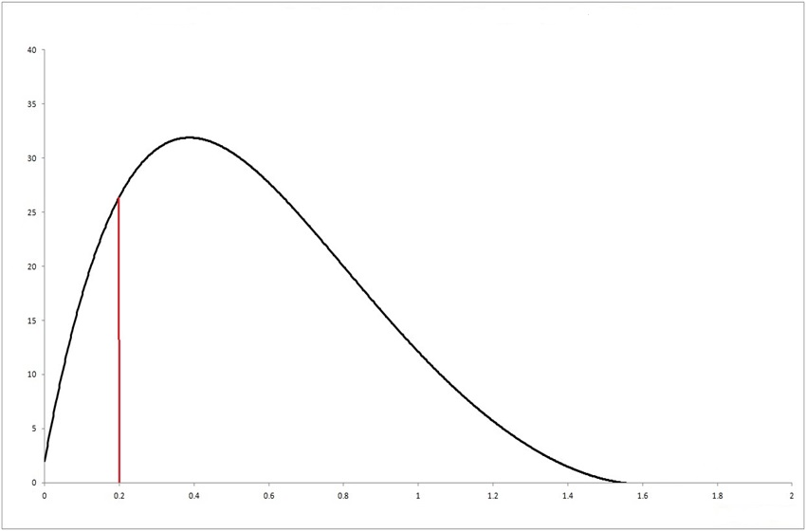
Neutron Energy Spectrum after 5 cm Bismuth, 55 cm Iron, 15 cm Aluminum, 5 cm Graphite, 85 cm Water
Count [au]
Neutrons
Up to 200 keV
20.7%
Energy [MeV]

Slide 17
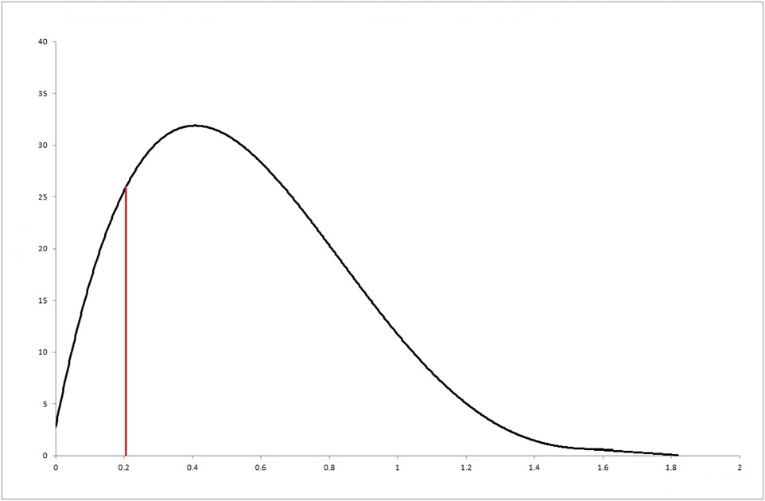
Neutron Energy Spectrum after 5 cm Bismuth, 55 cm Iron, 15 cm Aluminum, 5 cm Graphite, 85 cm Heavy Water
Count [au]
Neutrons
Up to 200 keV
20.7%
Energy [MeV]

Slide 18
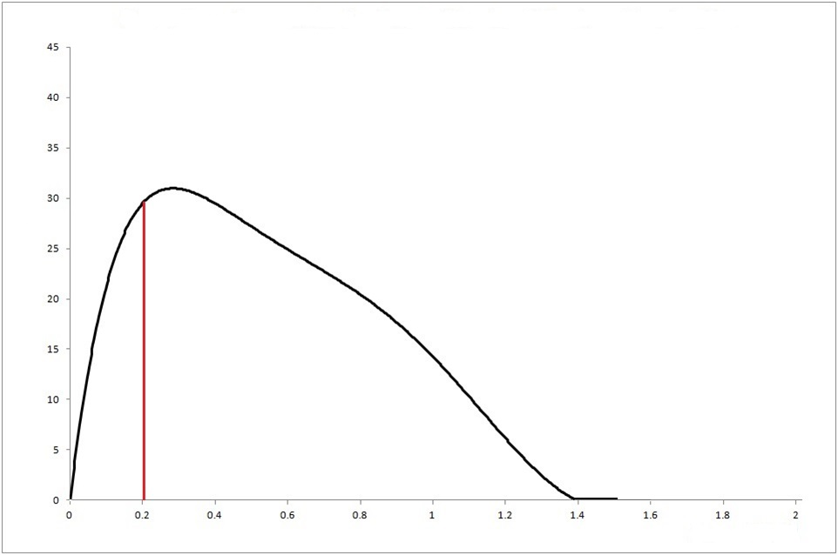
Neutron Energy Spectrum after 5 cm Bismuth, 55 cm Iron, 15 cm Aluminum, 90 cm Graphite
Count [au]
Neutrons
Up to 200 keV
22%
Energy [MeV]

Slide 19
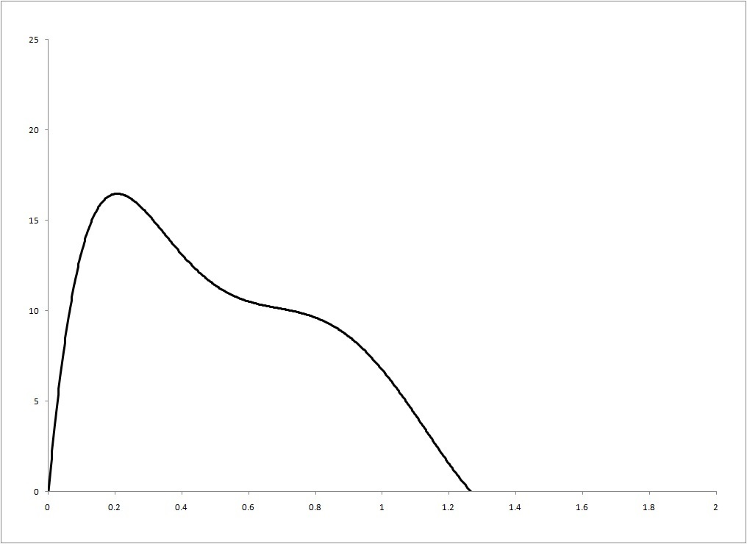
Neutron Energy Spectrum after 5 cm Bismuth, 55 cm Iron,
15 cm Aluminum, 150 cm Graphite
Count [au]
Neutron Beam: 1.27*10⁷ n/s*cm²
For 100 μA Proton Current
Neutrons from
Up to 200 keV
27.5%
Energy [MeV]

Slide 20
Neutron Energy Spectrum after 5 cm Bismuth, 55 cm Iron, 20 cm Aluminum, 165cm Graphite
Count [au]
Neutrons
Up to 200 keV
26.7%
Energy [MeV]

Slide 21
Neutron Energy Spectrum after 5 cm Bismuth, 55 cm Iron, 10 cm Aluminum, 5cm Graphite and 10 cm ⁷LiF
Count [au]
Neutrons
Up to 200 keV
61.1%
Energy [MeV]

Slide 22
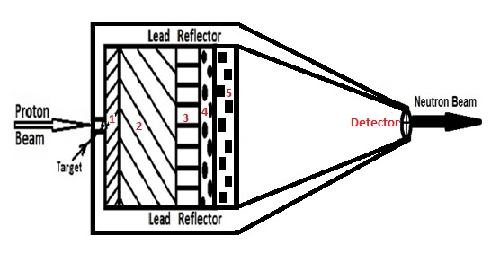
Conclusion BSA: 2.5 mm ⁹Be target, 5 cm Bismuth (1), 55 cm Iron (2), 10 cm Aluminum (3), 5cm Graphite (4), 10 cm ⁷LiF(5), Lead Reflector (6)
Neutron Beam: 0.96 *10 ⁶ n/s*cm²
For 100 μA Proton Current

Slide 23
Conclusion
BSA: 2.5 mm ⁹Be target, 5 cm Bismuth (red), 55 cm Iron (blue), 10 cm Aluminum (yellow), 5cm Graphite (white), 10 cm ⁷LiF (green), Lead Reflector (purple)
Neutron Beam: 0.96 *10 ⁶ n/s*cm²
For 100 μA proton current
2nd Jagiellonian Symposium on Fundamental and Applied Subatomic Physics
23

Slide 24
Publications
R. Avagyan, R. Avetisyan, V. Ivanyan , I. Kerobyan
Calculations of neutron yield and gamma rays intensity by Geant4
Armenian Journal of Physics 9(4) 2016, pp. 315-323
R. Avagyan, R. Avetisyan, V. Ivanyan , I. Kerobyan
Study of Low Energy neutron beam formation based on GEANT4 simulations
Nuclear Instruments and Methods in Physics Research Section B, Beam Interactions with Materials and Atoms
(Available online, In Press)

Slide 25
Thank You

Slide 26
IAEA Recommendations of Neutron Current
Φ th, Φ epi, Φ fast : Thermal, Epithermal, and fast Neutrons
Φ th [%] | 3.5
Φ epi [%] | 87.4
Φ fast [%] | 9.1

Slide 27
Publications
R. Avagyan, R. Avetisyan, V. Ivanyan , I. Kerobyan
Calculations of neutron yield and gamma rays intensity by Geant4
Armenian Journal of Physics 9(4) 2016, pp. 315-323
R. Avagyan, R. Avetisyan, V. Ivanyan , I. Kerobyan
Study of Low Energy neutron beam formation based on GEANT4 simulations
Nuclear Instruments and Methods in Physics Research Section B, Beam Interactions with Materials and Atoms
(Available online, In Press)

