Slide 1
Validation and verification
of real-time data processing system in programmable devices
for Digital J-PET scanner DAQ system
3rd Symposium on Positron Emission Tomography
Cracow, 2018
Karol Farbaniec
Notes:
“The man of science has learned to believe in justification, not by faith, but by verification.”
― Thomas H. Huxley
Dear all,
my name is Karol Farbaniec, I have a great pleasure to present you evaluation of current development process for real-time data processing system in Digital J-PET scanner.

Slide 2
Validation and verification
"Validation. The assurance that a product, service, or system meets the needs of the customer and other identified stakeholders..."
"Verification. The evaluation of whether or not a product, service, or system complies with a regulation, requirement, specification, or imposed condition..."
Notes:
Let’s start with formal definitions
Validation ensures that system meets users (or owners) requirements, it can be external process conducted by third-party.
Whereas verification is mostly internal process and evaluates if our system and subsystems complies specification.

Slide 3
Validation of developed system
Key functionality assumptions based on previous project iterations
continuous triggered readout
modularity and parametrization of subsystems
Bottlenecks candidates
resources
throughput
Next steps in further development...
Notes:
Requirements formation is based on previous J-PET project iteration
Continouos trigered readout lie behind streaming nature of application
Modularity and parametrization enables customization and code reuse
Bottlenecks candidates are
Resources in reference to processing
Throughput in reference to data transmission

Slide 4
Verification in reference to programmable devices
Data source emulation
HLS (High Level Synthesis) simulation environment for implemented modules
Complementary HDL simulation
Testing and evaluating design on hardware
Notes:
At current level more important than validation is verification of developed modules.
I would like to point out that it is a R&D project, so we do not have complete knowledge of a system and challenges to come while development.
That is why prepared verification environment and functional modules are so important.
They let us grab some idea and decide on a compromise between what we would like to have and what we are able to create.
From variety of technologies and tools I've choose most suitable for me.
Data source emulation – Ipython jupyter notebook for example data sets generation
HLS embedded simulation tool for grabbing rough idea about module performance
Detailed HDL simulation in SystemVerilog
Later tests and evaluation on HW

Slide 5
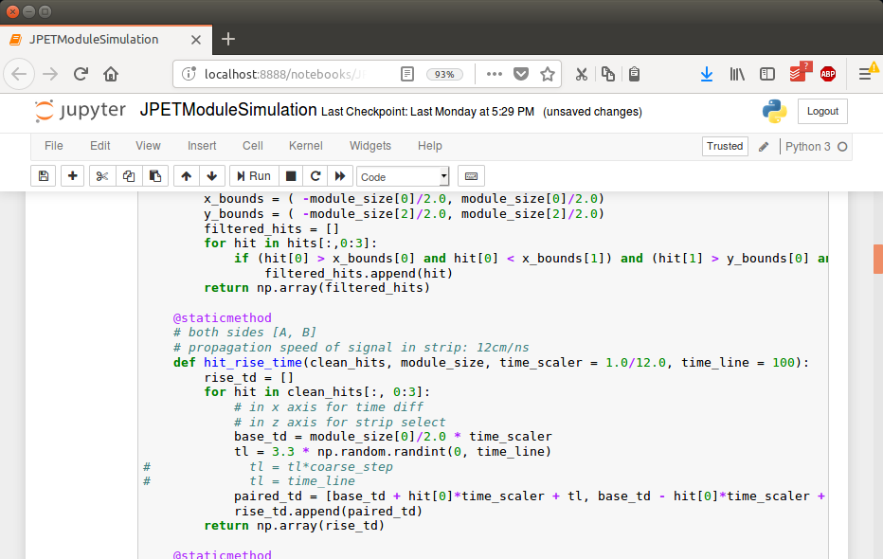
Data source emulation
Digital J-PET scanner module data generator in python.
Why python? Why Jupyter notebook?
Jupyter: No hardware setup or configuration needed. Work and further development can be easily done online in web browser
Python is high-level programming language, so creation of utility applications is fast and code is brief and legible.
Python contains scientific libraries, so we can easily extend and integrate current application with complex mathematical models
Notes:
- Jupyter: online, no configuration required
- Python: brief, legible, scientific

Slide 6
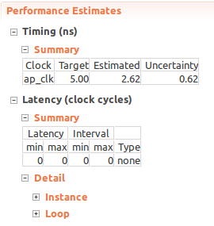
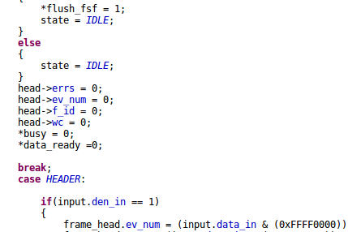
HLS simulation environment for designed modules
FPGA subsystems prototyping and testing in Vivado HLS IDE.
HLS programming language abstraction enables implementation and rough debug on main functionality faster than traditional Hardware Description languages
HLS enables agile design optimizations with pragmas
Software algorithms migration to programmable logic with HLS is easier because of same abstraction level implementation (C/C++)
Notes:
- We benefit from HLS abstraction by faster prototyping and rough debug
- Optimizations with few lines of pragmas drive complex HDL code generation for final solution
- For C/C++ algorithms implementation migration is programming language independent – same abstraction level

Slide 7
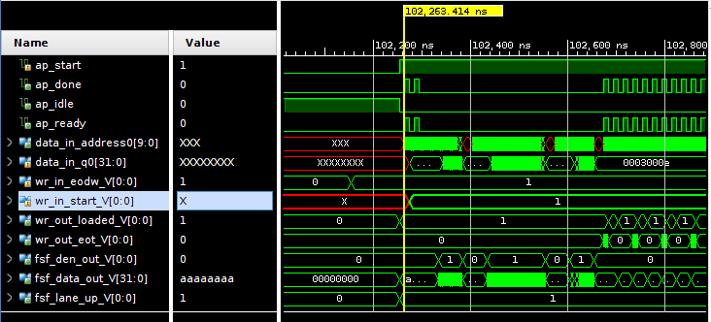
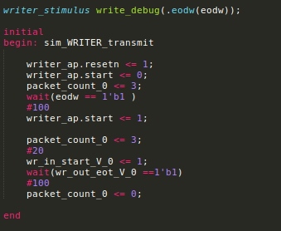
Complementary HDL simulation
HDL testbench and transactions simulation
Examination of low level signals in intergration testing and subsystems simulation
SystemVerilog based verification for HLS modules – testing on low-level abstraction
AXI transactions as freuqent method for in hardware FPGA testing, monitoring, slow-control and debug. Common interface in proposed system design

Slide 8
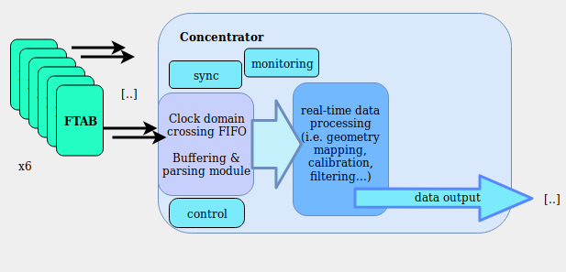
Data processing system – conceptual design
Notes:
Lets have a look at

Slide 9
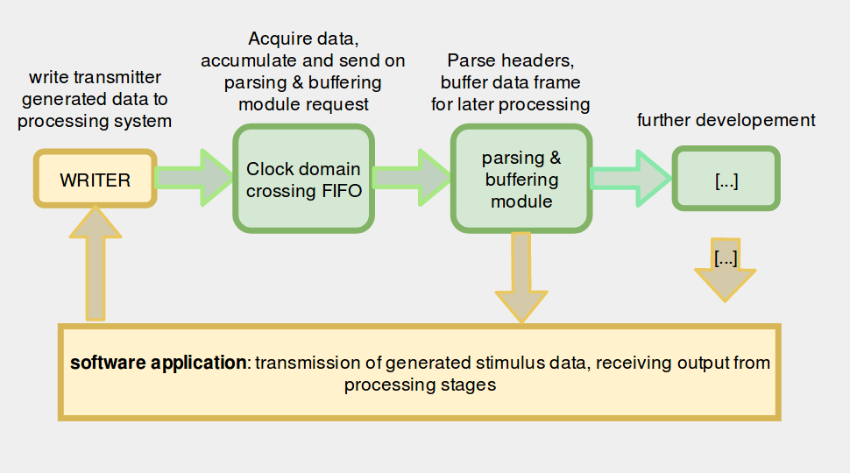
Testing and design evaluation in hardware

Slide 10
Summary & conclusions
Suitable verification enviroment enables faster developement of modules
Variety use of dedicated tools, software and programming languages is essential in complex HW/SW systems developement
Scripts, applications and designs reuse its a nice to have approach while working on R&D
Parser and interfacing tests ongoing
Module-wise coincidence finder as a next step
Notes:
Breadth and depth of real-time data processing

