Slide 1
Positronium migration
Radosław Zaleski
Maria Curie-Skłodowska University, Lublin, Poland

Slide 2
Chapter 1
Positronium formation and thermalization
e⁻
e⁺
Ps

Slide 3
Blob model
e⁺ emission from source (E ~ several hundred keV)
Rare central collisions → δe⁻
Non-central collisions → electron‑ion pairs in spherical spurs
Overlapping spurs (E < 3 keV) → cylindrical column of ionization
+
-
+
+
-
-
+
+
-
+
δe⁻
+
-
-
-
-
+
+
-
+
-
-
+
-
+
+
-
+
-
-
+
+
-
-
+
-
+
-
+
-
+
+
-
-
-
+
+
+
-
+
+
+
+
-
+
-
e⁺
-
+
+
-
-
-
+
+
-
+
+
-
-
+
-
-
+
E ≈ 3 keV
S.V. Stepanov, V.M. Byakov, J. Chem. Phys. 116, 14 (2002)

Slide 4
Blob model
then
Positron diffusive-like movement (E < 0.5 keV) → spherical blob
Correlated positron-electron pair escapes blob (E < E_{jon}) → pre-Ps
Pre-Ps finds free volume (R > 0.1 nm) → Ps
+
-
+
+
-
-
+
+
-
+
δe⁻
+
-
-
-
-
Ps
+
+
-
+
-
-
+
-
+
+
-
+
-
-
+
+
-
-
+
E ≈ 500 eV
-
+
e⁻
10-20 nm
e⁺
+
-
+
-
+
+
-
+
-
-
-
+
-
+
-
+
-
+
-
+
+
-
-
-
+
-
+
+
-
+
+
+
+
-
+
-
+
-
+
-
-
+
-
-
-
-
+
-
-
+
+
+
-
+
+
-
+
+
E ≈ 3 keV
E ~ eV
S.V. Stepanov, V.M. Byakov, J. Chem. Phys. 116, 14 (2002)

Slide 5
Blob model
No description if formation occurs in porous material!
(Especially blob and pre-Ps part)
+
-
+
+
-
-
+
+
-
+
δe⁻
+
-
-
-
-
Ps
+
+
-
+
-
-
+
-
+
+
-
+
-
-
+
+
-
-
+
E ≈ 500 eV
-
+
e⁻
10-20 nm
e⁺
+
-
+
-
+
+
-
+
-
-
-
+
-
+
-
+
-
+
-
+
+
-
-
-
+
-
+
+
-
+
+
+
+
-
+
-
+
-
+
-
-
+
-
-
-
-
+
-
-
+
+
+
-
+
+
-
+
+
E ≈ 3 keV
E ~ eV
S.V. Stepanov, V.M. Byakov, J. Chem. Phys. 116, 14 (2002)

Slide 6
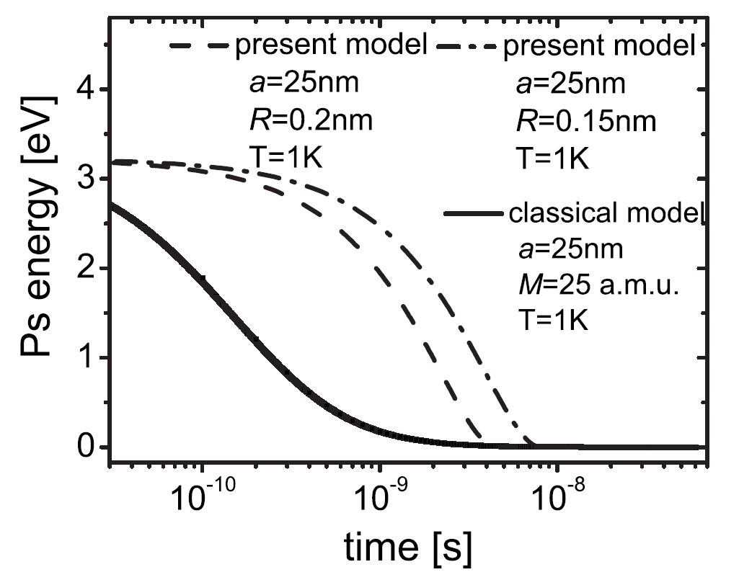
Positronium thermalization
Elastic Thermalisation Lifetime Analysis
C. Dauwe, B. Van Waeyenberge, D. Segers, T. Van Hoecke and J. Kuriplach, J. Radioanal. Nucl. Chem. 210, 293-308 (1996)
Phonon scattering
S. Mariazzi, A. Salemi and R.S. Brusa, Phys. Rev. B: Condens. Matter Mater. Phys. 78, 085428-085428 (2008)
Ps

Slide 7
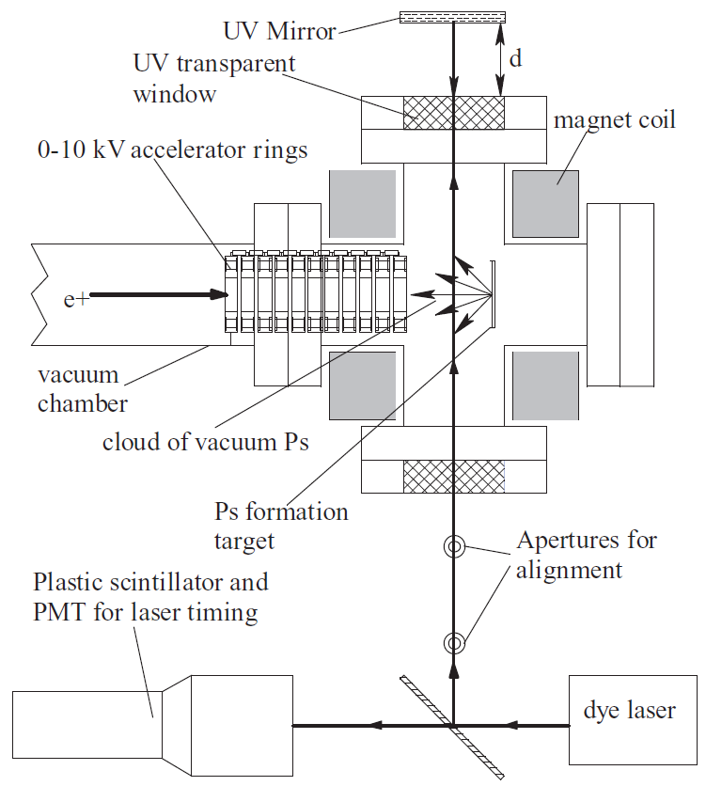

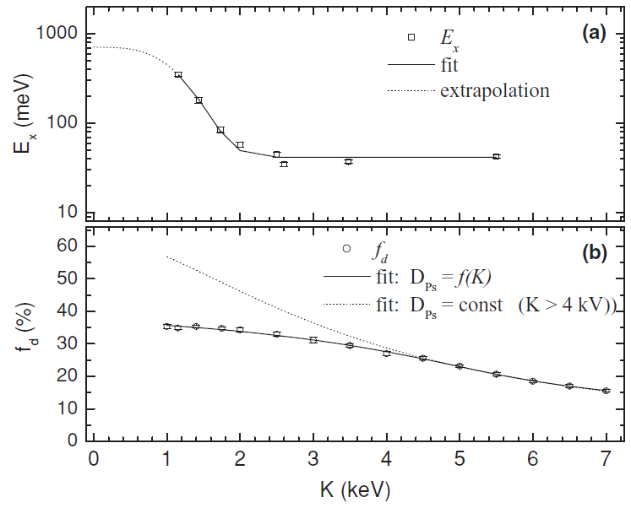
Positronium thermalization
Doppler spectroscopy
D.B. Cassidy, P. Crivelli, T.H. Hisakado, L. Liszkay, V.E. Meligne, P. Perez, H.W.K. Tom and A.P. Mills, Jr., Phys. Rev. A 81, 012715 (2010)

Slide 8
Chapter 2
Positronium migration
Ps

Slide 9
o-Ps migration
?
Ps
Ps
Ps
Ps formation
in mesopores
o-Ps migration from mesopores
to intergranular space
o-Ps (re)trapping
and annihilation

Slide 10
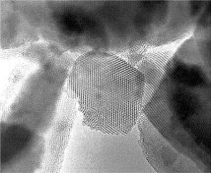
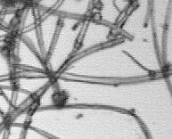

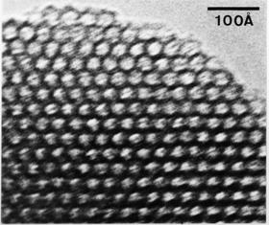
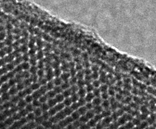
Open pores vs. closed pores
MCM-41
MSF

Slide 11
Open pores vs. closed pores

Slide 12
Template removal by MCM-41 heating in vacuum
Ps
Ps
~ 25%

Slide 13
o-Ps intensity vs. oxygen pressure
Ps migration from
small to large pores in oxygen
SUPPRESSED
Ps
!

Slide 14
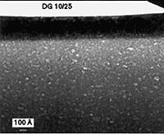
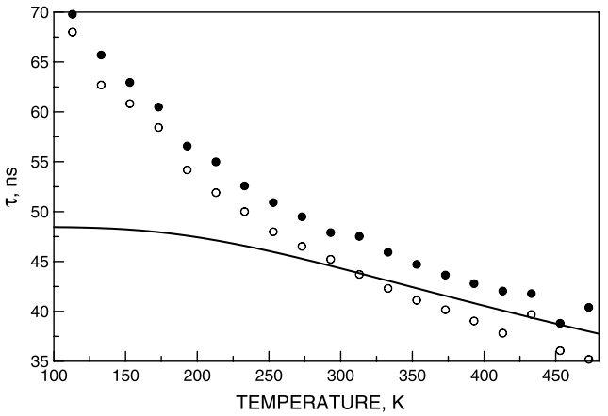
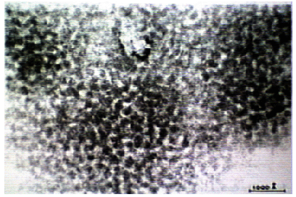
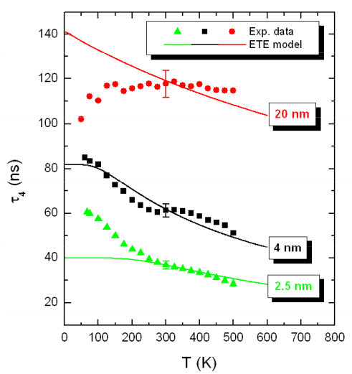
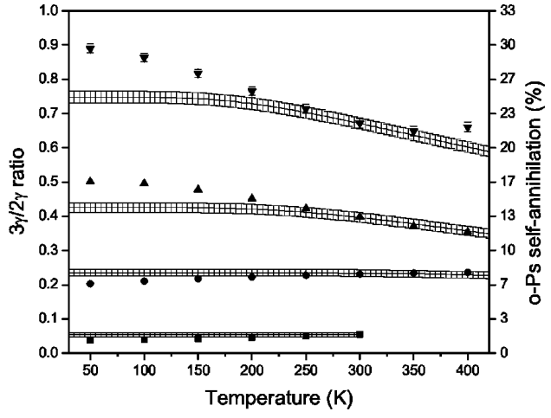
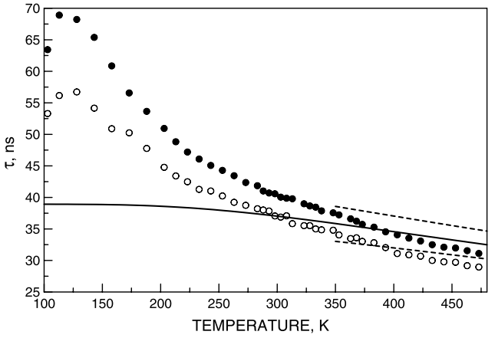
Disagreement between experiment and model
porous silica
(polymer template)
Vycor
MSSQ
fotonic glass
C. G. Fischer, M. H. Weber, C. L. Wang, S. P. McNeil, and K. G. Lynn, Physical Review B 71, 180102 (2005)
M. Sniegocka, B. Jasinska, T. Goworek, and R. Zaleski, Chem. Phys. Lett. 430, 351 (2006)
S. Thraenert, E. M. Hassan, D. Enke, D. Fuerst, and R. Krause-Rehberg, physica status solidi (c) 4, 3819 (2007)
Numerous effects can cause Ps lifetime shortening, but
what causes its elongation?

Slide 15
o-Ps lifetime vs. temperature
MELT
100 K
220 K
460 K
3,4 nm
2,8 nm
3,4 nm
2,8 nm
E

Slide 16
o-Ps localization
2,8 nm
3,4 nm
Ps Ps Ps Ps
460 K
LEVEL OCCUPATION
LEVEL OCCUPATION
Ps
Ps
Ps
100 K
E
LEVEL OCCUPATION
LEVEL OCCUPATION

Slide 17
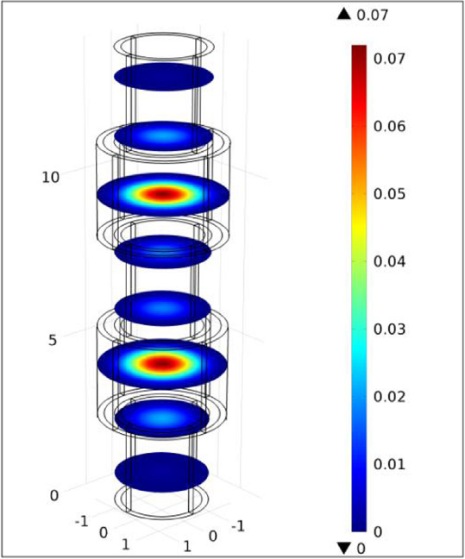
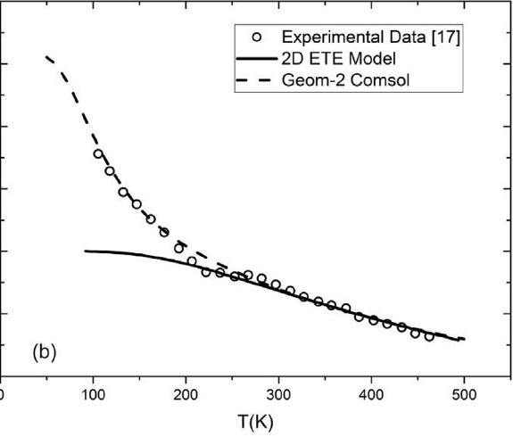
o-Ps localization
M. Khaghani and A. A. Mehmandoost-Khajeh-Dad, Nucl. Instr. Meth. Phys. Res., 2017, 396, 11-17.

Slide 18
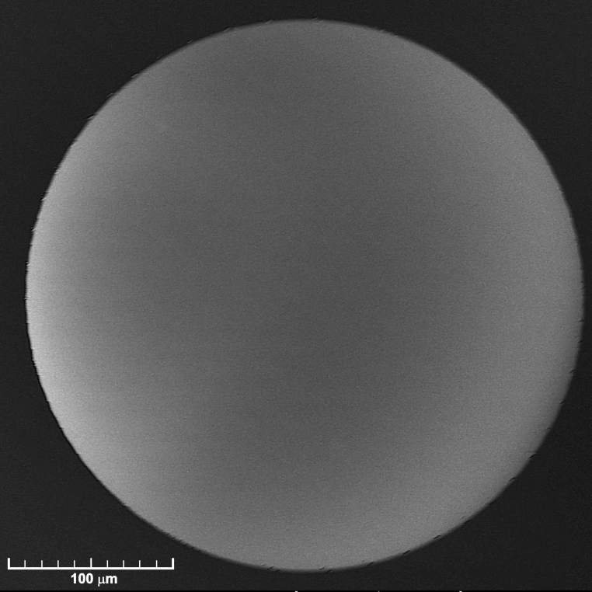
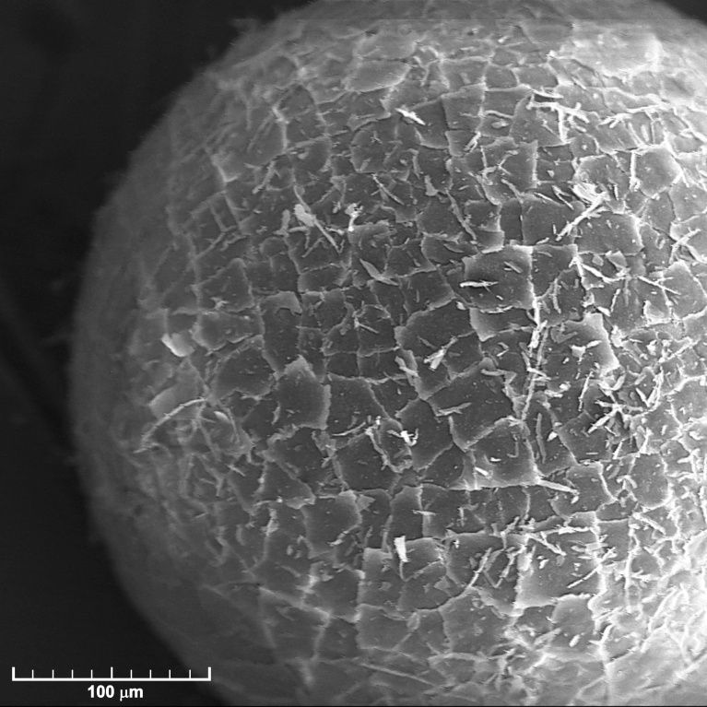
Polymer-silica composites

Slide 19
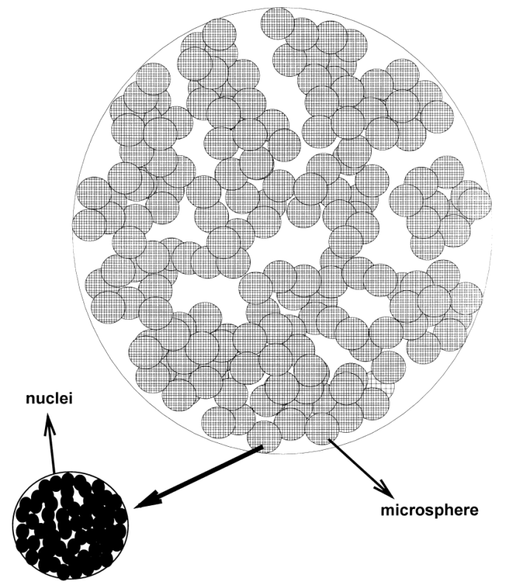
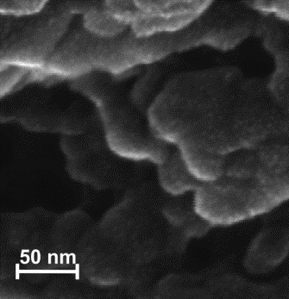
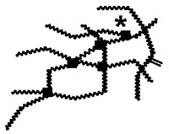
Micro- and mesopores
O. Okay, Prog. Polym. Sci. 25 (2000) 711-779.
XAD7HP
V
δ_{D}
D_{avg}

Slide 20
Amount of silica (PALS vs. LN₂ adsorption)
25%
50%
75%
95%

Slide 21
Amount of silica (PALS vs. LN₂ adsorption)

Slide 22
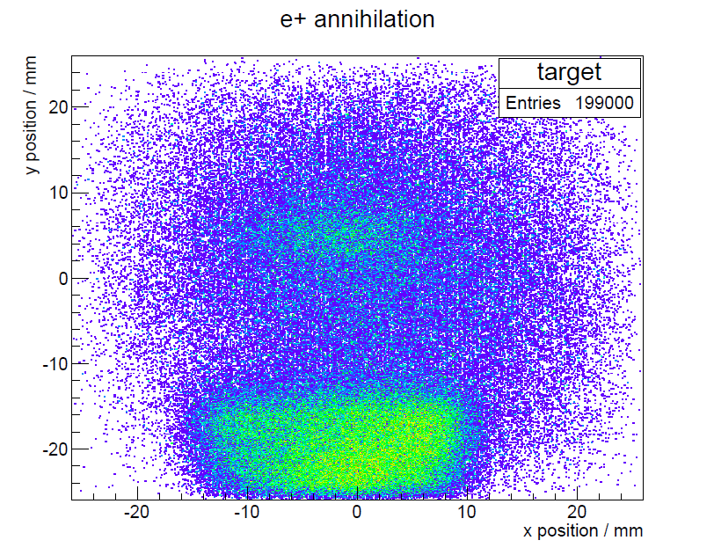
Chapter 3
The experiment

Slide 23

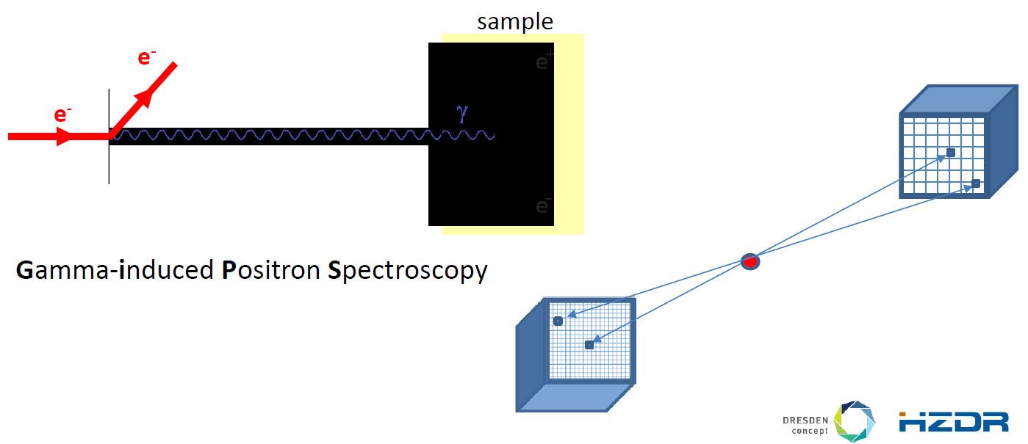
Feasibility study
Position resolved PALS setup @ GiPS
Time of flight of positronium
formation and thermalization times
positronium final energy

Slide 24
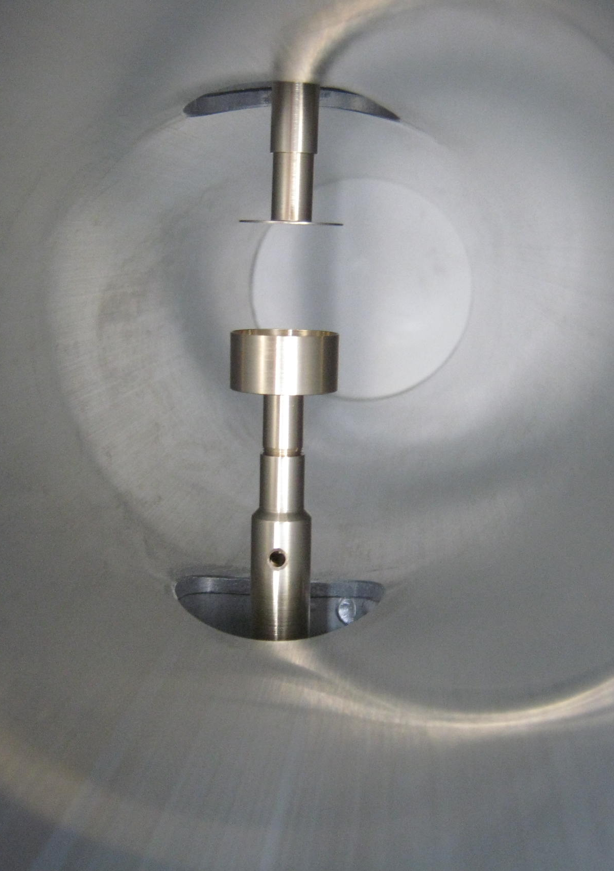
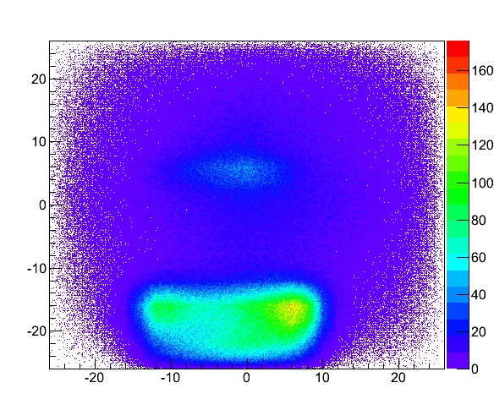
Feasibility study
“There is slight increase in number of counts at time expected for positronium migrating from the sample. Unfortunately it is still within statistical uncertainty. Despite the lack of statistics due to short beam time, we conclude the experiment to be feasible in general. “

Slide 25
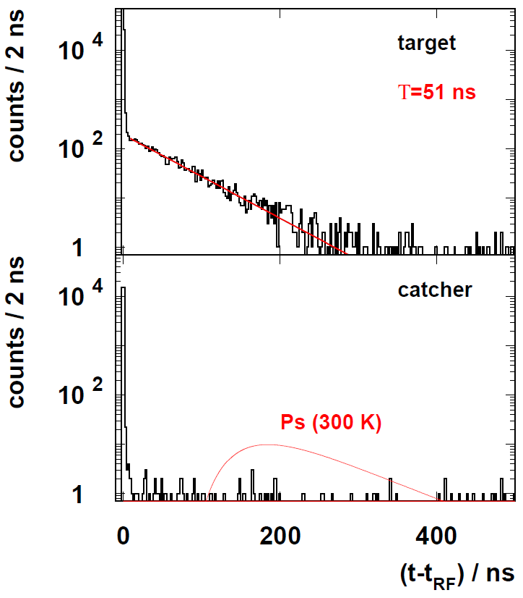
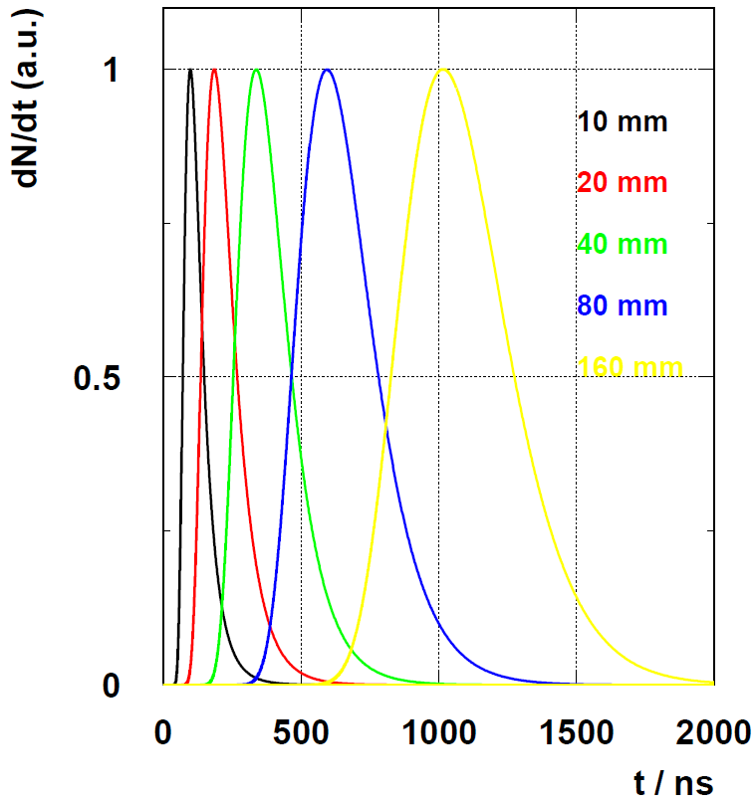
Feasibility study

Slide 26
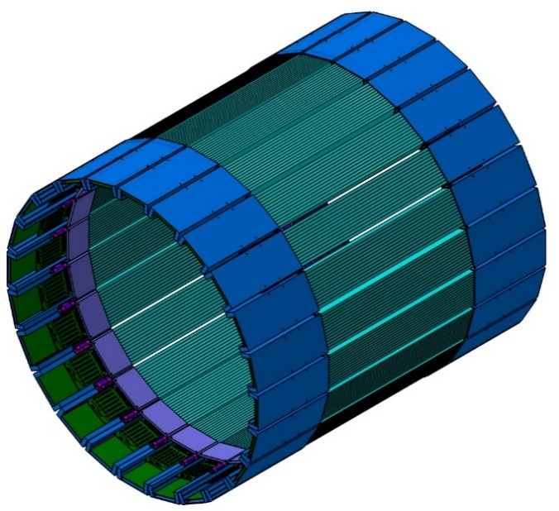
Epilogue
Can J-PET do this?

