Slide 1
A Monte Carlo-based treatment planning tool for proton therapy
A. Mairani^{1,2}, T.T. Böhlen^{4,5}, A. Schiavi³, T. Tessonnier^{1,7}, S. Molinelli¹, S. Brons², G. Battistoni⁶, K. Parodi², V. Patera³
¹CNAO, Pavia, Italy, ²HIT, Heidelberg, Germany, ³La Sapienza Università di Roma, Rome, Italy,
⁴CERN, Geneva, Switzerland, ⁵Medical Radiation Physics, Karolinska Institutet
and Stockholm University, Stockholm, Sweden, ⁶INFN Sezione di Milano, Milan, Italy,
⁷Joseph Fourier University, Grenoble, France
PMB 58 (2013) 2471-2490

Slide 2
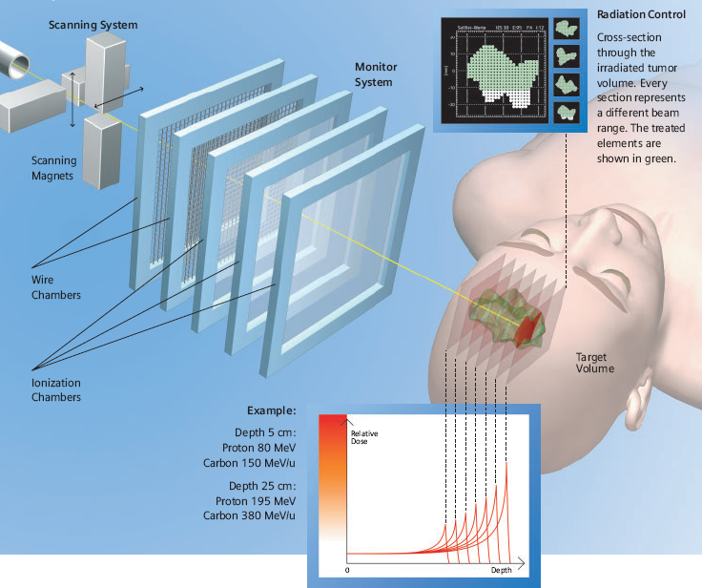
Hadron Therapy with active scanning

Slide 3
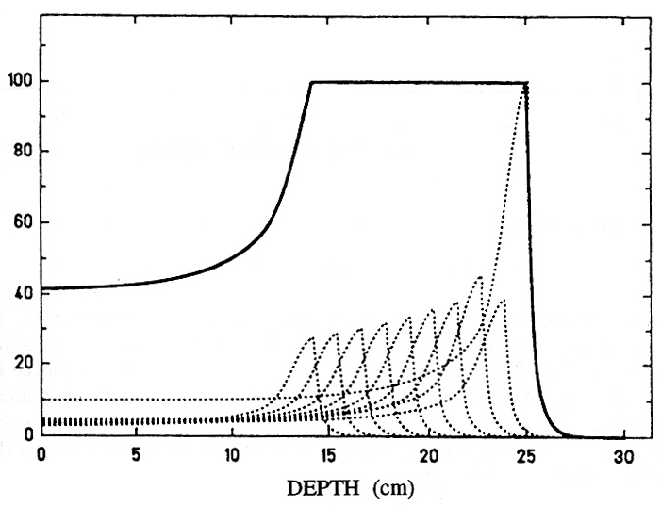
The concept of Treatment Planning (in a 1D-approx.)
Size of the tumor region
PTV = Planned Treatement Volume
This plot is in physical dose for a constant biogical effectiveness

Slide 4
Treatment planning and Monte Carlo
Currently treatment planning for hadron therapy are commonly based on fast analytic dose engines using Pencil Beam algorithms.
MC calculation of doses and fluences are superior in accuracy because they take into account heterogeneities, large densities, geometry details. They can predict secondary particle production. However they require much longer execution times…

Slide 5
Present application of MC calculations in hadron therapy
Calculation of input physics databases (for example: the case of TPS developed within the INFN-IBA collaboration)
Validation of TP calculation (in Water/CT systems)
Forward (re)check of TP predictions (and possibly provide corrections
Calculation of secondary particle production
Data analysis in dosimetry experiments
Commissioning of infrastructures

Slide 6
In all cases there is the question of the proper RBE to be used. MC coupled to proper radiobiological models can account better for mixed field situations (ion therapy)
In proton therapy a constant value of 1.1 is often used (in accordance to ICRU 2007), but there are data showing that a variation occurs in the last few mm
Use of MC to recheck and correct standard TPS calculations has been discussed several times in literature.

Slide 7
Towards a new TPS approach based on MC
Can we build a TPS using the accuracy achievable by a detailed MC calculation?
An integrated MC+optimization tool:
to explore the possibility of a treatment planning which overcomes the “water-equivalent” approach
to take into account all details about geometry and materials
which can be applied to realistic treatment conditions with acceptable CPU time
That can be applied in planning for ions with 1<Z<8: today’s talk will be focused on protons only

Slide 8
Goals
A tool which not only allows to recheck a given plan, but which also suggest a better solution
To be used stand-alone (using some pre-processing code, see later) or as post re-optimization of plans obtained from commercial TPS (as applied at CNAO)
To be used in research:
  New ions and combined ion fields
  testing of new bio-models and algorithms
  to predict secondary fluxes: β⁺ emitters, prompt γ, etc.

Slide 9

Choice of the MC code
FLUKA (INFN-CERN property) is the baseline choice for this project
(http://www.fluka.org)
Presently used in hadron therapy contect
Includes sound physical models
Capability of being coupled to CT scans to import geometry, to import volume/organ definitions
Possibility to be coupled to a Radiobiological model

Slide 10
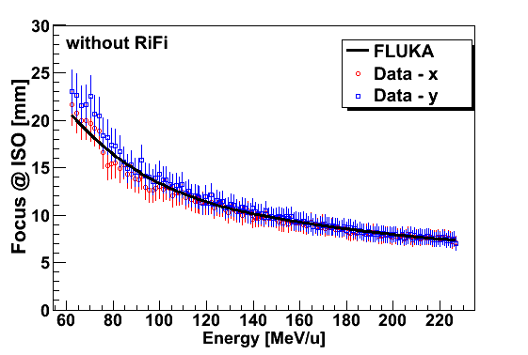
Use of FLUKA @CNAO to provide input databases
Beam delivery
Scanning with active energy variation
Required parameters
147 Energy steps (30-320 mm)
1 Focus size @ ISO
FLUKA calculated FWHM at the isocentre as function of the proton beam energy
CNAO Med Phys Group

Slide 11
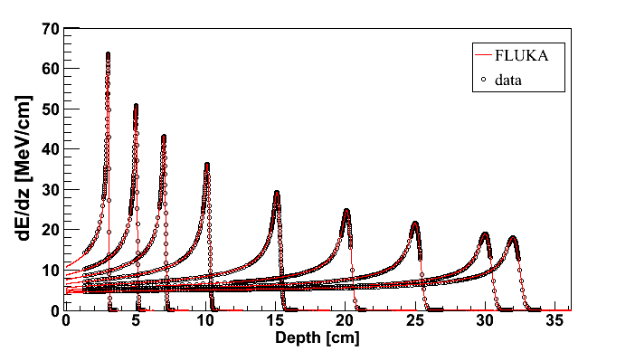
FLUKA calculated depth-dose distribution in water

Slide 12
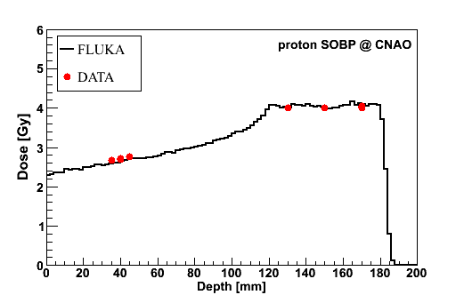

Slide 13
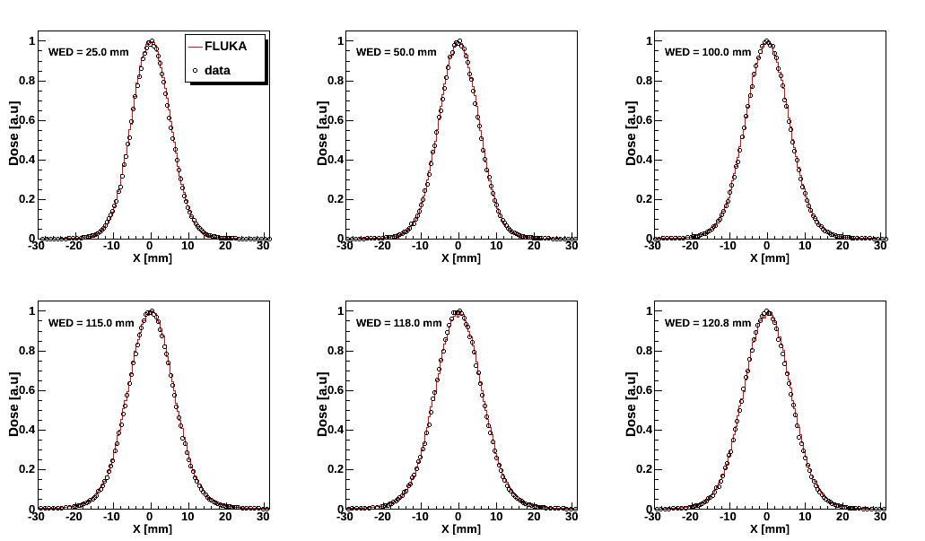
FLUKA calculated lateral dose profiles at
different Water Equivalent Depths (WED) for 130.57 MeV/u protons
CNAO Med Phys Group
Both the experimental data and the MC results are renormalized to the maximum at each depth.

Slide 14
FLUKA recalculation of a patient PLAN
Capability to import a CT scan to build 3D voxel geometry
Capability to assigm materials and composition according to HU numbers from CT scan
Capability of coupling to radiobiological models based on Dual Radiation Approach Theory ➔ Calculation of RBE-weighted dose (D_{RBE})

Slide 15
Basic principles
Multistep procedure:
start from a a given set of PBs P₁(N₁) with pre-optimized initial particle numbers N₁
This set can be obtained from a pre-selection and pre-optimization of available PBs deliverable by the “accelerator beam library”: P₀ for a given treatment and beam port:
    Two alternatives: - an already available certified TPS - a fast simulator
Starting from P₁(N₁) the MC (FLUKA) allows to calculate a Dose Kernel (D_{MC}) using the fully detailed case geometry, composition and machine setting
An optimization code will derive iteratively from D_{MC} the optimized solution P₂(N₂)

Slide 16
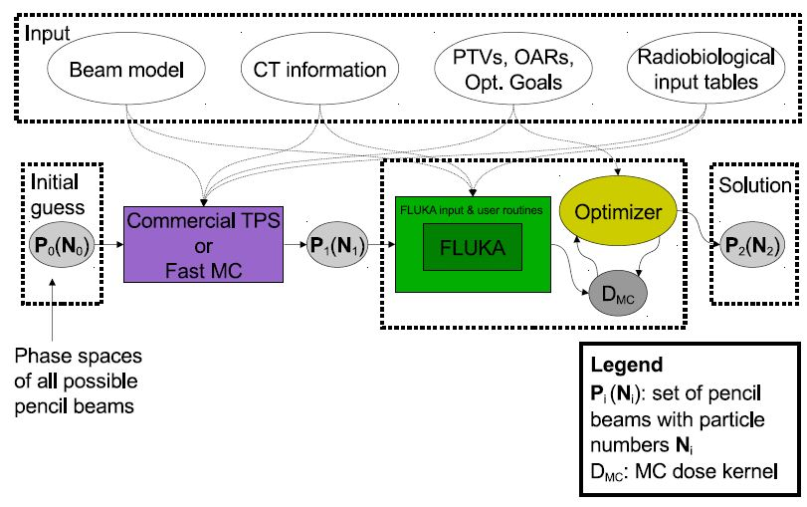
Components and program flow

Slide 17
Optimization procedure
Absorbed dose in voxel j from PBs (running on i index)
N has to be determined by minimizing the following cost function:
Prescribed dose in dose grid voxel
Weight associated to grid voxel j based on planner’s prescription
Two optimization methods tested:
Gradient-Based optimization (“Steepest Descent”)
“Dose-Difference Optimization”Approach described in Lomax, PMB 44 (1999) 185

Slide 18
Dose-to-medium vs Dose-to-water
In order to compare to standard TP calculation Dose has to be expressed as Dose-To-Water (MC calculated directly Dose-To-Medium)
TP rescale depth-dose profiles in water using Water Equivalent Path Length (WEPL) approximantion
in our approach we get Dw by scoring in MC
Fluence x LET in Water (from MC model)

Slide 19
Calculating RBE-weighted doses
RBE: ratio of the dose from a reference radiation (D_{RX}) and the dose for the actual radiation (D_{r}) needed to achieve the same biological effect under consideration
for a given radiation field, RBE is not a univoque quantity
… it depends on:
The definition used in the calculus;
The considered biological effect (survival, induction of mutations etc.)
The cell type
The considered “Level of expression” for a given biological effect

Slide 20
RBE defined using Survival Fraction

Slide 21
Radiobiological Model
Values of non-constant RBE are obtained by a re-implementation of the “local effect model” (LEM, version IV) developed in Heidelberg.
  Elsasser T. et al., Int. J. Radiat. Oncol. 78 (2010) 1177-1184
Warning: using for the moment a reference cellular line (non-human) typical in radiobiology studies…
Radiobiological input tables computerd with LEM are interfaced with FLUKA to calculate RBE-weighted doses D_{RBE}

Slide 22
Coupling to radiobiological model
LEM predicts α_{ion} and β_{ion} for single ion at a given energy.
In a real case this condition is never met: energy straggling, scattering and nuclear fragmentation, mixed radiation field contribute to the same given voxel with fluences of different particle species of different energies.
Common approach: by MC calculation we derive dose-weighted averages for a and b in voxel j:

Slide 23
Optimization of D_{RBE}
D_{RBE,j} replaces D_{j}
In gradient based optimization, the case of constant RBE weigth (e.g. RBE=1.1 for protons) is trivial
for varying RBE values one has to consider the following gradient:
However, at typical target dose levels, RBE is a slowly varying function of Ni as compared to Dose. This allows us to neglet the second term and approximate W_{RBE} as a stepwise constant.
Similar arguments apply to DDO approach

Slide 24
Verification of MCTPS Plans
Cases:
  single field irradiation of homogeneous 3D dose distribution of 2 Gy in a cubic shale (3x3x3 cm³) in water phantom
  Patient cases with 2 or 3 beam ports. D_{RBE} = 2 Gy for PTV either with fixed RBE=1.1 or variable RBE as predicted by LEM. PTVs of 32.5 ml and 103.5 ml
For Patient Cases: TP at CNAO is Syngo RT Planning by Siemens AG (Version VB10A). This is used for pre-optimization phase.
Input to Syngo and to our Fast MC are: acc. beam energies, FWHM of lateral profiles at isocenter, CT or contoured phantom, optimization goals and radiobiological tables (only for fast MC)

Slide 25
MC Set-up
SImulation set up includes CNAO Nozzle so to generate “PB” with actual phase space distribution: lateral FWHM ~ 1.0 cm at isocenter, lateral spacing of 3 mm. Spacing between Bragg peak position of 2 neighboutring beam energies 2 mm.
Simulation includes voxelized water phantom or CT patient image: 2x2 mm² transaxial pixels and 2 mm slices (as for the certified default TPS at CNAO). This defines transport and scoring granularity in MC
Materials and Composition assigned to voxels according to Schneider et al, PMB 45 (2000) 459 and Parodi et al. PMB 52 (2007) 3369
Dose Kernel Matrix D_{MC} ≡ (d_{j,i}; a_{j,i}; b_{j,i})
Total no. of PB to be simulated: 3438 for the cube-shaped PTV to 6257 and 13920 for the 2 patient cases
5 10³ primary protons per PB at the given granularity ➔ mean statistical uncertainty on PTV ~ 1% (max 2%)

Slide 26
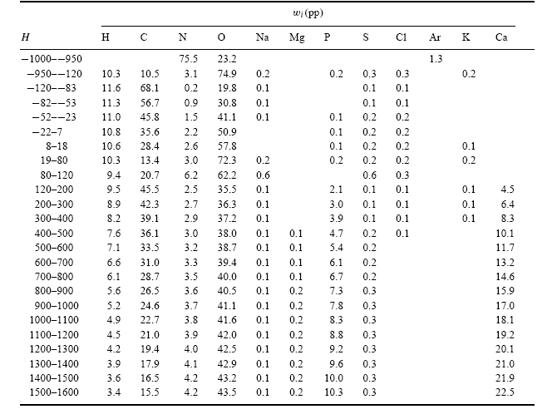
CT stoichiometric calibration
CT segmentation into 27 materials of defined elemental composition (from analysis of 71 human CT scans)
Air, Lung,
Adipose tissue
Soft tissue
Skeletal tissue
Schneider et al PMB 45, 2000
Notes:
26

Slide 27
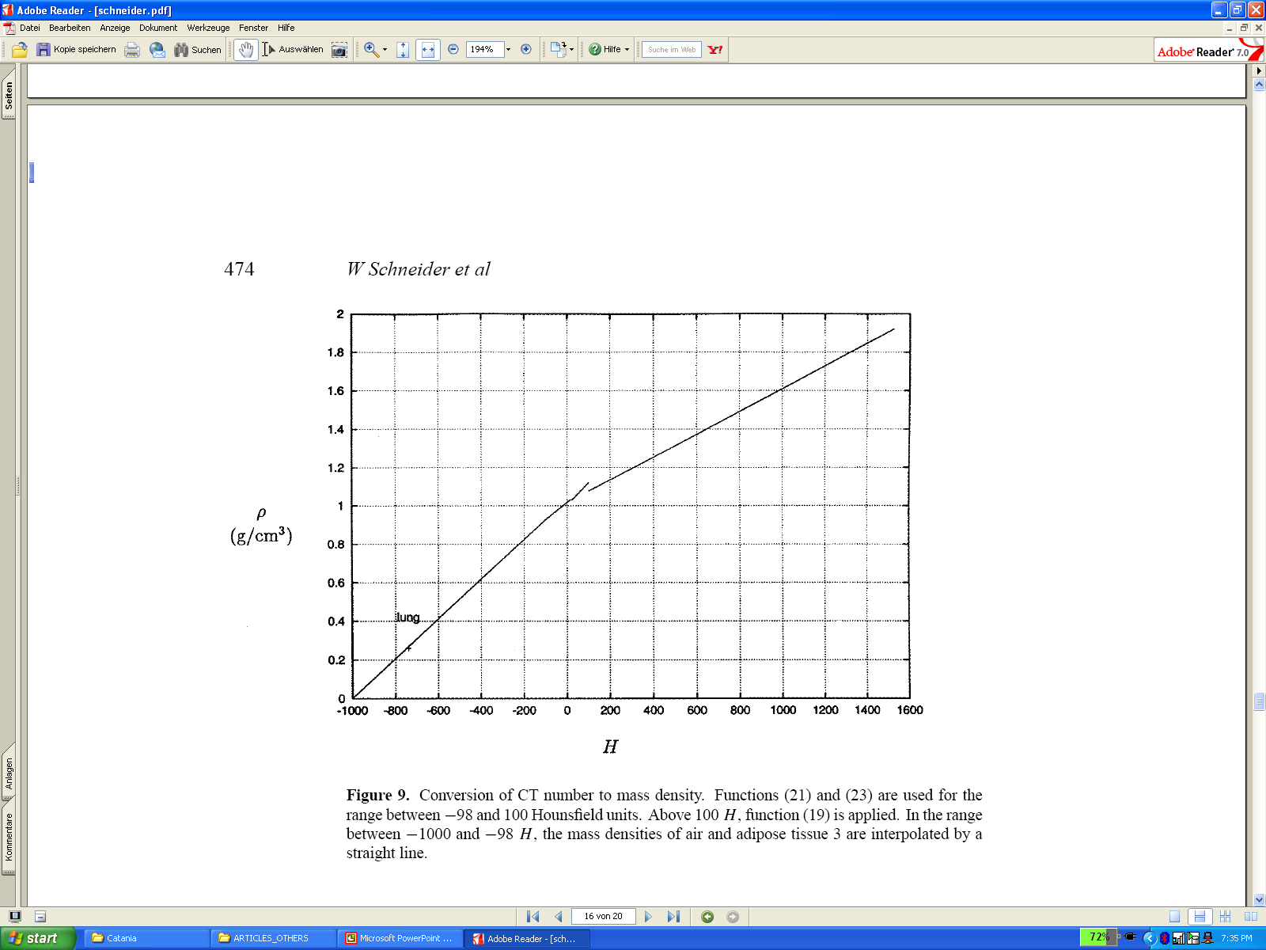
CT stoichiometric calibration (II)
Assign to each material a “nominal mean density”, e.g. using the density at the center of each HU interval (Jiang et al, MP 2004)
Schneider et al
PMB 45, 2000
But “real density” (and related physical quantities) varies continuously with HU value: a HU-dependent correction on density on each voxel is applied

Slide 28
Details on dosimetric checks
Validation of MCTPS calculations we present dosimetric verification results performed following the same procedure for patient quality assurance adopted at CNAO.
Water phantom (MP3-P T41029, PTW) typically employed for patient paln verification.
3D stack of PinPoint Ionization Chambers (ICS, TM31015, PTW). Simultaneous readout of 12 IC.
Acceptance criteria: average (μ) and r.m.s (s) of [D_{meas}-D_{calc}]/D_{max} over a data set of 12 points are within ±5% and below 5% respectively

Slide 29
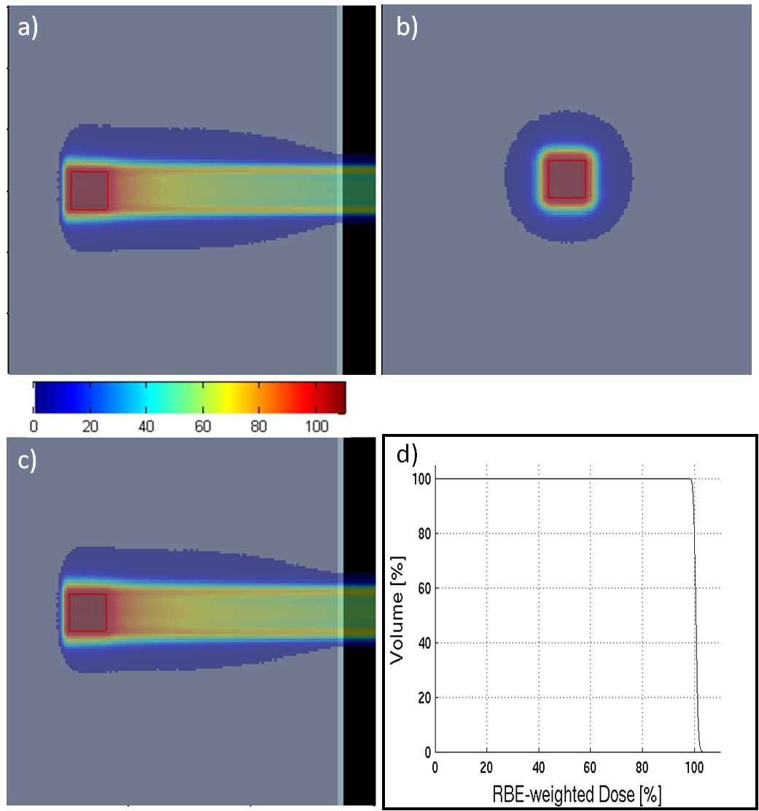
The Cube case
Here we also used a
fast MC as
pre-processor:
FRED

Slide 30
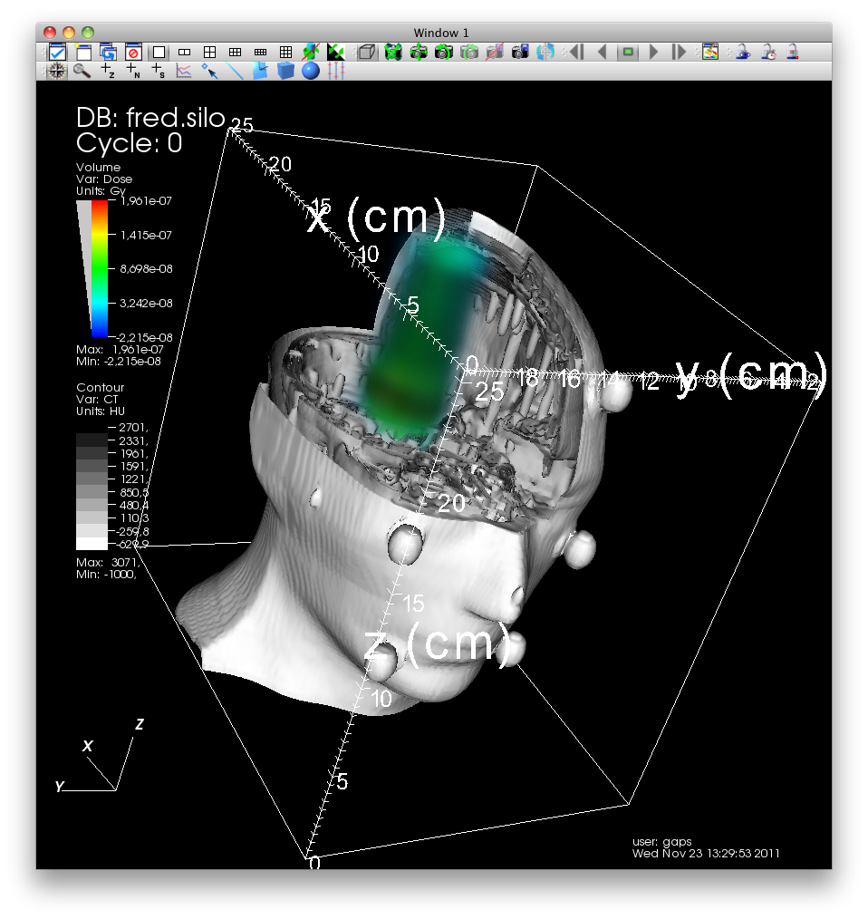
FRED (by A.S.)
Num of Fields,
energy numbers,
Monitors/filters
Treatment Facility
Specs
PB skimming:
set of PB to be traced
FRED
Pre-opimization:
different statistical weight for each PB
Patient data
Fast-TPS:
whole MC-TPS check with reduced physics model
CT,PTV,OAR

Slide 31
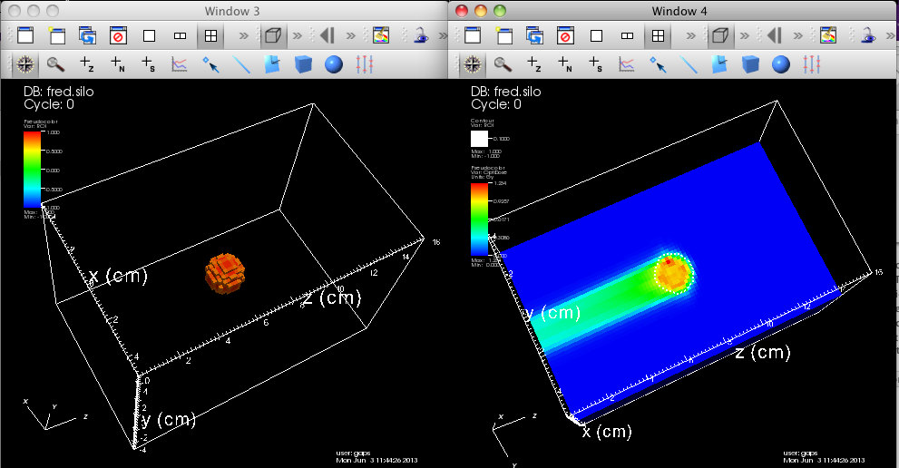
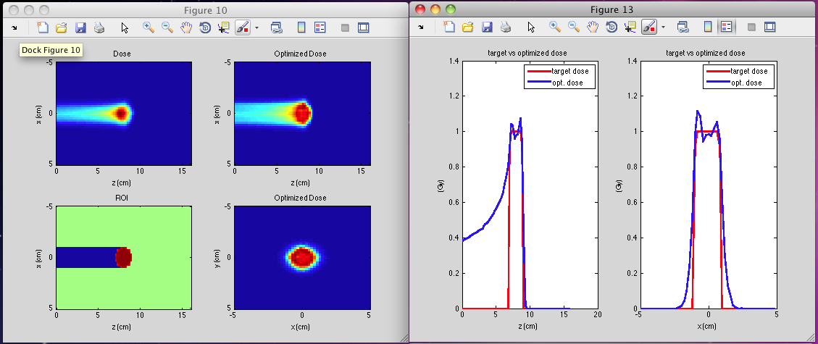
FRED
Light-weight C++ Monte Carlo code written for high tracing-rate performance
Reduced physical model for capturing essential features of PB energy deposition
Converts CT into density map and stop.pow. scale factors:
goes beyond water equivalent phantom
Multiple fields, arbitrary geometry, modular beam filter package
Can be used to drive external/auxiliary codes in the TPS workflow
Parallel execution: multi-core, multi-node
Porting to GPU accelerated hardware underway
Input: dicom files, free-form text finput file, tabulated data
Output: ASCII files, silo format for Visit, binary maps for Matlab post-processing
Visit 3D visualization
Matlab visualization and post-processing

Slide 32
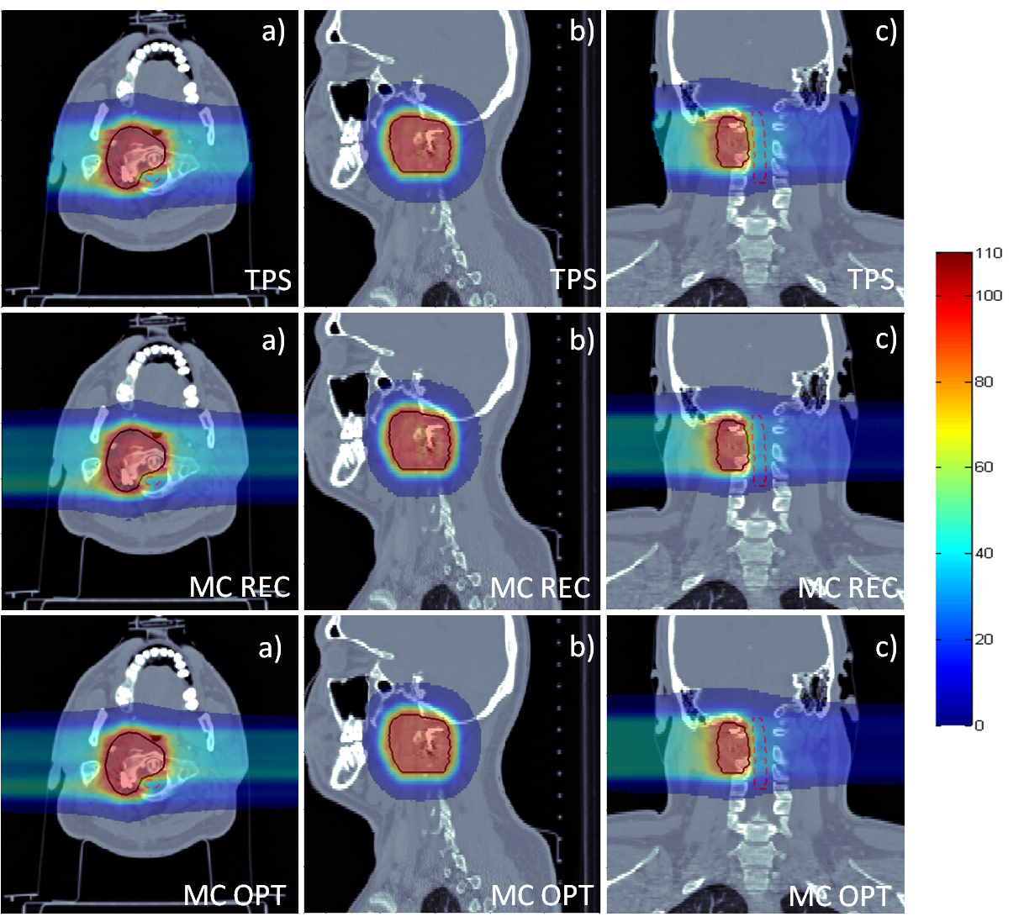
The 2-port chordoma case
The Syngo TPS prescription
MC fw simutation of
TPS prescription
Result of our MC
Optimization

Slide 33
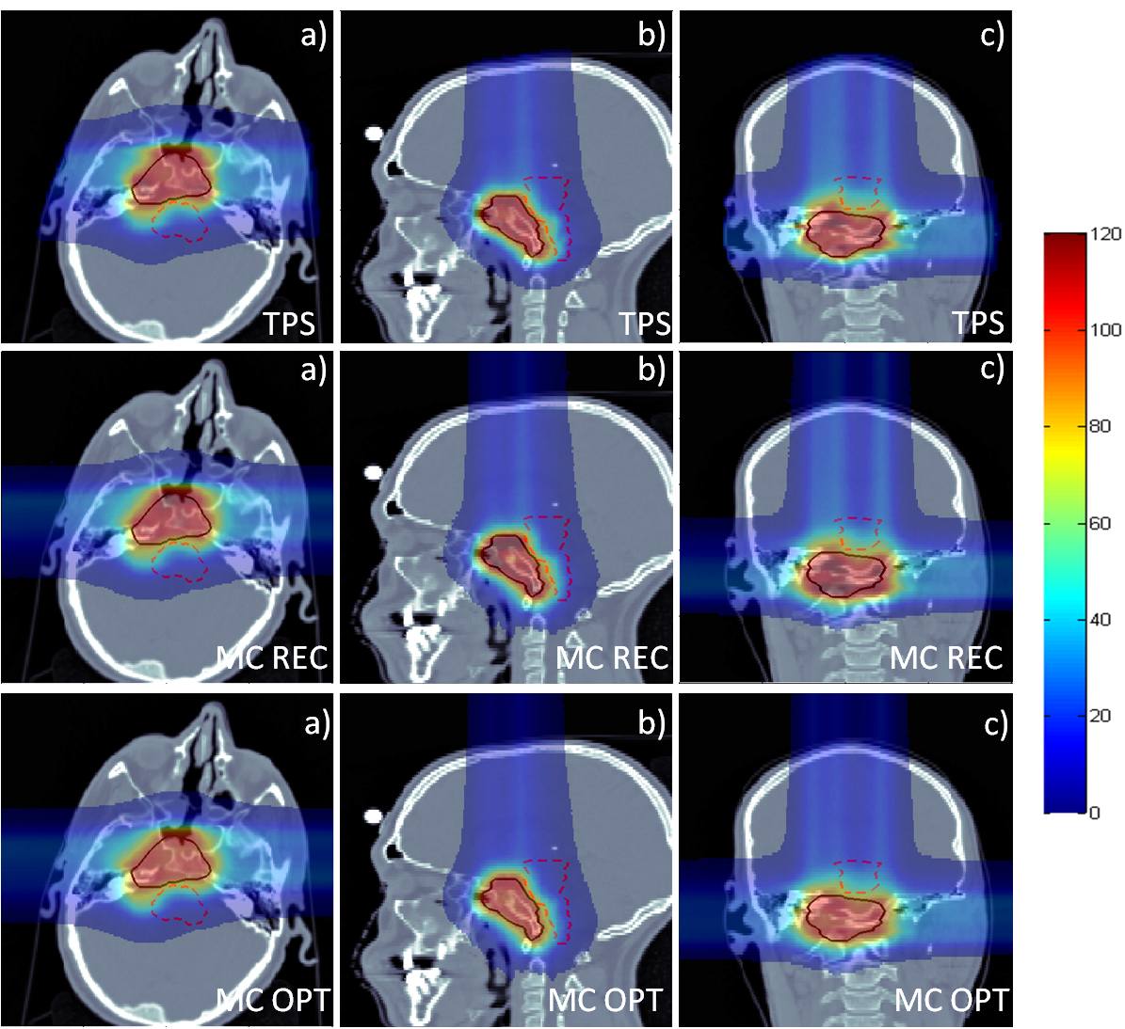
The 3-port chordoma case
The Syngo TPS prescription
MC fw simutation of
TPS prescription
Result of our MC
Optimization

Slide 34
Results of the QA tests
Confirmation of:
a) dose prediction by MCTPS and also of
b) conversion of MCTPS plans to the formats needed by the machine controls and dose delivery system

Slide 35
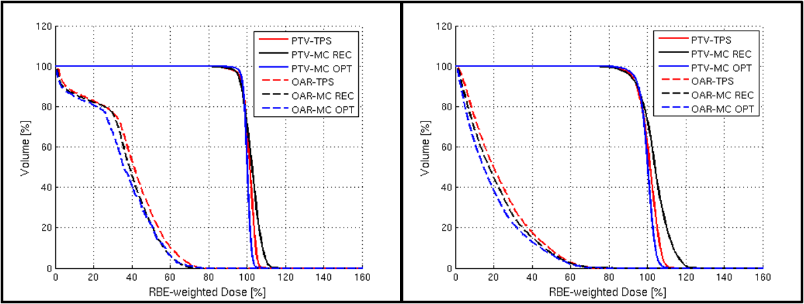
DVHs for PTV and OAR
2-port
3-port
By comparing TPS with MC-REC:
The % of volume fulfilling gamma-index criterion for PTV is 91% and 81% for OAR
The % of volume fulfilling gamma-index criterion for PTV is 72% and 90% for OAR

Slide 36
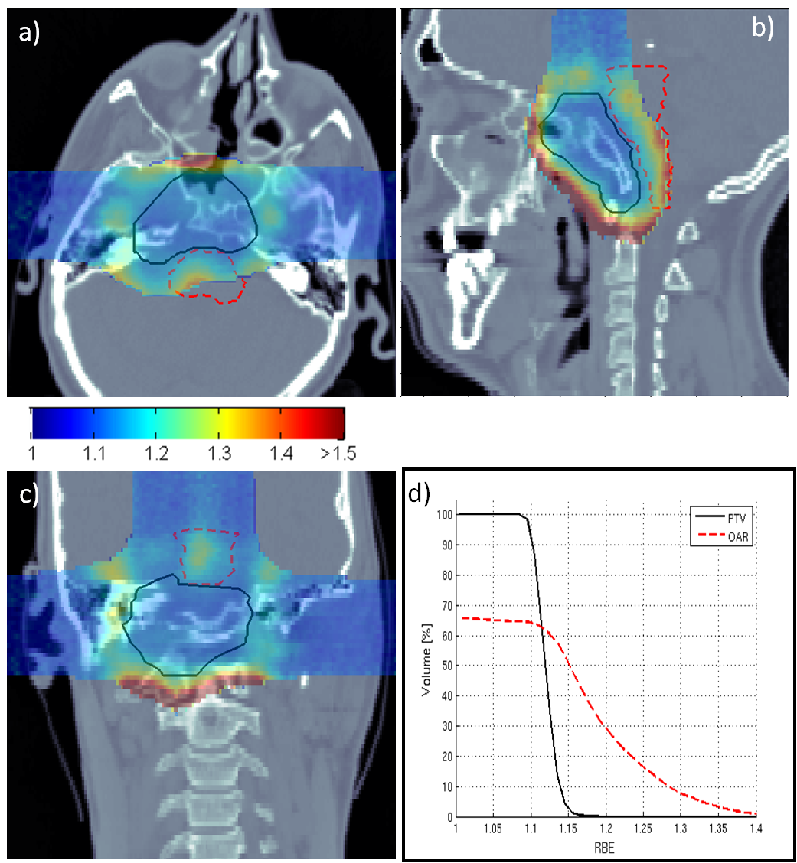
RBE as predicted by LEM for abs. doses larger than 10% of prescribed dose
3-port case
RBE as predicted by LEM for abs. doses larger than 10% of prescribed dose

Slide 37
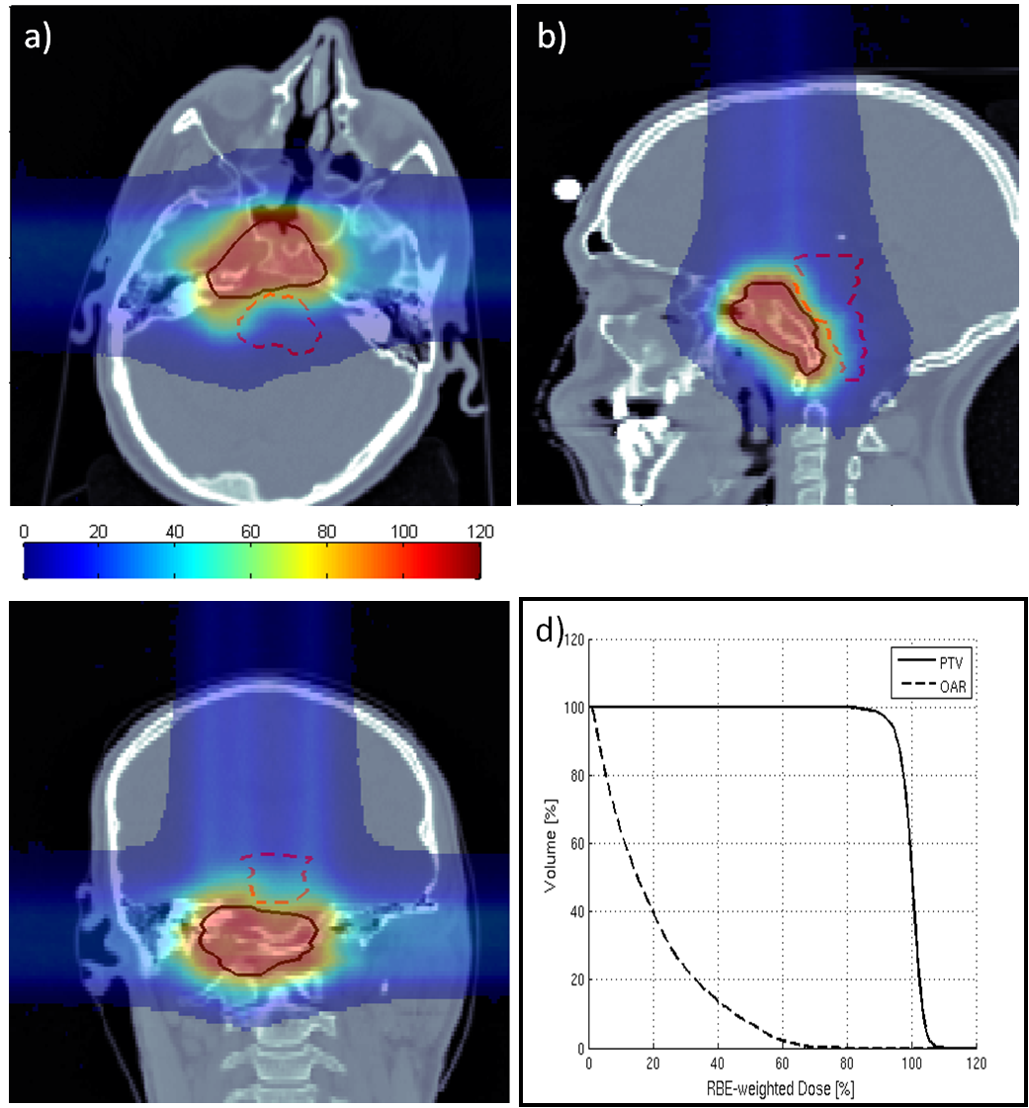
Optimization of D_{RBE} (with variable RBE from LEM) 3 port case

Slide 38
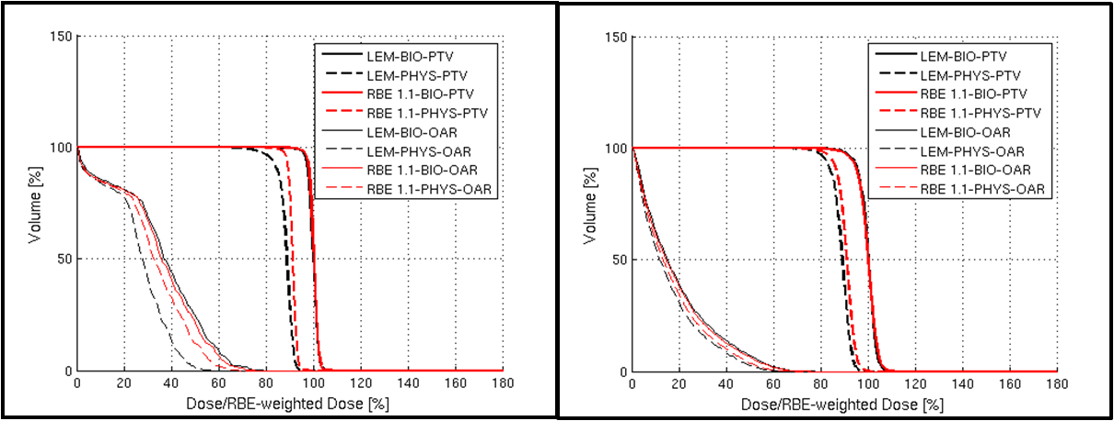
Comparing fixed vs variable RBE
Optimization using constant RBE=1.1 resulted in about 9%/4% higher total energy deposited in the patient (for 2/3 port case respectively) as compared to the case of variable RBE
Effective Range increases (see also Paganetti, PMB 57 (2012) R99)
Warning: this is just a demonstrative effect. RBE calculated only for one cellular line! (V79)

Slide 39
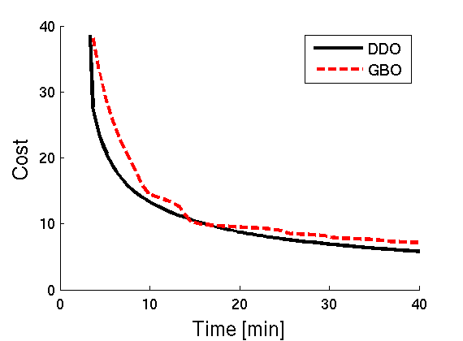
Computing effort
Example: for the 2-port parient case:
MC calc. of RBE-weighted dose matrixes (5 k MC histories per PB) =
50 h (20 CPUs, 10 CPUs/field
Optimization time = 2h (1 CPU)
52 hours
Work in Progress!!
Comparison of Optimization methods

Slide 40
Some Conclusions about the MCTPS
The achieved results are very promising
Computation speed is actually acceptable only for a research tool
Next steps:
  Study robustness of MCTPS plans
  Work the case of hadron therapy with Z>1 ions
  Integrate the different pieces together with the Fast MC preoptimizer plus graphical tools

Slide 41
Spare slides

Slide 42
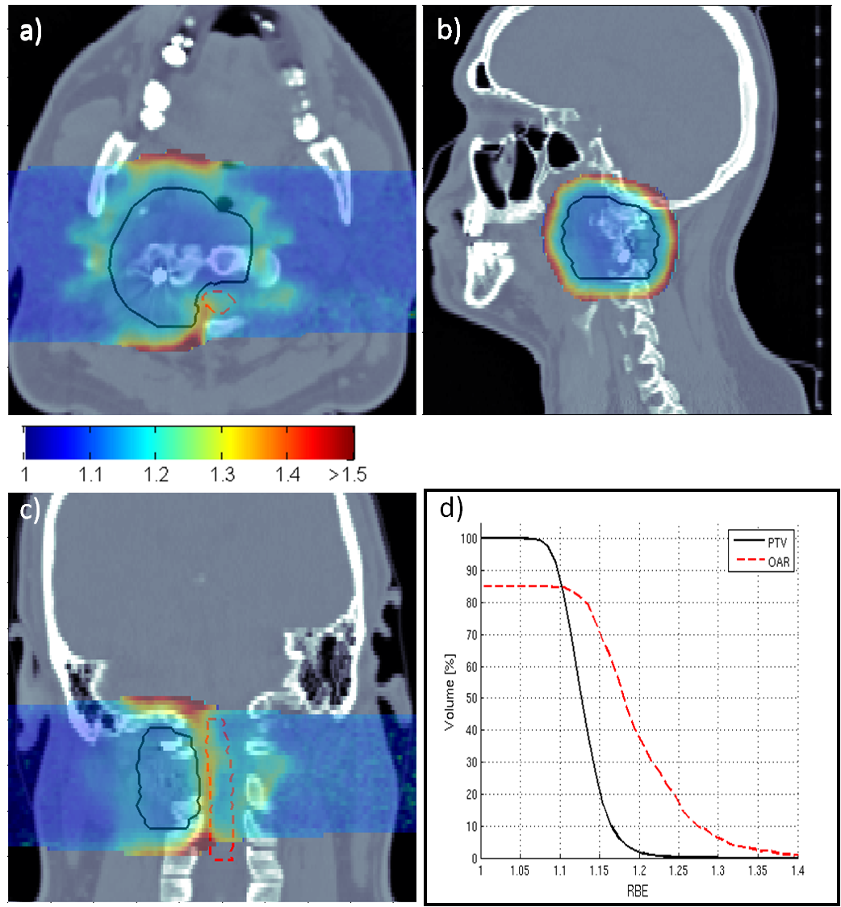
RBE as predicted by LEM for abs. doses larger than 10% of prescribed dose
2-port case

Slide 43
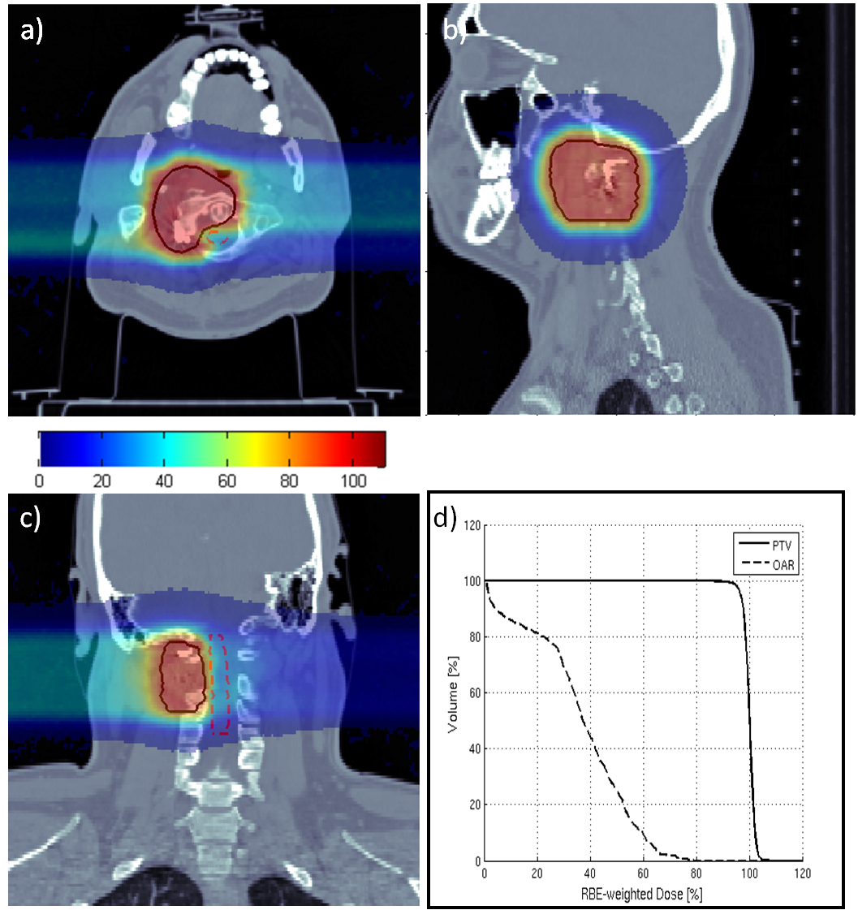
Optimization of D_{RBE} (with variable RBE from LEM) 2 port case

