Slide 1
E. De Lucia
LNF-INFN
Development of CGEM technology for ultra-light tracking detectors
June 4 th 2013 Jagiellonian University Krakow

Slide 2
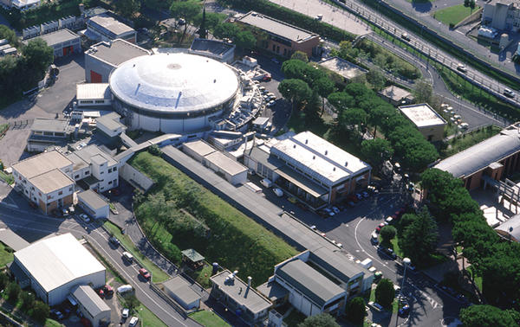
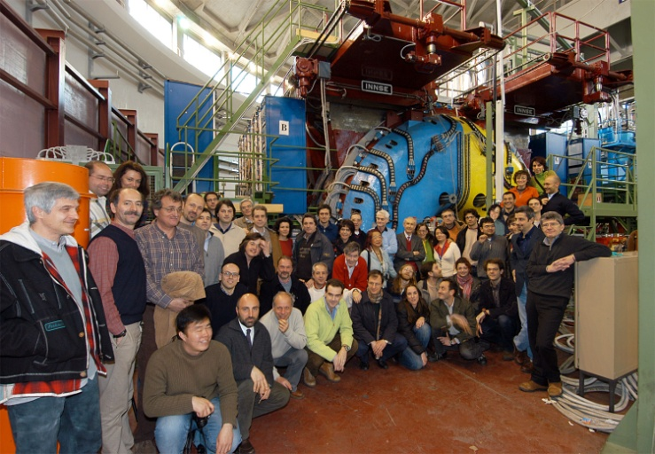
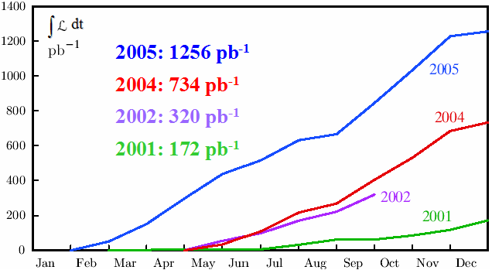
KLOE at DAFNE φ-factory
Frascati φ-factory DAφNE: an e⁺e⁻ collider @ √s =1019.4 MeV = M_{φ}
Best performance in 2005:
L_{peak} = 1.4 × 10³² cm⁻²s⁻¹
∫ Ldt = 8.5 pb⁻¹/day
KLOE has acquired 2.5 fb⁻¹ @ √s=M_{φ} (2001-05)
+ 250 pb⁻¹ off-peak @ √s=1 GeV
Precision Kaon and Hadron Physics with KLOE Rivista del Nuovo Cimento Vol.31, N.10 (2008)

Slide 3
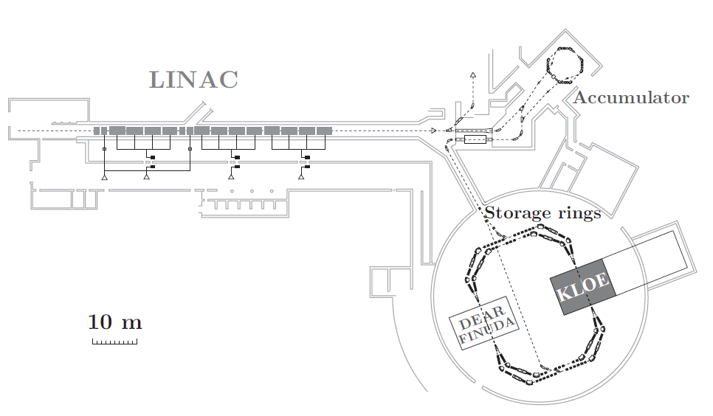
KLOE at DAFNE φ-factory
Frascati φ-factory DAφNE: an e⁺e⁻ collider @ √s =1019.4 MeV = M_{φ}
Best performance in 2005:
L_{peak} = 1.4 × 10³² cm⁻²s⁻¹
∫ Ldt = 8.5 pb⁻¹/day
KLOE has acquired 2.5 fb⁻¹ @ √s=M_{φ} (2001-05)
+ 250 pb⁻¹ off-peak @ √s=1 GeV
Precision Kaon and Hadron Physics with KLOE Rivista del Nuovo Cimento Vol.31, N.10 (2008)

Slide 4
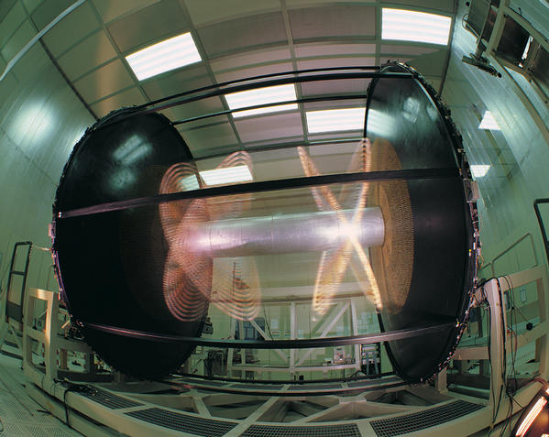
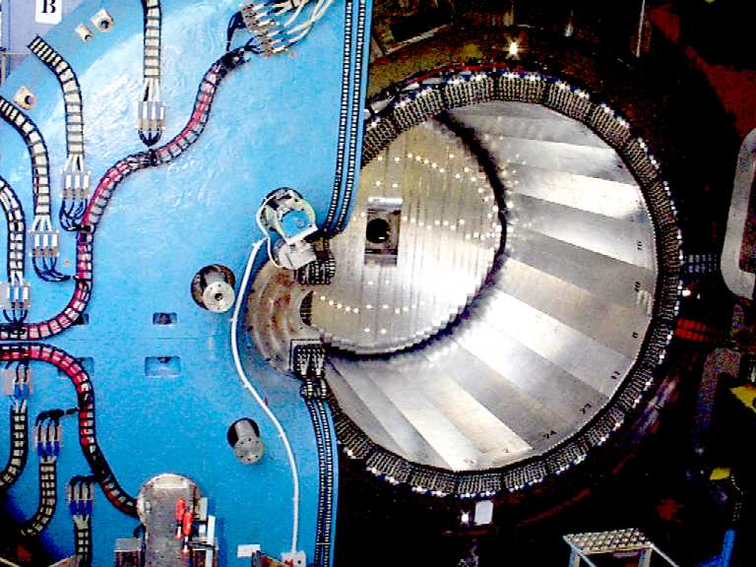
KLOE at DAΦNE φ-factory
Φ → K_{S} K_{L}
4 m diameter × 3.3 m length
90% helium, 10% isobutane
12582/52140 sense/tot wires
All-stereo geometry
Lead/scintillating fiber
98% coverage of solid angle
88 modules (barrel + end-caps)
4880 PMTs (two side read-out)
λ_{KS} = 0.6 cm λ_{KL} = 340 cm λ_{K±} = 95 cm
Drift Chamber
7m
Electromagnetic Calorimeter
σ_{E} /E = 5.4%/
σ_{t} = 54 ps/
σ_{r φ} = 150 μm σ_{z} = 2 mm
σ_{V} = 3 mm σ_{p} /p = 0.4 %
6 m
50 ps(calib)
B = 0.52 T

Slide 5
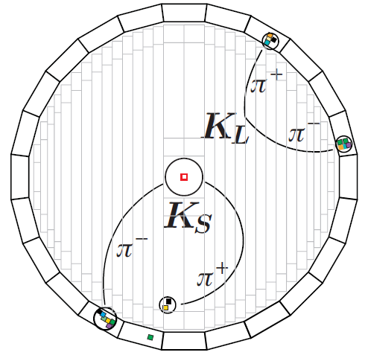
KLOE at DAΦNE φ-factory
Φ → K_{S} K_{L}
4 m diameter × 3.3 m length
90% helium, 10% isobutane
12582/52140 sense/tot wires
All-stereo geometry
Lead/scintillating fiber
98% coverage of solid angle
88 modules (barrel + end-caps)
4880 PMTs (two side read-out)
λ_{KS} = 0.6 cm λ_{KL} = 340 cm λ_{K±} = 95 cm
Drift Chamber
7m
Electromagnetic Calorimeter
σ_{E} /E = 5.4%/
σ_{t} = 54 ps/
σ_{r φ} = 150 μm σ_{z} = 2 mm
σ_{V} = 3 mm σ_{p} /p = 0.4 %
6 m
50 ps(calib)
B = 0.52 T

Slide 6
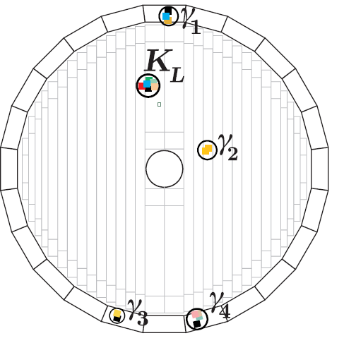
KLOE at DAΦNE φ-factory
Φ → K_{S} K_{L}
4 m diameter × 3.3 m length
90% helium, 10% isobutane
12582/52140 sense/tot wires
All-stereo geometry
Lead/scintillating fiber
98% coverage of solid angle
88 modules (barrel + end-caps)
4880 PMTs (two side read-out)
λ_{KS} = 0.6 cm λ_{KL} = 340 cm λ_{K±} = 95 cm
Drift Chamber
7m
K_{L} in Calorimeter
K_{S}→ π⁰π⁰→γγγγ
Electromagnetic Calorimeter
σ_{E} /E = 5.4%/
σ_{t} = 54 ps/
σ_{r φ} = 150 μm σ_{z} = 2 mm
σ_{V} = 3 mm σ_{p} /p = 0.4 %
6 m
B = 0.52 T
50 ps(calib)

Slide 7
The KLOE-2 Project: Physics & Collider
The KLOE-2 project aims at improving the successful and fruitful results achieved by the KLOE Collaboration in Kaon and Hadron Physics and extending the physics program to :
γγ-physics from
search for particles from “hidden sectors” that might explain dark matter
The project will exploit the new interaction scheme implemented on the Frascati DAFNE phi-factory collider with the SIDDHARTA experiment in 2008/09 with:
Larger beam crossing angle and crab-waist sextupoles
Luminosity increase up to a factor of ∼3

Slide 8
The KLOE-2 Project: Physics & Collider
The KLOE-2 project aims at improving the successful and fruitful results achieved by the KLOE Collaboration in Kaon and Hadron Physics and extending the physics program to :
γγ-physics from
search for particles from “hidden sectors” that might explain dark matter
The project will exploit the new interaction scheme implemented on the Frascati DAFNE phi-factory collider with the SIDDHARTA experiment in 2008/09 with:
Larger beam crossing angle and crab-waist sextupoles
Luminosity increase up to a factor of ∼3

Slide 9
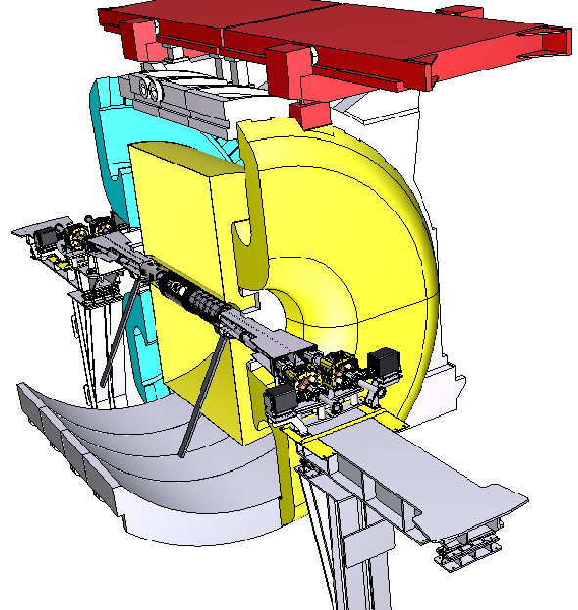
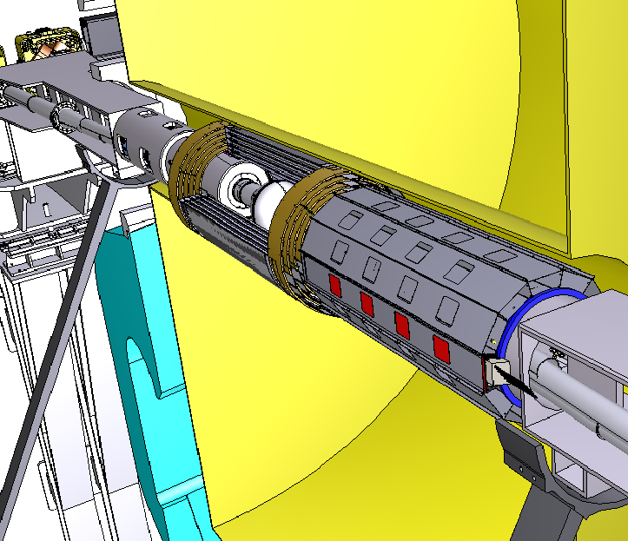
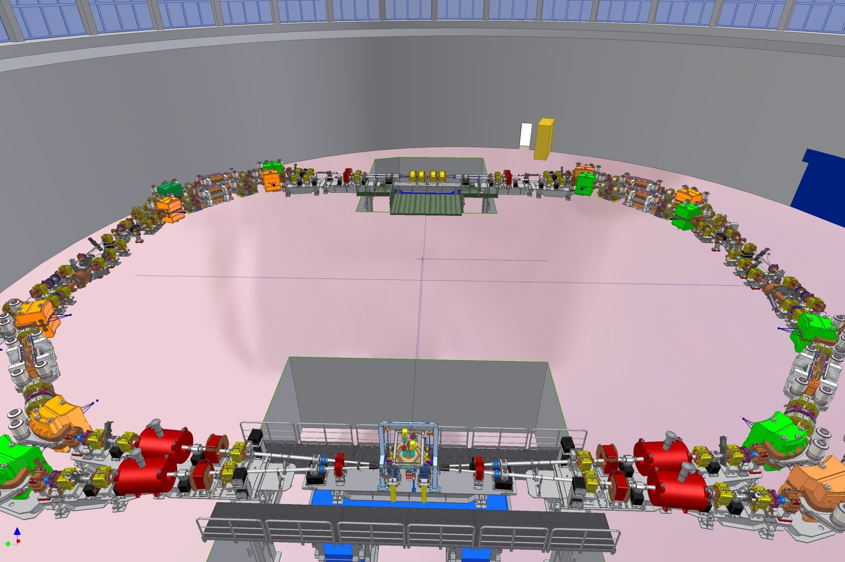
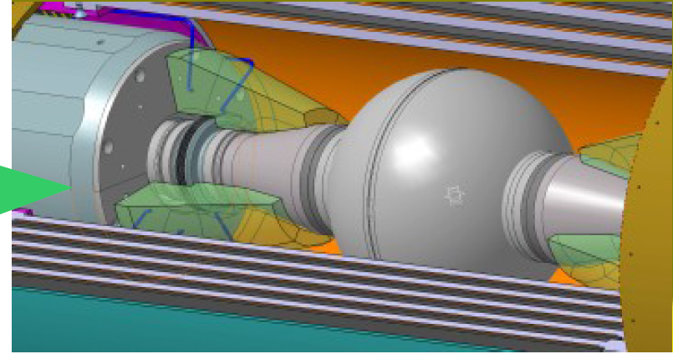
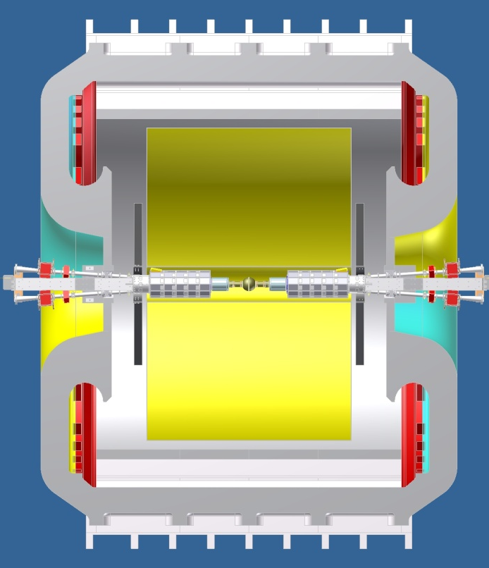
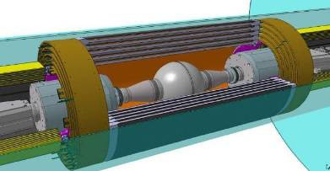
The KLOE-2 Project: detector upgrades
1st phase/step-0 :
LET & HET
LYSO+SiPMs & Scint+PMTs
Lepton taggers for γγ-physics
Technical Design Report LNF - 10/14(P)
2nd phase /step-1 now :
CCAL
CCAL
LYSO + APD
Increase acceptance for γ’s from IP
(21°→10°)
INNER TRACKER
4 layers of cylindrical triple GEM
Better vertex reconstruction near IP
Larger acceptance for low pt tracks
QCALT
W + scintillator tiles + SiPM/WLS
quadrupoles coverage for K_{L} decays
HET E>400MeV, 11m from IP
LET 160-230 MeV inside KLOE
Technical Design Report - arXiv:1002.2572
INNER TRACKER
KLOE
Notes:
CCAL: ks gg , ks 3pi0, eta pi0gg increase the acceptance for very forward electrons/photons
IT: Ks, KL precoce, eta, interferometry
QCALT: detection of photons from KL decays in the DC
For the forthcoming run [10], upgrades have also been proposed for the detector. In a first phase, two different devices (LET and HET) will be installed along the beam line to detect the scattered electrons/positrons from interactions. In a second phase, a light–material internal tracker (IT) will be installed in the region between the beam pipe and the drift chamber to improve charged vertex reconstruction and to increase the acceptance for low pT tracks [11]. Crystal calorimeters (CCALT) will cover the low region, aiming at increasing acceptance for very forward electrons/photons down to 8. A new tile calorimeter (QCALT) will be used to instrument the DANE focusing system for the detection of photons coming from KL decays in the drift chamber. Implementation of the second phase is planned for late 2011. The integrated
luminosity for the two phases, from here on dubbed as step-0 and step-1, will be 5 fb−1 and 20 fb−1, respectively.

Slide 10
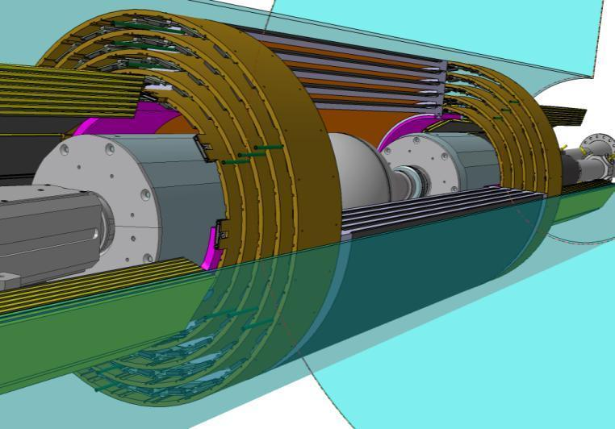
KLOE-2 Inner Tracker Upgrade
For fine vertex reconstruction of K_{s} , η and η’
rare decays and K_{s}- K_{L} interference and QM tests:
σ_{rφ} ∼ 200 µm and σ_{z} ∼ 500µm
low material budget:<2%X₀
5 kHz/cm² rate capability
Cylindrical GEM (CGEM ) detector is the solution
4 CGEM layers with radii 13/15.5/18/20.5 cm from IP and before DC Inner Wall
700 mm active length
XV strips-pads readout (∼25° stereo angle)
2% X₀ total radiation length in the active region with Carbon Fiber structure
Cylindrical Triple GEM
Read-out
Induction
Transfer 2
Anode
2 mm
Transfer 1
GEM 3
2 mm
GEM 2
2 mm
Conversion & Drift
GEM 1
3 mm
Cathode
K_{S} → π π vertex resolution will improve of about a factor 3 from present 6mm
Notes:
For CPT violation from K₀ interference an improvement of a factor of 10 of present error with 20 fb-1 (100 fb-1 needed without IT) is achievable.

Slide 11
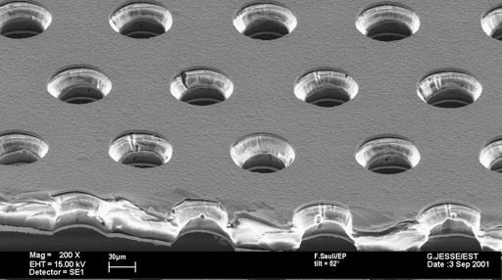
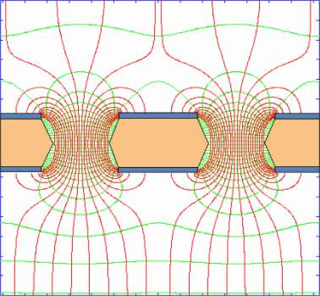
Gas Electron Multiplier (GEM)
The GEM is a 50 μm thick copper- coated kapton foil, with high density of holes (70 μm ∅, 140 μm pitch) manufactured with standard photo-lithographic technology [F. Sauli, NIM A386 (1997) 531]
Conversion & Drift
By applying a difference of potential (400-500 V) between the two copper sides, in presence of external Drift and Collection fields, an electric field as high as ~100 kV/cm is produced into the Holes, acting as Multiplication Stages for ionization electrons released in the drift gas gap
Collection
Notes:
A copper-clad polyimide foil is
laminated on one side with a photosensitive coating (usually named photo resist) and
exposed to UV light through a mask with the desired holes’ pattern; the process is
repeated on the other side. After curing, the coating is chemically removed in the
exposed areas, and the underlying metal etched with a standard printed circuit
technology. The foil is then immersed in a polymer solvent to open the channels in the
regions not protected by the metal; due to the wet etching process, the holes in the
polymer tend to have a double-conical shape, with the minimum diameter in the
centre

Slide 12
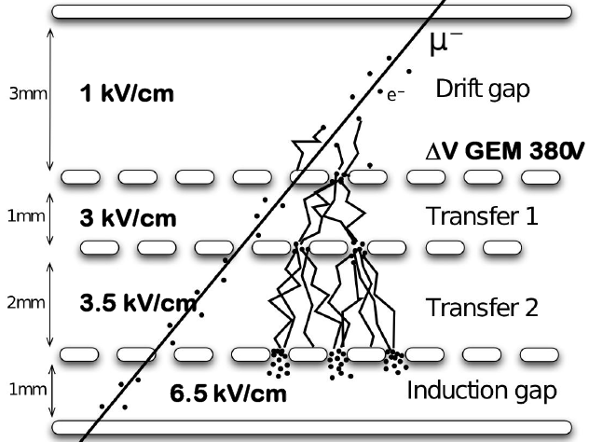
Gas Electron Multiplier (GEM)
Gains up to 1000 can be easily reached with a single GEM foil.
Higher gains (and/or safer working conditions) are usually obtained by cascading two or
three GEM foils
G ∝ e ^{∑ Vgem}

Slide 13
Novel Idea: a Cylindrical GEM detector

Slide 14
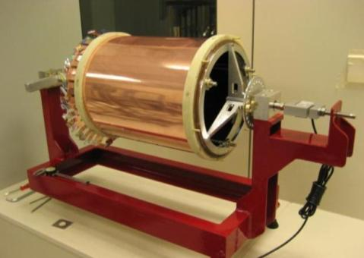
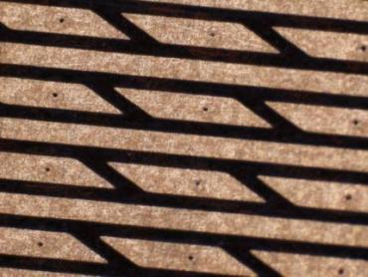
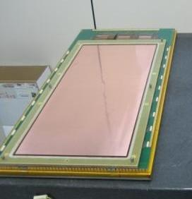
The CGEM project : three years of R & D
The CGEM is a low-mass, fully cylindrical and almost dead-zone-free detector
Construction and characterization of a CGEM prototype built using 3 GEM foils (354 x 330 mm²) spliced together. Axial strips single view (TB 2008) NSS Conf. Rec. Vol. I (2009) 2268
XV strips on the same plane
X pitch 650µm
Construction of 100 x 100 mm² planar chambers equipped with new concept for XV readout and study operation in magnetic field (TB 2009).
NIMA 628 (2011) 194
V pitch 600µm
Construction and characterization of two large planar chambers 300x700 mm with the new single-mask photolitographic technique equipped with final XV readout (TB 2010). Physics Procedia 37(2012) 522

Slide 15
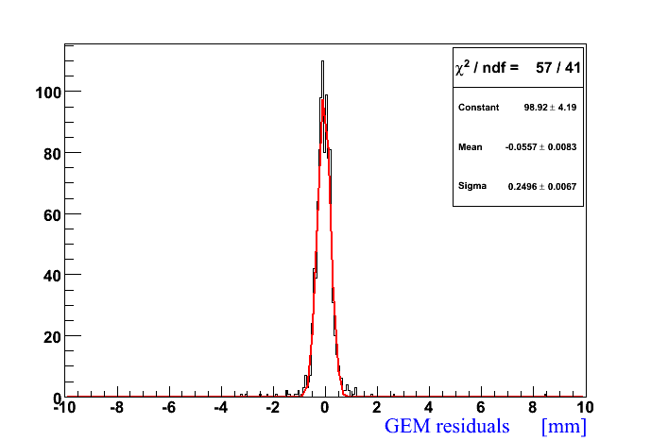
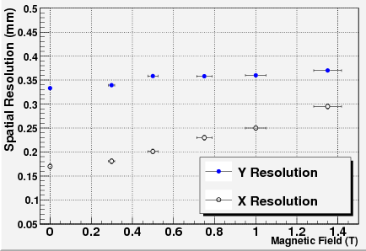
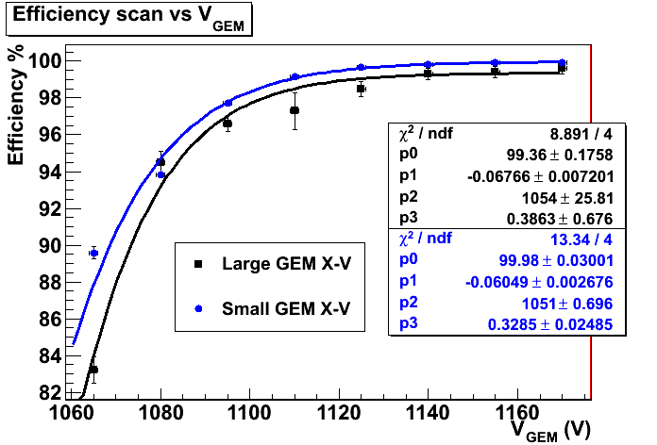
The CGEM project : three years of R & D
The CGEM is a low-mass, fully cylindrical and almost dead-zone-free detector
Construction and characterization of a CGEM prototype built using 3 GEM foils (354 x 330 mm²) spliced together. Axial strips single view (TB 2008) NSS Conf. Rec. Vol. I (2009) 2268
σ(GEM) ∼ 200µm
ResY ∼350µm
Residuals (mm)
KLOE B-field
Construction of 100 x 100 mm² planar chambers equipped with new concept for XV readout and study operation in magnetic field (TB 2009).
NIMA 628 (2011) 194
ResX ∼190µm
Construction and characterization of two large planar chambers with the new single-mask photolitographic technique equipped with final XV readout (TB 2010). Physics Procedia 37(2012) 522
Efficiency(%)
V_{GEM} (V)

Slide 16
Building the Final Detector

Slide 17
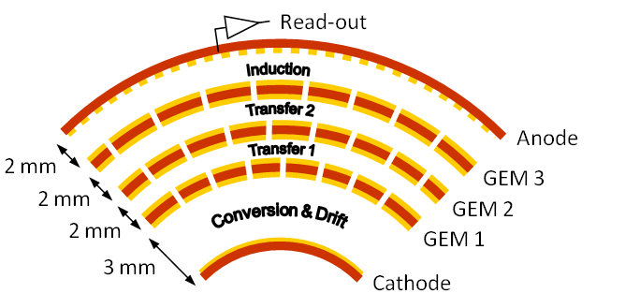
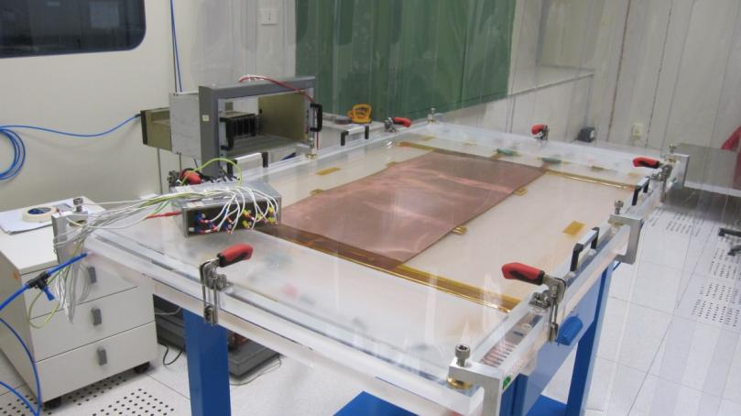
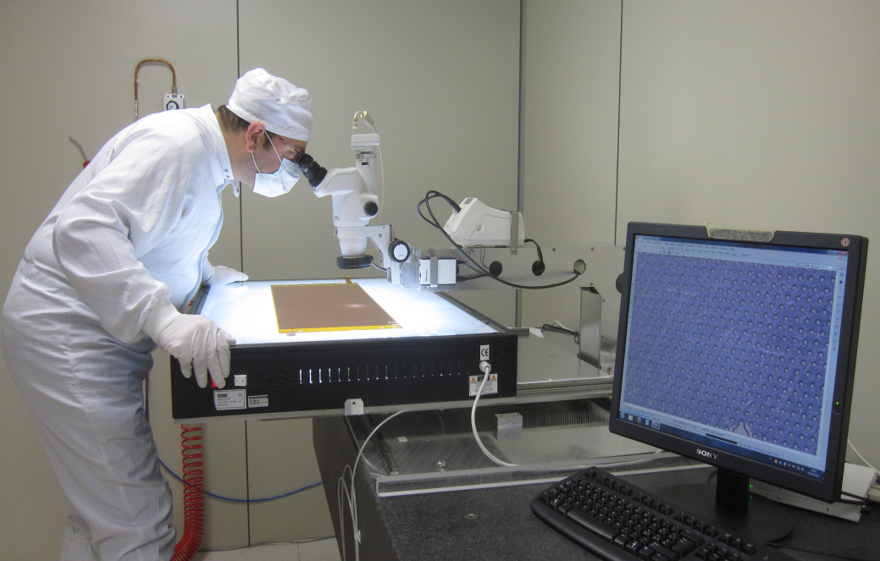
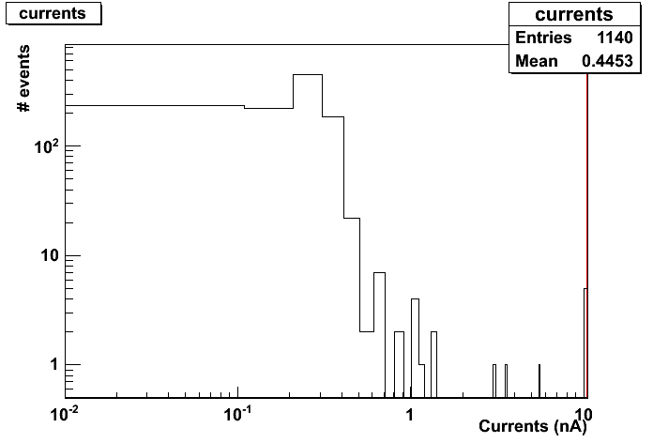
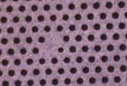
Quality check s on GEM foils
1) HV test in N₂ environment RH<10%
2) Optical inspection
Good HV sector have I < 1nA @ 600V
Discharge rate measured over ~1h
Over-etching
GEM holes have 70µm diameter and 140µm pitch
few sectors with current > 1 nA @600 V
Missing holes
Scratches

Slide 18
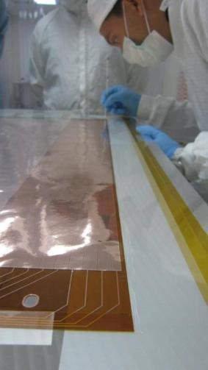
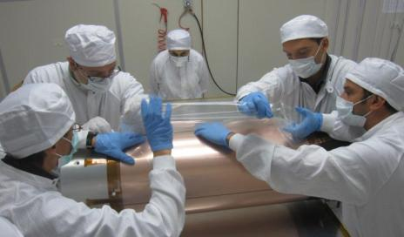
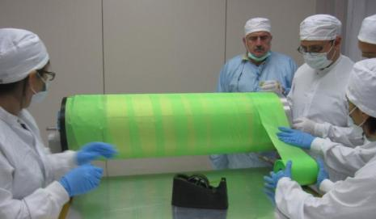
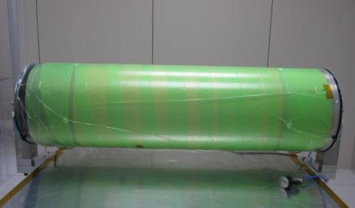
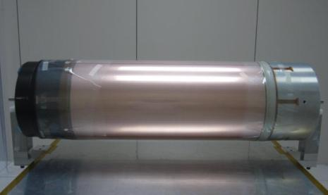
Building the Cylindrical GEM
2)
3)
Electrode wrapped on cylindrical mold & covered with Mylar
Transpirant tissue is placed around to distribute vacuum
4)
5)
1)
3 foils spliced - Epoxy glue distributed on a 2mm wide line
Vacuum bag envelope at 0.9 bar
CGEM with fiberglass rings: gap spacers and mechanical support
Notes:
Epoxy glue (Araldite 2011)
3 GEM foils are spliced together with a 3 mm overlap and closed in a vacuum bag (0.9 bar)
curing cycle several hours up to 12 h

Slide 19
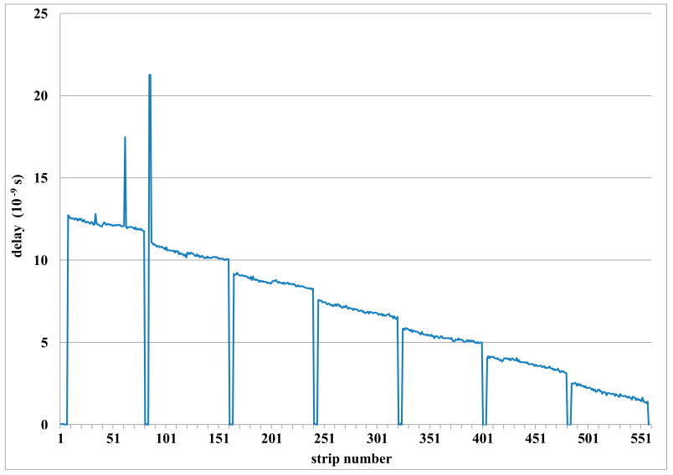
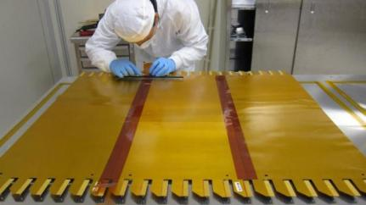
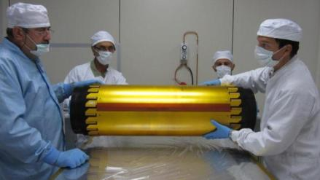
Building the cylindrical Anode
XV strips on the same plane
Anode Quality Control with a 100 ps precision
Time Domain Reflectometer NIMA 698 (2013)
Transmission line length and its damages evaluated by measuring the delay of the reflected signal
Shorts
X pitch 650µm
Delay (ns)
V pitch 600µm
V Strip#
1)
2)
~1m
1k strips
1M pads
~1mm
dead zones
3 foils spliced w/o overlap: 6 cm kapton strips are glued on the back of head-to-head joints
Foil wrapped on the mold for cylindrical shape
Notes:
the length of the transmission line and hence a possible damage in it is evaluated by measuring the delay of reflected signal
100 ps = DeltaLength 1 cm

Slide 20
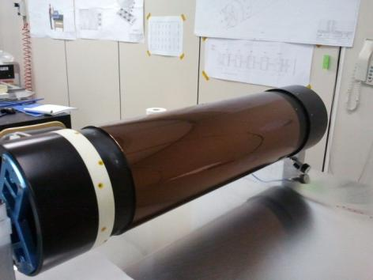
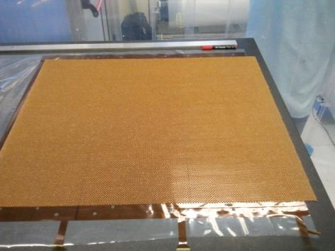
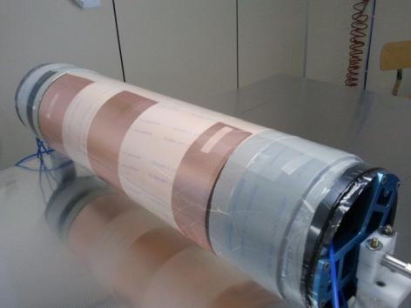
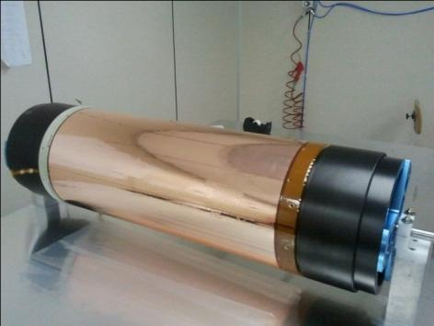
Manufacturing a Cathode
We place an inner cylindrical kapton layer on the mold
Nomex honeycomb 3 mm thick is glued on the back of the cathode
Cathode (made by 3 foils) is wrapped around the mold and closed with a vacuum bag
Final cathode is ready with both internal and external fiberglass rings

Slide 21
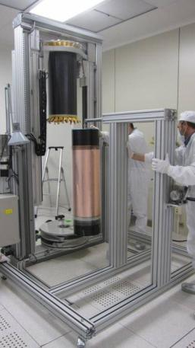
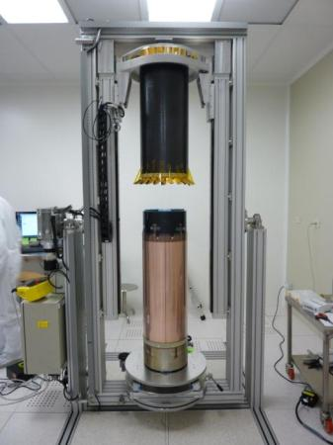
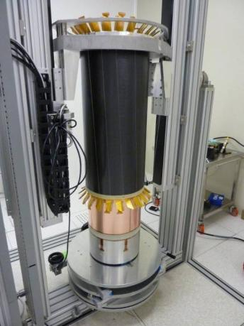
Detector assembly: Anode+GEM3+GEM2+GEM1+Cathode
Anode
GEM
The GEM is placed on the Machine with its mold
Everything is aligned with an axial precision of ≈0.1mm/1.5m
The Anode Readout is moved down around the GEM

Slide 22
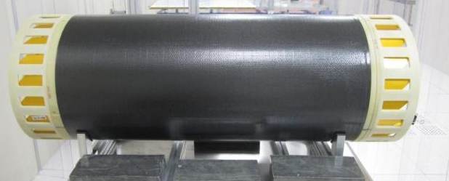
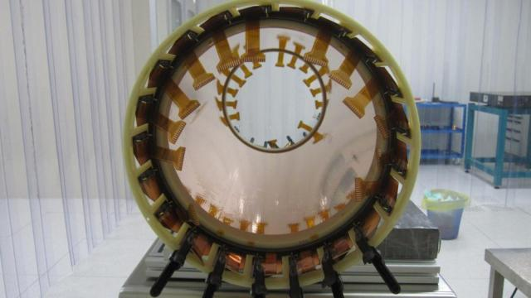
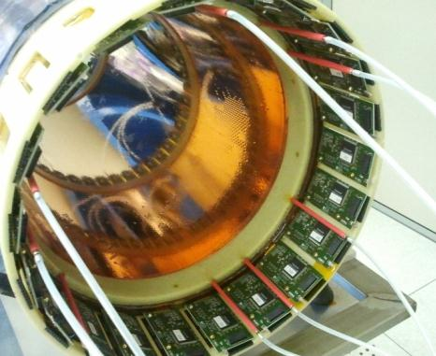
The 1st CGEM layer completed
FEE is supported by 2 fiberglass outer rings
HV tails
18+21 on the two sides
Layer2 w Custom Gastone FEE
FEE tails
21 on each side

Slide 23
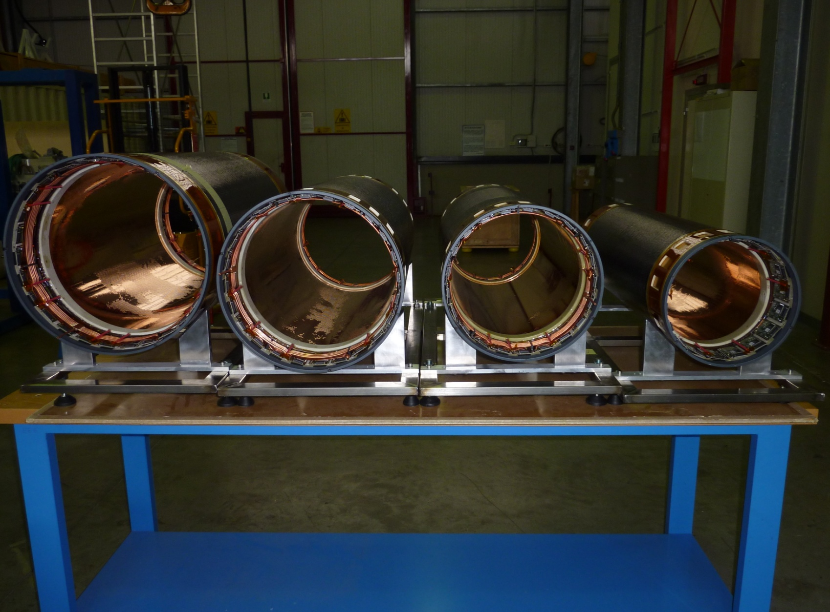
The four CGEM Layers of Inner Tracker

Slide 24
CGEM Layers Validation Tests

Slide 25
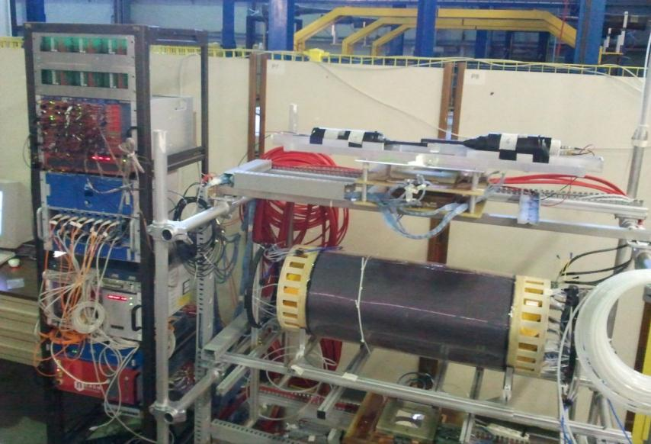
Setup for cosmic-ray muons & ⁹⁰Sr Tests
Each layer instrumented with:
The DAQ System uses the Final custom Global Interface Boards (GIB) and Transition Boards (TB) and ROD JINST 8 T04004 (2013)
Final HV cables and Custom HV distribution
Final Signal cables & Gastone FEE NIMA 604 (2009)
Trigger:
2 scintillators
(Top - Bottom)
External Tracking System provided by three Planar Triple-GEM chambers
PGEMs
(Top - 2 Bottom)

Slide 26
Validation Test with ⁹⁰Sr Source (I)
S1-S12 HV Sectors
Source Scan positioning ⁹⁰Sr inside CGEM on
each HV sector
Unrolled Anode Foil: X-view Strips
FEE Boards
ξ
Source on S1
X-view Fired Strips
S1
S2
S1
S2
S3
S4
S5
S6
S7
S8
S9
S10
S11
S12
All X-view Strip
illuminated with ⁹⁰Sr
Source on S2
X-view Fired Strips
ρ

Slide 27
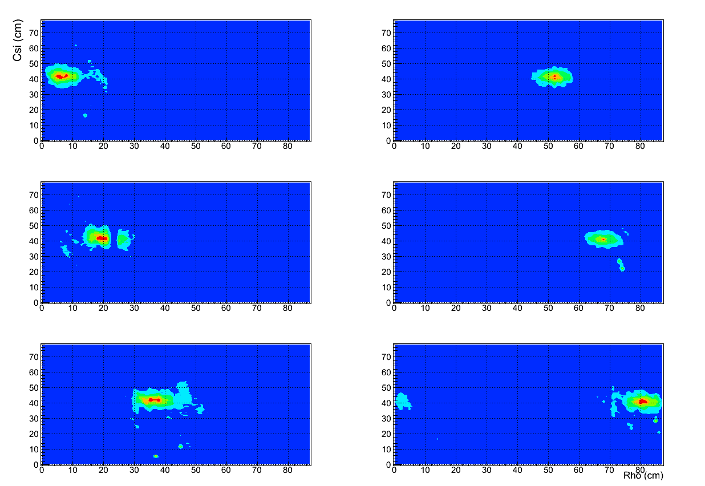
Validation Test with ⁹⁰Sr Source (II)
Layer 1 Source Scan
The profile of the source in 6 different positions is reconstructed by triggering the DAQ with a clock signal
This fast test allows to check the cabling and the uniformity of the detector
Layer 1 has 6 HV sectors only

Slide 28
Cosmic-ray muons setup
Trigger with Coincidence of 2 scintillators Top AND 2 scintillators Bottom
Require External Tracking provided by 3 Planar Triple-GEM 10x10 cm²
Select events in CGEM

Slide 29
Layer 1 validation with cosmic-ray muons
Selecting events using External Tracking provided by 3 Planar Triple-GEM
Front view
3D view
GASTONE Board Threshold not optimized

Slide 30
Layer 1 validation with cosmic-ray muons
Selecting events using External Tracking provided by 3 Planar Triple-GEM
Unrolled Anode Foil
(ρ, ξ ) coordinate system
ρ
1 ^{st} X and V strip positions are not at the edge of trigger-illuminated area

Slide 31
Layer 2 Validation with cosmic-ray muons
Selecting events using External Tracking provided by 3 Planar Triple-GEM
3D view

Slide 32
Layer 2 Validation with cosmic-ray muons
Selecting events using External Tracking provided by 3 Planar Triple-GEM
3D view
Z vs X (Lego View)
PGEMs misalignment
& Masked Channels
GASTONE Board Threshold not optimized

Slide 33
Layer 3 validation with cosmic-ray muons
Selecting events using External Tracking provided by 3 Planar Triple-GEM
3D view
Front view
GASTONE Board Threshold not optimized

Slide 34
Layer 3 validation with Cosmic-ray muons
Selecting events using External Tracking provided by 3 Planar Triple-GEM
Unrolled Anode Foil ρ, ξ coordinate system

Slide 35
KLOE-2 Inner Tracker assembled

Slide 36
Inner Tracker Integration on Beam Pipe

Slide 37
Conclusions
The GEM-based detector lightness and flexibility have been exploited to build a low-mass (X₀ ≈ 2%) , fully cylindrical and almost dead-zone-free Inner Tracker as an upgrade of the KLOE detector
After three years of R&D and more than one year of construction we have completed the 4 Cylindrical GEM layers of KLOE-2 Inner Tracker
The detectors have been extensively tested showing good operational stability and fulfilling the expected performance
The final assembly of the KLOE-2 Inner Tracker, the first Cylindrical GEM ever built, has been completed on March, 14th.
Detectors Integrated on DAFNE beam-pipe, cabling ongoing these days
Commissioning of the Inner Tracker will start soon after, together with DAFNE commissioning

Slide 38
Thank you

Slide 39
CGEM Material Budget
 | Thickness (µm) | Radiation Length (%)
Copper | 3 | 1,68E-04
Polyimide | 50 | 1,40E-04
Copper | 3 | 1,68E-04
GEM foil | 56 | 4,76E-04
Copper | 3 | 2,10E-04
Polyimide | 50 | 1,75E-04
Honeycomb | 3000 | 2,40E-04
Polyimide | 50 | 1,75E-04
Copper | 3 | 2,10E-04
Cathode foil | 3106 | 1,01E-03
Material | Radiation Length (cm)
Copper | 1,43
Polyimide - Kapton | 28,6
Carbon fiber | 28
Argon | 14000
Isobuthane | 17000
Epoxy - Araldite 2011 | 33,5
Honeycomb - Nomex | 1250
Fiberglass - FR4 | 16
Air | 30500
Aluminum | 8
Gold | 0,33
Gold | 0,1 | 3,03E-05
Copper | 5 | 2,45E-04
Polyimide | 50 | 1,75E-04
Copper | 5 | 1,05E-04
Epoxy | 12,5 | 3,73E-05
Polyimide | 125 | 4,37E-04
Epoxy | 12,5 | 3,73E-05
Polyimide | 50 | 1,75E-04
Copper | 3 | 2,10E-04
Gold | 0,1 | 3,03E-05
Anode Foil | 263 | 1,48E-03
The KLOE-2 requirement of X0 < 2% is fulfilled
Carbon fiber | 90 | 3,21E-04
Honeycomb | 5000 | 2,40E-04
Carbon fiber | 90 | 3,21E-04
CF Shield | 3200 | 9,54E-04
Gas (90% Ar – 10% iC4H10) | 9000 | 6,29E-05
Total 1 Layer |  | 4,93E-03
Total 4 Layers |  | 1,97E-02

Slide 40
Large-area GEM foils for KLOE-2 IT
The wide request of Large Detectors by the GEM community, including KLOE-2 Inner Tracker, started the development of a new GEM production procedure
A Single-Mask etching technique has been developed by TE-MPE-EM CERN workshop, allowing GEM foils as large as 450x2000mm² to be realized.
Larger foils are obtained with GEM foils spliced together
Starting material 50 μm Kapton foil with 5μm Copper clad
Photoresist coating, Single Mask laid down and exposed to UV light
Hole opened with top side metal etching are used as self-mask for the kapton etching
Bottom side metal etching. Top side metal is preserved with Cathodic Protection technique
Back to kapton etching for 30 s to get cylindrical shaped hole
Notes:
the metal holes etched on one side of the foil are used as self-mask for the polymer removal into
the holes down to the second copper layer; a successive etching tuned to remove half
of the metal reduces correspondingly the copper thickness, and, acting from both
sides, opens narrower holes on the second layer.

Slide 41
Gas Electron Multiplier (GEM)
The GEM is a 50 μm thick copper- coated kapton foil, with high density of holes (70 μm ∅, 140 μm pitch) manufactured with standard photo-lithographic technology [F. Sauli, NIM A386 (1997) 531]
Starting material 50 μm Kapton foil with 5μm Copper clad
Photoresist coating, Double Mask laid down and exposed to UV light
Double side metal etching with a standard printed circuit technology
Double side kapton etching with polymer solvent. The hole has bi-conical shape
Notes:
A copper-clad polyimide foil is
laminated on one side with a photosensitive coating (usually named photo resist) and
exposed to UV light through a mask with the desired holes’ pattern; the process is
repeated on the other side. After curing, the coating is chemically removed in the
exposed areas, and the underlying metal etched with a standard printed circuit
technology. The foil is then immersed in a polymer solvent to open the channels in the
regions not protected by the metal; due to the wet etching process, the holes in the
polymer tend to have a double-conical shape, with the minimum diameter in the
centre

Slide 42
Gas Electron Multiplier (GEM)
Conversion & Drift
By applying a difference of potential (400-500 V) between the two copper sides, in presence of external Drift and Collection fields, an electric field as high as ~100 kV/cm is produced into the holes, acting as multiplication stages for ionization electrons released in the drift gas gap
Gains up to 1000 can be easily reached with a single GEM foil. Higher gains (and/or safer working conditions) are usually obtained by cascading two or three GEM foils
G ∝ e ^{∑ Vgem}
Collection

Slide 43
IT FEE: Gastone Board
128-channel Custom
GASTONE Board
[NIMA 604 (2009)]
Mixed analog-digital circuit
Low input equivalent noise, low power consumption and high integrated chip
4 blocks:
charge sensitive preamplifier
shaper
leading-edge discriminator
monostable
Technology | 0.35 CMOS -no radhard
Sensitivity (pF) | 20 mV/fC
Z_{IN} | 400 Ω (low frequency)
C_{DET} | 1 – 50 pF
Peaking time | 90 – 200 ns (1-50 pF)
Noise (erms) | 800 e⁻ + 40 e⁻/pF
Channels/chip | 64
Readout | LVDS/Serial
Power consum. | ≈ 0.6 mA/ch

Slide 44
Off-detector electronics and DAQ
Data from the detector are collected using the front-end Gastone boards interconnected to the GIB Boards.
The data are then delivered to the ROD using Optical fibers connection. A VME CPU board collects data from the ROD and sends them to the Farm on-line system through TCP/IP
Finally, the data are written to the storage disks.
[JINST 8 T04004 (2013)]

Slide 45
Test with ⁹⁰Sr Source (III)
S1-S12 HV Sectors
Source Scan positioning ⁹⁰Sr on each HV sector
Unrolled Anode Foil: V-view Strips
FEE Boards
ξ
Source on S1
V-view Fired Strips
V-view Strips not illuminated with ⁹⁰Sr
S1
S1
S2
S3
S3
S4
S5
S6
S7
S8
S9
S10
S11
S12
Source on S3
V-view Fired Strips
ρ

Slide 46
(1) CGEM prototype: test-beam
Proto0.1: Ø=300mm,L=350mm; 1538 axial strips, 650 µm pitch
MDTs
MDTs
10 GeV pion beam
CERN-PS T9 area
Efficiency ε = 99.6%
Gas: Ar/CO₂ = 70/30
Fields: 1.5/2.5/2.5 /4 kV/cm
V_{GEM}: 390-380-370 =1140V, gain~2·10⁴
FEE: 16-channels GASTONE [NIMA 604 (2009)]
Trigger: 2x8-MDT stations -- External Tracking
[NSS Conf. Rec.(2009)]
Spatial Resolution
σ(GEM) =√(250µm)² – (140µm)² ∼ 200µm

Slide 47
(2) XV readout and magnetic field
A 10x10 cm² Planar GEM w/650 µm pitch XV strips has been realized and tested in magnetic field.
The readout is a kapton/copper multilayer flexible circuit:
X-view will provide r-φ coordinate in CGEM
V-view: pads connected by internal vias and
with ~40°stereo angle
XV crossing will provide z coordinate in CGEM
readout w/GASTONE FEE prototype
X strip
X strip
X strip
V pad
V pad
vias
vias
vias
common V backplane
ground
X pitch 650 µm
40°
V pitch 650 µm
1000 µm

Slide 48
(2) XV readout and magnetic field
The effect of the magnetic field is twofold: a displacement (dx) and a spread of the charge over the readout plane (effect visible only on the “bending plane”)
Garfield Simulation
Ar/CO₂=70/30 and B=0.5 T
average Lorentz angle α_{L} = 8°- 9°
dx = 700 μm
σ_{dx} = 200 μm

Slide 49
(2) XV readout : test beam
H4 beam-line at CERN-SPS: 150 GeV pions
Goliath Magnet: dipole field up to 1.5T in a ~3x3x1m³
Semi-permanent setup for RD51 users
X-Y GEMs
Y
Gas: Ar/CO₂ = 70/30
Fields: 1.5 - 3.0 - 3.0 - 5.0 kV/cm
V_{GEM}: 390-380-370 =1140V, gain~2·10⁴
FEE: GEMs partially equipped with 22 GASTONE boards
Trigger: 6 scintillators with SiPM (3 upstream, 3 downstream)
External Trackers: 4 planar GEMs w/650 µm pitch XY strips
X
BEAM
X-V GEM

Slide 50
(2) B-induced displacement
In our configuration the magnetic field effect is mainly present on the X-view
Align the setup with B = 0
Turn on B field
Track reconstruction using the 4 X-Y GEMs (likewise oriented)
Measure the displacement on the X-V GEM (reversed wrt the other GEMs)
D = 2 × dx → tan(θ_{L}) = D ∕ 2r ( r = effective detector thickness)

Slide 51
(2) B-induced displacement
Distribution of dx = D (measured displacement)/2 as a function of B field The black open squares are from GARFIELD simulation

Slide 52
(2) Spatial resolution: X-view
KLOE B - field
CGEM r-φ resolution

Slide 53
(2) Spatial resolution : Y coordinate
The Y coordinated is measured from the crossing of X and V views
KLOE B - field
CGEM z resolution
Notes:
No visible displacement in Y within 40 microns

Slide 54
(3) Large area XV chamber
The Large area planar prototype 300x700 mm using new singl-mask technique was tested at CERN-PS T9, equipped with the final X-V readout strips-pads
Gas: Ar/CO₂ = 70/30
Fields: 1.5 - 3.0 - 3.0 - 5.0 kV/cm
V_{GEM}: 390-380-370 =1140V, gain~2·10⁴
Final DAQ and electronics chain test
External tracking: 4 planar GEMs, 650 μm pitch XY strips
Trigger: 4 scintillators (2 upstream, 2 downstream)
Y
X

