Slide 1
The phenomenology and experiment of spallation processes
Session VII
Fission, fusion and spallation processes
Frank Goldenbaum

Slide 2
Contents
what is spallation? Definition & classification of nuclear reaction(s)
  relevance of and need for Nuclear Data (→ applications, fund. physics)
basic description of Computer models for spallation reactions (INC/evap. model)
  limits & constraints
  validation and development of codes (→ Sushil Sharma)
nuclear data/databases, Services Data access: NEA (EXFOR), CINDA, BNL
IAEA Nuclear Data Services
  Benchmark of Spallation Models
    Examples (IAEA, ITEP, NEA,…) n-,p-,LCP-ddxs, n-multiplicities, multiplicitiy distributions, excitation functions, mass-, charge-, isotopic-distributions, residues,…
Conclusion

Slide 3
What is Spallation---Definition
projectile
(p, n, π, ...)
target
(Encyclopedia Britannica): “high-energy nuclear reaction in which a target nucleus struck by an incident (bombarding) particle of energy greater than about 50 million electron volts (MeV) ejects numerous lighter particles and becomes a product nucleus correspondingly lighter than the original nucleus. The light ejected particles may be neutrons, protons, or various composite particles equivalent…”
*has to be specified in the context of accelerator driven systems or high intense neutron sources. Here spallation is the disintegration of a nucleus by means of high energetic proton induced reactions. In this nonelastic nuclear interaction typically approximately 20 neutrons are created per incident GeV proton

Slide 4
Classification of nuclear reactions
Spallation
Induced Fission
Fragmentation
Multifragmentation
Vaporization

Slide 5
Decay channels as a func. of thermal excitation
excitation and subsequent decay modes of highly excited hot nuclear matter
  Evaporation
  Fission (collective process)
  Multifragmentation Def.: MF manifests in sudden onset of emission of intermediate mass fragments IMFs; 4 < A < fission fragments
  Vaporization: complete desintegration of excited hot nucleus into its constituents; signature: all ejectiles A < 4; E* > binding energy of system
D.H.E. Gross et al. Rep.Prog.Phys. 53, 605 (1990).
Notes:
Definition:} For the so-called {\em thermal} multifragmentation (MF) the formation of intermediate mass fragments (IMFs) at higher temperatures is a consequence of increasing thermal motion linked with increasing mean distance of the nucleons. An excited remnant achieves thermal equilibrium state and than expands, eventually reaching the freeze-out volume. At this point it fragments into neutrons, light charged particles and IMFs. Due to the short ranging nuclear forces of nucleons the mean field collapses and IMFs are formed by condensation. This unique phenomenon can be observed only for nuclei. Dynamical fragmentation in contrast is caused by high angular momenta, compression of the nuclear density, large momentum transfer and the formation of non-compact deformed nuclei. In this case the whole system and its parts (projectile and target remnants) never pass through states of thermal equilibrium. As schematically illustrated in Fig.~\ref{FIG:multifragmentation} MF is observed in the $E^*$ domain between spallation-evaporation and the ``explosive'' fragmentation regime. As mentioned in the previous section the global properties of nuclear matter are well described by the LDM for $E^*/A\le 1$~MeV/nucleon. In this domain the basic decay mechanism is the successive emission of particles via evaporation from the surface of the compound nucleus (left picture in Fig.~\ref{FIG:multifragmentation}) and fission. In case of evaporation a heavy residual remains which is comparable in size to the original target nucleus.

Slide 6
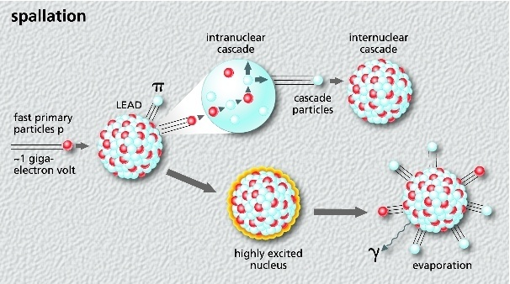
The Spallation Process
High energy hadron causing an intra-NC on a time scale ≈10⁻²²s
secondary particles (n,p,π) themselves produce secondaries creating an inter-NC placing many individual nuclei into highly excited states
Release energy by evaporating n, p, d, t, α, γ… on a time scale ≈ 10⁻¹⁸ 10⁻¹⁶s
Notes:
When a high energy hadron (or lepton) interacts with a nucleus of the target material causing an {\bf intra-nuclear} cascade (INC) inside the nucleus within a time scale of the order of $10^{-22}$~s, many secondary particles (n,p,$\pi$-mesons) are emitted which could themselves have a high enough energy to produce further secondaries when they interact, thus creating an {\bf inter-nuclear} cascade, placing many individual nuclei into highly excited states
The nuclei then release energy by evaporating nucleons (mainly neutrons), d, t, $\alpha$'s and $\gamma$'s, some of which will leave the target. The process of evaporation taking place within a much longer time scale\footnote{depending strongly on the thermal excitation energy $E^*$ of the hot nucleus} of $10^{-18}$ to $10^{-16}$~s may be characterized by a nuclear temperature $T=2\dots8$~MeV

Slide 7
Interest in Spallation reactions / Motivation (1)
i) Basic research / fundamental physics driven aspect
decay modes of highly excited hot nuclear matter
systematics on production cross sections for H,He,Li,Be isotopes (complex particles) in GeV pN reactions
understanding of reaction mechanism and cluster formation (coalescence, cascade exciton model, successive elementary reactions,…)
decomposition of evaporative and pre-equilibrium components
systematic comprehensive data set on angular-, energy distributions (over wide range of target nuclei) provide test grounds for model development and improvements and sensitive benchmarking

Slide 8
Interest in Spallation reactions / Motivation (2)
ii) Application driven aspect
    Astrophysics (Reedy et al., J. Geophys. Res. 77 (1972) 537)
    Production of isotopes, future tritium production units
    Transmutation of nuclear waste (Bowmann et al, Nucl. Instr. Meth. A320 (1992) 326; Rubbia et al, Report CERN/AT/95-44/(ET), 1995)
    Space technologies (Buchner et al, IEEE Trans. Nucl. Sci. 47 (2000) 705Tang et al, Mat. Res. Soc. Bull. 28 (2003))
    Biology and medicine (Wambersie et al, Radiat. Prot. Dosim 31 (1990) 421; Bartlett et al, Radiat. Res. Cong. Proc. 2 (2000) 719)
    Radioactive-beam production (EURISOL project)
    Spallation-neutron sources (SNS, J-Parc, ESS,…)

Slide 9
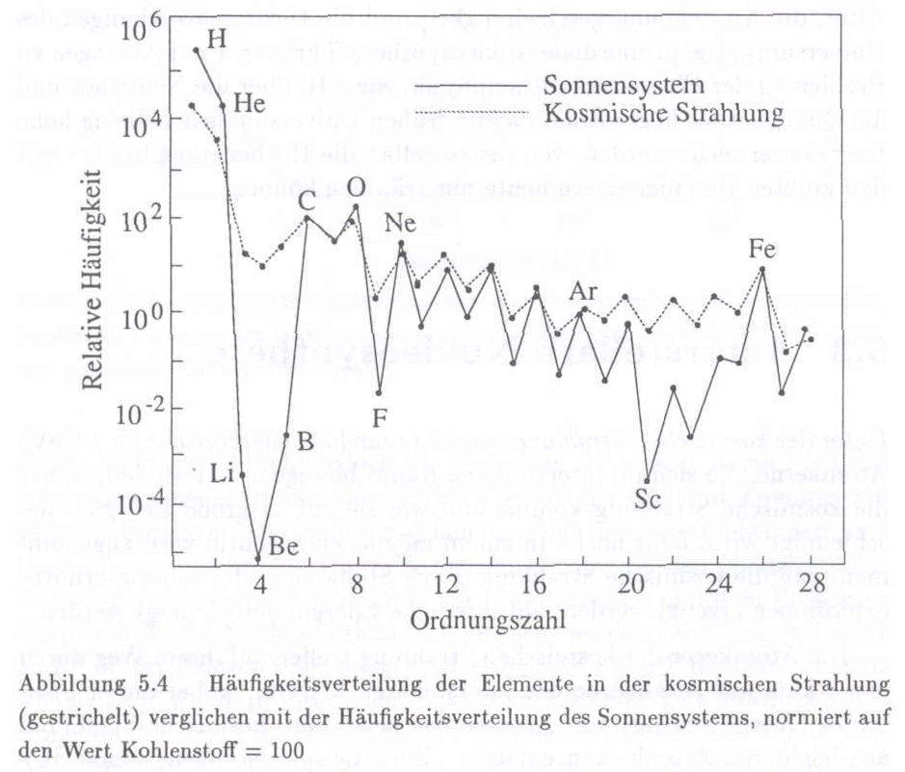
Nucleosynthesis in stars: composition of cosmic rays at upper atmosphere compared to solar abundancies of atomic nuclei
Li, Be, and B are enriched by
more than 6 orders of magnitude
→ Nuclear physics is needed !
Production of Li, Be, B
in galactic cosmic rays
High energy spallation reactions within the GCR. Protons from the GCR produce Li, Be, and B in spallation reactions induced on C, N, O
Meyer, Ramalty and Weber, Phys.Today, 1974
Notes:
using solar as a mean “standard” chemical composition

Slide 10
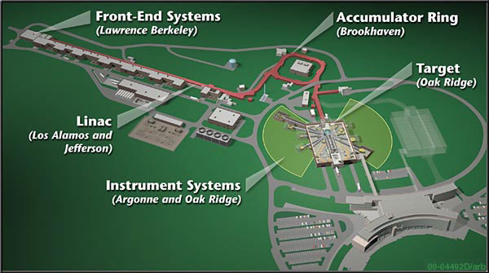
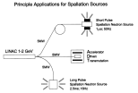
Important Spallation Neutron Sources
Europa
ISIS, Rutherford Appleton Laboratories, UK, http://www.isis.stfc.ac.uk/index.html
SINQ, PSI (Paul Scherer Institut), Switzerland http://www.psi.ch/sinq/
ESS-Europe, Sweden http://ess-scandinavia.eu/
USA
LANSCE, Los Alamos, New Mexico, http://lansce.lanl.gov/
SNS, Oak Ridge, Tennessee, http://neutrons.ornl.gov/facilities/SNS/
Japan
KENS und J-PARC, Tokai/Tsukuba, Japan, http://neutron-www.kek.jp/index_e.html
http://neutron-www.kek.jp/kens_e/j-parc.htm
Applications:
- chemistry
complex fluids
crystalline materials
disordered materials
engineering
magnetism and
superconductivity
polymers
- ….
SNS

Slide 11
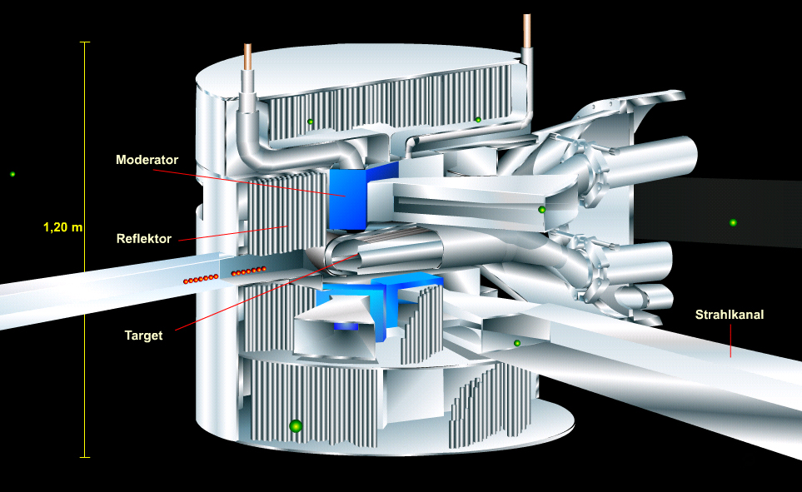
Neutron Spallation source, ADTransmutation
Radioactivity, Energy deposition, DPA,…
maximization of neutron flux
optimization of target/moderator /reflector assembly (geometry, material)
rad. damage due to embrittlement, dpa, …
activation of structural mat. and critical comp.
energy deposition
transmutation rates, …
☞

Slide 12
Contents
what is spallation? Definition & classification of nuclear reaction(s)
  relevance of and need for Nuclear Data (→ applications, fund. physics)
basic description of Computer models for spallation reactions (INC/evap. model)
  limits & constraints
  validation and development of codes (→ Sushil Sharma)
nuclear data/databases, Services Data access: NEA (EXFOR), CINDA, BNL
IAEA Nuclear Data Services
  Benchmark of Spallation Models
    Examples (IAEA, ITEP, NEA,…) n-,p-,LCP-ddxs, n-multiplicities, multiplicitiy distributions, excitation functions, mass-, charge-, isotopic-distributions, residues,…
Conclusion

Slide 13
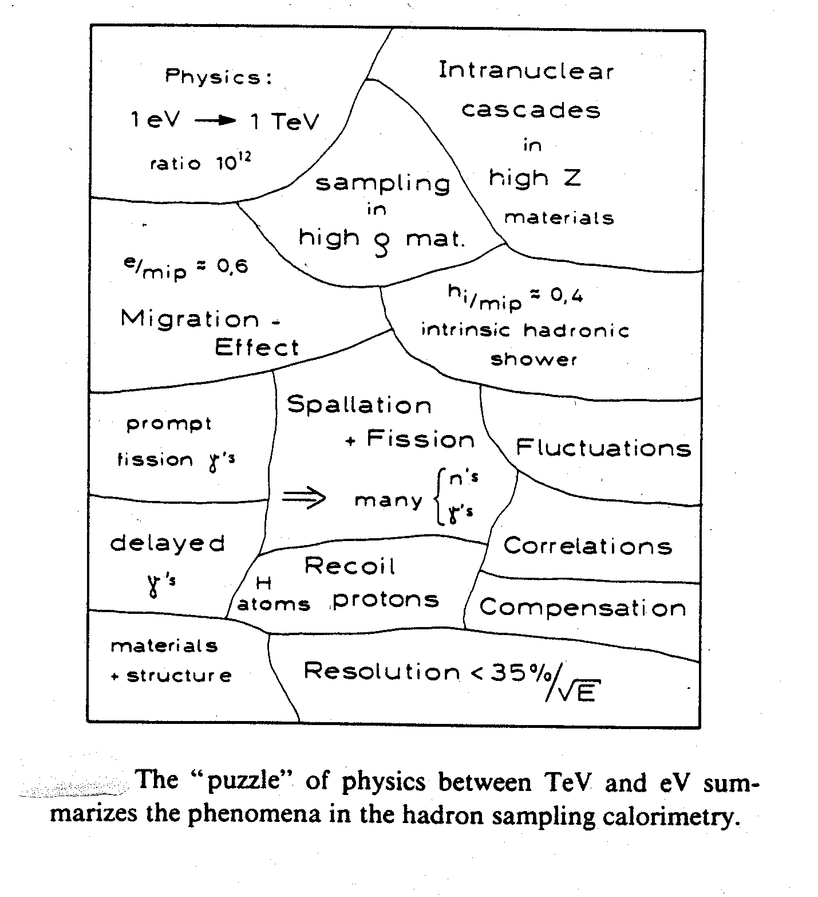
Modeling the process via Monte Carlo
due to the many aspects involved in the physics description of these complex processes
Sampling between GeV and meV !!!
therefore MC…
analytical approach difficult!
Notes:
I would like to communicate you
…to put across to you…. That due to the many aspects involved in the physics description of these complex processes an analytic description is essentially impossible.

Slide 14
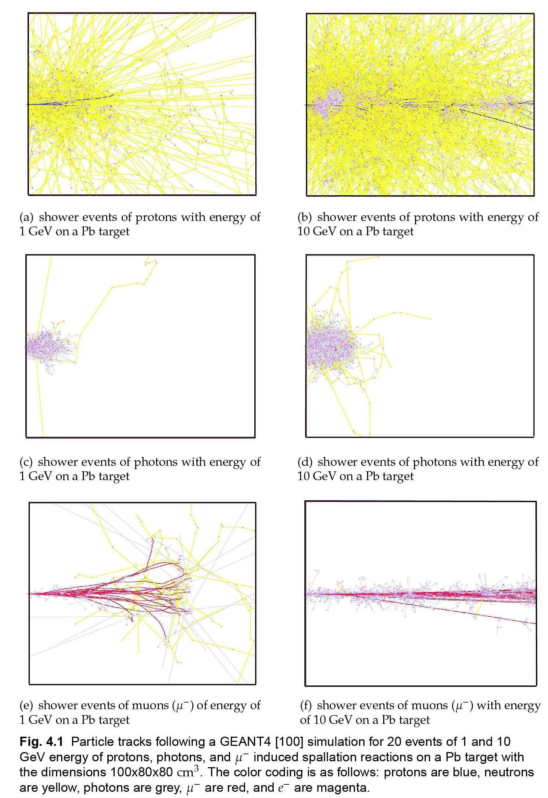
Illustration of complexity: Hadronic showers
Particle tracks of GEANT4
simulations for 20 events of
1 and 10 GeV protons, photons
and negative muons on a
100x80x80 cm³ Pb target

Slide 15
Modeling of transport processes

Slide 16
INCE Event Generators
(standard use and recent new models)
Models | Main authors
Bertini INC Model | H. Bertini (ORNL) in HETC/LAHET
Dresner EVAP Model GEM_EVAP Model ABLA Model | L. Dresner (ORNL) in HETC/LAHET Furihata (Mitsubishi-Research) K.H.Schmidt (GSI)
ISABEL Model | Y. Yariv, Soreq, Israel
Cugnon INC Model | J. Cugnon, Univ. Liege
FLUKA Event Generators | A. Ferrari et al., Univ. Milano, CERN
GEMINI Evaporation Model | R. Charity, Washington Univ. St. Louis
CEM | S. Mashnik, LANL
MC4 Generators | G. Sterzenbach, FZ-Jülich
Moscow Generator | E. Golubeva et al., Troitsk
MICRES | D. Theis et al., Univ. Bonn
MARS | N. Mokhov, FNAL

Slide 17
Code systems (to name a few…)
CALOR | T. Gabriel et al., ORNL
HERMES | P. Cloth et al., FZ-Jülich
LCS | R. Prael et al., LANL
GEANT4 | S.Agostinelli et al., CERN
MCNPX | LANL (Test-Version)  CEM, 150 MeV x-sec.
TIERCE | O. Bersillon, CEA
PSI-HETC/O5R | P. Atchison, PSI
PHITS/NMTC/JAM | K.Niita et al., JAERI/KEK
FLUKA | A. Fasso et al., CERN, Milano*
Cross Section Calculation and Evaluation
ALICE | M.Blann, LLNL
GNASH | P.G.Young, LANL, M.B.Chadwick, LLNL
NJOY | R.E.MacFarlane, LANL

Slide 18
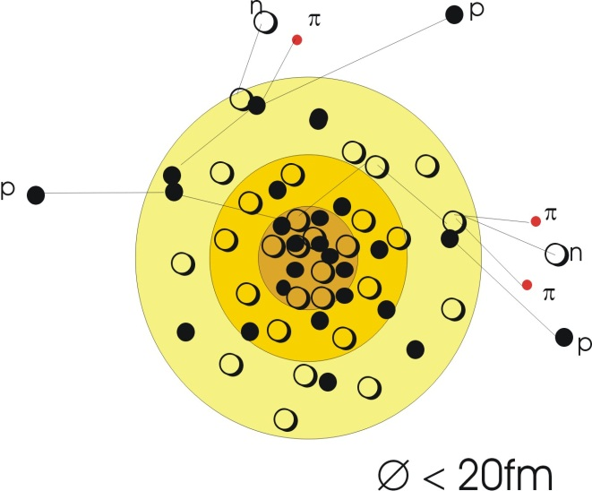
Physical Processes and Models(1): codes applied
spallation
  intranuclear Cascade
    INC+ISOBAR H.W.Bertini Phys.Rev.188(1969)1711
    INCL J. Cugnon, Phys. Rev. C 22(1980)1885
    ISABEL Y. Yariv and Z. Fraenkel, Phys. Rev. C 20(1979)2227
  evaporation
    EVAP (Dresner), GEM (Furihata), ABLA (Schmidt)
    RAL (Atchinson)
    Gemini (Charity)
  optionally multistage preequilibrium exciton model
  for ejectile energies <20 MeV neutron transport by MORSE and MCNP
  Deexcitation by γ-Emission
    NDEM (Database of nuclear Levels)
Ionization
Elastic Scattering (at high energies)
Particle Decay (Pions)

Slide 19
Physical Processes and Models(2): The INC
fundamental presumptions
    hadron-nucleus interaction is consequence of independent collisions of primary and secondary particles with nucleons of nucleus.
    trajectories of cascade particles treated “classical”---no interaction among each other.
    interaction based on elementary cross sections valid under vacuum. cross sections derived from empirical approximations of
        NN → NN (elastic)
        πN → πN (elastic)
        NN → N* N → Nπ N
        NN → N* N* → Nπ N π
        πN → πN* → π Nπ
        N* N → NN (delta absorption)
        πN → πN (charge exchange)
    Pauli blocking, Fermi motion of target and projectile nuclei, pion production, and effects of target mean field are included.
    nucleus considered as degenerated Fermi gas of n’s and p’s.

Slide 20
Physical Processes and Models(3): The INC
Adopted from Ye.Golubeva, Nucl.Phys A483,1988
Notes:
For high energies this presumption is certainly valid and the interacting nucleons do not ``see'' the nucleus as whole but as an assembly of individual nucleons bound together by their mean field.

Slide 21
Physical Processes and Models(4): The INC
Assumptions for which fundamental presumptions (within the INC) are valid:
  De-Broglie-wavelength λ of cascade particles smaller* than average distance of nucleons in nucleus (δ≈1.3fm) and mean free path length L in nuclear matter: λ<<δ, λ<<L
  duration of elementary impact τ_{int}∼ r_{int}/v smaller than time between two collisions, i.e. radius of strong interaction smaller than mean free path length: r_{int}<<L
  number of participating cascade particles N_{c} should be considerably smaller than number of target nucleons A_{t}: N_{c} <<A_{t}
λ=h/(2mE)^{1/2}
λ=0.7 fm ↔ 1000 MeV
λ=2.7 fm ↔ 100 MeV
λ=9 fm ↔ 10 MeV
*For high energies this presumption is certainly valid and the interacting nucleons do not ``see'' the nucleus as whole but as an assembly of individual nucleons bound together by their mean field.
Notes:
For high energies this presumption is certainly valid and the interacting nucleons do not ``see'' the nucleus as whole but as an assembly of individual nucleons bound together by their mean field.

Slide 22
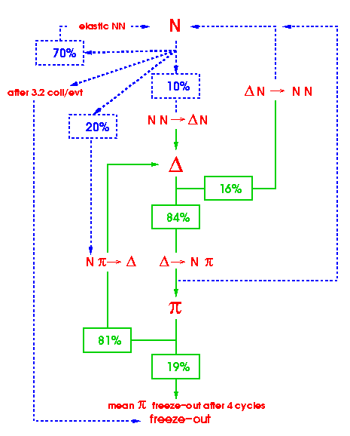
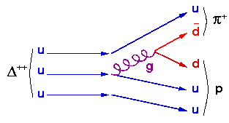
Physical Processes and Models(4): The INC
production of pions
pions are decay products of Δ resonances. (mesons--exchange particles of the strong interaction between nucleons). Δ resonances and pions are coming from inelastic NN reactions at beam energies above few 100 MeV (M_{π} ~ 140 MeV).
Pion cycle ( Δ → Nπ → Δ )
• NN → ΔN hard Δ production
• Δ → Nπ Δ decay
• ΔN → NN Δ absorption
• Nπ → Δ soft Δ production
4 sorts of Δ’s
Δ⁺⁺ → 1 (p+π⁺)
Δ⁺ → 2/3 (p+π⁰) + 1/3 (n+π⁺)
Δ⁰ → 2/3 (n+π⁰) + 1/3 (p+π⁻)
Δ- → 1 (n+π⁻)
C. Hartnack et al., Nucl. Phys. A 495(1989)303

Slide 23
Physical Processes and Models(5): The INC
Reactions / cross sections
  NN → NN (elastic)
  NN → N* N → Nπ N
  NN → N* N* → Nπ N π
  πN → πN (elastic)
  πN → πN* → π Nπ
  πN → πN (charge exchange)
  Further channnels ?
  Further particle species ?
nucleon density distribution, Pauli principle (time dependent ? ) (~ 10⁻²² s )
scattering on nucl. potential ?
cut off criteria: energy / time
collective interactions ?
coalescence (cluster) …. !!

Slide 24
Hot nuclei / time scale
Dynamical picture of the energy dissipation
E* increases during the first NN, πN collisions
during this very fast stage of the INC, pre-equilibrium processes cool down nucleus
statistical equilibrium after ~30-60 fm/c
final stage: evaporation from a thermalized nucleus
beam energy 0.2 to 2GeV, target (Al-U)
Impact parameter from central to surface
INC
evaporation

Slide 25

Physical Processes and Models(8): Evaporation SM
Evaporation
Which particles should be considered?
Is there a dependency of V from U ?
How precise accounted for tunneling?
σ and V depend on nucleus radius R₀A^{1/3}, therefore R₀ is a critical parameter!
B₀ critical parameter for level density ω!
i emitted particle type (n,p,d,t,³He,⁴He)
ε kinetic energy
S_{i} Spin of the emitted Particle
m_{i} emitted particle mass
σ_{i,cap} inv cross section
E‘ Excitation energy of the resudual
ω(E‘) density of energy levels of exi.residual
a level density parameter
Extension of SM to high E*
Validity of the SM at high E*
  small lifetime of hot nucleus
  system equilibrated?

Slide 26
Contents
what is spallation? Definition & classification of nuclear reaction(s)
  relevance of and need for Nuclear Data (→ applications, fund. physics)
basic description of Computer models for spallation reactions (INC/evap. model)
  limits & constraints
  validation and development of codes (→ Sushil Sharma)
nuclear data/databases, Services Data access: NEA (EXFOR), CINDA, BNL
IAEA Nuclear Data Services
  Benchmark of Spallation Models
    Examples (IAEA, ITEP, NEA,…) n-,p-,LCP-ddxs, n-multiplicities, multiplicitiy distributions, excitation functions, mass-, charge-, isotopic-distributions, residues,…
Conclusion

Slide 27
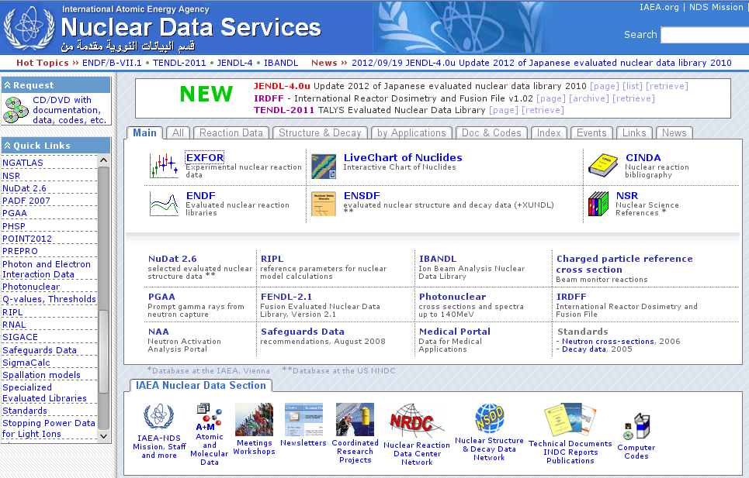
http://www-nds.iaea.org/

Slide 28
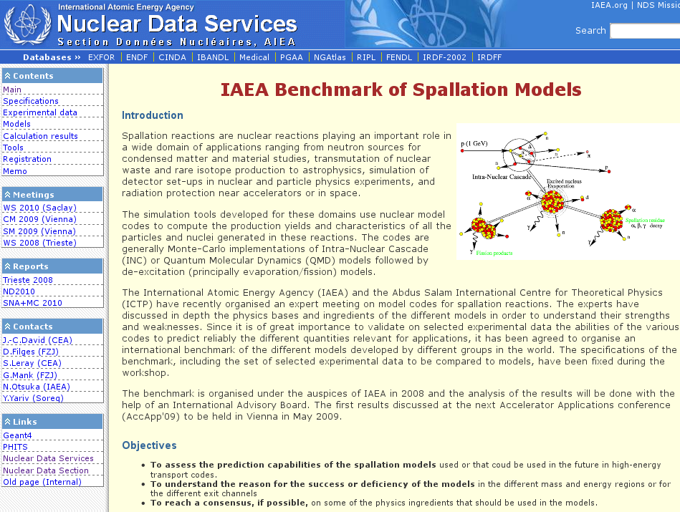
http://www-nds.iaea.org/spallations/

Slide 29
IAEA Benchmark of Spallation Models – Specifications + Experimental Nuclear Data
Participation (rules…)
Domain N + A, 20 MeV to 3 GeV, A≥12, i.e.
  nucleon-induced reactions on nuclei from C to U
  mostly >100 MeV, but with a few sets at low incident energies down to 20 MeV, (certain isotopes) 20-150 MeV libraries are not available for all isotopes
  test physics models (also implemented in high-energy transport codes to compute the production yields and properties of particles and nuclei emitted in a fundamental spallation interaction. only comparisons with elementary exp. data on thin targets considered
Model ingredients and parameters
http://www-nds.iaea.org/spallations/spal_spc.html
Notes:
Domain: …nucleon-induced reactions on nuclei from carbon to uranium.

Slide 30
IAEA Benchmark of Spallation Models – Specifications + Experimental Nuclear Data
Observables of the data base /data and formatting
  particle cross sections (d²σ/dΩdE of n, p, π, d, t, ³He, alphas, etc. )
  multiplicities (M_{n}, M_{p ,}M_{π} , M_{d}, M_{t}, M_{He}, M_{IMF}), + multiplicity distributions
  isotope production (isotopic distributions) Z, A, σ (mb), error (mb) in direct and inverse kinematics
  production cross sections up to 3 GeV (excitation functions)
  isotope production cross sections (isomers)
  units energies in MeV, cross-sections and errors in mb
http://www-nds.iaea.org/spallations/spal_spc.html
Notes:
Domain: …nucleon-induced reactions on nuclei from carbon to uranium.

Slide 31
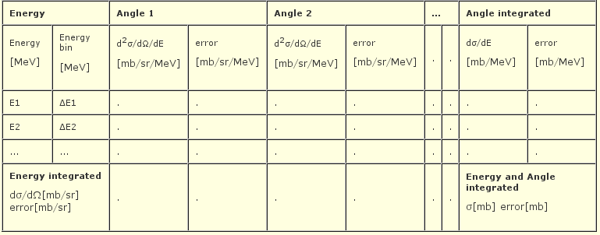
IAEA Benchmark of Spallation Models – Specifications + Experimental Nuclear Data
Observables of the data base /data and formatting
  particle cross sections (d²σ/dΩdE of n, p, π, d, t, ³He, alphas, etc. )
  Multiplicities (M_{n}, M_{p ,}M_{π} , M_{d}, M_{t}, M_{He}, M_{IMF})
  isotope production (isotopic distributions) Z, A, σ (mb), error (mb) in direct and inverse kinematics
  production cross sections up to 3 GeV (excitation functions
  isotope production cross sections (isomers)
  units energies in MeV, cross-sections and errors in mb
http://www-nds.iaea.org/spallations/spal_spc.html
Notes:
Domain: …nucleon-induced reactions on nuclei from carbon to uranium.

Slide 32
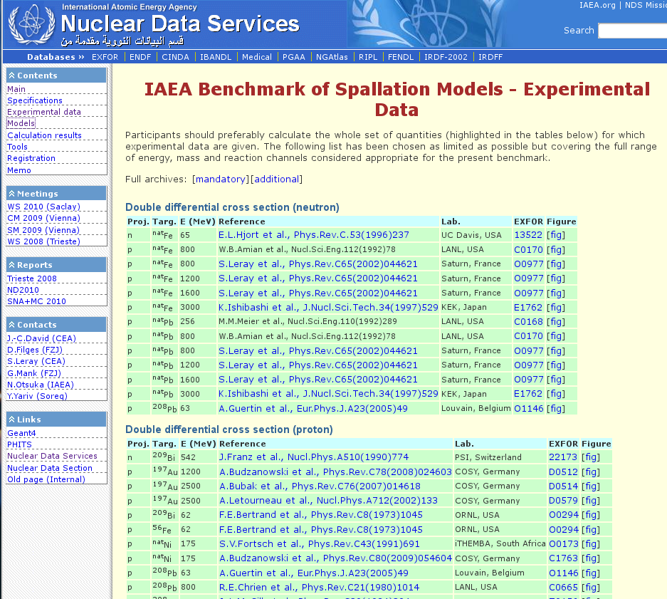

Slide 33
IAEA Benchmark of Spallation Models - Experimental Data
Double differential cross sections (n, p, d, t, ³He,⁴He, π⁻, π⁺ )
Mass distributions
Charge distributions
Isotope distributions
Neutron multiplicity distributions
Excitation functions (isotopic, mass, charge)
…
Website and tools to analyze results fully operational
Continue benchmark in a dynamic way,
i.e. add new experimental data, new versions of models
(in progress OECD/NEA framework for next benchmark…)

Slide 34
Few examples of Evaluated Results
Benchmark data/calculations

Slide 35
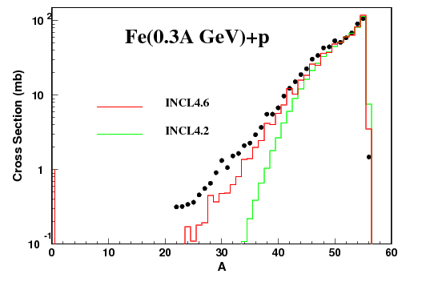
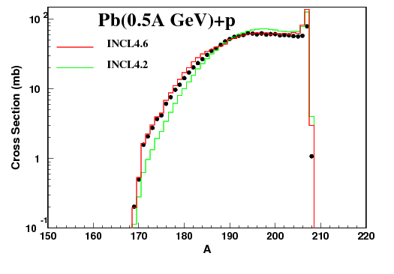
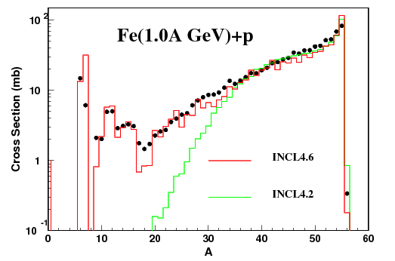
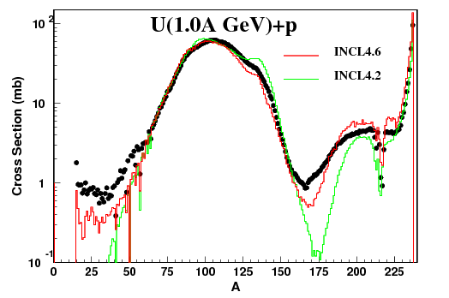
Residual Nuclei
Data: GSI experiments, Villagrasa-Canton, Audouin, Taieb, M.Bernas, Ricciardi et al. Pys. Rev C75(2007) 44603, Nucl. Phys. A768(2006) 1
Improved: More E* (INCL) , light nuclei production and fission (ABLA07)

Slide 36
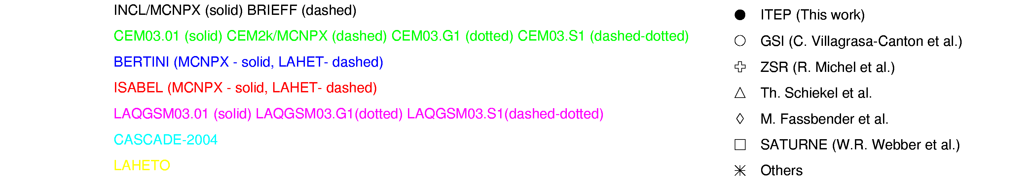
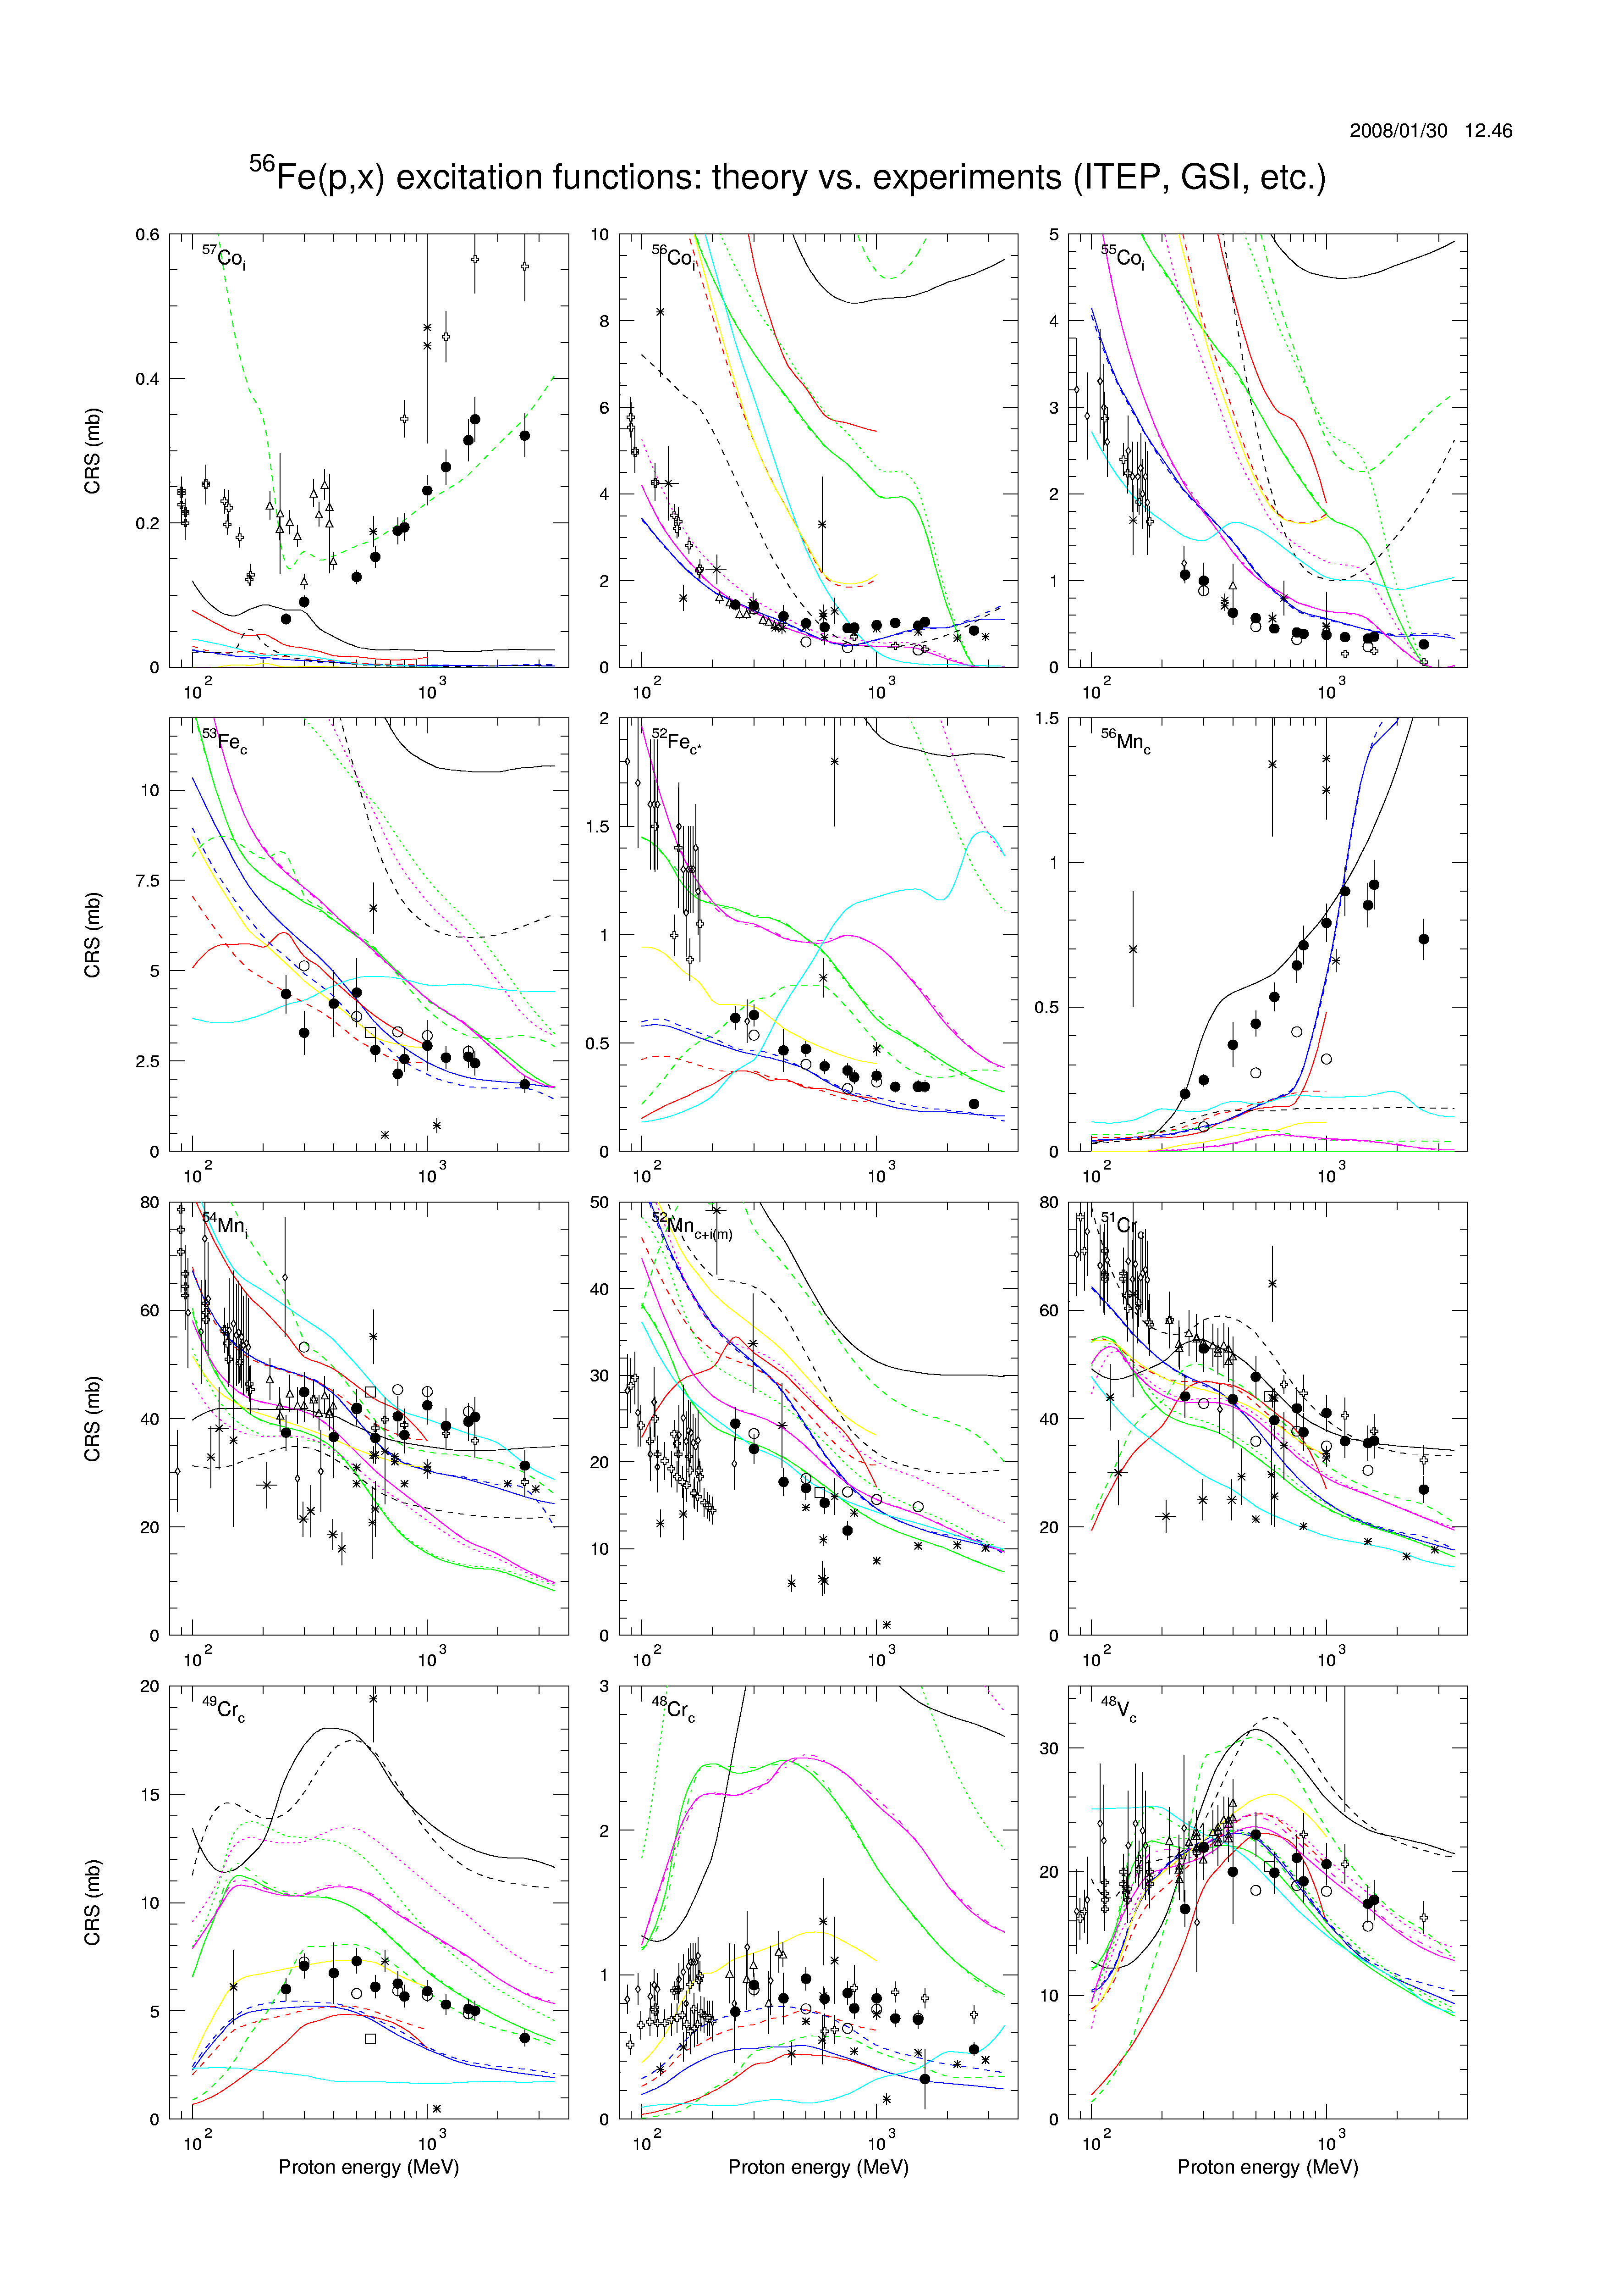
⁵⁶Fe(p,x)

Slide 37
Neutron energy ddxs 1.2GeV p+Pb
Neutrons:
Generally good
Agreement with
Model desciption
Saturne Data 1.2GeV p +Pb
INCL4.2

Slide 38
Concluding Remarks
high intense spallation neutron sources recently commissioned or under construction worldwide (need for neutrons, … )
basically existing intranuclear cascade-evaporation models capable of describing spallation reaction process
Sets of benchmark data do exist, for code validation/improvement
  → data valuable for identification of deficiencies of INC/evap. codes
  → nevertheless high quality nuclear data still needed !
To do:
solve discrepancies between different sets of data …
solve deficiencies of models

Slide 39
Backup slides…

Slide 40
History
First observations:
1937: Shopper et al, Naturw. 25 (1937) 557 – interaction of cosmic rays in a track detector
1937: Seaborg, PhD thesis - inelastic scattering of neutrons
1947: E.O. Lawrence discovers that “…the number of emitted nucleons, especially neutrons, may be quite large depending upon the conditions of the spallation reaction. “
The concept of nuclear spallation was first coined by Glenn T. Seaborg: 'In order to distinguish these reactions from the ordinary nuclear reactions in which only one or two particles are ejected, in 1947 I coined the term “spallation” reactions. This term has since become standard in the field'.
90’s: new interest for spallation reactions → they are of pivotal importance for the development of powerful neutron sources for various purposes

Slide 41
Nuclear reactions / Fragmentation
Definition: Formation of a unique fragment from the peripheral collision of a projectile nucleus with a target nucleus. The impact results in the abrasion of few nucleons. The excited pre-fragment decays by emitting few other nucleons.
evaporated nucleons
projectile
pre-fragment
fragment
abraded nucleons
target

Slide 42
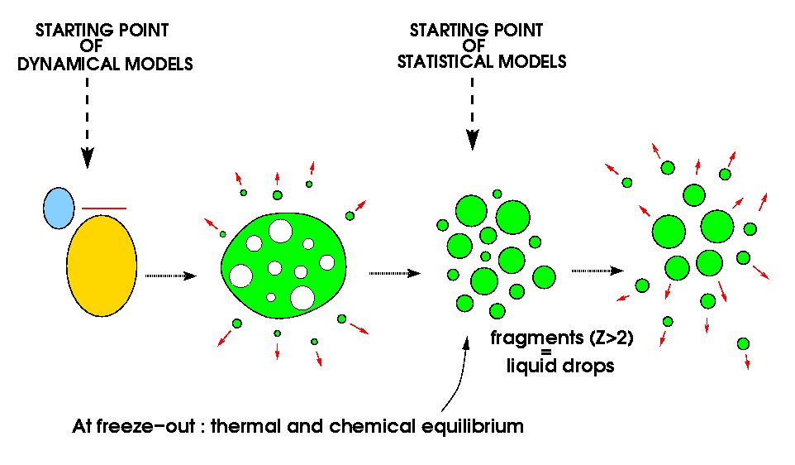
Nuclear reactions / Multifragmentation
Definition: for thermal multifragmentation formation of IMFs at higher T consequence of increasing thermal motion linked with increasing mean distance of the nucleons. Excited remnant achieves thermal eq. state and than expands, eventually reaching the freeze-out volume. At this point it fragments into n, lcp and IMFs. Due to short ranging nuclear forces of nucleons the mean field collapses and IMFs are formed by condensation. Dynamical fragmentation in contrast caused by high angular momenta, compression of the nuclear density, large momentum transfer and formation of non-compact deformed nuclei. It is a very fast decay mode, the time scales involved are at most of the order of several hundred fm/c (1 fm/c = 3.10⁻²⁴ s).
preequilibrium
emission
J. Bondorf et al., Phys. Rep. 257(1995)133
freeze-out: density r ~ r₀/3
temperature T ~ 5 MeV
excitation energy E*~ 4-6 AMeV

Slide 43
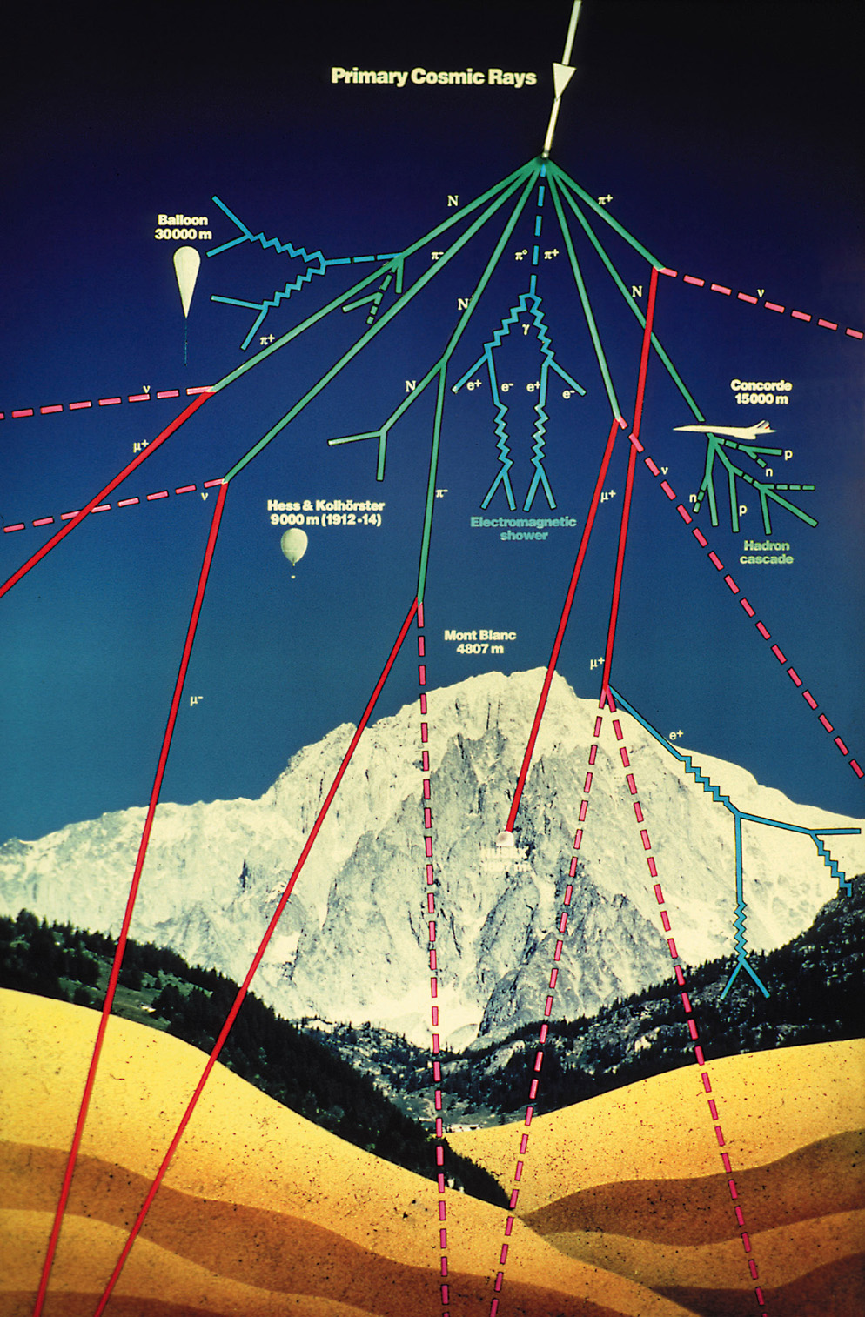
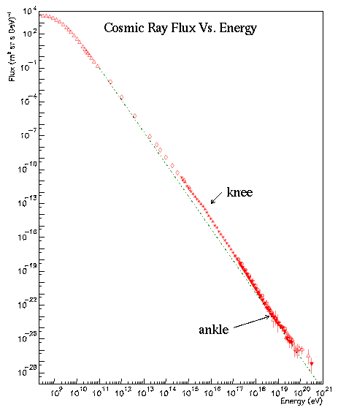
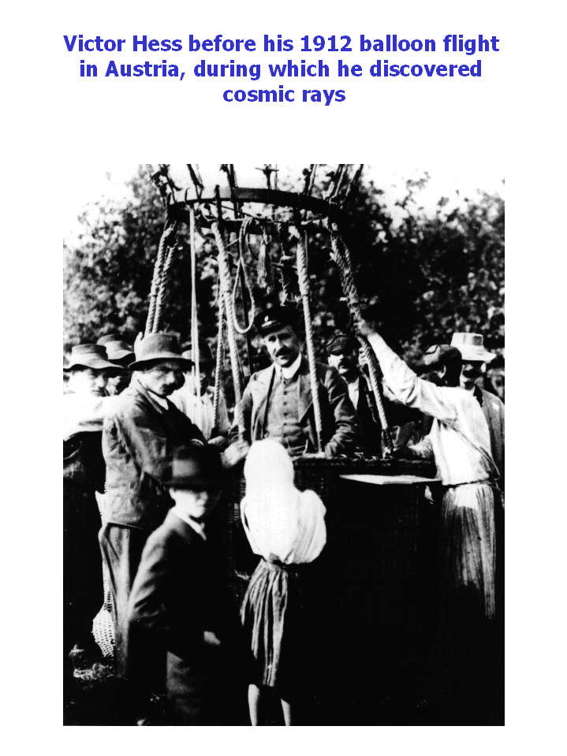
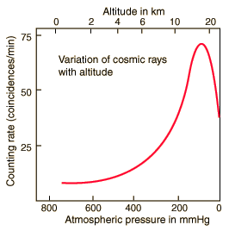
Astro particle physics
~90% of cosmic rays are
nuclei of H, 8% are He
nuclei, electrons, or
heavier nuclei
cosmic rays, interaction with ISM, cosmogenic nuclide formation
highly energetic photons and other particles
neutrinos (Supernovae, sun, ?)
antimatter-nuclei, antigalaxies
dark matter ?
…
Flux
Energy
cascade of subatomic particles
associated with cosmic rays
Notes:
LiBeB-puzzle ok with GeV spallation ractions
But:
Particles >∼1015 eV have not been accelerated in our galaxy
must come from outside of the galaxy
Problem: Above ∼5×1019 eV GCR particles lose energy continually by interactions with the 2.7 K cosmic microwave background
Therefore: Few particles with 1020 eV should be able to reach us from sources more than about 50 Mpc away ⇒ Most of the high energetic GCR particles must have travelled less than ∼50 Mpc (1 Mpc ≈ 3 Mly, size of the galaxy 50 kpc)
But: There is no proper source within this radius to generate such large amounts of high energetic GCR particles
⇒ Still an open question ⇐

Slide 44
why nuclear physics? The Target (ESS)
ESS, SNS, JSNS, ISIS,….
layout and design of moderators (coupling, poisoning, pre-moderation…) and reflectors, shielding layout…
…each subject certainly filling a whole lecture by itself
→ Nuclear physics is needed !
activation of structure material and critical components, as well as energy deposition should be minimized…
deactivation properties of individual nuclides can be studied
→ Nuclear physics is needed !
H-, He-, IMF and residual production cause radiation damage due to embrittlement, dpa, … in structural materials
→ Nuclear physics is needed !
Neutron flux is to be optimized in terms of proper energy, timing and maximum intensity…
→ Nuclear physics is needed !
☞

Slide 45
Spallation vs …
Process | Example | Yield | Energy Deposition [ MeV/n]
DT solid target | 400keV deuterons on tritium in Titan | 4.0 x 10⁻⁵ n/d | 10 000
Deuteron stripping | 35 MeV deuterons on liquid Lithium | 2.5 x 10⁻³ n/d | 10 000
electrons Bremsstrahlung (Photo-neutrons) | 100MeV electrons on U-238 | 5.0 x 10⁻² n/e | 2000
Fission | U-235 (n,f) | 1 n/fission | 180
DT-fusion | laser or ion-beams imploding pellets | 1 n/Fusion | 3
spallation | 1 GeV protons on Pb | 30 n/p | 20
spectra…

Slide 46

Neutronen Yield u. Wärmefreisetzung verschiedener nuklearer Prozesse
Prozess | Beispiel | Neutronenproduktion | Wärmefreisetzung [ MeV/n] ^{(a)}
D-T Feststofftarget | 400 keV d auf Tritium-Titantarget | 4 x 10⁻⁵ n/d | 10 000
Deuteron-Stripping | 40 MeV d auf flüssig Li-Target | 7 x 10⁻² n/d | 3500
e⁻ Bremsstrahlung | 100 MeV e⁻ auf ²³⁸ U-Target | 5 x 10⁻² n/e⁻ | 2000
⁹Be (p,n; p,pn) | 11 MeV Protonen auf Be-Target | 5 x 10⁻³ n/p | 2000
⁹Be (d,n)¹⁰Be | 15 MeV d auf Be-Target | 1 n/d | 1000
Spaltung | ²³⁵U mit thermischen Neutronen | 1 n/Spaltung | 180
Spallation | 800 MeV Protonen auf ²³⁸U ^{nat}Pb | 27 n/p 18 n/p | 55 30
Inertial Fusion | d-t Pellets durch Laser komprimiert | 1 n/d-t Paar | ca. 20
(a) 1 MeV ~ 1,6 x 10⁻¹³ J ~ 4.45 x 10⁻²⁰ kWh
05.06.2013
46

Slide 47
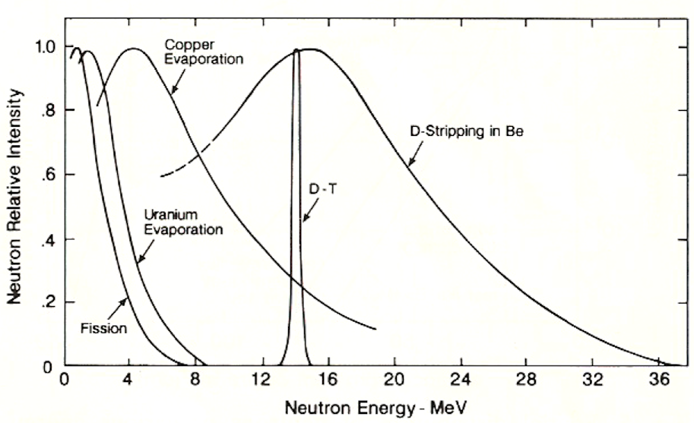
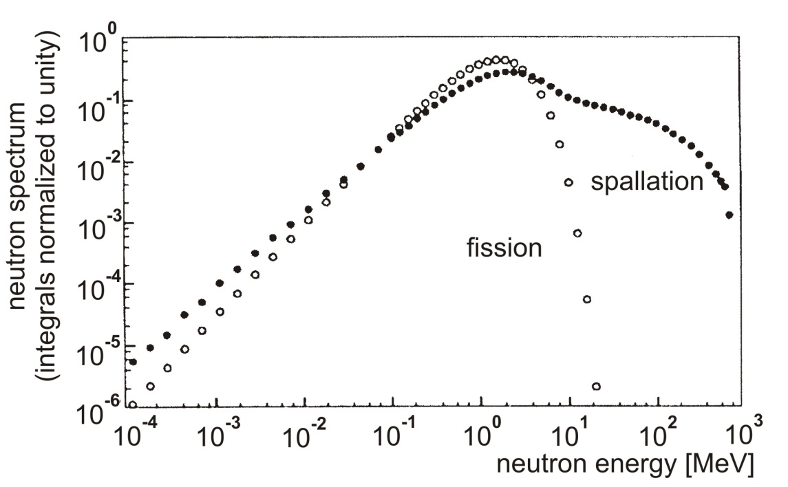
Spektren von verschiedenen Neutronenquellen
Verdampfungsspektren
Spallation
(folgen Maxwell Verteilungen)
Problem der Abschirmung
05.06.2013
47

Slide 48
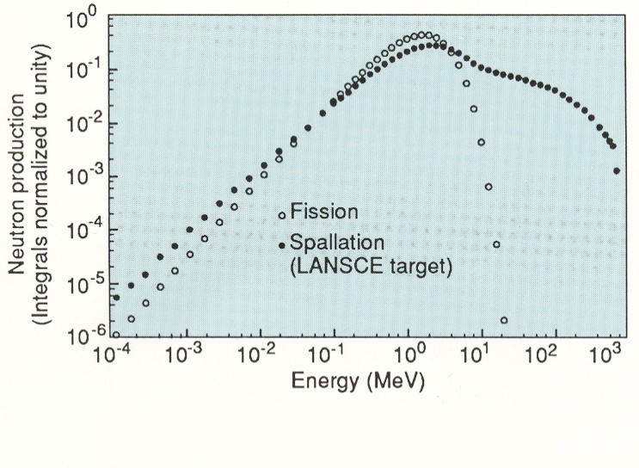
Shielding problem in spallation reactions…
The integral neutron spectrum can be fitted with a Maxwellian distribution:
With T_{M} the only parameter characterizing the distribution. The average neutron energy is given by <E_{n}> = 3/2 T_{M}.
T_{M} = 1.352 MeV
<E_{n}> = 2.028 MeV
²³⁵U(n,f):

Slide 49
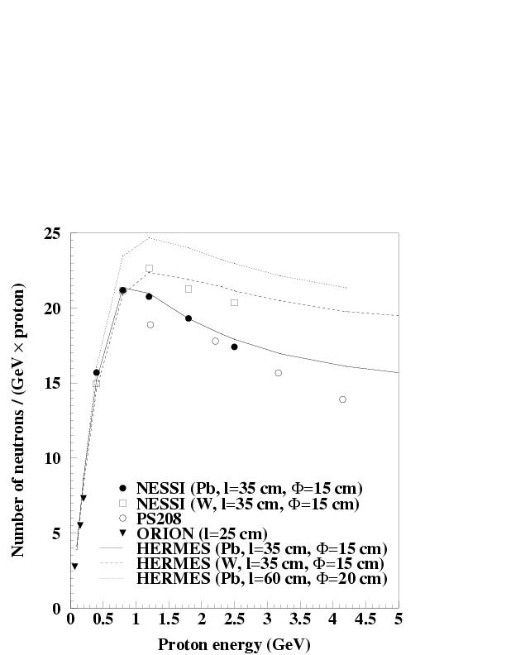
The Spallation Process (2)
inelastic interaction of a high energy hadron striking a nucleus of the material approaches the geometrical cross section of the nucleus.
spallation processes are endothermic; incoming cp energy taken up as neutron separating and kinetic energy; up to about 1~GeV linear relation between total neutron production yield and proton energy; at higher p-beam energies π⁰ production--``electromagnetic drain'‘; rapid decay (half-life 10⁻¹⁶s) does not allow π⁰ to take part in INC, although the π⁺, π⁻ do; π⁺, π⁻ decay time (26ns) sufficiently long to allow for further hadronic interactions. At still higher energies, well above 10GeV, other meson production channels open up which in addition deplete the cascade of energy
Notes:
When a high energy hadron (or lepton) interacts with a nucleus of the target material causing an {\bf intra-nuclear} cascade (INC) inside the nucleus within a time scale of the order of $10^{-22}$~s, many secondary particles (n,p,$\pi$-mesons) are emitted which could themselves have a high enough energy to produce further secondaries when they interact, thus creating an {\bf inter-nuclear} cascade, placing many individual nuclei into highly excited states
The nuclei then release energy by evaporating nucleons (mainly neutrons), d, t, $\alpha$'s and $\gamma$'s, some of which will leave the target. The process of evaporation taking place within a much longer time scale\footnote{depending strongly on the thermal excitation energy $E^*$ of the hot nucleus} of $10^{-18}$ to $10^{-16}$~s may be characterized by a nuclear temperature $T=2\dots8$~MeV

Slide 50

Neutron Spallation source, ADTransmutation
Radioactivity, Energy deposition, DPA,…
optimization of target/moderator /reflector assembly (geometry, material)
maximization of neutron flux
transmutation rates,
…
☞

Slide 51
Coming back to neutron spallation sources… challenges — capabilities of models
optimization:
  maximum neutronen flux in proper energy- and time structure
  limited material damage in critical components
  small irradiation dose and energy-deposition
simple variation of design-parameter (without experiments)
  beam properties
  geometry
  Material
evaluation of physics parameter
  particle flux as function of space and time
  energy deposition
  activation of material
  damage of material
  irradiation dose

Slide 52
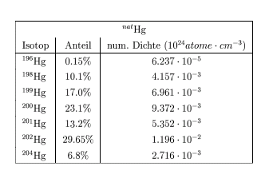
Activation (here for a spallation source)

Slide 53
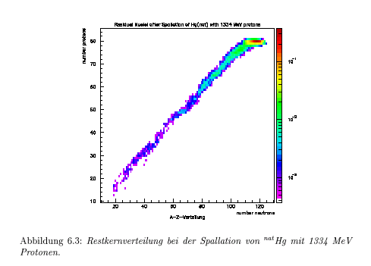
Activation (here for a spallation source)

Slide 54
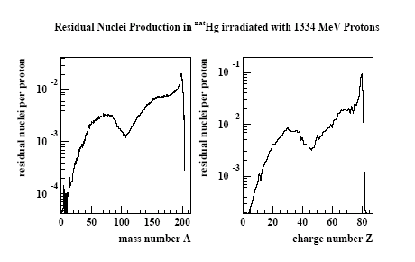
Activation (here for a spallation source)

Slide 55
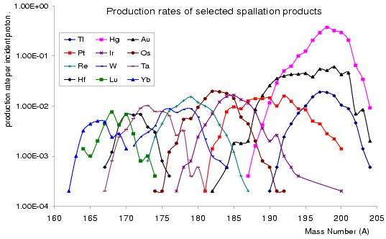
Production rates of the 12 most prob. Elements in 1.334 GeV p+Hg induced spallation
Activation (here for a spallation source)
Sum of all rates: 4.3 per incident proton 5MW, 2.34E16p/s, 30 years = 156mol (0.16% of 20t Hg)

Slide 56
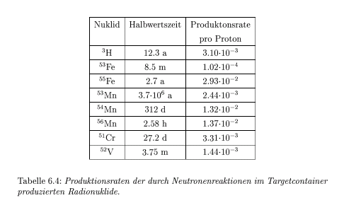
Activation (here for a spallation source)

Slide 57
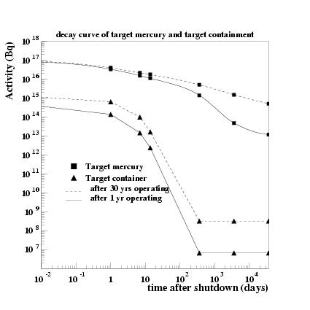
Total activity of target and container (ESS parameter)
decay curve of Hg and
the target container
after 1 and 30 years of
operation, respectively
target: during operation,
activity same after 1
and 30 years
after 1 year of operation
long living isotopes did
not yet reach equilibrium!

Slide 58
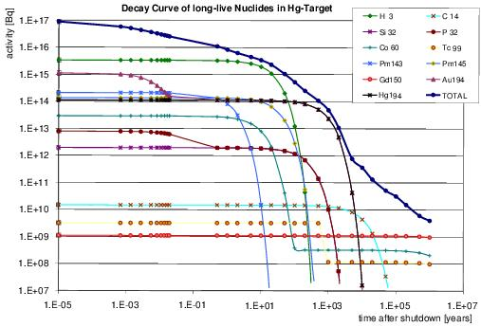
Activity of individual nuclides (ESS parameter)
after 30 years
of operation
t=10 years tritium, t=1000 years 194Hg, 194Au (e-capture)

Slide 59
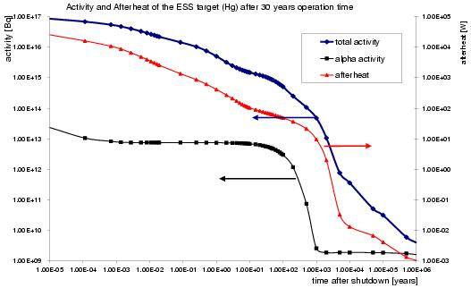
Activity and afterheat of target (ESS parameter)
after 30 years
of operation
afterheat at t=0 25.4 kW
t=7 days 2.0 kW (101 mW/kg)
…..all the same calculations for moderator, container and reflector…..

Slide 60
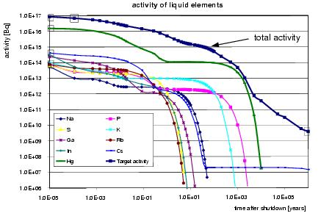
Activity of liquid* elements (ESS parameter)
after 30 years
of operation
* liquid at operation temperatures of the target

Slide 61
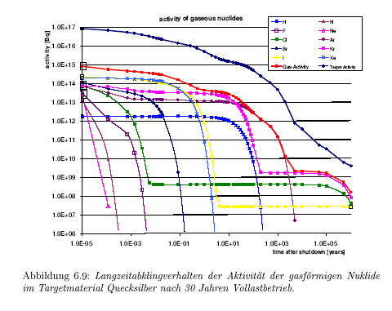

Slide 62
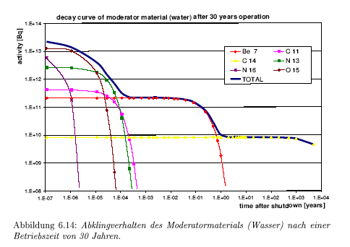

Slide 63
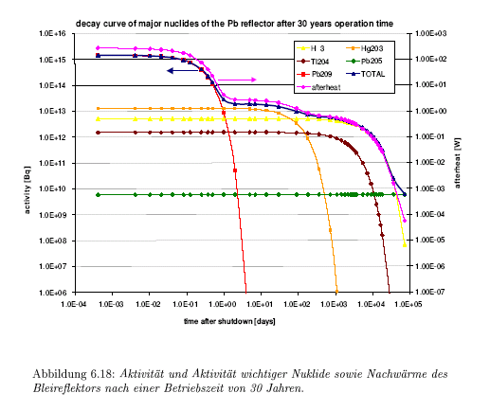

Slide 64
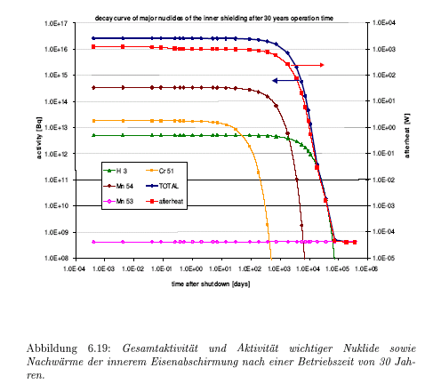

Slide 65
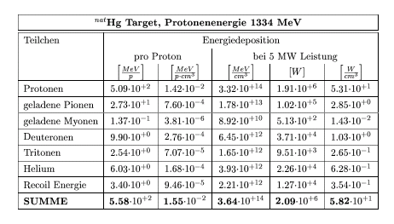

Slide 66
Illustration of complexity: Hadronic showers
Transport of particles in thick targets
Mainly secondary particle production→initial increase of particle intensity with depth and time
Track length flux of n and p reflects the radial and longitudinal propagation of particles involved in the INC
P develop along their trajectory in a more narrow cone (elec.stopping power)
At the end of internuclear cascade subsequent emission of low energy particles….
Complex record keeping of all particles in terms of energy location and direction
2.5 GeV p + Si/CsI (0.5/70mm)
GEANT4
Analytical approach difficult!
2.5 GeV p + Pb (15dia,35cm length), HERMES

Slide 67
Spatial distribution of shower generation
Transport of particles in thick targets
p + Pb (15dia,35cm length), Hermes
Radial direction determined by intensity profile of incoming beam
Axially controlled by σ_{inel}=15.9πA^{2/3} mb/A as consequence of σ_{inel}intensity of proton beam (power deposition, neutron release) decreases exponentially along axis of target
Parameterization of the axial distribution:
N,N₀ quantity to be described (neutron yield, power density, temperature, radial power integral,…), z₀ extrapolation length, λ_{b} buildup length, λ_{a} attenuation length (N_{a}/σ_{inel} where N_{a} is number of target nuclei per cm³ )
Analytical approach possible?!
G.S.Bauer NIM A463 2001, 505

Slide 68
Why particle transport?
Due to significant increase of computing power Monte Carlo methods have turned out to be the first choice
→ „Monte Carlo is what nature does“
…at least if you put the right physics in
in reactor-technique, fusion, spallation physics, spallation sources, transmutation, ADS design, shielding of particle beams, cosmic rays, therapy,…
adresses to questions in material composition, geometry, particle- and beam parameters
MC (nuclear physics implemented) important for many scientific and technological problems

Slide 69
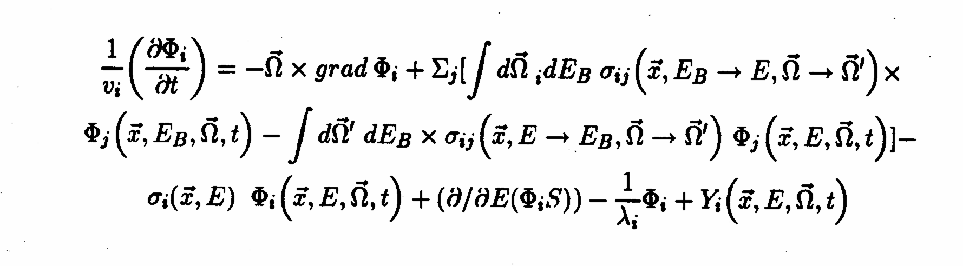
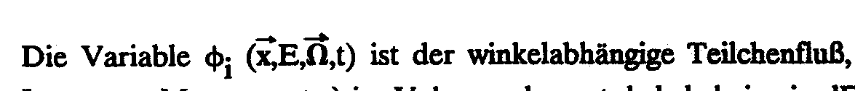
General Boltzmann equation
for particle transport and interaction with matter
Non rel. integro-differential eqn. settled in 1872---continuity eqn in phase space consisting of 3 space coordinates, kin. energy and direction of motion
System of coupled transport eqn difficult to solve in particular for hadronic cascades because of secondary particle production…
…numerical procedures emerged i) deterministic methods, discrete ordinates…
ii) MC: construct stochastical model in which the expected value of a random variable is equivalent to the physical quantitiy to be determined– estimated by the average of many independent samples representing the random variable; In order to describe real. phys. situation, no need for invoking transport eqn.; „only“ complete math. description of probability relationships needed…

Slide 70
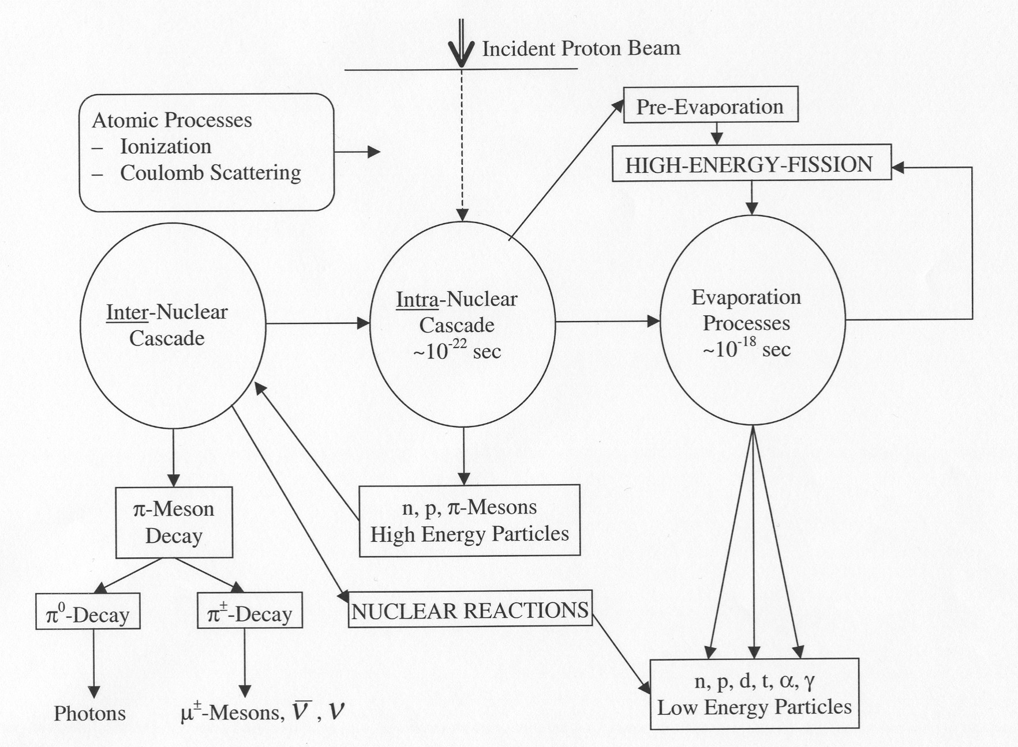
Modeling the two stages of the spallation process
Notes:
Da gibt‘s noch ne ähnliche 2.te folie….siehe Detlef

Slide 71
Physical Processes and Models(6): Evaporation
These models are used to simulate the second step of the reaction, i.e. the decay of the excited residue.
Main features:
- life-time of the excited residue much longer than its formation time
T(residue) = several hundreds of fm/c
T(formation) ~ 30 fm/c
- individual properties of quantum states have negligible effect at high
excitation energy, due to the small distance between the energy levels, in
particular in heavy nuclei.
All the states are equiprobable so the deexcitation of the nucleus may be treated in a statistical way.
In other words, a statistical model considers the probabilities of the different deexcitation possibilities with comparable weights, which correspond to individual processes of similar time scales.

Slide 72
Physical Processes and Models(7): Evaporation
Most of the current evaporation code describe the residue deexcitation according to the Weisskopf theory which is based on the energy conservation and the assumption of the micro-reversibility of the process.
This assumption is verified for the light particle emissions (n, p, d, t, ³He, ⁴He), but not for the emission of heavier nuclei or for fission.
Note: the average total neutron multiplicity is about 4 times the multiplicity of the neutrons coming from the cascade stage.

Slide 73
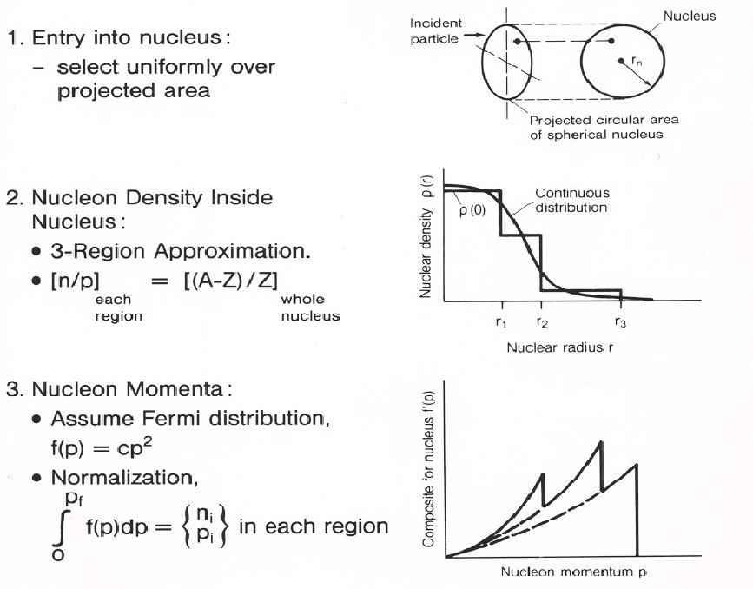

Slide 74
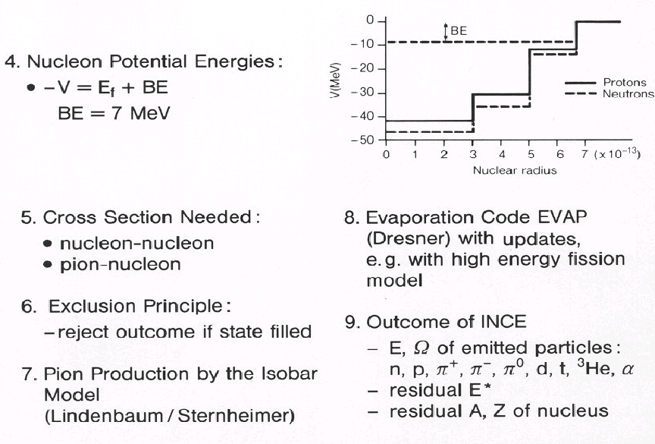

Slide 75
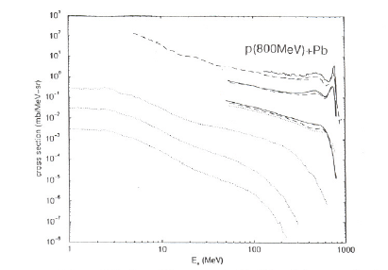
Light particle emission
Neutron spectra
due to quasi-elastic scattering
 peripheral collisions
p(800 MeV) + Pb
0°
Cross section (mb/MeV-sr)
7.5°
due to quasi-inelastic scattering
 neutron ejected by the proton which is excited to a Δ⁺ resonance
30°
evaporation process
 independent of the angle!
60°
150°
120°
1 10 100 1000
E_{n} (MeV)
Conclusion: the spallation reaction is a TWO STEP process!
Proton spectra
similar shapes as the neutron spectra

Slide 76
Design Items in Association with Nuclear Data
High Power Proton Accelerator
Nuclear
Data
Beam loss
Radiation Safety Design
Shielding,
Maintenance Device
Induced Radioactivity
Spallation Neutron Source
Target-moderator neutronics
Radiation Transport
Neutronic Performance
Intensity, Pulse shape
Radiation Safety Design
Shielding,
Maintenance Device
Induced Radioactivity
Radiation damage (DPA)
Life Estimation
Nuclear Heating
Engineering Design

Slide 77
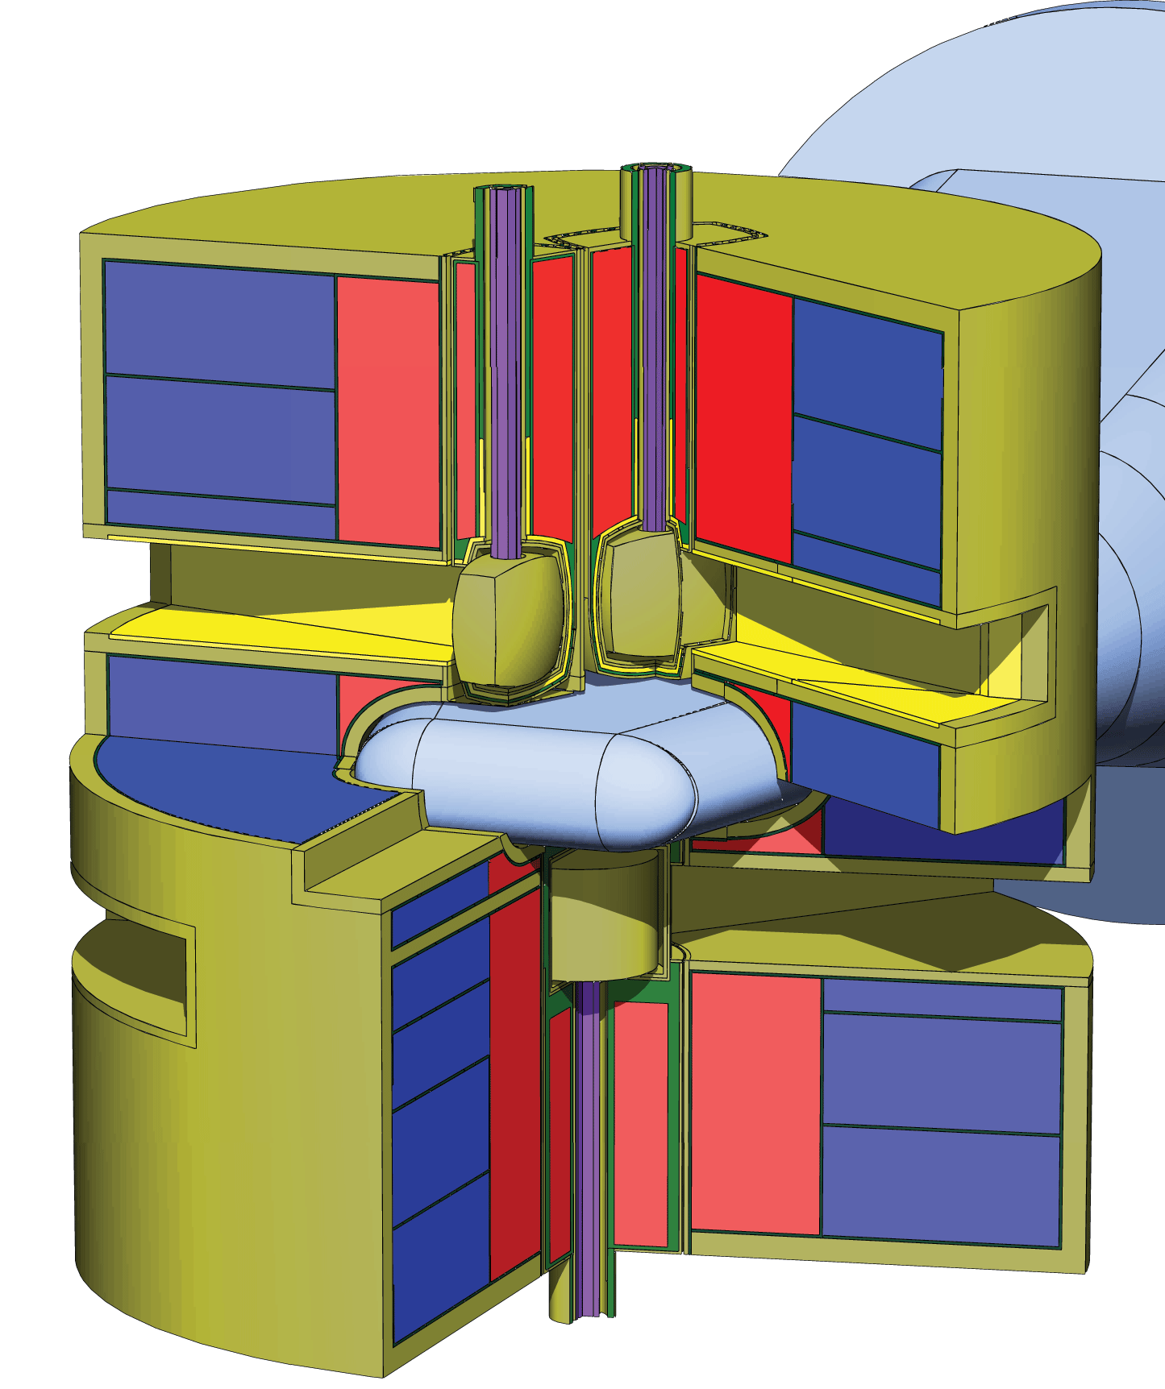

J-Parc target station…
Mercury target system
3 supercritical hydrogen cold moderators
  2 for superior pulse characteristics
  1 for highest intensity
Reflector (Iron)
D₂O cooled
Reflector (Be)
10m
1 m
Shutter
9.2m
Heavy
Concrete
Shield
Target (Hg)
Neutron
φ 1 m
Proton
3GeV, 25Hz
Beam
window
Notes:
Well, let us look the role through the design results. This is the three dimensional view of JSNS target station. Target-moderator-reflector is installed in the center of the target station. Proton beam with energy of 3GeV in repetition rate of 25 Hz is incident on the mercury target system through the proton beam window placed in front of the target.
3 supercritical hydrogen moderators as placed up and down of the mercury target. Upper 2 are for production of superior pulse characteristcs. The lower one is for highest neutron intensity. The other components like shutter works as shielding other than their own function.

Slide 78

DPA Map of Target-Moderator (J-Parc)
Highest DPA in target vessel
Estimated lifetime less than 1yr
Large contribution of secondary neutrons
Component Vessel | Material | DPA/5000MWh |  | Allowable Value
 |  | Total | Proton
Target | 316L-SS | 3.9 | 0.81 | 5
Reflector | A5083 | 2.8 | 0.02 | 20
Moderator | A6061-T6 | 2.8 | 0.02 | 20
Beam window | A5083 | 0.44 | 0.33 | 10
Close link with materials research is required for advanced material development
Vertical plane
Proton beam
window
Moderator
Target (Hg)
Moderator
Notes:
Here is the estimated DPA map near target-moderator assembly in JSNS.
The highest DPA is induced in the target vessel made of 316L-SS, especially front part where proton beam is injected, The contribution of the secondary neutron is large.as shown in this table. Considering the allowable DPA value is 5DPA, the life-time is estimated as less than 1 year. The lifetime of other components are also determined in the same manner.
Radiation damage is important issues. so close link with materials research is required for advanced material development.

Slide 79

Neutronenquellen höchster Intensität
Wohin geht die Reise ? Inertial Fusion Source
Derzeitige Grenzen
Reaktoren: Grenze der Wärmeabfuhr für Reaktoren mit kompakten Core für
maximalen N-Fluß (ILL→ 58 MW, Advanced Neutron Source→330 MW
(nicht gebaut) für ein H₂O gekühltes Core
Spallationsquellen: Problem der Energiedeposition durch Protonenstrahl,
dpa‘s im Targetfenster und bei kurzen Pulsen (μs) Stress im Targetmaterial
05.06.2013
79

Slide 80

Neutronenquellen
Wohin geht die Reise ? Inertial Fusion Source
Studien zeigen (A.Taylor et al., Science, Vol. 315, 2007), dass Neutronenausbeuten
von 1o¹⁹ -10²⁰ Neutronen pro Puls möglich sind.
Prozessablauf:
Kompression (DT)-Pellet
10 ns später Laserpuls
entzündet das Pellet
ein 14 MeV isotroper
Neutronenpuls entsteht
Anmerkung:
~ 300 kJ Laser produziert ca. 30 MJ Fusionenergie
22 MJ werden verfügbar für Neutronenproduction
Pb Converter - beweglich
05.06.2013
80

Slide 81



Benchmark of Spallation Models
http://nds121.iaea.org/alberto/mediawiki-1.6.10/index.php/Benchmark:CalculRes
Thank you for your attention

Slide 82
before going to the details of data/databases:
Classification/terminology targets…
Classification of targets with thickness d in terms of the interaction length μ = 1/Σ_{a}:
thin targets | d << μ | secondaries negligible
thick targets | 0.1 μ < d < 10 μ | secondaries relevant
extended targets | 10 μ << d | secondaries dominant
Notes:
The interaction length (or mean free path) is the inverse of the macroscopic cross section

Slide 83


Classification/terminology invers/direct reaction kinematics
target (almost) at rest in laboratory frame
secondary n and p leave the target
residues are stopped in the target
residues are measured off-line via their decay or by mass spectrometry
fast experiments: full excitation functions
mostly isobaric distributions are provided
full kinematical information more difficult
target with high velocity in laboratory frame
residues / secondaries leave target in forward direction
residues measured on-line via Z,A identification; in-flight magnetic identification
full isotopic identification
only selected reactions can be investigated
long beam times
from: José Benlliure,
accelerator experiments (few GeV) provide quantitative basis for model calculations by measuring relevant cross sections and by realistically simulating interactions of galactic protons with extraterrestrial matter under completely controlled conditions
Notes:
Isotopes (nuclides having the same number of protons)
Isotones (nuclides having the same number of neutrons)
Nuclear isomers (different excited states of the same nuclide)
SCR and GCR (protons) are most abundant in the energy range up to few GeV

