Slide 1




<number>
G. Khatri, MPD Symposium, Kraków
05 June, 2013
Three- and Four-Nucleon Dynamics
at
Intermediate Energies
By:
Ghanshyam Khatri
Notes:
<number>
|50

Slide 2

<number>
G. Khatri, MPD Symposium, Kraków
05 June, 2013
Outline
Motivation
3N dynamics
Experiment with BINA: present work
- Data Analysis Progress (dd @ 80MeV/n)
Outlook
-Experiment with WASA
-BINA@CCB
Summary

Slide 3
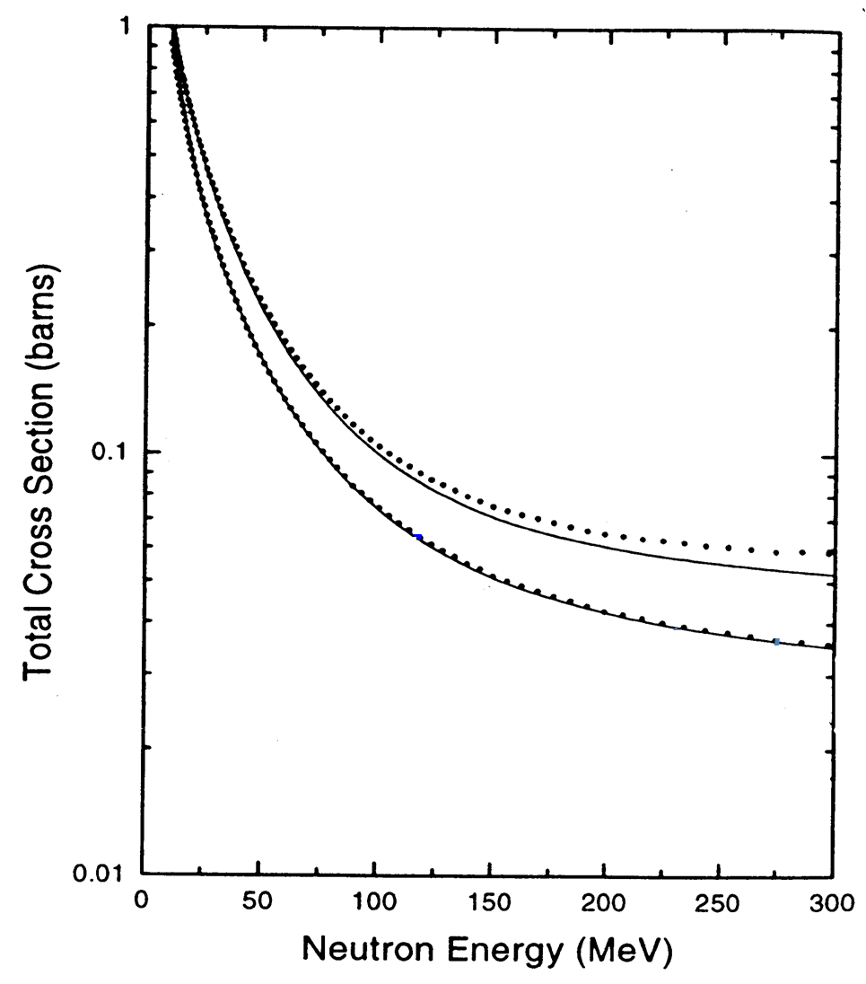
Motivation
<number>
G. Khatri, MPD Symposium, Kraków
05 June, 2013
Short-Range Strong Nuclear forces
-> holds nucleons together in an Atomic Nuclei
-> 1935: first theorized as meson exchange
-> 1947: Pions experimentally observed
-> today: models based on phenomenology and meson exchange ,
more commonly used are :
Nijmegen - I & II, Argonne V18, CD Bonn, Reid-93, Paris …
Other Approaches: Coupled-Channel & Chiral Perturbation
…reproduces nucleon-nucleon interaction data (χ2 /datum ~ 1)
. . .
Experiment
Theory
̶ ̶ ̶
nd-scattering
Rigorous Calculations
of 3N systems
In
Faddeev framework
Model | 3H B.E. [MeV]
Nijm I | 7.72
Nijm II | 7.62
AV18 | 7.62
Reid-93 | 7.63
Exp. | 8.48
np-scattering
High precision data from Los Alamos
W. P. Abfalterer et al., PRL 81, 57 (1998)
H. Witala et al. PRL 81, 1183 (1998)
St. Kistryn et al. PRC 68, 054004 (2003)
BUT fails to describe system with A>2
Notes:
Discrepancy increases as we go from low energy to intermediate energy
Perturbative QCD works only for high energy:
Resudual color force
Parameterized to N-N data (many fit parameters with chi-square per datum ~1)
CD = charge dependant
ChPT & CC are consistent ways
Three Groups of theories:
NN+3N
CC
ChPT
|50
<number>

Slide 4
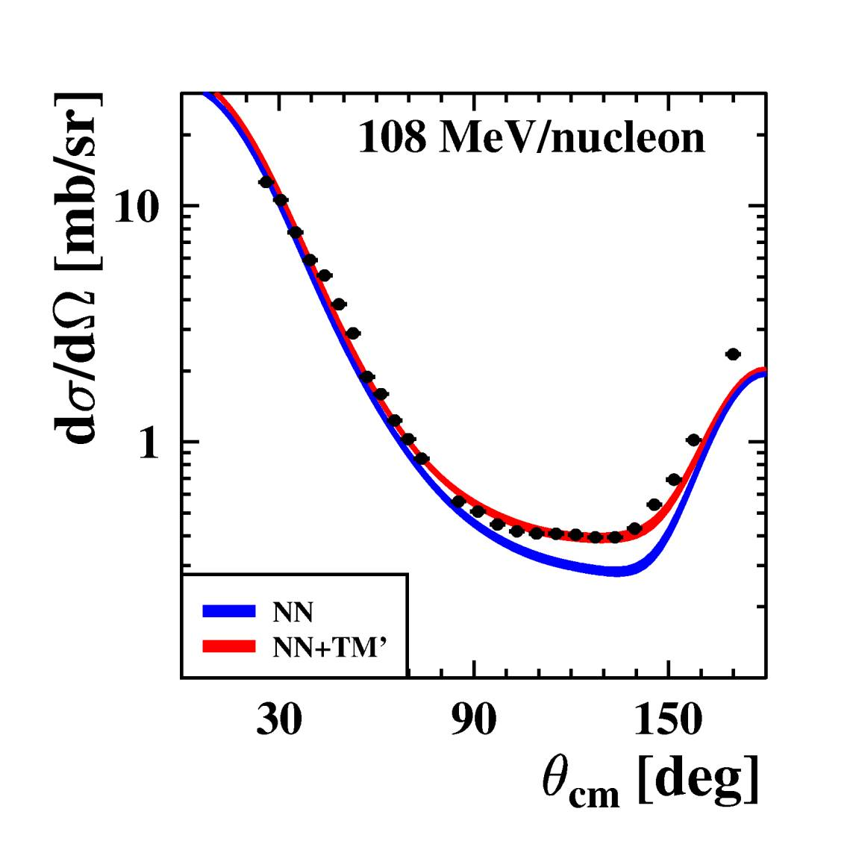
Motivation
<number>
G. Khatri, MPD Symposium, Kraków
05 June, 2013
….adding 3NF in original 2NF helps ! (Binding Energies )
…. also for elastic cross sec. - pictures below
additional 3NF
CD-Bonn+TM99
AV18+Urbana IX
K. Ermisch et al. PRC 71, 064004 (2005)
Model | 3H [MeV] | 4He [MeV]
2NF | 7.62 | 24.2
2NF +3NF | 8.47 | 28.3
Experiment | 8.48 | 28.4
H. Witala et al. PRL 81, 1183 (1998)
St. Kistryn et al. PRC 68, 054004 (2003)

Slide 5
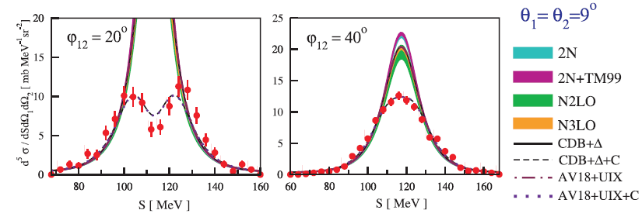
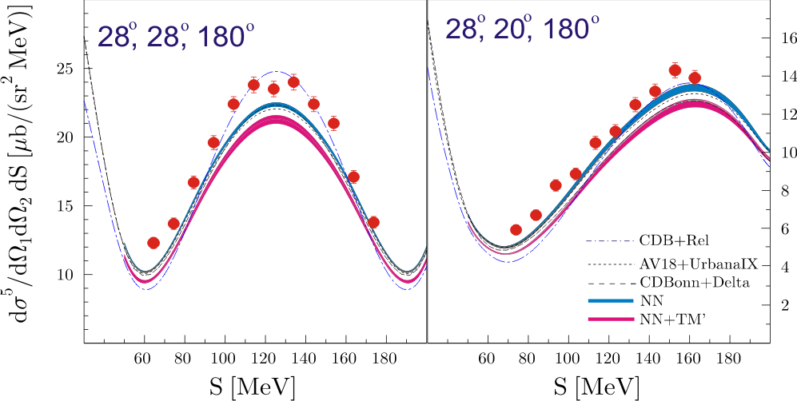
3N Dynamics
<number>
G. Khatri, MPD Symposium, Kraków
05 June, 2013
Effects other than 3NFs ? …Yes
Coulombic and Relativistic (big in certain region of phase-space)
Cross Sections of 1H(d,pp)n Breakup
@ 65MeV /n- FZ-Juelich Experiment
I. Ciepał et al (2010)
Cross Sections of 2H(p,pp)n Breakup
@ 135MeV/n - KVI Experiment
M. Eslami-Kalantari et al (2009)
4NF ? :
ChPT predicts 2NF>>3NF>>4NF

Slide 6
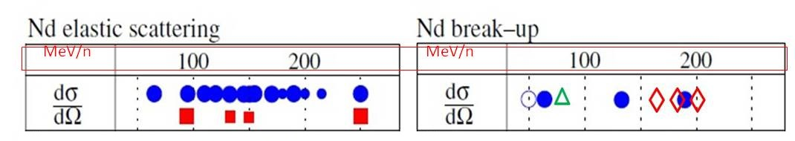
3N Dynamics
<number>
G. Khatri, MPD Symposium, Kraków
05 June, 2013
Are we done ? …No !
3NFs helped to improve theories, but still some discrepancy remains
Do we really understand 3NF !!?
Include other ingredients ?
Can we consider the validity through complete phase-space of 3N dynamics ?
Urgent need for systematic and High-Precision data-base
KVI-2011
WASA-2013
Available data
Rep. Prog. Phys. 75 (2012) 016301
N. Kalantar-Nayestanaki
Dot-Size show angular
coverage of detection
Need more data with larger Phase-Space
- to test models !
- to get general picture Of 3NF
Only cross-sec. presented
- but final test of predictions is for analyzing power when we have spin interaction also included.

Slide 7
05 June, 2013
G. Khatri, MPD Symposium, Kraków
<number>
Present work is analysis of data from BINA detector.
d+p and d+d reactions
@ 160 MeV unpolarized d-beam

Slide 8
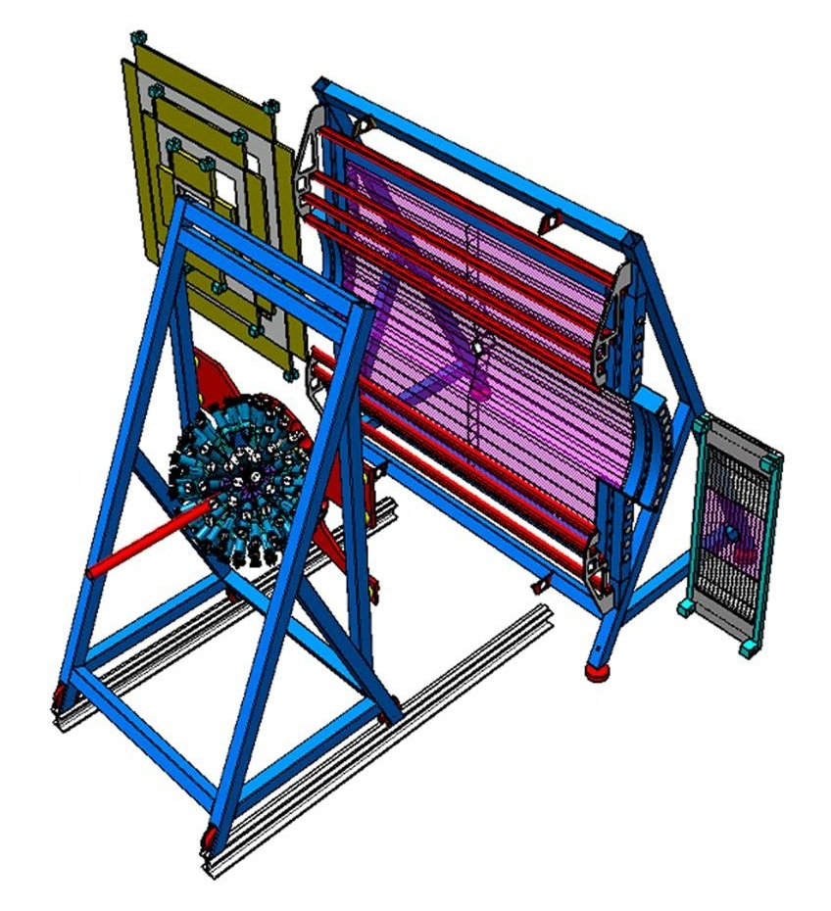
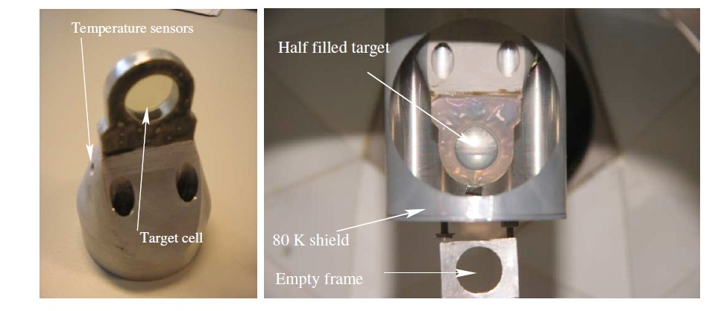
BINA Experiment
<number>
05 June, 2013
G. Khatri, MPD Symposium, Kraków
Big Instrument for Nuclear-polarization Analysis
Wire chamber (MWPC)
Three planes X, Y & U
[118x118x148 wires]
Wall covers
θ=10-35 ͦ
+
Ball covers
θ=up to 165 ͦ
≡
4π Phase-Space
150 phoswich
Scintillators
=Target chamber
(~10-5 mbar)
Thin scintillators for
particle identification
(ΔE -wall)
[1.8x10.8x0.1 cm3]
MWPC:
CF4(80%) +
Isobutane(20%)
gas-mixture
20µm diameter
tungsten wire
Beam
Ball:
Triangular fast scint. and
slow phoswitch parts
connected to PMT’s
through lightguide
Forward scintillators
(E-wall)
[9x12x220 cm3]

Slide 9
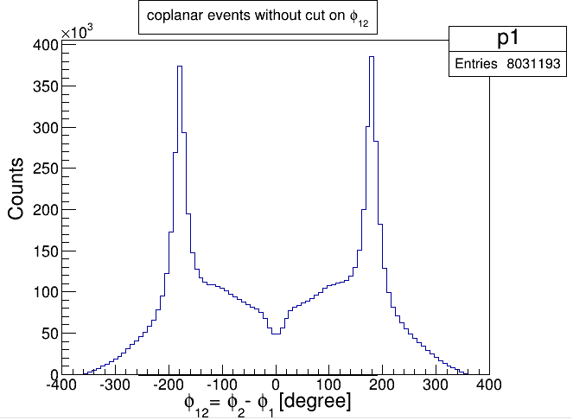
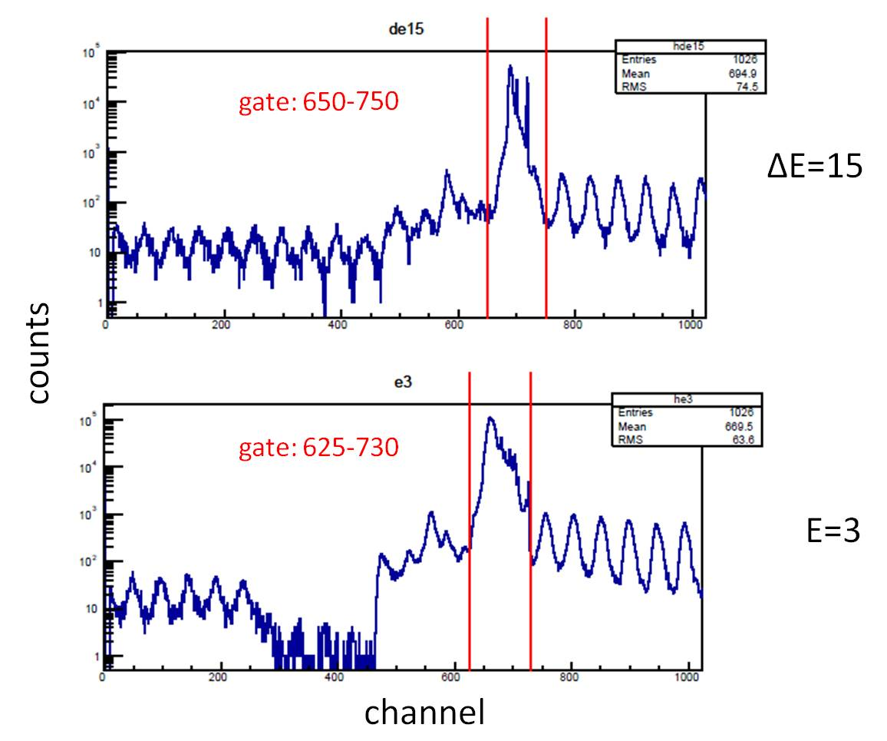
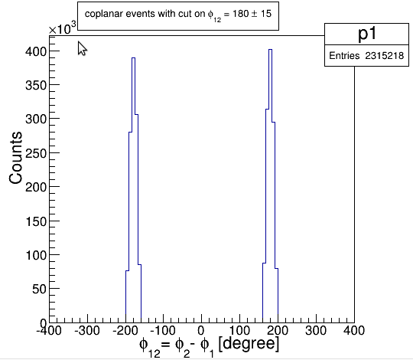
Data Analysis: Progress
<number>
G. Khatri, MPD Symposium, Kraków
05 June, 2013
- Data collection in April-2011 with BINA-detector (in KVI, Groningen)
- Reactions: d+p , d+d (with deuteron beam@160MeV)
- Expected output channels:
Triggers:
2 charged particles in coincidence
d+p → d+p elastic
d+p → p+p+n 3-body breakup
4-body breakup
n-transfer
d+d → d+d
d+d → d+p+n
d+d → p+p+n+n
d+d → t+p
basic assumptions of the analysis
Coplanarity to select elastic dp channel:
narrow peaks
time(ch)
TDC spectra of individual detectors
Notes:
- Large Peak : coincidence events
- RF signal of cyclotron as reference
- Red lines define tdc gate for event selection
|50
<number>

Slide 10
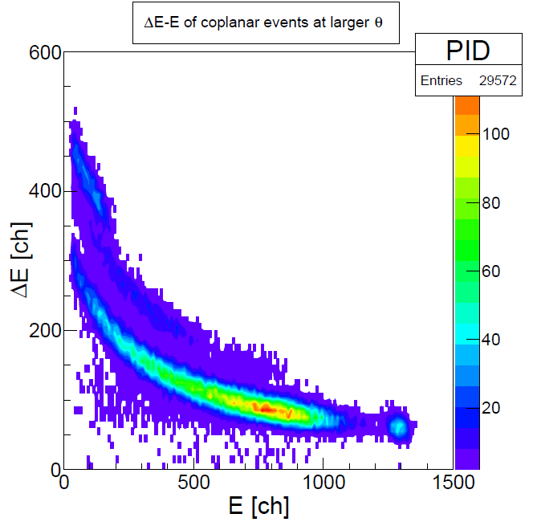
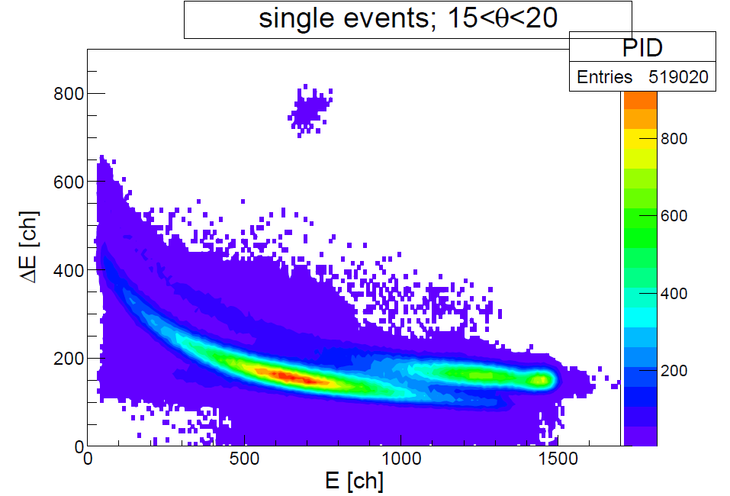
Data Analysis: Progress
05 June, 2013
G. Khatri, MPD Symposium, Kraków
<number>
d+d reaction: ΔE-E spectra (only forward detector, θ12=74˚)
(where θ12 = coplanar particles polar angle difference)
Single events: one particle from coincidence
in forwards WALL & 2nd in backward BALL.
Since the same mass target and projectile,
the elastic scattering would always be at θ12=90˚
(imagine billiard ball)
Coincidence events: coplanar events, both charged particles
In forward WALL.
Due to kinematical constraints on d+d → t+p channel,
took larger angle to show triton as well.
30<θ<36
d+d → t+p
?
d+d → p+p+n+n
3H
d+d → d+p+n
single elastic
deuterons
d+d →d+d
2H
2H
1H
1H

Slide 11
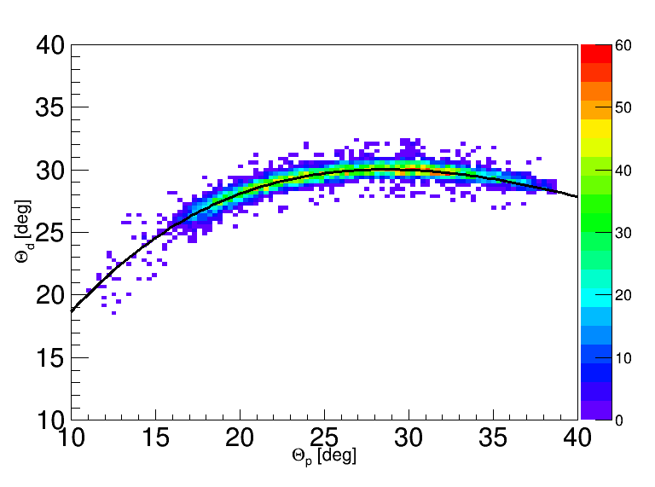
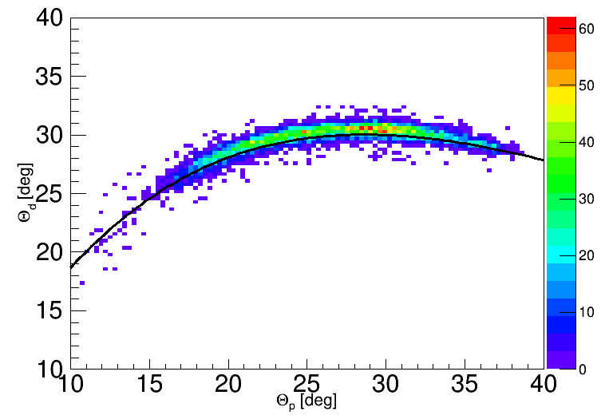
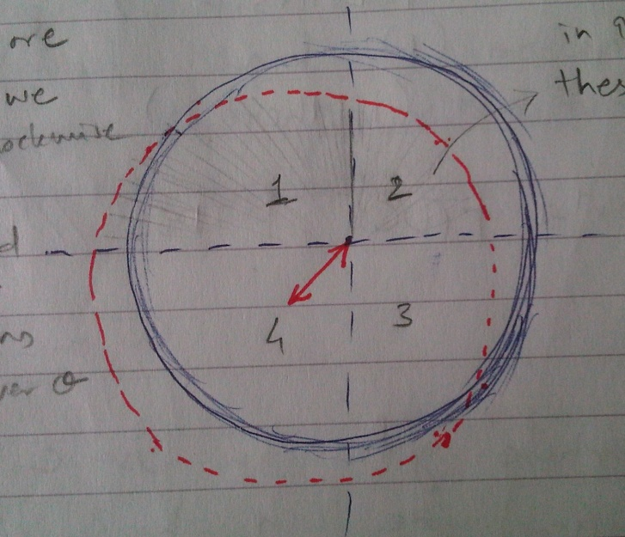
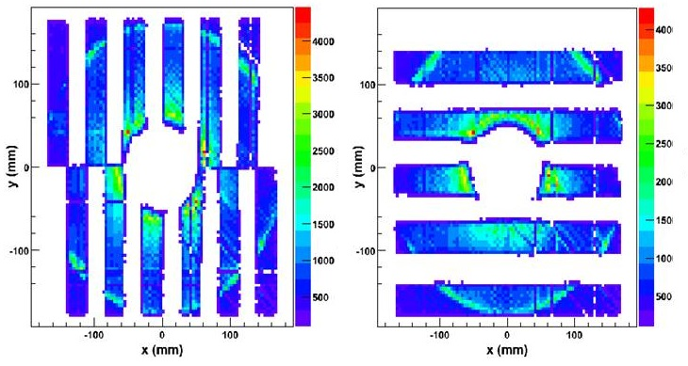
Data Analysis: Progress
05 June, 2013
G. Khatri, MPD Symposium, Kraków
<number>
Geometry (systematic) corrections using elastic channel
elastic events can be used, not only for cross-section normalization but also, for geometry cross-check and consistency ! (Fine tuning of geometry. )
Beam center
2. Hodoscope projection on MWPC
3. Z- distance from target to ΔE
Correlation between MWPC, E and ΔE gave
Track number for few different expected
values.
Since ΔE was renewed, exact position
was necessary to be determined.
Precise check even below mm range !

Slide 12
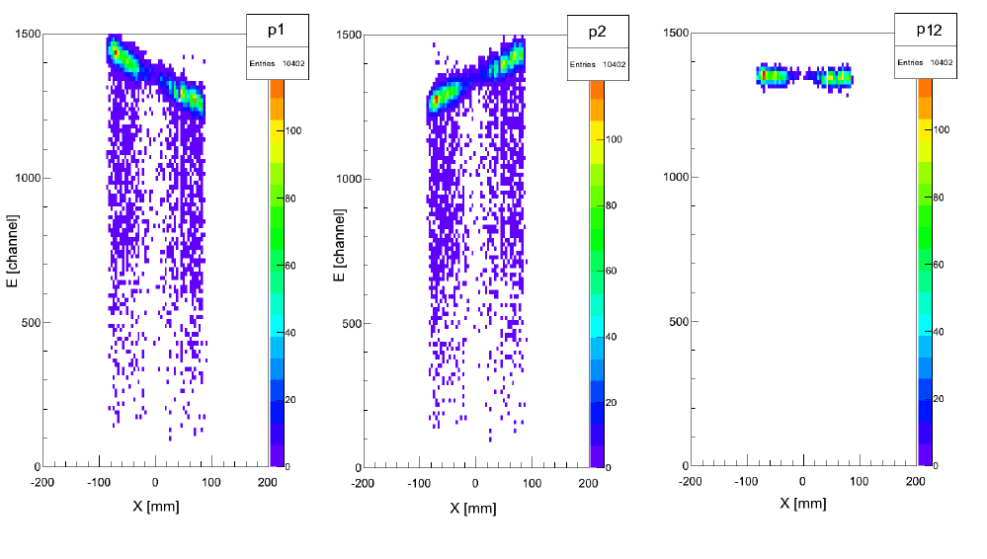
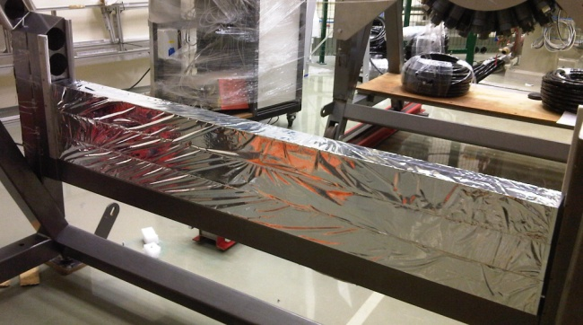
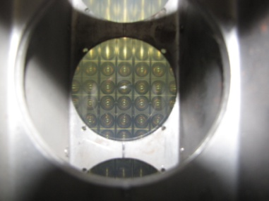
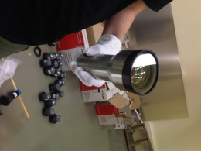
Data Analysis: Progress
05 June, 2013
G. Khatri, MPD Symposium, Kraków
<number>
Combining two PMT signals of an E-slab: for ENERGY calib.
Position sensitive
Hodoscopes !
Geometrical
Mean
Of
PMT signals
PMT
One end
without PMT
Notes:
Note: in case of dE-slabs, situation is different. We have cut in the center, so we rather take
Exponential function of PMT signal with respect to the hit position along the dE-slab
|50
<number>

Slide 13
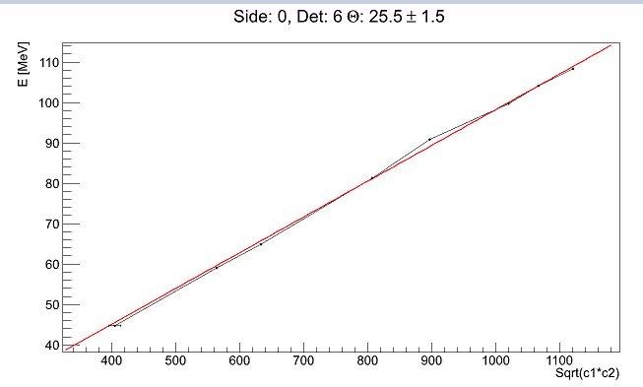
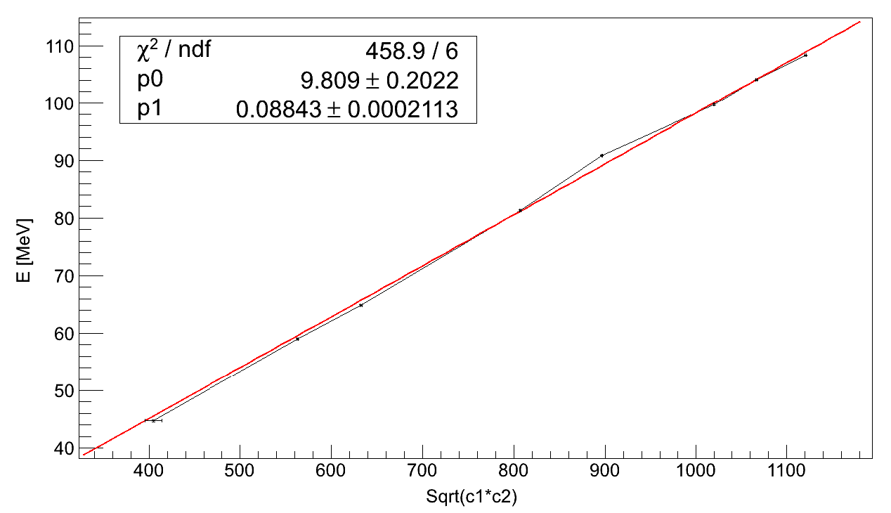
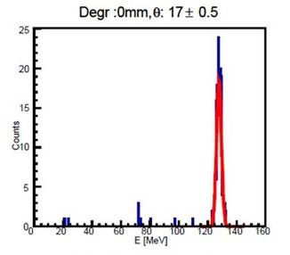
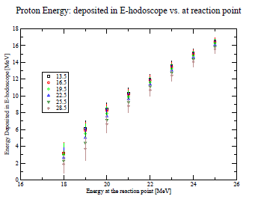
Data Analysis: Progress
05 June, 2013
G. Khatri, MPD Symposium, Kraków
<number>
Energy Calibration (with help of Geant4 Simulation)
Done in two steps:
Convert channel to deposited energy:
In this step we take events at specific θ value for different degrader thickens. The same procedure is simulated on Geant4 and the data (channel) plotted against simulated energy (MeV) .
- Gauss fit
counts
Energy (or channel)
2. Convert deposited energy into energy at interaction points: this is because only E measured, not the total and there are other energy losses in medium, which becomes non linear at lower energy due to straggling effect (Bragg Peak !)

Slide 14
Data Analysis: Next Steps
05 June, 2013
G. Khatri, MPD Symposium, Kraków
<number>
Efficiency analysis (Multi-Wire Chamber, ΔE-E hodoscopes)
Normalization Diff. Cross-Sec
Comparison with different theory predictions
(qualitative and quantitative, for different kinematical configurations)

Slide 15

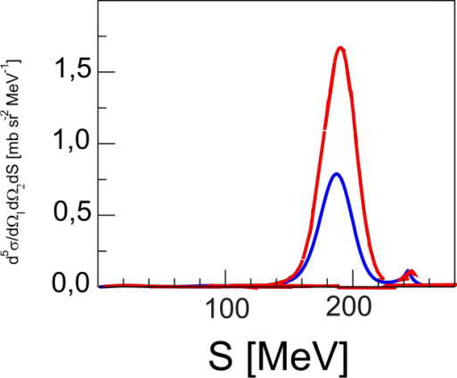
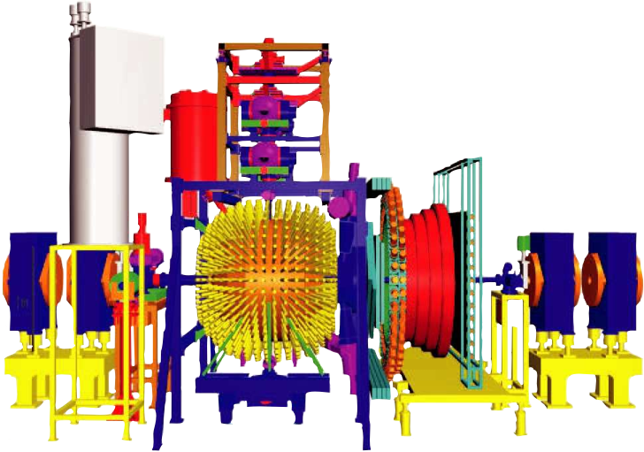
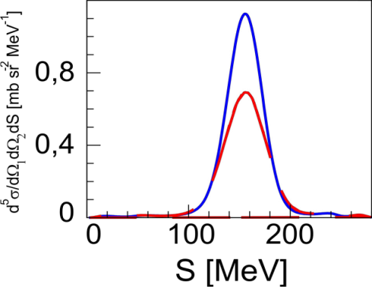
Outlook
<number>
WASA@COSY, FZJ (ongoing analysis)
4π geometry
θ2=37.50, ϕ12=1800
θ1=57.50
CD Bonn relat.
CD Bonn non relat.
θ1=42.50
very strong
effects
(dynamical
& kinematical)
even up to 60% !!
H. Witała, R. Skibiński,
Eur. Phys. J. A 30, 369 (2006)‏
1H(d,pp)n cross sections @ 340, 380 and 400 MeV
investigation of relativistic and 3NF effects
Notes:
<number>

Slide 16
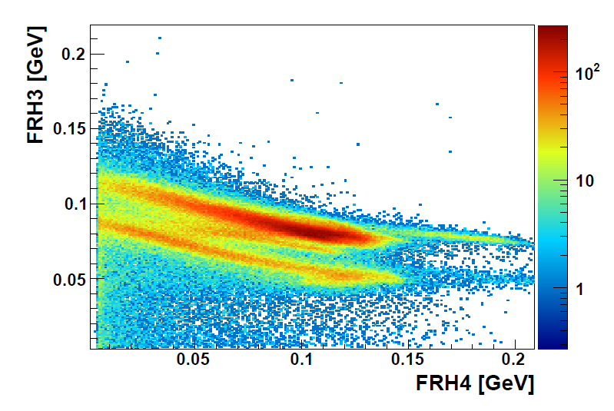
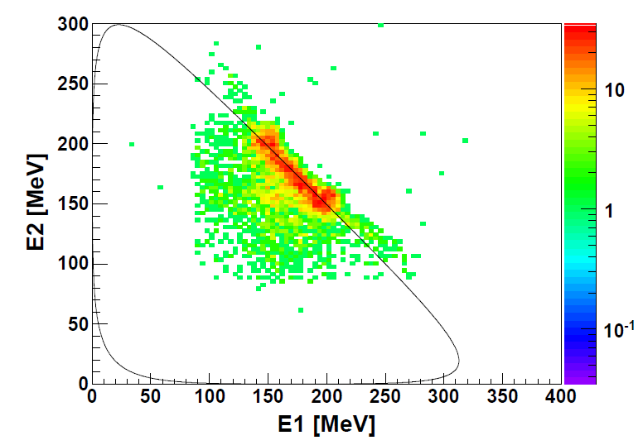
WASA Experiment
<number>
G. Khatri, MPD Symposium, Kraków
05 June, 2013
Very Preliminary Results
dE-E identification
Seen clear separation of the d & p branches
Breakup kinematics: two protons from dp->ppn
θ1=5˚±1˚
θ1=10˚ ±1˚
φ12=90˚ ±5˚
Solid line: calculated from 3body kinematics program

Slide 17
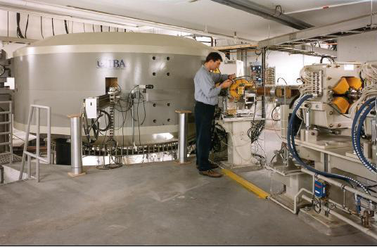
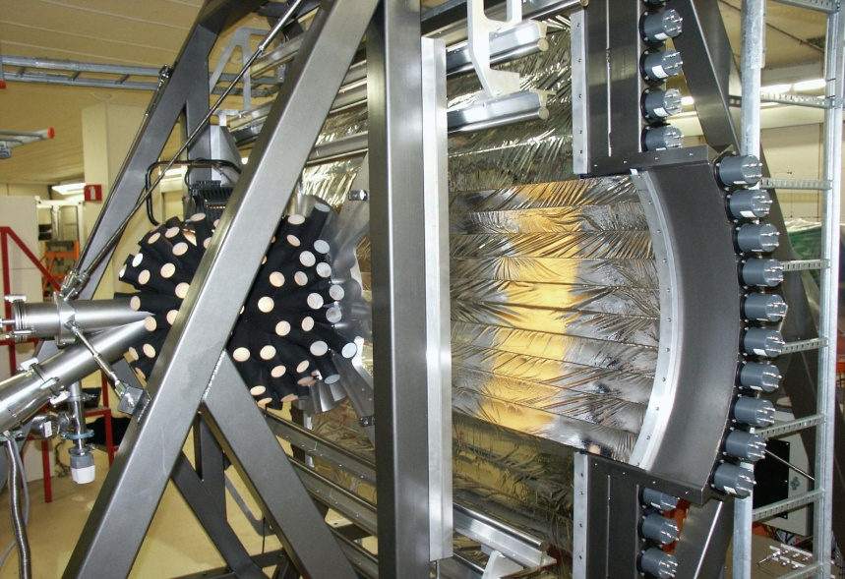
Outlook
05 June, 2013
G. Khatri, MPD Symposium, Kraków
<number>
Perspectives: BINA @ CCB Cracow
- It is the MAIN and LEADING experiments at CCB
CYCLOTRON CENTER BRONOWICE
proton beam energy: 70 - 230 MeV
energy resolution: ΔE/E < 0.7%
intensity: 500 - 0.1 nA
(3.3 x 1012 - 6.6 x 108 p/s)
GENERAL RESEARCH PROGRAM
feasibility studies
measurements of elastic scattering
and breakup reactions – systematic
and consistent data base for investigating
of the 3N continuum at medium energies
development of the detection system

Slide 18
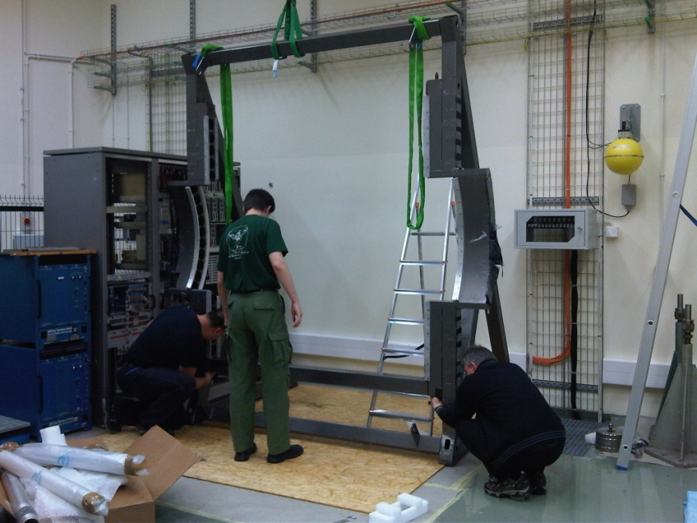
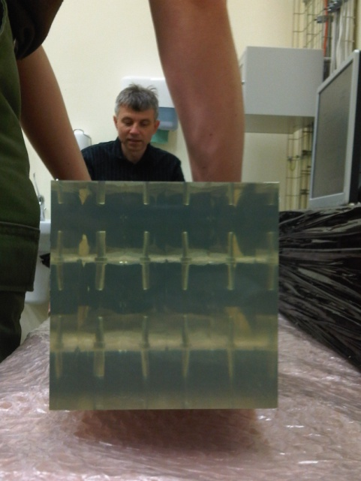
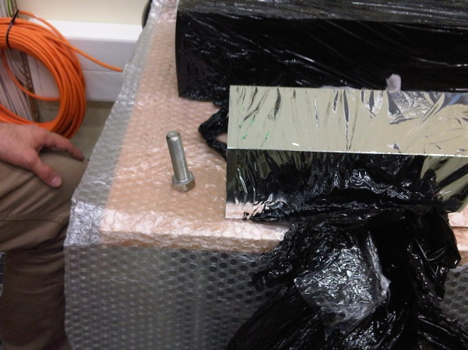
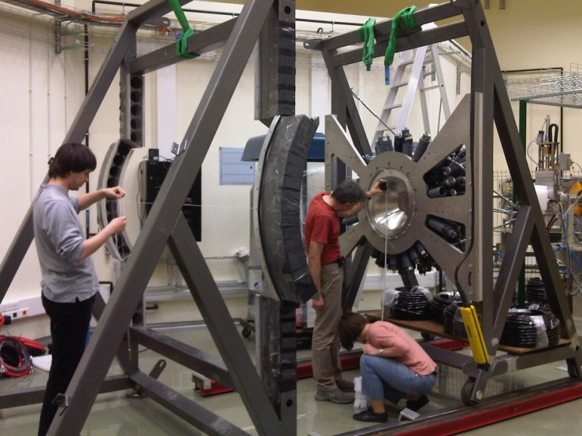
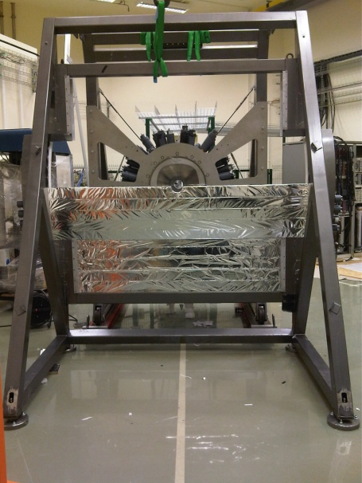
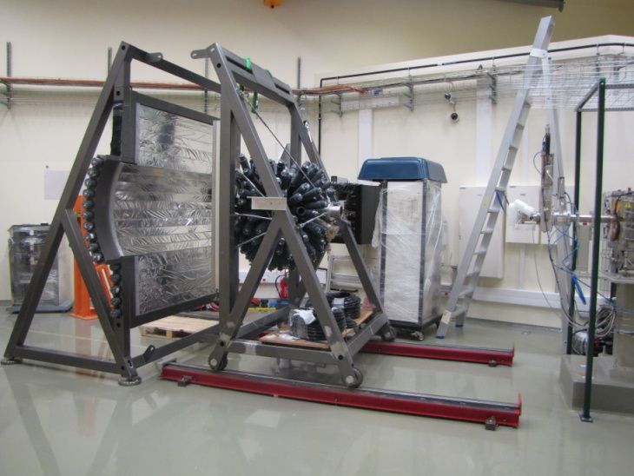
Outlook
05 June, 2013
G. Khatri, MPD Symposium, Kraków
<number>
Perspectives: BINA @ CCB Cracow
2
Some PHOTOS (2013)
1(b)
1(a)
3
4
5

Slide 19
Summary
<number>
G. Khatri, MPD Symposium, Kraków
05 June, 2013
Analysis of data from KVI @ 160 MeV is under progress.
So far geometry checks, sorting of good data, and calibration have been done
Next steps : Efficiencies, Cross-sec. Normalization, compare to theory
Currently BINA is being installed at CCB in Krakow: test experiments will
performed by July, 2013
Analysis of WASA data is next exciting task

Slide 20

<number>
G. Khatri, MPD Symposium, Kraków
05 June, 2013
Thank you for your attention !!!

Slide 21
<number>
G. Khatri, MPD Symposium, Kraków
05 June, 2013
end!!!

