Slide 1




Experimental Investigation of
Few-Nucleon Dynamics at
Medium Energies
by
Ghanshyam Khatri

Slide 2
Outline
Introduction
Three-body (3N) force
Experimental tools
BINA Detector and it’s status at CCB (Krakow)
3N data base: present and future
Results
Conclusion
Notes:
Introduce you with the subject
Briefly explain the few nucleon dynamics (of course in simplest possible way)
Describe the BINA detector, why is it so special for US to have it working in Krakow
Highlight Important results
Conclude

Slide 3

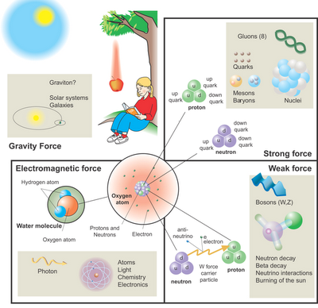

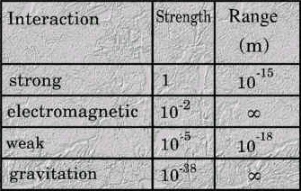

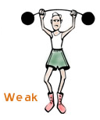
Introduction
Notes:
So intro
Let’s start from four fundamental interactions,
The
Gravity -> apple fall on ground, earth revolve around sun
EM -> Atomic Electrons hold precisely around its Atomic nucleus
The

Slide 4
Introduction
Residual of the strong forces
Nuclear Force
holds protons and neutrons
together in an atomic Nuclei
Notes:
So intro
Let’s start from four fundamental interactions,
The
Gravity -> apple fall on ground, earth revolve around sun
EM -> Atomic Electrons hold precisely around its Atomic nucleus
The

Slide 5
Introduction
Nuclear Force
1935: Yukawa presented a Theory
1947: Powell proved the theory by experiments
Today , many different Theoretical models are available to exactly describe the nuclear force between any two nucleons.
(Note: Nucleons is a general term for Protons and Neutrons)

Slide 6
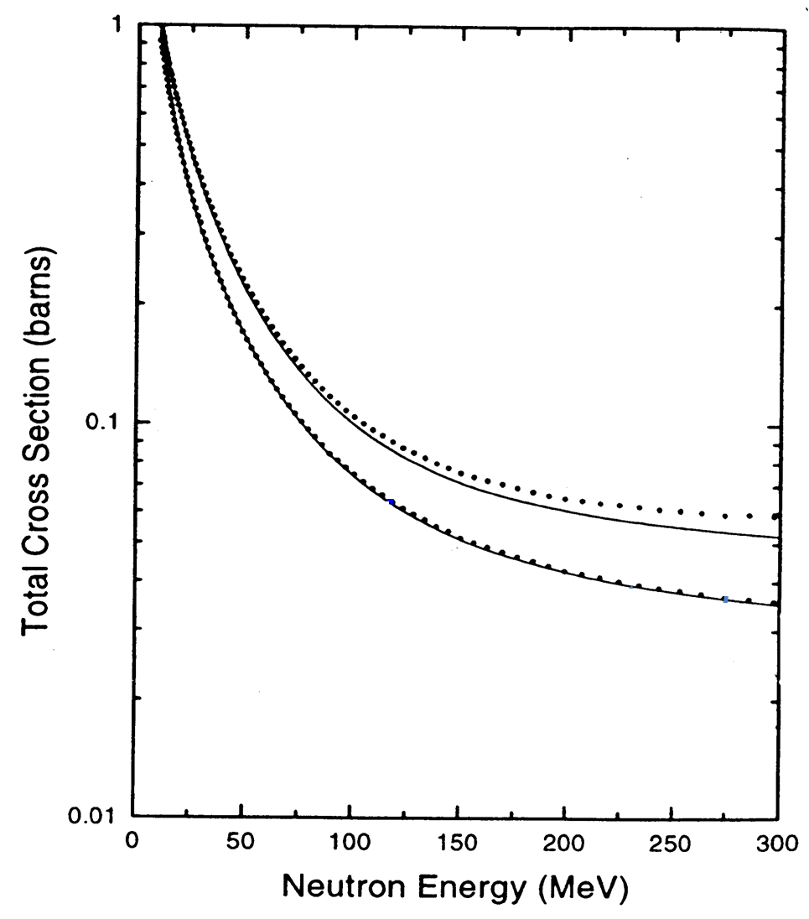
Introduction
Nuclear Force
1935: Yukawa presented a Theory
1947: Powell proved the theory by experiments
Today , many different Theoretical models are available to exactly describe the nuclear force between any two nucleons.
(Note: Nucleons is a general term for Protons and Neutrons)
…but FAILS to describe Interaction between
more than two nucleons!
. . .
Experiment
Theory
̶ ̶ ̶
even for the simplest Atomic Nucleus
e.g. ³H and ³He
nd-scattering
Model | [MeV]
Nijm I | 7.72
Nijm II | 7.62
AV18 | 7.62
Reid-93 | 7.63
Exp. | 8.48
Binding
Energy
of
Triton
np-scattering
High precision data from Los Alamos
W. P. Abfalterer et al., PRL 81, 57 (1998)

Slide 7
Three-body force
….adding 3NF in original 2NF helps !
Model | ³H [MeV] | ⁴He [MeV]
2NF | 7.62 | 24.2
2NF +3NF | 8.47 | 28.3
Experiment | 8.48 | 28.4
₊
~
?
₌
V₁₂+V₂₃ +V₃₁=V_{theory}
3NF = V₁₂₃
3N System

Slide 8
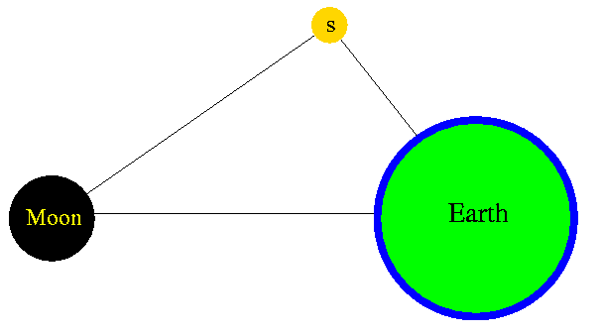
Three-body force
….adding 3NF in original 2NF helps !
Model | ³H [MeV] | ⁴He [MeV]
2NF | 7.62 | 24.2
2NF +3NF | 8.47 | 28.3
Experiment | 8.48 | 28.4
₊
~
?
₌
V₁₂+V₂₃ +V₃₁=V_{theory}
3NF = V₁₂₃
3N System
Three-body forces in nature; example

Slide 9
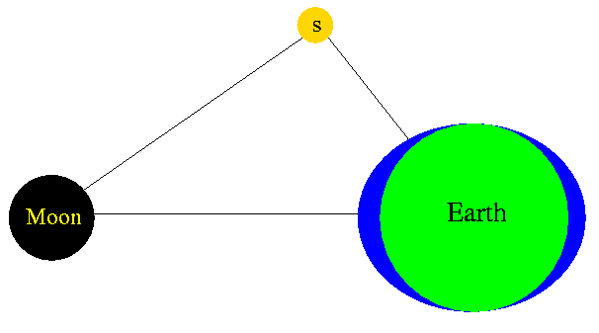
Three-body force
….adding 3NF in original 2NF helps !
Model | ³H [MeV] | ⁴He [MeV]
2NF | 7.62 | 24.2
2NF +3NF | 8.47 | 28.3
Experiment | 8.48 | 28.4
₊
~
?
₌
V₁₂+V₂₃ +V₃₁=V_{theory}
3NF = V₁₂₃
3N System
Three-body forces in nature; example
Earth (and nucleon)
are not point like
but having internal
structure
But still there are descripancies between data and theories ! Need detailed study of 3NF.

Slide 10
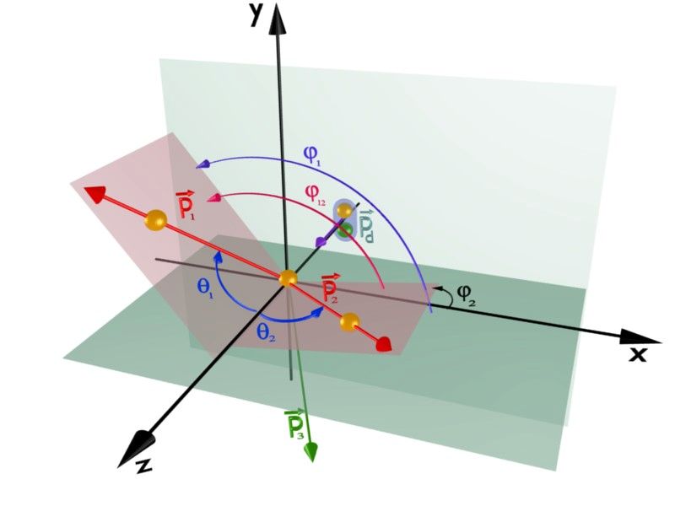
Experimental Tools
Nucleon - Deuteron Scattering
(Relatively Simplest but not simple):
Elastic: N + d → N + d
Breakup: N + d → N + N + N
Very limited phase-space
rich phase-space: a large amount of kinematical config.

Slide 11
Experimental Tools
Nucleon - Deuteron Scattering
(Relatively Simplest but not simple):
Elastic: N + d → N + d
Breakup: N + d → N + N + N
Very limited phase-space
rich phase-space: a large amount of kinematical config.
deuteron-nucleon breakup
reaction is best suited to study 3N interactions
Notes:
Breakup is better choice over elastic

Slide 12
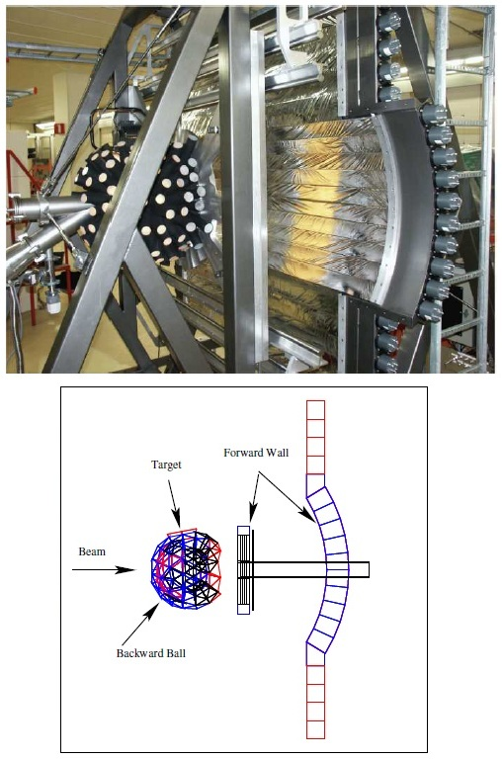
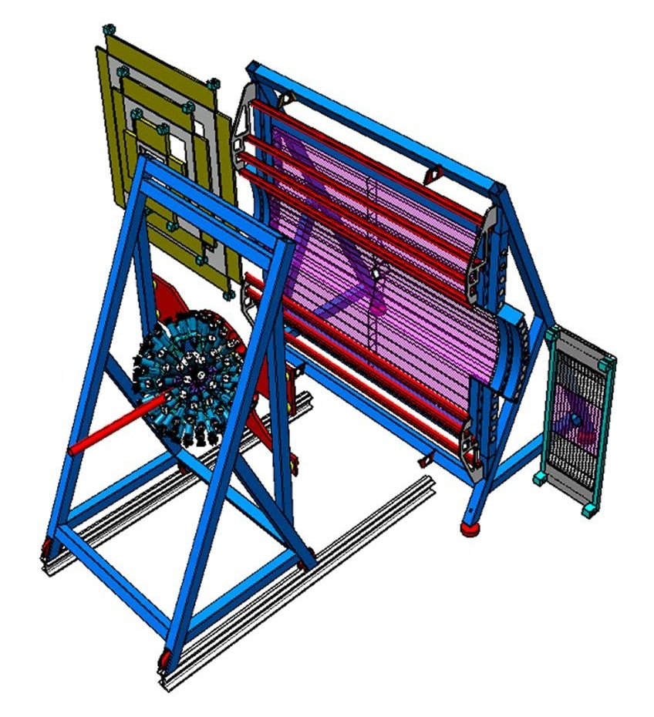
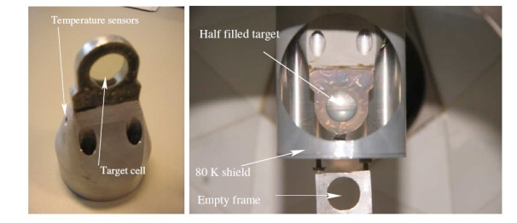
BINA Detector
Big Instrument for Nuclear-polarisation Analysis
Wire chamber
(MWPC)
ΔE
Ball + Target
Beam
E
TARGET
Dedicated for few-body !
High-precision data !
Notes:
Dedicated detector for few-nucleon scattering

Slide 13
BINA Detector
Big Instrument for Nuclear-polarisation Analysis
Wire chamber
(MWPC)
ΔE
Ball + Target
Beam
p
E
d
TARGET
Dedicated for few-body !
High-precision data !

Slide 14
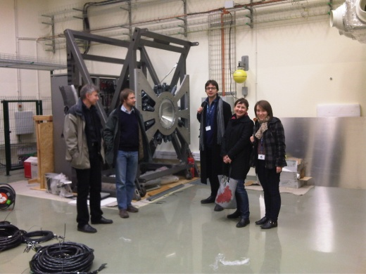
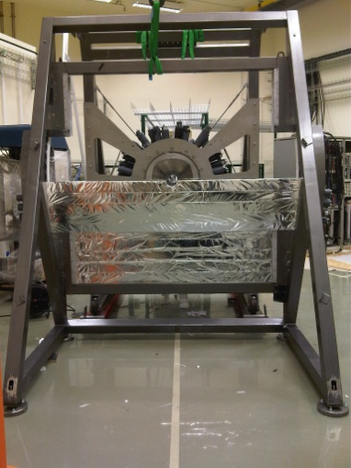
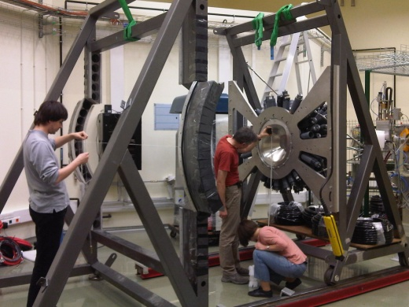
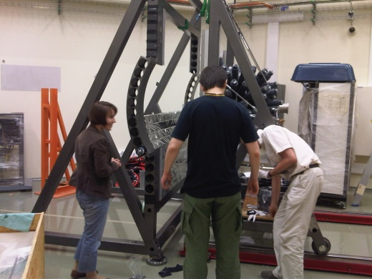
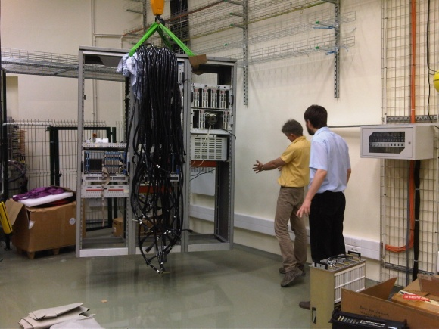
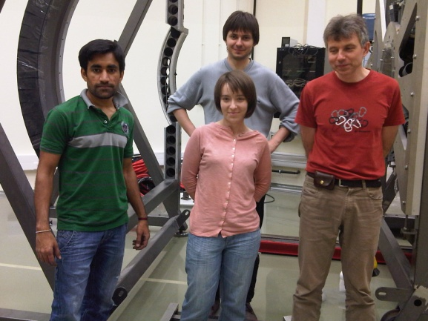
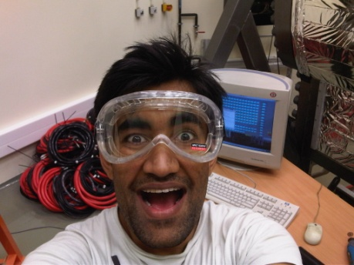
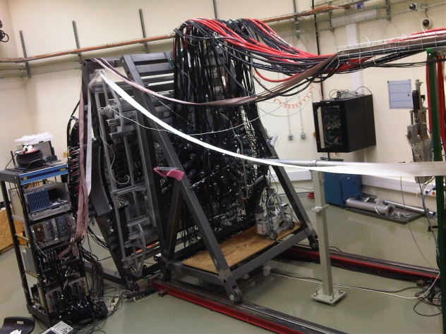
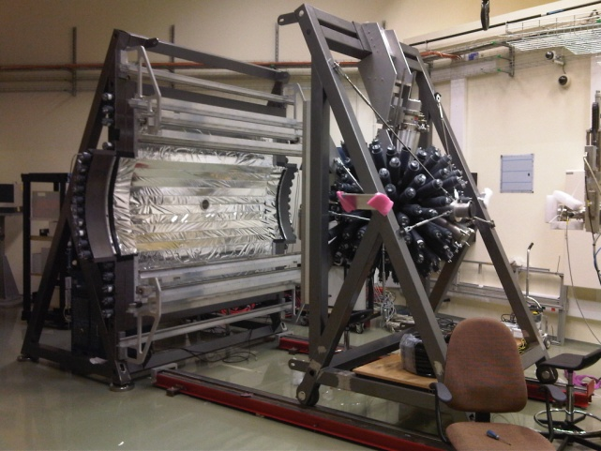
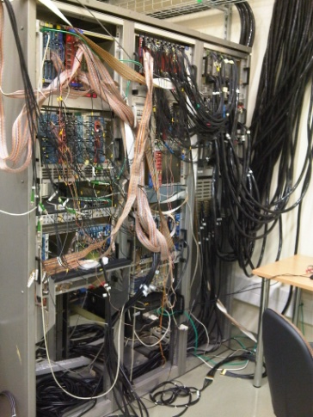
BINA in Kraków
BINA @ Cyclotron Center Bronowice
2012
2014

Slide 15
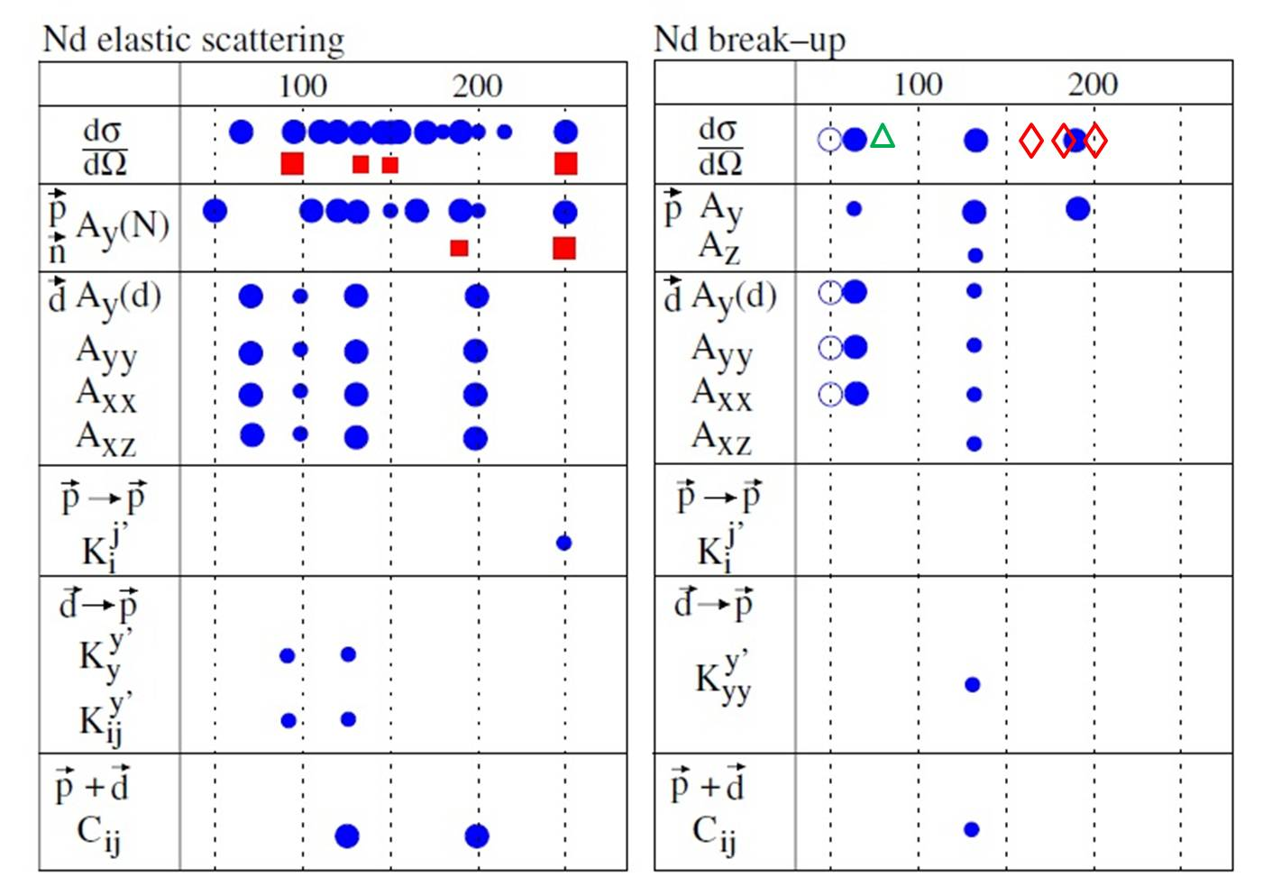
3N Data Base: Present and Future
MeV/n
MeV/n
KVI-2011
WASA 2013
p or d beam data
neutron beam data
Note: dot size tells angular coverage

Slide 16
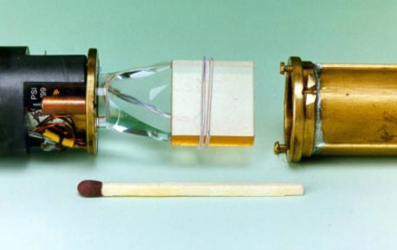
3N Data Base: Present and Future
MeV/n
MeV/n
KVI-2011
WASA 2013
BINA@CCB
BINA@CCB FUTURE !!
p or d beam data
neutron beam data
Note: dot size tells angular coverage
Few-body program very successful
Krakow-Katowice-KVI collaboration, new Cyclotron at CCB in Krakow
Energy Range of CCB suitable for this research (50 to 230 MeV)
No need to travelling abroad, (US, Japan and now in Poland)
Strong collabration with theory group of prof Witała in UJ, Kraków
Future:polarized terget, opens a new line of research

Slide 17
Results
Experiment performed at KVI with BINA in April 2011.
beam: deuteron,
energy: 160 MeV,
target: Liquid Deuterium
Important Remarks: a step forward with 4N, theories are limited
d+d - EVEN MORE COMPLICATED SYSTEM
d + d →d + d ... elastic
d + d → d + p + n ... three-body final state
d + d → p + p + n + n ... four-body final state
d + d → d + p (+ n_{spectator}) ... QFS
d + d → p + p (+2n_{spectator}) ... double QFS
d + d → ³H + p ... neutron transfer
d + d → ³He + n ... proton transfer
Theoretical calculations
Will be available for
Two-body final states
(private comunication
With A. Deltuva)

Slide 18

18
24 Sept, 2014
G. Khatri, MPD Symposium, Kraków
Results
Most basic analysis steps :
all data

Slide 19
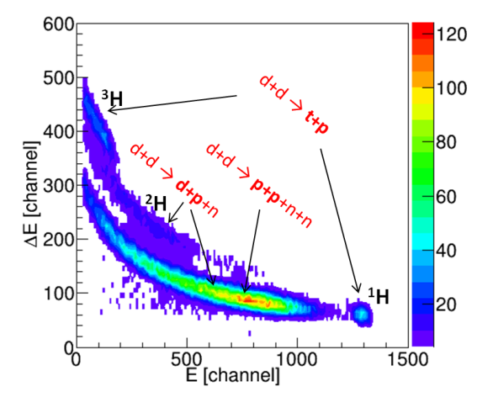
19
24 Sept, 2014
G. Khatri, MPD Symposium, Kraków
Results
Most basic analysis steps :
step 1: Presort
all data

Slide 20
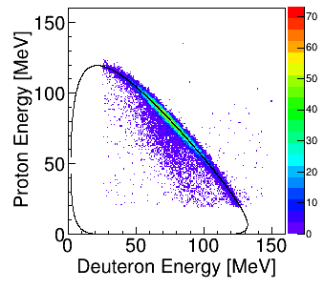
20
24 Sept, 2014
G. Khatri, MPD Symposium, Kraków
Results
Most basic analysis steps :
step 1: Presort
all data
θ_{d} =20±1, θ_{p} =30±1, φ₁₂ =180±5
step 2:
Selection of the
reaction-channels
d+d →d+p+n

Slide 21
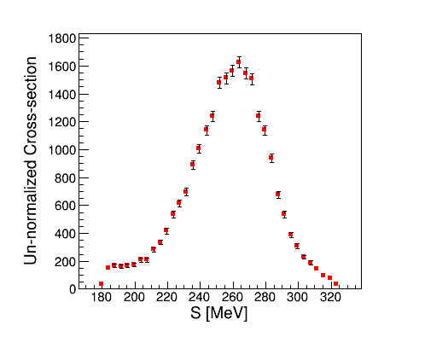
21
24 Sept, 2014
G. Khatri, MPD Symposium, Kraków
Results
Most basic analysis steps :
step 1: Presort
OUR GOAL
all data
PRELIMINARY
θ_{d} =20±1, θ_{p} =30±1, φ₁₂ =180±5
step 2:
step 3:cross sections
Selection of the
reaction-channels
d+d →d+p+n

Slide 22
Achievements
BINA@CCB
preparation
tests,
liquid-target
expert
visiting
facilities ,
learned and gained
experience
KVI, FZ-Juelich,
Lisbon
MPD
FEW-BODY
PROJECT
Publications
&
Conferences
Grants:
SONATA-BIS
Preludium 7
(application)

Slide 23
Conclusion and Outlook
Current data analysis of 160MeV data on dp and dd reactions at final stage
Theoreticians have been requested to provide calculations for dd reaction
BINA has been put into operation in Krakow, two tests with BINA were done successfully, 2013 and 2014
Future: Polarised target, we recently comunicated with Japanese expert this month.

Slide 24

Thank you for your attention !!!

Slide 25
Backup slides

Slide 26
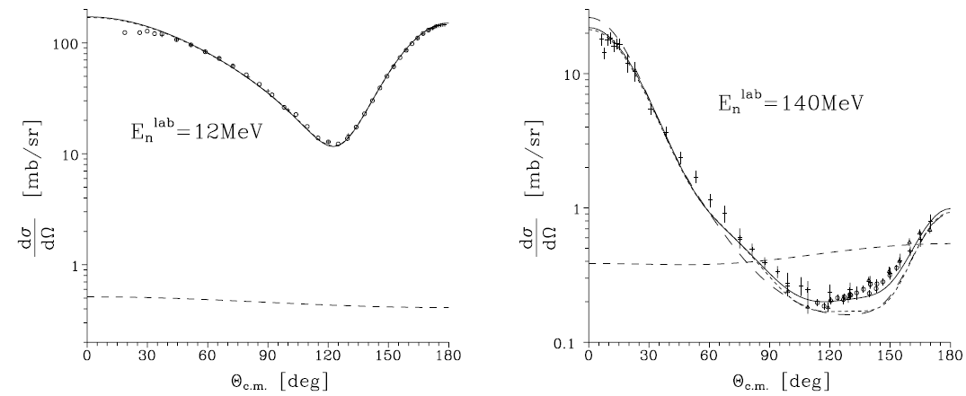
Introduction
….adding 3NF in original 2NF helps !
Model | ³H [MeV] | ⁴He [MeV]
2NF | 7.62 | 24.2
2NF +3NF | 8.47 | 28.3
Experiment | 8.48 | 28.4
₊
~
₌
V₁₂+V₂₃ +V₃₁=V_{theory}
3NF = V₁₂₃
3N System
Hot-Spot to see 3NF:
medium energies ?!
3NF contribution

Slide 27
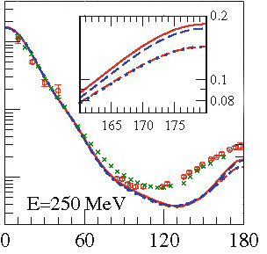
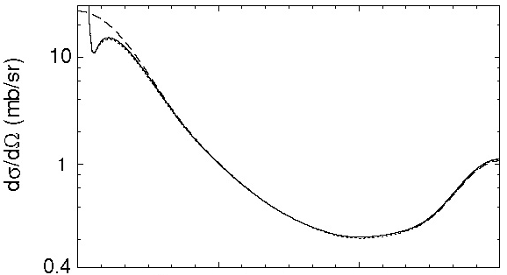
Experimental Tools: Three-Nucleon Scattering
@ Medium Energies
Three-body force
Elastic: N + d → N + d
Relativity
Coulomb
1
10
without Coul.
with Coul.
0
10
-1
10
0
60
120
180
Effects small, located at extreme angles only !
Notes:
Breakup: N + d → N + N + N
Beams of p or d
Various observables

Slide 28
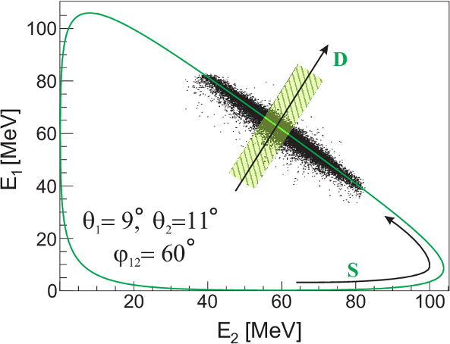
Three-body force
Breakup Reaction Kinematic
Three nucleons in the final state
- 9 variables
Energy-momentum conservation
– 4 equations
Five independent kinematical variables:
θ₁, θ₂, φ₁₂=φ₁-φ₂, E₁, E₂
¹H(d,pp)n measured:
directions and energies
of two protons
arclength variable S
distance from kinematical curve D

Slide 29
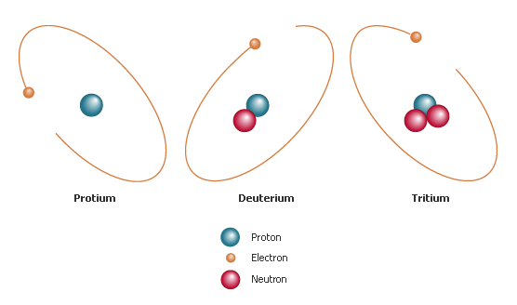
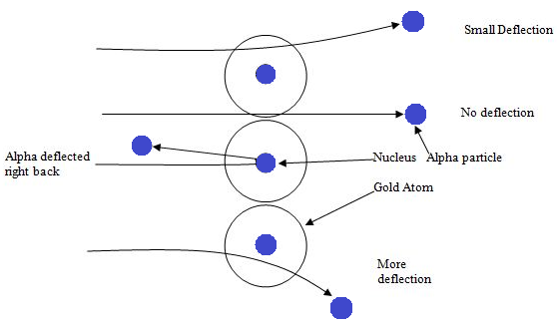

Slide 30
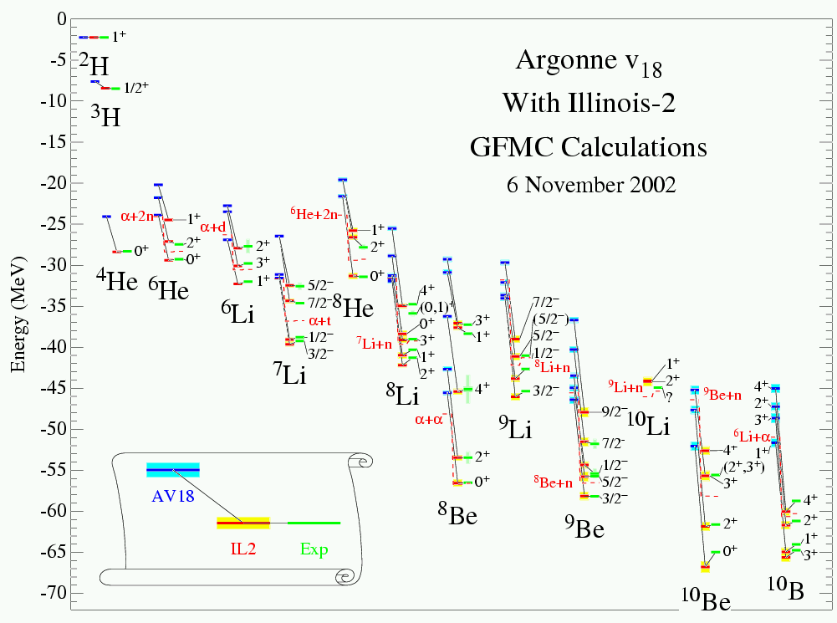
Ab-initio calculations for light nuclei
Introduction
Courtesy S. Pieper, Argonne
(+3NF)

Slide 31
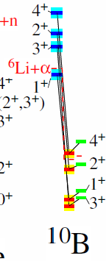
Ab-initio calculations for light nuclei
Introduction
Courtesy S. Pieper, Argonne
(+3NF)

Slide 32
3N dynamics
Three-body forces in a NUCLEAR system !
N
N
N

Slide 33
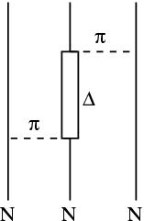

3N dynamics
Three-body forces in a NUCLEAR system !
N
N
Δ
N

Slide 34
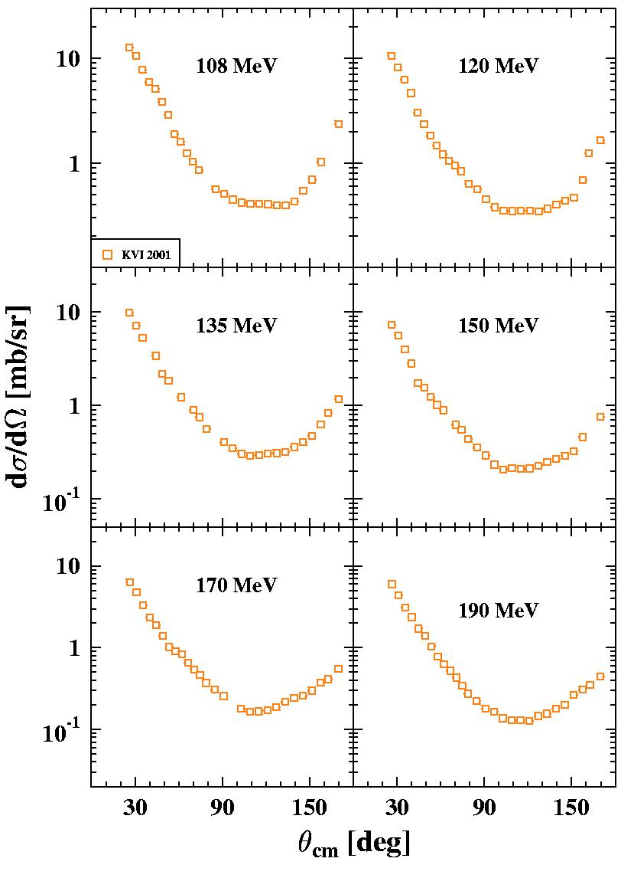
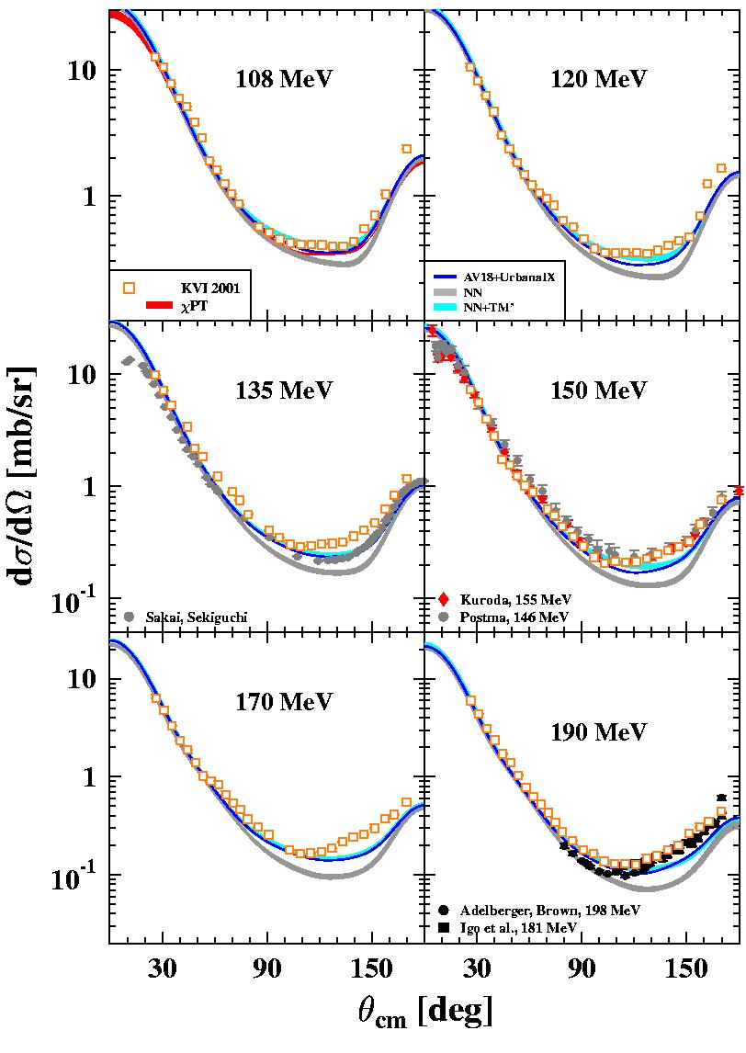
pd elastic scattering cross sections
3N dynamics
Models vs. Data
K. Ermisch et al.,
PRC 68, 054004 (2003),
PRC 71, 064004 (2005)

