Slide 1

Investigations of PCM microcapsules
with paraffin filling
by positron lifetime spectroscopy
Bożena Zgardzińska
Department of Nuclear Methods
Institute of Physics, Maria Curie-Sklodowska University, Lublin
Notes:
Foundations of physics and techniques of positron spectroscopy were just presented by Professor Jasińska, and now I would like to show an exapmple of application of this technique. The title of my presentation is:…

Slide 2
Outline
Samples
Selected physical properties of alkanes
PALS measurements for alkane, polymer and microcapsules
Conclusions
Notes:
In the introduction I will say a few words about the samples, their properties and I will present the PALS results. I will discuss the results of investigations and at the end, of course, I will present some conclusions.

Slide 3
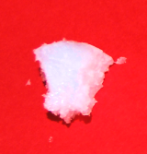
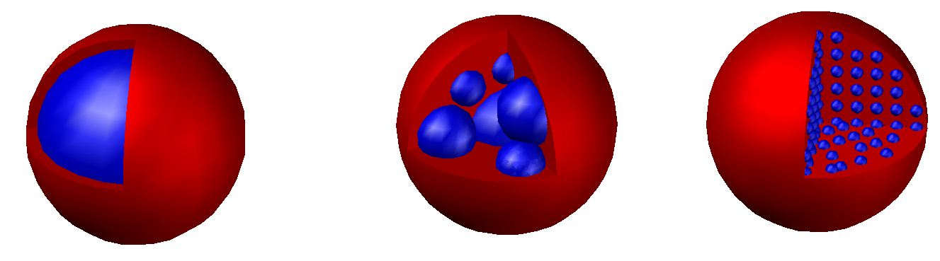
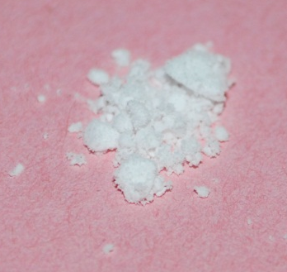
Samples
PCM – Phase Change Material
chemical
preparation
Alkane
(n-eicosane)
Polymer
(polysiloxane)
Microcapsules
The investigations were carried out on three materials
Notes:
The subject of my research were the Phase change materials in the form of microcapsules. The samples were prepared in Lodz, they were composed of alkane and polymer. It was expected that the final product should have the form of core-shell structures.
The investigations were carried out on all three samples.

Slide 4
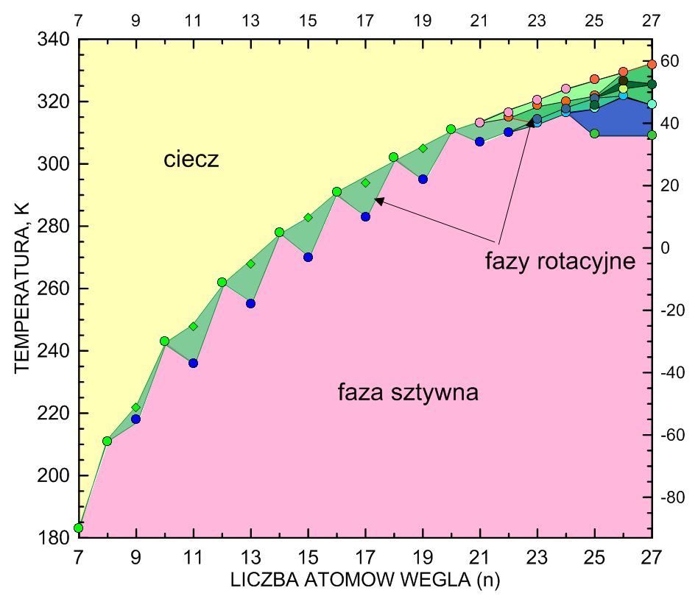
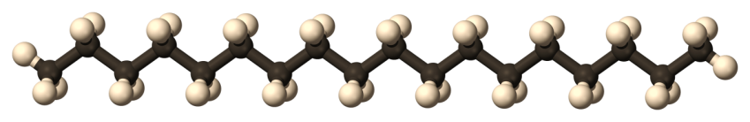
n-alkanes – general information
n-alkanes (paraffins)– saturated hydrocarbon chains in linear form
H
C
liquid
molecular formula
C_{n}H_{2n+2}
rotational
phases
TEMPERATURE, K
rigid phase
Alkanes phase diagram
(temperature, carbon chain length)
NOTE:
Odd-numbered alkanes with n≤9 and even-numbered with n≤22 do not show the existence of a rotator phases.
C₂₀H₄₂
CHAIN LENGTH (n)
R.R. Nelson, W. Webb, J.A. Dixon, J. Chem. Phys. 33, no. 6 (1960).
M. Marconcelli, S. P. Qi, H. L. Strauss, R.G. Snyder, J. Am. Chem. Soc. 104, 6237 (1982);
M. Marconcelli, H. L. Strauss, R.G. Snyder, J. Chem. Phys. 82, 2811 (1985)
F. Guillaume, J. Doucet, C. Sourisseau, A. J. Dianoux, J. Chem. Phys. 91, 2555, (1989)
T. Goworek, R. Zaleski, J. Wawryszczuk, Chem. Phys. Letters 394, 90 (2004)
Notes:
Some properties of alkanes are essential to the interpretation of the results, so to begin with a few words about alkanes. Alkanes are saturated hydrocarbons having CnH2n+2 formula. Odd-numbered alkanes with n≤9 and even-numbered with n≤22 have two phases: rigid and liquid, but the odd-numberd ones have a rotator phase too (just before the melting). As you can see, n-eicosane has 2 phases only: rigid and liquid.

Slide 5
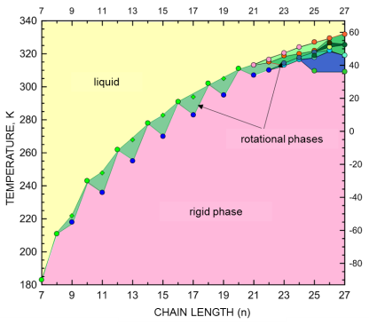

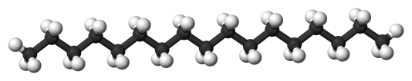
n-alkanes – general information
Lamellar structure
Rigid phase
The number of carbon atoms in the chain
odd even
distance of layers molecular
orthorombic,
monoclinic,
triclinic
Notes:
All n-alkanes in solid phase have the lamellar structure. The arrangement of molecules in odd and even alkanes is different. The alkanes with an even number of carbon atoms in the molecule are arranged at an angle to the gap between the lamellae. The distance between the lamellae is smaler here than in the odd numbered alkanes. Positronium locates in this gap.

Slide 6
n-alkanes – general information
Rotator phases
conformers
Schematic presentation
of molecules
109,5⁰
all-trans
end-gauche
double-gauche
kink
hexagonal,
pseudohexagonal
liquid
Notes:
In rotator phase some nonplanar conformers exist. Nonplanar form produces an additional free volume near the molecules able to accomodate Ps atom.
In liquid phase we can’t talk about the arranging of molecules.

Slide 7
Alkanes – PALS measurement
In the PAL spectra in neat alkanes we can distinguish usually three components corresponding to:
Free annihilation e⁺
γ
γ
τ₂=0,35 ns
The component related to o-Ps annihilation is most sensitive to the changes in the crystal structure.
Positronium annihilation
p-Ps
γ
γ
τ₁=0,125 ns
Ps
e⁻
e⁺
o-Ps
pick-off process
τ₃=0,7÷10 ns
γ
γ
Notes:
The analysis of the spectra was already mentioned by prof. Jasinska. In neat alkanes we can distinguish usually three components corresponding to the annihilation of free e+ with lifetime t2, para positronium annihilation with short lifetime t1, and the long lived component corresponding to ortho-positronium decay ruled by the pick-off process. The component related to o-Ps annihilation is most sensitive to the changes in the crystal structure.

Slide 8
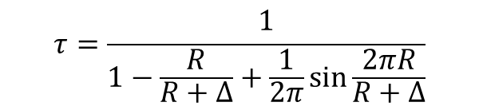
Free volume size
To determine the size of free volume we can use the Tao-Eldrup model:
$$τ=\frac{1}{1−\frac{R}{R+∆}+\frac{1}{2π}\sin{\frac{2πR}{R+∆}}}$$
τ – o-Ps lifetime
R – void radius
Δ=0,166 nm – empirical constant
And the size of free volume in liquid, we use the bubble model. The radius R of a bubble is determined by the minimum of energy:
E_{Ps}(R) is the energy of Ps in the potential well
σ – the surface tension
p – the external pressure
Notes:
To determine the size of free volume we can use two models: one of them was mentioned in the previous talk. The other model, called bubble model, we use here to determine the size of the free volume in liquids. The radius of the bubble produced by Ps is determined by the minimum of three energy: positronium energy, the surface tension energy and the external pressure energy. These two models we use to determine the size of free volume in our samples.

Slide 9
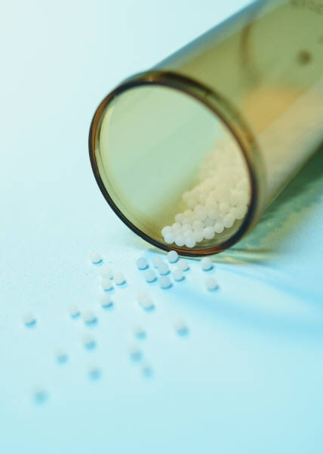

Measuring procedure
Temp.,ºC
+60
room temperature
LED power supply
PUMP
LED
sample and source
thermocouple
heater
-150
AC heater
„cold finger”
0 24 26 ….
Time, h
THERMOREGULATOR
Cu
Rs-232
LN₂
COMPUTER
Notes:
The samples were placed in the measuring chamber at room temperature, then cooled to -150C, left at this temperature for 24 h. Finally the temperature was raised stepwise up to + 60C.

Slide 10

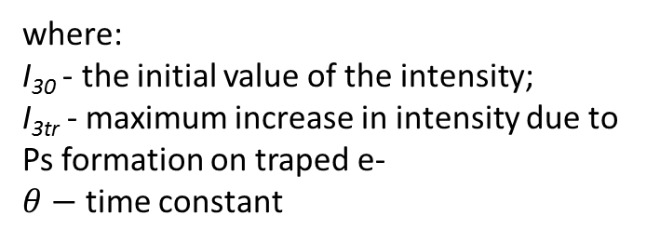
C₂₀ at low temperature
Growth of intensity I₃ - typical for pure alkane.
Temperature -150ºC
The growth of intensity I₃ can be described by an exponential curve:
$$I_{3}=I_{30}+I_{3tr}\left(1−e^{−\frac{t}{θ}}\right)$$
where:
I₃₀ - the initial value of the intensity;
I_{3tr} - maximum increase in intensity due to Ps formation on traped e-
$θ−$ time constant
C₂₀H₄₂
θ_{C20}≈8,3 h
Notes:
In the figure you can see the result of the measurement for n-eicosane as a function of time at -150 C. The intensity increases with time constant 8.3 h. The growth of intensity is typical for pure alkanes. The o-Ps lifetime does not change in time.
The growth of intensity is associated with the electron trapping effect. High energy positrons lose their energy in the process of ionization and produce electrons, which can be trapped and accumulated in the medium structure. The next positrons emitted from the source may create additional Ps with those trapped electrons. Hence the increase in the o-Ps component intensity in time.

Slide 11
C₂₀ – temperature dependence
The value of lifetime τ₃ in rigid and liquid phase typical for alkanes
Stepwise change of τ₃ and I₃ at the melting temperature
The area of thermal emptying of the traps
C₂₀H₄₂
Notes:
The intensity I3 increases with temperature until reaching the saturation value. At 230 K the intensity begins to fall, which we ascribe to thermal emptying of electron traps. Just before the melting point the intensity is small (20% only). The o-Ps lifetime in rigid phase is about 1.2 ns; this lifetime corresponds to that expected for the interlamellar gap size and its typical for even alkanes in rigid phase. In liquid phase the lifetime is independent of the hydrocarbon chain length, and is equal 3.15 ns just above the melting point. At 37,5C you can see the stepwise change of o-Ps lifetime and intensity. At this temperature the sample melts.

Slide 12
Polysiloxane – PALS results
Two different lifetime τ_{o-Ps} means two different free volumes
Only one of them changes with temperature
Lack of a stepwise change in lifetimes and intensities at 37,5ºC
At -150ºC the lifetimes and intensities are stable in time
The intensities of both o-Ps components are more or less stable
Notes:
We have analyzed also the polymer used for the capsule shell construction. As you can see, we can distinguish two o-Ps lifetimes attributed to two differing sizes of free volume. Only one of them changes with temperature, but any stepwise changes at 38C (the melting point in n-eicosane) can not be seen. At -150ºC the lifetimes and intensities are stable in time. In this polymer the electron trapping effect does not appear. The intensities of both o-Ps components are more or less constant.

Slide 13
Distinguishability components
Blue – n-eicosane
Red, green - polysiloxane
At the low temperature range two o-Ps lifetimes τ_{3_C20} and τ_{3_PSX} are almost identical
Above 38ºC the lifetimes τ_{3_C20} and τ_{4_PSX} are quite similar too
Notes:
Comparing the results obtained by PALS technique for alkane and polymer we conclude that in the low temperature range the o-Ps lifetimes in alkane and in polysiloxane are almost identical. On the other hand in the range of higher temperatures the lifetime in alkane and the longer of two lifetimes in polymer are quite similar.

Slide 14
About microcapsules
properties
The shell material determines physical properties
(size, strength, toxicity, reactivity, …)
The core material determines thermal properties
(operating temperature, capacity to accumulation and emission energy, …)
application
As phase change materials (PCM) for thermoregulation, thermal energy storage and cooling (building industry, textile, …)
morphology
core-shell multicore matrix
Notes:
The microcapsules are composed of the polymer and the alkane. The shell material of microcapsules determines their physical properties, and the core material determines thermal ones. The microcapsules of micrometer diameters are used, among others, in the textile industry, where they are added to the fiber material, used in the clothes of improved thermal protection parameters. Depending on the manufacturing techniques used and the materials we obtain the microcapsules by varying morphology: core-shell type, multicore or matrix.

Slide 15
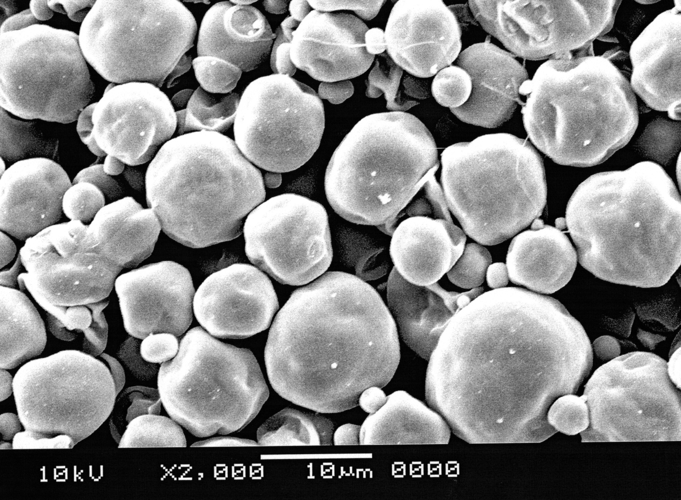
SEM microcapsules image
more or less similar in shape to a sphere
grain size (average) is about 11 μm
W. Fortuniak, Center of Molecular and Macromolecular Studies, Polish Academy of Science, Łódź
Notes:
Microcapsules which we studied were more or less similar in shape to a sphere and the average grain size of them was abaut 11 micrometers.

Slide 16
Micocapsules – PALS results
In microcapsules we see two o-Ps components
Stability in time at -150ºC
No increase of intensity means that the electron trapping present in the pure alkane does not appear when the n-ecosane is enclosed within the microcapsule
There can be two reasons of this:
The impurities in the sample (its results in a reduction or total lack of effect)
The crystal structure of n-eicosane in microcapsule is different than that of macroscopic sample size (the electron traps are not created)
Notes:
In the PALS measurements we see two o-Ps components. At low temperature the o-Ps intensity is stable in time. In the pure alkane we observe an increase of intensity, while here o-Ps intensities are stable in time, it means that the electron trapping does not appear when the n-ecosane is enclosed within the microcapsule. There can be two reasons of this behaviour:
The impurities in the sample (its results in a reduction or total lack of effect)
The crystal structure of n-eicosane in microcapsule is different than that of macroscopic sample size (the electron traps are not created)

Slide 17
Micocapsules – PALS results
Two different o-Ps components
(τ_{3_PSX}/I_{3_PSX} blue and
τ_{4_PSX}/I_{4_PSX} yellow)
Lifetimes vary smoothly with temperature
The intensities change abruptly with temperature twice:
at 38ºC and 42ºC
Between -30ºC and 10ºC the I_{3_PSX} increases and then falls significantly
Notes:
The PAL spectra parameters change as a function of increasing temperature. We see two diffrerent o-Ps lifetimes, one of them is short, like o-Ps lifetime in n-eicosane or the shorter of two lifetimes in polymer, and the other one – as long as in polymer. Both lifetimes vary smoothly with temperature. The intensity of longer-lived o-Ps component is small below 37 C, at 38C grows to 24% while the intensity of short-lived component decreases. The intensity of long–lived component increases again at 42 C. Some changes in intensity I3 at low temperature are seen, but the nature of this changes requires further investigation and will not be discussed.

Slide 18
Phase transition
The intensities change abruptly with temperature twice:
at 38ºC and 42ºC
Between 38ºC and 42ºC the intensity I₄ is constant, thus we suppose the appearance of the rotator phase.
The melting point is shifted by 4.5 K compared to the pure alkane.
Notes:
The n-eicosane melts at 38C and we expect to observe the same melting temperature in microcapsules. Although change of intensity I4 in two steps indicates that the melting point of the microcapsules is shifted to a 42C, and preceded by the rotational phase covering the range of 4 C. The existence of the rotator phase was a surprise, but it confirms our earlier conclusion about structural modifications of alkane core.

Slide 19

Size of free volume
Below 38ºC the τ_{3_PSX} and τ_{3_C20} are visible as one component τ₃; similarly above 42ºC τ_{4_PSX} and τ_{3_C20} form ther component τ₄.
There are two types of free volume.
Two different o-Ps components
(τ_{3_PSX}/I_{3_PSX} blue and
τ_{4_PSX}/I_{4_PSX} yellow)
τ_{4_PSX}
& τ_{3_C20}
τ_{3_PSX} & τ_{3_C20}
Lifetimes vary smoothly with temperature
-150ºC÷-10ºC
45ºC÷60ºC
The intensities change abruptly with temperature twice:
at 38ºC and 42ºC
Between -30ºC and 10ºC the I_{3_PSX} increases and then falls significantly
R
Ps
Notes:
The o-Ps lifetime give us information about the free volume size, and we can determine these sizes using the Tao-Eldrup and bubble model.
I have mentioned, that still before performing the measurements on microcapsules, we expected that the o-Ps lifetimes in n-eicosane and in the polymer will be hard to distinguish. In microcapsules there are two o-Ps lifetime components, so also two sizes of free volume. As it is seen in figure, in microcapsules at low temperature the o-Ps lifetime in alkane and shorter lifetime in polymer are visible as one component τ₃, but the longer lifetime t4 can be assigned to the polymer only. Similarly, above 42ºC the longer lifetime in polymer and the lifetime in alkane form t4 component, and the t3 component we assign to polymer only.

Slide 20




Mass fraction of substrates
$$I_{3}=I_{3_C20}+I_{3_PSX}$$
$$I_{3}=I_{3_PSX}$$
Two different o-Ps components
(τ_{3_PSX}/I_{3_PSX} blue and
τ_{4_PSX}/I_{4_PSX} yellow)
$$I_{4}=I_{4_PSX}$$
$$I_{4}=I_{3_C20}+I_{4_PSX}$$
Lifetimes vary smoothly with temperature
-150ºC÷-10ºC
45ºC÷60ºC
The intensities change abruptly with temperature twice:
at 38ºC and 42ºC
Between -30ºC and 10ºC the I_{3_PSX} increases and then falls significantly
Notes:
It was said previously that at the low and high temperatures some lifetimes relate to the sum of components. This applies also to the intensities, for which we can write the following relationships:

Slide 21

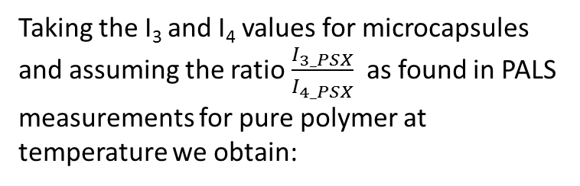
Mass fraction of substrates
$$I_{3}=I_{3_C20}+I_{3_PSX}$$
$$I_{3}=I_{3_PSX}$$
Two different o-Ps components
(τ_{3_PSX}/I_{3_PSX} blue and
τ_{4_PSX}/I_{4_PSX} yellow)
$$I_{4}=I_{4_PSX}$$
$$I_{4}=I_{3_C20}+I_{4_PSX}$$
Taking the I₃ and I₄ values for microcapsules and assuming the ratio $\frac{I_{3_PSX}}{I_{4_PSX}}$ as found in PALS measurements for pure polymer at temperature we obtain:
The intensities change abruptly with temperature twice:
at 38ºC and 42ºC
Lifetimes vary smoothly with temperature
-53ºC
52ºC
Between -30ºC and 10ºC the I_{3_PSX} increases and then falls significantly
0,7μm
the PSX component is:
38%±2% 42%±2%
4,8μm
Notes:
Now, if we put to these equations the I₃ and I₄ values for microcapsules and assume the ratio $\frac{I_{3_PSX}}{I_{4_PSX}}$ as found in PALS measurements for pure polymer at two selected temperatures we obtain the mass fractions of microcapsule components. The polymer constitutes about 40% of microcapsule weight. Taking into account the size of the microcapsules, we can estimate the thickness of their shell.

Slide 22
Mass fraction of substrates
Two different o-Ps components
(τ_{3_PSX}/I_{3_PSX} blue and
τ_{4_PSX}/I_{4_PSX} yellow)
Another microcapsule for textile industry with n-eicosane filling
relatively large shell thickness
The intensities change abruptly with temperature twice:
at 38ºC and 42ºC
Lifetimes vary smoothly with temperature
Between -30ºC and 10ºC the I_{3_PSX} increases and then falls significantly
0,7μm
the component of PSX was evaluated:
38%±2% 42%±2%
4,8μm
Notes:
This estimated shell thickness is rather large. In the commercially available microcapsules the polymer shell constitutes 20% of mass only. So we suspect that our microcapsules have a different core-shell morphology.

Slide 23
Micocapsules – SEM image
A check by SEM microscope:
Notes:
This supposition was checked by SEM microscope. On the first picture you can find cracked microcapsules showing the interior of the microcapsules. To have a close look into the structure, the samples were solidified in resin, then the resulting formulation has been cut with a knife, and a photo of morphology was obtain. On the photo you see the skeletal structure of microcapsules which confirmed our suspect.

Slide 24
Conclusions
PALS technique can be successfully used to study the phase change materials (e.g. microcapsules).
Similarity of the PALS results obtained for the microcapsules to the results obtained for materials composing them (alkane and polymer) is observed.
It should be noted that, in the microcapsules, in contrast to the pure alkane:
- no electron trapping effect at low temperature;
- melting point is preceded by the rotational phase in the range of 4 K;
- melting point is shifted to a higher temperature by 4.5 K.
Basing on the PALS results, we can:
- estimate the percentage content of components building the microcapsules (here ~40% belongs to the polymer);
- notice the morphology of the microcapsules differing from that declared by the manufacturer.

Slide 25
Thank you for your attention

