Slide 1








S³ : Super
Separator
Spectrometer
Spiral 2
Physics objectives
Optics
Construction status
Phase 1++
S³ Collaboration (LoI signed by 28 laboratoires)
ANL (US), CENBG, CSNSM, JINR-FLNR, (Russia), GANIL, France, GSI (Germany), INFN Legnaro, (Italy), IPHC, France, IPNL, , Irfu CEA Saclay, IPNO, France, JYFL (Finland), K.U. Leuven (Belgium), Liverpool-U, (UK), LNS (Italy), LPSC, MSU (US), LMU, (Germany), Nanjing-U (China), Northern Illinois University (US), SAS Bratislava, (Slovaquia), IFJ PAN Cracow (Poland), Smoluchowski Institute (Poland), CEA-DAM; SUBATECH, TAMU (US), U. Mainz (Germany), York-U (UK), Vinca Institute (Serbia)
INP

Slide 2
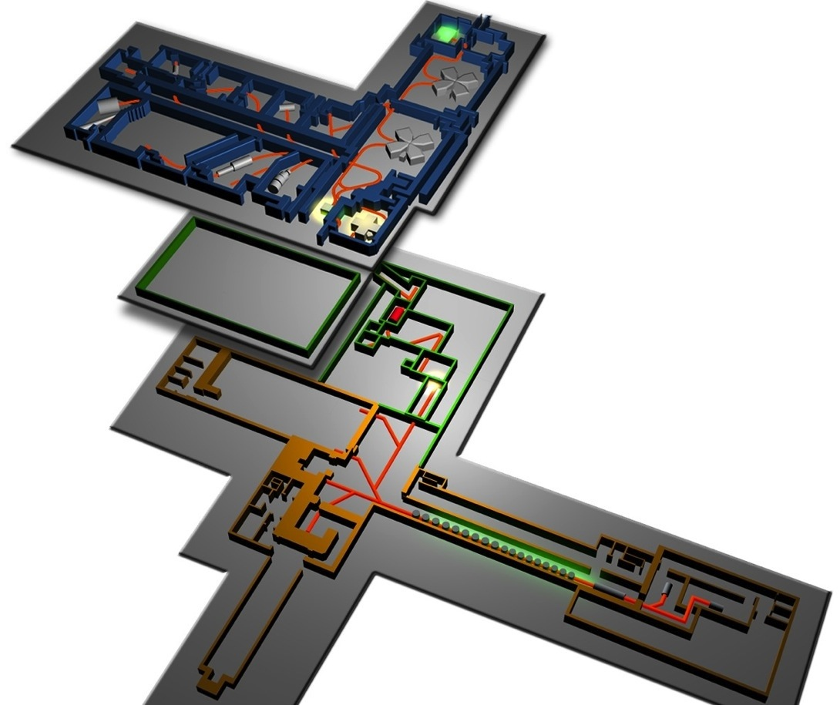
S³ in the Spiral2@Ganil project
Present Ganil
Fed by the very high intensity
stable heavy ion beams
of LINAG
- He to U nuclei
- From 2 to 14MeV/u
Desir
Spiral2
Phase 1++
(2015)
S³
Goal:
Study of very rare events in nuclear and atomic physics
NfS

Slide 3
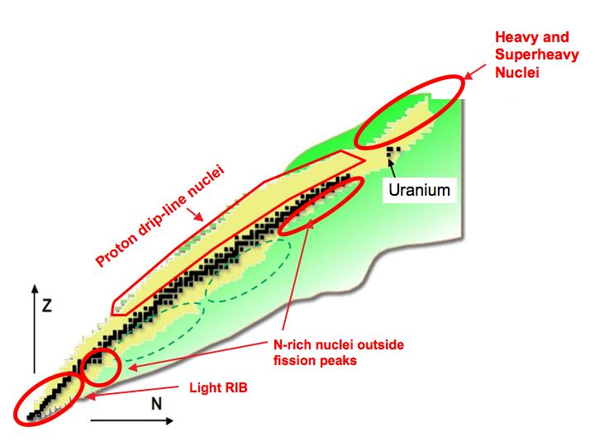
LoI Physics objectives
FISIC project
LoI_Day1_1
Collaboration meeting March 2014
Number of participants : 100
12 LoIs updated + 3 new proposals
Fusion-evaporation
Heavy and Superheavy
Elements
  Spectroscopy and Structure
  Reaction mechanism
  Ground-State Properties
  Synthesis
Proton Dripline & N=Z nuclei
  Tests of Shell Model
  Shapes of nuclei
  Exotic decay
  Ground-State Properties
Neutron-Rich Nuclei
LoI_Day1_7
  ➢ Single-Particle structure
  ➢ Quenching of Shell Gaps
Delayed spectroscopy (SIRIUS) : 4 loIs
GS properties measurements (REGLIS³) : 6 LoIs
In beam spectroscopy (PARIS,EXOGAM, …) : 4 LoIs
Atomic physics (FISIC) : 1 LoI

Slide 4
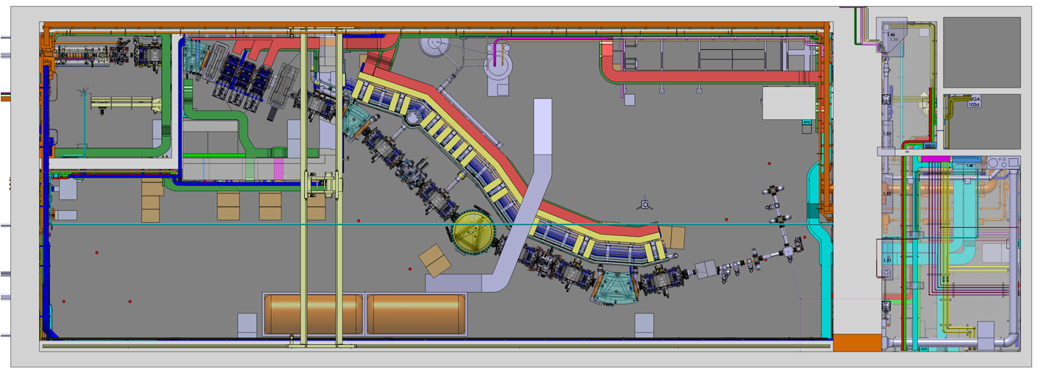


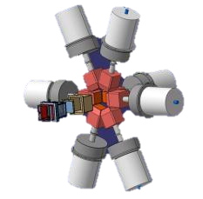
Experimental Techniques
Converging mode
Gas catcher + Laser ionisation + Mass Resolution by Time-of-flight
β/β–delayed
Laser spectroscopy
High resolution Mass measurement
Chemistry
Final focal plane
Selection & Identification
Time of flight + Energy
A measurement
Beam
Multi-purpose
Experimental
Room
Achromatic point
Two step reactions
Transfer+Fusion (transfer)
Specific Modes
Ion-ion collision : FISIC Program
Mass dispersive mode
Delayed spectroscopy
p, α, γ, e- decay
DESIR

Slide 5
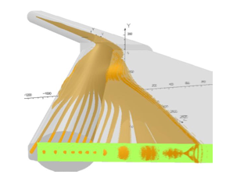
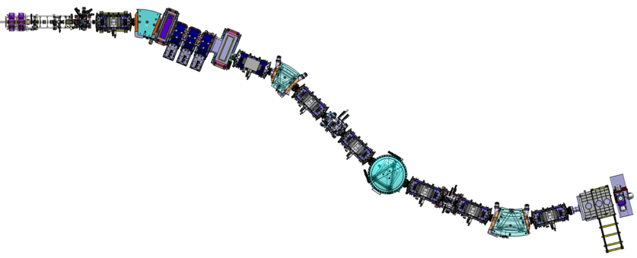
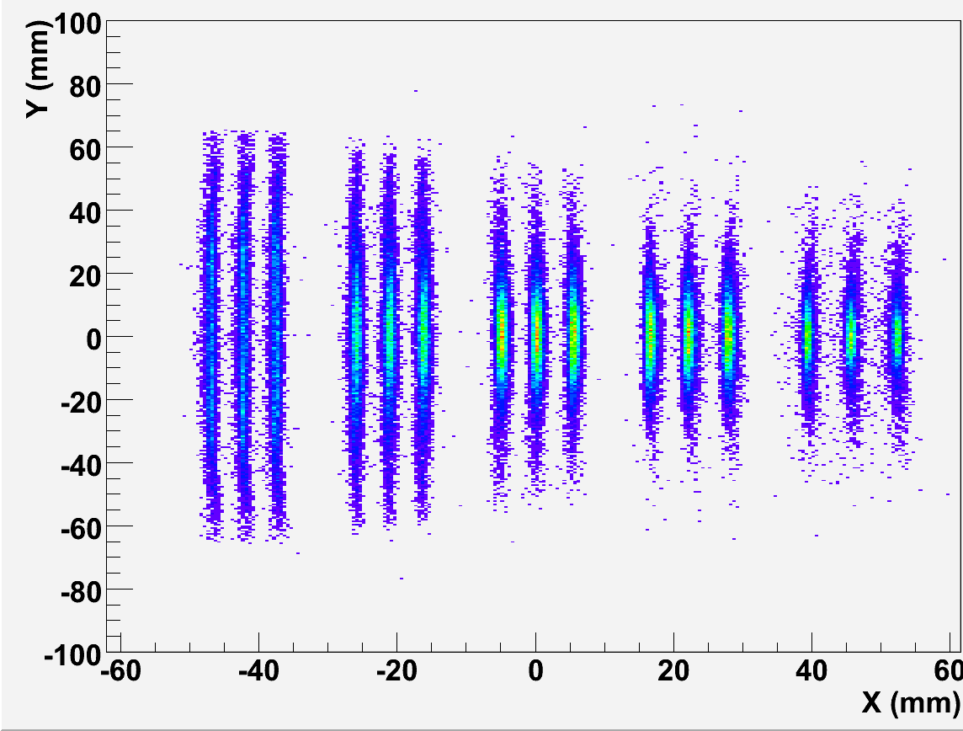
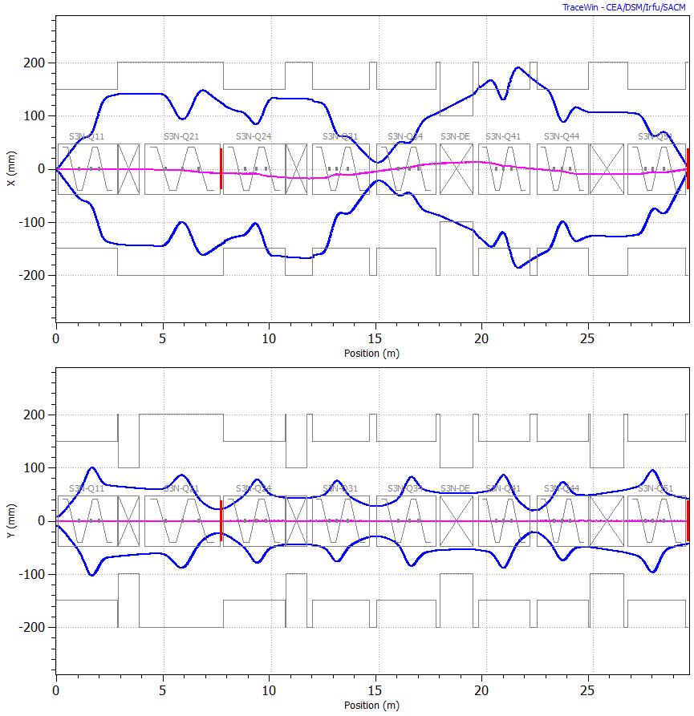
Optics
J. Payet, D. Uriot (SACM) D. Boutin, F. Dechery (IPHC)
* 1st Selection :
block 99.9% of the beam
Target
Achromatic
Focal point
Beam dump*
Momentum
Dispersive plane
Final
focal plane**
A=101,100,99
Horizontal
300
mm
Momentum Achromat
Mass spectrometer
22+
23+
24+
25+
26+
300
mm
**2nd selection:
Simulated Mass resolution = 460
Vertical
Tracewin simulations : Full raytracing in the multipole 3D field maps
Automatic optimisation of 70 field values
Under process: implementation of 3D field maps of the magnetic and electric dipoles

Slide 6
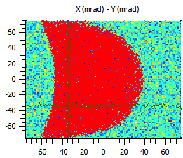
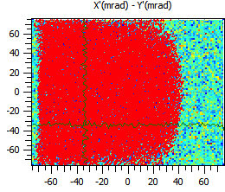
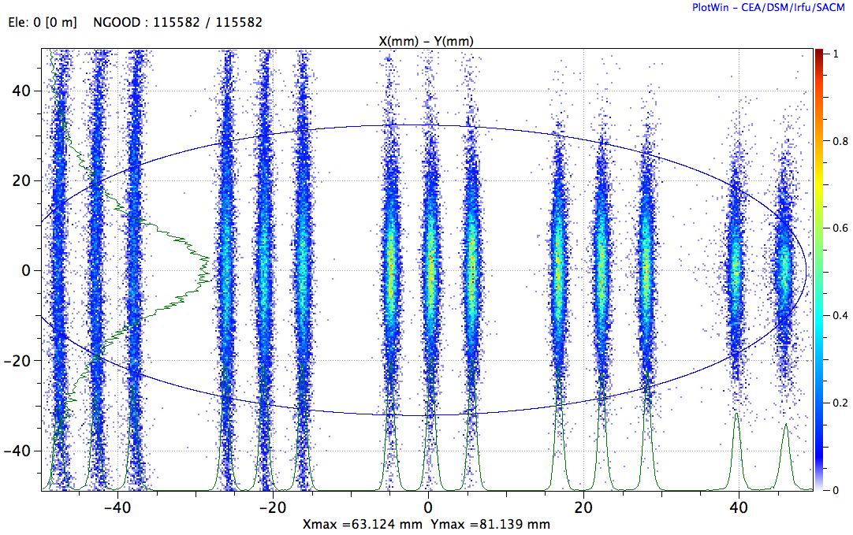
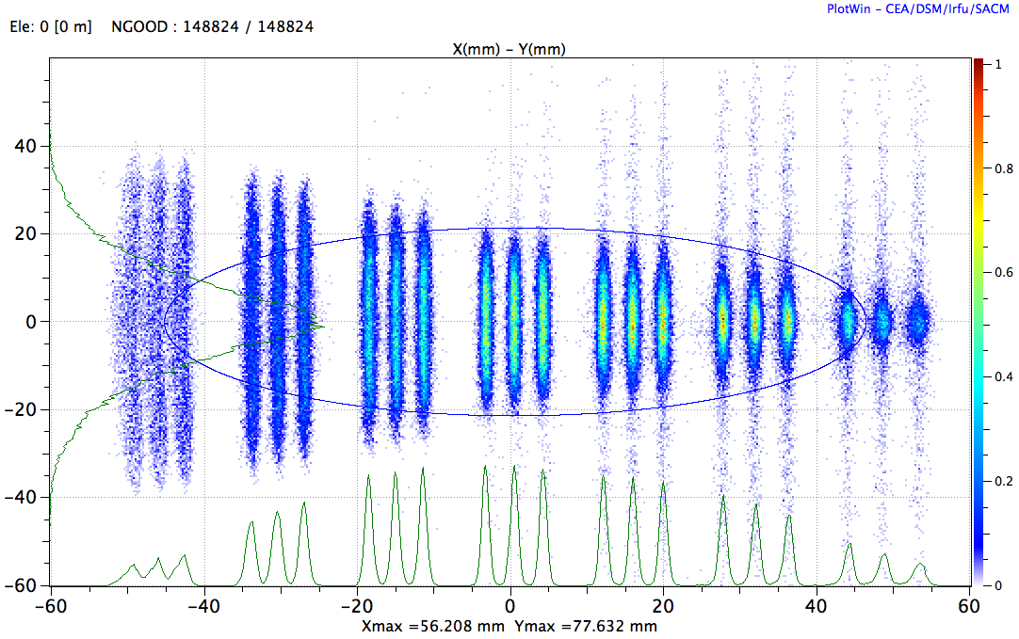
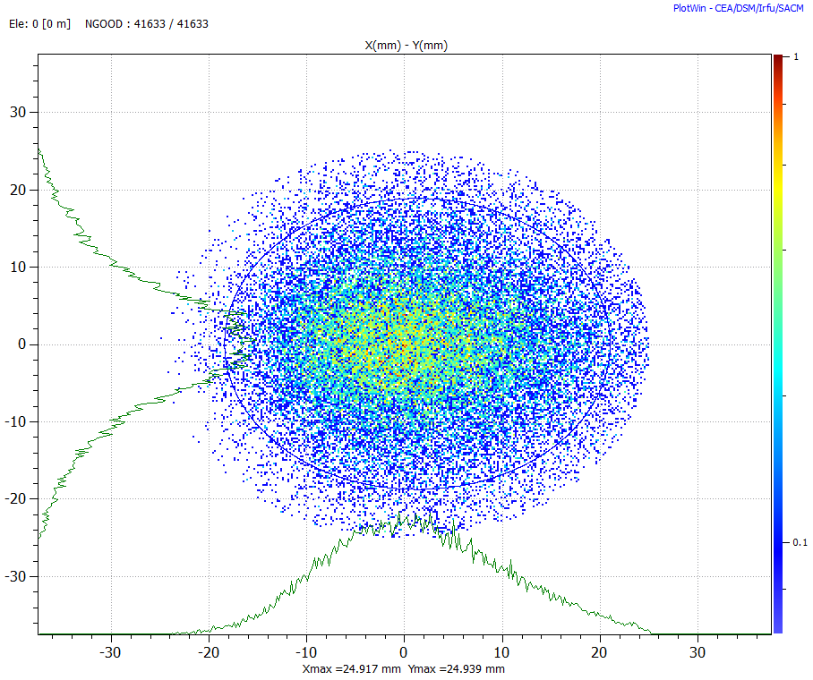
Operational modes and Performances
Reference reaction : ⁵⁸Ni + ⁴⁶Ti → ¹⁰⁰Sn²⁴⁺ + 4n σ(E) = 1.7% σ(θ) = 20mrad
Close
Target
Position
1) High resolution
2) High transmission
3) Converging
φ=5cm
1)
2)
3)

Slide 7
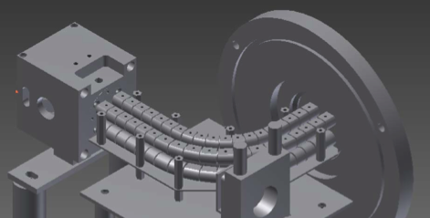
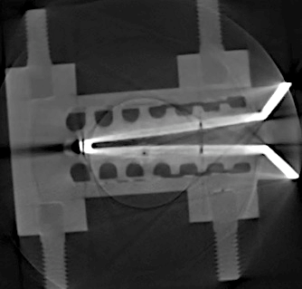
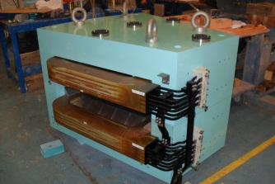
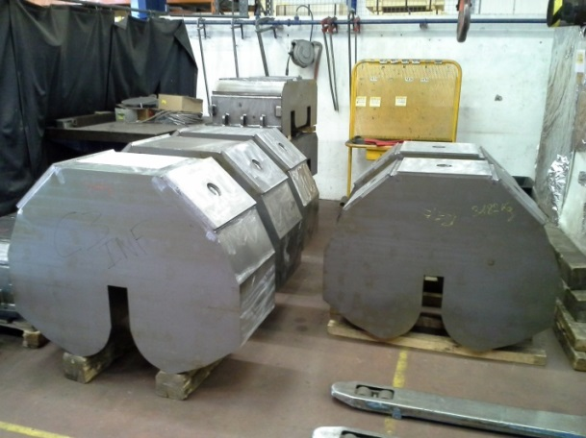
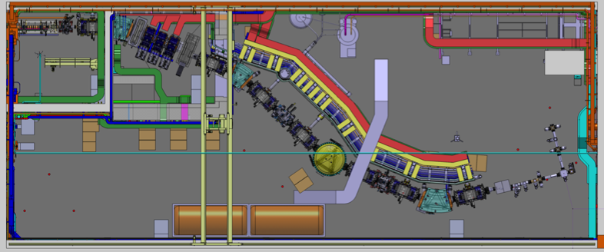
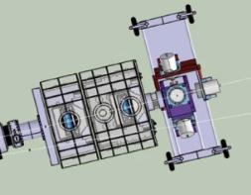
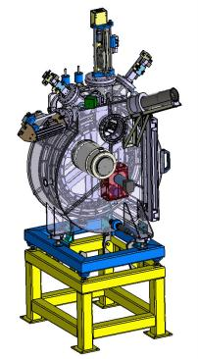
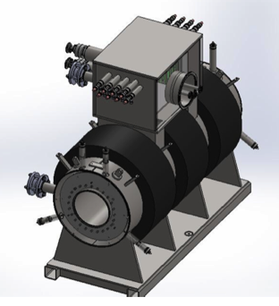
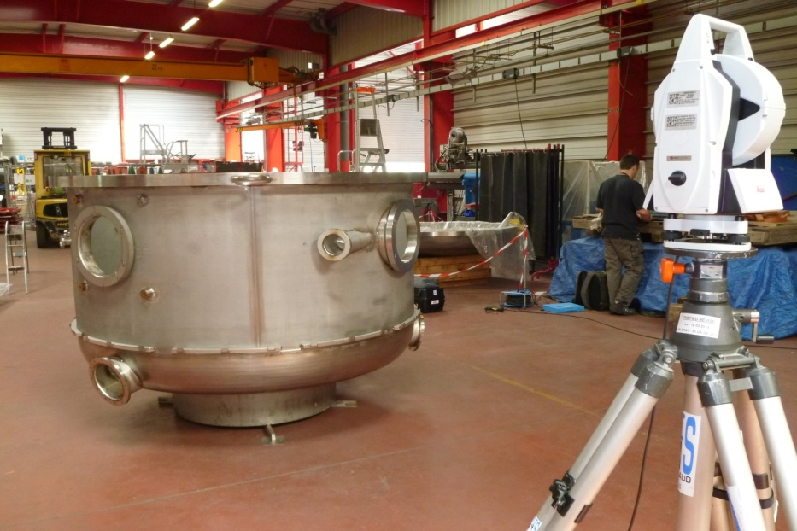
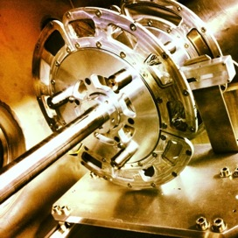
Technical Highlights
Dispersive zone
3 × dipoles
Open triplet
Construction by Sigmaphi
Low Energy Branch
Fingers :
tested for 5kW/cm²
Delivery: March 2013
Detection system
Target system
Prototype tested
in 2012
7 × SC multipoles
Q+S+O fields
Prototype
of 1st coil
Tested
E dipole

Slide 8
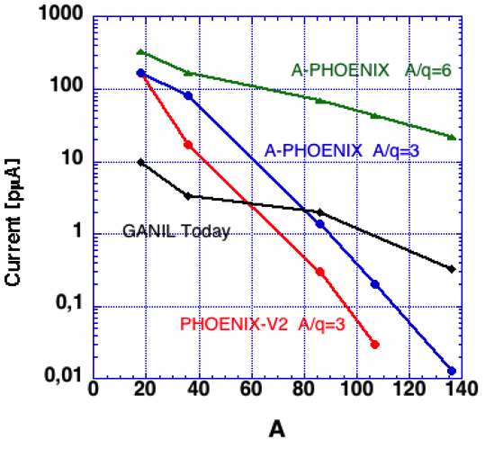
Phase 1++
Very high intensity beams with:
Phoenix V3 source ➔ Superconducting ion source
A/q=3 RFQ ➔ Low charge state injector A/q=6
Ions | Intensity (pµA) Phoenix V2 PHOENiX V3 | High Intensity project (A/Q=6 & SC ECR source)
⁴He | 850
¹⁸O | 216 | 375
¹⁹F | 28,6 | 500
³⁶Ar | 17.5 | 500
⁴⁰Ar | 2.9 | 120
³²S | 7.3 | 50
³⁶S | 4.6/9 | 50
⁴⁰Ca | 3/5 | 15
⁴⁸Ca | 1.25/2.5 | 15
⁵⁸Ni | 1.1/2 | 11
⁵⁰Ti | 1/2 | 10
⁵⁴Cr | 1/2 | 10
⁸⁴Kr | 0 | 33
¹³⁹Xe | 0 | 18
²³⁸U | 0 | 2.5
Rate summary vs GSI UNILAC
2-4 [A/Q=3, Phoenix V3]
15-20 [A/Q=6, SC source]

Slide 9
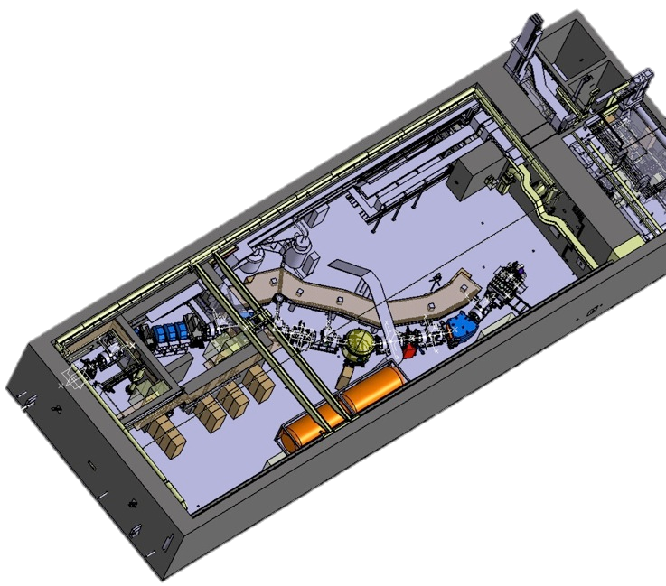
Conclusions
S³ is a low energy separator-spectrometer for the Spiral2 stable beams
    Fusion-evaporation, two-step reactions, rare channels, electron exchange…
High versatility
  High energy mode (up to 1.8Tm)
  Various optical modes: high resolution, high transmission, converging
Designed for the selection and identification of rare events
  2 steps rejection and >300 Mass resolution
  High transmission of evaporation residues
Construction phase has started
  Commisionning in 2016
  Phase 1++ to reach full power

Slide 10
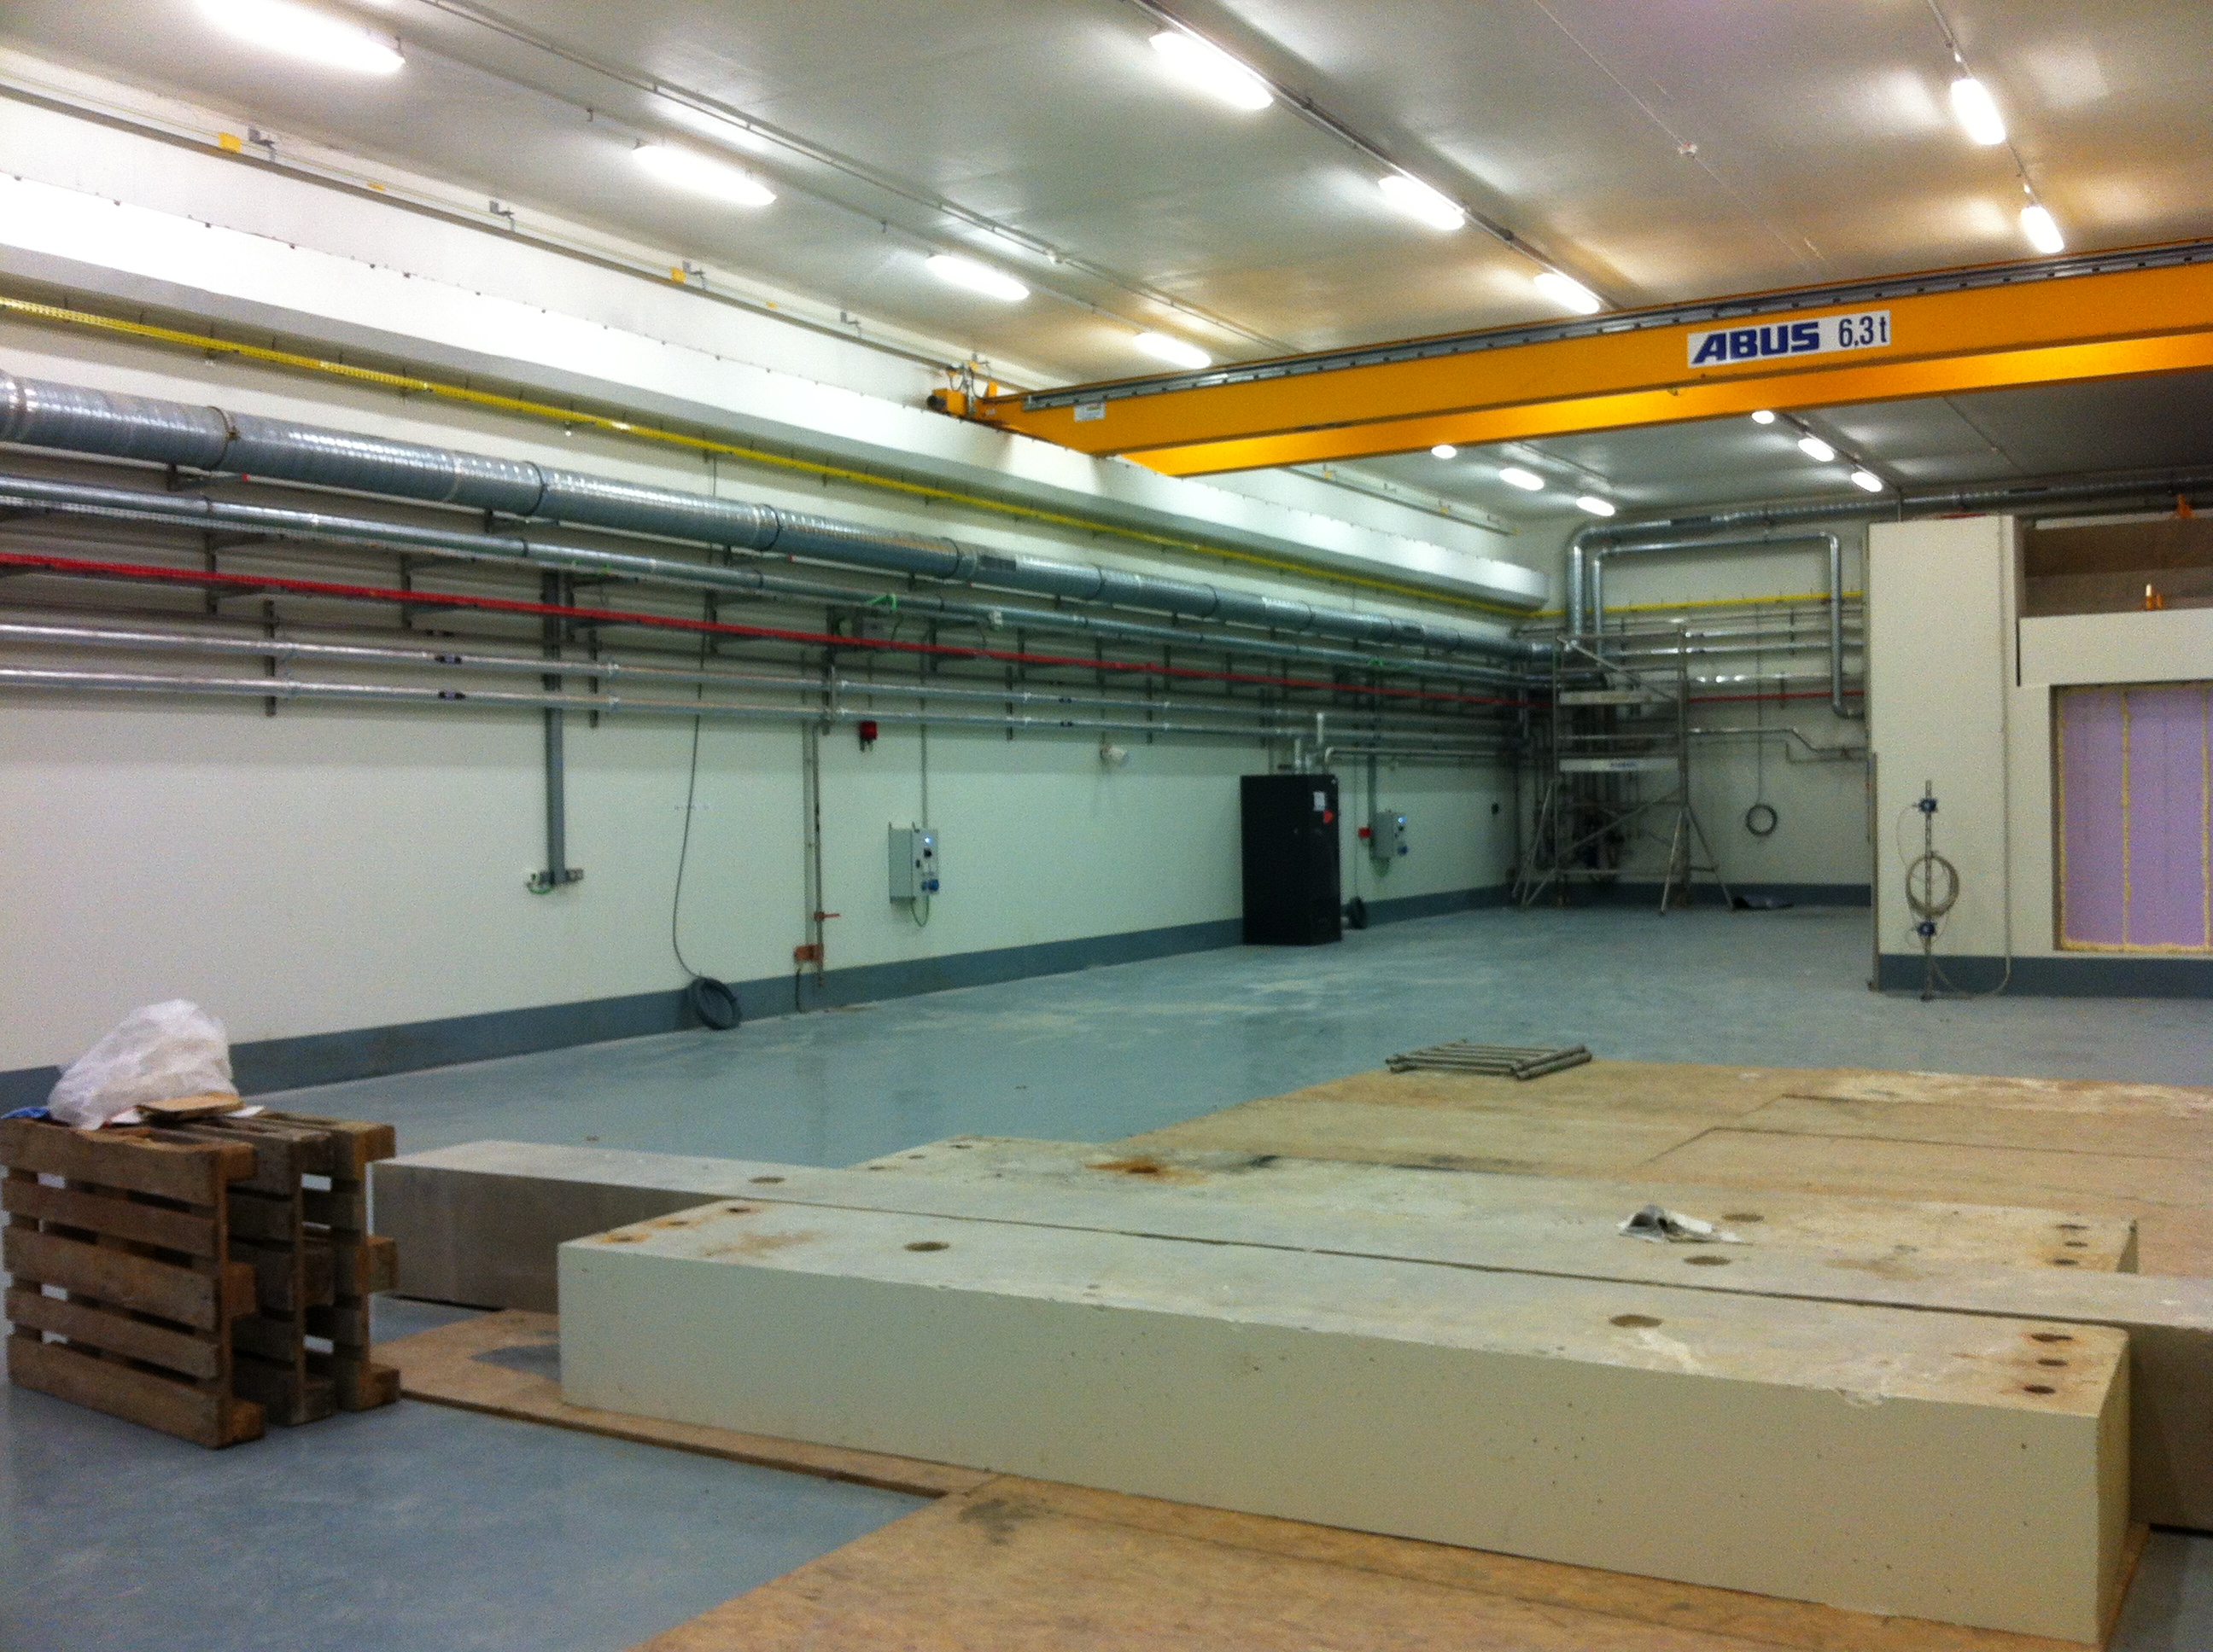
S³ room, one week ago
Thank you for your attention!

Slide 11
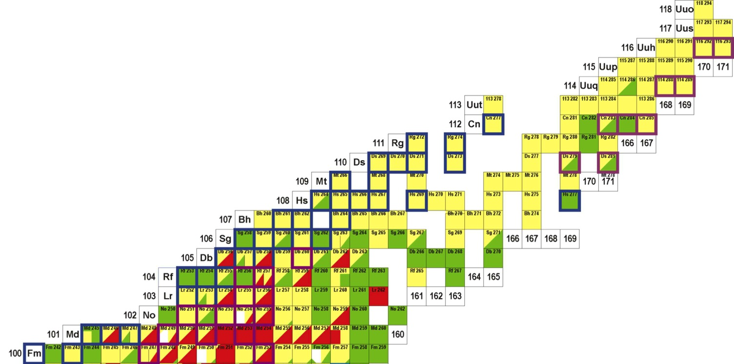
Very and Superheavy elements studies
nuclide | feature | X-section [nb] | rate [h⁻¹] | 21UT integral
 |  |  |  | day 1 | phase 1++
²⁵⁴No | ER | 2000 | 60.000 | 6×10⁷ | 1×10⁷
²⁵⁶Rf | ER | 17 | 550 | 90.000 | 5.4×10⁵
²⁶⁶Hs | ER | 15 (²⁷⁰Ds) | 0.34 | 57 | 285
^{266m}Hs | K-isomer | 15 (²⁷⁰Ds) | 0.01 | 2.5 | 12.5
²⁷⁰Ds | ER | 15 | 0.45 | 76 | 380
^{270m}Ds | K-isomer | 15 (²⁷⁰Ds) | 0.22 | 38 | 190
²⁶²Sg | α-decay | 15 (²⁷⁰Ds) | 0.02 | 5 | 25
²⁷⁶Cn | ER | 0.5 (²⁷⁷Cn) | 0.01 | 2.5 | 12.5
²⁸⁸115 | ER | 10 | 0.3 | 50 | 300
²⁸⁸115 | L X-rays | 10 | 1,8 | 300 | 1800
Nuclear structure
Quasi-particle excitations ➔ deformation/K-isomers
Alpha/gamma/electron spectroscopy
X ray spectroscopy
Reaction studies
Isospin dependent investigation
Instrumentation
SIRIUS setup
Z > 112 ➔ Actinide targets
⁴⁸Ca beam and heavier

Slide 12
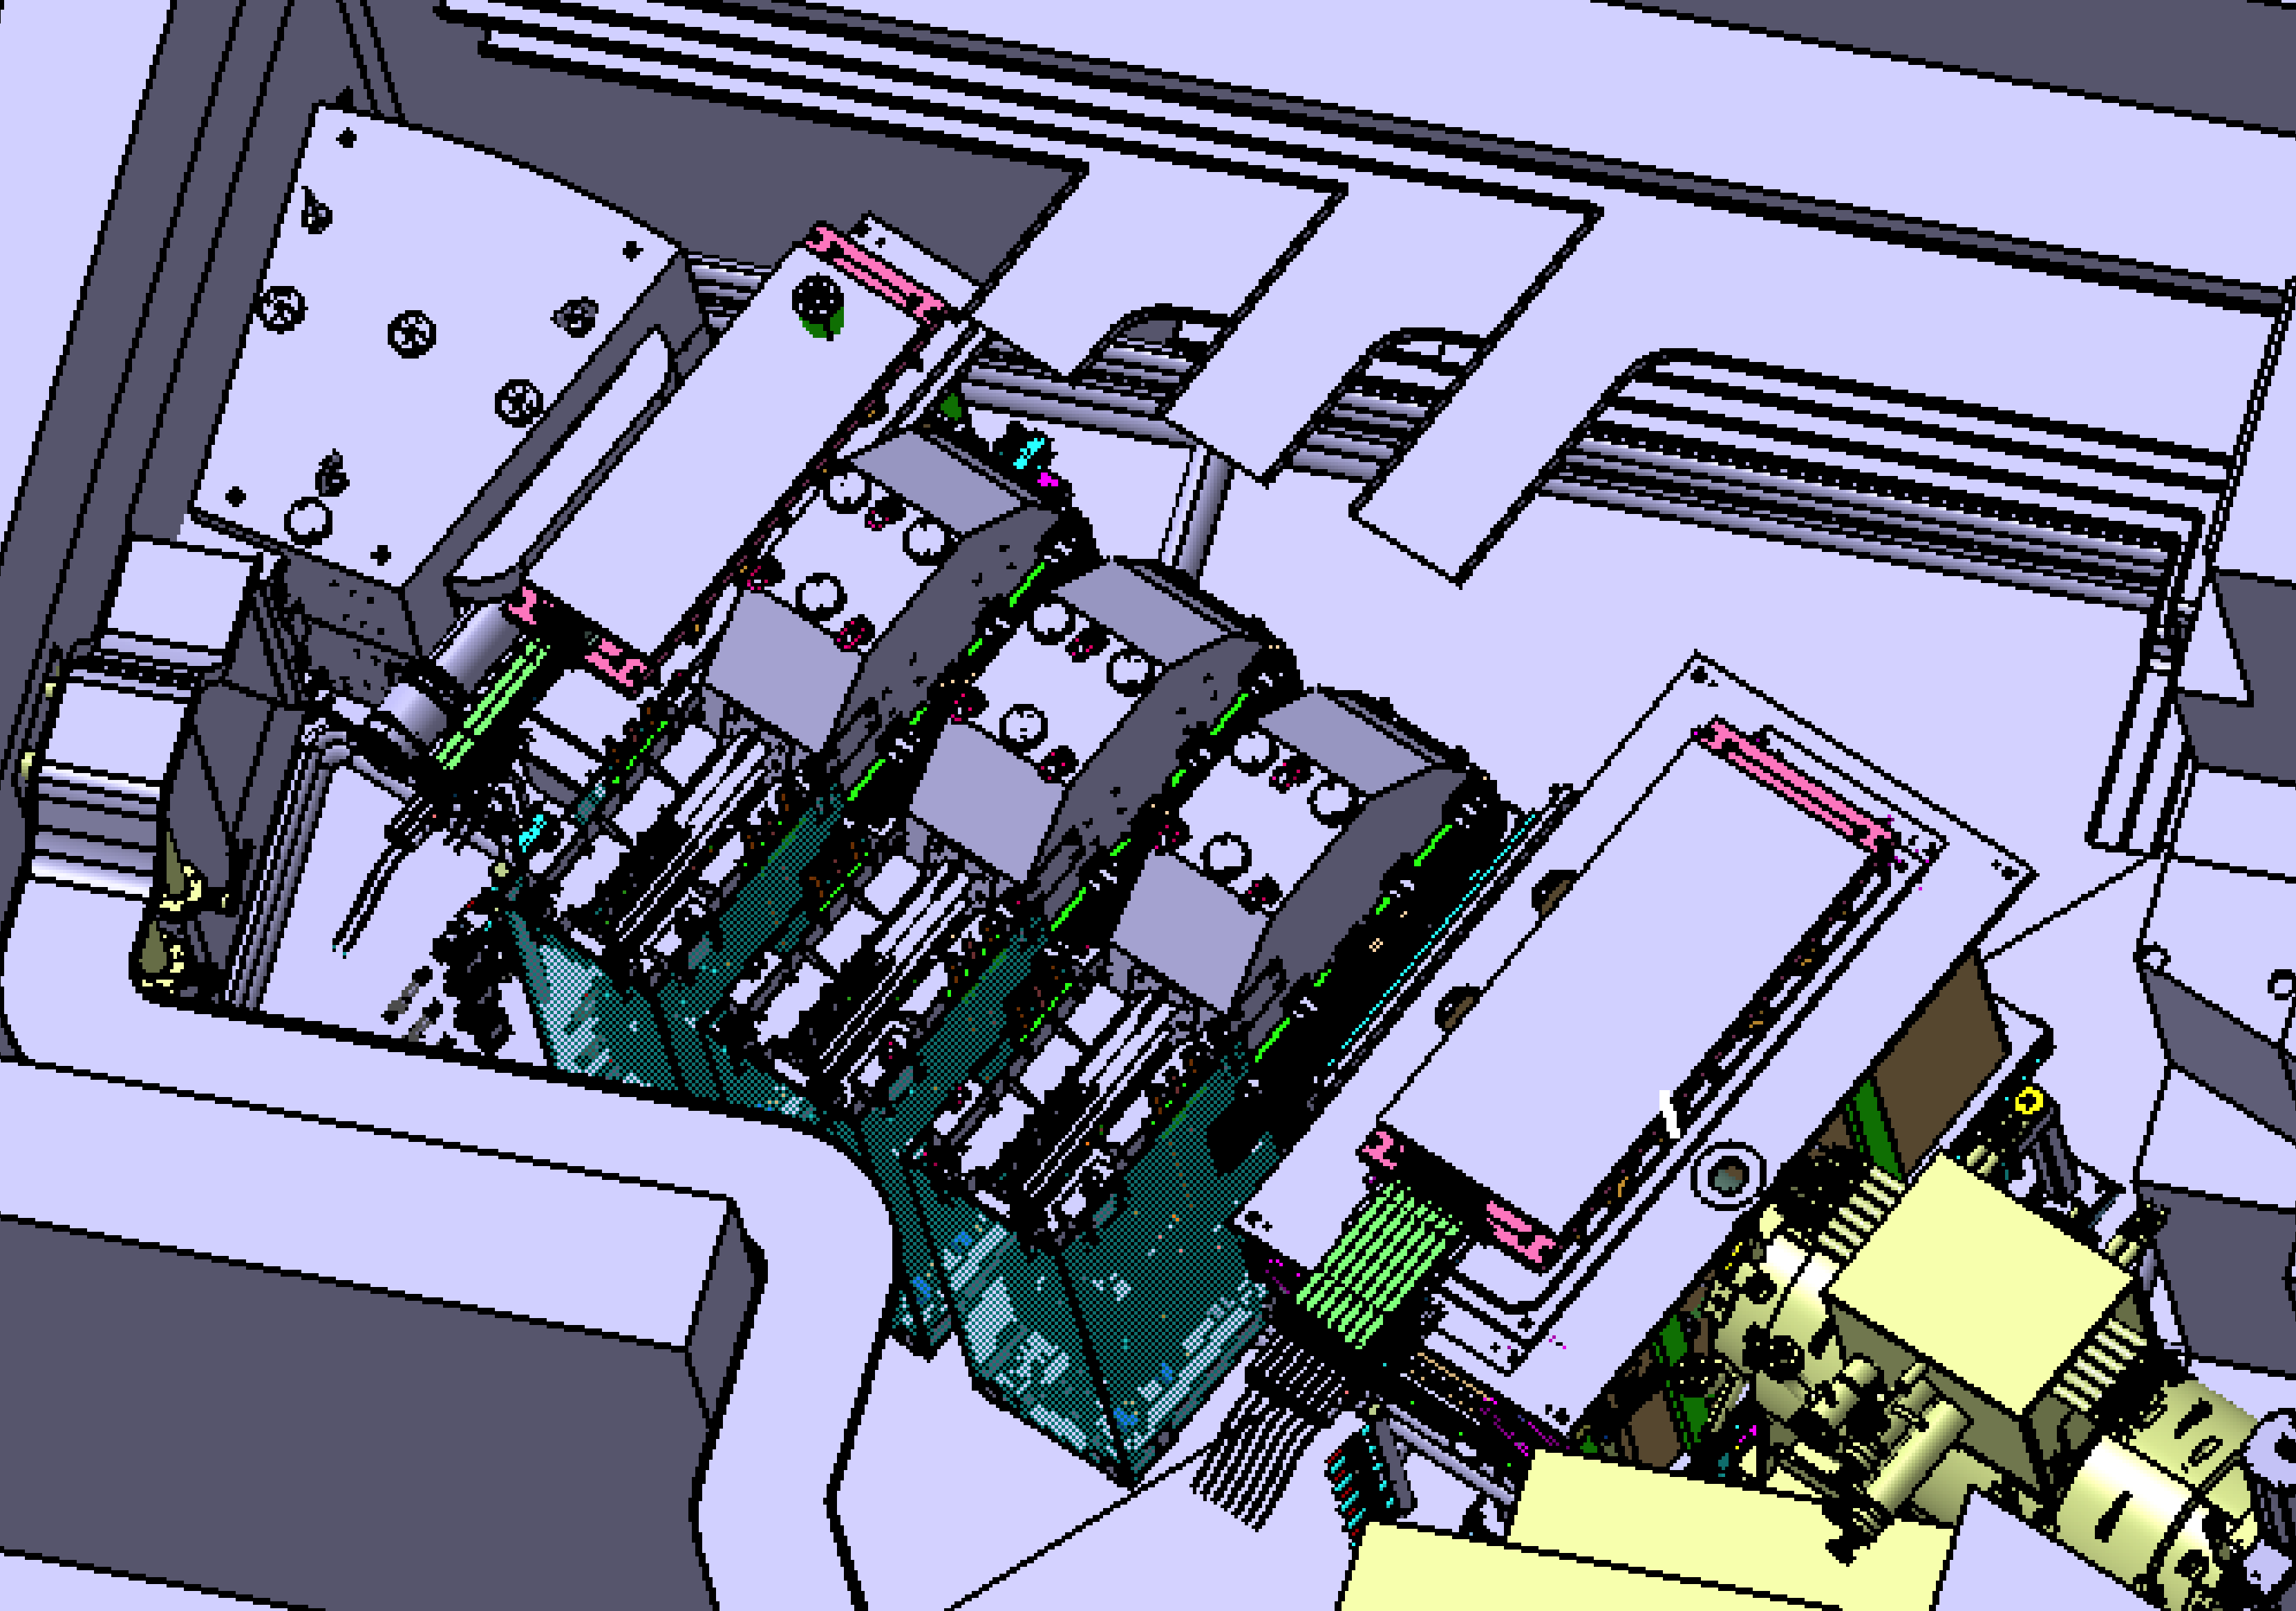
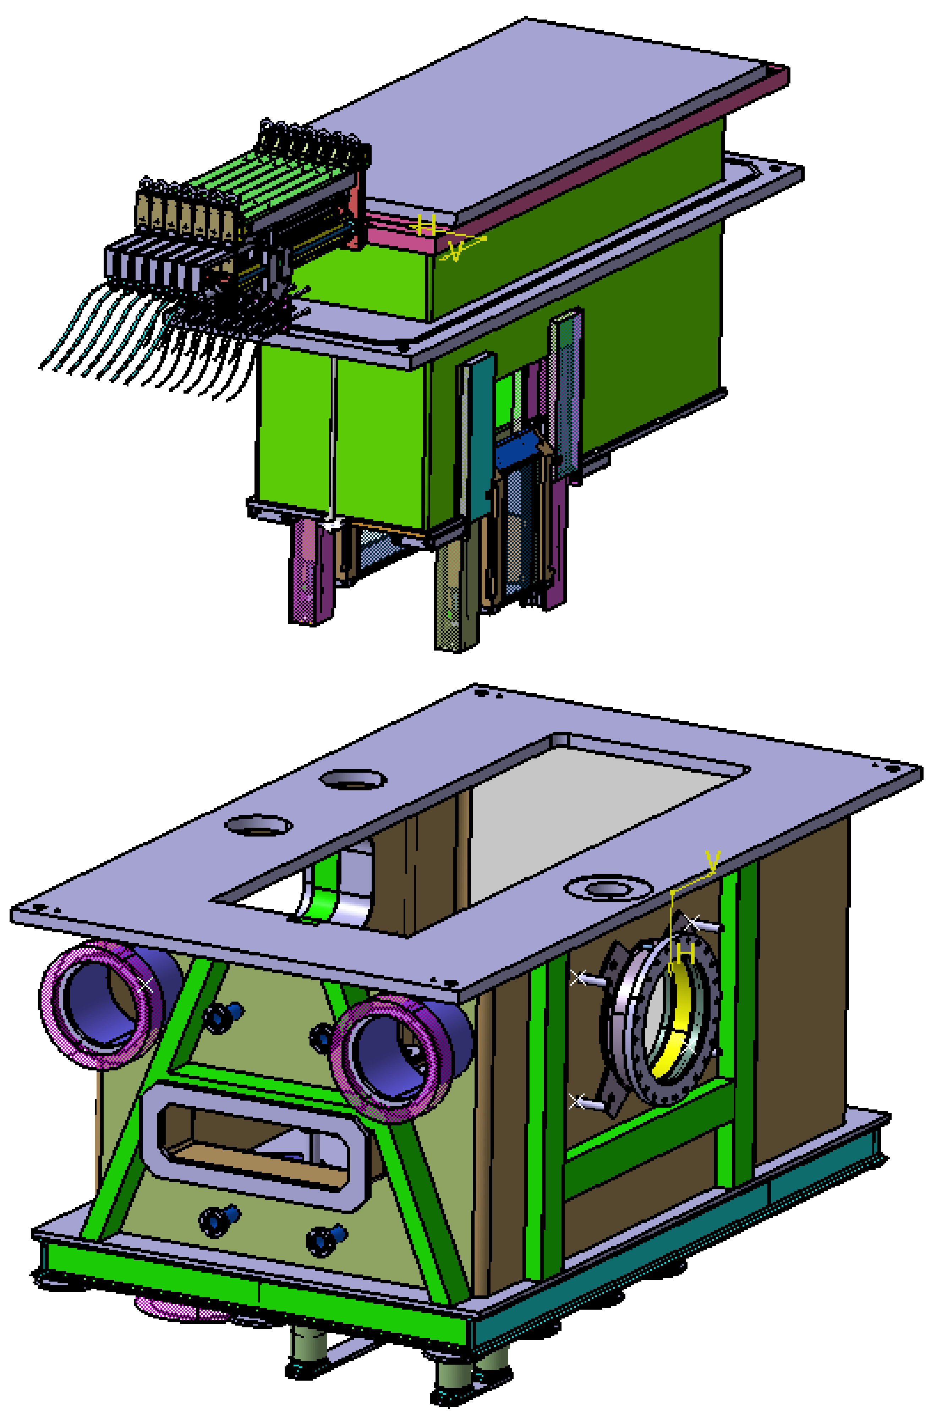
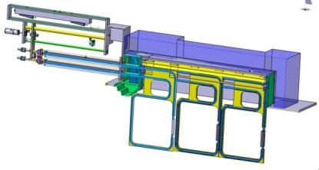
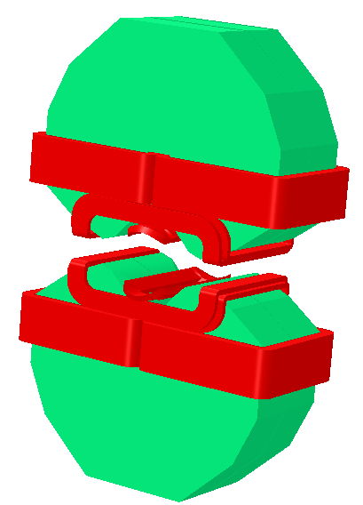
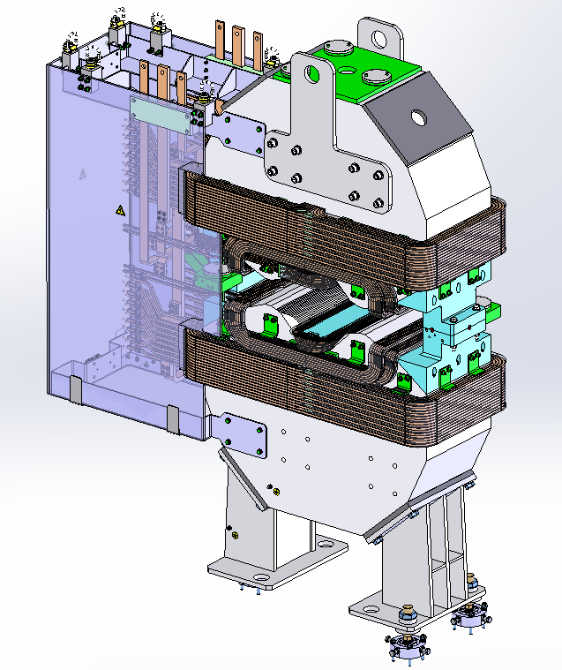
Beam Dump (O. Cloué, SIS)
Stopping 99.9% of the primary beam charge states
Upstream
Beam dump
Downstream
Beam Dump
Shielded
removable
“plugs”
Design by F. Nizery (SIS)
Open magnets
quadrupole+sextupole
Under construction by Sigmaphi
(O. Delferrière, J. Payet SACM)

Slide 13
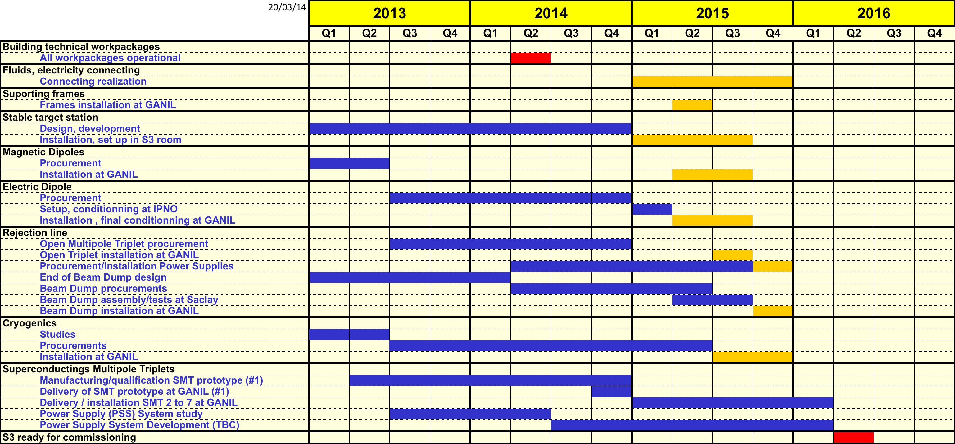
Planning

Slide 14
Technical Challenges
High Beam intensity
  High power target : 10pµA (= 6.10¹³p/s) or more
  Rejection of the beam : >10¹³
Low Energy (fusion-evaporation residues)
  Large angular acceptance : +/- 50 mrad X and Y
  Charge state acceptance of +/- 10% (q=20⁺)
  Momentum acceptance for each charge state Bρ: +/- 10%
Many reaction channels (evaporation channels)
  M/q selection : 1/300 (FWHM) resolution
  Identification when possible
  Versatility (transfer reactions & atomic physics)
  ➔ High energy first stage : Bρ_{max} = 1.8Tm
  ➔ Secondary reactions

Slide 15
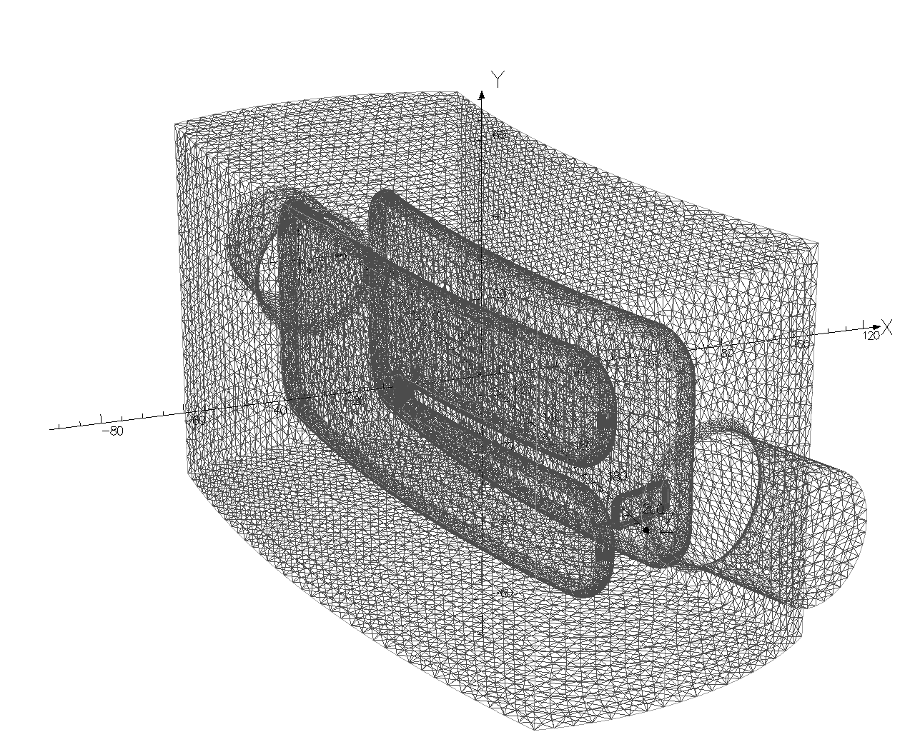
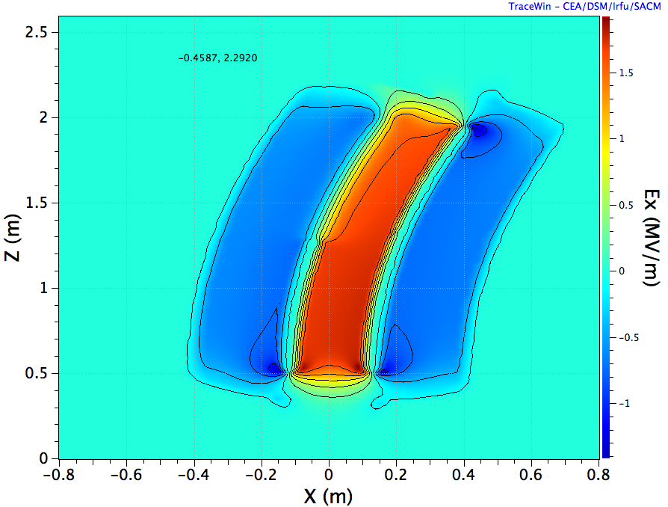
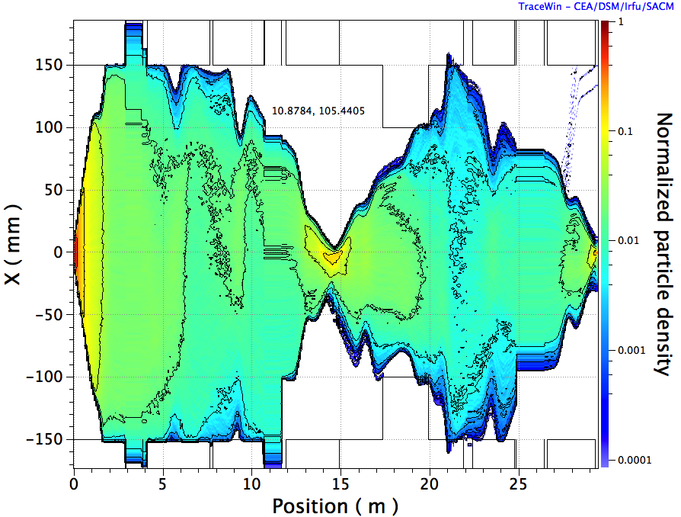
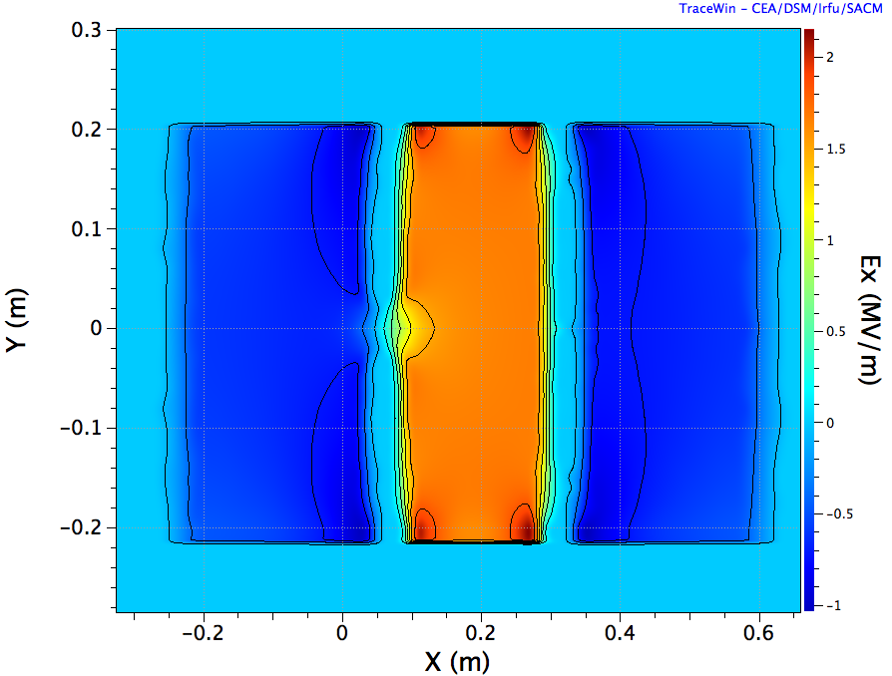
New : implementation of 3D electric dipole field map
2cm high slit to reduce scattering

Slide 16
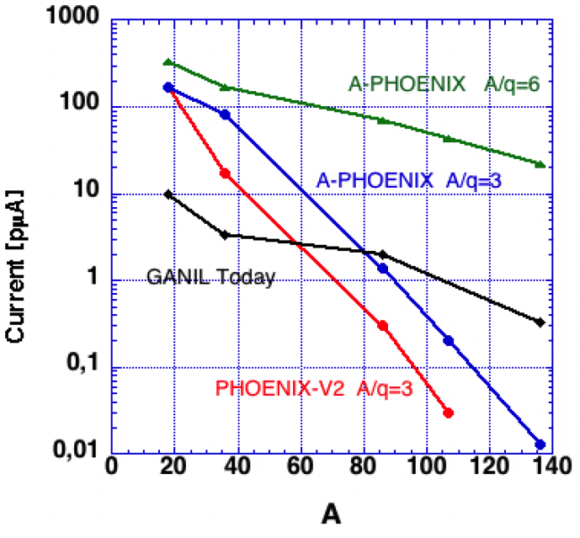
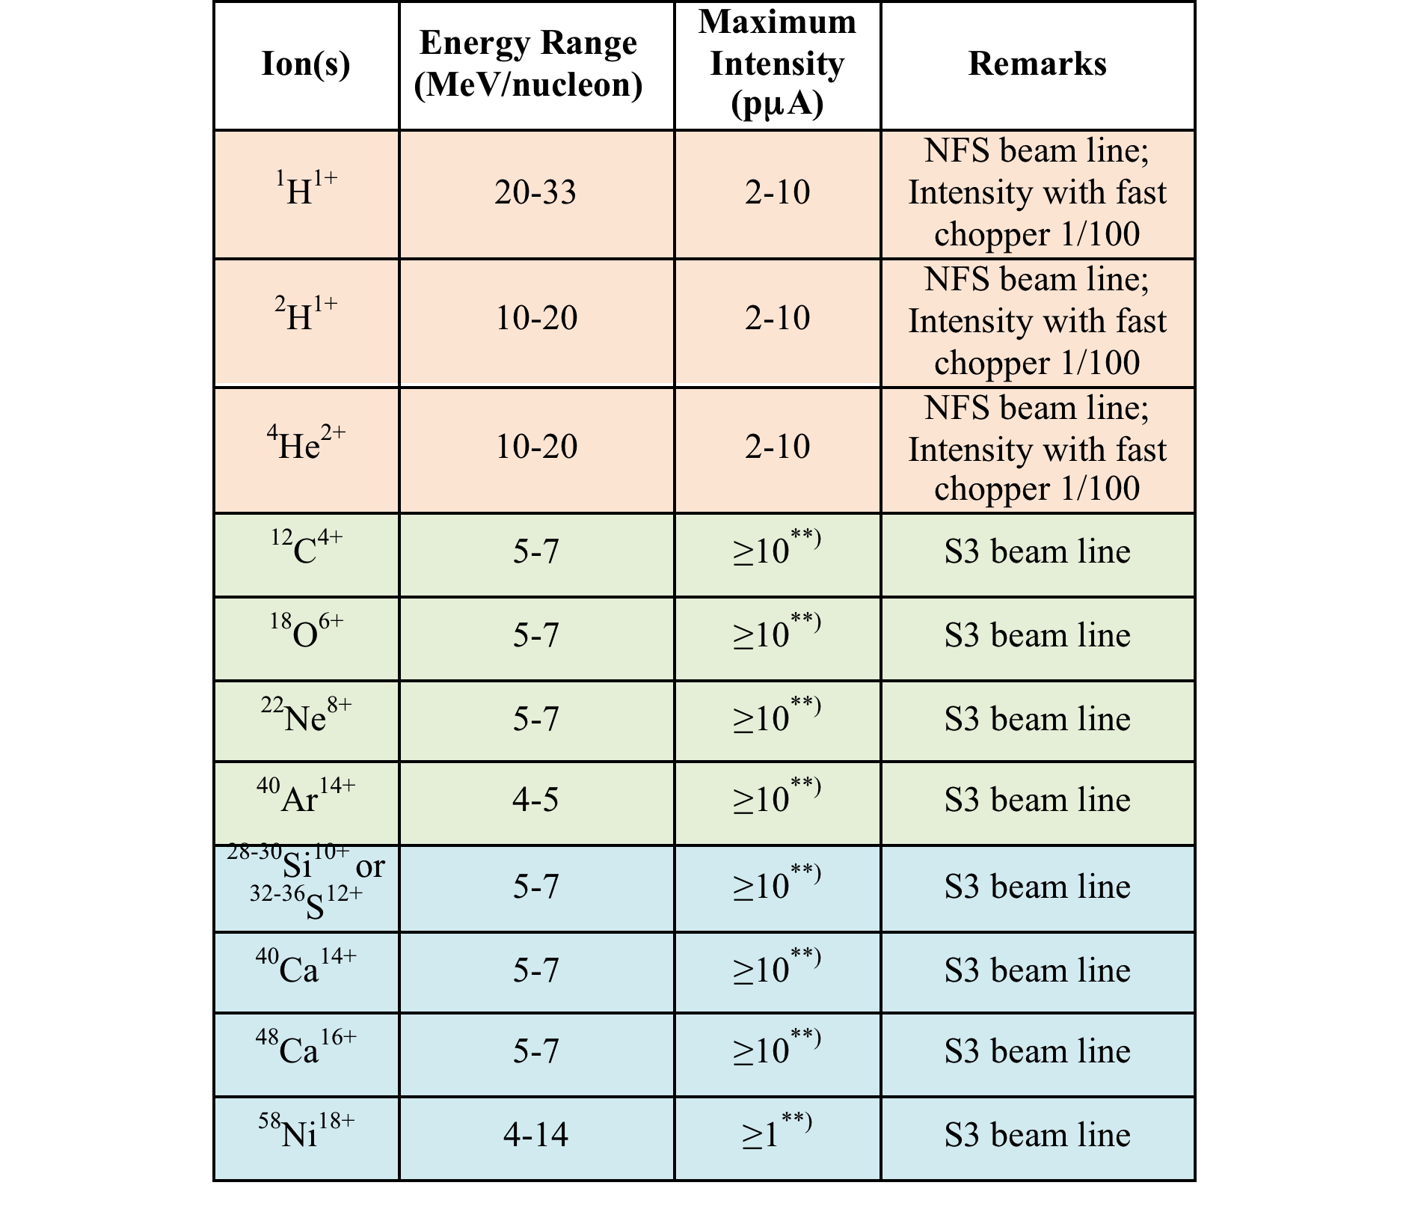
Day 1 SPIRAL2 LINAC beams
Energy = 0.75-15 A.MeV
Gases
¹⁸O⁶⁺
³⁶Ar¹²⁺
⁵⁸Ni¹⁹⁺
Beam Intensity Reached
6
9 (³⁶S)
6
2.5
2
Phoenix V2 :
⁴He²⁺: 850 pµA
¹⁸O⁶⁺ (from ¹⁶O¹⁶⁺): 216 pµA
¹⁹F⁷⁺ : 28,6 pµA
³⁶Ar¹²⁺: 17.5 pµA
⁴⁰Ar¹⁴⁺: 2.9 pµA
³²S¹¹⁺: 7.3 pµA (not opt.)
³⁶S¹²⁺ (from ³²S¹²⁺): 4.6 pµA
⁴⁰Ca¹⁴⁺: 3 pµA
⁴⁸Ca¹⁶⁺ (from ⁴⁰Ca¹⁶⁺): 1.25 pµA
⁵⁸Ni¹⁹⁺: 1.1 pµA
➔Phoenix V3 (Apr. 2014)
50-100% Int. increase
➔Beam developments
Improvement Ca,Ni, S
Development Si,Ti,Cr
PHASE1+ scientific programs require at middle term very high Intensity HI beams
(>10 pμA for A>50)
➔Development of a new SC ECR Ion Source
➔New RFQ A/Q=6-7

Slide 17
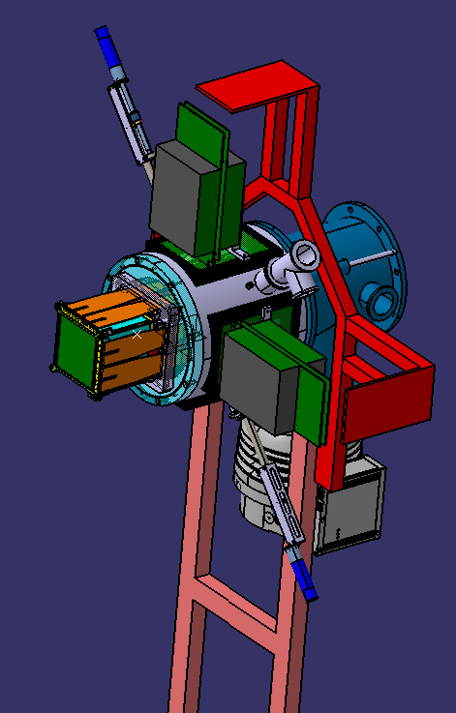
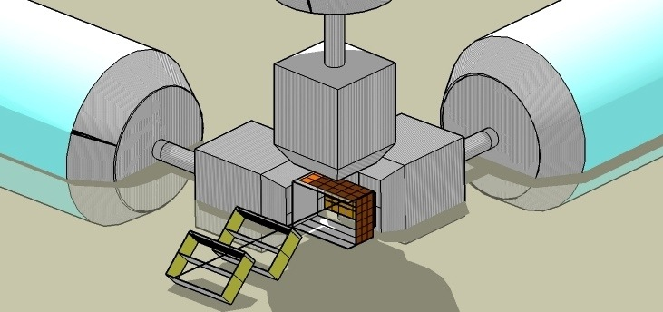
SIRIUS (Spectroscopy & Indentification of Rare Ions Using S³)
Germanium detector
e.x. Exogam2, CLODETTE
Time of flight + tracking detector
Implantation detector
(HI, α and e⁻ decay)
Tunnel detector for escaped e⁻ and α
Large size (200x150 mm²)
Time Resolution < 1ns
Position resolution = 1mm
Very low thickness
Large detector size 10x10cm²
High resolution FWHM
  Ability to detect large> 50MeV pulse
  Followed (≈ 10µs)
  by a weak (<15MeV) pulse.
No Dead time
Conversion electrons FWHM <5 keV
Escaped alpha FWHM 15 keV
R&D is ending ➔ Construction phase could start
Search for the funds !

Slide 18
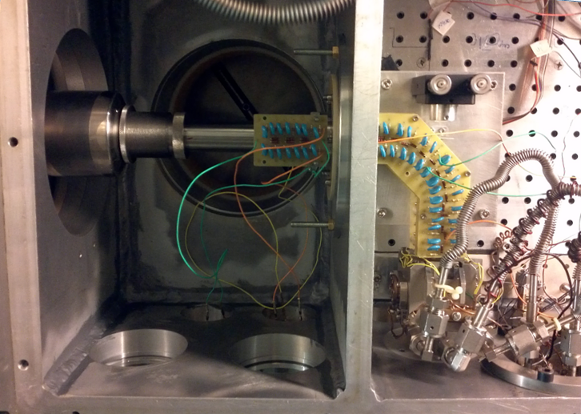
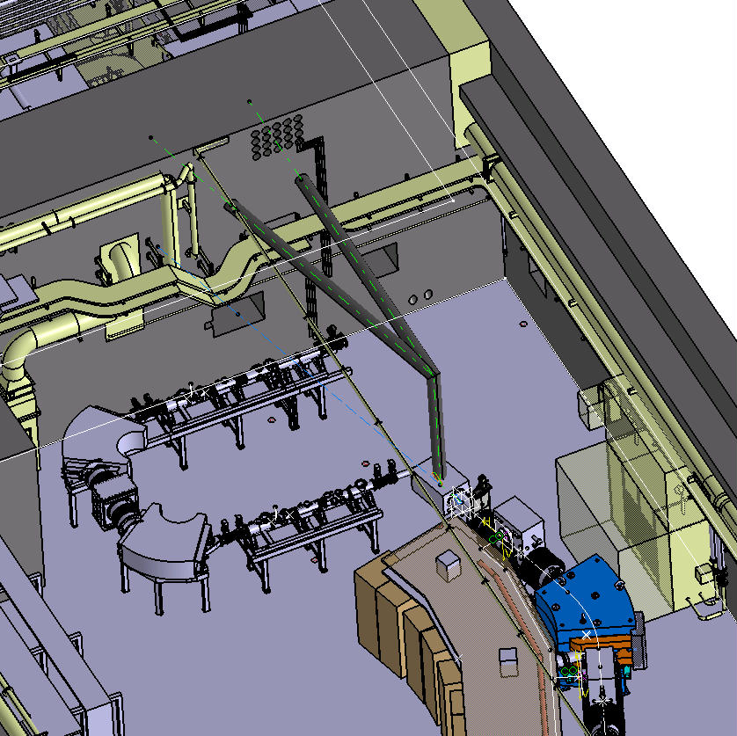
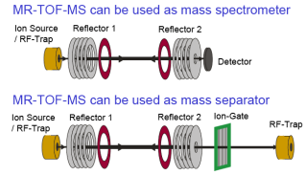
Low Energy Branch
Gas cell chamber
^{(LEUVEN, GANIL, IPNO, LPC…)}
10⁻² mbar
électrode
extraction
HRS
RFQ 90º
Identification
Station
RFQ
extraction
DESIR
Cellule
gazeuse
500 mbar
Faisceau laser
10⁻⁵ mbar
S³
Pure Beam
Expected performances
HRS or MRTOF
Thermalization, diffusion and transport towards the exit hole | 90 %
Neutralization in to the atomic in GS | 30 %
Formation of the gas jet | 90 %
Laser ionization | 50 %
Capturing efficiency | 80 %
Detection efficiency | 85 %
Total efficiency | 4 %
cocktail
beam

Slide 19
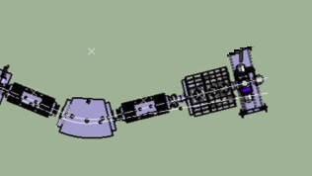
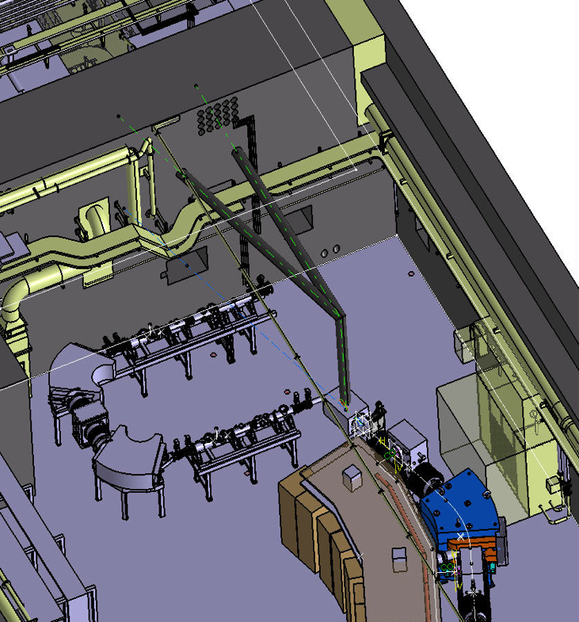
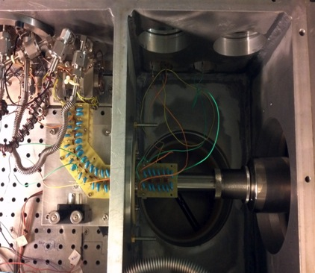
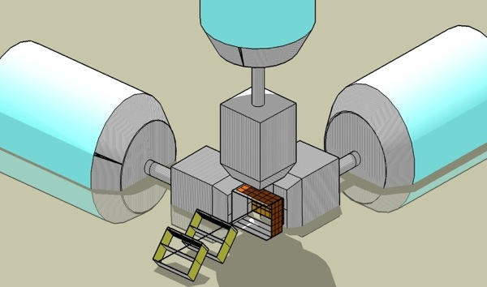
Basic Detection set-ups
Low energy branch
^{(LEUVEN, GANIL, IPNO, LPC…)}
Gas cell chamber
Implantation-decay station
extraction
HRS
10⁻² mbar
Identification
Station
(CSNSM, Ganil, IPHC, Irfu)
HRS
RFQ 90º
RFQ
extraction
DESIR
LASER BEAM
500 mbar
Pure Beam
10⁻⁵ mbar
S³
HRS or MRTOF
Emissive foils : Time of flight and tracking
Silion box :
  Energy
  Decay correlation
  α, p, e- spectroscopy
Ge detectors : gamma spectroscopy
cocktail
beam

Slide 20
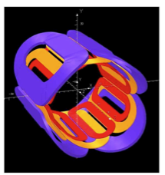
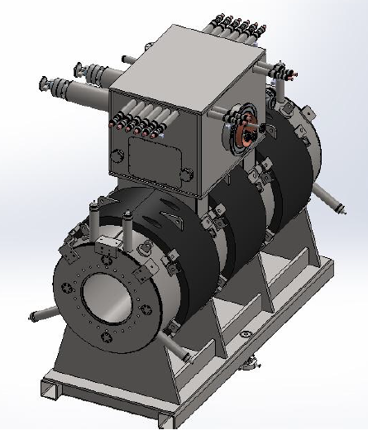

Superconducting Multipole Triplets

Slide 21



⁵⁸Ni + ⁴⁶Ti → ¹⁰⁰Sn + 4n
Simulations by F. Déchery (PhD thesis)
Bρ of evaporation residues, target and beam
(first stage selection)
Eρ of evaporation residues, target and beam
(second stage selection)
XY image at the beam dump

