Slide 1


Slide 2
Overview
What is Matter?
Hierarchies of Matter
Some Puzzles About Matter
Using Antimatter to Learn About Matter
Some Physics Topics to be Studies at PANDA
Very Brief Status of PANDA Detector
Summary/Conclusions

Slide 3
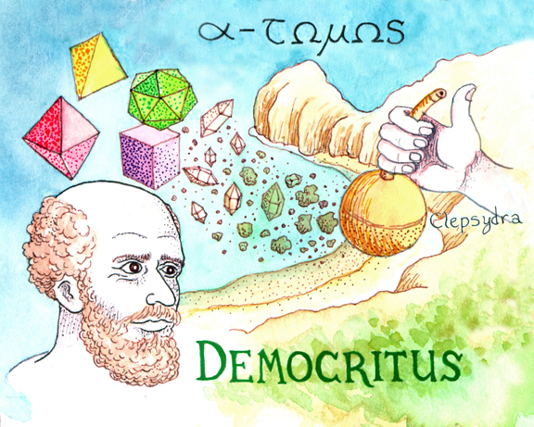
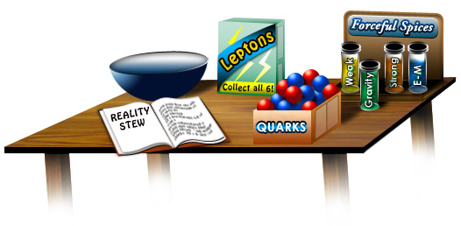
Matter and Forces
Democritus (~400 BC) postulated
that the world consists of particles
(Atoms) with nothing (vacuum) in
between them and forces.
Each type of atom has a few basic
properties (size, shape, mass).
Everything else (all complex structures) can
be reduced to those few simple properties.
This agrees surprisingly well
with our understanding today:

Slide 4
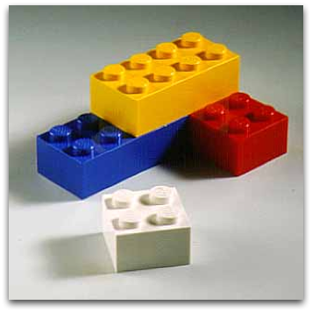
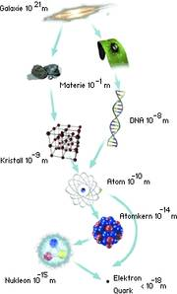
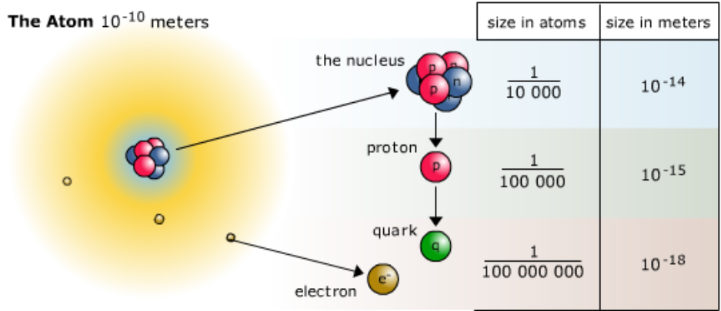
Reductionists View of the Hierarchy of Matter
The total is the sum of the parts
(think LEGOs) and how they interact.
This seems true at different scales,
but what happens at the first step??

Slide 5
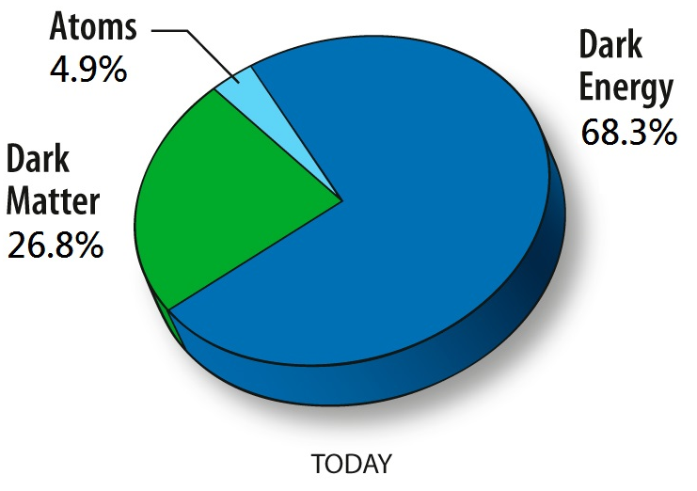
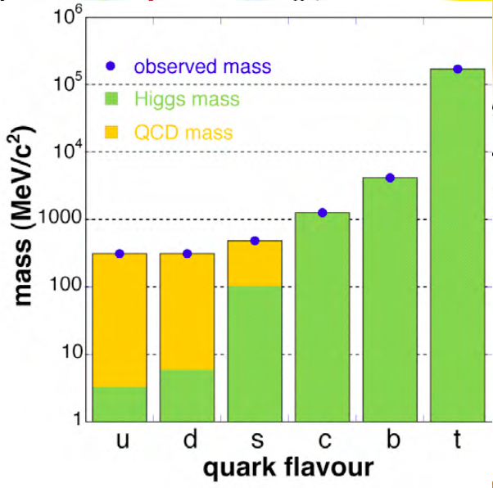
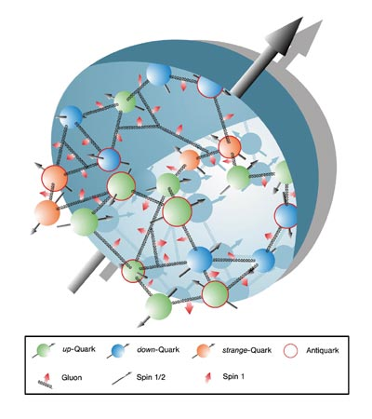
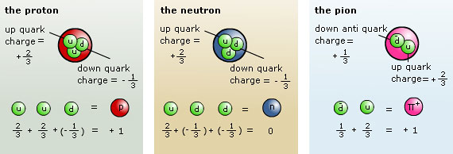
Puzzle One: Hadronic Mass
Visible matter is mostly atoms:
The total is the sum of the parts
True to ~10⁻⁸ for an atom
True to ~10⁻² for nuclei
Wrong by x100 for nucleons (protons and neutrons)!

Slide 6
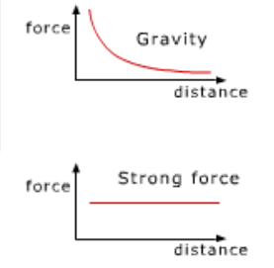

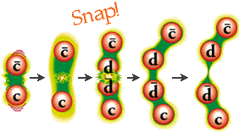
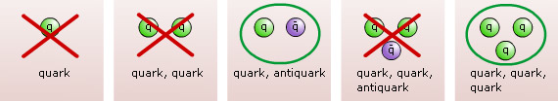
Puzzle Two: Why Only Some Types of Hadrons?
Strong force: only “color neutral” objects (confinement)
Mesons and baryons are color neutral

Slide 7
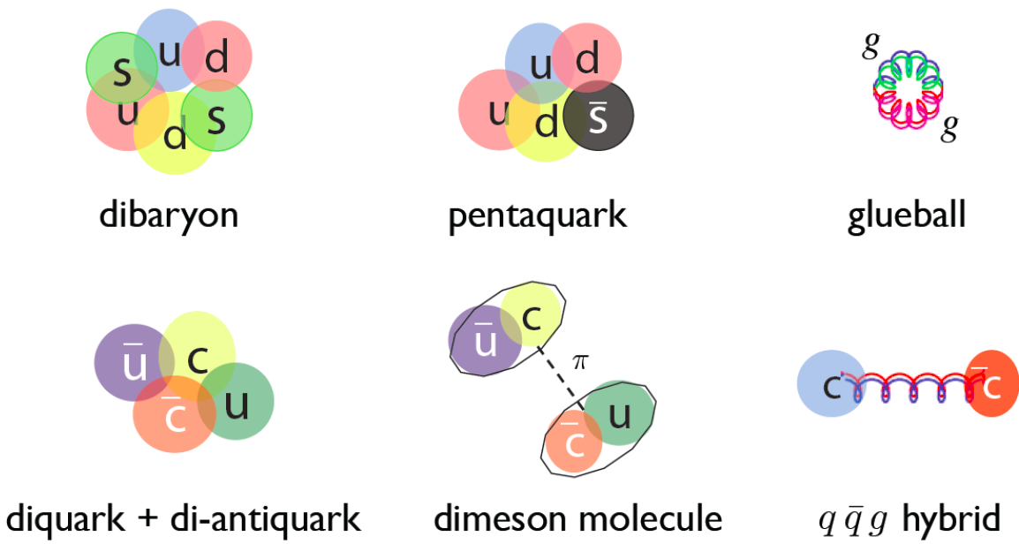
Puzzle Two: What About Other Combinations?
There are other ways to make color neutral objects:
Why do we see hundreds of mesons and baryons, but there is no undisputed proof of these other types?
Where are they, or if they are not there, then why?
(Zhu)

Slide 8
Puzzle Three: How are Properties of the
Whole Derived from the Constituents?
How do effective degrees of freedom emerge from the underlying theory (e.g. hadrons from quarks)?
What is the deep structure of
e.g. the nucleon?
How are its macroscopic properties
determined by partons?
Can we constrain theoretical approaches?

Slide 9
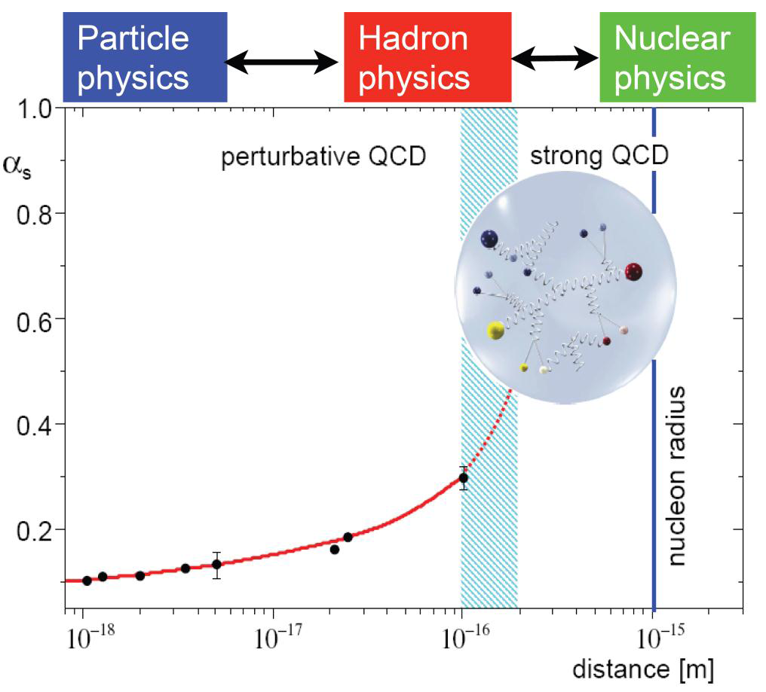
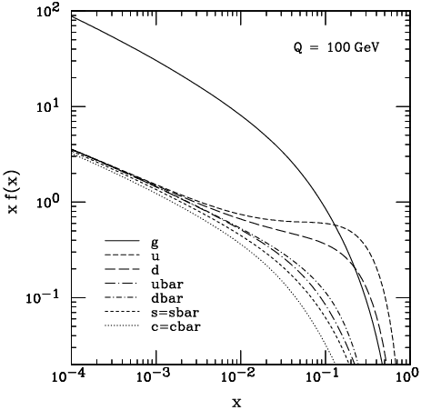
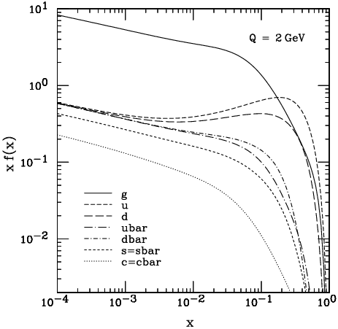
Hadron Physics with PANDA
QCD well understood at high Q²
Emergence of eff. DoF at low Q²
Phenomena appear that are hard
to predict from QCD:
e.g. confinement, nature of
hadrons, hadronic masses…
To gain further insight
precision experiments needed:
  Statistics
  Resolution
  Exclusiveness
J. Pumplin et al., JHEP 0207 (2002) 012

Slide 10
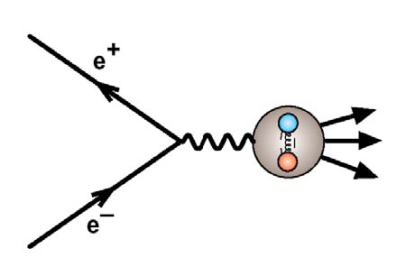
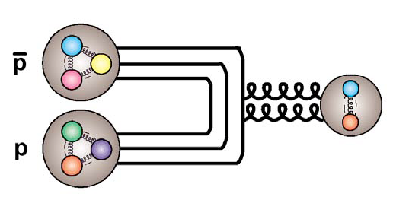
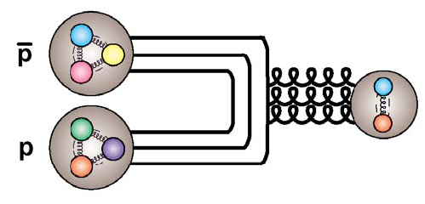
Why to Use Antiprotons ?
Annihilation is a gluon rich process
~2 GeV annihilation energy
“for free”
All fermion-antifermion quantum numbers accessible (compared to e⁺e⁻)
production reactions
Very high mass resolution in
formation reactions
High angular momentum accessible
J^{PC} = 1⁻⁻
J = 0, 2; C = +
J = 1; C = −

Slide 11
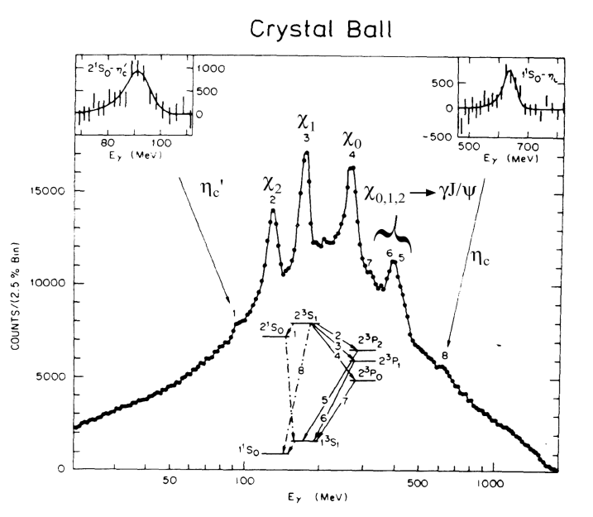
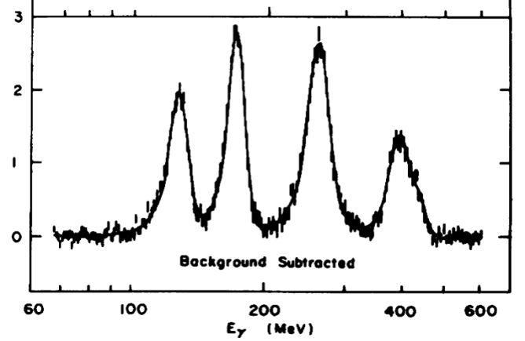
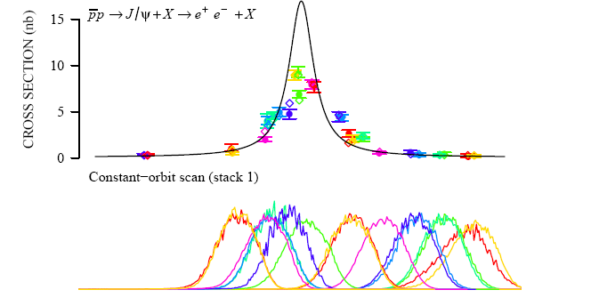

High Mass/Width Resolution, e.g.: χ_{c1,2}
Invariant mass reconstruction depends
on the detector resolution ≈ 10 MeV
Formation:
Resonance scan: resolution depends
on the beam resolution
E760@Fermilab ≈ 240 keV
PANDA ≈ 50 keV

Slide 12
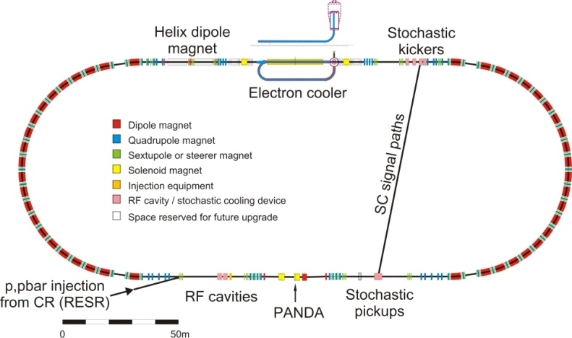
HESR Layout at FAIR
SPARC
Day-1
Main machine parameter
Momentum range 1.5 to 15 GeV/c
Circumference 575 m
Magnetic bending power 50 Tm
Dipole ramp 25 mT/s
Acceleration rate 0.2 (GeV/c)/s
Geometrical acceptances for β_{t} = 2 m
horizontal 4.9 mm mrad
vertical 5.7 mm mrad
Momentum acceptance ± 2.5×10⁻³
Jülich is leading lab for design and construction

Slide 13
_
PANDA Scientific Program
    Nucleon structure
    E.M. processes
    Meson spectroscopy
  light mesons
  charmonium
  exotic states
    glueballs
    hybrids
    molecules/multiquarks
  open charm
Baryon/antibaryon production
Charm in nuclei
Strangeness physics
  Hyperatoms
  S = -2 nuclear system
    Ξ⁻ nuclei
    ΛΛ hypernuclei
p Momentum [GeV/c]
0
2
4
6
8
10
12
15
ΛΛ
ΣΣ
ΞΞ
ΩΩ
DD
Λ_{c}Λ_{c}
Σ_{c}Σ_{c}
Ξ_{c}Ξ_{c}
Ω_{c}Ω_{c}
D_{s}D_{s}
qqqq
ccqq
nng,ssg
ccg
nng,ssg
ccg
ggg,gg
ggg
light qq
π,ρ,ω,f₂,K,K*
cc
J/ψ, η_{c}, χ_{cJ}
1
2
3
4
5
6
Mass [GeV/c²]

Slide 14
Hadron Structure with Electromagnetic Probes

Slide 15
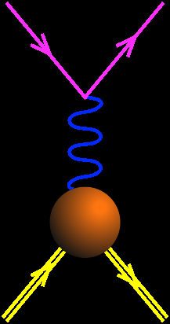
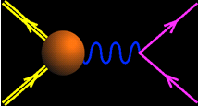
Time-Like & Space-Like EM Form Factors
Space-like
SL
Constraints:
G_{E}^{p}(0)=1
G_{M}^{p}(0)=μ_{p}
G_{E}^{p}(4m_{p}²)= G_{M}^{p}(4m_{p}²)
Asymptotics
|G_{E,M}(q²)| ~ (q²)⁻²
e⁻
e⁻
Time-like
TL
q²<0
p
e⁻
q²>0
p+p → e⁺+e⁻ + X
Unphysical region
p
e⁺
p
p
_
Real FFs
Complex FFs
_
e+p → e+p
0
3.52 (GeV/c)²
p+p ↔ e⁺+e⁻
q²
(Phragmén-Lindelhöf theorem)
Imaginary part of Time-Like form factors vanishes for q²→+∞

Slide 16
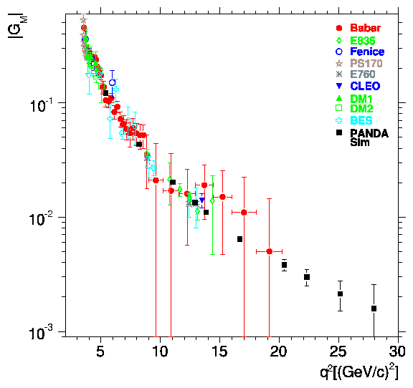
Time-Like Form Factor Measurement with PANDA : Estimates of Precision
L =2 fb⁻¹
Courtesy of S. Pacetti
Sudol et al. EPJA 44 (2010) 373
E. Tomasi-Gustafsson and M.P. Rekalo, PLB504,291
E. Tomasi-Gustafsson, arXIv:0907.4442
G_{eff}
PANDA
PANDA
BES
BES
< 1% ~10% ~23% ~50%
pQCD ?
Phragmèn-Lindelöf theorem ?
Notes:
In this publication, we also evaluate the precision on the form factor measurement that will be achieved with PANDA and compare it to the existing data. The ratio of electric to magn FF can be measured up to 14 GeV/c2 from an analysis of the angular distributions with a good precision. This will improve very much the present experimental situation. In addition, it will allow to discriminate among models which are all able to reproduce the Geff and also the space like data, but give different predictions for the ratio GE/GM. Here we see for example the Iachello model in green, which predicts a very strong electric form factor.
Cross-sections and therefore the effective form factor can be measured with good precision up to 30 GeV/c2, which is the maximum available q2 at PANDA.

Slide 17
Hadron Spectroscopy with Antiproton Annihilation

Slide 18
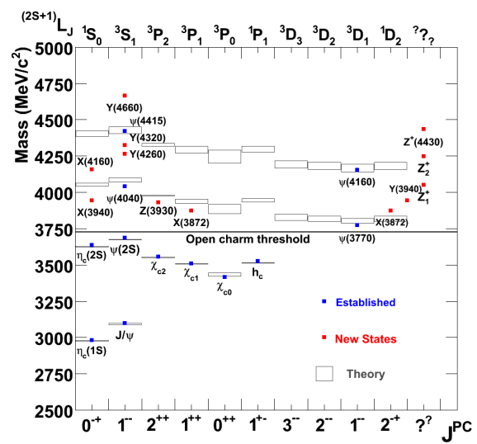
Charmonium Spectroscopy
New observations: We must go beyond simple quark models
new „XYZ“ states (Belle, BaBar, CLEO, CDF, D0, LHCb …)
  masses are poorly known;
  often widths are just upper limits;
  few final states have been studied;
  statistics are poor;
  quantum number assignment is possible for few states;
  some resonances need confirmation…
new degrees of freedom: molecules, tetraquarks, gluonic excitations?
open questions below DD threshold widths, branching
conventional states above DD
high L states:
access in pp but not in e⁺e⁻
_
_
_

Slide 19
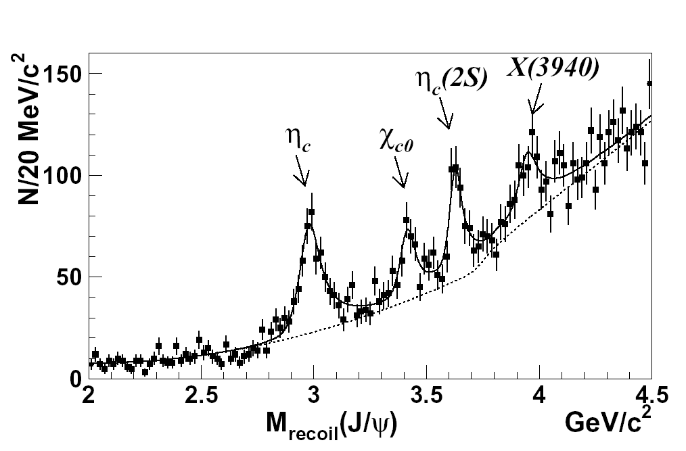
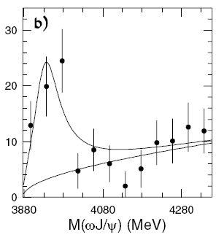

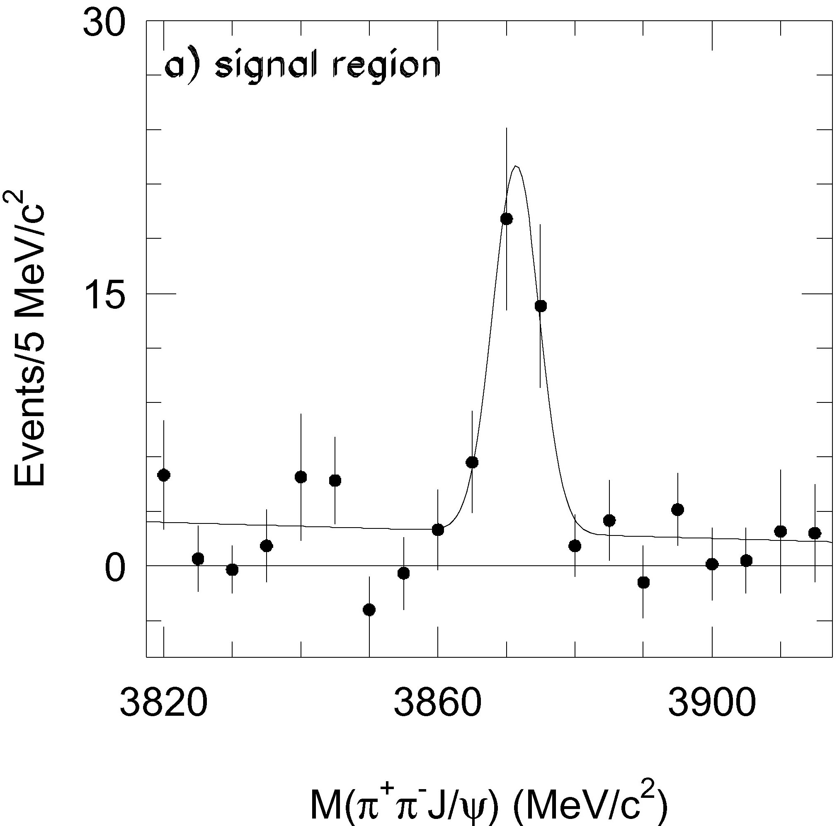
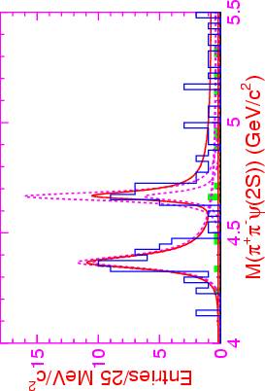
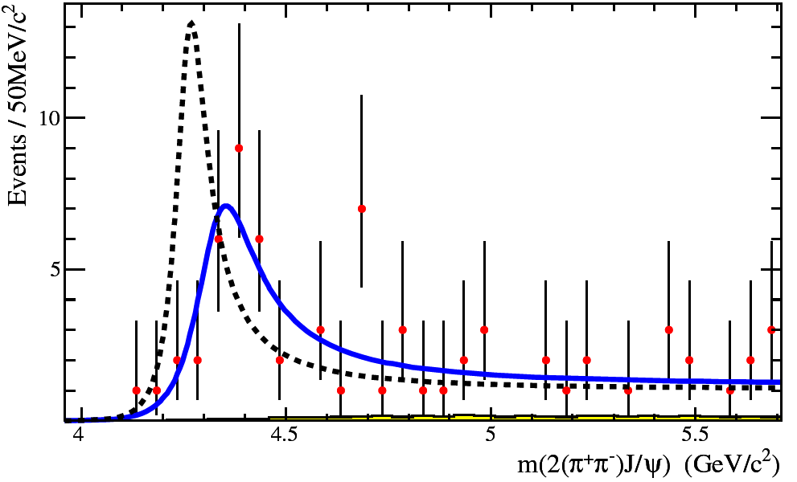
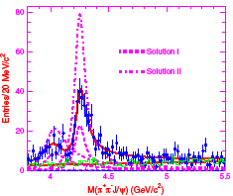
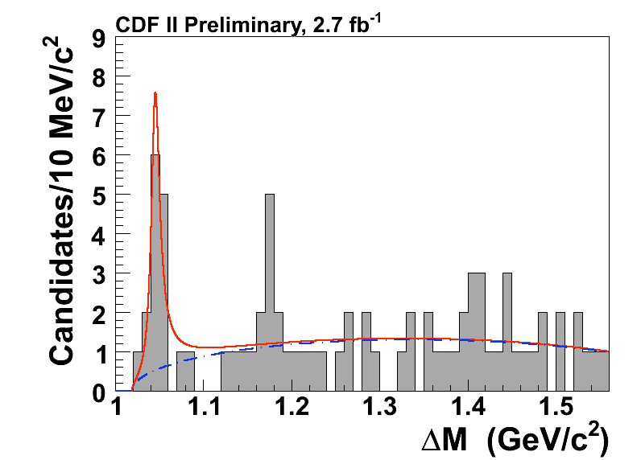
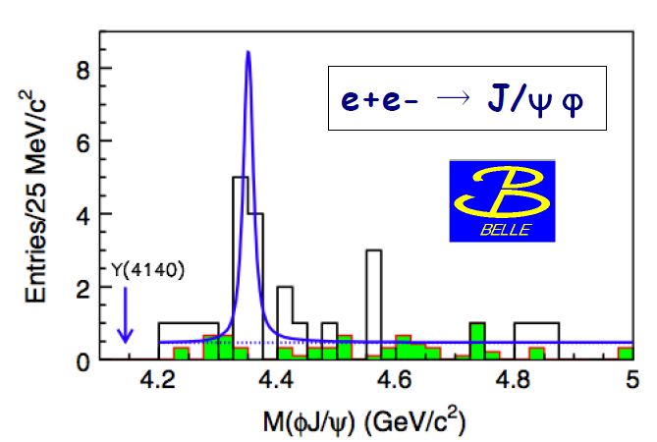
New Charmonium-like Discoveries
X(3872) PRL 91,262001 (2003) | X(3940) PRL 98,082001 (2007) | Y(3940) PRL 94,182002 (2005) | X(3915) PRL 104,092001 (2010)
Y(4260) PRL 95,142001 (2005) | Y(4350) PRL 98,212001 (2007) | Y(4008) PRL 99,182004 (2007) | Y(4660) PRL 99,142002 (2007)
Z(4430)⁻ PRL 100,142001 (2008) | Z₁⁻ & Z₂⁻ PRD 78,072004 (2008) | Y(4140) PRL 102,242002 (2009) | X(4350) PRL 104,112004 (2010)
in addition to many more open charm states
Notes:
Alle anderen Zustaende, die in den letzten Jahren entdeckt wurden und diskutiert werden, habe ich hier zusammengestellt und werde sie nicht einzeln vorstellen …

Slide 20
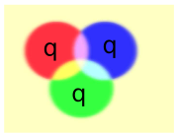
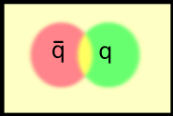
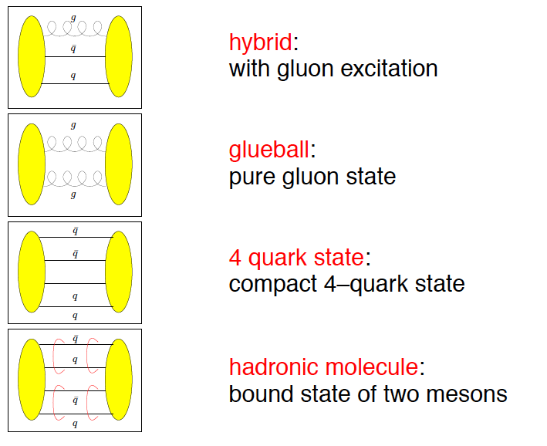
Beyond standard quark configurations
QCD allows much more than what we have observed:
Baryons
Mesons
Exotics:
may have J^{PC} not
allowed for qq
_
Courtesy C. Hanhart

Slide 21
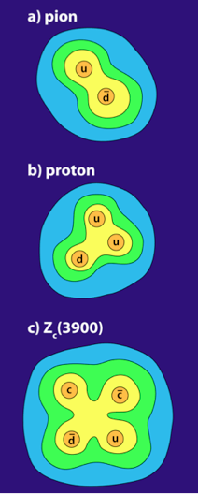
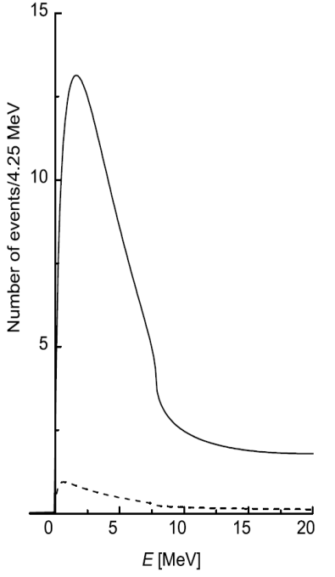
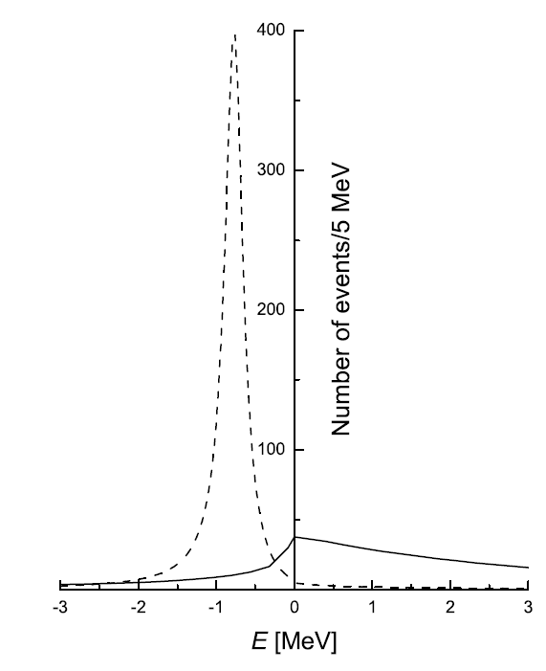
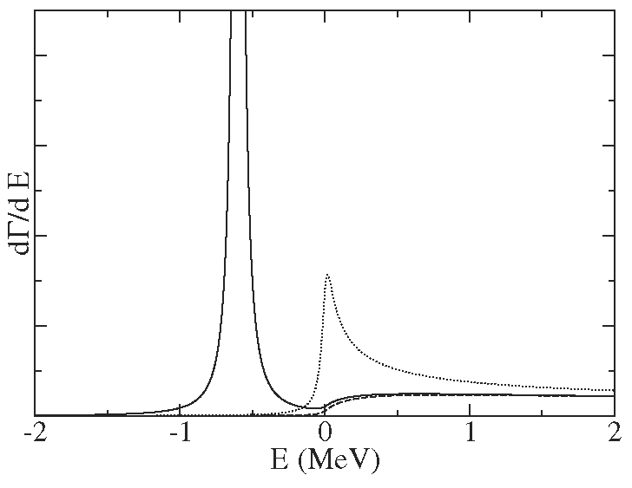
How can PANDA contribute?
J/ψπ⁺π⁻, J/ψπ⁰π⁰, χ_{c}γ → J/ψγγ, J/ψγ, J/ψη, η_{c}γ
direct formation in pp: line shapes !
Exotics: compare formation with production
d target: pn with p spectator tagging, e.g. Z⁻(3900)
_
_
D⁰D^{*0}
D⁺D^{*-}
_
D⁰D⁰π⁰
E. Braaten, M. Lu,
PRD 77 (2008) 014029
J/ψππ
D⁰D^{*0}
peak
cusp
virtual state
binding state
C. Hanhart et al.,
PRD 76 (2007) 034007
Compare lineshapes
in different final states!

Slide 22
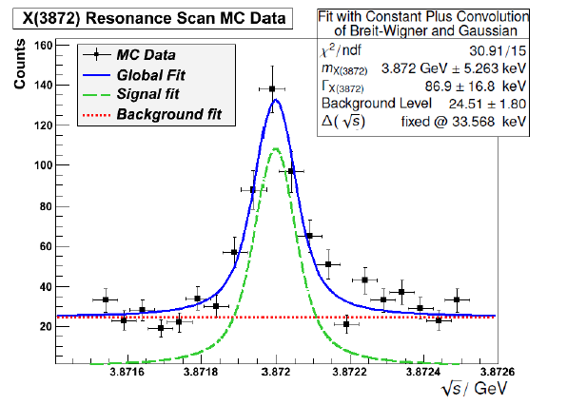
X(3872)
Upper limit on the branching ratio by LHCb
BR(X→pp) < 0.002*BR(X→J/Ψπ⁺π⁻)
And BR(J/Ψπ⁺π⁻) > 0.026 [pdg12]
Implies:
σ(pp→X(3872)) ~ (67 +- ?) nb
_
Γ < 1.2 MeV
_
Here: assume σ=50 nb
“Low lumi” – mode 2x10³¹
Mass resolution < 100 keV
M. Galuska

Slide 23
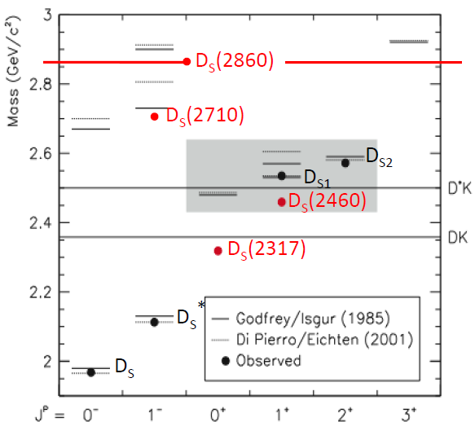
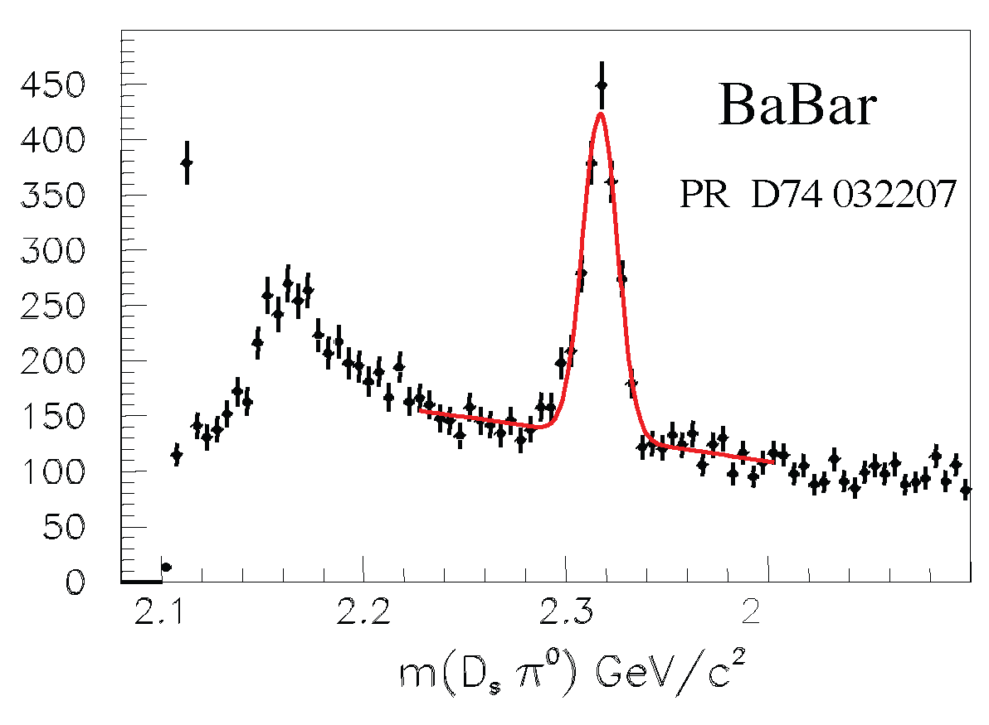
Open Charm: The D_{s} Spectrum
Th./expt. in qualitative agreement for D states, but some details open
Many new D_{J} mesons (LHCb)
new narrow states (2003):
D_{s}*(2317) and D_{s}*(2460) , (and other broad states more recently)
masses significantly lower than quark model expectation, and just below DK and D*K threshold
Widths are only upper limits
Interpretation unclear: DK / D*K molecules, tetraquarks, chiral doublers, …? Sensitive to width

Slide 24
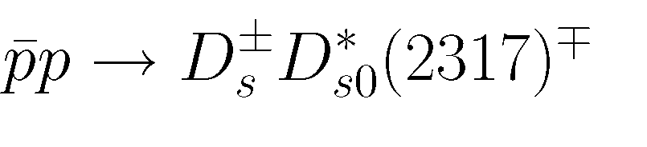
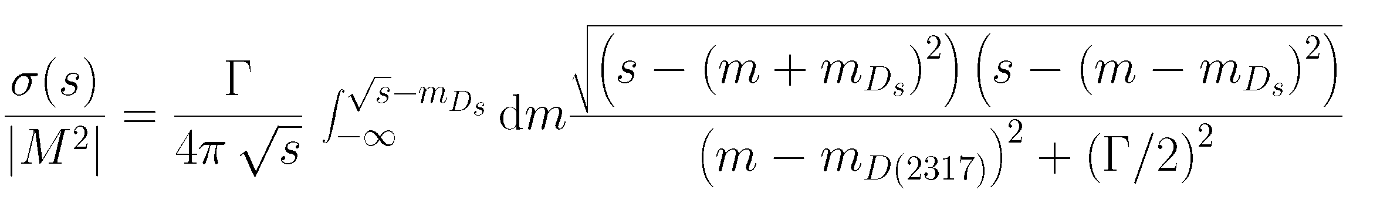
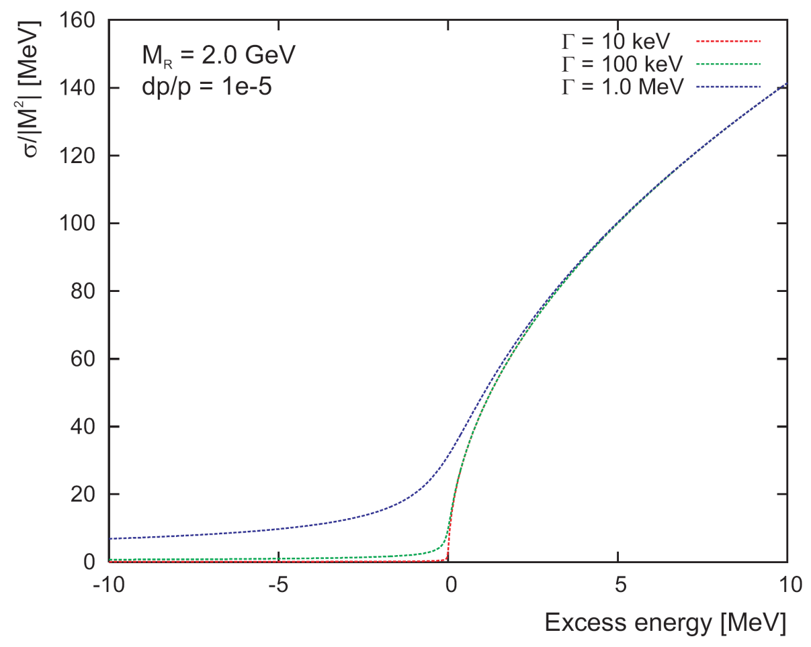
Method: Threshold Scan
reaction:
excitation function only depends on m and Γ of D_{s}(2317)
experimental accuracy determined by beam quality (Δp, σ_{p}/p), not by detector resolution

Slide 25
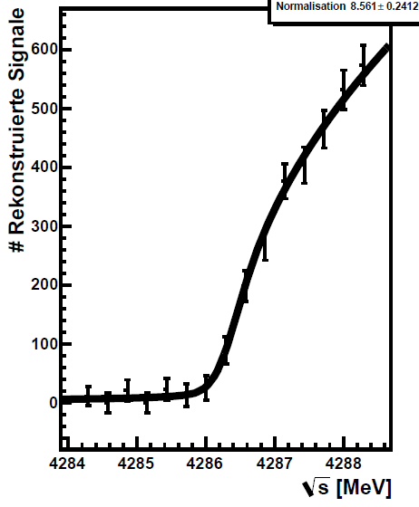
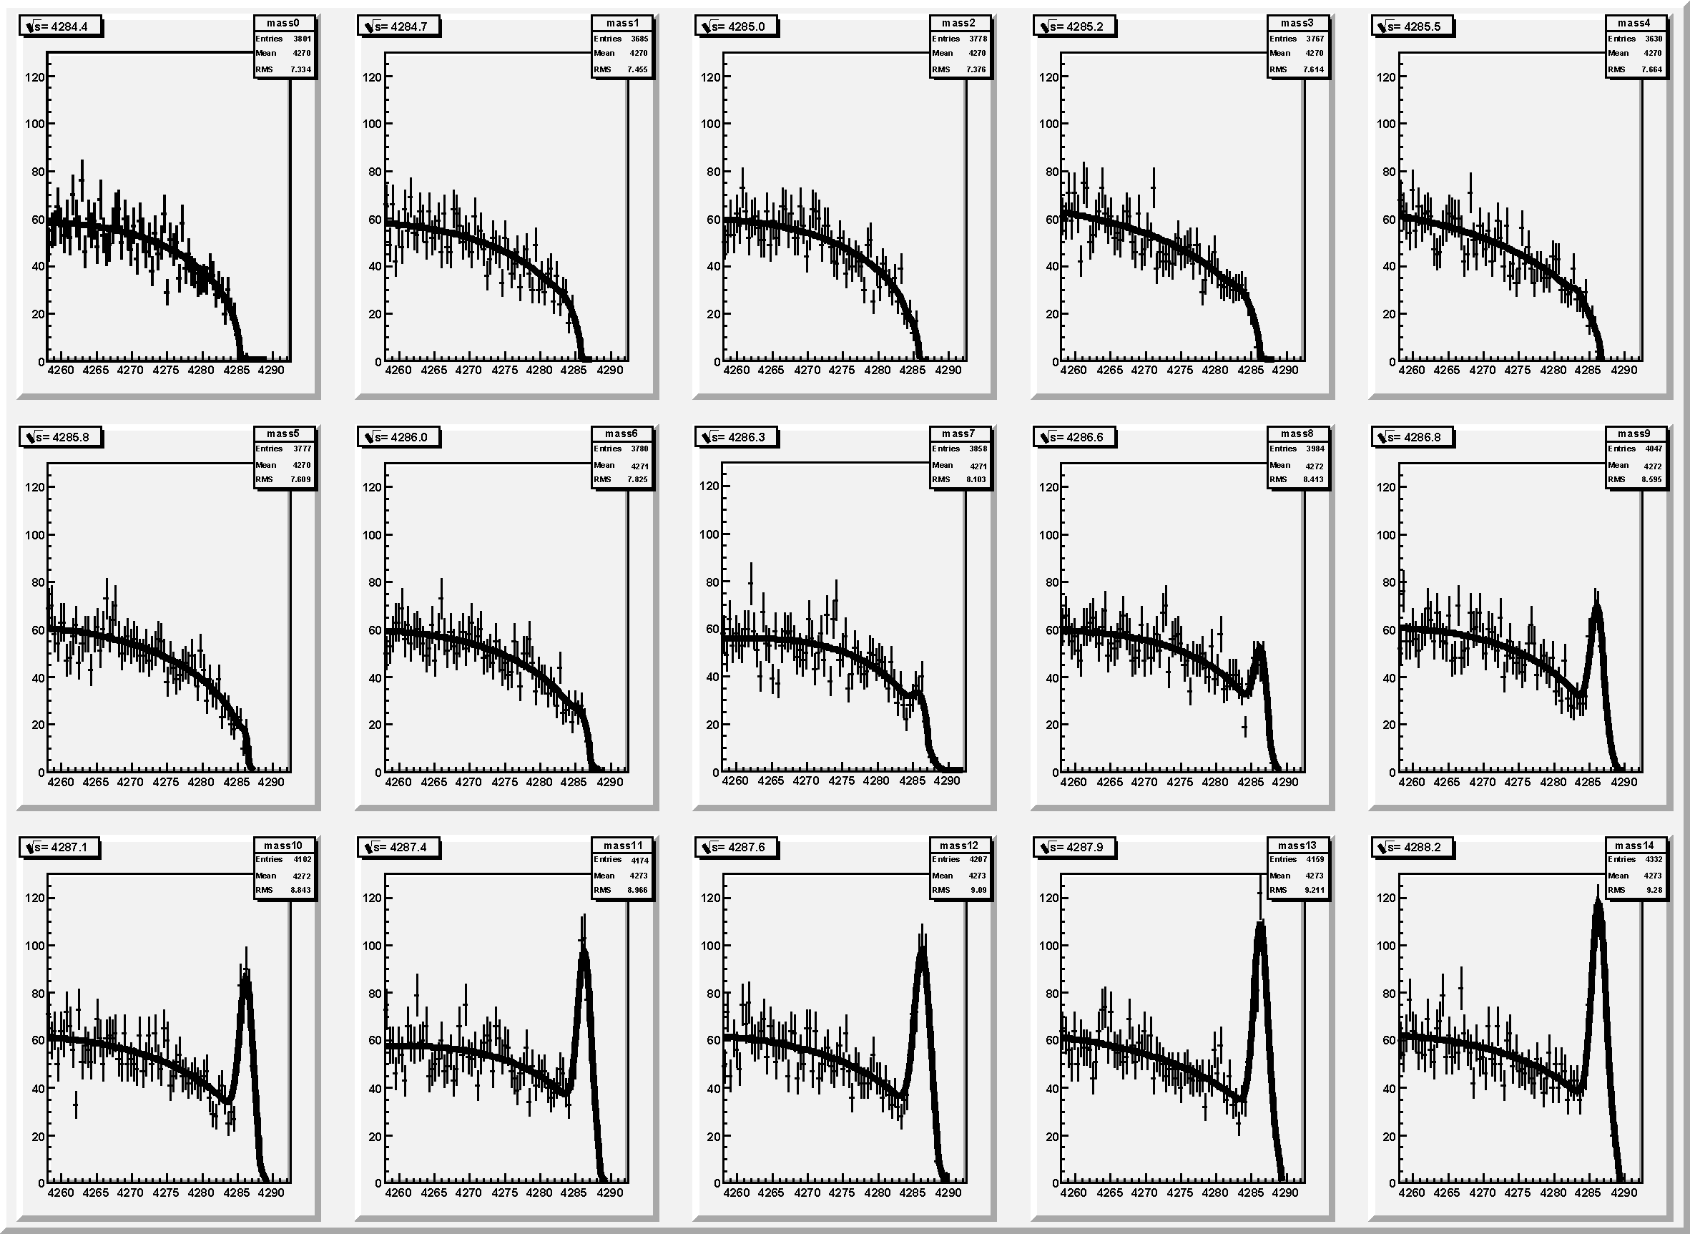


Simulation Results: Energy Scan
M_{sum} = M_{miss}(D_{s}) + M(D_{s})
Γ = 100 keV

Slide 26
Baryon-Antibaryon Spectroscopy

Slide 27


Baryon Spectroscopy
_
significant fraction of pp cross section into final state B B + mesons
almost nothing known on excited states of Ξ or Ω hyperons
σ(pp → ΞΞ) ≈ μb
σ(pp → ΩΩ) ≈ 0.1 μb
_
Ξ∗ : 1 ∗∗∗∗
_
_
_
_
Ω∗ : 0 ∗∗∗∗
Quark Model: B. Metsch et al.

Slide 28


Ξ* detection with PANDA
characteristic event topology
σ ~ μb: ~10⁷ Ξ /d produced
final states to be studied: Ξ* → Ξ π, Ξ η, Λ K, Σ K, Ξ(1530) π, Ξ π π, …
benchmark channel: 6.57 GeV/c p p → Ξ⁻ Ξ⁺ π⁰
no empty regions or discontinuities in Dalitz plot
_
_
_
_

Slide 29
A Few Words to the Detector

Slide 30





Target and Charged Particle Tracking
Target
Solenoid
Dipole
MVD
STT
Forward
Tracker
Luminosity
Detector
GEM

Slide 31


PID and Calorimetry
ECAL
HCAL
EMC
RICH
Muon
DIRC
DISC-
DIRC
SciTil-
TOF

Slide 32
The Computing Challenge

Slide 33
Event Structure
2 · 10⁷ events/s
2000 ns revolution time
40 events per Burst
400 ns gap
Time based simulation by T. Stockmanns

Slide 34

Hitstream Display:
XY-View
Dual Parton Model (DPM):
Standard pp background generator
  Black circles: Early isochrone
  Blue circles: Early skewed isochrone
  Green circles: Close isochrone
  Red circles: Late isochrone
  Black dots: MVD hits
  Green dots: MVD hits r/z > 0.3
  Black+Red dots: Triplets/Skewlets
  Yellow tracks: Timed out track
  Blue tracks: Current track
  DPM Benchmark:
  Realistic event rate
  and structure,
  continuous operation

Slide 35
Summary/Conclusions
Many open questions on how complex structures are derived from underlying degrees of freedom
Hadrons represent the 1st level of complexity
Antiprotons provide precision measurements
Broad/fascinating physics program at PANDA
Accelerator and detector are on track
We want data!

Slide 36


The PANDA Collaboration
~ 520 Members, 69 Institutes, 18 Countries
Austria, Australia, Belarus, China, France,
Germany, India, Italy, Poland, Romania,
Russia, Spain, Sweden, Switzerland,
Thailand, Netherlands, USA, UK

