Slide 1
Quest for spontaneous time-reversal symmetry breaking in atomic nuclei
Ernest Grodner
University of Warsaw

Slide 2
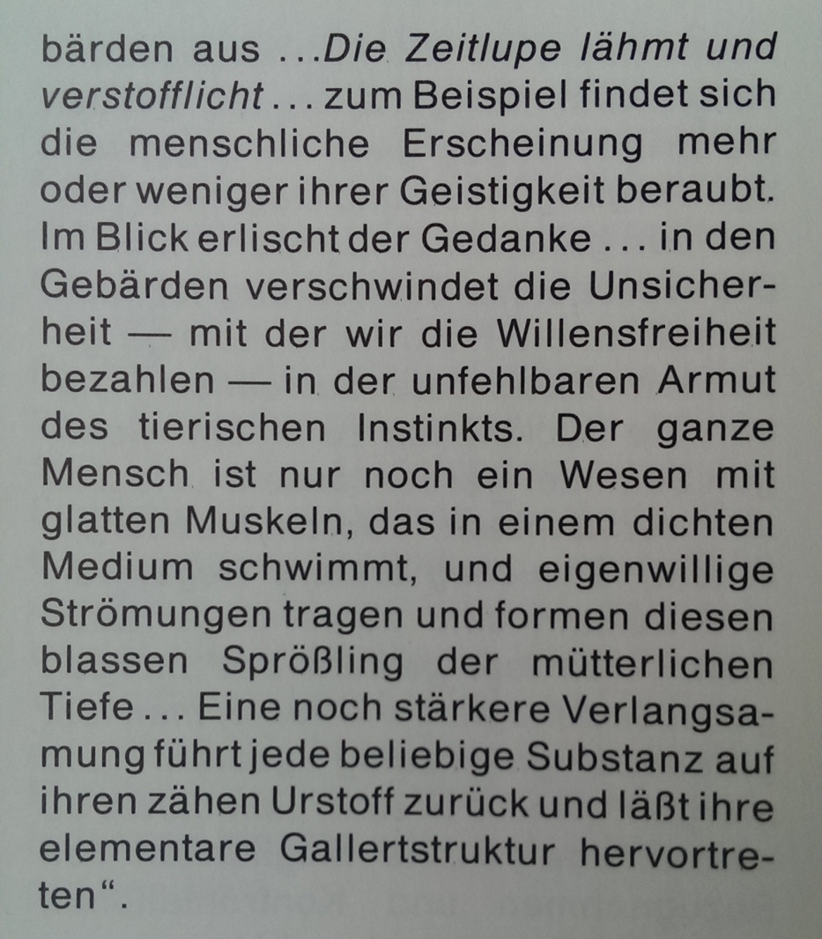
Hollywood physics
…Slow-motion paralizes and materializes …
For example an appearence of a humankind
seems to be more or less
robbed of its spitiruality….
„DuMonts’s Lehrbuch der Filmgestaltung”, Pierre Kandorfer, 1987,
DuMont Buchverlag, Koln.

Slide 3
Hollywood physics
t
t’=t/γ
V=dx/dt
V’=dx/dt’
t’=t/γ
t
V =V’/ γ
a=a’/ γ²
m→m’

Slide 4
Hollywood physics
a
γ² a=a’
ma
m’a’
ma=m’a’
m= γ²m’
implications
Momentum:
γmv=m’v’
Energy (rest mass):
mv ² =m’v’ ²
mc ² =m’c’ ²

Slide 6
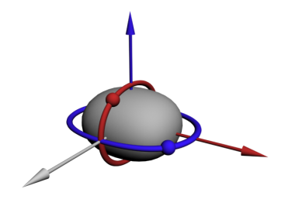
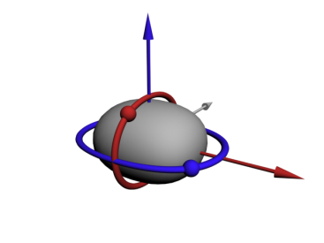
Spontaneous T-reversal

Slide 7
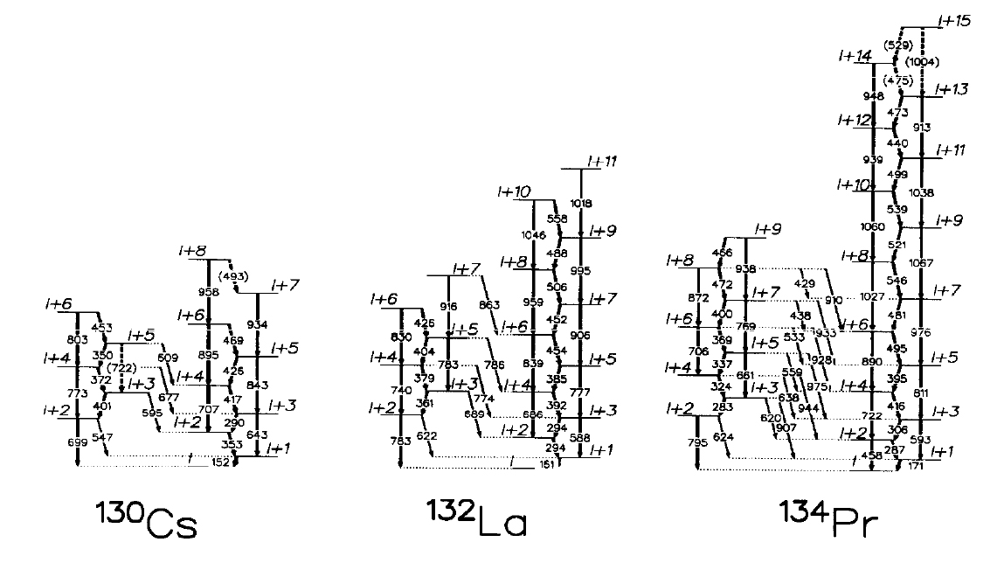
Breaking of the chiral symmetry
EXAMPLES OF THE PARTNER BANDS

Slide 8
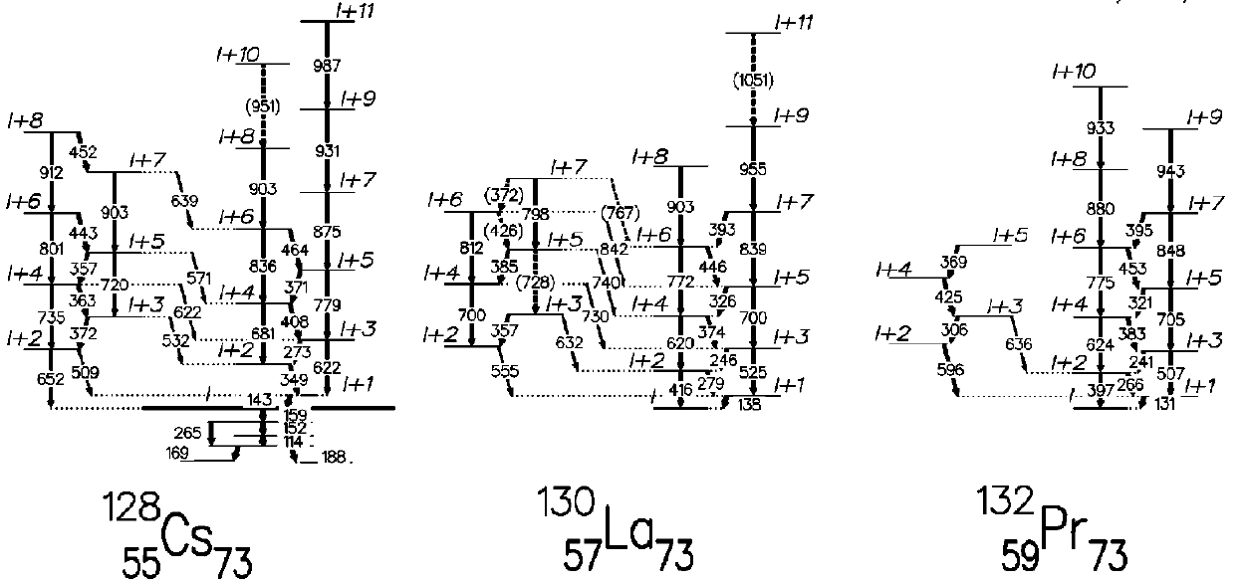
Breaking of the chiral symmetry
EXAMPLES OF THE PARTNER BANDS

Slide 9
We are twice lucky
ENERGIES AND TRANSITION PROBABILITIES
Energy
Doubling of energy levels.
Chiral doublets
Chiral partner bands
Transition probability
Doubling of transition probabilities.
The same electromagneti behavior
of two partner bands.

Slide 10
Chiral partner bands Cs, La
Lifetime results from the DSA experiments –warsaw cyclotron
Partner bands populated in fusion evaporation reaction
M1 interband transitions yrast->side observed in ¹²⁶Cs
Energy separation in Cs Isotopes around 150 keV
configuration
E.Grodner. et al.,
Partner bands of ¹²⁶Cs – first observation of chiral electromagnetic selection rules
Phys. Lett. B703 (2011) 45
E.Grodner. et al.,
¹²⁸Cs as the best example revealing the chiral symmetry breaking phenomenon
Phys. Rev. Lett. 97 (2006) 172501

Slide 11
¹²⁴Cs level scheme
KNOWN SPIN AND PARITIES
A. Gizon et al..
Nucl. Phys. A694, 63, (2001)
E.Grodner. et al.,
DSA lifetime measurements of ¹²⁴Cs and the time-reversal symmetry
Submitted to J.Phys. Conf. Series (2012)

Slide 13
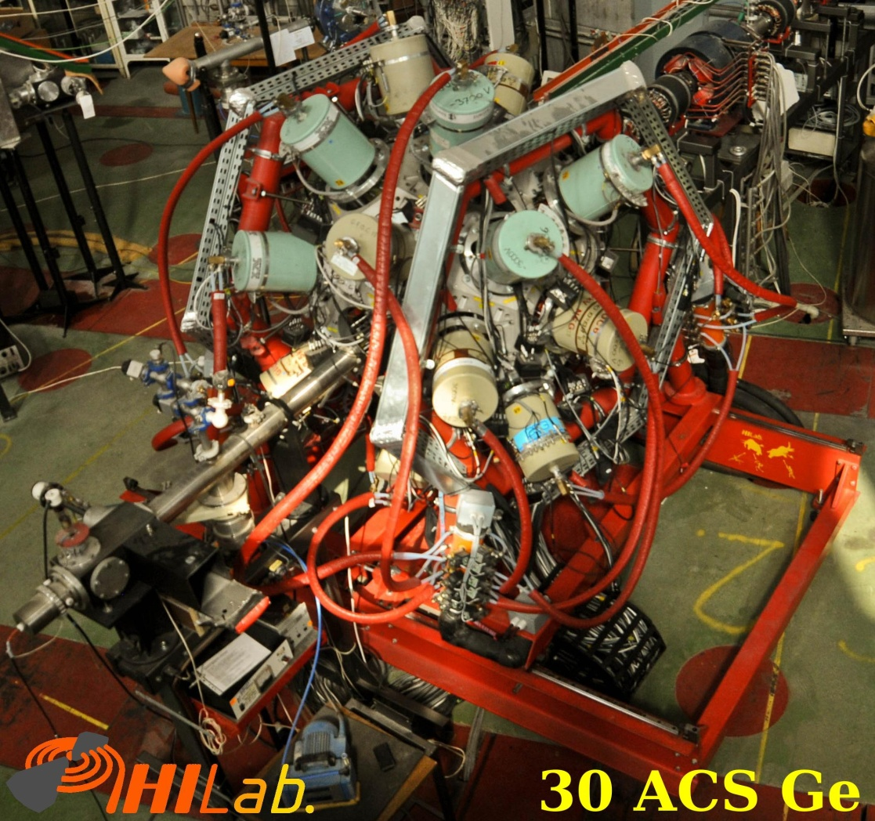
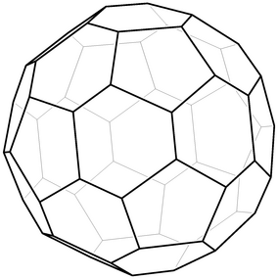
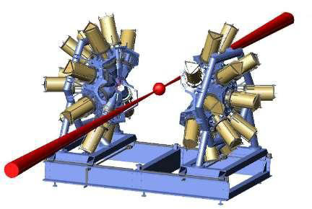
EAGLE array
J.Mierzejewski et al.,
Nucl. Instr. and Meth. A 659, 84 (2011)

Slide 14
EAGLE campaign 2011-2013.
Study of electromagnetic properties.
Lifetime mesurements in 1ps ragne.
Chiral gamma selection rules
Two DSA experiments in the period of March, 2011 – May, 2013
Beam time 12 days, March 2012
Beam time 12 days, May 2013

Slide 15
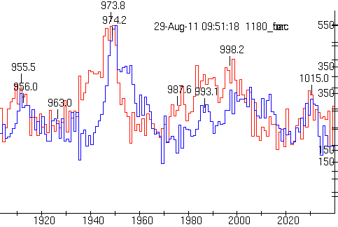

Slide 16
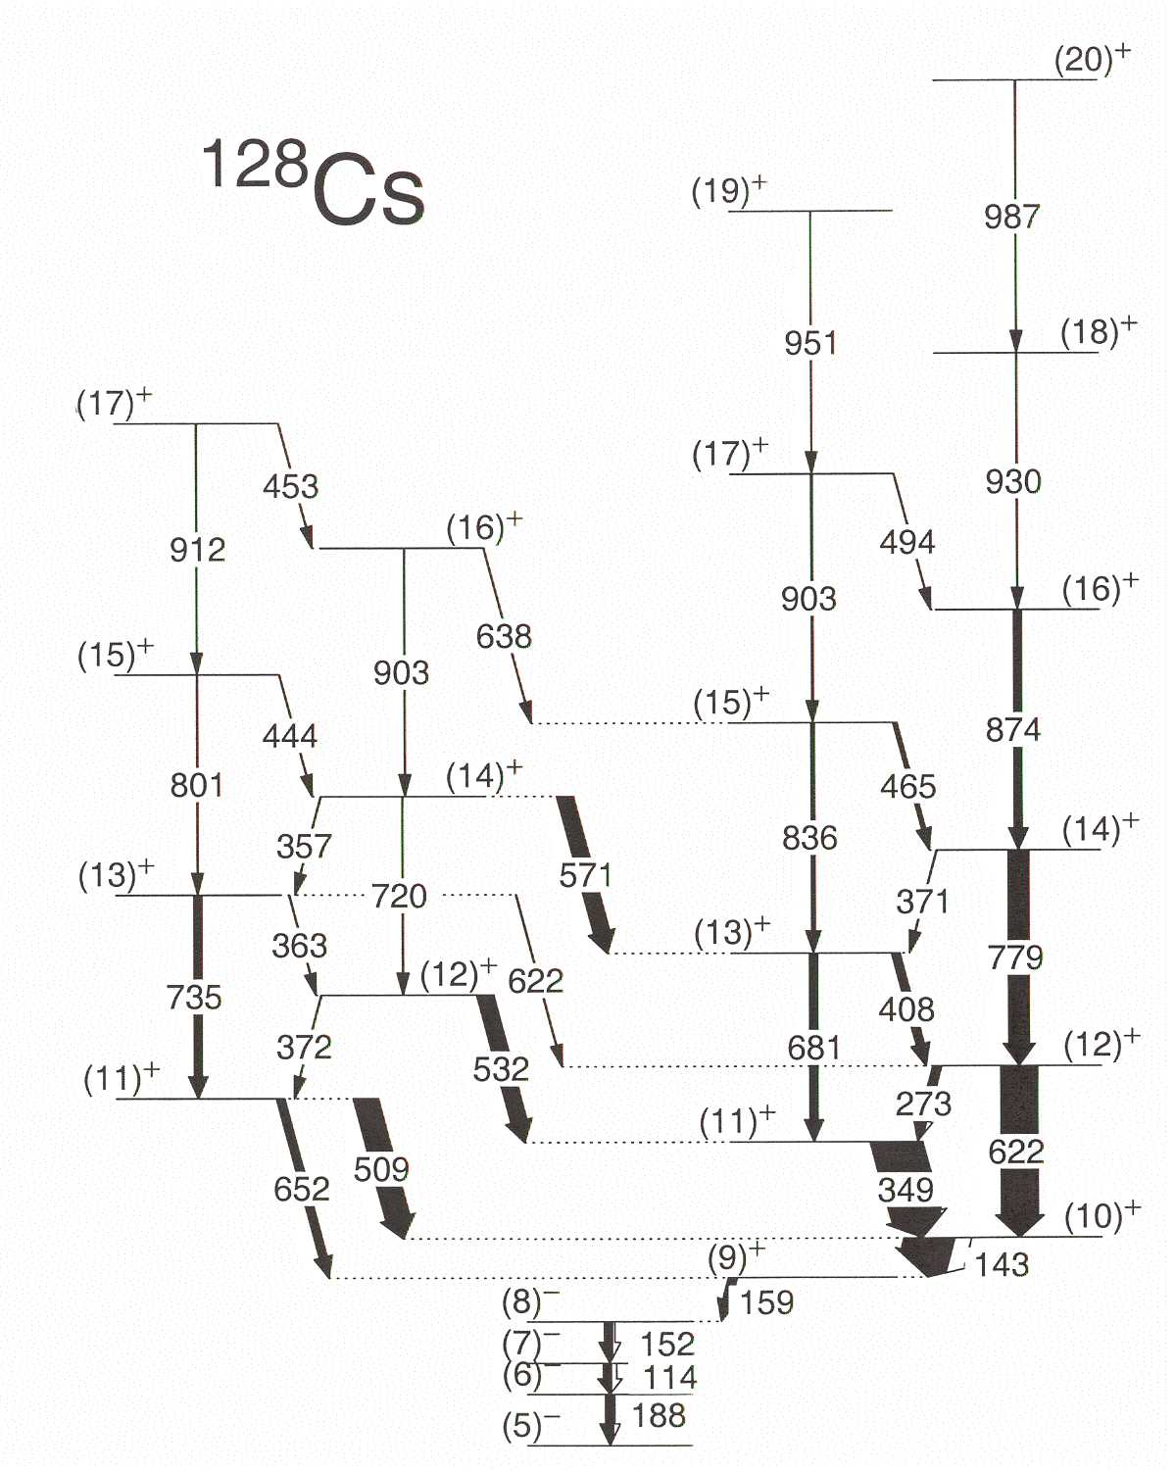
Data analysis process
FIT TO EXPERIMENTAL DATA
forward
backward

Slide 17
Data analysis process
FIT TO EXPERIMENTAL DATA

Slide 18
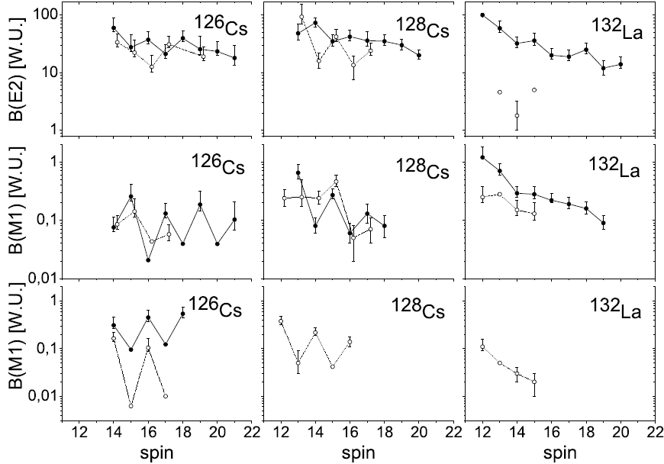
Transition probabilities
chiral
chiral
Not chiral

Slide 19
¹²⁴Cs

Slide 20
New S-symmetry
Def. potential
triaxial
γ soft
oblate
prolate
γ deformation
γ=30

Slide 21
Nuclear microscope for T-symmetry
Doublet states as a magnifier of the fundamental T-symmetry breaking.
Quest for parity violation
Barry R. Holstein „Weak interactions in nuclei” Princeton Series in Physics (1989)

Slide 22
Collaboration
E. Grodner T. Morek, Ch. Droste, M. Kowalczyk,
J. Mierzejewski, T. Marchlewski, R. Szenborn
Institute of Experimental Physics, Warsaw University, Warsaw, Poland
A. A. Pasternak
A. F. Ioffe Physical Technical Institute RAS, St. Petersburg, Russia
S. G. Rohoziński, L. Próchniak,
J. Dobaczewski, W. Satuła
Institute of Theoretical Physics, Warsaw University, Warsaw, Poland
J. Kownacki, M. Kisieliński, P. Napiorkowski, J. Srebrny
Heavy Ion Laboratory of Warsaw University, Warsaw, Poland

Slide 23
Transition probabilities ¹²⁸Cs
Transition probabilities similar in both bands
Inband transition strong => interband weak (vice-versa)
Imaginary
interband
B(M1) staggerings correspond to ideal case of chirality:
1)TRIAXIALITY γ=-30°
2)THREE ANGULAR MOMENTUM VECTORS PERPENDICULAR
3)2qp SIGLE-J SHELL CONFIGURATION
Real
inband
T. Koike et al.,
Phys. Rev. Lett. 93, 172502-1 (2004)
Yrast -> side
transitions not observed

Slide 24
Chirality vs. Structural composition
3qp configuration
Single-j configuration
2qp configuration
Triaxiality γ=30°
S.Mukhopadhyay et al.,
Phys. Rev. Lett. 97 (2007) 172501
Nonaxial deformation
γ=-40°
B(M1) yrast->yrast
γ=-20°
Ch. Droste, S.G. Rohoziński,
K. Starosta, L. Próchniak
Sequential CQPC calculation
T. Suzuki et al.,
Phys. Rev. C78 (2008) 031302(R)
B(M1) side->yrast
Different-j shell configuration

Slide 25
B(M1) staggerings correspond to ideal case of chirality:
1)TRIAXIALITY γ=-30°
2)THREE ANGULAR MOMENTUM VECTORS PERPENDICULAR
3)2qp SIGLE-J SHELL CONFIGURATION
T. Koike et al.,
Phys. Rev. Lett. 93, 172502-1 (2004)
1)What about gamma softness?
2) What about spin precession?

Slide 26
Chirality in particle physics
chiral symmetry
breaking consequence
There are no righthanded massles particles
Left-handed lepton and neutrino form SU(2) doublet
Right-handed lepton form SU(2) singlet

Slide 27
Time - quantum illusion?
Coherent
decoherence
Illusion of time
Appears by separating a component
from the system
DECOHERENCE

Slide 28
Collaboration
E. Grodner, I. Zalewska, T. Morek, J. Srebrny, Ch. Droste,
M. Kowalczyk, J. Mierzejewski
Institute of Experimental Physics, Warsaw University, Warsaw, Poland
A. A. Pasternak
A. F. Ioffe Physical Technical Institute RAS, St. Petersburg, Russia
S. G. Rohoziński, J. Dobaczewski, P.Olbratowski,
W. Satuła
Institute of Theoretical Physics, Warsaw University, Warsaw, Poland
J. Kownacki, M. Kisieliński, P. Napiorkowski
Heavy Ion Laboratory of Warsaw University, Warsaw, Poland

Slide 29
Conclusion
FIRST EXPERIMENTAL CONFIRMATION OF COMPLETE SET OF CHIRAL GAMMA SEL. RULES
Transition probabilities similar in both bands
Inband B(M1) staggering observed
Interband B(M1) staggering with opposite phase observed
¹²⁶CS
TWO GENERAL FEATURES OF GAMMA TRANSITION PROBABILITIES
CHIRALITY
Similar electromagnetic properties of both of the bands
Inband transition strong=>interband weak (vice-versa)
Characteristic B(M1) staggerings
STRUCTURAL COMPOSITION
NEW TERM
To distinguish the nuclear phenomenon
from the one in theory of fundamental interactions
SPIN-CHIRALITY

Slide 30
Transition probabilities ¹²⁶Cs
First experimental confirmation of the full set of chiral electromagnetic selection rules
B(E2) transition probabilities similar in both bands
B(M1) transition probabilities similar in both bands
B(M1) staggering observed for M1 inband transitions
B(M1) staggering observed for M1 interband transitions
in both directions: side->yrast & yrast ->side
Interband B(M1) staggering has an opposite phase to the inband one
Similar electromagnetic behavior
of both bands
Well separated left- and right-handed states
Strong triaxial deformation
Angular mommentum vectors mutually perpendicular
Partner bands built on 2qp single-j shell configuration
CHIRALITY
The corresponding Hamiltonian has additional invariances
and correspodning quantum numbers
Staggering of the B(M1) values
STRUCTURAL COMPOSITION

Slide 31
Collaboration
E. Grodner, I. Zalewska, T. Morek, J. Srebrny, Ch. Droste,
M. Kowalczyk, J. Mierzejewski
Institute of Experimental Physics, Warsaw University, Warsaw, Poland
A. A. Pasternak
A. F. Ioffe Physical Technical Institute RAS, St. Petersburg, Russia
S. G. Rohoziński, J. Dobaczewski, P.Olbratowski,
W. Satuła
Institute of Theoretical Physics, Warsaw University, Warsaw, Poland
J. Kownacki, M. Kisieliński, P. Napiorkowski
Heavy Ion Laboratory of Warsaw University, Warsaw, Poland

Slide 32
Intrinsic states (symmetry breaking)
NONRELATIVISTIC SCHROEDINGER EQUATION
TIME REVERSAL T
T-SIGNATURE R_{Y}^{T} =R_{Y}T
A. Bohr, B. Mottelson
Nuclear Structure
W.A. Benjamin (1969)

Slide 33
Laboratory states
ELECTROMAGNETIC MATRIX ELEMENTS
Inband transition probabilities
Identical in both bands
Interband transition probabilities
Identical in both bands

Slide 34
Experimental transition probabilities
chiral
chiral
Not chiral

Slide 35
Data analysis process
A.A. PASTERNAK - MONTECARLO SIMULATIONS
Apparatus lineshape
Entry-states distribution
GAMMA
Initial velocity distribution
Stopping power
Known level scheme
Time-velocity correlation
Side-feeding simulation
SHAPE
Feeding time distribution
beam
recoil
COMPA
target
lifetime

Slide 36
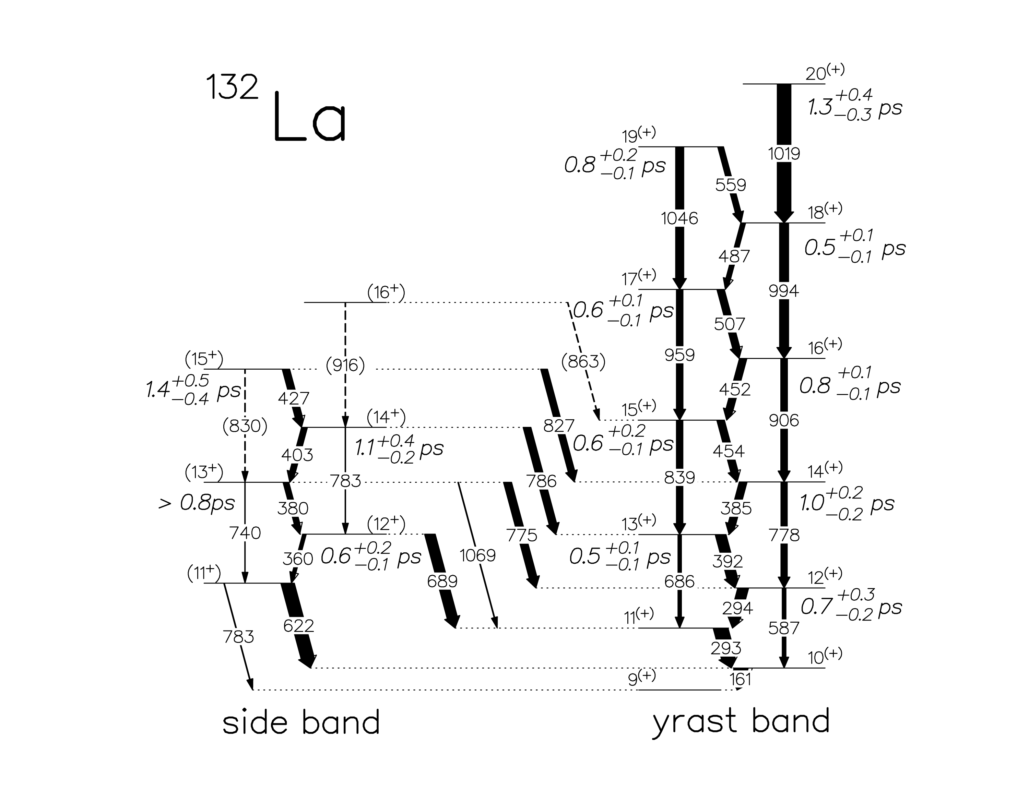
Side-feeding process
gating above method
gate set on the Doppler shifted part of the feeding transition
(fast component of feeding)

Slide 37
Principles of the lifetime determination
DATA ANALYSIS
Doppler shift
Velocity at gamma emission
Level lifetime
Required
good energy resolution
excellent apparatus lineshape (gaussian and symmetric)
Required
time-velocity correlation for the recoils
feeding time distribution

Slide 38
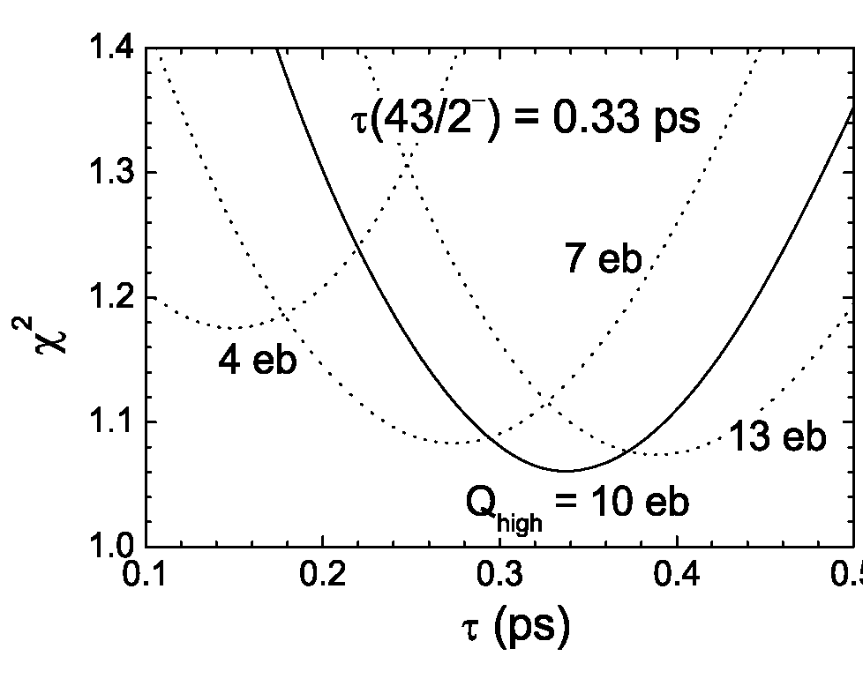
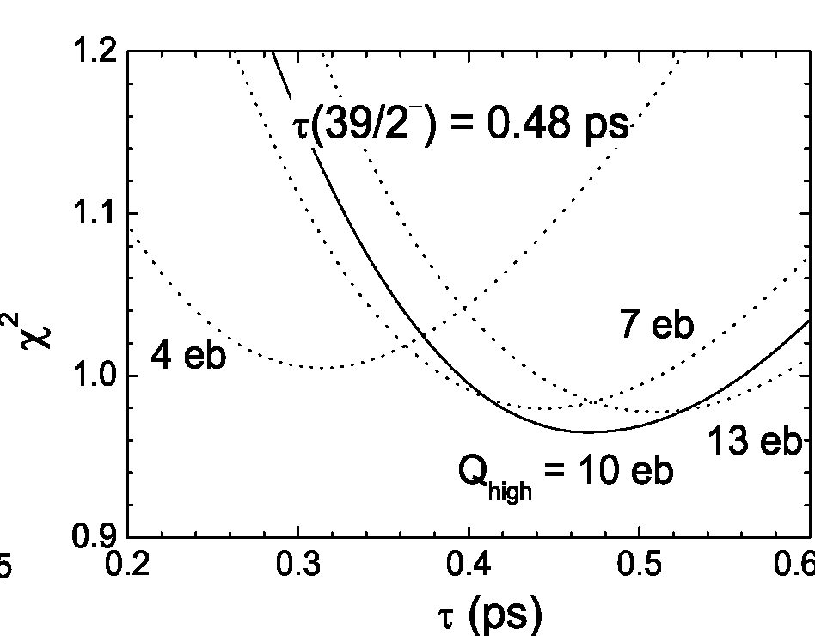
Side-feeding, experimental parameters ¹³¹La
TOP LEVEL LIFETIMES+INTENSITY DISTRIBUTION
Q_{high} – effective quadrupole moment for high spin levels.
Q_{low} – effective quadrupole moment for low spin levels

Slide 39
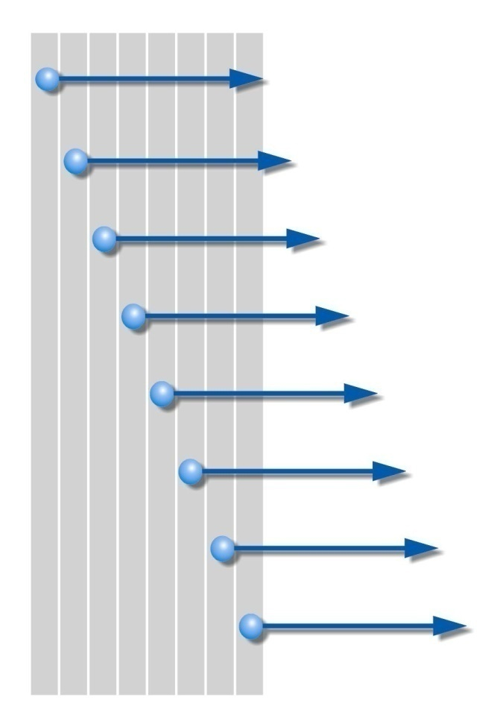
Stopping power of La and Cs recoils in Sn target
Semi-thick target method
Recoils emerging into vacuum
Velocity distribution corresponds to stopping power parameters
Target thickness – recoils range
Velocity distribution obtained form doppler broadening of gamma line from levels with lifetimes >2 ps

Slide 41
Chiral symmetry breaking
SPONTANEOUS CHIRAL SYMMETRY BREAKING
Specified handedness
Chiral dublets
Chiral
Symmetry
breaking
LAB
Handedness not observed
The energy barrier between |L> and |R> states is finite. Tunneling process faster than the gamma emission time.
Only eigenstates of the hamiltonian are observed (not dynamical states).
Symmetric and antisymmetric combinations of |L> and |R> configurations.
Chiral doublets.

Slide 42
Inband transition probabilities
Identical in both bands
Interband transition probabilities
Identical in both bands

Slide 43
Introduction
SPONTANEOUS SYMMETRY BREAKING
Localized particle
Translational states
Translational
Symmetry
breaking
LAB
Deformed nucleus
Rotational states
Rotational
Symmetry
breaking
LAB

Slide 45
T symmetry breaking
TIME REVERSAL IN LOW ENERGY REGION (MEV)
No explicit T violation
Higgs mechanism gives mass terms not diagonal in quark flavour.
Diagonalization via Kobayashi-Maskawa matrix that can contain complex elemets.
Spontaneous time reversal symmetry breaking
Although hamiltonian conserves T
The wave function violates T i.e, is not an eigenstate of T
„The T violating phase is only associated to the heavy quark sector, and no T-violation is expected to be seen in low energy nuclear interactions. (…) It is the only model of T-violation that arises naturally within the context of already known physics.”
Barry R. Holstein „Weak interactions in nuclei” Princeton Series in Physics (1989)
No eigenstates of T
How to study Time reversal via nuclear spectroscopy where mostly eigenstates observables are measured?

