Slide 1



Prompt gamma monitoring of proton and carbon therapy: comparative development of a Time-of-Flight Compton camera and a multi-collimated camera
Denis DAUVERGNE
Institut de Physique Nucléaire de Lyon, CNRS/IN2P3 Université Lyon 1
II Symposium on Positron Emission Tomography
Krakow, 20-24 September 2014

Slide 2
Outline
Basic features:
    prompt radiation production by nuclear reactions
    prompt gamma yields and profiles
        Time of Flight issue
Online range verification with prompt gammas
    passive collimation systems
    active collimation: Compton cameras

Slide 3
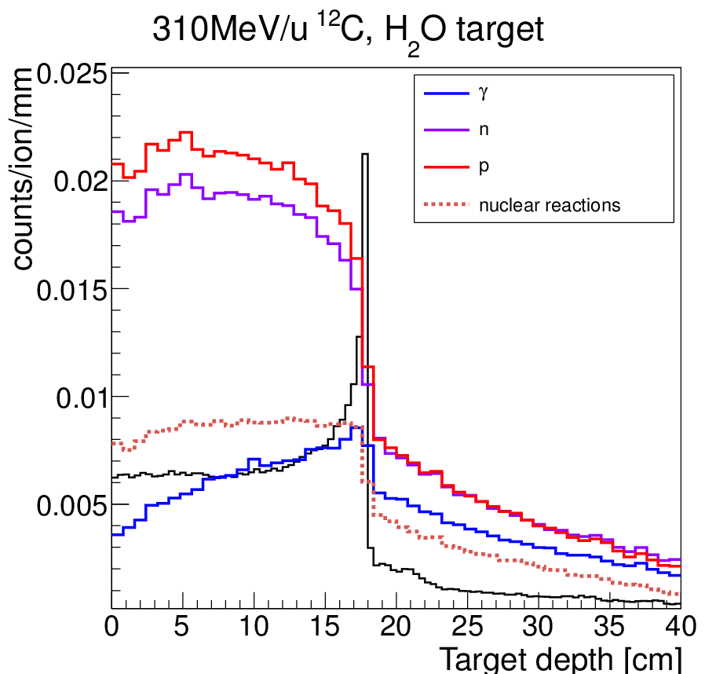
Motivation
Dose deposition during radiotherapy:
  Ionization (uncertainties → margins)
Hadrontherapy:
  Nuclear fragmentation
    High probability
    Influence on dose deposition
    Secondary particles
      γ, n, p, fragments
      Radioactive Isotopes (β⁺)
  Range control by means of
  nuclear reaction products:
      β⁺ annihilation
      Secondary protons (only carbon)
      Prompt gamma
        ≤ 1 per nuclear reaction
        ~ isotropic emission
        Massive particles: background
GEANT4

Slide 4
Prompt gamma measurements
with collimated detectors
moving target
beam
collimator
detector

Slide 5
Prompt gamma measurements
with collimated detectors
moving target
monitor
beam
Synchronization with accelerator HF or monitor: Time of Flight
collimator
detector
First evidence of correlation between prompt-gamma profile and ion range: Min et al, APL 2006
or
Timing
Accelerator HF

Slide 6
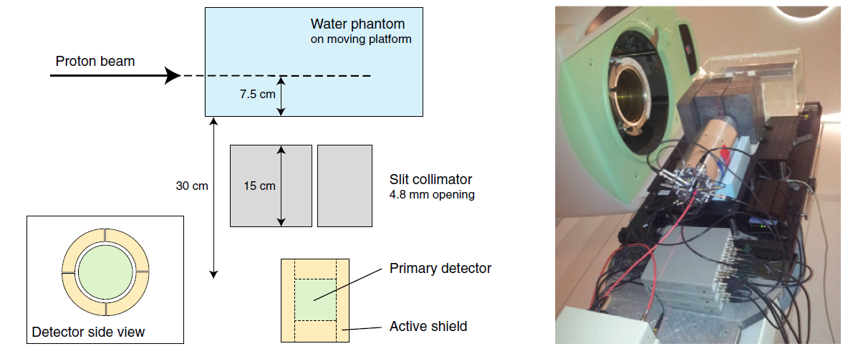
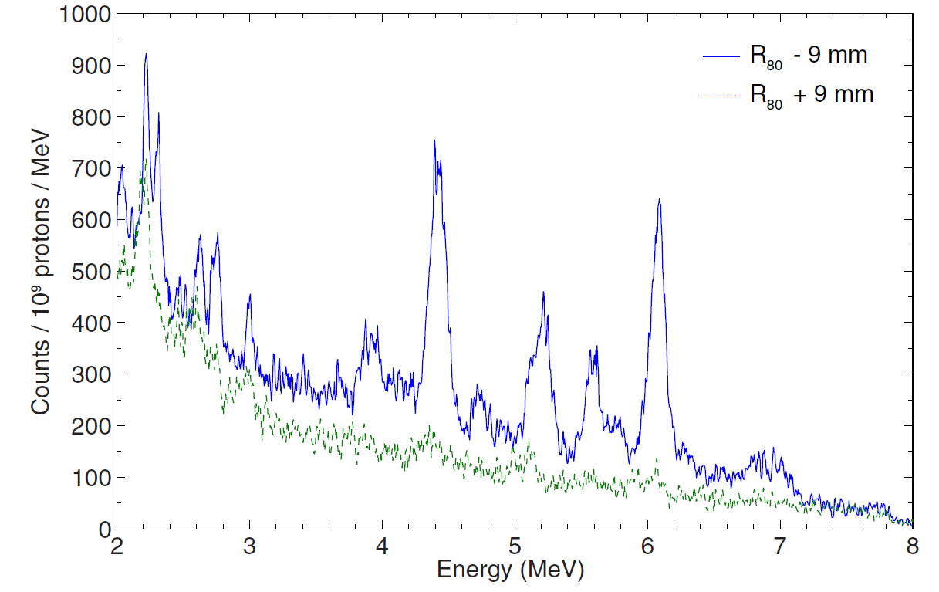
Fast timing and high energy resolution measurements
J. Verburg, PMB 2013
76mm
Fast timing (2ns window)
High spectral resolution (Large volume LaBr + Compton rejection BGO)
Spatial resolution (~1cm FOV)
→ 10 – 100 counts/ peak for 10⁹ protons
+ Polf PMB 2013:
Oxygen concentration monitoring

Slide 7
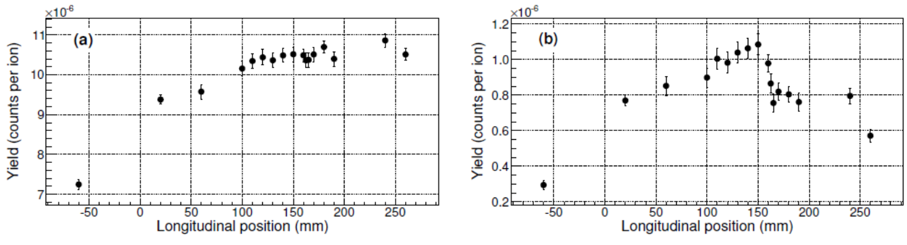
Influence of TOF on PG profiles (collimated cameras)
160 MeV protons in PMMA
IBA C230 cyclotron
9.4 ns
Roellinghoff PMB 2014
310 AMeV carbon ions in PMMA
No TOF
TOF selection
TOF : mandatory for carbon ions
M. Pinto, submitted New J Phys

Slide 8
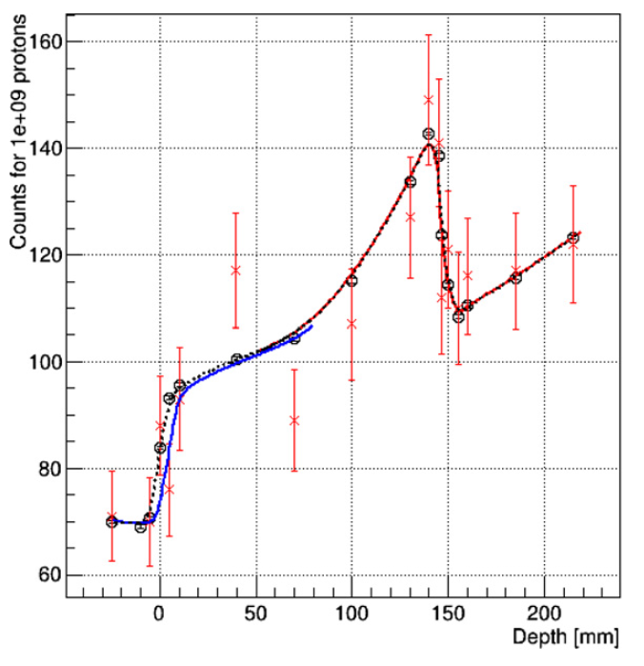
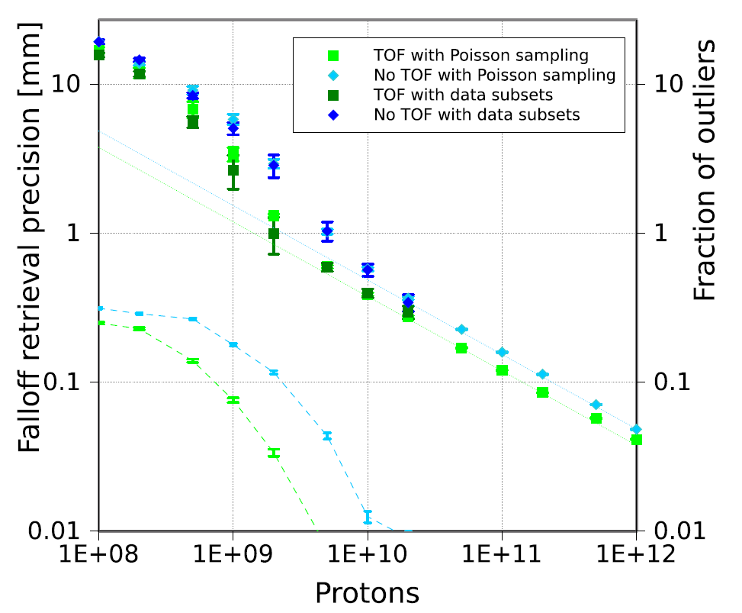
Fall-off retrieval precision
160 MeV protons in PMMA
IBA C230 cyclotron
Measurement with single (small) detector
Real clinical detector 10 times more efficient → millimetric precision for a distal spot
Roellinghoff PMB 2014

Slide 9
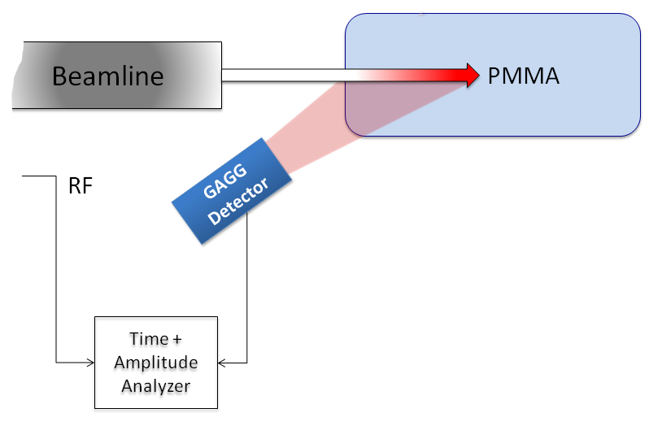
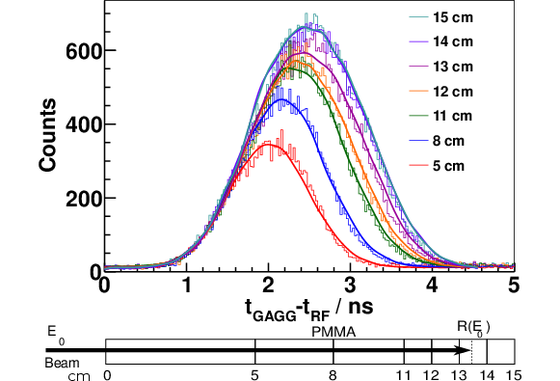
Prompt gamma timing
Principle:
Variations of the transient time inside the patient
Measurable with high precision
By means of the prompt-gamma timing profiles
→ Measurements at KVI:
Clinical applicability: 2mm range deviation measurable within few seconds
C. GOLNIK, PMB 2014

Slide 10
Online control with prompt gammas
What do we want ?

Slide 11
Online control with prompt gammas
What do we want ?
- Range verification with mm accuracy
    For single pencil beam spot (distal)
      Protons: 10⁸ particles
      Carbon ions: 10⁶ particles

Slide 12
Online control with prompt gammas
What do we want ?
- Range verification with mm accuracy
    For single pencil beam spot (distal)
      Protons: 10⁸ particles
      Carbon ions: 10⁶ particles
    For distal energy slide (statistics x10)

Slide 13
Online control with prompt gammas
What do we want ?
- Range verification with mm accuracy
    For single pencil beam spot (distal)
      Protons: 10⁸ particles
      Carbon ions: 10⁶ particles
    For distal energy slide (statistics x10)
    For whole fraction (Statistics x1000) or passive delivery

Slide 14
Online control with prompt gammas
What do we want ?
- Range verification with mm accuracy
    For single pencil beam spot (distal)
      Protons: 10⁸ particles
      Carbon ions: 10⁶ particles
    For distal energy slide (statistics x10)
    For whole fraction (Statistics x1000) or passive delivery
- real time?
- 2D or 3D spatial information?
- target composition: spectral information
PG yield above 1 MeV : ~ 0.3% /cm per proton, ~ 2% /cm per carbon
→ Compromise with statistics

Slide 15
Main features - Challenges
Relatively large number of PG emitted ( >10⁸ per fraction)
Correlated to ion range
Real time information
Poly-energetic
E> 1MeV : minimum absorption
  Escape from patient
  Difficult to collimate and detect
  Current SPECT devices not adapted:
  New technologies/concepts needed
Large background (neutrons…)

Slide 16
Collimated cameras
2 kinds of cameras
  Multi-slit (Lyon, Delft, Seoul, IBA)
  Knife-edge (Seoul, Delft, IBA)
+ Simplicity
+ Large field of view for multi-collimated
- Mechanical collimation…
IBA Knife edge camera :
under clinical tests: millimetric precision
at pencil beam scale.

Slide 17
Multislit TOF-gamma camera

Slide 18
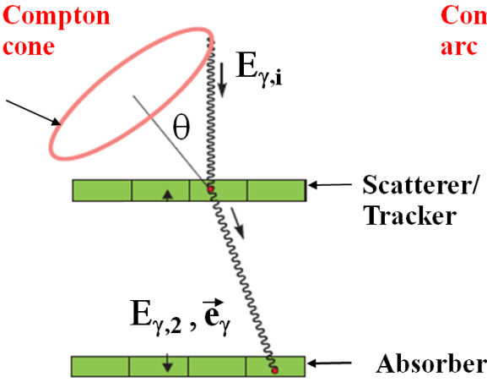
Compton cameras
No collimation: potentially higher efficiency
Potentially better spatial resolution (< 1cm PSF)
If beam position known → simplified reconstruction
3D-potential imaging (several cameras)
Group |  |  | stages | scatterer | absorber | Efficiency (10⁻⁵) | Resolution (mm) | Proto/simu | ref
Lyon |  |  | 3 | DSSD | LYSO | ~1 | 6 | simu | Richard 2010
Baltimore -Texas |  |  |  | Ge CdZnTe | Ge/LaBr CdZnTe | ~1 ? | ? | Simu proto | Peterson 2010
Seoul |  |  |  | DSSD | NaI | ? | ~12 | Proto tested | Seo 2011
ENVISION | Valencia |  | 2 -3 | LaBr | LaBr | ? | 7.8 | Proto tested | Llosa 2013
 | Lyon |  | 2 | DSSD | BGO | ~25 | ~8 | Simu/proto in prog | Roellinghoff 2011, Ley 2014
 | Dresden |  |  | CdZnTe | LSO/BGO | ? |  | Proto tested | Hueso- Gonzalez 2014
Munich |  |  |  | DSSD | LaBr | ~1-100 | ~8 | Proto in prog | Thirolf 2014
ETCC |  | Kyoto | Gas: Ar+C₂H₆ |  | GSO | 0.3 | ? | Proto tested | Kurosawa 2012
 |  | Seoul | γ conv.+hodo |  | CsI | 0.6 | 100 | Simus | Kim 2012

Slide 19
Jean-Luc LEY, PTCOG 2014

Slide 20
Silicon double-sided strip detectors
J. Krimmer, ANNIMA 2014

Slide 21
DSSD front-end electronics

Slide 22
BGO absorber

Slide 23
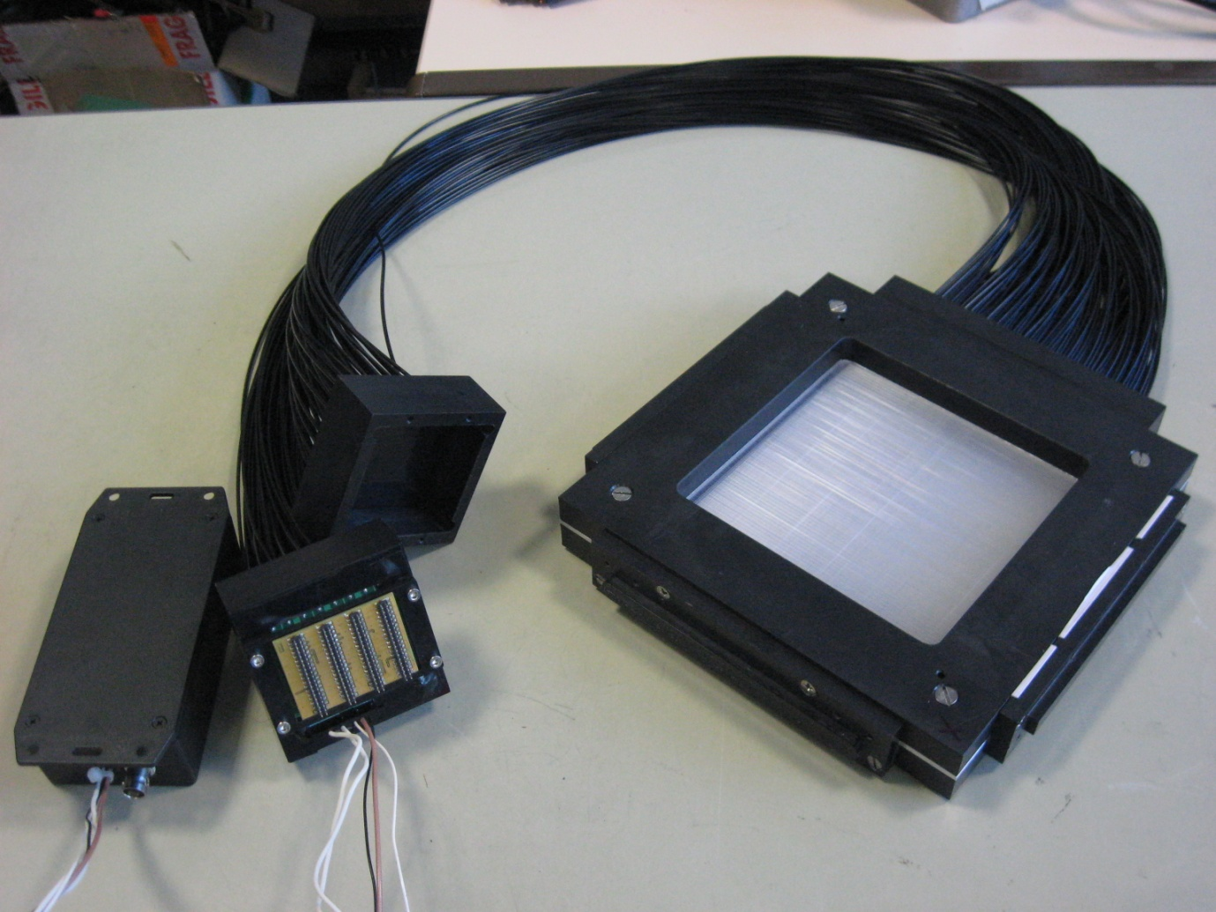
Precise timing: fast monitor
Scintillating fibers hodoscope
Prototype
1mm² square fibers (128 +128 fibers)
Light transmission: optic fibers
Photomultiplier : Hamamatsu H8500
Home-made ASICs electronic readout : discriminator + TDC at 10⁸ Hz rate capability (S. Deng 2011)
Tests:
0.5 ns resolution
Admissible dose > 10¹² carbon ions/cm²
Count rate < 4x10⁶ Hz per PMT: use of several PMTs

Slide 24
Construction of full-size prototype
(collaboration IPN Lyon, CREATIS Lyon, LPC-Clermont, CPPM-Marseille)

Slide 25
Compton-camera count rate issue
Simulation: line-cone reconstruction for Lyon prototype
1 distal spot (10⁸ incident protons) incident on PMMA target, 160 MeV
Pulsed beam (IBA C230)
Clinical intensity: Reduced intensity:
200 protons/bunch 1 proton/bunch
Absorber count rate: 200MHz
JL Ley, PTCOG 2014

Slide 26
Concluding remarks
Prompt gamma :
emerging technique close to clinical translation
The most appropriate modality for real time control of the range during proton treatment
  Collaborative effort during ENVISION (FP7), worldwide competition
Collimated systems
  Millimetric range-control at the pencil-beam scale for protons
  First prototype tested in clinical conditions (knife-edge IBA)
  Multi-collimated cameras: similar performances, better potentialities
Compton cameras: still under development
  Lyon prototype with TOF: comparable statistics with collimated devices, spatial resolution, 2-3D imaging
  Necessity to work at reduced intensity
  New concepts (with calibration issue): PG timing, PG spectroscopy
Accelerator-dependent devices (count rates, TOF)

Slide 27



Special thanks
Collaborators:
CPPM Marseille:C. Abellan, J.P. Cachemiche, C. Morel
IPN Lyon: L. Caponetto, X. Chen, M. Dahoumane, J. Krimmer, J.-L. Ley, H. Mathez, M. Pinto, E. Testa, Y. Zoccarato
CREATIS Lyon: N. Freud, J.M. Létang,
LPC-Clermont: D. Lambert, M. Magne, G. Montarou
Acknowledgements:
France Hadron, FP7 ENTERVISION, FP7 ENVISION, FP7 ULICE

Slide 28
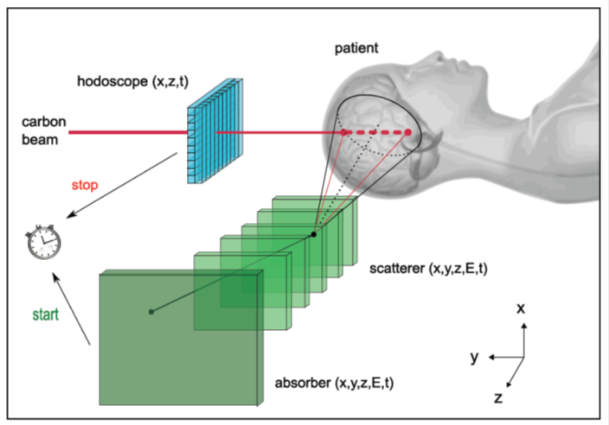
Compton cameras
Lyon project:
TOF and beam position with hodoscope
Large size camera
Group |  |  | stages | scatterer | absorber | Efficiency (10⁻⁵) | Resolution (mm) | Proto/simu | ref
Lyon |  |  | 3 | DSSD | LYSO | ~1 | 6 | simu | Richard 2010
Baltimore -Texas |  |  |  | Ge CdZnTe | Ge/LaBr CdZnTe | ~1 ? | ? | Simu proto | Peterson 2010
Seoul |  |  |  | DSSD | NaI | ? | ~12 | Proto tested | Seo 2011
ENVISION | Valencia |  | 2 -3 | LaBr | LaBr | ? | 7.8 | Proto tested | Llosa 2013
 | Lyon |  | 2 | DSSD | BGO | ~25 | ~8 | Simu/proto in prog | Roellinghoff 2011, Ley 2014
 | Dresden |  |  | CdZnTe | LSO/BGO | ? |  | Proto tested | Hueso- Gonzalez 2014
Munich |  |  |  | DSSD | LaBr | ~1-100 | ~8 | Proto in prog | Thirolf 2014
ETCC |  | Kyoto | Gas: Ar+C₂H₆ |  | GSO | 0.3 | ? | Proto tested | Kurosawa 2012
 |  | Seoul | γ conv.+hodo |  | CsI | 0.6 | 100 | Simus | Kim 2012

Slide 29
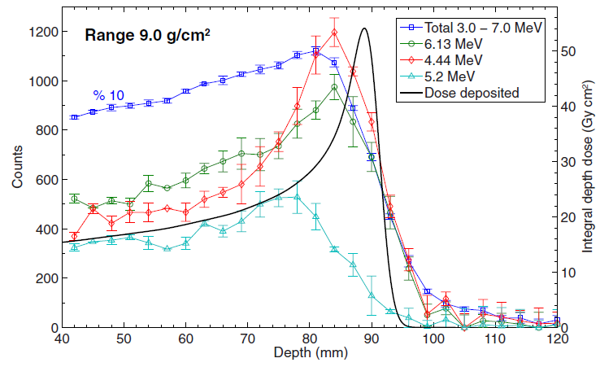
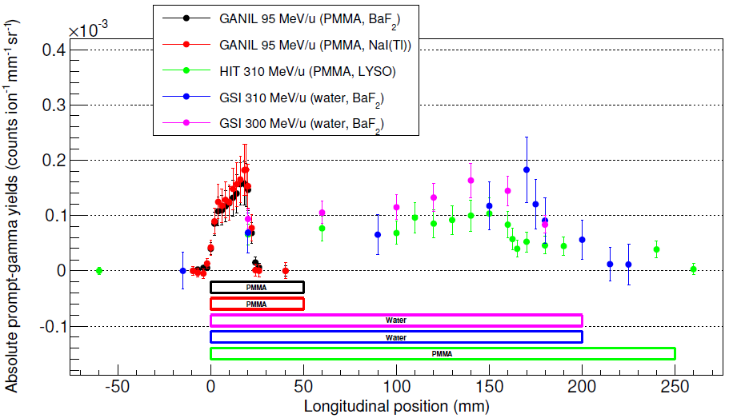
Prompt gamma measurements
110 MeV protons in water
95, 300, 310 MeV/u carbon in H₂0 and PMMA
E> 1MeV
J.Verburg, PMB 2013
M.Pinto, submitted New J Phys
PG yield above 1 MeV : ~ 0.3% /cm per proton ~ 2% /cm per carbon

Slide 34
Prompt gamma yields: heterogeneous targets
95 MeV/u carbon ions
High resolution profiles: influence of heterogeneities close to the Bragg peak
M. Pinto et al, submitted to Med Phys

Slide 35
Prompt gamma measurements
with collimated detectors
Energy spectrum 160 MeV protons in PMMA, NaI(Tl) detector
moving target
beam
collimator
detector
Energy: <1 MeV to 10 MeV
A small fraction is measured as discrete lines
Low energy gammas: larger scattered fraction
Smeets PMB 2012

