Slide 1


Trigger-less and reconfigurable data acquisition system for
J-PET
II PET Symposium 2014
Grzegorz Korcyl – Jagiellonian University, Kraków

Slide 2
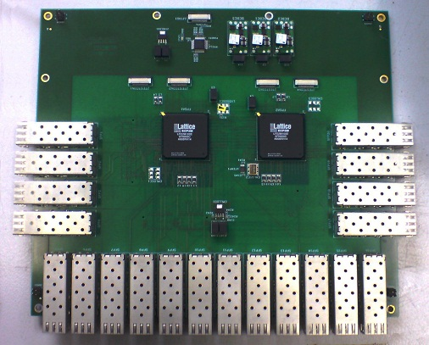
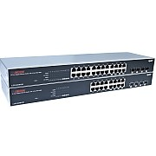
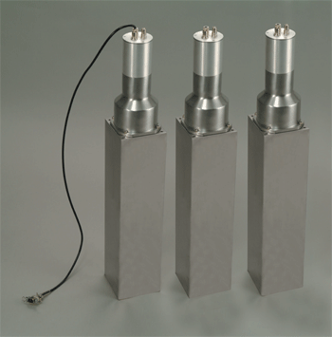
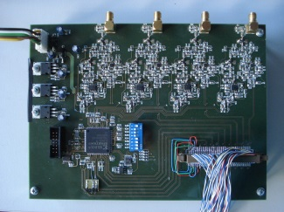
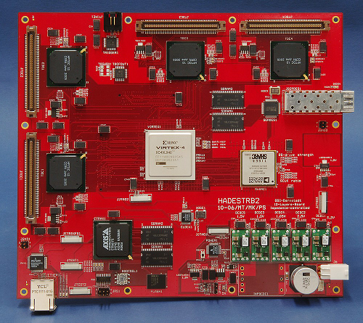
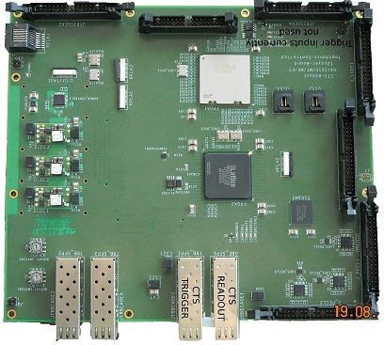
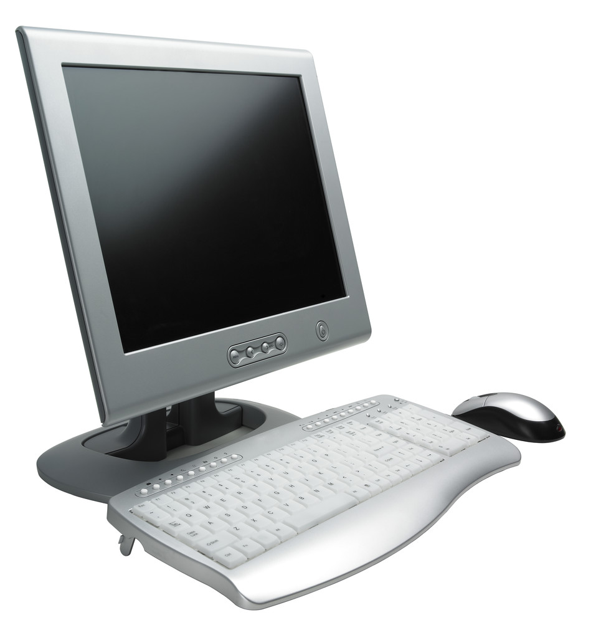
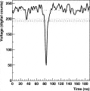
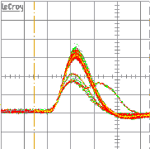


Introduction – General DAQ Components
Concentrators
Detectors
Front-End Electronics
Digitizer electronics
Control modules
Event builders
Slow control

Slide 3
J-PET DAQ Components
Many Frontend prototypes:
  Multi-threshold discriminators based on FPGAs (M. Pałka, P. Strzempek)
    16 input channels
    4 thresholds per channel
    TRB3 Mezzanine
    Cheap, low power consumption, small form factor
  Multi-threshold discriminators with QTW conversion FEE (Inst. Fotonowy)
    Based on standard analog components
    3 input channels
    2 signal paths:
      Fast – 4 thresholds discrimination
      Slow – Charge to Width conversion
    3U VME form factor
    Expensive, power consuming, VME crate needed
  Constant Fraction discriminators FEE (J. Majewski)
    8 input channels
    4 fraction levels per channel
    Manually configurable fraction levels
    Expensive, power consuming, custom form factor
  Several other solutions tested (HEP experiments)

Slide 4
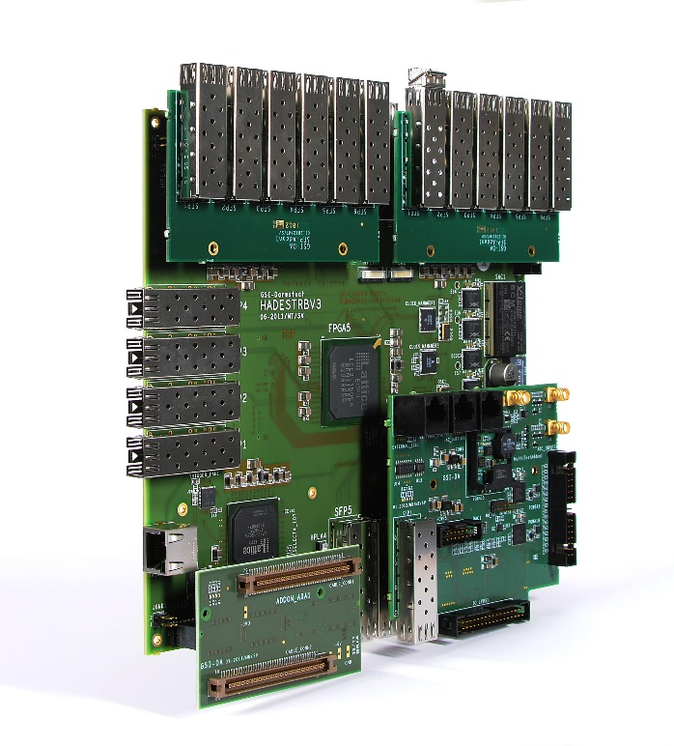
J-PET DAQ Components
Digitizer / Collector module
  TRBv3
    4x configurable edge FPGAs
      TDC firmware
        ~15ps resolution
        Up to 48 single edge input channels
    Central FPGA
      Data collector firmware
      Interface to the system
        Gigabit Ethernet Gateway
  Jagiellonian University – member of TRB Collaboration
    Hardware and firmware development

Slide 5
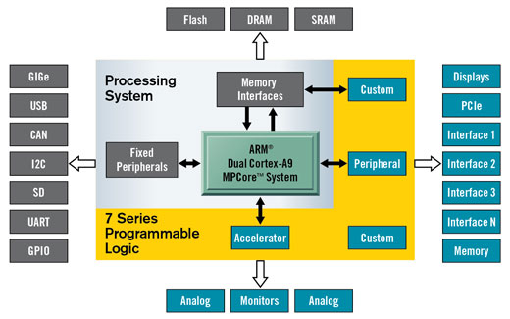
J-PET DAQ Components
Central Controller (M. Kajetanowicz)
  Hardware
    Xilinx Zynq SoC
      FPGA + ARM
    DDR2 memory slot
    16x SFP Optical fiber transceivers
  Measurement control
    Distribution of stable and precise „start” signal to TRBs
    Distribution of timestamp information
  Analyzer
    Collection of readout data
    Online analysis algorithms, feature extraction
      Online histograming, monitoring
      Unpacking and offline analysis suport

Slide 6
J-PET DAQ Components
Networking
  Standard commercial Ethernet equipment
Event building and slow control
  Standard commercial PC

Slide 7
J-PET DAQ Architecture

Slide 8
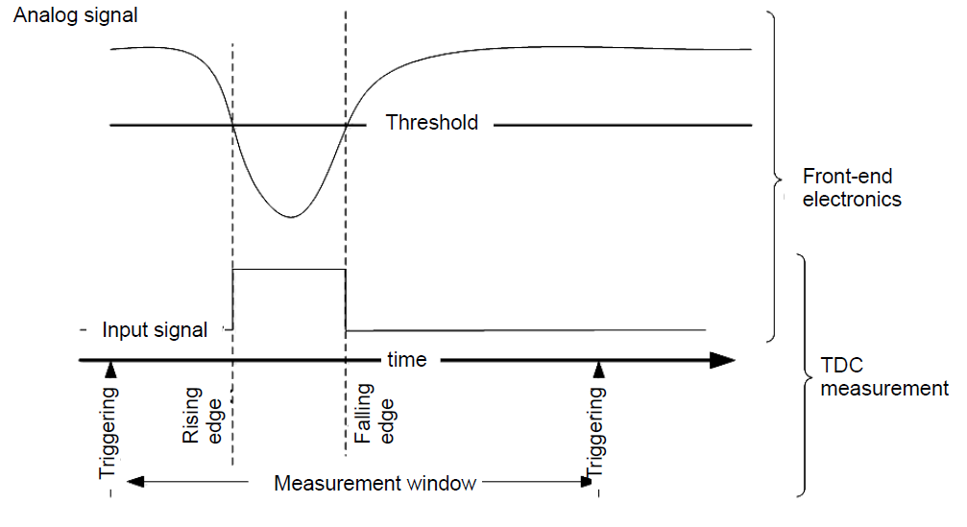
J-PET Trigger-less system
Measurement electronics require a „start” signal
  Usually selects interesting events -> trigger system
Trigger-less – no preliminary data selection
  50 kHz periodic „start” signal
  Electronics record detector state over 20us
  Negligible dead-time – constant measurement over selected time period
Pros:
  No data loss due to filtering – more accurate offline analysis
Cons:
  High rate and data load for online processing
  Significant amount of storage needed
  A lot of „garbage” to filter out offline

Slide 9
J-PET Reconfigurable system
Electronics based on Field Programmable Gate Array Devices
The functionality is limited to the firmware
Central Controller equipped with Zynq SoC
  Firmware
  High Level software
Pros:
  Functionality easily upgradable
  Flexible and extensible setup
Cons:
  Manpower with specific skills set required

Slide 10
Summary
DAQ system is designed, tested and ready for operation
  Central Controller still in development
Straight-forward expansion to larger setups
Polish and International patent applications
(P.405178, PCT/EP2014/068352)

