Slide 1
Radiopharmaceuticals production for PET imaging in Poland
Jarosław Choiński
HIL UW
II Symposium on Positron Emission Tomography
September 21st - 24th 2014, Jagiellonian University, Kraków, Poland

Slide 2
In Poland the PET diagnostic is present since 2003
The first PET center was opened, Feb. 26, 2003 in the prof. F. Łukaszczyk Cancer Center at Bydgoszcz

Slide 3
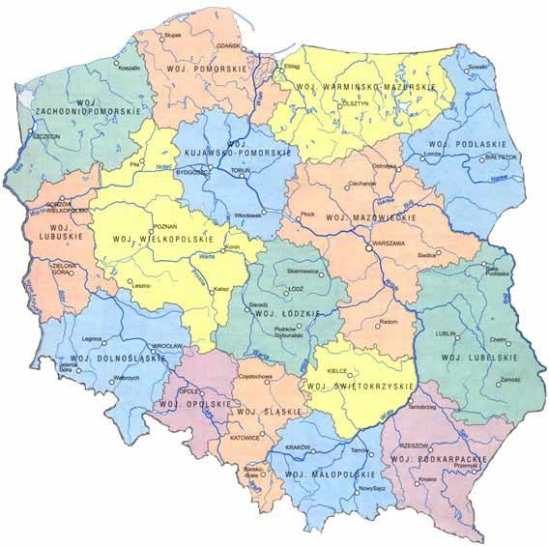
Cancer C. - Bydgoszcz
E&Z – Ożarów Mazowiecki
IASON - Warszawa
AAA Polska - Warszawa
MONROL - Mszczonów
Cancer C. - Łódź
IASON - Kielce
Operating PET scanner
Cancer C. - Gliwice
VOXEL - Kraków
Operating cyclotron
Under construction cyclotron

Slide 4
All 9 centers equipped with cyclotrons are focused to produce
- mainly Fludeoxyglucose (18F) (also commonly called
fluorodeoxyglucose and abbreviated [¹⁸F]FDG, ¹⁸F-FDG or FDG)
but also - others radiopharmaceuticals containing F-18, C-11, O-15 and …

Slide 5
Radiopharmaceuticals Production and Research Center (RPRC)
at
Heavy Ion Laboratory
University of Warsaw
Currently the site for commercial activity is leased to ADVANCED ACCELERATOR APPLICATIONS POLSKA (AAA Polska)

Slide 6
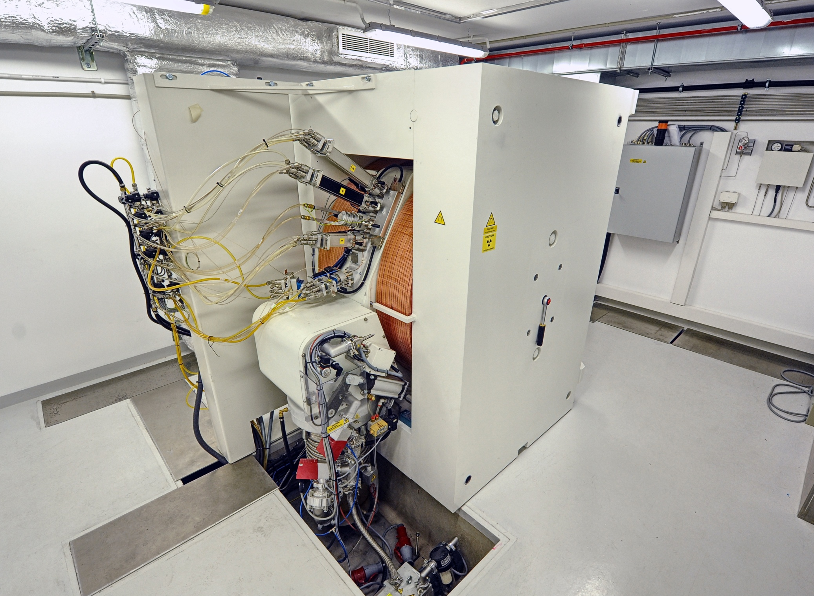
fot. Grzegorz Krzyżewski

Slide 7
General Electric cyclotron PETtrace 840 parameters
Proton beam on target ≥ 80 μA
Deuteron beam on target ≥ 60 μA
length 1.25 m
width 1.2 m
height 1.91 m
electricity consumption in running mode < 70 kW
all-up weight 20 ton

Slide 8
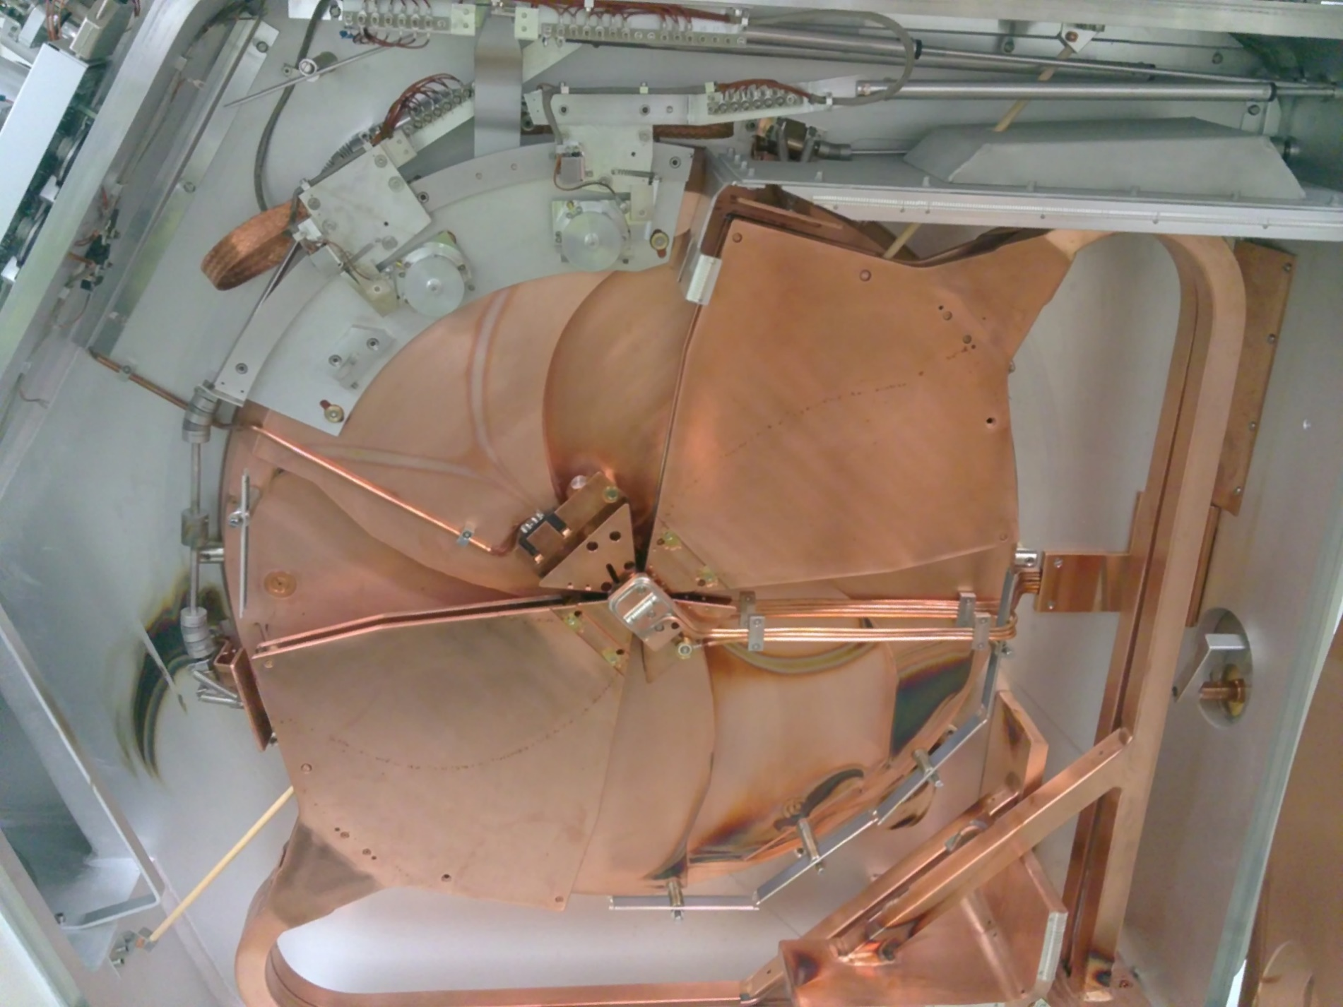

Slide 9
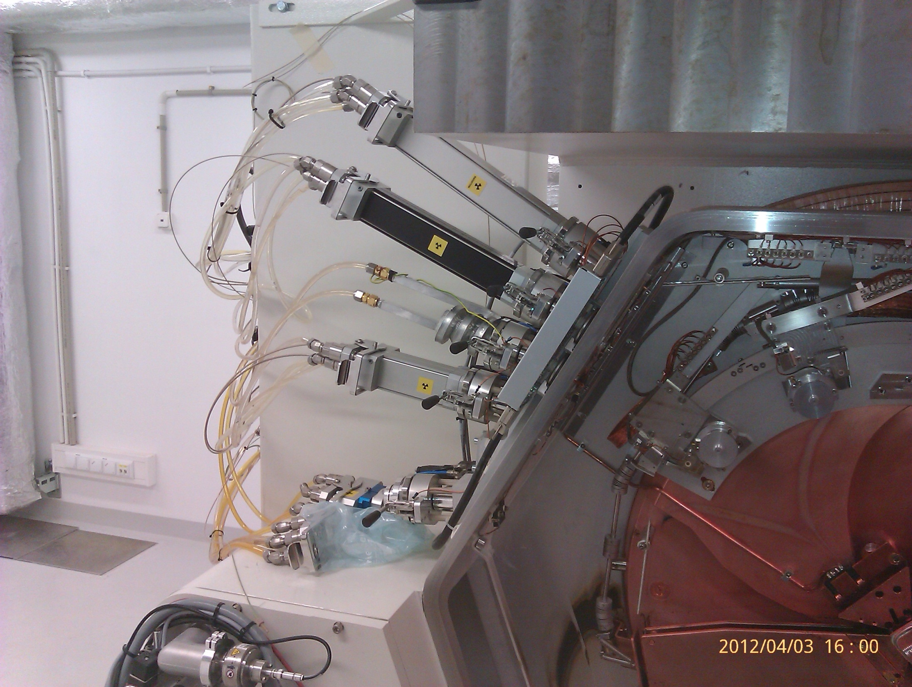
The set of target systems at RPRC: F-18, C-11, O-15
C-11 normal
C-11 high pressure
FC
O-15
Exit to an external beam line
F-18
F-18

Slide 10
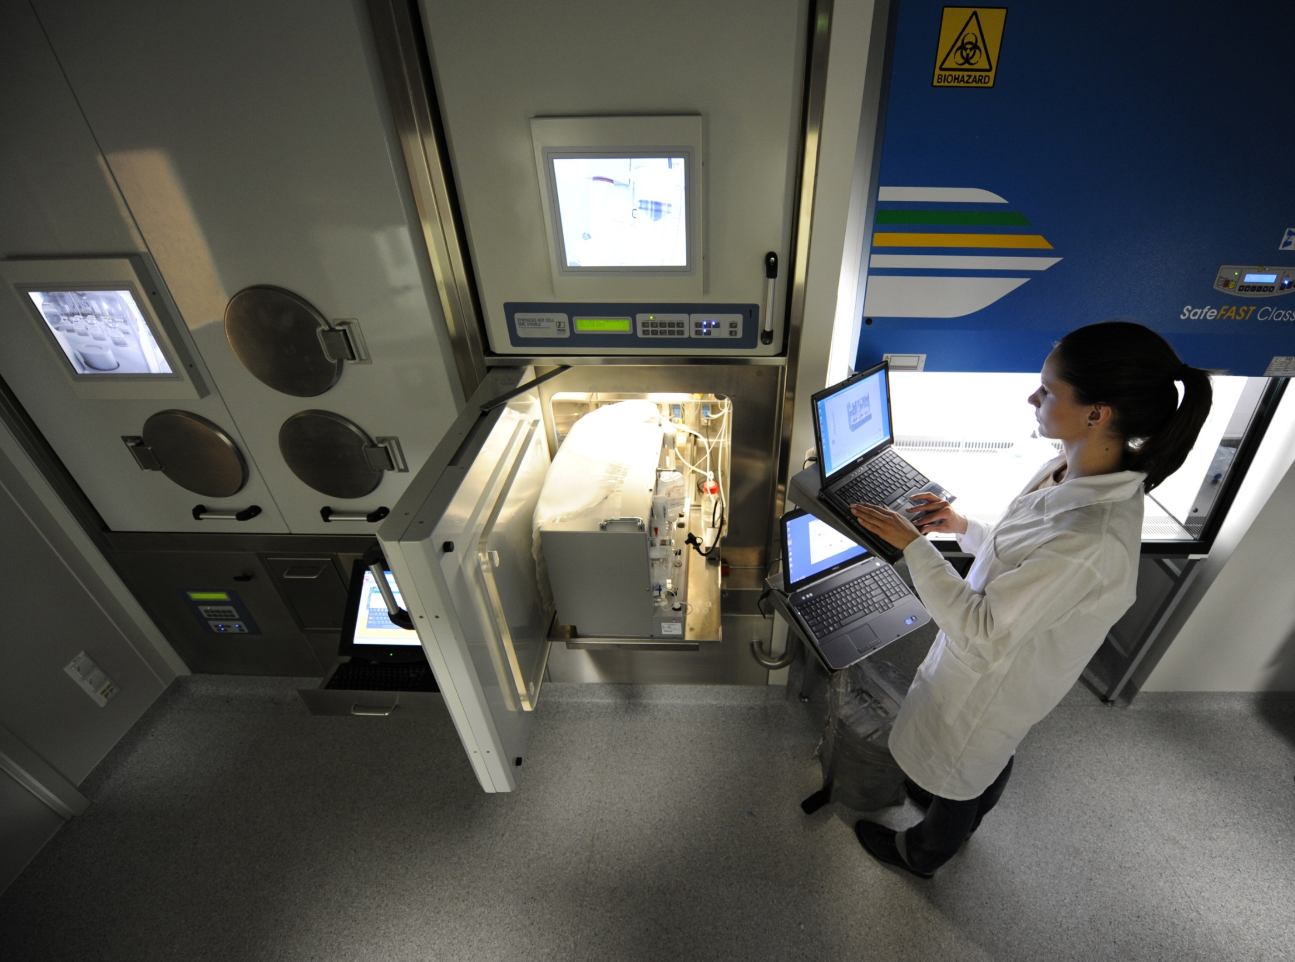
FDG lab

Slide 11
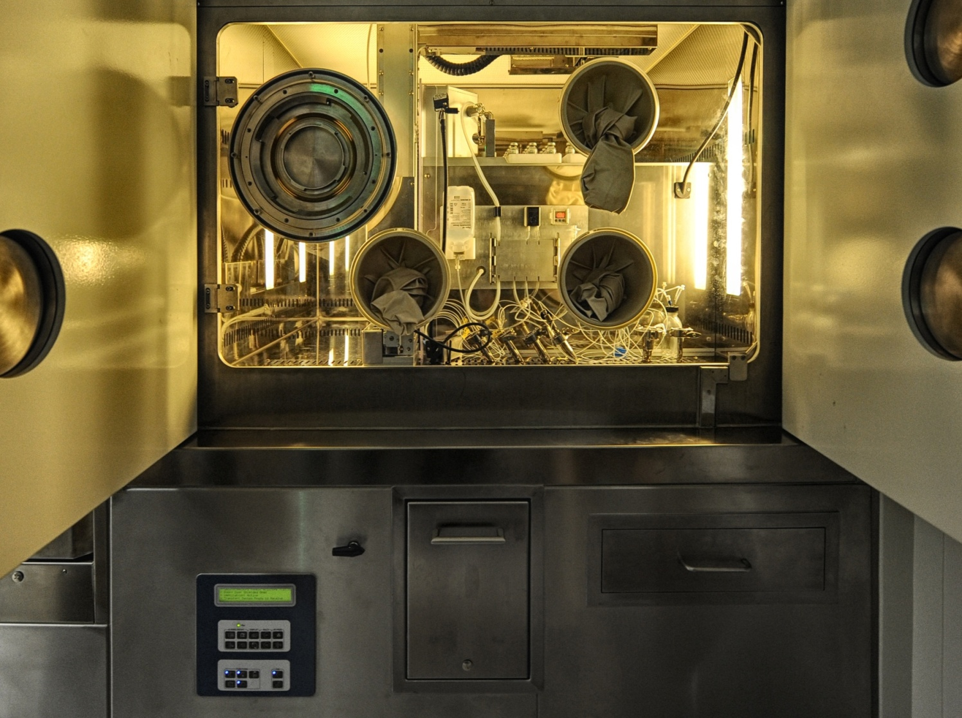
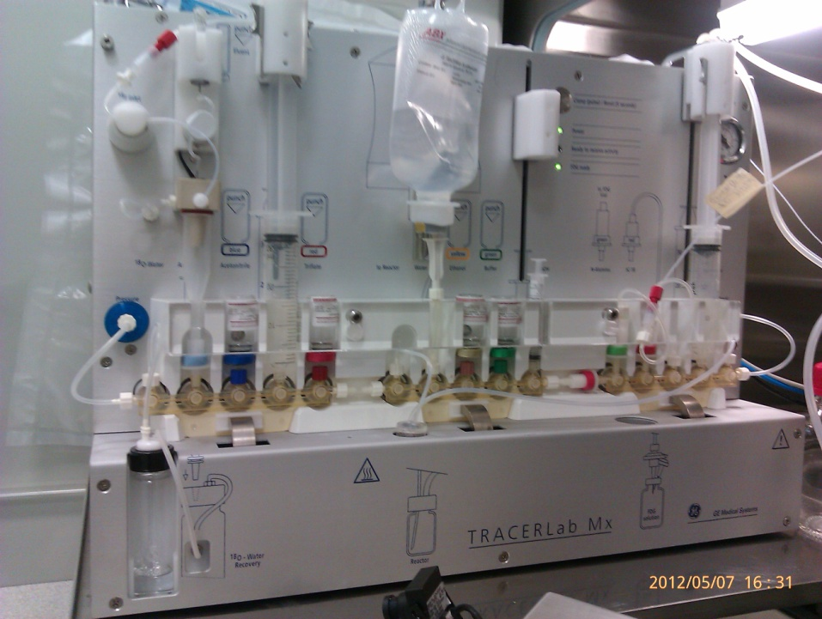
Commercially available FDG - Gluscan
Laboratory of FDG 1 dispenser unit
2 TRACERLab MX-FDG units

Slide 12
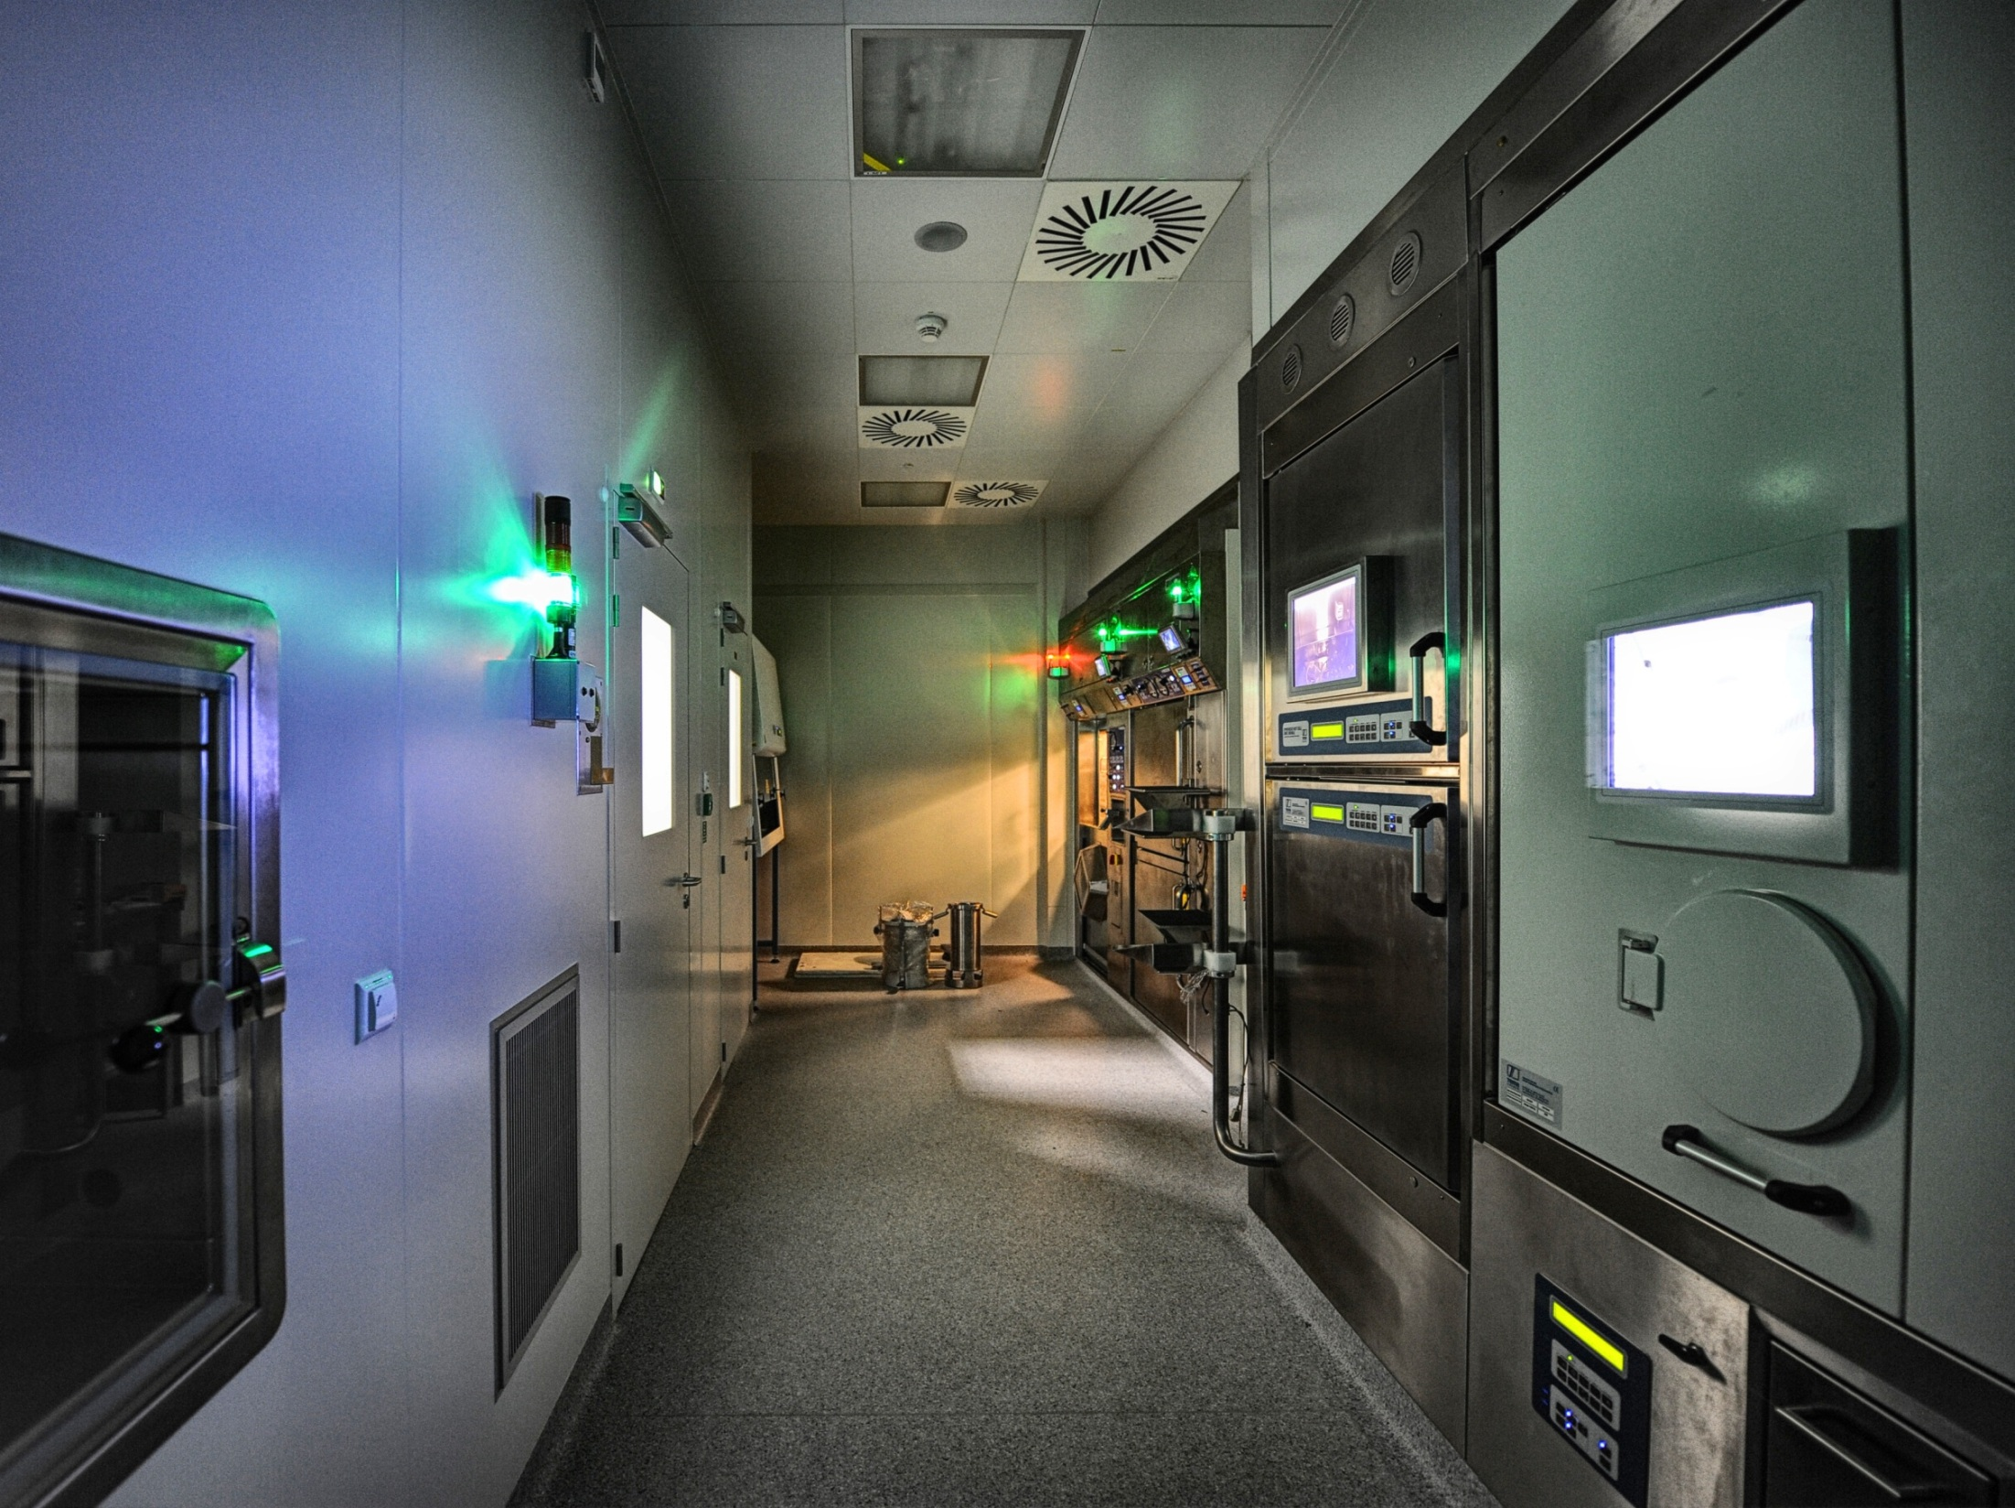
R&D lab

Slide 13
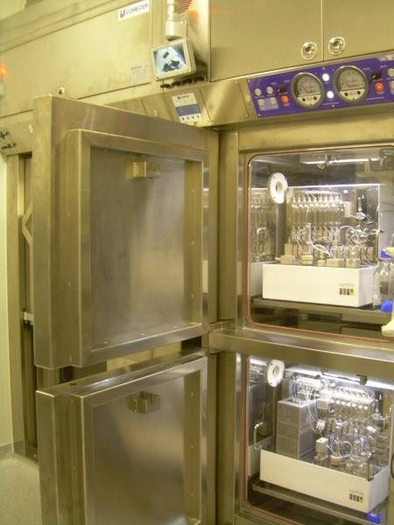
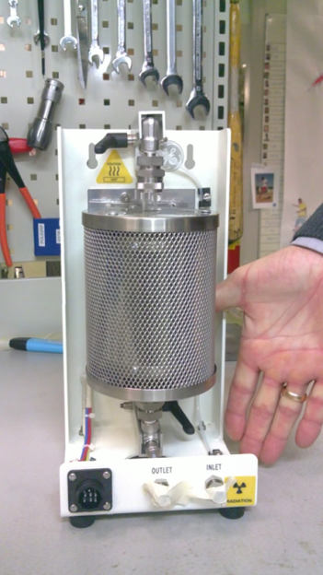
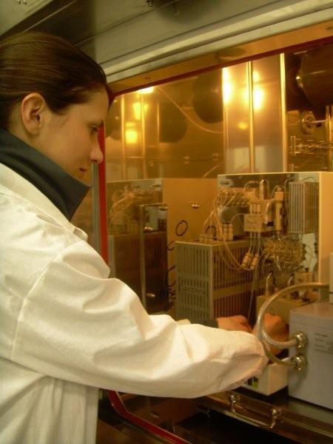
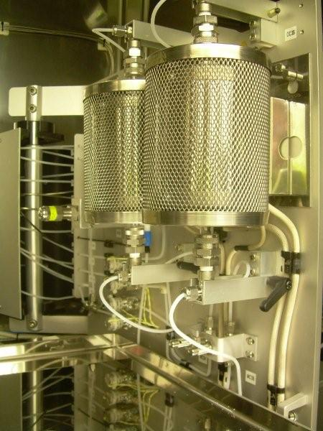
R&D Laboratory equipment - 1 water O-15 unit, 1 C-11 „process unit”
3 units of C-11 synthesizers: - Synthra MeI, - Synthra MeIplus,
- Synthra GPextent

Slide 14
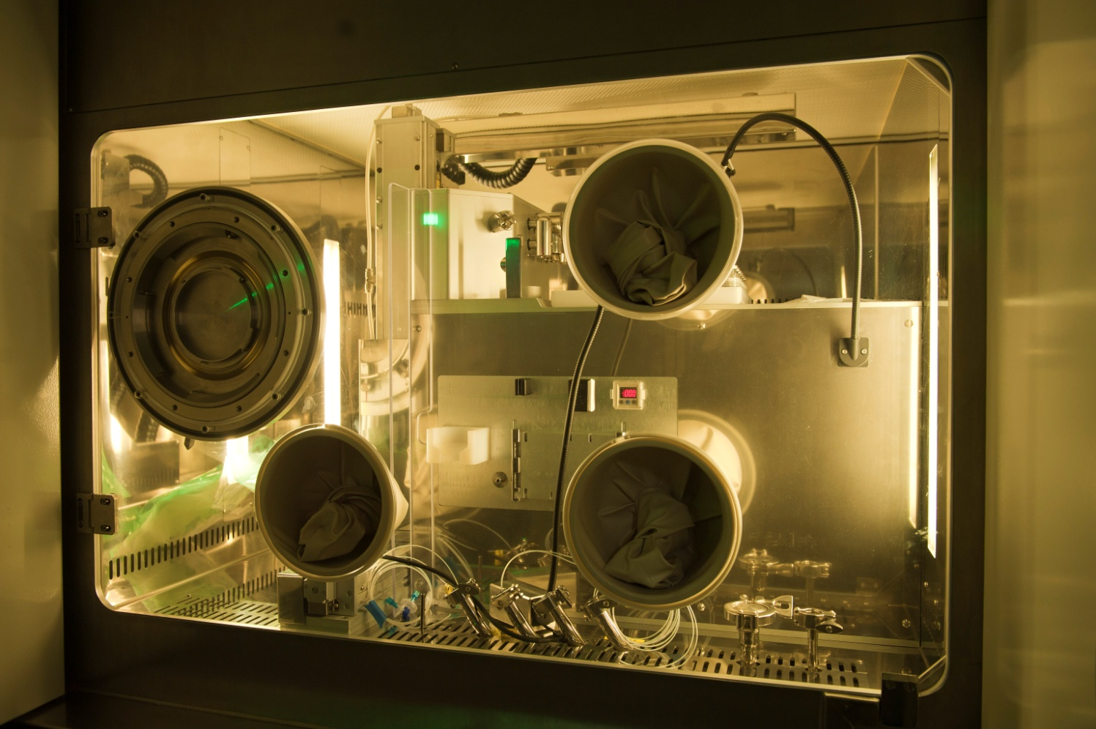
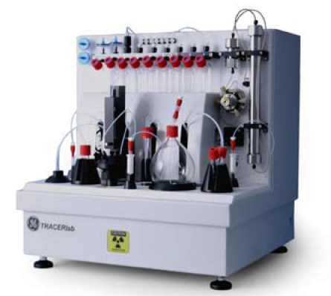
R&D Laboratory equipment - 1 dispenser unit
1 TRACERLab FX F-N (nucleophilic substitution with ¹⁸F⁻)

Slide 15
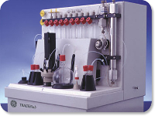
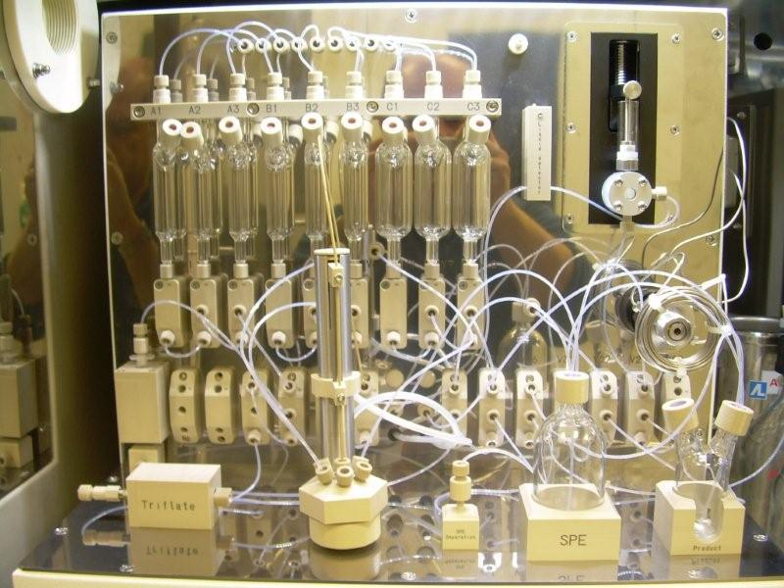
PET Radiopharmaceuticals
TRACERlab FX F-N
Synthra - synthesizers
nucleophilic substitution with [18F] F⁻
methylation reactions using methyl iodide or methyl triflate
¹⁸F Fluoromisonidazole
¹¹C Raclopride
¹⁸F Methylbenperidol
¹¹C Methionine
¹⁸F Fluorostradiol
¹¹C Acetate
¹⁸F Altanserine
¹¹C Palmitate
(see yesterday dr K. Kilian’s presentation)

Slide 16
„Alternatywne metody produkcji technetu-99m”
Agreement Nr PBS1/A9/2/2012
consortium of
the Institute of Nuclear Chemistry and Technology
the Polatom – National Centre for Nuclear Research
the University of Warsaw
01.11.2012 – 31.10.2015
One of the goals of this program is to construct an external solid state target station.

Slide 17
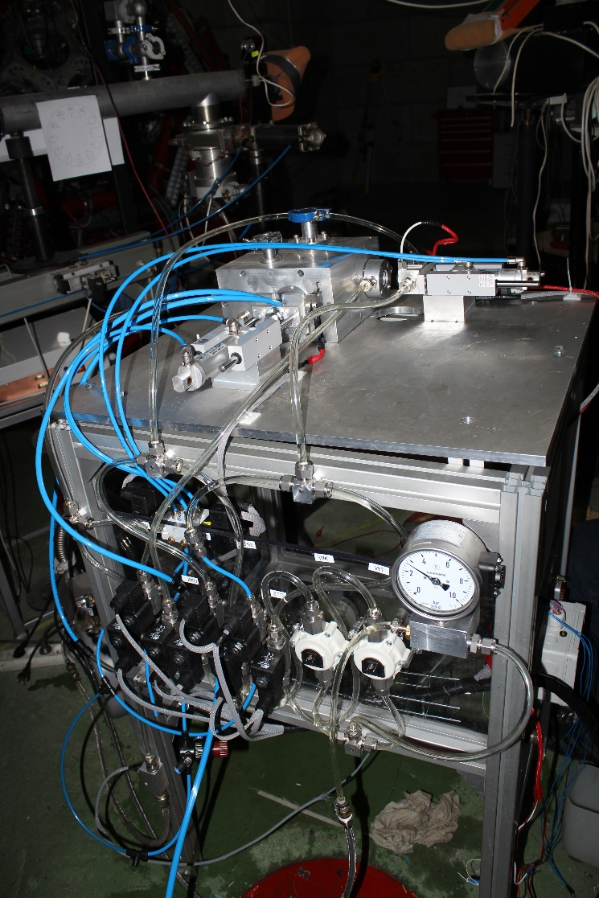

Slide 18
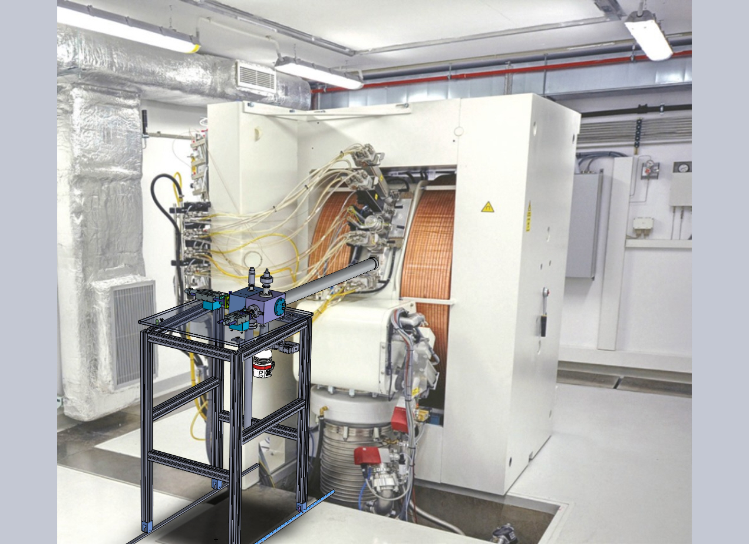

Slide 19
In the next coming year we will execute the grant ”OTRZYMYWANIE RADIOFARMACEUTYKÓW OPARTYCH NA RADIONUKLIDACH SKANDU DLA POZYTONOWEJ TOMOGRAFII EMISYJNEJ”
[PET-SKAND]
Production of:
⁴⁴Ca(p,n)⁴⁴Sc
⁴²Ca(d,n)⁴³Sc
consortium of
the Institute of Nuclear Chemistry and Technology
the Polatom – National Centre for Nuclear Research
the University of Warsaw
(see yesterday prof. J. Jastrzębski’s presentation)

Slide 20
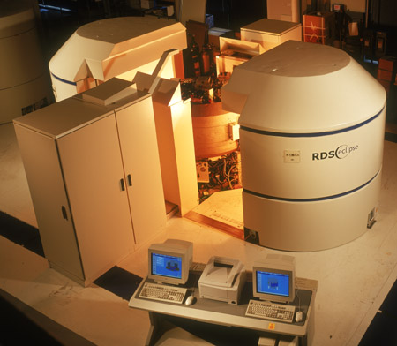
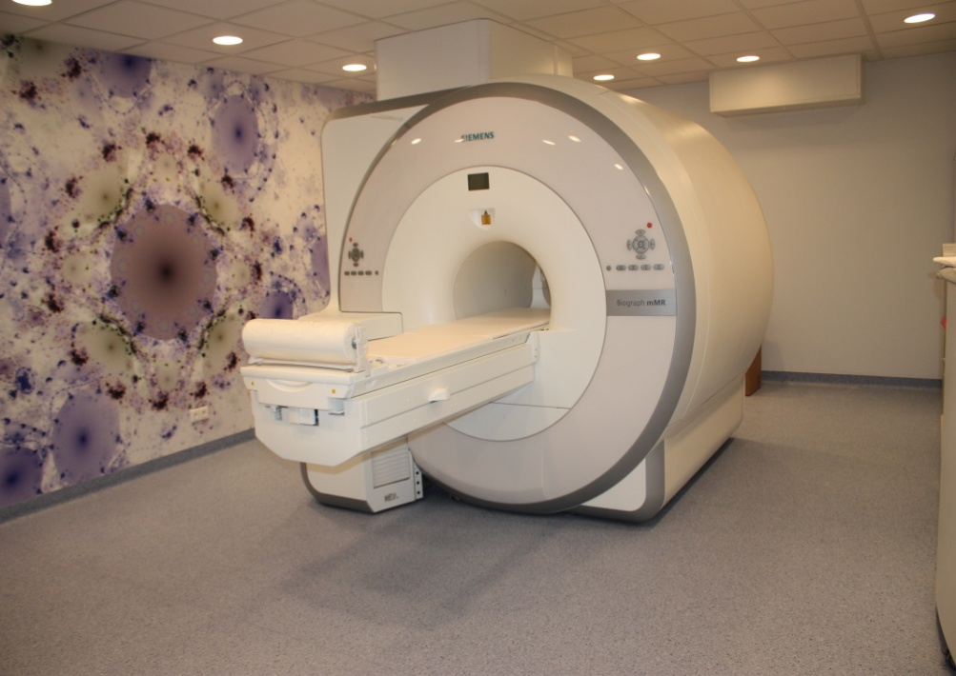
The prof. F. Łukaszczyk Cancer Center at Bydgoszcz
Cyclotron Eclipse HP - 11 MeV proton beam from Siemens (¹⁸F, ¹¹C, ¹³N, ¹⁵O and ⁶⁴Cu)
Siemens PET/MR
courtesy of B. Małkowski

Slide 21
The prof. F. Łukaszczyk Cancer Center at Bydgoszcz
So far radiopharmaceuticals production only for internal use of:
¹⁸F-FDG since 2002
¹⁸F-FLT since 2008
¹⁸F-FET since 2009
¹¹C-acetate since 2010
¹⁸F-Sodium fluoride since 2006
⁶⁸Ga-DOTA-TATE since 2009
water ¹⁵O-H₂O since 2011
¹¹C–Methionine since 2013
¹¹C –Choline since 2013
⁶⁸Ga – GLP-1 since 2014
¹⁸F–DOPA since 2014
Soon:
⁶⁸Ga–RGD
⁶⁸Ga–PSMA
⁶⁸Ga–Aneksyna,
¹⁸F–MFBG ?
courtesy of B. Małkowski

Slide 22
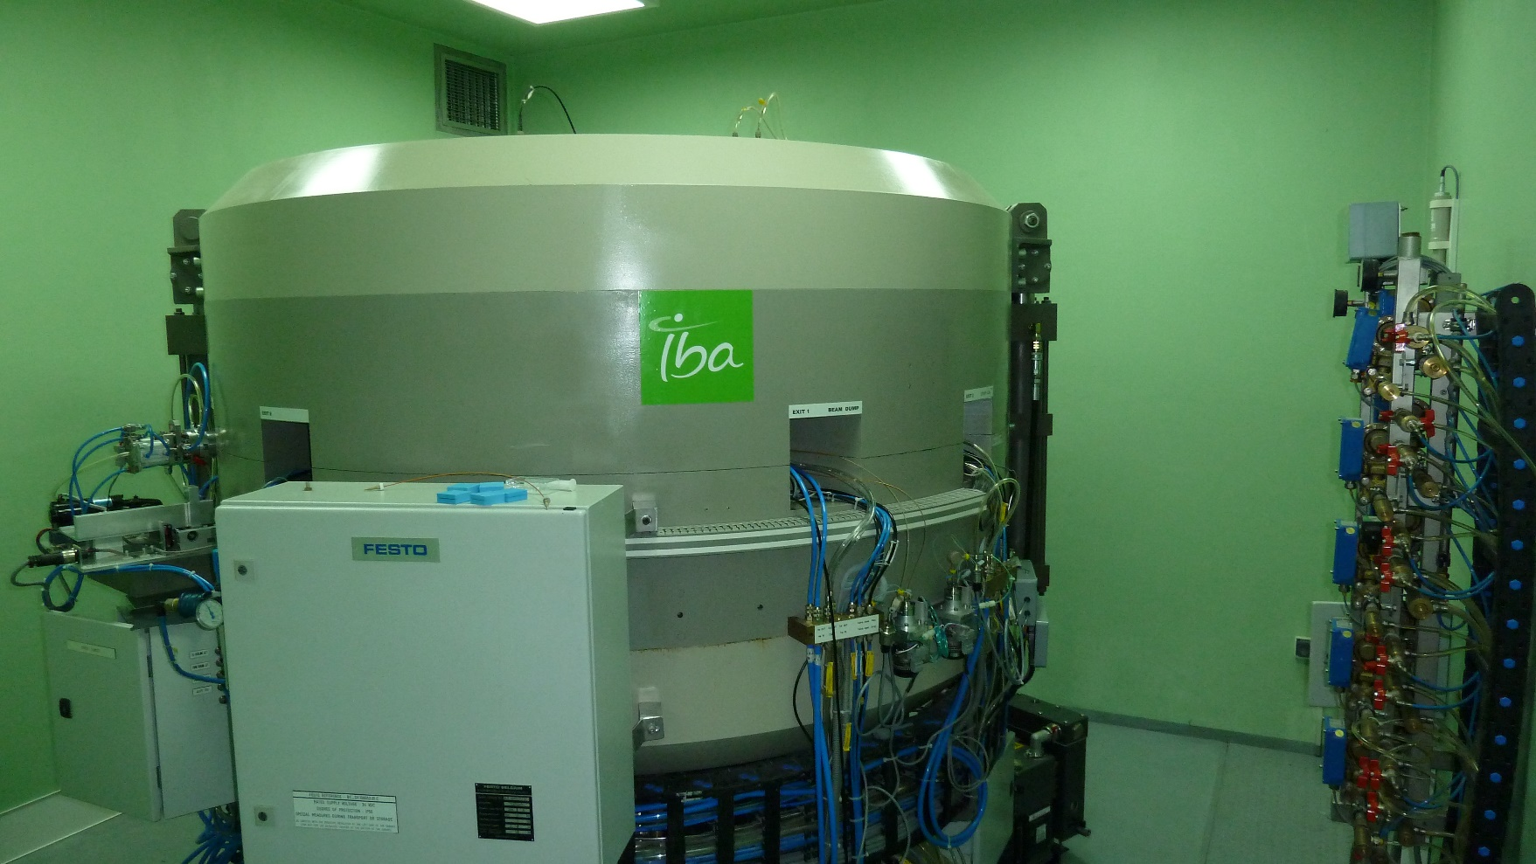
The Maria Sklodowska-Curie Memorial Cancer Center
and Institute of Oncology Gliwice Branch
Cyclotron Cyclone 18/9 from Ion Beam Application (IBA)
courtesy of A. d’Adamico and D. Pogoda

Slide 23
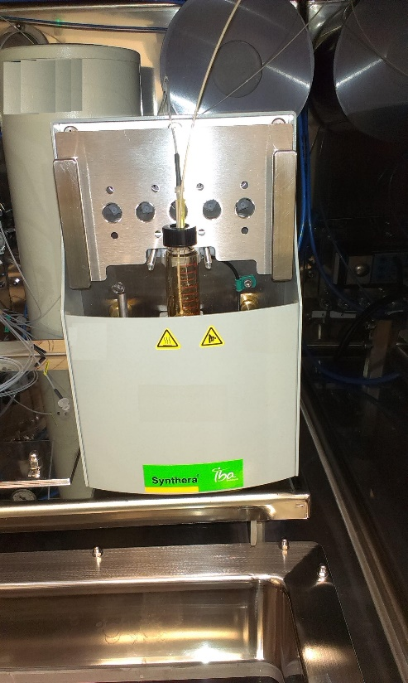
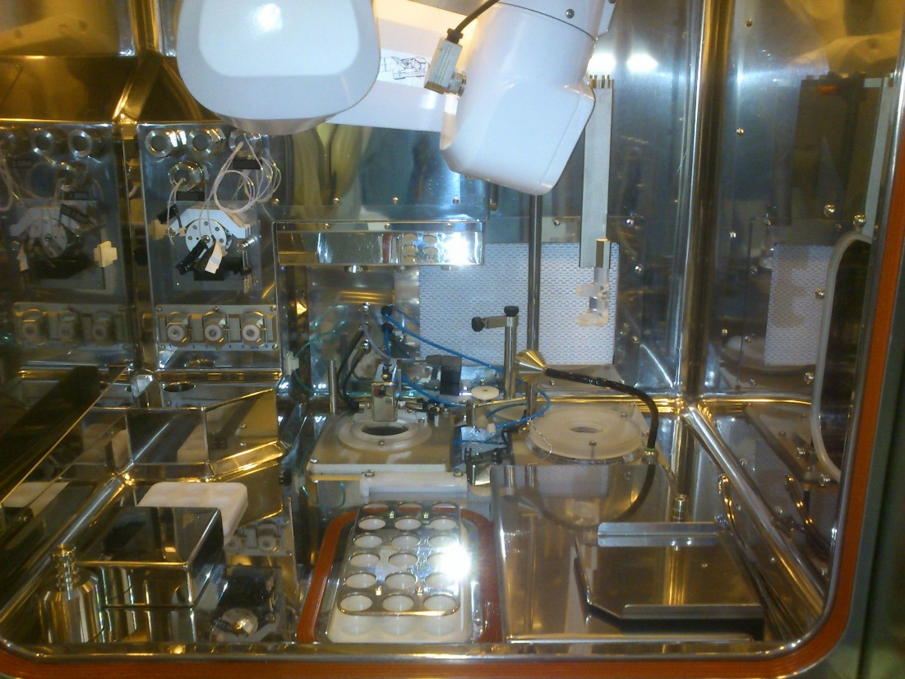
The Maria Sklodowska-Curie Memorial Cancer Center
and Institute of Oncology Gliwice Branch
Radiopharmaceuticals production only for internal use of:
FDG - licensing process in the course
Synthera synthesizer
(IBA)
Theodorico dyspenser
(Comecer)
courtesy of A. d’Adamico and D. Pogoda

Slide 24
The Maria Sklodowska-Curie Memorial Cancer Center
and Institute of Oncology Gliwice Branch
Isotope | Radiopharmaceutical | Synthesizer / Producer
¹¹C | Choline | Reform / BIOSCAN
 | Methionine
 | Carbon acetate
⁶⁸Ga | Ga-DOTATATE
¹⁸F | Sodium fluoride | Synthera / IBA
 | Fluoro-L-Thymidine
 | ¹⁸F-Choline
 | Fluoro-Dopamine | SynChrom / Raytest
¹²⁴I | Sodium iodide | Terimo / IBA
 | Metaiodobenzylguanidine
courtesy of A. d’Adamico and D. Pogoda

Slide 25
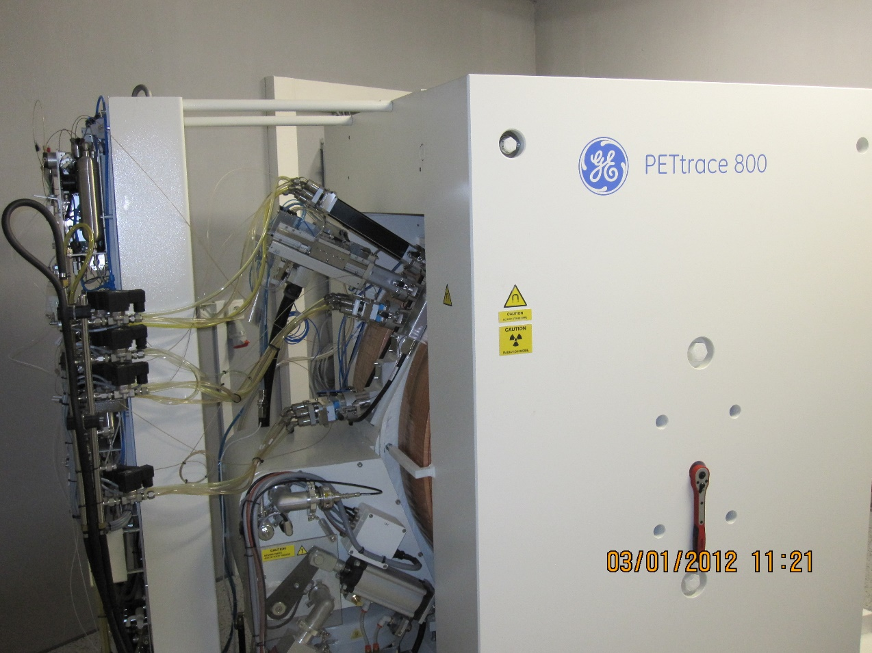
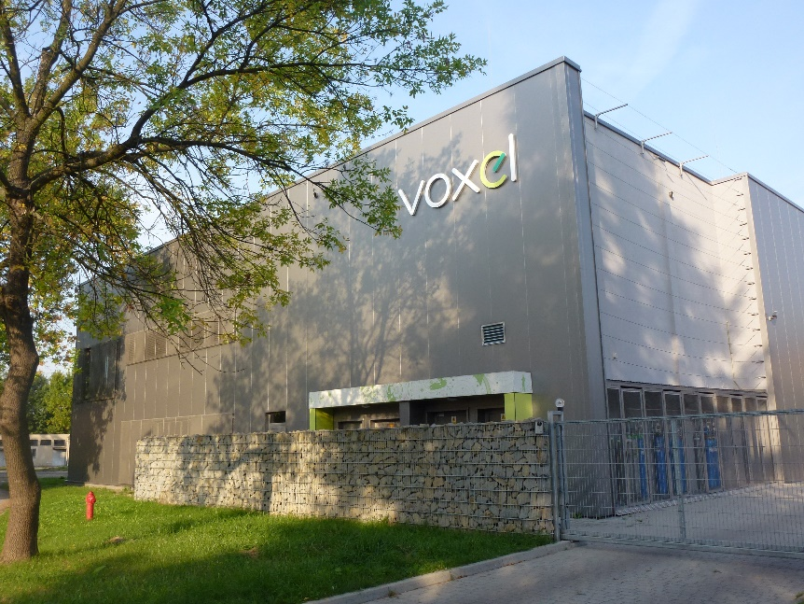
NZOZ MCD VOXEL OŚRODEK PET-TK-MR at Kraków
Cyclotron PETtrace 860 General Electric
courtesy of J. Liszka and M. Pilch-Kowalczyk

Slide 26
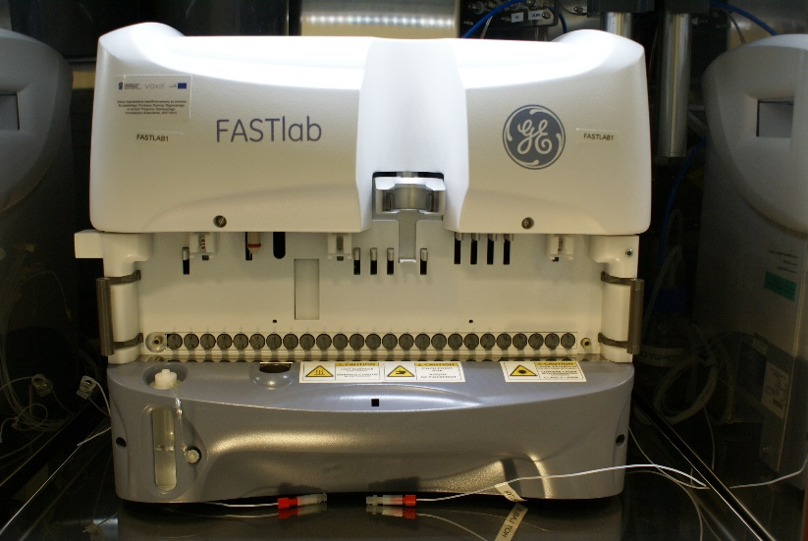
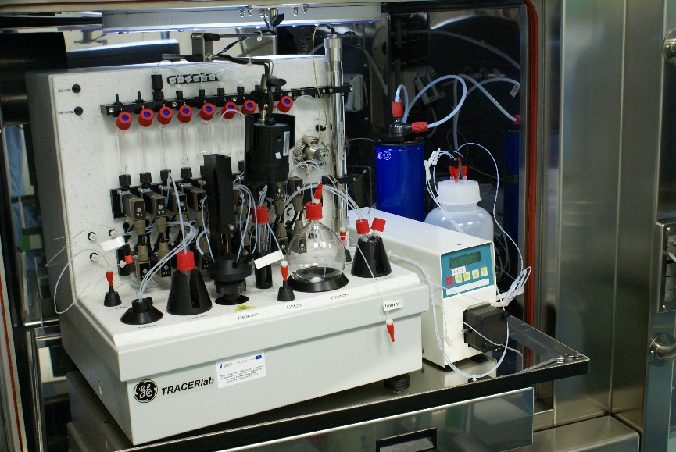
NZOZ MCD VOXEL OŚRODEK PET-TK-MR at Kraków
The comercial production of FDG (SteriPET)
Installed synthesizers :
FDG synthesizer FASTlab
TRACERlab FX_{F-N}
TRACERlab FX C PRO
TADDEO cupper chloride synthesizer
courtesy of J. Liszka and M. Pilch-Kowalczyk

Slide 27
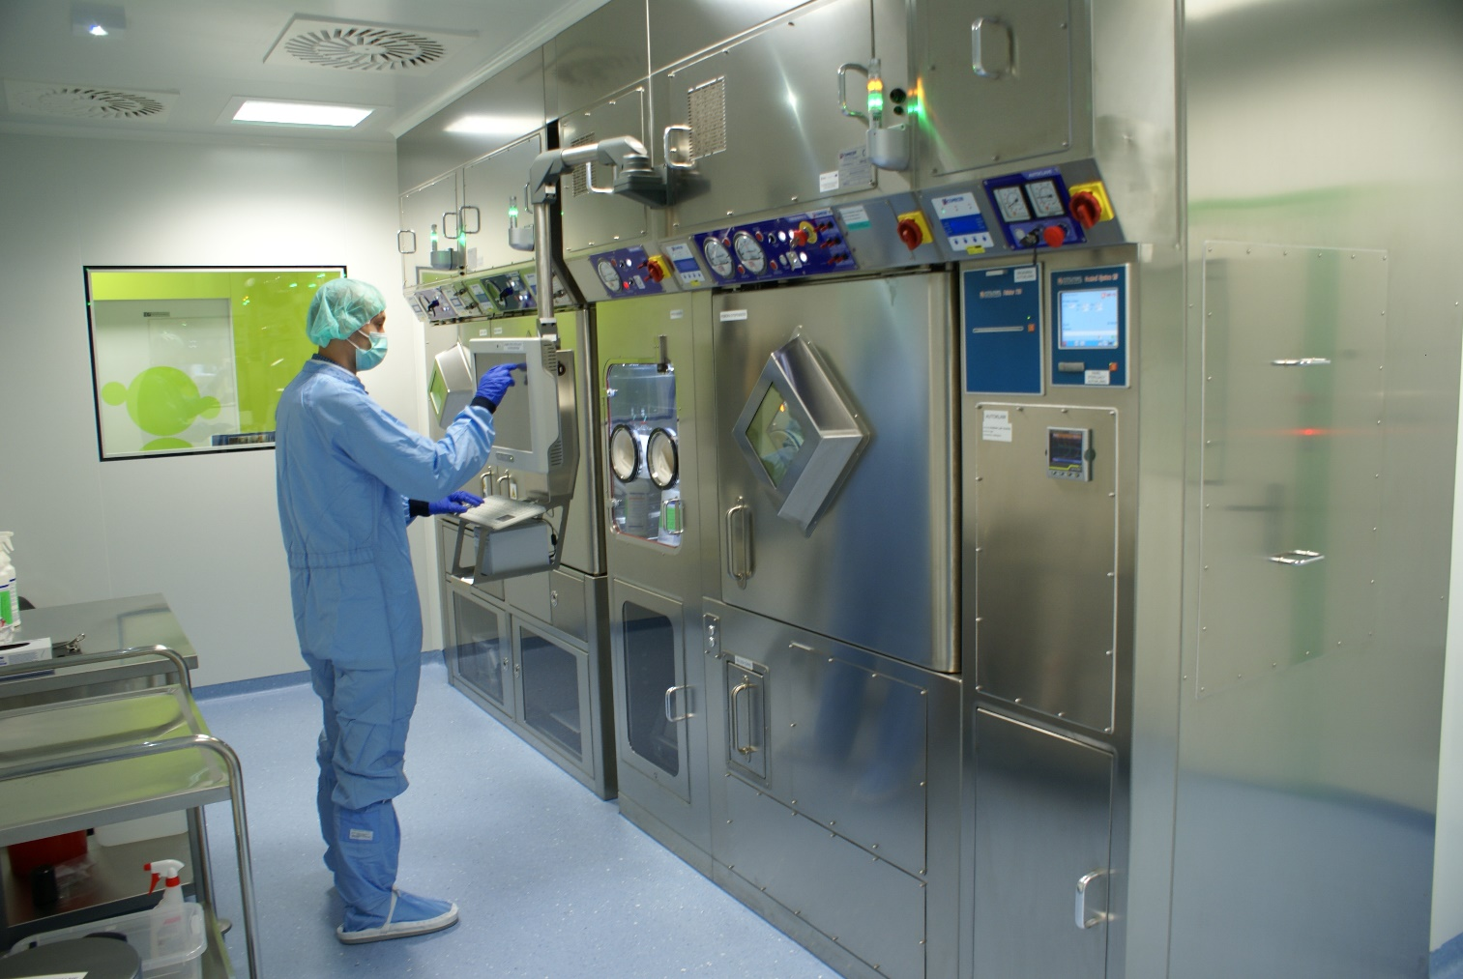
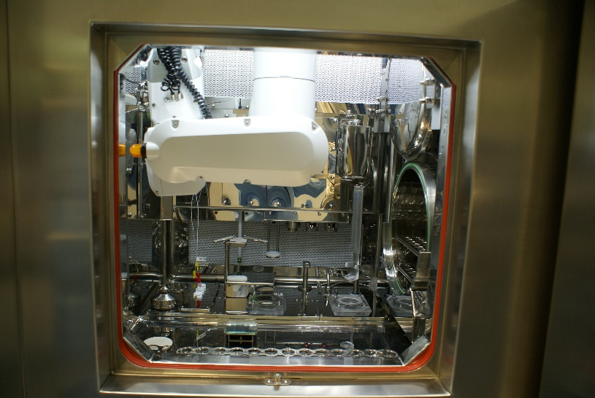
NZOZ MCD VOXEL OŚRODEK PET-TK-MR at Kraków
hot cells from Comecer
dyspenser Theodorico - 2 units
courtesy of J. Liszka and M. Pilch-Kowalczyk

Slide 28
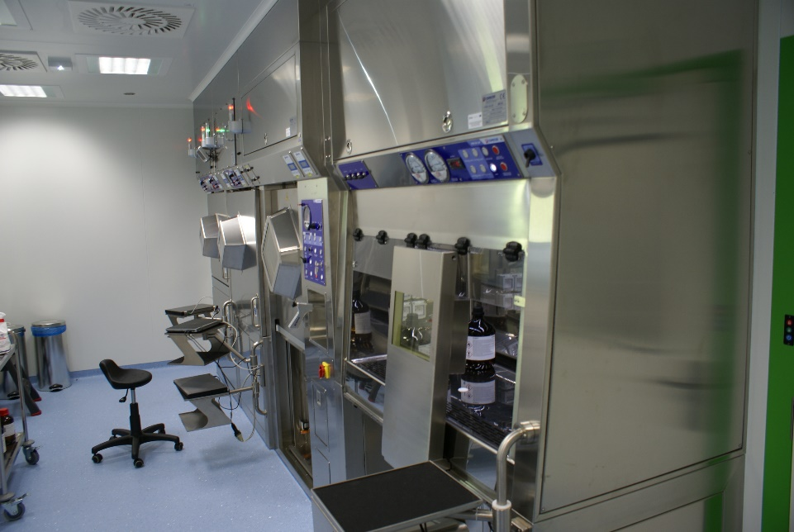
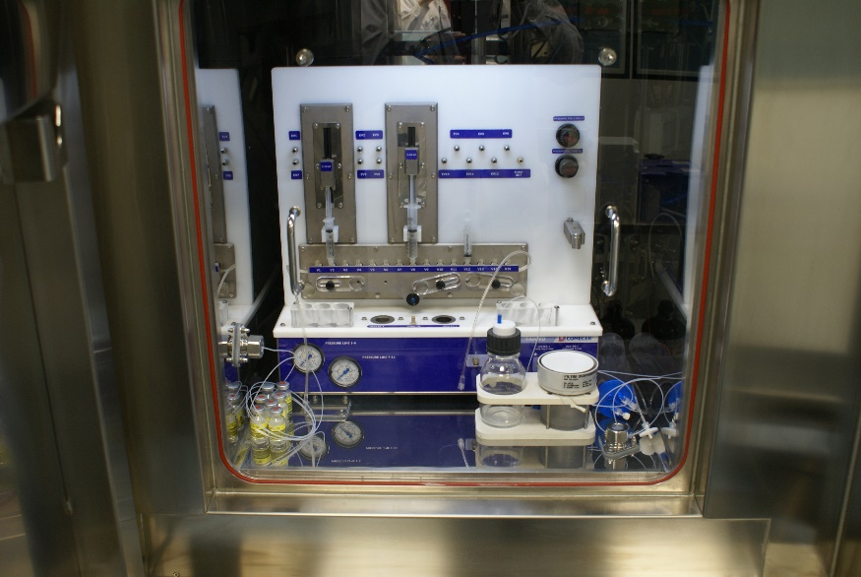
NZOZ MCD VOXEL OŚRODEK PET-TK-MR at Kraków
The production of:
¹¹C-Choline (application for registration in Poland very well advanced)
⁶⁴Cu-Cupper chloride (Comecer TADDEO)
involved in amyloid radiopharmaceuticals developments
in the near future ⁸⁹Zr zirconium
courtesy of J. Liszka and M. Pilch-Kowalczyk

Slide 29
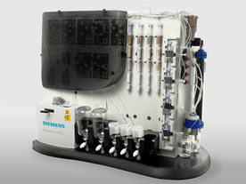
The Regional Oncology Center of the Kopernik Hospital at Łódź
Cyclotron Eclipse Siemens
FDG synthesizer Explora
The radiopharmaceuticals production
only for internal use of:
FDG
Sodium fluoride
¹⁸F-Choline
Explora FDG₄
courtesy of P. Misiewicz

Slide 30
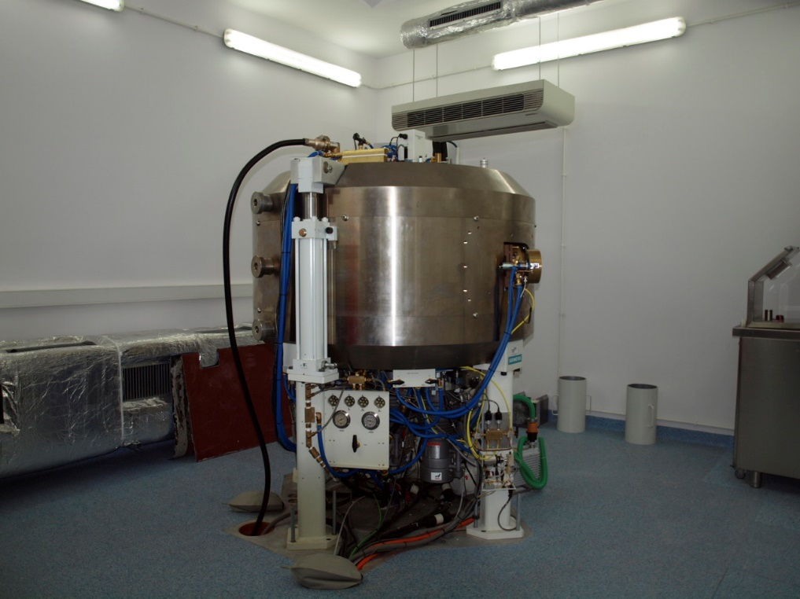
IASON Sp. z o.o
The company owns two premises in:
the Świętokrzyskie Oncology Center at Kielce – commercial production center
the Military Institut of Medicine at Warsaw – research center
Cyclotron Eclipse
courtesy of P. Kozanecki

Slide 31
IASON Sp. z o.o
In the Świętokrzyskie Oncology Center at Kielce – IASON produces:
1) EFDEGE – Fludeoksyglucose
and
2) IASOflu – [18F]Natriumfluoride
courtesy of P. Kozanecki

Slide 32
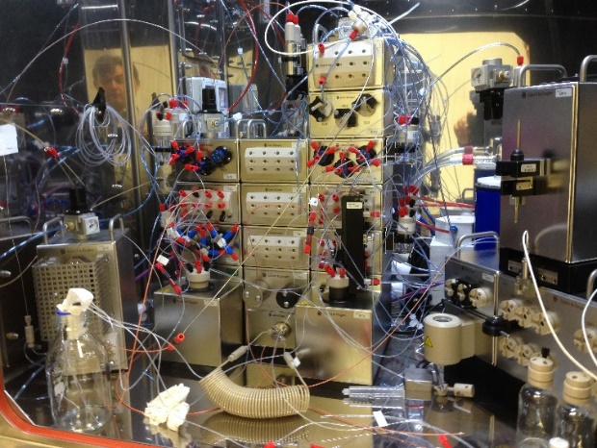
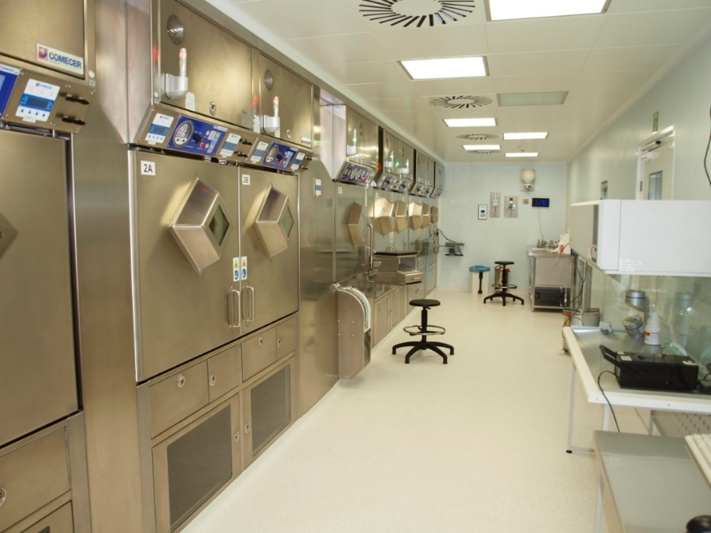
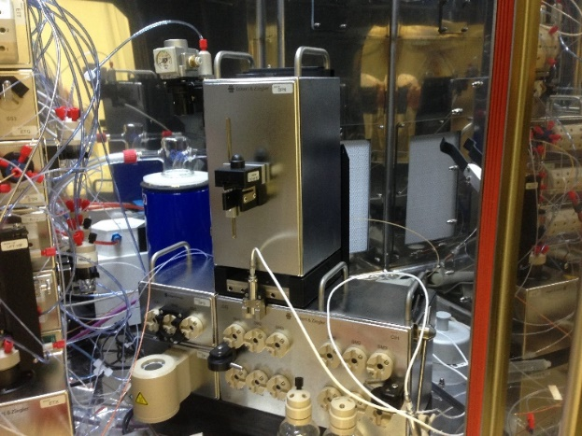
IASON Sp. z o.o
In the Military Institut of Medicine at Warsaw the assembled equipment allows to produce:
Cholina
Dopa
FLT
FET
F-Miso
The Eckert and Ziegler ¹¹C Modular-Lab Chemistry Solution
courtesy of P. Kozanecki

Slide 33
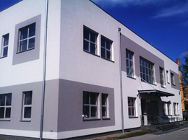
MONROL POLAND
Warsaw Plant
Built on a 2000 m² area in Mszczonow
1 IBA Cyclone 18/9, 18 MeV Cyclotron
FDG Production
courtesy of R. Tomecki and H. Dilaver

Slide 34
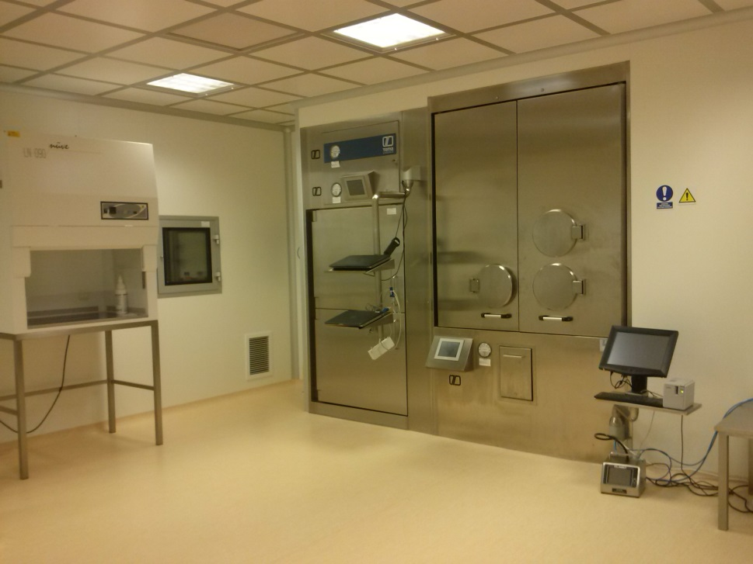
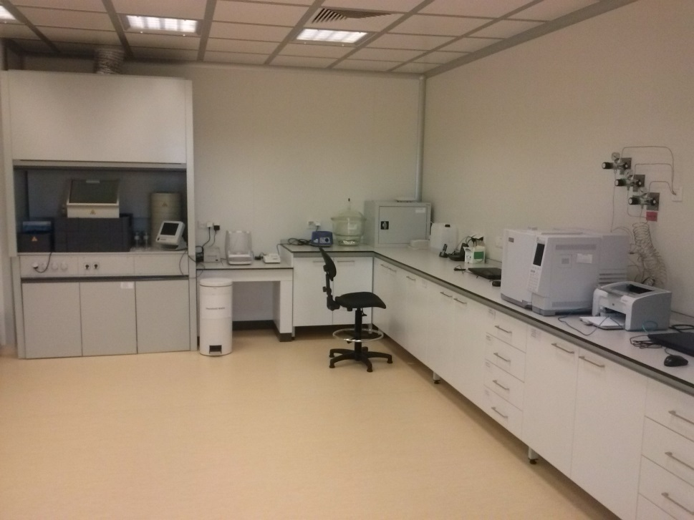
MONROL POLAND
FDG Production Lab
Quality Control Lab
courtesy of R. Tomecki and H. Dilaver

Slide 35
MONROL POLAND
PET
FDG
NaF
SPECT
Mo99/Tc99m Generator
Idodine-131 Oral Capsule
Iodine-131 Oral Solution
Thallium-201 Injectable Solution
Cold Kits
Distributed
Therasphere
courtesy of R. Tomecki and H. Dilaver

Slide 36
Eckert & Ziegler EURO-PET
Many times I have been trying to contact representatives of this company
but to no avail.
http://ww.ceepharma.com/news/205336/eckert-ziegler-to-start-production-of-radiopharmaceuticals-in-h2-2014
”Eckert & Ziegler to start production of radiopharmaceuticals in H2 2014
18 February 2014
Karolin Riehle, of Eckert & Ziegler, a global provider of isotope technology for medical use,
has told PMR that the company plans to start the production of fludeoxyglucose (18 FDG) and
other tracers for cancer imaging diagnostics at its cyclotron-based PET radiopharmaceuticals
factory in the Warsaw area in the second half of 2014. Mrs Riehle added that the factory has already received the occupancy permit. The group has selected Warsaw because of the availability of highly qualified,
skilled personnel and the large number of nuclear medical facilities in the region. Its location near
the beltway and Warsaw's city center will enable fast delivery of short half-life radiopharmaceuticals
to the cancer diagnostic centers. …”

Slide 37
Eckert & Ziegler EURO-PET
Expected radiopharmaceuticals production
FDG (Fludeoxyglucose [¹⁸F]) solution for injection
Yttriga ([⁹⁰Y]Yttrium chloride) radiopharmaceutical precursor, sterile solution
http://www.ezag.com/home/products/radiopharma/radionuclides/radiopharmaceuticals.html
Radiopharma
We provide a range of radiopharmaceuticals, radiochemicals and related equipment for
the synthesis and labeling of PET and SPECT tracers or other radioisotopes.

Slide 38
Conclusions
The National Health Fund in 2014 has signed contracts with PET scanner operators for reimbursement roughly 20 000 FDG PET examinations.
Real limitation for regular usage of other then FDG radiopharmaceuticals is lack of reimbursement from the National Health Fund.

Slide 39
Thank you very much for your attention !

