Slide 1
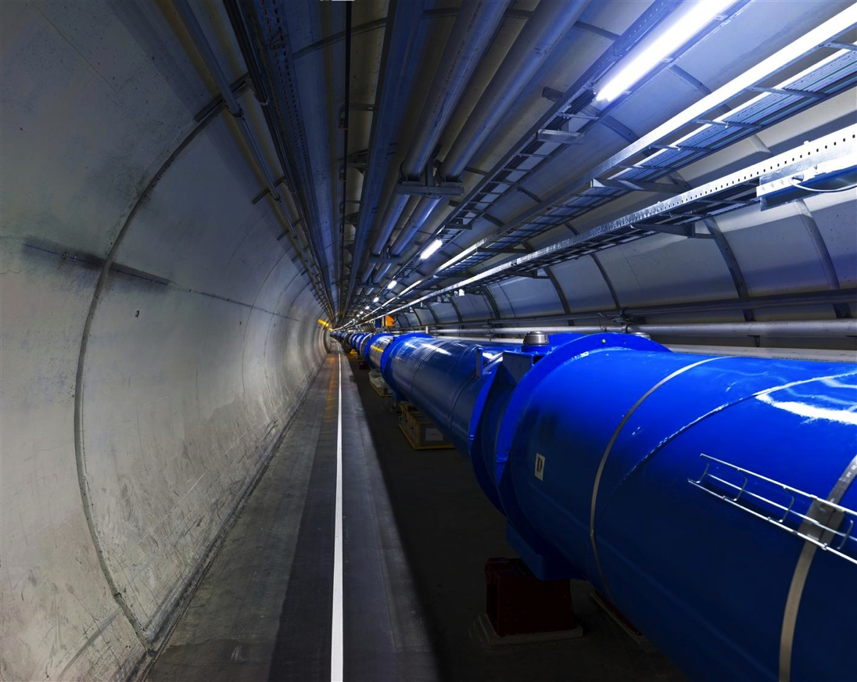
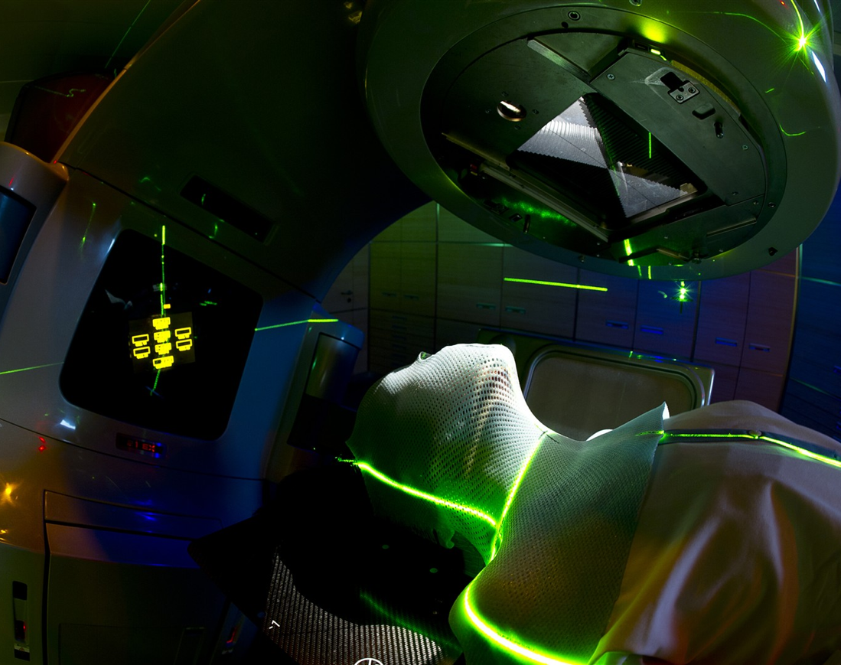

Biomedical research perspectives @CERN
II Symposium on Positron Emission Tomography
Manjit Dosanjh, CERN
manjit.dosanjh@cern.ch

Slide 2
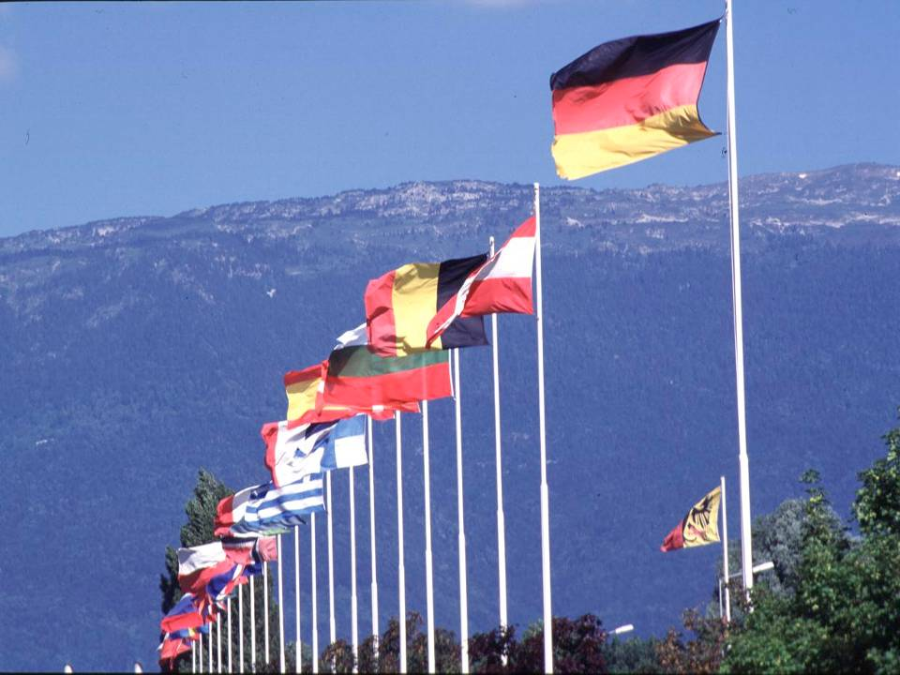

CERN was founded 1954: 12 European States
“Science for Peace”
Today: 21 Member States
~ 2300 staff
~ 1600 other paid personnel
~ 10500 scientific users
Budget (2014) ~1000 MCHF
Member States: Austria, Belgium, Bulgaria, the Czech Republic, Denmark, Finland, France, Germany, Greece, Hungary, Israel, Italy, the Netherlands, Norway, Poland, Portugal, Slovakia, Spain, Sweden, Switzerland and
the United Kingdom
Candidate for Accession: Romania
Associate Member in Pre-Stage to Membership: Serbia
Applicant States for Membership or Associate Membership:
Brazil, Croatia, Cyprus, Pakistan, Russia, Slovenia, Turkey, Ukraine
Observers to Council: India, Japan, Russia, Turkey, United States of America; European Commission and UNESCO
2
Notes:
2
----- Meeting Notes (09/01/2013 14:16) -----
nnn

Slide 3
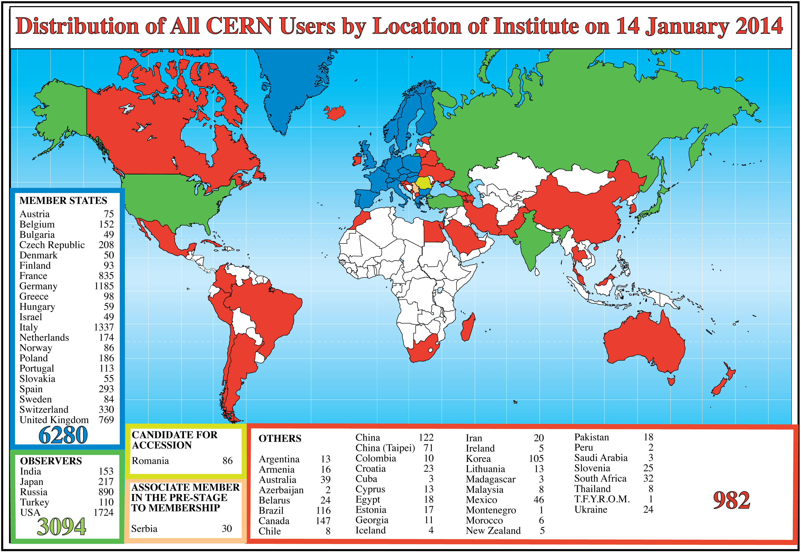
Science is getting more and more global
Notes:
3
3

Slide 4
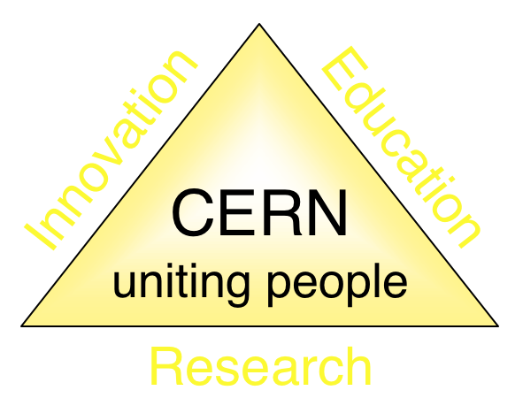
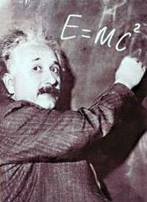
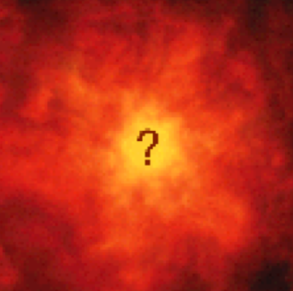

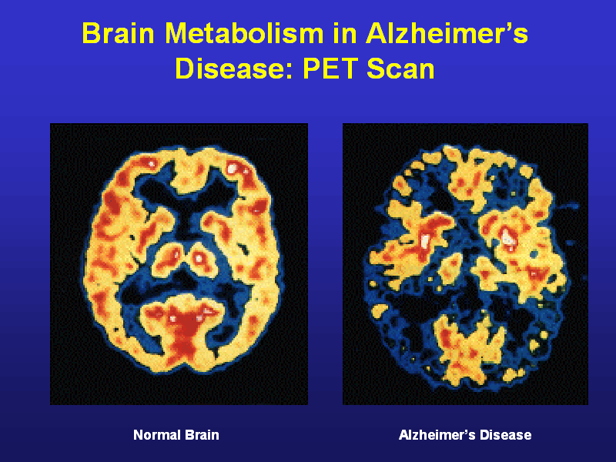
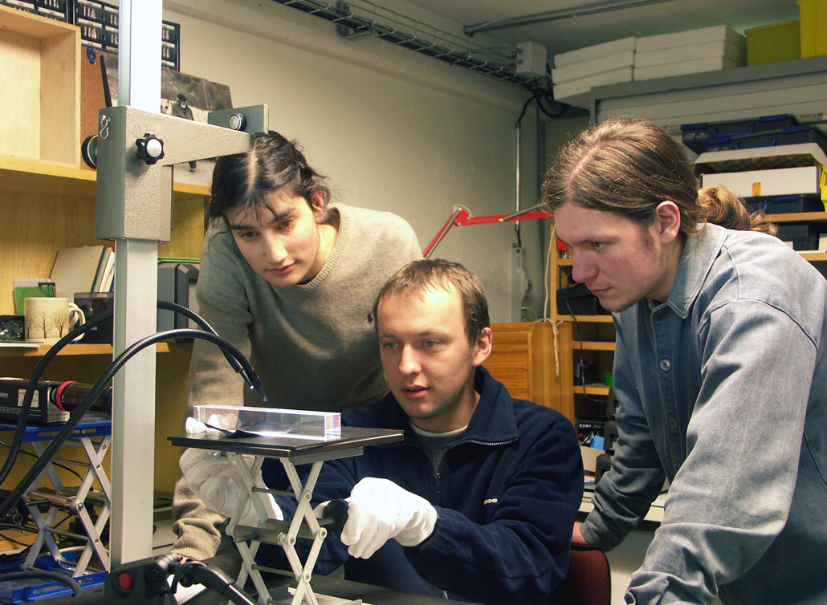
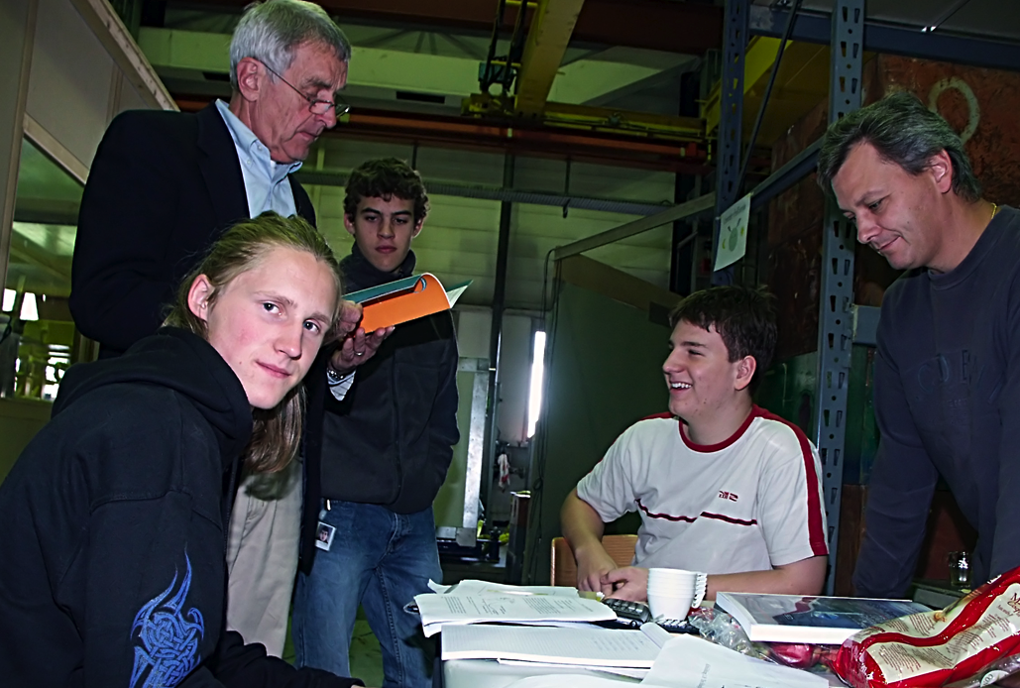
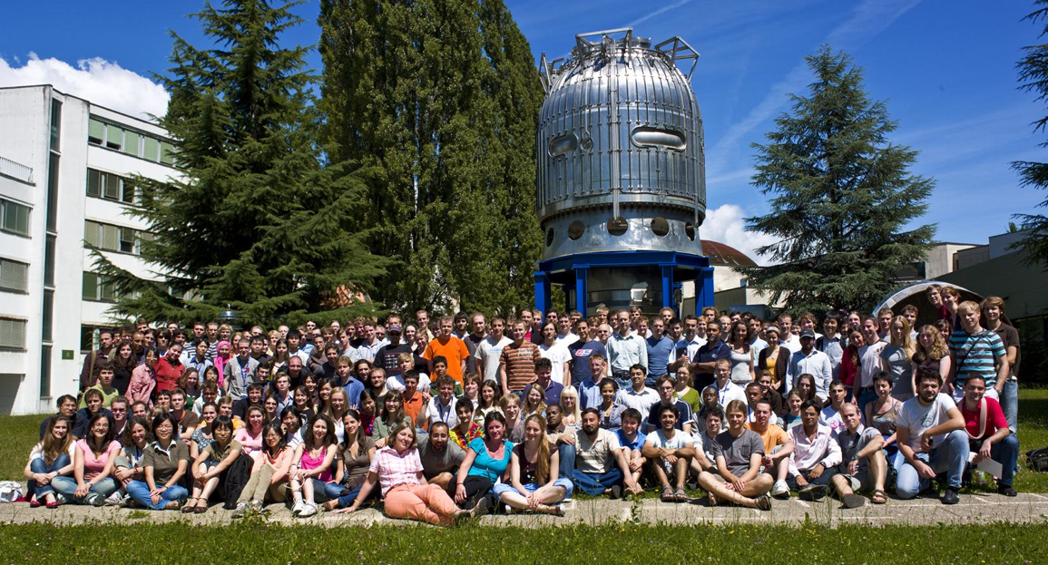
The Mission of CERN
Push forward the frontiers of knowledge
E.g. the secrets of the Big Bang …what was the matter like within the first moments of the Universe’s existence?
Develop new technologies for accelerators and detectors
Information technology - the Web and the GRID
Medicine - diagnosis and therapy
Train scientists and engineers of tomorrow
Unite people from different countries and cultures
Notes:
4

Slide 5
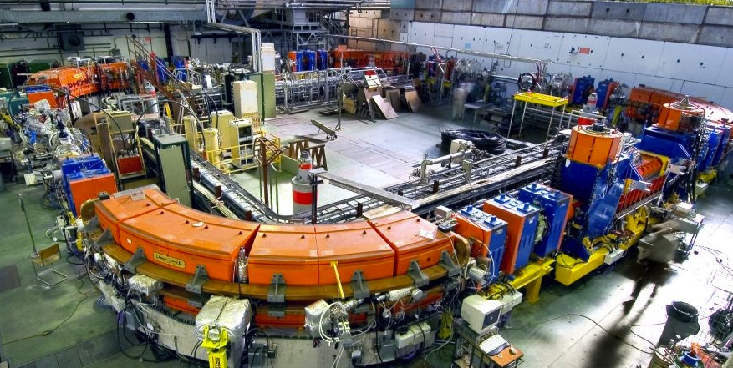

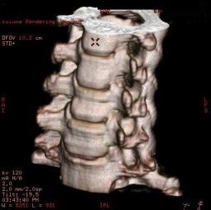
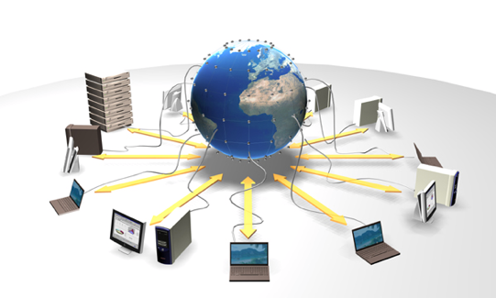
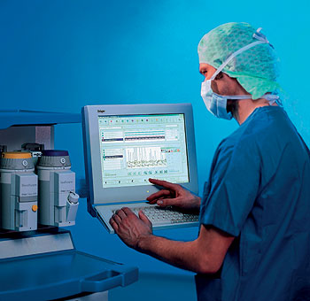
catalysing & facilitating collaboration
Accelerating particle beams
Particle Therapy
Tumour Target
Detecting particles
Medical imaging
Large scale computing (Grid)
Grid computing for medical data management and analysis

Slide 6
Biomedical and Physics Needs
HEP
Highest possible performance
Lab environment/physicist operated
Complex maintenance
Complex operation
Single unit production
Non commercial
Industry as a manufacturer
Biomedical
Robustness
Non-specialist operate
Minimal maintenance
Simple to operate
Small series production
Commercial distribution
Industry as a major partner

Slide 7
Catalysing collaboration in health field
Challenges:
Bring together physicists, biologists, medical physicists, doctors
Cross-cultural at European and global level
Why is CERN well placed to do this?
It is widely acknowledged as a provider of technologies and as a catalyst for collaboration.
It is international, non-commercial, not a health facility.
Notes:
ULICE Kick-off in 2009
ENVISION approval in 2009
Enlight meeting leading to subm. Of ENTERVISION
PARTNER: 21 researchers recruited last year.

Slide 8
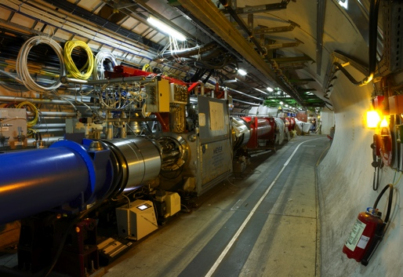

Physics technologies and innovation
accelerators, detectors and IT to fight cancer
Detecting
particles
Accelerating particle beams
Large-scale computing (Grid)
CANCER
Notes:
8

Slide 9
Cancer is a large and growing challenge
Need: Earlier diagnosis, better control, fewer side-effects
How?
new technologies
  Imaging, dosimetry, accelerator & detector technology
  Better understanding – genetics, radiobiology…
  Advanced healthcare informatics …
international collaboration
  If progress is to be maintained
Although cancer is a common condition, each tumour is individual
  personalised approach
  Large patients data to understand the key drivers of the disease
Contribution from CERN & physics is considered timely

Slide 10
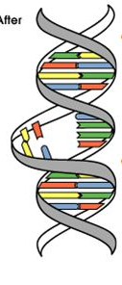
Conventional Radiotherapy in 21st Century
3 "Cs" of Radiation
Cure (~ 45% cancer cases are cured)
Conservative (non-invasive, few side effects)
Cheap (~ 5% of total cost of cancer on radiation)
(J.P.Gérard)
There is no substitute for RT in the near future
The rate of patients treated with RT is increasing
Present Limitation of RT:
~30% of patients treatment fails locally
Notes:
10

Slide 11
How to decrease failure rate?
Accelerator technologies to improve treatment: higher dose
Detectors/imaging: accuracy, multimodality, real-time, organ motion
Data: storage, analysis and sharing (confidentiality, access)
Biology: fractionation, radio-resistance, radio-sensitization
Collaboration in this multidisciplinary field is key
Raymond Miralbell, HUG
Notes:
11

Slide 12
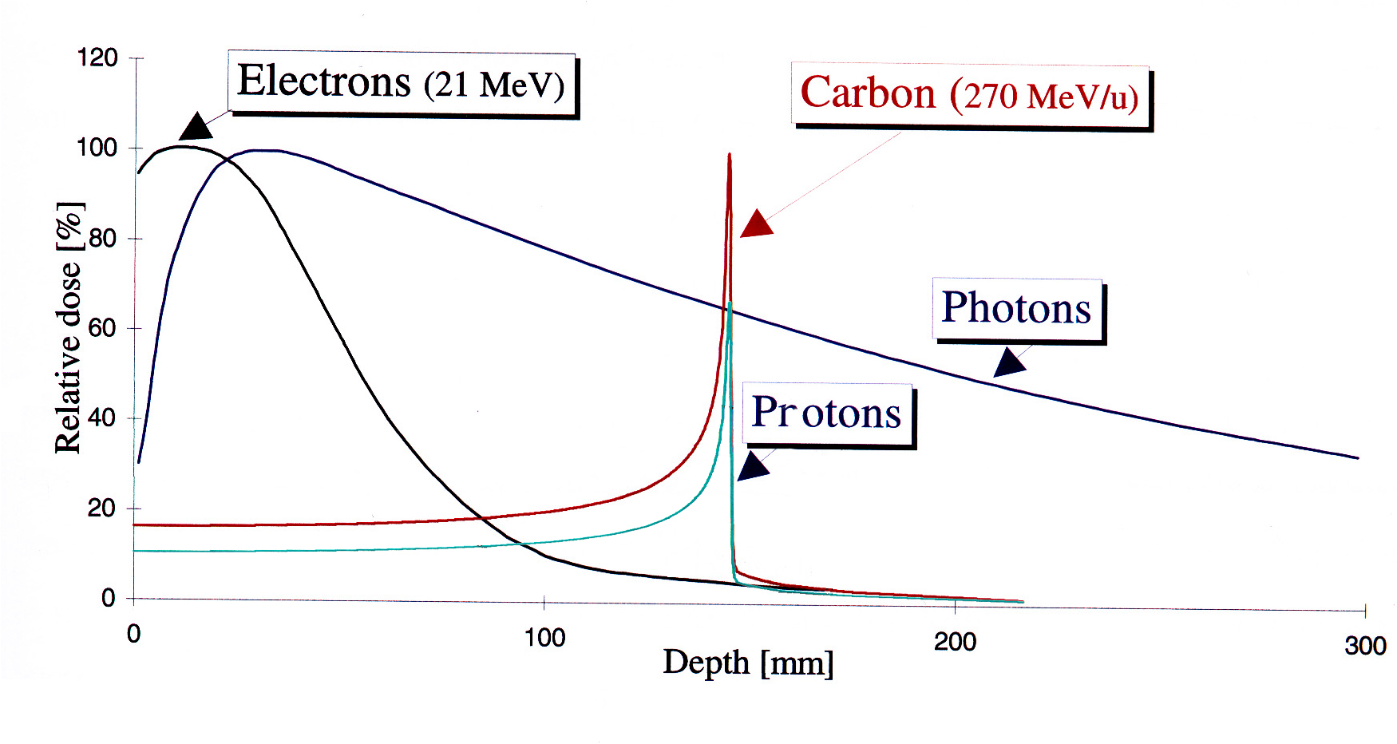
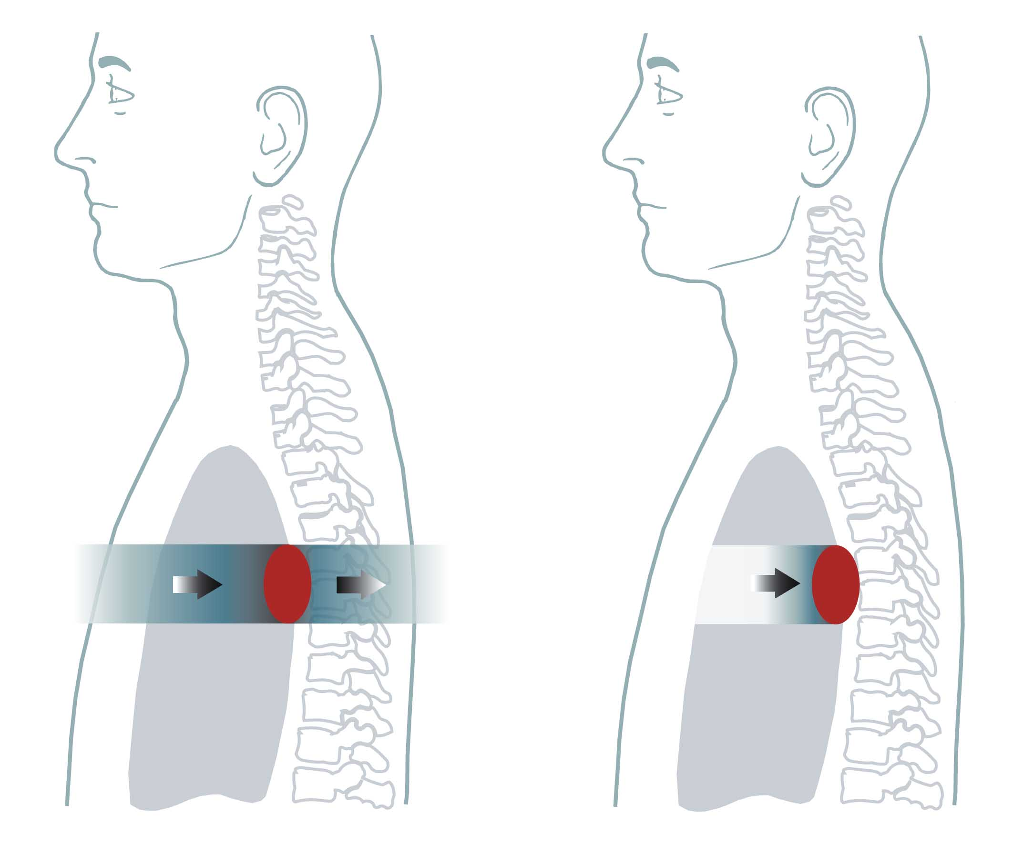
Hadrontherapy: all started in 1946
In 1946 Robert Wilson:
  Protons can be used clinically
  Accelerators are available
  Maximum radiation dose can be placed into the tumour
  Particle therapy provides sparing of normal tissues
- Tumours near critical organs
- Tumours in children
- Radio-resistant tumours
Conventional: X-Rays Ion Radiation
Depth in the body (mm)
Notes:
12

Slide 13
Proton & Ion Beam Therapy: a short history
Proposed by R.R. Wilson
MedAustron (Austria)
1st patient at Berkeley by Lawrences
CNAO, Pavia (Italy)
1st patient in Europe at Uppsala
HIT (carbon), Heidelberg (Germany)
1984
1989
1990
1991
1992
1993
1994
1996-2000
2002
1946
1954
1957
2009
2011
2015
PSI, Switzerland
PIMMS
Eye tumours, Clatterbridge, UK
GSI carbon ion pilot, Germany
ENLIGHT
ENLIGHT
10th year
CPO (Orsay), CAI (Nice), France
Loma Linda (clinical setting) USA
Boston (commercial centre) USA
NIRS, Chiba (carbon ion) Japan

Slide 14
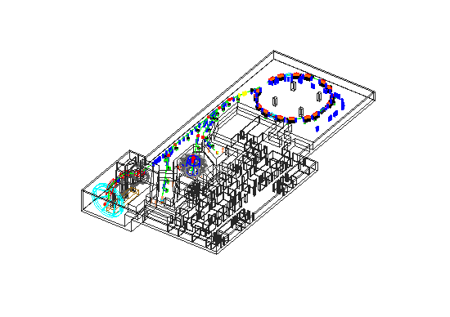
The Proton-Ion Medical Machine Study (PIMMS)
Facility for hadron therapy
Carbon-ions and protons
High precision active scanning (C, p)
Conventional passive spreading (p)
Fixed beam lines and gantries for maximum flexibility (C,p)
Green-field solution, no starting constraints
Generic study, to be adapted to specific regional needs

Slide 15
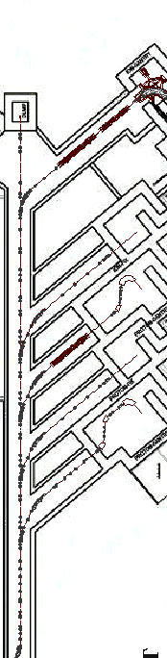
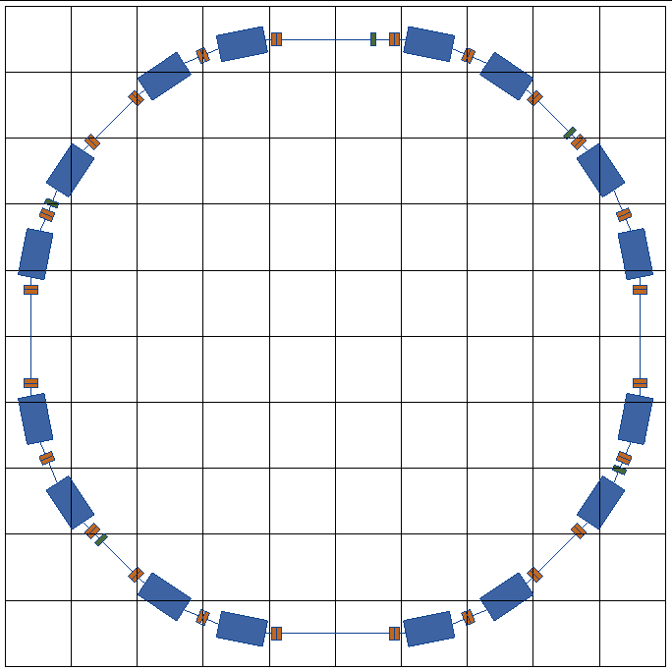
PIMMS at CERN (1996-2000)
linacs for
carbon ions
and protons
400 MeV/u synchrotron
p
p
p
C
C
RF cavity
Resonance sextupole
Sextupole horiz. chromaticity
Sextupole vert. chromaticity
Betatron
core
Circumference C = 76.84 m
Tune horizontal Q_{x} = 1.67
Tune vertical Q_{z} = 1.72
Sextupole vert.
chromaticity
Sextupole horiz. chromaticity
Electrostatic septum
CERN-TERA-MedAustron
Injection septum
Extraction septum

Slide 16
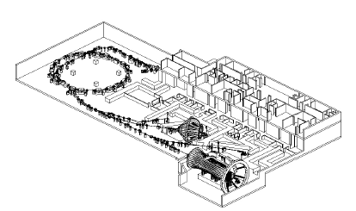
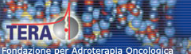
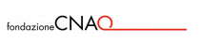
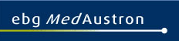
Accelerator Technologies
PIMMS 2000 (coordinated by CERN) has led to:
Treatment centre in Pavia, Italy.
First patient treated with in 2011
Treatment centre in Wiener Neustadt, Austria,
foundation stone in 2011, installation moved to MedAustron at beginning of 2012, first patient in 2015

Slide 17
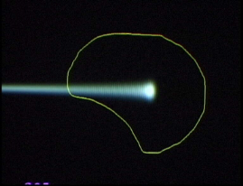
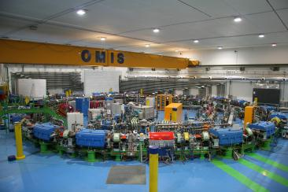
ENLIGHT: Importing CERN collaboration philosophy into a medical environment
  Create common multidisciplinary platform
  Cancer treatment
  Identify challenges
  Share knowledge
  Share best practices
  Harmonise data
  Provide training, education
  Innovate to improve
  Lobbying for funding
Notes:
17

Slide 18


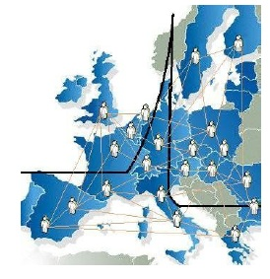
10 years of ENLIGHT collaboration
  Common multidisciplinary platform
  Identify challenges
  Share knowledge
  Share best practices
  Harmonise data
  Provide training, education
  Innovate to improve
  Lobbying for funding
  Coordinated by CERN
> 150 institutes
> 400 people
> 25 countries
(with >80% of MS involved)

Slide 19





EU funded projects
Wide range of hadron therapy projects: training, R&D, infrastructures
A total funding of ~24 M Euros
All coordinated by CERN,(except ULICE coordinated by CNAO
Under the umbrella of ENLIGHT
Marie Curie ITN
12 institutions
Infrastructures for hadron therapy
20 institutions
R&D on medical imaging for hadron therapy
16 institutions
Marie Curie ITN
12 institutions

Slide 20


ENVISION
European Novel Imaging Systems for Ion Therapy
Accurate positioning is a crucial challenge
for targeting moving organs during particle treatment
4-year EU funded project: Budget 6M euros
launched in February 2010
16 leading European research centres and industrial partners, coordinated by CERN
R&D in real-time medical imaging for more precise and effective particle therapy
  2 demonstrators for real time imaging have been constructed and are being tested
  > 40 scientific publications and 80 conference talks/posters

Slide 21
Current Status

Slide 22

Particle therapy facilities in operation (Tsujii, 2014)
Europe/Russia: 16
Asia: 16
USA/Canada: 15
St Petersburg
Dubna
Moscow
Clatterbridge
Uppsala
Vancouver
Seoul
Wajie
Chicago
Krakow
Bloomington
Prague
Chiba
Hyogo
Gunma
Saga
Seattle
Boston
Lanzhou
Pennsylvania
Villigen
Sacrament
Orsay
Nice
Someset
Loma Linda
Shanghai
Tsukuba
Kashiwa
Shizuoka
Fukui
Nagoya
Koriyama
Ibusuki
Sapporo
Hampton
Pavia
San Diego
Catania
Oklahoma
Jacksonville
Heidelberg
Berlin
Munich
Essen
Houston
St Louis
Faure
Proton | 40
Carbon | 4
P + C | 4
Total | 48

Slide 23
Particle therapy facilities in a planning stage or under construction (Tsujii, 2014)
Essen
Kein
Uppsala
Dresden
Marburg
Bratislava
Ruzomberok
Seoul
Flint
Delft
Protvino
Pusan
Rochester
Wiener
Neustadt
Beijing
Chicago
St.Louis
New York
Lanzhou
Wuwei
Phoenix
Galgenen
Nice
Kanagawa
New Brunswick
Trento
San Diego
Orsay
Nagano
Osaka
Okayama
Jacksonville
Oklahoma
Orland
Riyahdt
Taipei
Shreveport
Knoxville
Europe/Russia: 12
Asia: 10
USA/Canada: 13
Proton | 30
Carbon | 4
P + C | 2
Total | 36

Slide 24
Number of patients treated with
Protons and C-ions in the world
Referred to PTCOG (As of 26-June-2012)

Slide 25
Challenges for future…
Clinical trials
Optimisation of the present facilities to increase patient output
Cheaper/compact facilities easier to run, cheaper treatment
Help countries in Europe wanting facilities
Collaboration outside of Europe
Still on going
Heterogeneous network: differing needs and interests
How to balance between basic research and the clinical needs?
Many partners. How to collaborate effectively and make progress with the key objectives?
How to position ourselves for the future

Slide 26


RT Information Sharing
RT-DB
Connect:
Users
Data sources
by
Grid core
Security
Integration
Portals
Interfaces
Research
Patient
Referral
Grid
Middleware
Data Integration
Data Access Services
Security
Further
Use Case
Use Scenarios
HISP
DNA
PACS
Tissue
HIS
Data Sources
Physics

Slide 27
The New (2013) CERN Medical Initiatives
Medical Accelerator Design
  coordinate an international collaboration to design a new compact, cost-effective accelerator facility, using the most advanced technologies
Biomedical Facility
  creation of a facility at CERN that provides particle beams of different types and energies to external users for radiobiology and detector development
  Iterative experimental verification of simulation results
Detectors for beam control and medical imaging
Diagnostics and Dosimetry for control of radiation
Radio-Isotopes (imaging and treatment)
Large Scale Computing (large data transfers and analysis, treatment planning and simulations)
Applications other than cancer therapy
Will be carried out in a global collaboration

Slide 28
What do we need in the future?
Treat the tumour and only the tumour
    control and monitor the ideal dose to the tumour
    ⇒ Minimal collateral radiation “outside” the tumour
    Minimal radiation to nearby critical organs
  Even if the tumour is moving
Be affordable
    Capital cost ?
    Operating costs ?
    Increased number of treated patients per year ?
Compact: Fit into every large hospital ?

Slide 29
User Specs for Hadron Therapy
Radio-Oncologists,
Radio-Biologists
Medical Physicists,
Beam parameters:
  Particle type(s),
  Measured position,
  Energy range
  Required dose,
  Real time feedback from detectors
Distributing the beam
  rep rate,
  spot scanning,
  gantry
Accelerator type,
Cost-effectiveness and compactness parameters
User Specifications
Detectors and imaging
Accelerator Physicists

Slide 30
Many of these questions can only be answered with
  experimental verifications
  significant simulations
  Development of diagnostics (imaging, dosimetry)
⇒ We need a dedicated test facility

Slide 31
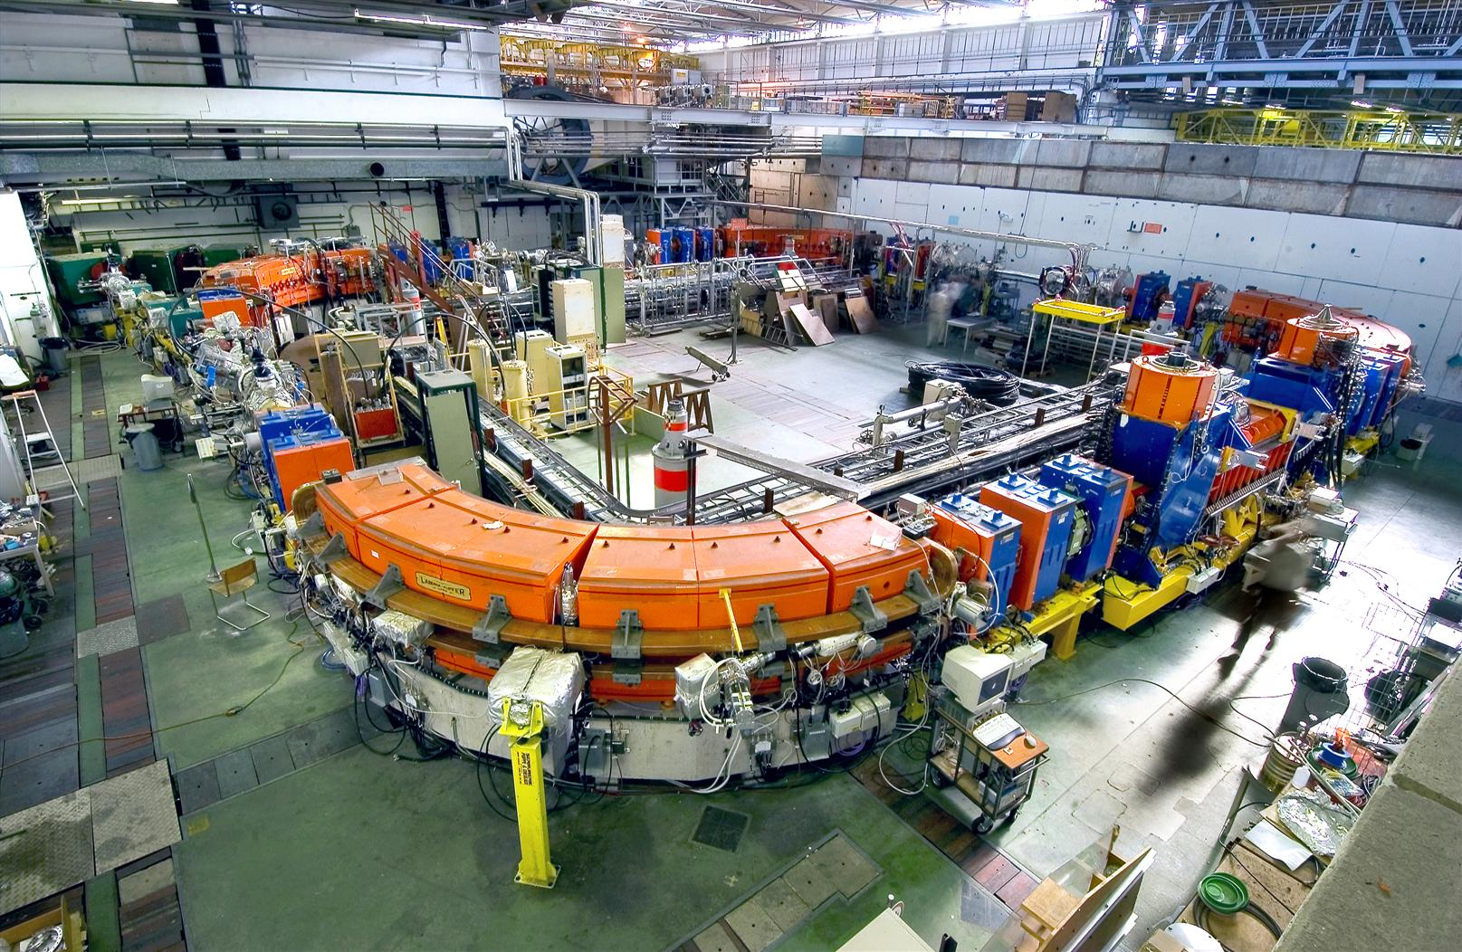
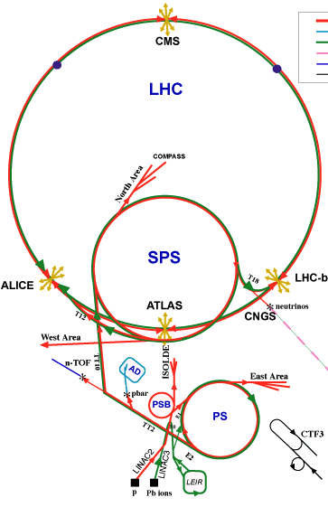
OPENMED: Biomedical Research Facility at CERN
Biomedical facility at CERN using LEIR:
  radiobiology
  fragmentation of ion beam
  Dosimetry
  Detector development
  test of instrumentation
LEIR

Slide 32
What is new on the technology side?
LHC accelerator technology development
    Operation of 8T magnets
    Testing of 11T magnets for Luminosity upgrade
    Development of 18-20T magnets for energy upgrade
LHC Detectors developments
    Crystal scintillators improvements
    Medipix proliferation and enhancements
    Developments of new vertex detectors for LHC luminosity upgrade
    Development of TOF resolution for Luminosity Upgrade (40ps aim)
CLIC
    Accelerating structure frequency reduced from 30GHz to 12GHz
    Development of room temperature structures for 100MV/m gradient
    Proposals for structures of 3 and 5.7 GHz with 30 and 50 MV/m for medical applications
LHC Grid
    Demonstration of the efficiency and reliability
    Rapid adoption to new domains
Developments of medical simulations with FLUKA
How can we improve the previous design using the new technologies?

Slide 33
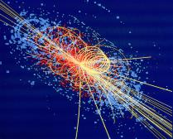
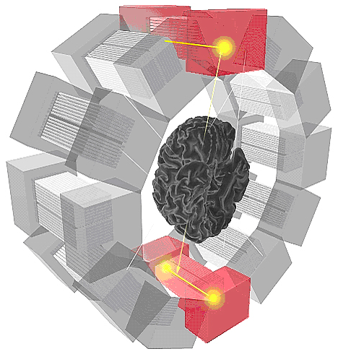
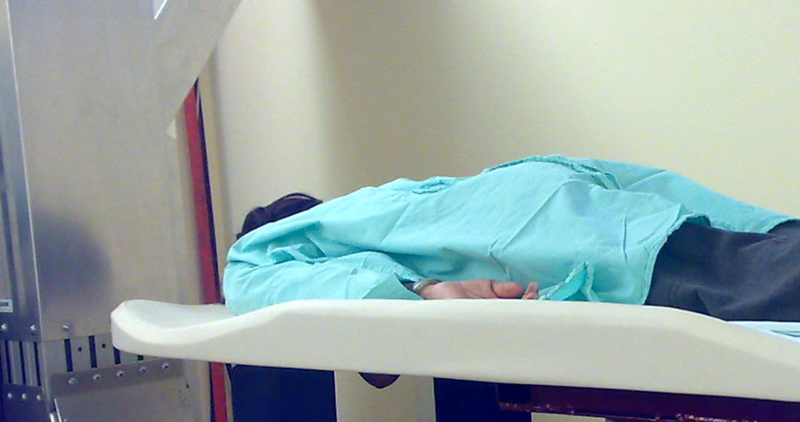
No treatment without detection!
Particle Detection
Imaging
PET Scanner
Breast imaging
(ClearPEM)

Slide 34
Detectors
Continuous development on particle physics detectors at CERN
Scintillating crystals
Medipix
Diamond detectors

Slide 35
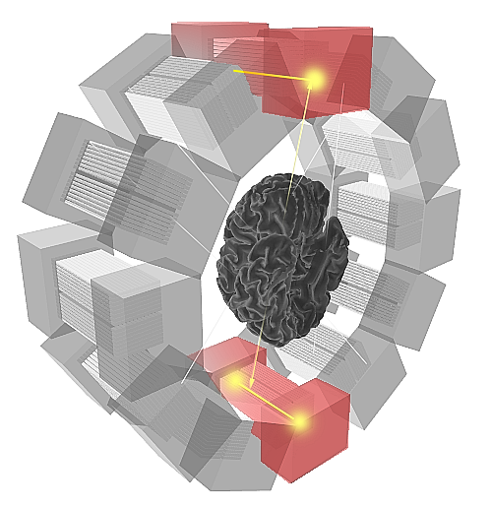
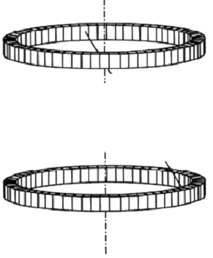

3D Axial PET concept
Conventional concept
New 3D axial concept
http://cordis.europa.eu/technology-platforms/
Illustration:
F. Schönahl, HUG
Rings of block detectors
Axial arrangement of camera modules based on matrices of long crystals read out on both sides by HPDs
Christian Joram PHE2010
Notes:
Advantage: 3D reconstruction without parallax error; depth of measurement;

Slide 36
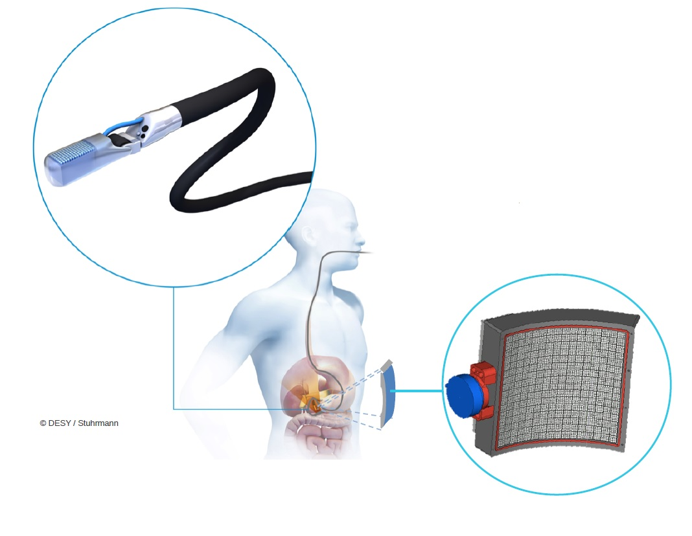

A new PET !
A novel imaging system for endoscopic exams
of the pancreas or the prostate.
A combination of high resolution metabolic
imaging with TOFPET and anatomical imaging
with ultrasound.
The development of targeted biomarkers.
Paul Lecoq, 2014

Slide 37
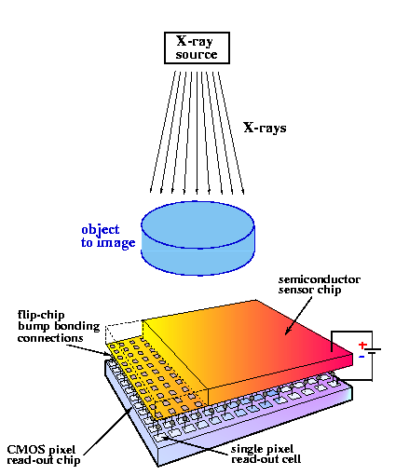

MEDIPIX
Notes:
In this slide it is shown the typical structure of a hybrid pixel detector. You can see that it consists of a CMOS pixel readout chip, which is composed by a matrix of pixel signal processing circuitry, plus a piece of semiconductor sensor material. As you can see, the electrode on the lowest face of the sensor is also pixelated, so that readout chip and sensor are connected together pixel by pixel through bump bonding. It is also shown here that a voltage is applied between the electrodes of the sensor to make it sensitive to particles passing through it.
This is a sketch of the cross section of a pixel in the hybrid pixel detector. In blue the pixel readout circuitry, in green the corresponding sensor pixel and the grey ball is the bump bonding to connect both. We can see in the animation how the signal is generated in the detector. Initially the ionizing particle passes through the sensor material, creating free charge carriers. Then due to the voltage applied to the sensor electrodes, these charge carriers move towards the electrodes, generating the signal in their movement that will be processed by the pixel readout circuitry.

Slide 39
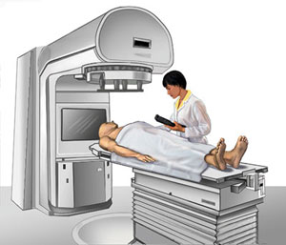
We need to collaboration
Epidemiologists
Imaging centres
Biologists
Research institutes
Hospitals
Physicists
& Medical physicists
ICT
Funding agencies
Academic institutes
Industry
Policy makers
Doctors

