Slide 1
Clinical PET in neurology
Małgorzata Trofimiuk-Müldner
Chair and Department of Endocrinology MC JU

Slide 2
Agenda
History
Brain malignancy
Dementia
Movement disorders
Epilepsy

Slide 3
History

Slide 4
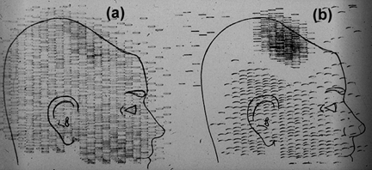
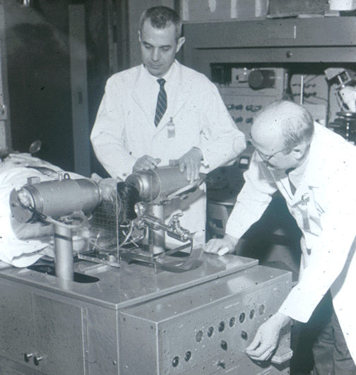
First positron probe – first human brain study with positron emitting radioisotope
The use of positron emitting isotopes in brain tumor detection suggested independly by Wrenn and Sweet (1951)
Detailed description published in 1953 by Bronwell and Sweet (⁷⁴As)

Slide 5
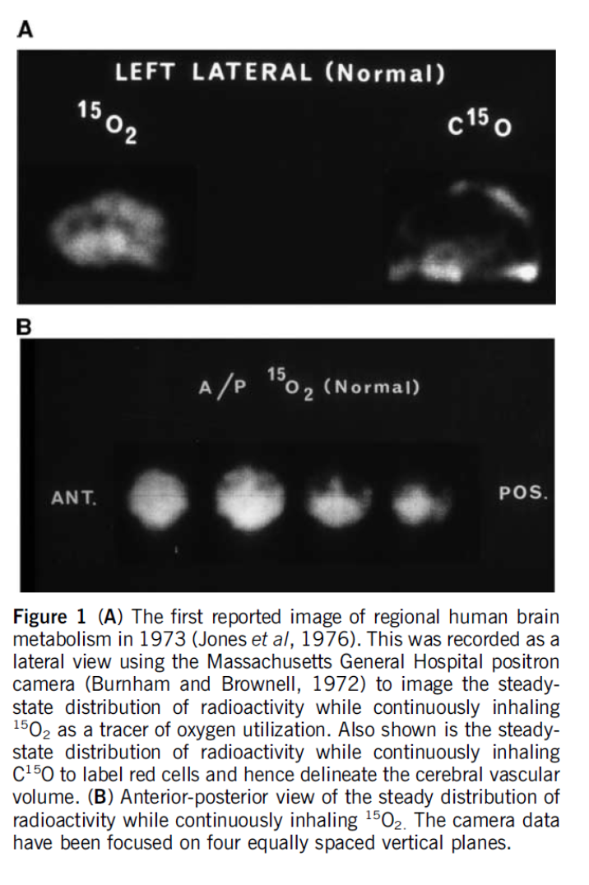
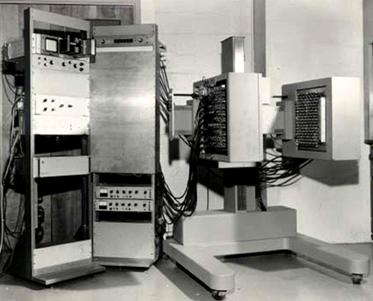
PC (positron cammera) series
Constructed by Burnham and Brownell in mid1960-ties to early 1970-ties
Field of view: 27 x 30 cm
First transaxial images obtained by Chesler -1973 – through rotating the PC

Slide 6
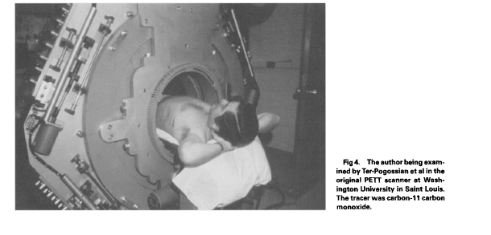
Positron emission (transaxial) tomography – PE(T)T
Constructed in 1973/1974 by group of Ter-Pogossian, Phelps, Hoffman
Hexagonal array of 24 NaI(Tl) detectors with coincidence detection, attenuation correction , image reconstruction using a proper filtered backprojection algorithm
Fist human PET (PETTIII) – 48 detectors in hexagonal array
THE ESTABLISHING THE PRONCIPLES OF PET AS WE KNOW IT
Wagner HN Jr. Sem Nucl Med. 1998; 28: 213

Slide 7
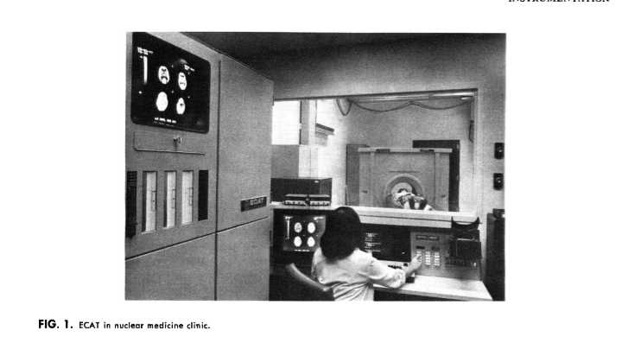
First commertial PET scanners – ECAT (Emission computed axial tomograph) -1978
96 NaI(Tl) cristals
PDP-11 computer with 32 Kbytes memory
Sold for $600000=$2000000 in year 2000
J Nucl Med. 1978; 19:635

Slide 9
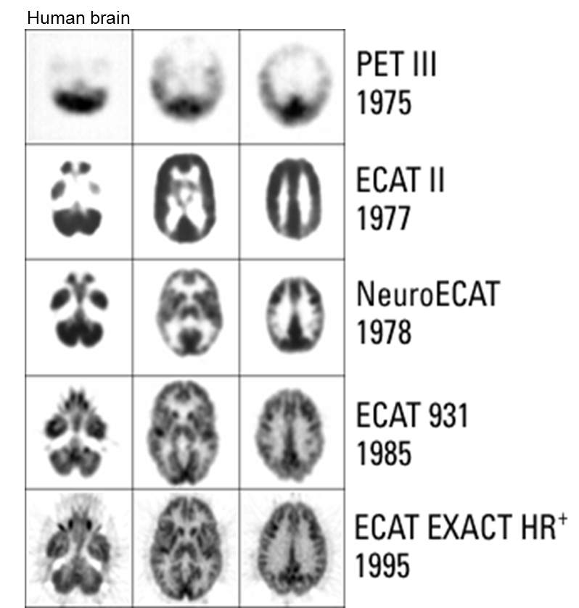

Slide 11
Current applications
Brain malignancy
Cerebrovascular disease
Movement disorders
Dementia
Epilepsy
Schizoprenia
Addiction
Depression and anxiety
Studies on healthy brain
Drug development

Slide 12
Brain malignancy

Slide 13
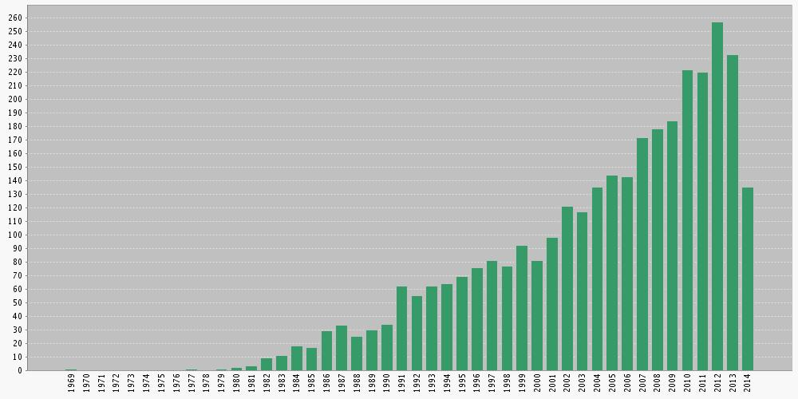
Number of publications on PET in brain tumors

Slide 14
Brain tumors

Slide 16
18F-FDG
Main drawbacks:
High background activity;
Low/absent uptake in low grade gliomas

Slide 17
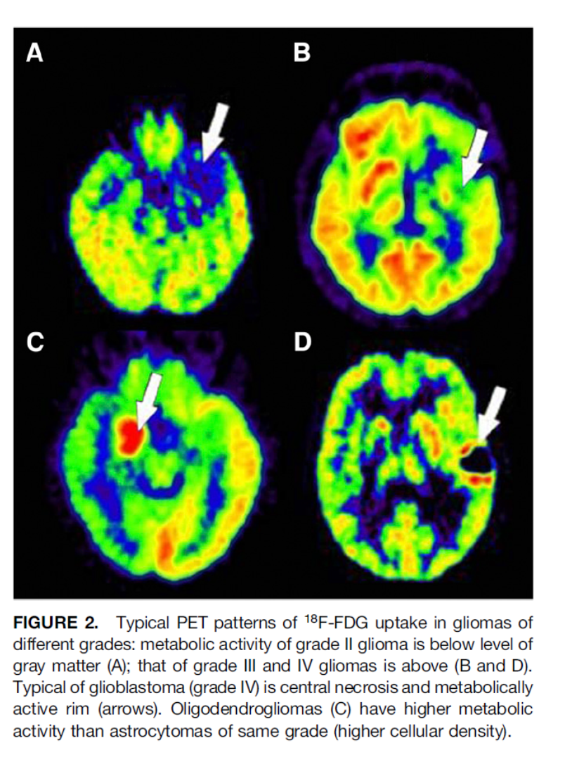
Indications: diagnosis and grading

Slide 18
Indication: prognosis

Slide 19
Indications: tumour recurrence/ differentiation between necrosis and viable tumour tissue

Slide 21
Other indications:
Differentiation between lymphoma and toxoplasmosis
Determination stereotactic biopsy site
Radiation planning

Slide 22
Labeled aminoacids: 11C-MET, 18F-FET, (18F-FDOPA)
Incrased AA transporters expression on brain tumor cells
Low uptake in healthy brain tissue – better contrast between tumour and background
Uptake in low grade gliomas

Slide 23
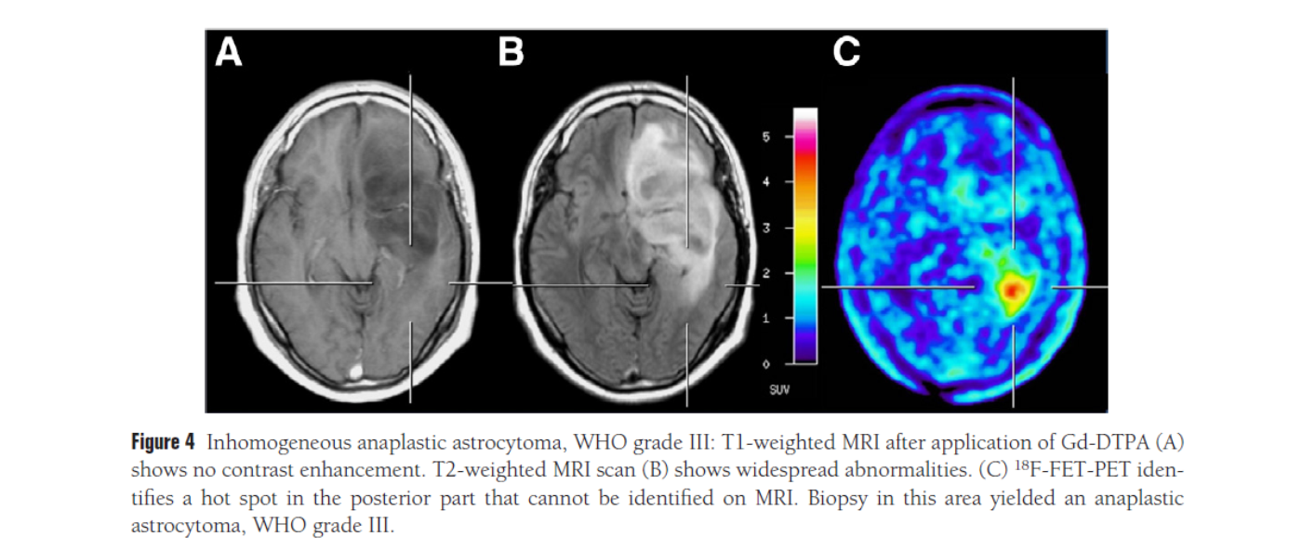
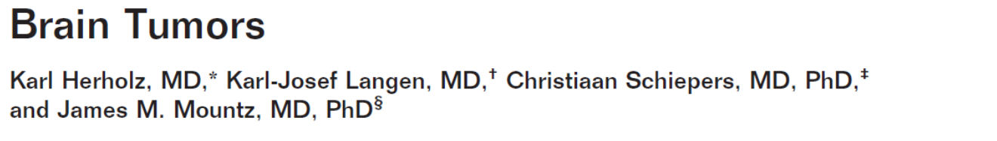
Indications: diagnosis

Slide 24
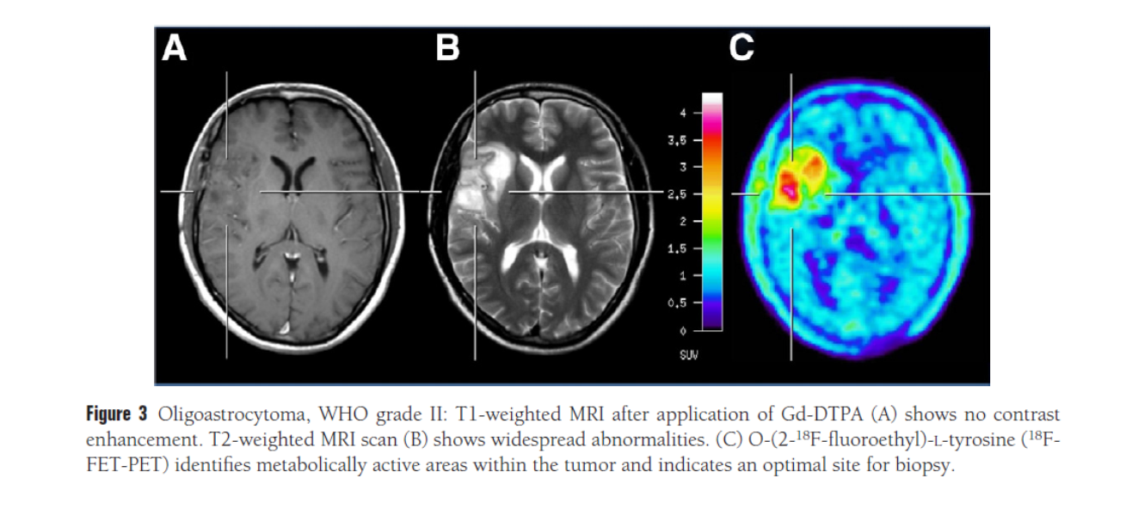

Slide 25
Indications: grading?
TBR – tumor/background ratio

Slide 26
Indications: grading – tracer kinetics

Slide 27
Indications: grading – tracer kinetics

Slide 28
Indications: identification of the optimal biopsy site

Slide 30
Indications: prognosis??

Slide 31
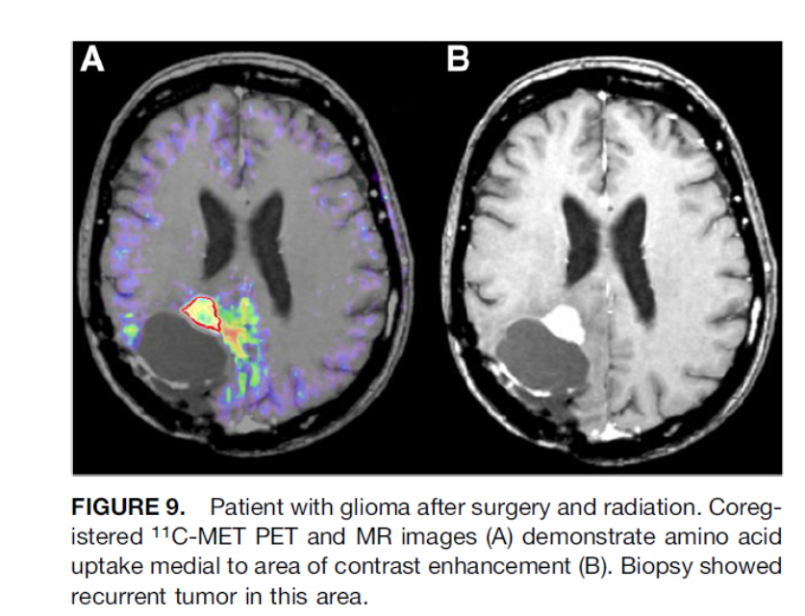
Indications: recurrence detection

Slide 32
Indications: discrimination between tumor and necrosis

Slide 33
Indications: radiotherapy planning

Slide 35
Indications: treatment monitoring

Slide 36
Other tracers: proliferation (18F-FLT)

Slide 37
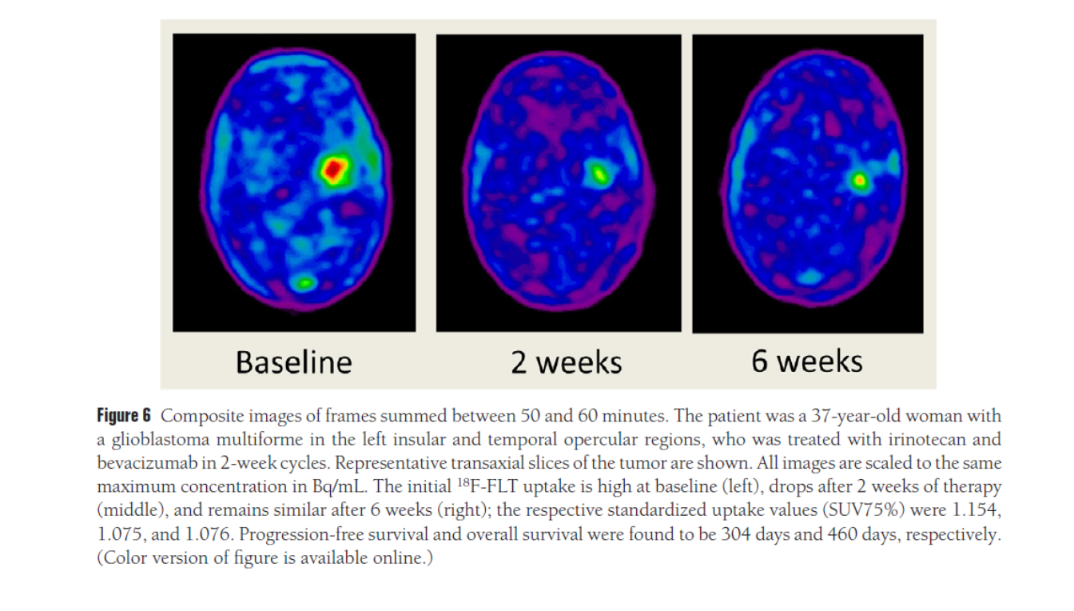
18F-FLT in therapy monitoring

Slide 38
Why PET/MR?

Slide 39
Dementia

Slide 40
Dementia
Decline of cognitive or neuropsychological function, not explained by other psychiatric disorder that interferes with usual activities
Causes: Alzheimer disease, dementia with Lewy bodies, fronto-temporal dementia, vascular dementia, structural changes including normal pressure hydrocephalus
Alzheimer disease, the most common cause of dementia
Progressive neurodegenerative disease
Connected with accumulation of amyloid neuritic plaques and neurofibrillary tangles comtaining the tau protein

Slide 42


Slide 44
18F-FDG
Provides possibility of early diagnosis (also differential)
Gives characteristic pattern of hypometabolism
Diagnostic accuracy 93%
Sensitivity 96%
Specificity 90%

Slide 45
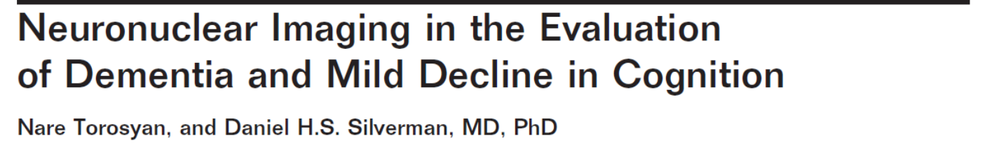

Slide 47
Amyloid-binding tracers

Slide 50
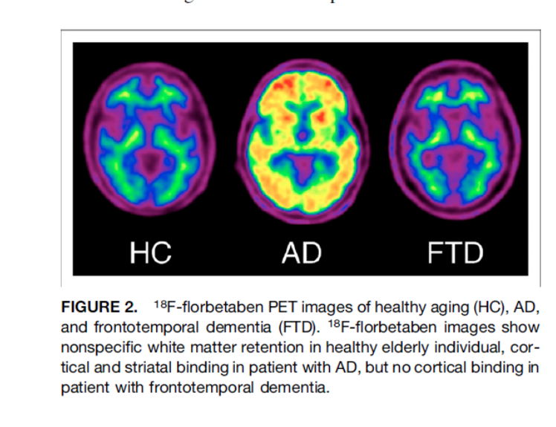

Slide 51
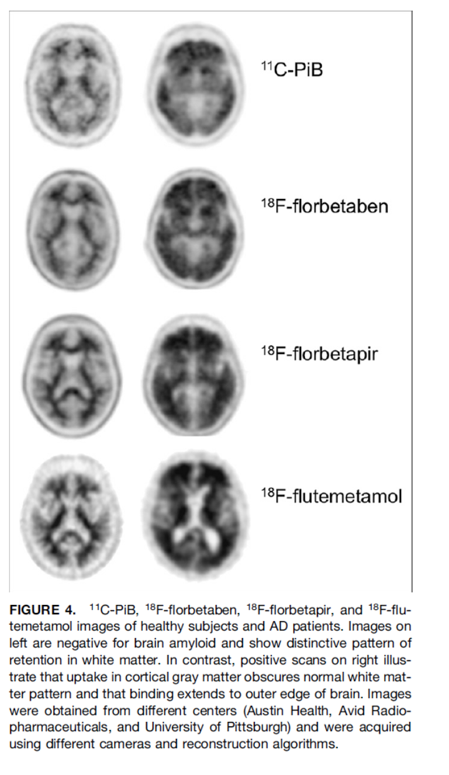

Slide 52
Amyloid imaging in healthy elderly
Positive 11C-PiB are found in 12% of healthy persons in their 60s, 30% of those in their 70s, and at least 50% of persones over 80 years.
More frequently in carriers of ApoE-ε4 allele, who are also at increased risk of development of Alzheimer disease.

Slide 53
Amyloid imaging in minimal cognitive impairment
70% of MCI subjects with positive 11C-PiB scans will progres to dementia due to Alzheimer disease over 3 years
Less than 10% of 11C-PiB negative patients will progres to Alzheimer disease and 20% of hem will progres to other dementia type (fronto-temporal dementia or dementia with Lewy bodies)

Slide 54


Slide 59
Movement disorders

Slide 60
Parkinsonian syndromes
Group of movement disorders with tremor, bradykinesia and rigidity
Most frequently neurodegenerative diseases
Other etiologies: drugs, vascular, toxic
Include:
  Parkinson’s disease
  Atypical parkinsonism (multiple system atrophy, progressive supranuclear palsy, corticobasal degeneration)
  Huntigton’s disease
  Ataxia
  dystonia
At later stage diagnosis may be straightforward.
Imaging necessary for: early and differential diagnosis, drug response asessment

Slide 61
LOSS OF DOPAMINERGIC NEURONS

Slide 63
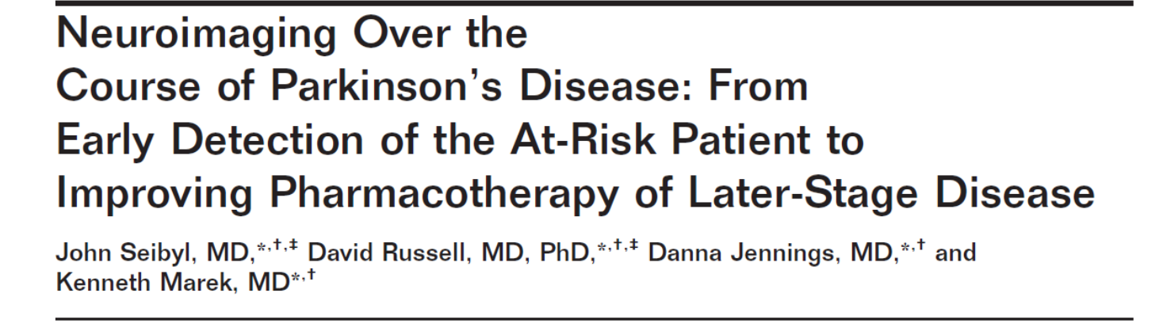
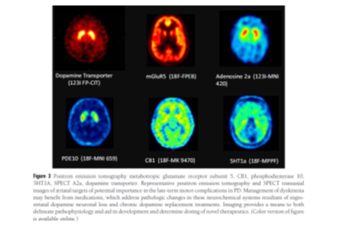

Slide 64
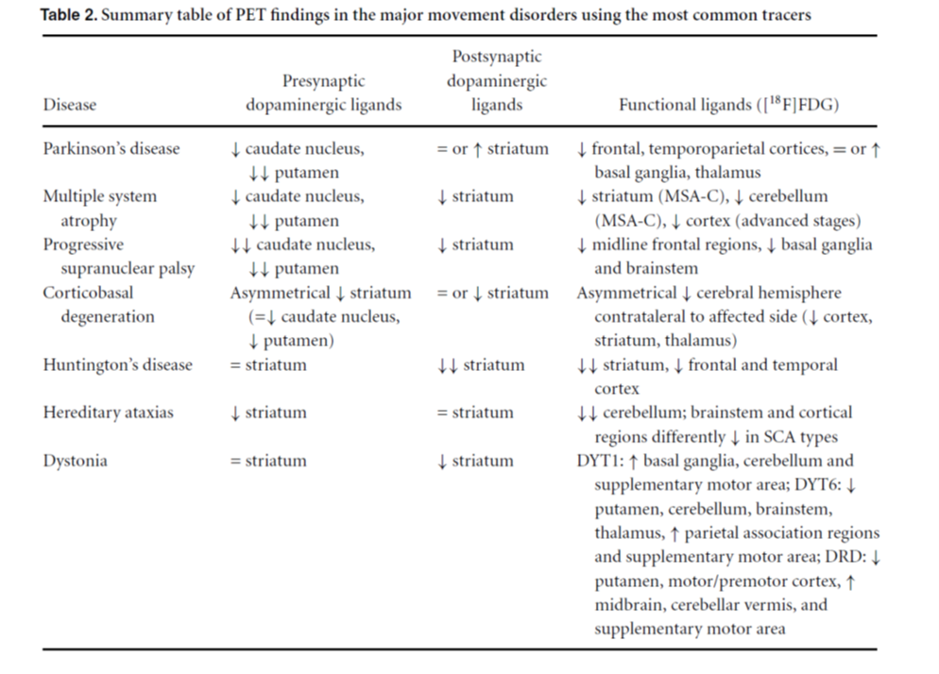

Slide 67
Epilepsy/seizures

Slide 68
Seizures
Affect 0.5-1.0% of population
Focal, partial, generalized and absence seizures
Treated with variaty of anticonvulsant medication
Drug-resistant epilepsy is of particular interest for nuclear medicine imaging
It allows identification of the primary site – epileptogenic focus, and if the surgical treatment is considered, it provides (jointly with MRI) information on: optimal surgical approach, delineation of seizure focus, facilitation of maximum resection
Tracers: 18F-FDG, receptors (GABA) ligands

Slide 69
Ictal vs. Interictal PET

Slide 70
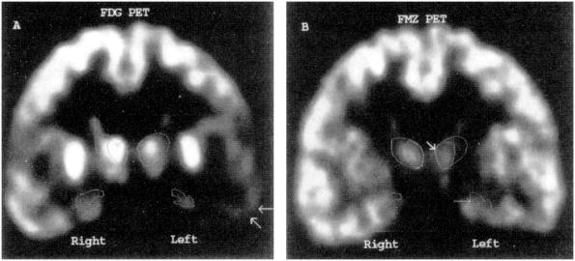

Glucose and [11C]flumazenil positron emission tomography abnormalities of thalamic nuclei in temporal lobe epilepsy.
Juhasz, C; Nagy, F; Watson, C; MD, PhD; da Silva, E; Muzik, O; Chugani, D; Shah, J; Chugani, H
Neurology. 53(9):2037-2045, December 10, 1999.
Figure 2 . 2-Deoxy-2-[18F]fluoro-D-glucose (FDG) and [11C]-flumazenil (FMZ) PET images of Patient 10, who had marked left hippocampal and mild left amygdaloid atrophy. FDG PET (A) shows hypometabolism in the left lateral temporal cortex (arrows), whereas the hippocampal abnormality was less pronounced. An abnormal asymmetry of glucose metabolism was detected in the dorsomedial thalamic nucleus (DMN; asymmetry index [AI]: 16.0%; lower on the left). FMZ PET (B) showed abnormal asymmetry in the hippocampus (thin arrow; AI: 21.4%), the amygdala (AI: 15.6%), and the DMN (thick arrow; AI: 7.5%), with lower values on the left side.
©1999 American Academy of Neurology. Published by LWW_American Academy of Neurology.
7

Slide 71
Future

Slide 73
Brain pathology to be studied with PET
Downstream effector pathways coupled to neuroreceptors
Neuroimmunity – neuroinflammation
Enhancing delivery of drugs across BBB
Specific imaging markers of neuronal and glial subtypes
Progenitor stem cel activity and their chemokines for repairing brain damage
Brain viral and bacterial infections
Brain plasticity – i.e. in stroke recovery
Neurochemical components underlying memory, learning,maturation, ageing cognitive decline/enhancement, personality

