Slide 1
Behaviour of radioactive ions in cryogenic liquids
Krzysztof Pelczar
M. Smoluchowski Institute of Physics
Jagiellonian University, Kraków

Slide 2
Physics beyond the Standard Model
…is probed by the most advanced experiments
Double-beta decay – The GERDA Experiment
Ions in cryogenic liquids – ⁴²Ar/⁴²K and ²²²Rn
Cold Dark Matter – The DarkSide Experiment
Electrostatic chamber for on-line gas monitoring
But the key to their success is in the extremely low background levels.
Notes:
J. W.

Slide 3
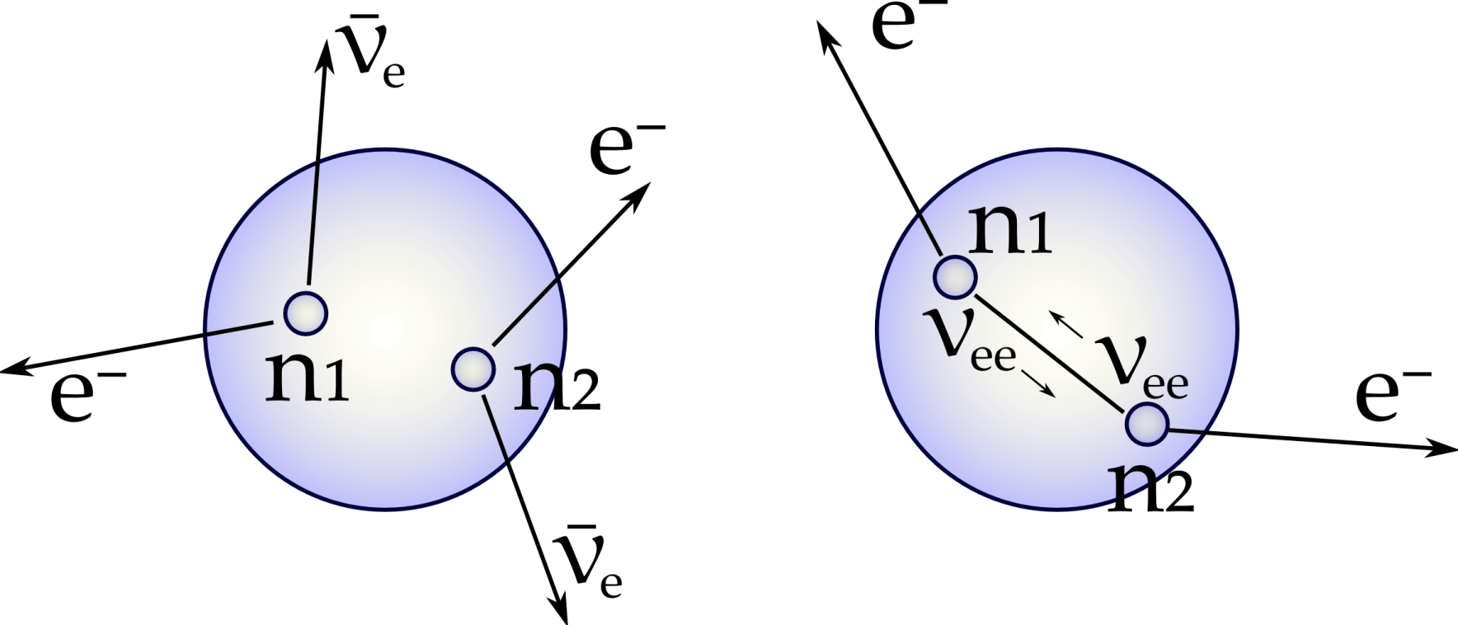
Double beta decay
2νββ
0νββ
Allowed in SM and observed for several isotopes with forbidden single beta decay. Conserves lepton number. Long half-lifetimes
(10¹⁹ ÷ 10²¹ y).
Does not conserve lepton number (ΔL=2). Possible if neutrinos are Majorana particles. Expected lifetimes > 10²⁶ y.
Notes:
J. W. The reason why extremely low backgrounds are inevitable lays in the expected event rates – the lifetime of 0nbb is order of 10²⁶ yr!

Slide 4
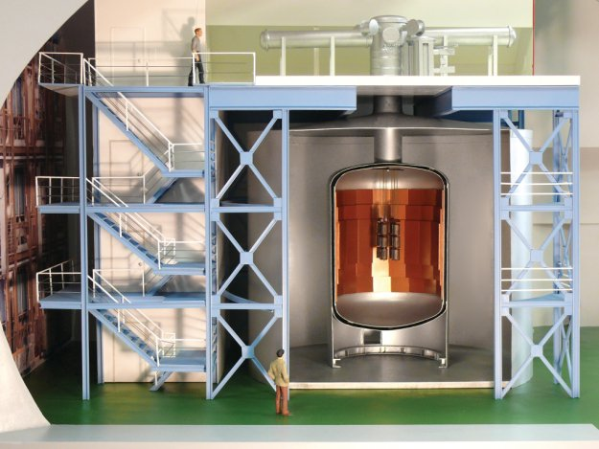
The Gerda Experiment @ LNGS
Steel cryostat with internal Cu shield
Clean room
Lock system
Phase I: 10⁻² cts/(kg keV yr)
Array of bare Ge-diodes
Water: γ,n shield Cherenkov medium for µ veto
High-purity liquid argon (LAr) shield & coolant Phase II: active veto
Notes:
Opis budowy Gerdy – istota niskiego tła w tego typu eksperymentach przekłada się na długość (sensowną) pomiaru i przez to na czułość. Pierwsza faza się zakończyła, druga jest natomiast w przygotowaniu. Planuje się obniżyć poziom tła o kolejny rząd wielkości, to 10⁻³ cts/kg/kev/yr!

Slide 5
Surprising ⁴²K
Drifting in E-field
+
-
⁴²K
⁴²Ar β⁻ decays to ⁴²K⁺
Charged ⁴²K drifts towards the detector
⁴²K β⁻ decays (Q = 3525 keV, above Q_{ββ})
possibly nearby the detector
O₂
e⁻
T_{1/2} = 12 h
+
⁴²Ar
⁴²K
+
⁴²K
e⁻
Detector surface
+
β⁻
Ar
e⁻
⁴²K
+
⁴²K
+
Ar
β⁻
O₂⁻
Germinate
recombination
Recombination on
electronegative impurities
µs
s
min
TIME
h
Notes:
The model of ⁴²K was developed in order to understand and tackle the possible sources of Gerda background. ⁴²K was studied in the dedicated experiment, called LArGe. Also ²²²Rn is considered as a possible background source for the Phase II of the Gerda experiment, so extensive program of measurements was carried out in Kraków, resulitng in a detailed model of ²²²Rn behaviour (more complicated due to several daughter isotopes and different decay modes).

Slide 6
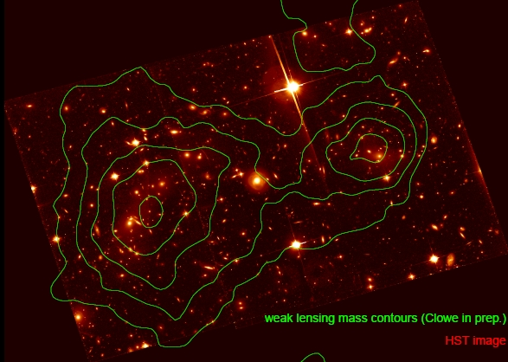
Cold Dark Matter
One of the candidates are WIMPs – Weakly Interacting Massive Particles, possibly detectable through their collisions with ordinary nuclei, giving observable low-energy (<100 keV) nuclear recoils
Astronomical evidences (large-scale galaxy surveys and microwave background measurements) indicate that the majority of matter in the Universe is non-baryonic
The “dark matter” is typically a factor of 10 times greater in total mass
The nature of this non-baryonic component is unknown, but of fundamental importance to cosmology, astrophysics, and elementary particle physics
Notes:
J.W. Zwrócenie uwagi na istotność badań nad DM w dedykowanych eksperymentach. – poziom tła znów wymagany przez oddziaływania słabe DM.

Slide 7
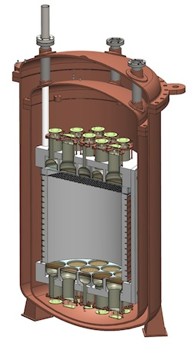
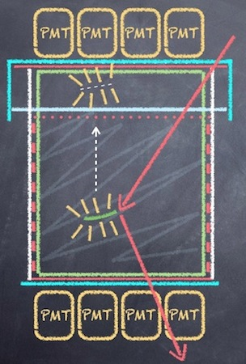
The DarkSide Experiment
WIMP
Gaseous argon
Liquid argon
Two-phase Liquid Argon TPC
Notes:
One of the most advanced experiments is the DarkSide experiment, also located in the LNGS laboratory. The experiment utilizes a new technique for registering DM interactions – a Two Phase Liquid Argon Time Projection Chamber. Due to the background requirements, the experiment was assembled and is operated in ultra-pure clean rooms, supplied with radon-free gases (air). Suppression of Rn in gases was critical for the success of the experiment…

Slide 8
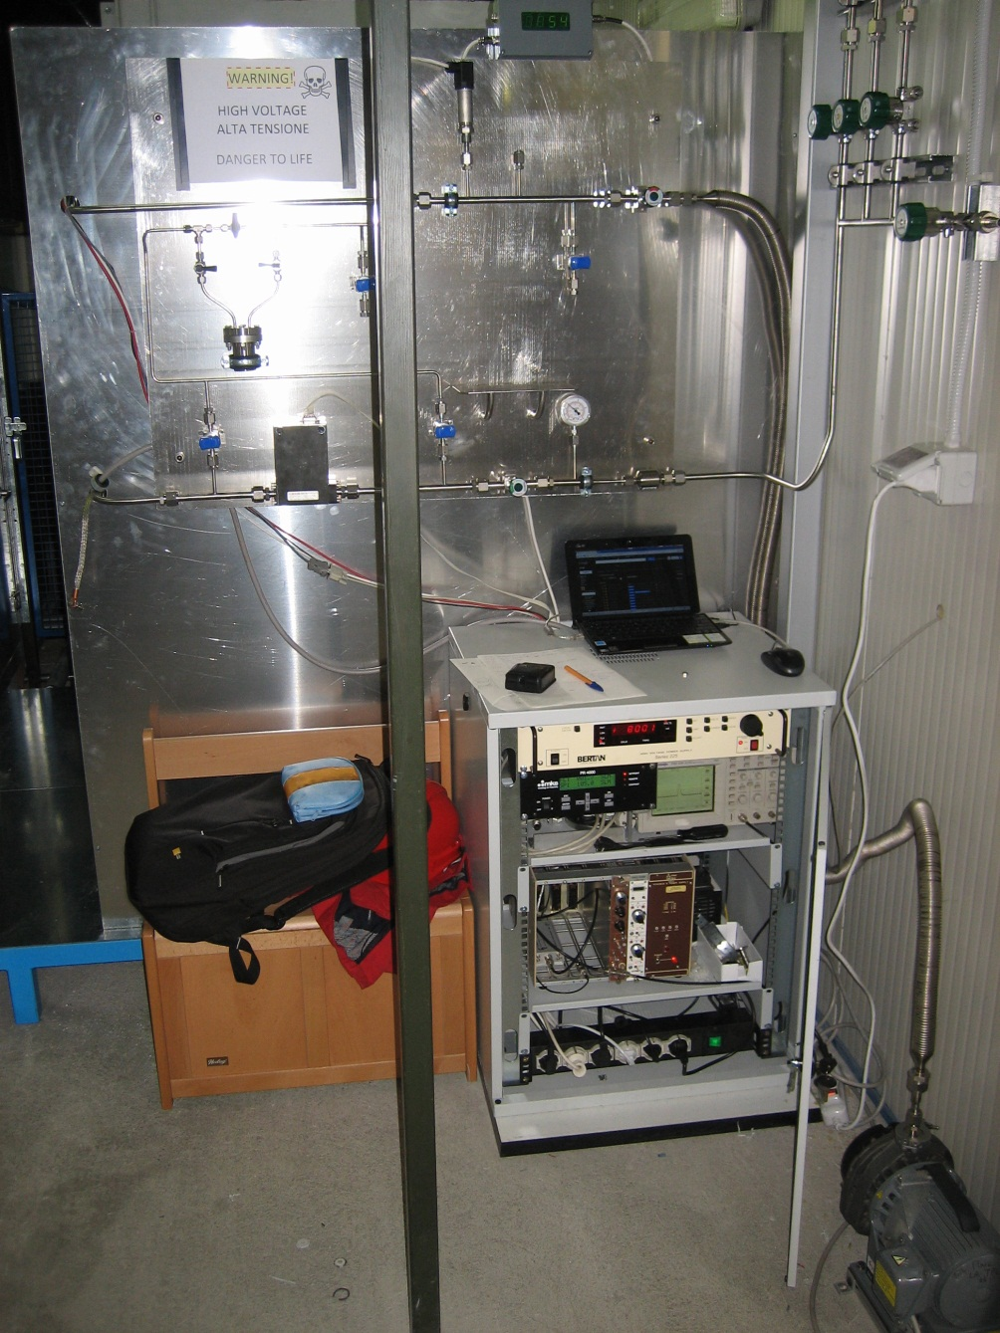
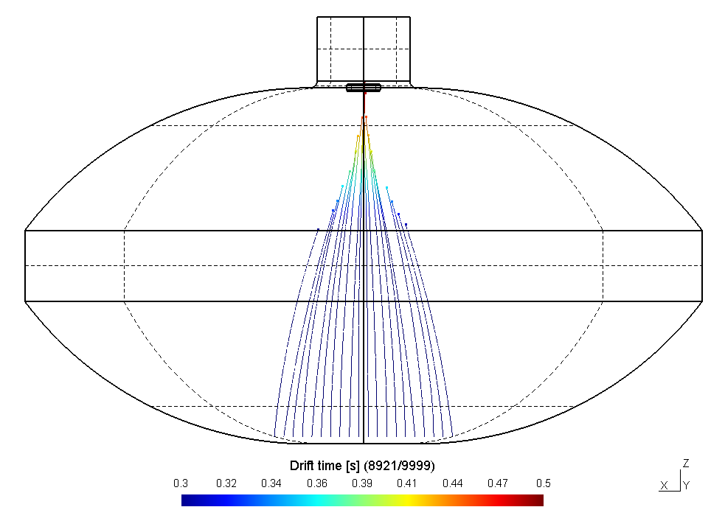
DarkSide – Electrostatic Rn monitor
On-line monitoring of the ²²²Rn content in the DarkSide clean-rooms (nitrogen, Rn-reduced air);
Sensitivity ~1.5 mBq/m³ (750 atoms of Rn/m³).
Notes:
…Therefore the experience gained with ²²²Rn studies was also used to design, construct and program a novel online Rn monitor for the DarkSide experiment. The device proved to be versatile and sensitive, measuring the Rn content in air flushing the DarkSide clean rooms.

Slide 9
Summary
Achievements
Papers
The GERDA Experiment
GERDA Phase I – search of the ⁷⁶Ge 0νββ decay
Measurement of 2νββ decay lifetime
GERDA background model
New pulse shape discrimination techniques in Ge detectors
GERDA Ge detectors characterisation
Model of ²²²Rn and its daughters in cryogenic liquids
⁴²Ar/⁴²K model („Symposium on applied nuclear physics and innovative technologies” – UJ)
²²²Rn model („Low radioactivity techniques” – LNGS)
Application of the ²²²Rn model – the DarkSide experiment
Alpha spectrometry optimization techniques
LArGe experimental setup, first nat. ⁴²K measurement
EPJC 2013
PRL 2013, highlighted by the APS
JPG 2013
EPJC 2014
EPJC 2013
Subm. EPJC 2014
NIMA 2014
APPB Supp. 2013
AIP Proc. 2013
tbp 2014
JARI 2013
tbp 2014
Notes:
Zwrócenie uwagi na drugą pozycję – publikacja wyróżniona przez APS, a także inne środowiska (CERN Courier etc.), prace zbiorowe (Gerda/DarkSide) oraz indywidualne (modele jonów).
TBP = to be published (ready, to be submitted )

Slide 10
Summary
12 papers
3 talks on (international) conferences („Particles and Cosmology”, Troitsk, INR, Russia; „Low Radioactivity Techniques”, Assergi, LNGS, Italy; „tmex2014”, Warsaw, NCBJ, Poland)
1 poster („Astrofizyka Cząstek w Polsce”, Cracow, UJ, Poland)
Multiple presentations (6) and reports (5) within the Gerda and DarkSide collaborations
Advanced software and Appliances:
LArGe slow control system
MPIK Heidelberg ultra-sensitive mass-spectrometer software
DarkSide online radon monitor (design, simulation, assembly and software)
Gerda Phase II PMT scaler (design, assembly and software)
…
Notes:
By the end of 2014 12 papers will be published. Additionally to that 3 talks on specialized conferences, presenting the achievements, were given, and one poster presented, not mentioning multiple presentations and progress reports within the Gerda collaboration.
I am also the author of: Slow Control system for the LArGe experiment (measurements of ⁴²K in LAr, test stand for Gerda Phase II), completely new software for the Hd mass spectrometer, design of the DarkSide online Rn monitor, photomultiplier scaler system for the Phase II of Gerda, and some other minor equipment.

Slide 11
References
Prof. Wójcik Group, ZDFK UJ: http://bryza.if.uj.edu.pl/
The GERDA Experiment: http://www.mpi-hd.mpg.de/gerda/
The DarkSide Experiment: http://darkside.lngs.infn.it/
11

