Slide 1

INTRODUCTION
SPALLATION REACTIONS
F/B ASYMMETRY FOR Au+p
RANKING OF SPALLATION MODELS
SUMMARY
Title
Proton induced spallation reactions
24/09/2014 Sushil K. Sharma
Proton induced spallation reactions 1

Slide 2
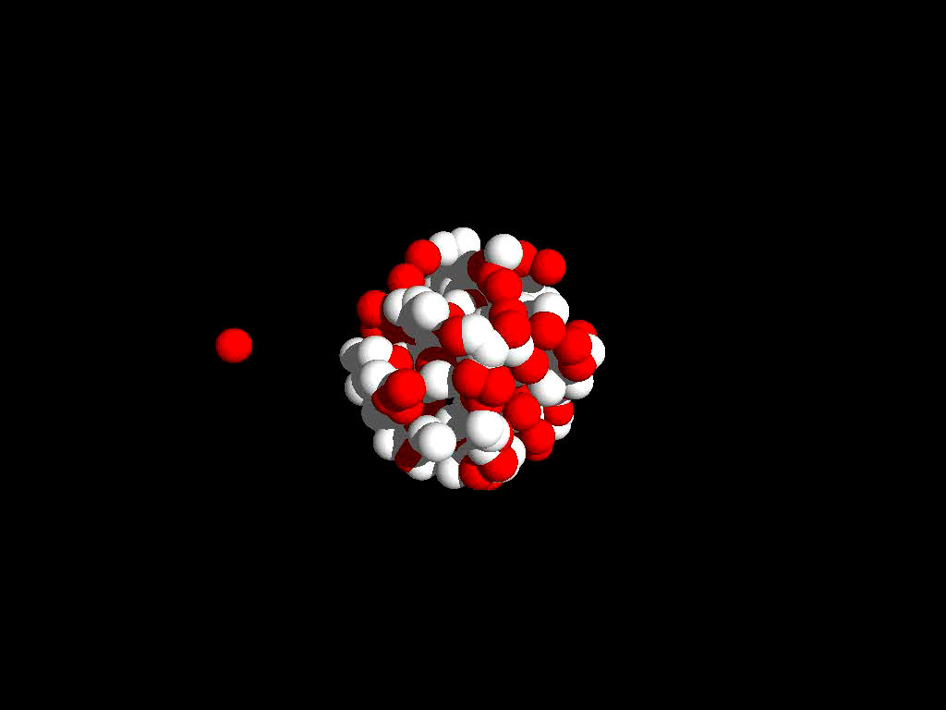
INTRODUCTION
SPALLATION REACTIONS
F/B ASYMMETRY FOR Au+p
RANKING OF SPALLATION MODELS
SUMMARY
What is spallation ?
24/09/2014 Sushil K. Sharma
Proton induced spallation reactions 2
2

Slide 3
INTRODUCTION
SPALLATION REACTIONS
F/B ASYMMETRY FOR Au+p
RANKING OF SPALLATION MODELS
SUMMARY
Wide range of applications
Astrophysics
- Reactions of cosmic rays with interstellar medium
- Nucleosynthesis in turbulence of Supernova explosions
Spallation neutron sources
- Efficient way for producing neutrons
- Shielding & aging of the constructions
ADS (Accelerator-driven system)
- Project for incinerating radioactive waste and for energy production
Secondary-beam facilities
- Production of rare isotopes
Biology and medicine
-Production of radionuclides
-Cancer therapy
Many applications…
Therefore, the realistic and reliable models which enable us to predict the cross sections are necessary.
24/09/2014 Sushil K. Sharma
Proton induced spallation reactions 3

Slide 4
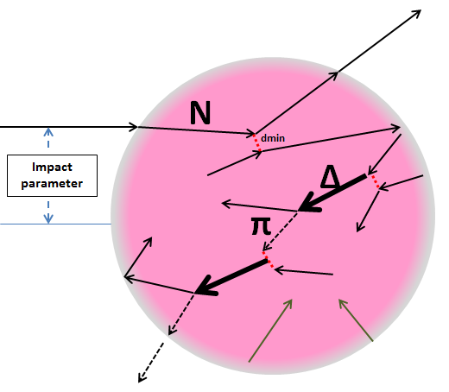
INTRODUCTION
SPALLATION REACTIONS
F/B ASYMMETRY FOR Au+p
RANKING OF SPALLATION MODELS
SUMMARY
Two stages of reaction
1ST STAGE OF REACTION
N
Equilibrated Heavy Residua
TIME
Intra-nuclear cascade of NN collisions
24/09/2014 Sushil K. Sharma
Proton induced spallation reactions 4
3

Slide 5
INTRODUCTION
SPALLATION REACTIONS
F/B ASYMMETRY FOR Au+p
RANKING OF SPALLATION MODELS
SUMMARY
Two stages of reaction
2nd STAGE OF REACTION
Evaporation
Equilibrated Heavy Residua
Fragmentation
Fission
Multi-fragmentation
De-excitations
24/09/2014 Sushil K. Sharma
Proton induced spallation reactions 5
3

Slide 6
INTRODUCTION
SPALLATION REACTIONS
F/B ASYMMETRY FOR Au+p
RANKING OF SPALLATION MODELS
SUMMARY
Theoretical Models
1ST STAGE OF REACTION
2nd STAGE OF REACTION
ABLA07
INCL4.6
SMM
GEMINI++
GEM2
De-excitation Models
24/09/2014 Sushil K. Sharma
Proton induced spallation reactions 6
3

Slide 7
INTRODUCTION
SPALLATION REACTIONS
F/B ASYMMETRY FOR Au+p
RANKING OF SPALLATION MODELS
SUMMARY
My Task
The goal:
to validate different spallation models
by comparing predictions of various models with measured data
qualitatively and quantitatively
for different targets and proton beam energies.
Outline :
Angular asymmetry of fragments emission
(results of the analysis for Au+p at 1 and 3 GeV)
27/05/14 Sushil K. Sharma
Proton induced spallation reactions 7

Slide 8
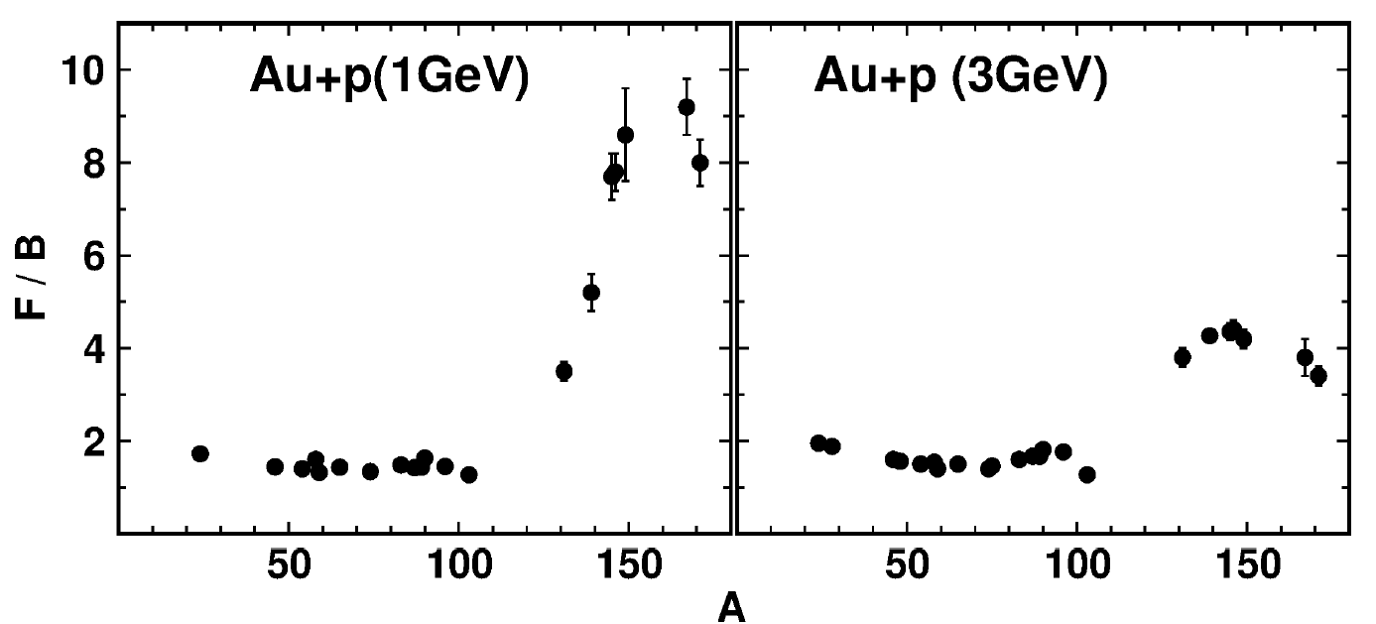
INTRODUCTION
SPALLATION MODELS
F/B ASYMMETRY FOR Au+p
RANKING OF SPALLATION MODELS
SUMMARY
F/B asymmetry
F = total probability to observe products of the reaction emitted in the FORWARD direction (in respect to the direction of impinging proton) , i.e. for angles smaller than 90 degree.
B = total probability to observe products of the reaction emitted in the BACKWARD direction, i.e. angles larger than 90 degree
The asymmetry is equal to the ratio of F/B - it measures anisotropy of the angular distribution of the reaction products
Mass and Energy dependence of F/B asymmetry
Data:
S.B Kaufmann et al.,
Phys. Rev. C 18, 1349(1978)
24/09/2014 Sushil K. Sharma
Proton induced spallation reactions 8

Slide 9
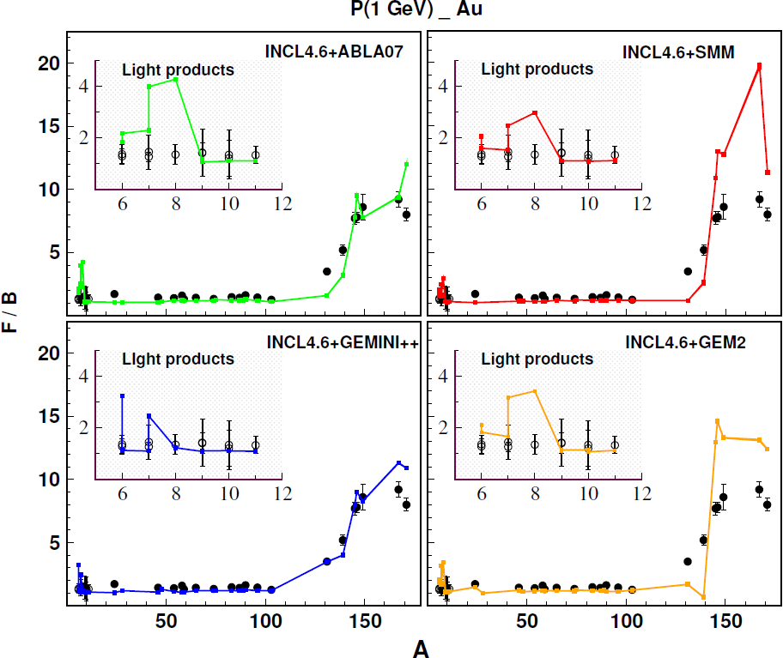
INTRODUCTION
SPALLATION MODELS
F/B ASYMMETRY FOR Au+p
RANKING OF SPALLATION MODELS
SUMMARY
F/B asymmetry at 1 GeV
Data: Light Products
A. Budzanowski et al.,
Phys. Rev. C78, 024603 (2008)
Data: Heavy Products
S.B Kaufmann et al., Phys. Rev. C 18, 1349(1978)
Lines = model predictions:
INCL4.6+ABLA07
INCL4.6+SMM
INCL4.6+GEMINI++
INCL4.6+GEM2
Shape and magnitude of mass dependence of F/B asymmetry is BEST reproduced by GEMINI++ for both light and heavy products.
The magnitude of F/B asymmetry of HEAVY products significantly OVERESTIMATED by GEM2 and SMM
24/09/2014 Sushil K. Sharma
Proton induced spallation reactions 9

Slide 10
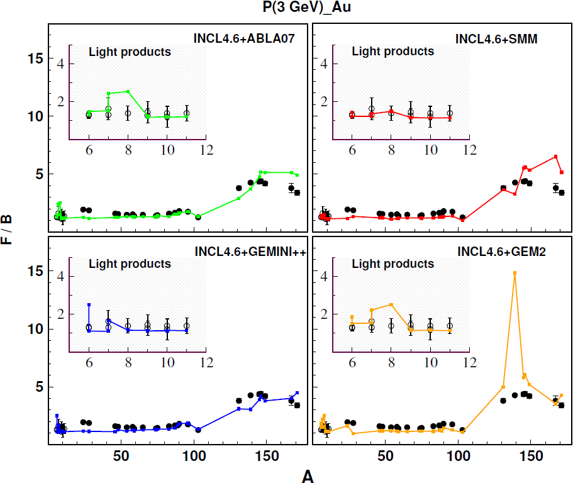
INTRODUCTION
SPALLATION MODELS
F/B ASYMMETRY FOR Au+p
RANKING OF SPALLATION MODELS
SUMMARY
F/B asymmetry at 3 GeV
Data: Light Products
A. Budzanowski et al.,
Phys. Rev. C78, 024603 (2008)
Data: Heavy Products
S.B Kaufmann et al., Phys. Rev. C 18, 1349(1978)
For light products SMM model is the best in reproducing the experimental data.
For heavy products:
GEMINI++ and ABLA07 are competing with each other in describing the exp. data.
GEM2 overestimates the F/B ratio for the fragment A=139.
24/09/2014 Sushil K. Sharma
Proton induced spallation reactions 10

Slide 11
INTRODUCTION
SPALLATION MODELS
F/B ASYMMETRY FOR Au+p
RANKING OF SPALLATION MODELS
SUMMARY
Need for statistical factors or tests ?
The qualitative agreement between the data and model calculations allows to conclude about general aplicability of the models.
However, it does not allow to judge in objective manner about quality of different model descriptions i.e. for the ranking of models.
One has to use some quantitative measures of (dis)agreement of the data and theoretical cross sections.
There are many tests (statistics) used in the literature for this purpose.
24/09/2014 Sushil K. Sharma
Proton induced spallation reactions 11
10

Slide 12
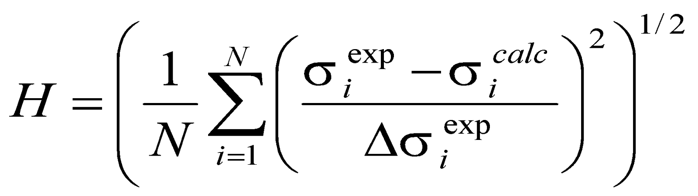
INTRODUCTION
SPALLATION MODELS
F/B ASYMMETRY FOR Au+p
RANKING OF SPALLATION MODELS
SUMMARY
Statistical tests
H- Test: ( Like Chi-square )
M - Test: (Modulus test)
24/09/2014 Sushil K. Sharma
Proton induced spallation reactions 12

Slide 13
INTRODUCTION
SPALLATION MODELS
TOTAL CROSS SECTIONS FOR Al+p
F/B ASYMMETRY FOR Au+p
RANKING OF SPALLATION MODELS
SUMMARY
Average of H and M test over 1GeV and 3GeV separately for light and heavy products
RANKS
MODEL | H-TEST | M-TEST
INCL4.6 + GEMINI++ | 0.75 | 0.62
INCL4.6 + SMM | 1.15 | 0.89
INCL4.6 + GEM2 | 1.93 | 1.43
INCL4.6 + ABLA07 | 2.31 | 1.60
1ST
2ND
Light
Products
3RD
4TH
MODEL | H-TEST | M-TEST
INCL4.6 + ABLA07 | 4.74 | 3.99
INCL4.6 + GEMINI++ | 5.02 | 3.95
INCL4.6 + SMM | 6.99 | 6.15
INCL4.6 + GEM2 | 7.18 | 6.16
1ST
Heavy
Products
2ND
24/09/2014 Sushil K. Sharma
Proton induced spallation reactions 13

Slide 14
INTRODUCTION
SPALLATION MODELS
F/B ASYMMETRY FOR Au+p
RANKING OF SPALLATION MODELS
SUMMARY
Conclusions
The INCL4.6 model coupled to GEMINI++, SMM, ABLA07 and GEM2 models without any free parameters is able to reproduce the shape of the mass number dependence of the F/B asymmetry.
The model predictions also agree with the beam energy dependence of the F/B asymmetry.
Ranking of Models:
Best Models ( Light Products ): INCL4.6+GEMINI++, INCL4.6+SMM, INCL4.6+GEM2, INCL4.6+ABLA07
Best Models ( Heavy Products ):
1st (INCL4.6+ABLA07, INCL4.6+GEMINI++)
2ND (INCL4.6+SMM, INCL4.6+GEM2)
24/09/2014 Sushil K. Sharma
Proton induced spallation reactions 14

Slide 15


Slide 16
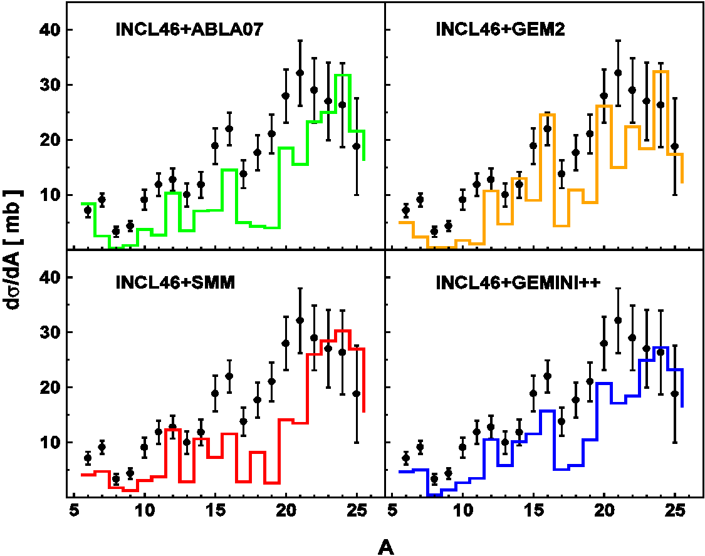
INTRODUCTION
SPALLATION MODELS
TOTAL CROSS SECTIONS FOR Al+p
F/B ASYMMETRY FOR Au+p
RANKING OF SPALLATION MODELS
SUMMARY
Isobaric cross section at 180 MeV
Points = Data:
K. Kwiatkowski et al., Phys. Rev. Lett. 50, 1648(1983)
Lines = model predictions:
INCL4.6+ABLA07
INCL4.6+GEM2
INCL4.6+SMM
INCL4.6+GEMINI++
Exp. and the. cross sections increase in average with increasing mass of fragment.
Maxima being observed for specific fragments in both, exp. and the. cross sections.
HOWEVER: None of the models is in perfect agreement with the data.
24/09/2014 Sushil K. Sharma
Proton induced spallation reactions 1

Slide 17
INTRODUCTION
SPALLATION MODELS
TOTAL CROSS SECTIONS FOR Al+p
F/B ASYMMETRY FOR Au+p
RANKING OF SPALLATION MODELS
SUMMARY
Isobaric angular dist. at 180 MeV
Angular distributions of fragments are forward peaked (A=24-25) in both measurements and calculations.
For fragments A < 24, models are able to reproduce the shape of distribution.
All models predictions are consistent with the conclusions observed from the fragments isobaric distributions.
24/09/2014 Sushil K. Sharma
Proton induced spallation reactions 2

Slide 18
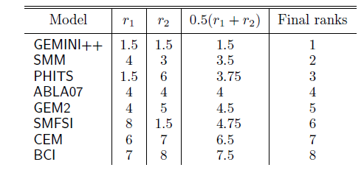
INTRODUCTION
SPALLATION MODELS
TOTAL CROSS SECTIONS FOR Al+p
F/B ASYMMETRY FOR Au+p
RANKING OF SPALLATION MODELS
SUMMARY
Ranking of models
Ranking to different Mdoels: ( Based on total isobaric cross section and angular distribution)
24/09/2014 Sushil K. Sharma
Proton induced spallation reactions 3

Slide 19
INTRODUCTION
SPALLATION MODELS
TOTAL CROSS SECTIONS FOR Al+p
F/B ASYMMETRY FOR Au+p
RANKING OF SPALLATION MODELS
SUMMARY
Isobaric Energy dist. at 180 MeV
Agreement between experimental data and model predictions improves towards the heavier fragments and increasing angles.
The (dis)agreement at LOW energy for A=7 ( BELOW ≈ 15 MeV ) clearly shows the absence of some reaction mechanism in models prescriptions.
24/09/2014 Sushil K. Sharma
Proton induced spallation reactions 4
9

Slide 21
INTRODUCTION
SPALLATION MODELS
TOTAL CROSS SECTIONS FOR Al+p
F/B ASYMMETRY FOR Au+p
RANKING OF SPALLATION MODELS
SUMMARY
Possible mechanism triggered in different models
GEM2
SMM
ABLA07
GEMINI++
Light particle evaporation
Light particle evaporation
Symmetric - splits
nhot_source=1
nhot_source=2
nhot_source≥3
Fragment evaporation
Fragment evaporation
1 asymmetric splits, heavy partner
Multi - fragmentation
1 asymmetric splits,
light partner
For the present study, I also used Generalized Evaporation Model ( GEM2 ) proposed by S. Furihata.
Based on Weisskopf – Ewing model , which allows to describe the evaporation of ejectiles up to as heavy as Mg.
Describe possible fission also, triggered only for nuclei having Z >70 .
24/09/2014 Sushil K. Sharma
Proton induced spallation reactions 5
5
Notes:
Smm:
First decay sstage is simultaneous break-up of the thermalized residua in a number of hot fragments and particles.
Break-ups are sampled according to their thermodynamical weights in a given freeze-out volume .
The ratio of the freeze out volume to the saturation volume is a free parameter and with choice equal to 3 favours the single fragment configuration over multifragmentation.
The dominance of of multifragmentation smoothly increase with increase of excitation energy.
Secondry de-excitation is applied to hot fragments. If they are light ( A <=16), fermi break up model is used to describe them, otherwise according to weisskopf –ewing evaporation model.
Fission is describe by bohr-wheeler model , which in present case is of marginal interst.
ABLA07:
Unlike SMM always enter in multifragmentation models, if excitation energy of residua is not high enough ( i.e temperature of residua cxceeds a mass dependent free out threshold ), ABLA07 enters the second de-excitation phase, where emission of any stable nucleus upto half the mass of the compound nucleus is possible and described by Weisskopf – Ewing evaporation formalism. Competition with fission is described based on the solution of fokker – plank equation for collective deformation of nuclear over the fission barrier.

Slide 22
INTRODUCTION
SPALLATION MODELS
NEED TO STUDY SPALLATION REACTIONS
TOTAL CROSS SECTIONS FOR Al+p
F/B ASYMMETRY FOR Au+p
RANKING OF SPALLATION MODELS
SUMMARY
Proton induced reactions at 1 GeV
MODEL | H-TEST | M-TEST
INCL4.6 + ABLA07 | 3.397 | 2.342
INCL4.6 + SMM | 1.744 | 1.281
INCL4.6 + GEMINI++ | 0.735 | 0.611
INCL4.6 + GEM2 | 2.221 | 1.620
IMF
MODEL | H-TEST | M-TEST
INCL4.6 + ABLA07 | 4.704 | 4.060
INCL4.6 + SMM | 7.209 | 6.110
INCL4.6 + GEMINI++ | 4.410 | 3.791
INCL4.6 + GEM2 | 7.095 | 5.955
HEAVY
RECOILS
Best Models ( IMF): INCL4.6+GEMINI++, INCL4.6+SMM, INCL4.6+GEM2, INCL4.6+ABLA07
Best Models( Heavy Recoils):INCL4.6+GEMINI++, INCL4.6+ABLA07, INCL4.6+GEM2, INCL4.6+SMM
24/09/2014 Sushil K. Sharma
Proton induced spallation reactions 5

Slide 23
INTRODUCTION
SPALLATION MODELS
NEED TO STUDY SPALLATION REACTIONS
TOTAL CROSS SECTIONS FOR Al+p
F/B ASYMMETRY FOR Au+p
RANKING OF SPALLATION MODELS
SUMMARY
Proton induced reactions at 3 GeV
MODEL | H-TEST | M-TEST
INCL4.6 + ABLA07 | 1.222 | 0.859
INCL4.6 + SMM | 0.551 | 0.503
INCL4.6 + GEMINI++ | 0.770 | 0.634
INCL4.6 + GEM2 | 1.645 | 1.241
IMF
MODEL | H-TEST | M-TEST
INCL4.6 + ABLA07 | 4.768 | 3.927
INCL4.6 + SMM | 6.772 | 6.192
INCL4.6 + GEMINI++ | 5.633 | 4.102
INCL4.6 + GEM2 | 23.134 | 10.67
INCL.46+GEM2_CORR | 7.256 | 6.355
HEAVY
RECOILS
Best Models ( IMF): INCL4.6+SMM INCL4.6+GEMINI++, INCL4.6+ABLA07, INCL4.6+GEM2
Best Models( Heavy Recoils): INCL4.6+ABLA07, INCL4.6+GEMINI++, INCL4.6+SMM, INCL4.6+GEM2
24/09/2014 Sushil K. Sharma
Proton induced spallation reactions 6

Slide 24
INTRODUCTION
SPALLATION MODELS
NEED TO STUDY SPALLATION REACTIONS
TOTAL CROSS SECTIONS FOR Al+p
F/B ASYMMETRY FOR Au+p
RANKING OF SPALLATION MODELS
SUMMARY
Average over 1GeV and 3GeV separately for IMF and Heavy Recoils
MODEL | H-TEST | M-TEST
INCL4.6 + ABLA07 | 2.310 | 1.601
INCL4.6 + SMM | 1.148 | 0.892
INCL4.6 + GEMINI++ | 0.753 | 0.623
INCL4.6 + GEM2 | 1.933 | 1.431
IMF
MODEL | H-TEST | M-TEST
INCL4.6 + ABLA07 | 4.736 | 3.994
INCL4.6 + SMM | 6.991 | 6.151
INCL4.6 + GEMINI++ | 5.022 | 3.947
INCL4.6 + GEM2 | 7.176 | 6.155
HEAVY
RECOILS
Best Models ( IMF): INCL4.6+GEMINI++, INCL4.6+SMM, INCL4.6+GEM2, INCL4.6+ABLA07
Best Models( Heavy Recoils):INCL4.6+ABLA07, INCL4.6+GEMINI++, INCL4.6+SMM, INCL4.6+GEM2
24/09/2014 Sushil K. Sharma
Proton induced spallation reactions 7

