Slide 1
Active shielding for measurements of ultra-weak and low frequency magnetic signals
Project by Grzegorz Wyszyński
Supervisor: prof. dr hab. Kazimierz Bodek

Slide 2
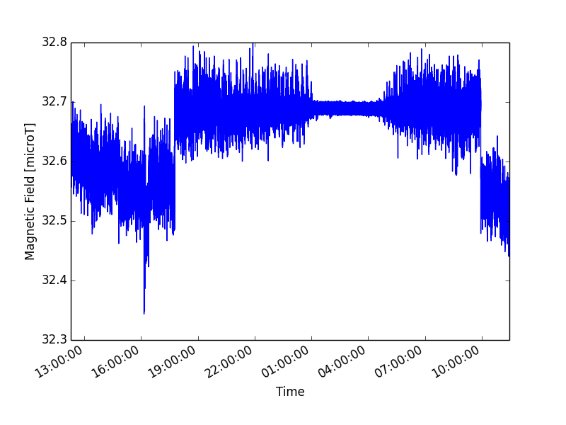
Magnetic field noise

Slide 3
Magnetocardiography (MCG)

Slide 4
Magnetocardiography

Slide 5
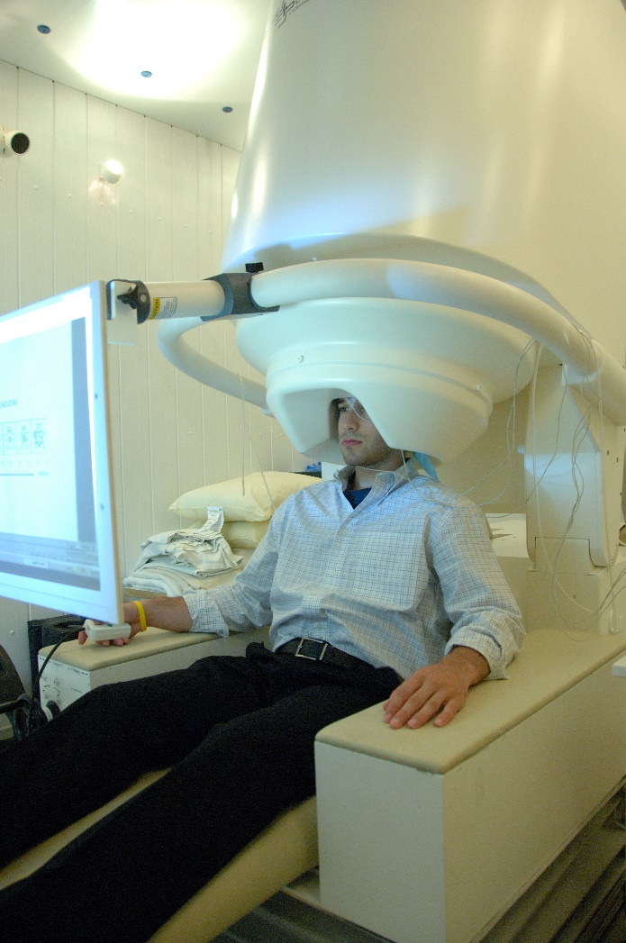
Magnetoencephalography (MEG)

Slide 6
How to shield the magnetic noise?
COMPUTER
B=0
CURRENT SOURCE

Slide 7
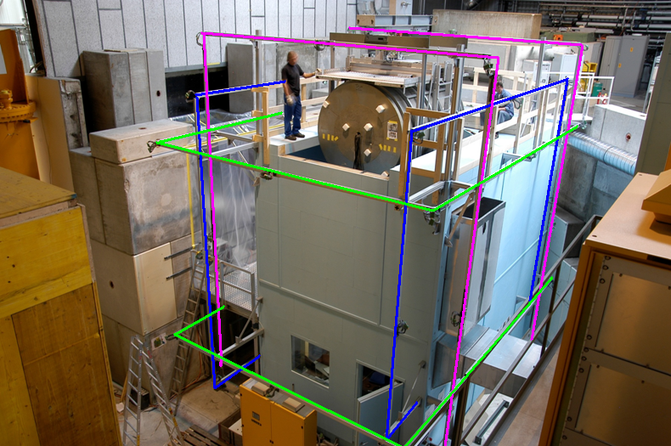
Current active compensation systems

Slide 8
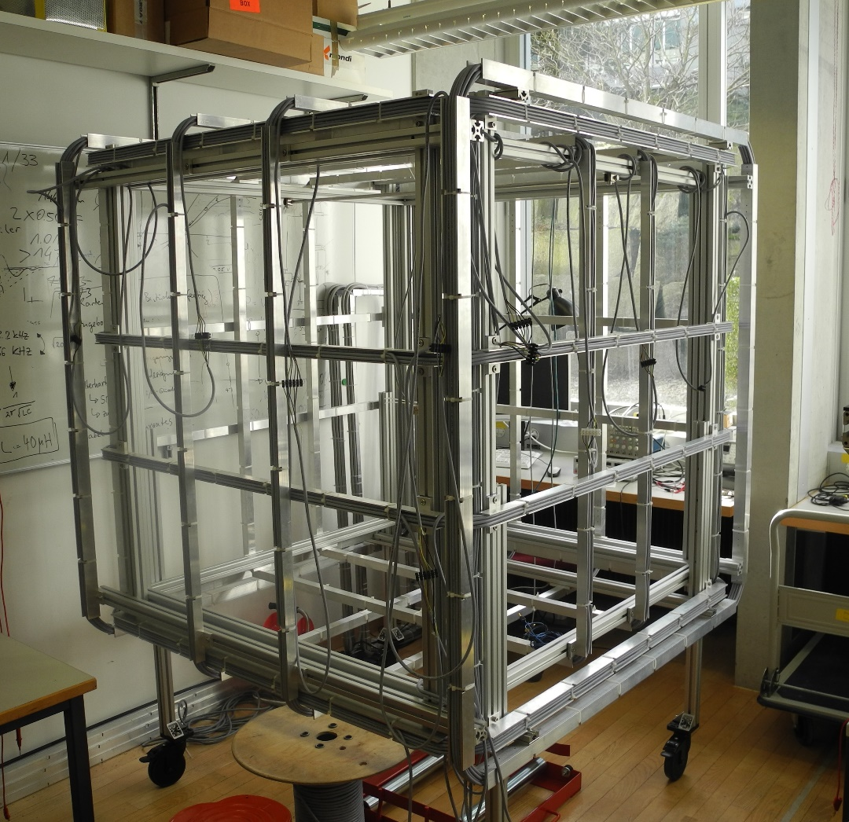
1st idea – additional coils

Slide 9
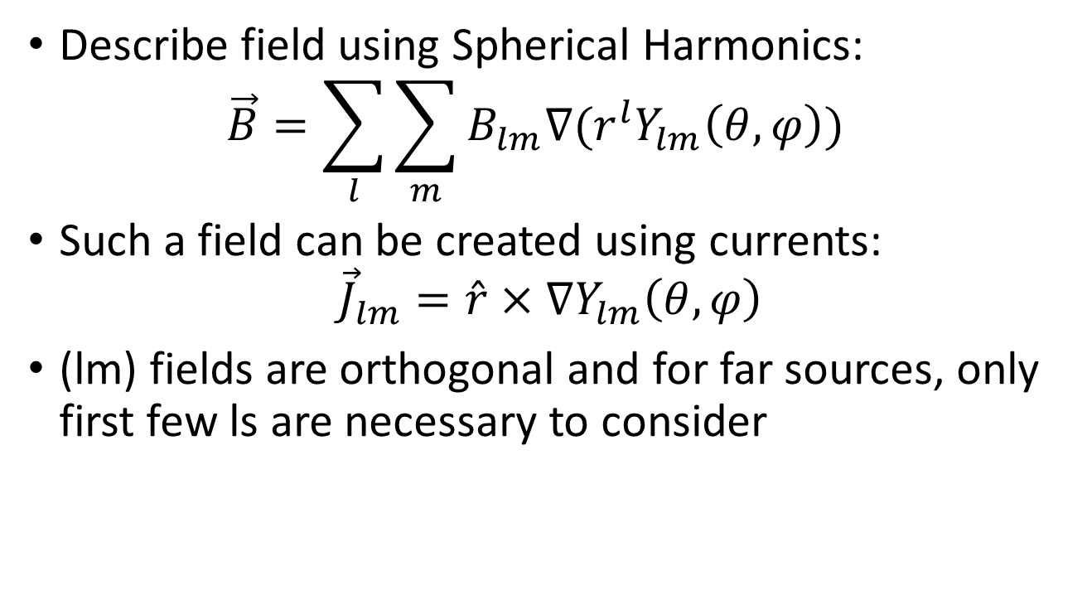
My idea:
Describe field using Spherical Harmonics:
$\vec{B}=\sum_{l}{\sum_{m}{B_{lm}∇(r^{l}Y_{lm}\left(θ,φ\right))}}$
Such a field can be created using currents:
${\vec{J}}_{lm}=\hat{r}×∇Y_{lm}\left(θ,φ\right)$
(lm) fields are orthogonal and for far sources, only first few ls are necessary to consider

Slide 10
My solution:

Slide 11
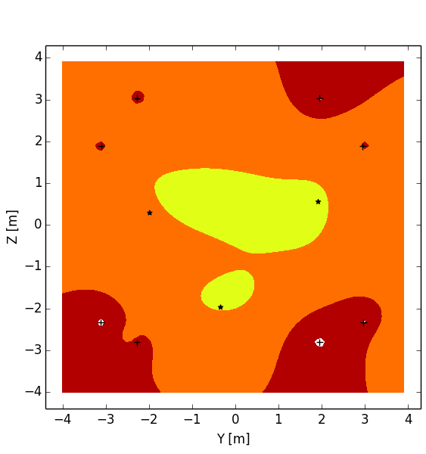
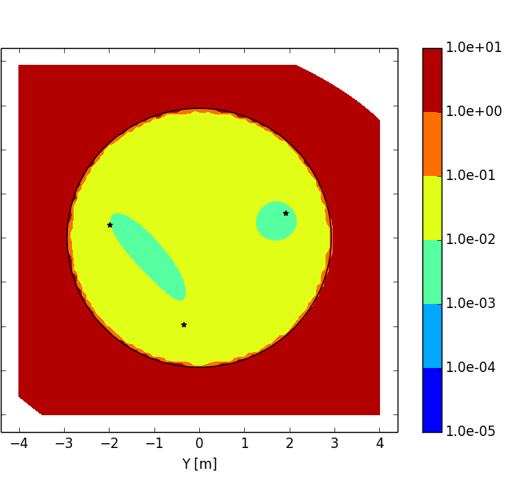
How good are the compensation systems?

Slide 12
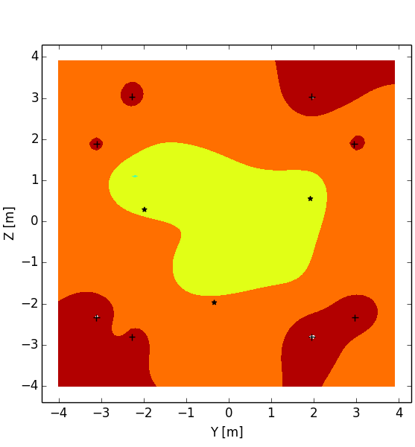
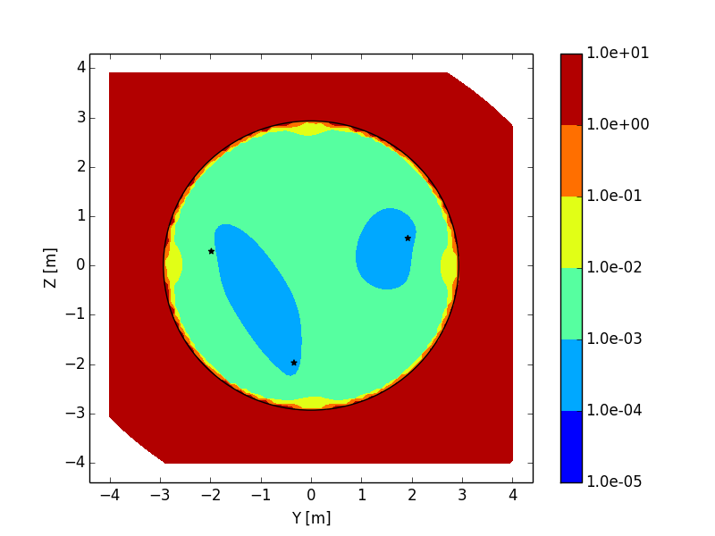
Comparison – more distant source

Slide 13
Improving spherical coil system

Slide 14
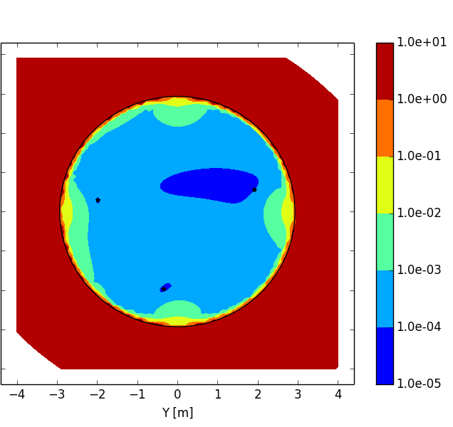
Improving spherical coils

Slide 15
Summary
Active magnetic shielding is a crucial part in many new medical diagnostic tools.
It is also crucial for many experiments
Commonly used systems are based on Helmholtz like coils
Coil system proposed by us is based on decomposition of magnetic field into orthogonal multipoles
Such systems gives 100 times better results

